Slide 1
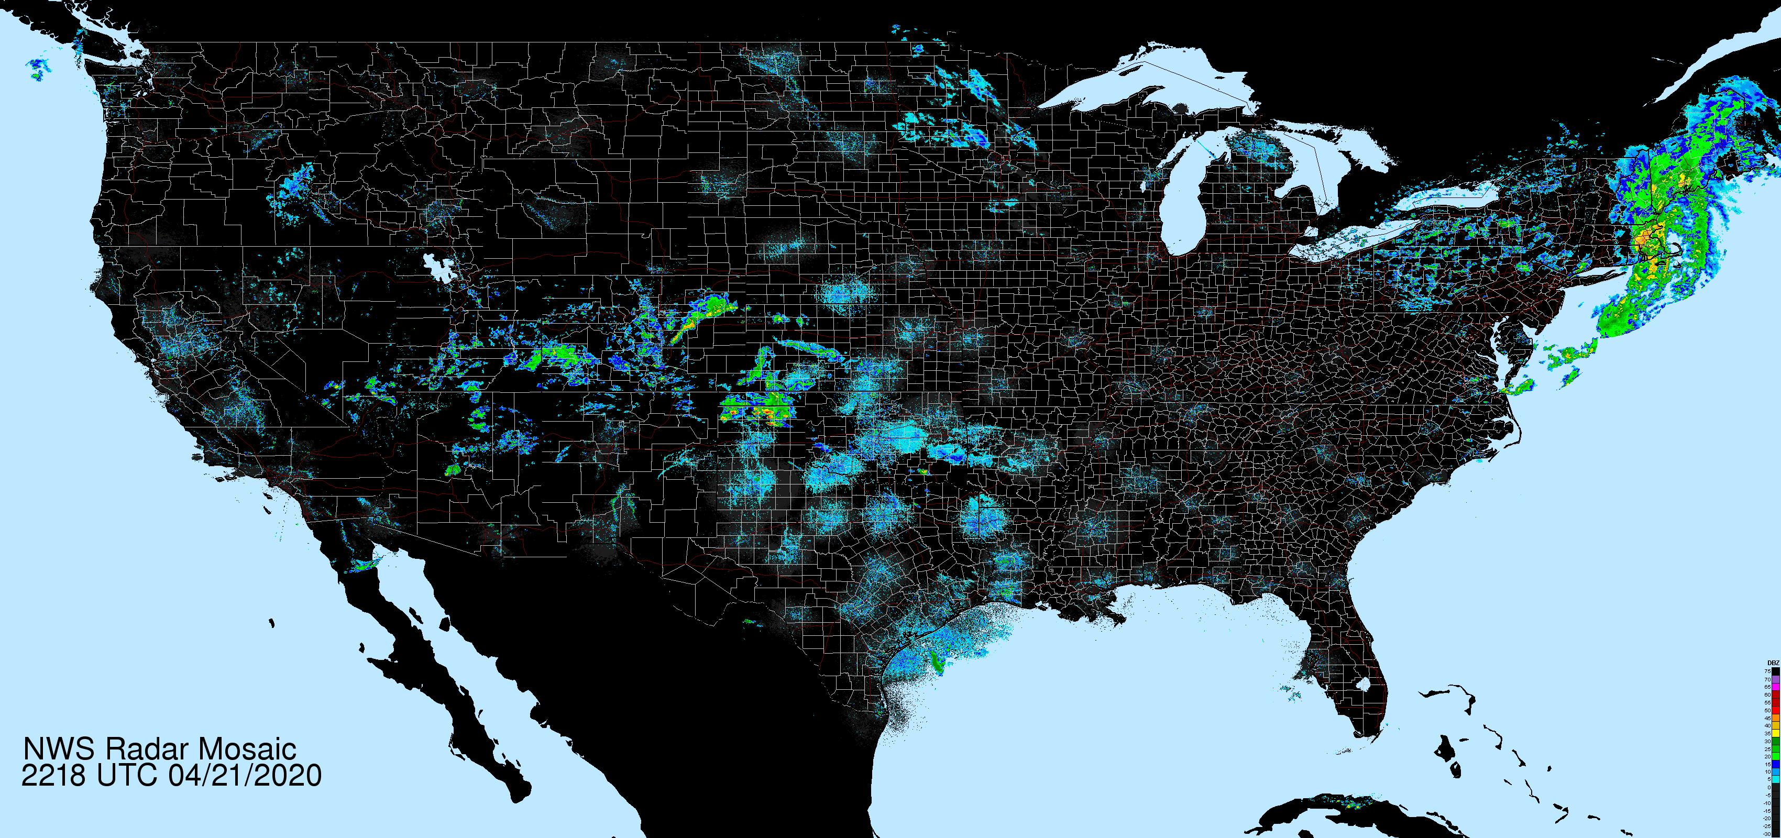
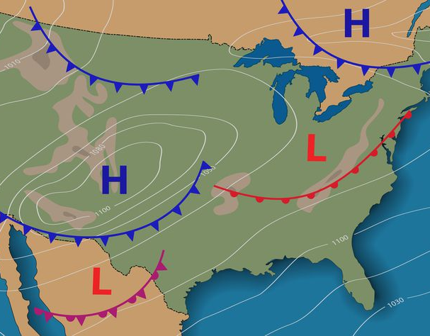
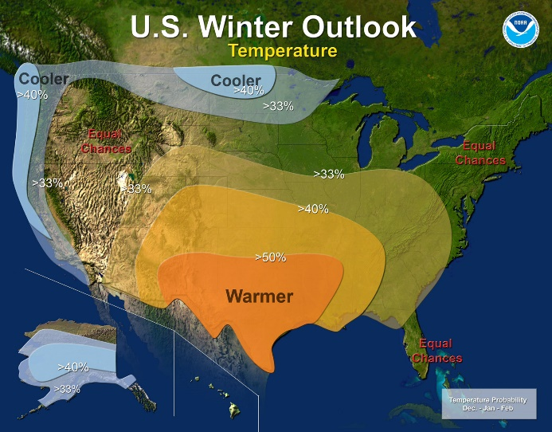
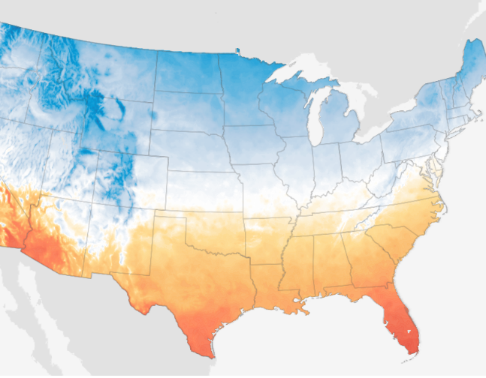

Forecasting the Earth system on different timescales
Gap Filling and Nowcasting
[Sønderby, ‘20, Veillette, ‘19]
Weather Forecasting
[de Witt, ‘20]
(Sub-) Seasonal Forecasting
[Cachay, ‘20]
Ocean & Climate Predictions
[Yuval, ‘21, Lütjens, ‘21]
Y. Shavyra
Now
6 hours
2 weeks
6 months
20 years
Indicates focus
Notes:
Within the application of estimating and forecasting weather and climate there's tons of interesting research opportunities
Gap Filling:
- Task: State estimation problem: Based on all the data from weather stations, satellites, planes, ; estimate the current state of weather; for every location and weather modality.
Nowcasting:
And when we have the current state we can start predicting it for 1-6 hrs ahead
And we do that by for example assuming constant dynamics, using methods from optical flow, or recently fast machine learning models have done a great job at this task
Weather forecasting:
If we give the model more than 6 hrs time, we can start running expensive numerical models that model the particle dynamics for the next days
However these models expensive to run and create relatively coarse grained weather predictions
So here machine learning has started to make an impact by learning surrogate models that are faster and can give higher resolution predictions
(Sub-) Seasonal forecasting:
If we try to forecast the weather for more than 14 days the particle dynamics are starting to get chaotic and we need to model weather modes, like el nino or la nina
But these are physically less understood, so machine learning has just started outperforming the us national model last year, based on the recent increase in data and compute
Climate forecasting
Finally in ocean and climate modeling we have a very similar story to weather predictions where machine learning-based surrogate models are increasing the resolution of the forecasts
Sources:
2: https://www.google.com/url?sa=i&url=https%3A%2F%2Fwww.thoughtco.com%2Foccluded-fronts-overview-3444112&psig=AOvVaw2WJ3K-QXAfxDy4C9d2WyEP&ust=1587593772357000&source=images&cd=vfe&ved=0CAIQjRxqFwoTCICot-nF-ugCFQAAAAAdAAAAABAD
3: https://www.google.com/search?q=el+nino+boston+noaa&tbm=isch&ved=2ahUKEwi2753LxfroAhVDCN8KHWGZBtQQ2-cCegQIABAA&oq=el+nino+boston+noaa&gs_lcp=CgNpbWcQA1CCphFYkrARYN2wEWgAcAB4AIABtwGIAZIEkgEDMC40mAEAoAEBqgELZ3dzLXdpei1pbWc&sclient=img&ei=b3CfXvb7NsOQ_AbhspqgDQ&bih=1210&biw=2133#imgrc=L7m1ln7gn8d6CM&imgdii=NFfe7xGK8eoL2M
4: https://www.climate.gov/maps-data/data-snapshots/averagemaxtemp-decade-LOCA-rcp85-2030-11-00?theme=Projections
https://www.climate.gov/sites/default/files/styles/featured-image/public/US_LOCA_october_meantemp_620.gif?itok=QG_lB-2P

