Slide 1
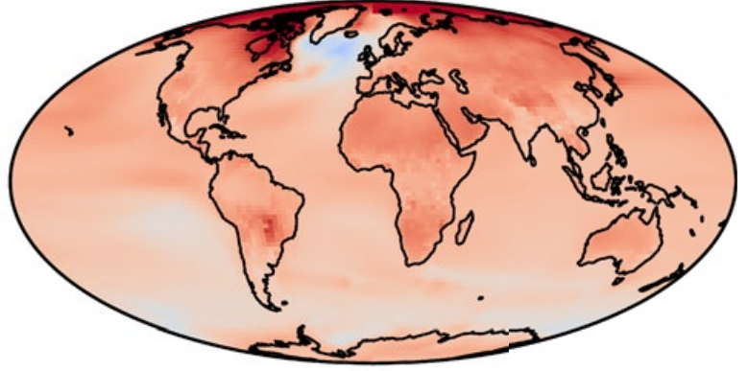
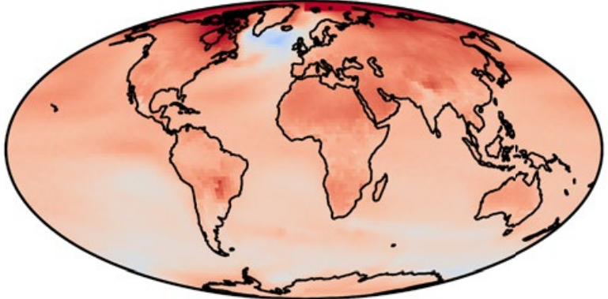
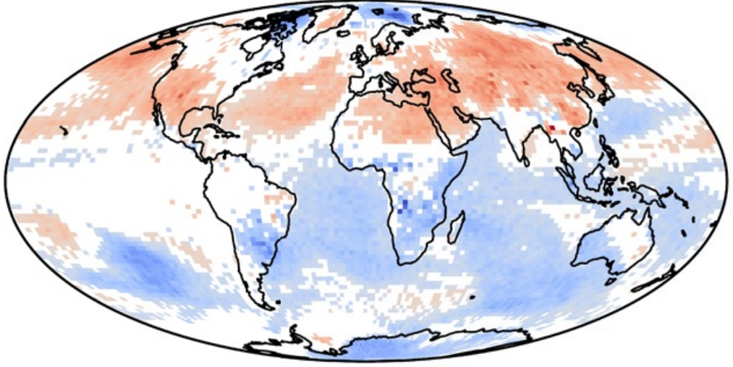
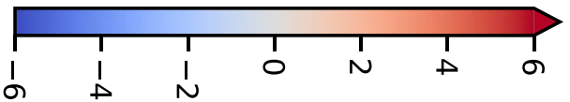
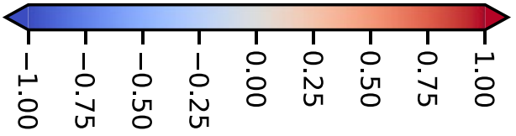
CNN-LSTM: global co2, ch4 and local so2, bc (t-10:t) -> local tas (t).
Trained on 1850-2100. Tested on held-out ssp245.
True tas, averaged over 2080-2100 in °C
Predicted tas, avg 2080-2100 in °C
Error (pred-target) in tas, avg 2080-2100 in °C

