Slide 1
Introducing the MIX Programming Interface
A New Approach for HDL Design Using MIX
Thorsten Lutscher, FEB/06/2009

Slide 2
Topics
Brief Introduction to the MIX Architecture
Using MIX through the API
The Micronas::ESL Class Library
Example for Using the ESL Library
Application in MIC32
Summary

Slide 3
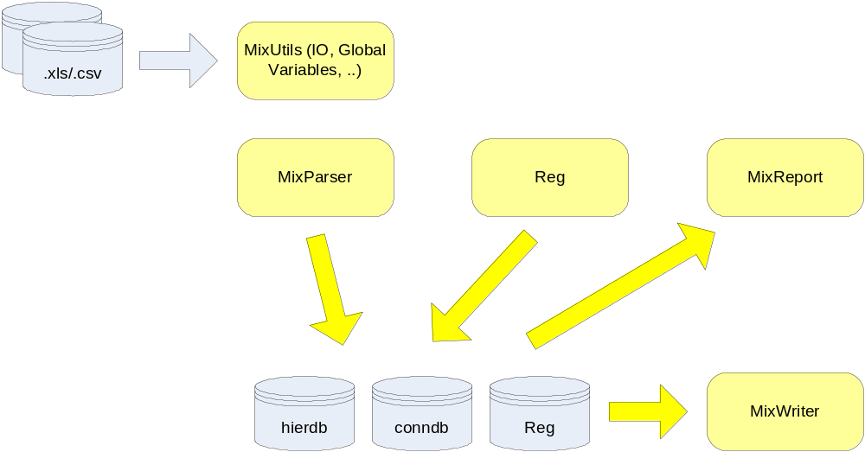
Brief Introduction to the MIX Architecture

Slide 4
Using MIX through the API (1)
The MixParser module provides two (non-OO) methods
  add_inst() -> adds instances to the hierarchy DB
  add_conn() -> adds signals to the connection DB
These are an alternative to the .xls sheets for building a Verilog/VHDL design
E.g. the Reg module uses this interface to generate register-shells

Slide 5
Using MIX through the API (2)
A simple template script can be provided that is extensible by the user:
  use Micronas::Mix;
  $o_mix = Micronas::Mix->new(...);
  $o_mix->read_input();
  ...<user-code>...
  $o_mix->write_output();

Slide 6

Using MIX through the API (3)
The Reg module can also be called through (OO) API functions
  $o_space=$o_mix->{reg};
  $o_domain=$o_space->find_domain_by_name_first(„SCC“);
  $o_reg=Micronas::RegReg->new(name => “VCID”);
  $o_domain->regs($o_reg); # link register into domain
  $o_field=Micronas::RegField->new(reg => $o_reg, name=> „prio“); # link field into register
=> You can use Perl to build a complete design

Slide 7
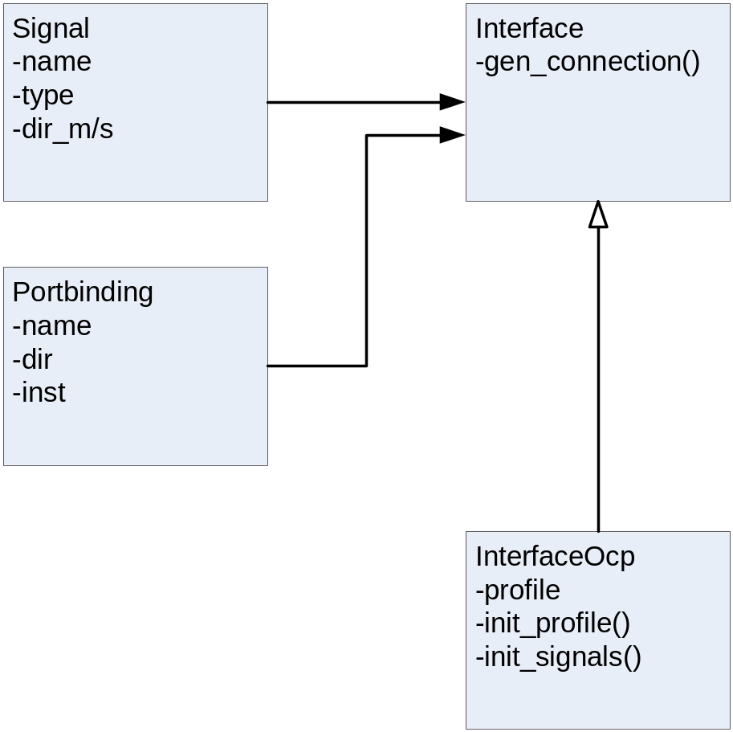
The Micronas::ESL Class Library
Created class library to wrap the MIX (non-OO) API functions
Contains classes to express higher-level connectivity
  Signal
  Portbinding
  Interface

Slide 8
Example for Using the ESL Library (1)
Create and connect a top-level OCP SCI interface to a register-shell instance
Generate SCI Interface object
my $o_sci = Micronas::ESL::InterfaceOcp->new((
'profile' => "SCI",
'addr_wdth' => 14,
'data_wdth' => $o_reg->global->{'datawidth'}
));

Slide 9
Example for Using the ESL Library (2)
Bind SCI i/f to register-shell instance
$top_inst = $o_reg->global->{'top_inst'};
$o_sci->add_portbindings({
'prefix' => “sci_scc”,
'name' => "sci",
'naming_signal' => "%PREFIX%_%SIGNAL%",
'dir' => "slave",
'inst' => $top_inst
});

Slide 10
Example for Using the ESL Library (3)
Generate connection of SCI i/f to the register-shell of the MIC32 BCU
$o_sci->gen_connection("sci");
Add clocks/resets for SCI
$bus_clock = $eh->get("reg_shell.bus_clock“);
$bus_reset = $eh->get("reg_shell.bus_reset“);
_add_primary_input($bus_clock, 0, 0, $top_inst."/".$bus_clock."%POSTFIX_PORT_IN%");
_add_primary_input($bus_reset,0, 0, $top_inst."/".$bus_reset."%POSTFIX_PORT_IN%");

Slide 11
Application in MIC32 (1)
the BMU (Buffer Management Unit) for FRCQ and MDXH is generated using this approach (example: MDXH)
it contains 2 register-shells (FH, BCU), <m> buffer descriptors, <l> Fifo Handlers and numerous multiplexers
it uses 4 OCP profiles (FPI, FRI, BRI, SCI), altogether <n>+2*<k>+2+<m>+<l> interfaces
the hardware configuration is captured in yet another .xls sheet; a special class library exists in the mic32 project to query this information

Slide 12
Application in MIC32 (2)
3 sub-blocks and some register-shell primitives (library) are fixed RTL
1 sub-block has a .m4 template (but m4 called from script flow)
9 blocks are fully MIX-generated

Slide 13
Summary
The MIX structure and logic generation capabilities can be utilized through CONN/HIER/Register-Master input sheets
Alternatively, all information can be passed via the programming interface of MIX
  A wrapper class library has been created to represent the structural elements of a HDL design
Both methods have their pros and cons

