Slide 1
MIX in-house software (1/2)
„MIX (Micronas Interconnect Expander) is a methodology and tool to generate hardware descriptions, low-level driver software, verification code and documentation out of a single-source specification“
Covers
  structural specification (hierarchy+interconnect),
  configuration registers („Register-Master“)
  IOs (pad-muxes)
Table-based spec entry format (Excel, csv); for configuration registers, IP-XACT compliant XML format possible
Ensures consistency between spec and design
Shortens design iterations for new modules/connections and changes of register interface

Slide 2
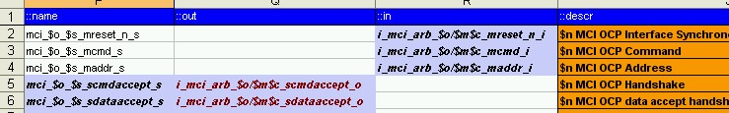
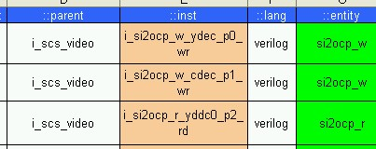
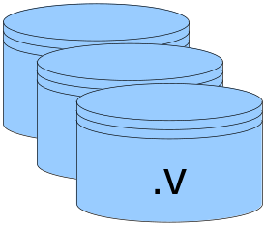
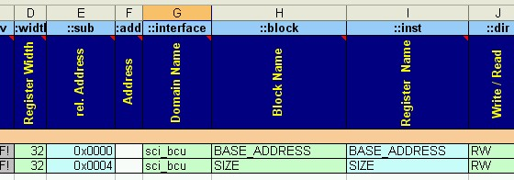
MIX in-house software (2/2)
MIX

