Slide 1

Transcendental Meditation: A Tool for Resilience and Healing in Wartime​

Slide 2
Table of contents
01
02
03
04
05
06
Introduction
Problem statement
Proposal
Studies
Application
Result

Slide 3

01
Introduction

Slide 4
Introduction
War is unfortunately a persistent reality in the world today.​
People died every day in war in different countries.​
About more than 37 million people worldwide have died while actively fighting in wars since 1800.

Slide 5
02
Problem statement

Slide 6
Problem statement
Since the start of the Russian invasion of Ukraine in 2022, there have been over 300,000 casualties.​
Every day, approximately 500 individuals are killed and 800 are wounded.​​
714 events (including Violence, Explosions, Battles, …) per week​
Reducing the number of daily fatalities is a fundamental goal for humanity. What is the solution to achieve this?​

Slide 7
03
Proposal

Slide 8
Proposal
As early as 1960 Maharishi predict that when even 1% of a population learned the TM technique, the whole population would become peaceful.
The hypothesis was confirmed in the early 1970.
Studies found that as soon as cities reached the 1% threshold, crime trends decreased significantly.​

Slide 9

Studies
04

Slide 10
Studies
Lebanon civil war – reduced warfare and improved quality of life.​
War deaths plummeted from nearly 34 per day to 1.5 per day.​
The results of these interventions included :
71% decrease in war related fatalities.​
68% decrease in war related injuries.​
48% decrease in the level of conflict.​
68% increase in cooperation among antagonists.​

Slide 11
05
Application

Slide 12
Application
The total population of​ Ukraine is approximately 38 Million​
The square root of 1% of the population in Ukraine's population is about 617.
If we could gather around 700 people for a group mediation in Ukraine, we could potentially trigger Maharishi effects and save lives there.​

Slide 13
Result
06

Slide 14
Result
If the group mediation in Ukraine, we are expecting to decrease to :​
65-70% (about 150 per day) decrease in war related fatalities.​
65-70% (about 240 per day) decrease in war related injuries.​
45-50%(about 51 per day) decrease in the level of conflict.​

Slide 15
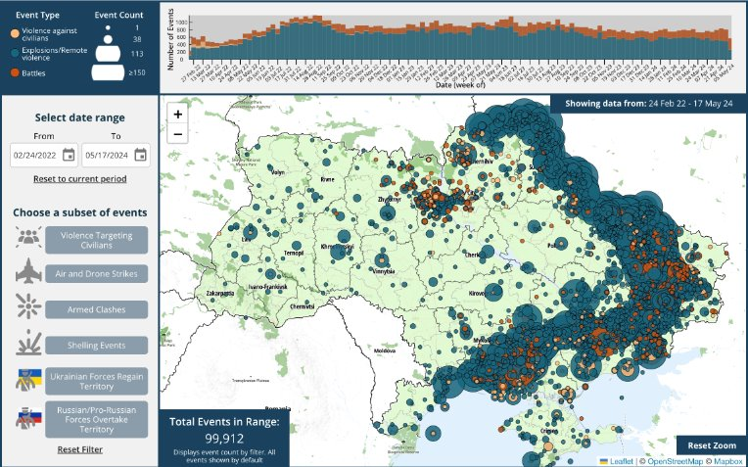
Total number of events since start of war from 24-Feb-2022 until 17-May-2024​

Slide 16
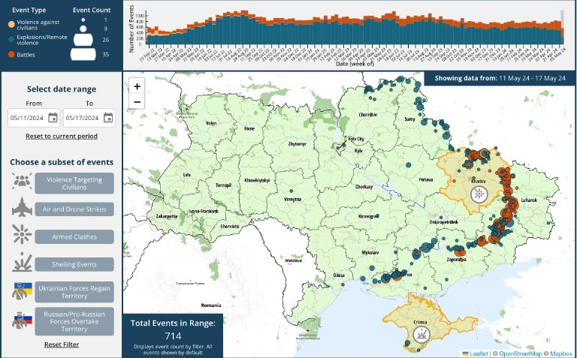
Current number of events per week​

Slide 17
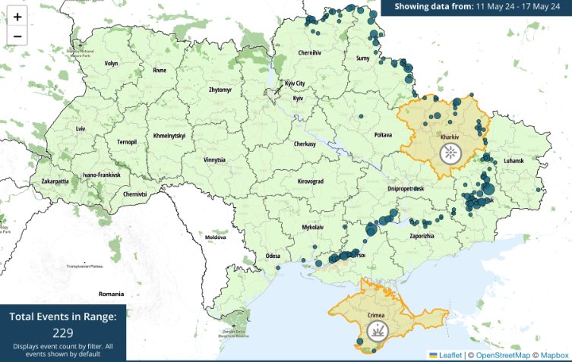
Estimate after applying TM per week​

Slide 18

Conclusion
The Maharishi effect is efficient to be used in War cases​

