Slide 1
Moore’s Law: Analysis on Chipsets
Presented by Sean Dickerson

Slide 2
Dataset
Dataset created by Michael Bryant , available on Kaggle.
Compares CPUs and GPUs by 13 variables such as frequency, transistor, TDP, die size etc.
4854 records across 14 fields.
Focusing on Freq (MHz), Transistors (million), FP16, FP32, and FP64 GFLOPS.
Notes:
Frequency: How many clock cycles per second.
Transistors: Semiconductor that amplifies/switches signals and power.
FP16 (etc) GFLOPS: 16-bit Giga Floating Point Operations Per Second. Measures computing performance.

Slide 3
Research Questions and Objectives
Is there any correlation between frequency and transistor count?
Is there any correlation between frequency and GFLOPS?
FP16, FP32, FP64 GFLOPS
Dataset omits CPUs for GFLOPS
Notes:
GFLOPS not commonly used anymore for estimating CPU performance. FLOP tasks carry on to GPUs today.

Slide 4
Hypotheses
Hypothesis #1: There's a correlation between frequency and transistor count.
Higher transistors likely to lead to higher frequencies.
Hypothesis #2: There’s a correlation between frequency and GFLOPS (FP16, FP32 etc).
Higher frequency likely to lead to higher GFLOPS.

Slide 5
Testing Process
Visualizations to display correlation between variables.
Bivariate and univariate graphs
Create correlation matrices between variables.
Expecting coefficients of 1

Slide 6
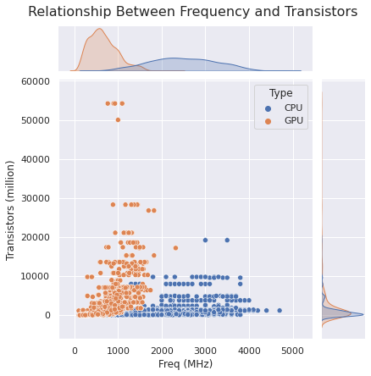
Hypothesis #1 Analysis
Used visualizations to show correlations of frequencies and transistor counts.
Almost no correlation for CPUs.
Very little correlation GPUs.
 | Freq (Mhz) | Transistors
Freq (Mhz) | 1.0000 | 0.0176
Transistors | 0.0176 | 1.0000

Slide 7
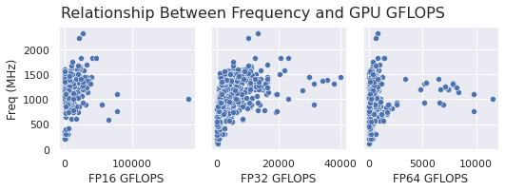
Hypothesis #2 Analysis
Used visualizations to show correlations of frequencies and GFLOPS.
Slight correlation for FP16 GFLOPS.
Moderate correlation for FP32 GFLOPS.
Very little correlation for FP64 GFLOPS.
 | Freq | FP16 | FP32 | FP64
Freq | 1.0000 | 0.2763 | 0.5824 | 0.1904
FP16 | 0.2763 | 1.0000 | 0.7285 | 0.6829
FP32 | 0.5824 | 0.7285 | 1.0000 | 0.5196
FP64 | 0.1904 | 0.6829 | 0.5196 | 1.0000

Slide 8
Summary of Findings
Hypothesis #1 not supported. Insignificant correlation of frequency clocks and transistor counts.
Multiple occurrences of chipsets having similar transistor count but significantly different frequencies.
Hypothesis #2 supported. Moderate correlation of frequency and GLFOPS.

Slide 9
Conclusion
Frequency isn’t correlated with transistor counts.
Frequency is moderately correlated with GFLOPS.
Review listed GFLOPS for rough estimate of GPU performance.
Cannot estimate CPU performance on frequency alone.
Proposal here. Google Colab Notebook here.

