Slide 1
An Analysis on EPA Fuel Economy
Presented by: Sean Dickerson

Slide 2
Goals and Objectives
Provide insights on consumer spending trends or habits for vehicles.
Does the size/class of the vehicle greatly affect the following:
Average highway MPG
Average annual fuel cost
Determine which vehicle class would be the best purchase for value and fuel efficiency.

Slide 3
Data Context
CSV obtained from EPA.
Contains data for Highway MPG, makes, models, fuel types, car classes, annual fuel costs etc.
Contains data recorded from 1984 to 2017.

Slide 4
Hypotheses
Null Hypothesis 1 (H₀):
Vehicle size/class does not greatly affect the highway MPG.
Alternate Hypothesis (H_{a}):
Compact cars will have the best highway MPG on average compared to other classes.
Null Hypothesis 2 (H₀):
Vehicle size does not greatly affect the annual fuel cost.
Alternate Hypothesis (H_{a}):
Compact cars will have the best annual fuel cost on average compared to other classes.

Slide 5
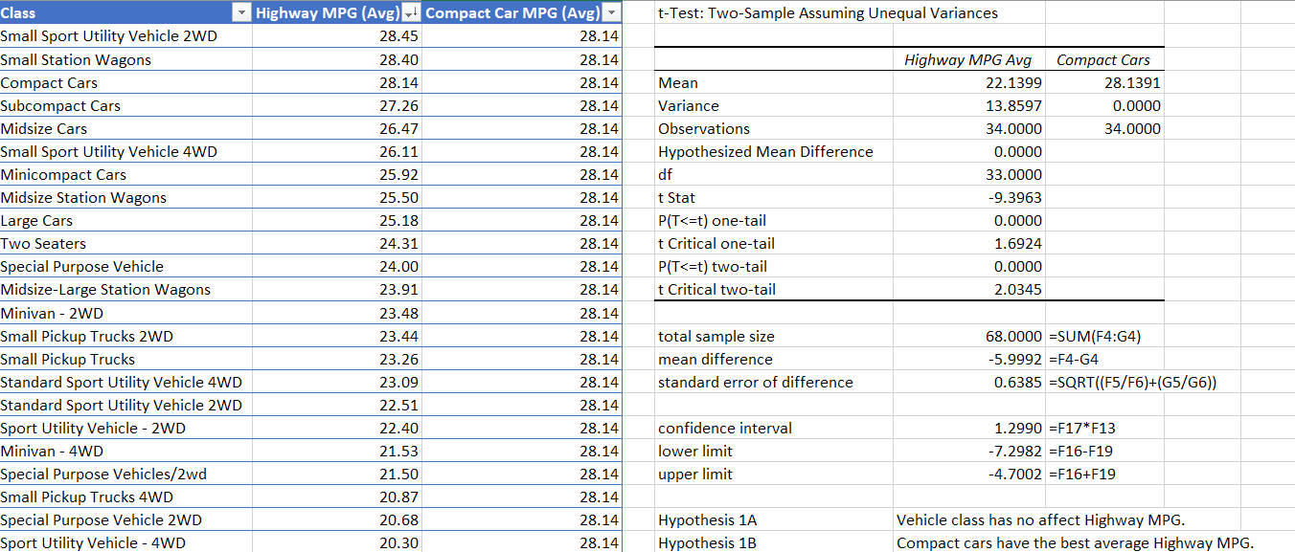
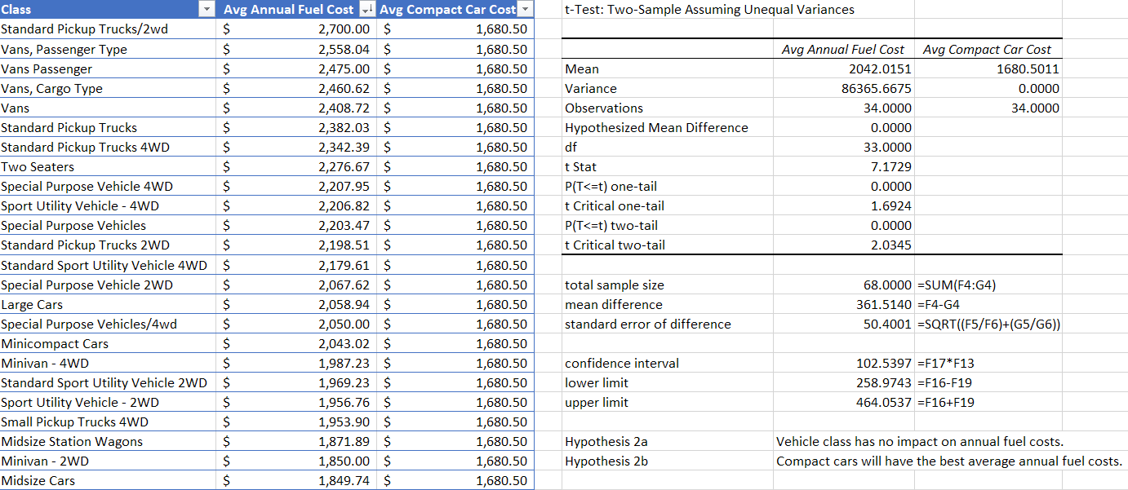
Data Processing
Conduct statistical analyses and clean data to determine if vehicle size can greatly affect highway MPG or annual fuel costs.
Ran t-tests for average highway MPG for each car class compared to Compact Cars.
Ran t-tests for the average annual fuel cost for each car class compared Compact Cars.

Slide 6
Analysis of Highway MPG
There is a difference between size/car class and average highway MPG.
Compact Cars ranks in the top 9% compared to other vehicles.

Slide 7
Analysis of Annual Fuel Costs
There is a difference between size/car class and average annual fuel cost.
Compact Cars have lower annual costs than 88% other vehicles.
Larger vehicles had higher annual fuel costs.

Slide 8
Summary and Conclusion
There is a difference in highway MPG and annual fuel cost between car size/class.
Slight difference among consumer grade classes, higher difference for larger commercial/special vehicles.
Recommend that consumers choose cars that fit their size needs to maximize on fuel savings.

