Slide 1

Finding business opportunity in Toronto neighborhoods.
Voranipit ch.

Slide 2
Introduction and Business Problem :
Which business will be recommended to do in the Toronto neighborhood,
Why it will profitable?
What is the target customer group?

Slide 3
Using data to solve problem.
Which data do you need to solve the problem?
We need data sets that contain the category of venues in Toronto as much as possible.
Where are the data sources?
· Postcode, neighborhood of each borough from Wikipedia to specified which neighborhood is in the Toronto Neighborhood.
· Foursquare API to get venues in each neighborhood.
Which format of data set we need?
-Rows of each neighborhood in Toronto and the columns of the Top 10 most common venues in each neighborhood(rows).
-Rows of each neighborhood in Toronto and the columns of frequent of each venue to use to train a model.
How data will use to solve the problem?
Once we know the cluster of other venues we will find inside of the data that why in that cluster has the most common venues.
when we know the reason we can use that reason to find out which business will be profitable.

Slide 4
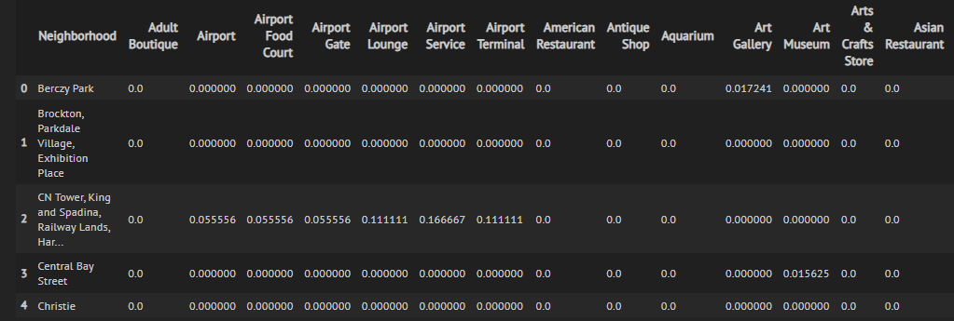
Data Preparation
Scrape from Wikipedia , Fetch from FourSquare API ,Merge ,adjust data to this format.

Slide 5
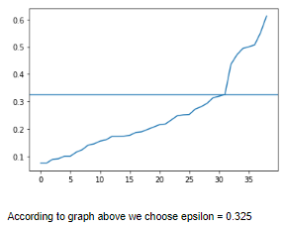
Clustering
- Using DBSCAN to deal with outliers .
- Use epsilon = 0.35 (see more detail in report or jupyter notebook)
- Fit model

Slide 6
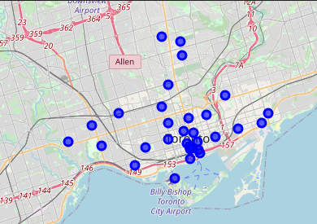
Cluster result .
From the DBSCAN we got only one cluster (31 components) and 8 outliers(ignored).

Slide 7
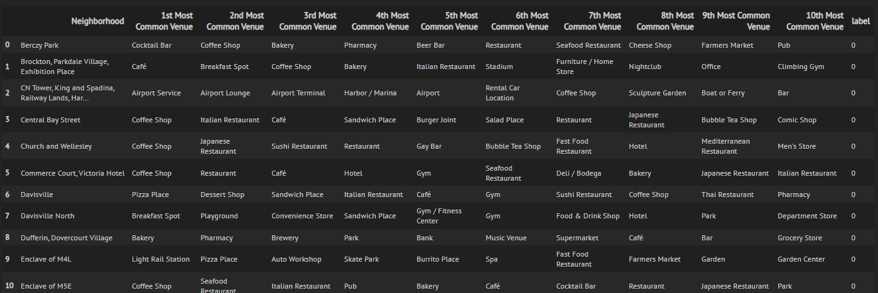
Identify the cluster
The only one cluster that we got is neighborhood of food and beverage venues .

Slide 8
What information we get form data cluster?
There are a lot of food venues in the neighborhood which maybe there are a lot of people (or tourism) in the area.
The area crowded with food and beverage venues so it is the red ocean area for restaurant business

Slide 9
How we can take advantage from this information ?
The answer is doing business to business (B2B) wholesale such as ingredient wholesale.
But why ? The reason is the area is crowded with business which mean it is the red ocean.
So It better to sell shoves for miners than mine with the crowd.

Slide 10
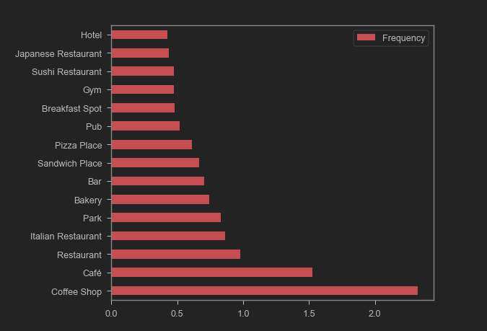
But which ingredient is suitable ?
The food in these venues have some ingredient in common which is “Flour”
because of there a lot of
bakery , pizza place, sandwich place and even coffee shop
(coffee shop need some bakery which mean
They our prospect’s customer)

Slide 11
Benefit of doing Flour wholesale business.
Repeatable profit because of food’s shelf - life.
Lot of demand so we don’t need depend to much in on either one category of venues.

Slide 12
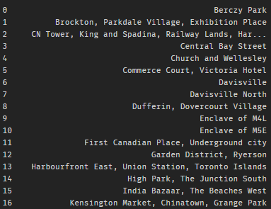
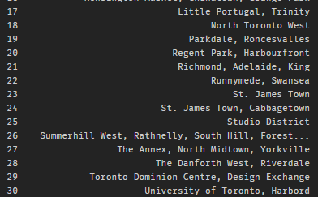
This is prospect’s neighborhood

Slide 13
Conclusion and recommendation
According to data set we used , If you want to do business in Toronto
(in prospect list above ) .
I recommend your business should be flour wholesale business which is can make repeatable profit and high demand .
but if you don’t want to do flour business , I still recommend you to do other ingredient wholesale or other B2B business
I don’t recommend you to do restaurant business in the area because it has already been
red ocean right now.

