Slide 1
💩Enshittification💩
Cory Doctorow
Broadly speaking, enshittification describes a company's downfall. Doctorow’s concept basically states that a company begins treating their users worse and worse to improve things for their business customers. Then they begin treating their business customers poorly to maximize the company's profits and satisfy shareholders etc… Then they go under because they have ‘abused’ all of the people who use the technology.
Another aspect of this concept is the idea that users and business customers eventually become locked in before the company starts treating them poorly.
Notes:
Then, before they know it, it is too difficult and/or expensive to switch to another company, IF they have not already been bought out by the company that they’re already using. Oftentimes, companies may undercut their competitors until they are successful, then they slowly become worse and worse, possibly becoming worse than their original competitors, while still dominating the market.

Slide 2
Recent experience with VRBO
While searching through the app it said the rental was $129/night. When I went to checkout, the total was $289… more than double the advertised price with a $85 cleaning fee, $30 service fee (15% of total including other fees), and $37 lodging tax.
Notes:
Even without the tax it’s still almost double. And what’s worse were all the rules and instructions from the owner. On top of the $85 cleaning fee they wanted us to remove all the linens, pile up the towels in the bathroom, take the trash out, and sweep… This wouldn’t normally bother me but don’t charge an $85 cleaning fee for a $129/night rental if you want the guests to do all that extra cleaning, or just lump it into your nightly rate. A hotel doesn’t ask you to do anything like that, in fact they actually clean your room for you daily, and they don’t charge an extra fee for it.
Hosts are typically only pay 3% of their rate to Airbnb which isn’t bad, although in some instances they may have to pay up to 15%. This leads me to believe that Airbnb is currently in its first phase of enshittification since the guests seem to be the ones seeing the brunt of the abuse as of now.

Slide 3
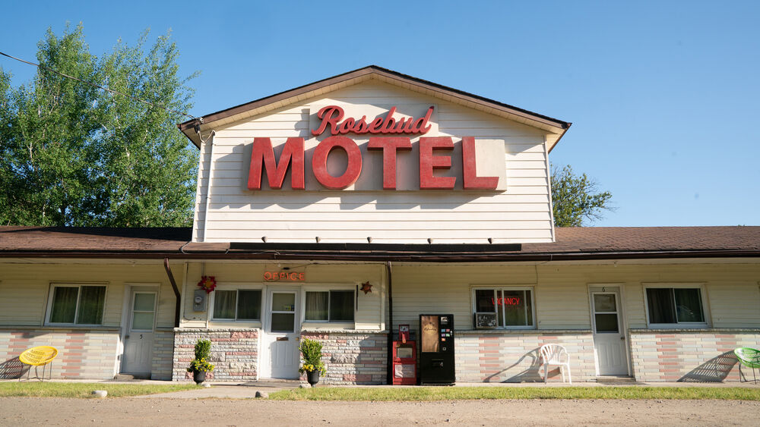
Other options…
Notes:
We can all fall back on hotels but sometimes vacation rentals are still the best option. I think the only way this issue may be resolved is for a new company to come in and do it the way it should be done, like Airbnb and VRBO did before their enshittification. The only problem is that even the new company would have a hard time resisting enshittification. Eventually investors want to be paid and shareholders want their investments to grow. I think if enough companies that go through enshittification start to die, everyone might start to realize it is not a good business method for anyone. CEO’s and shareholders seem to be the real root of this problem so maybe alternative business models may help, but I don’t see any other way to resolve this issue if not.

