Slide 1
Machine Learning Approach for an Anomaly Intrusion Detection System using ONOS
University of Texas at Dallas
CS 6301-503: Software Defined Networks (Spring 2018)
Professor Timothy Culver
Project Team
Stephen Blystone
Taniya Riar
Juhi Bhandari
Ishwank Singh

Slide 2
Introduction
Our project implements an Anomalous Intrusion Detection System Architecture using Big Data, Machine Learning, and the ONOS controller.

Slide 3
Problem Statement
Intrusion Detection Systems (IDS) fall into 2 categories:
Signature-based IDS look for known patterns (or signatures) in network traffic to identify Intrusions.
Example: Snort IDS
Anomaly-based IDS look for anomalous network traffic. This is used to identify new or previously unknown Intrusion methods.
Our goal is to develop an architecture that incorporates SDN, Big Data, and Machine Learning to:
Detect anomalies in network traffic
And send a REST API call to ONOS to block the source of the anomalous traffic in real-time.

Slide 4




Tools Used
Oracle VM VirtualBox
NetFlow
ONOS Controller
Mininet
StreamSet
UDP NetFlow Collector
Apache Zookeeper
Apache Kafka
Apache Spark
Elasticsearch
Kibana
Logstash

Slide 5
NetFlow
Network Protocol developed by Cisco for collecting IP traffic statistics.
NetFlow can be configured on many devices, including Open vSwitches used in Mininet.
We used NetFlow version 5. This is the only version currently available in Mininet.
The newest release is NetFlow version 10, aka IPFIX.
Version 5 statistics that can be collected include:
Source & Destination IP
Source & Destination Port
Total Number of bytes in the packets of the flow.
Etc.

Slide 6
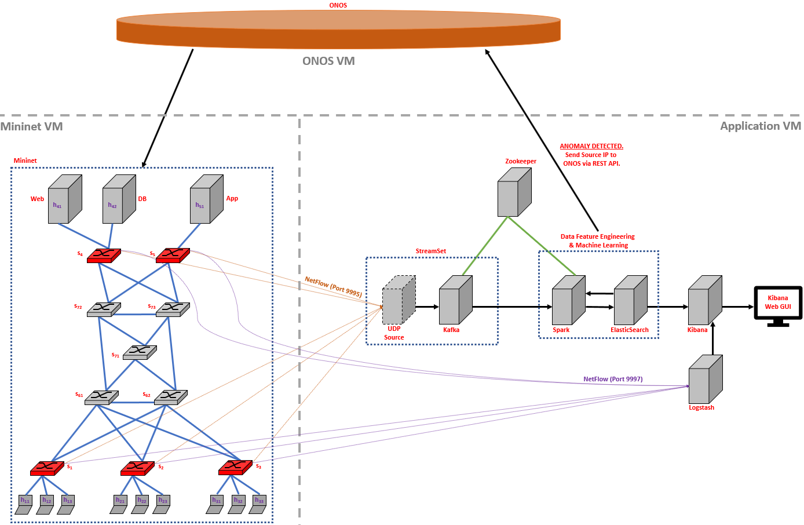
Architecture
ONOS Controller
Communicates with Mininet via OpenFlow
Receives REST API Calls from Big Data Infrastructure.
Miniature Network (Mininet)
Contains a realistic network architecture.
Python scripts written to generate random “normal” traffic patterns.
5 Open vSwitches are NetFlow-enabled (in red). They forward NetFlow messages to the Big Data Infrastructure.
Big Data Infrastructure
Receives and processes NetFlow messages from Mininet.
Performs Feature Engineering and stores data in ElasticSearch.
Performs Machine Learning (K-Means) to identify normal traffic patterns in stored data.
Determine if new NetFlow messages are anomalous compared to normal network traffic patterns.
If Anomaly is detected, send the source IP address to ONOS via REST API.
Use Logstash and Kibana to visualize NetFlow data.

Slide 7

Implementation

Slide 8
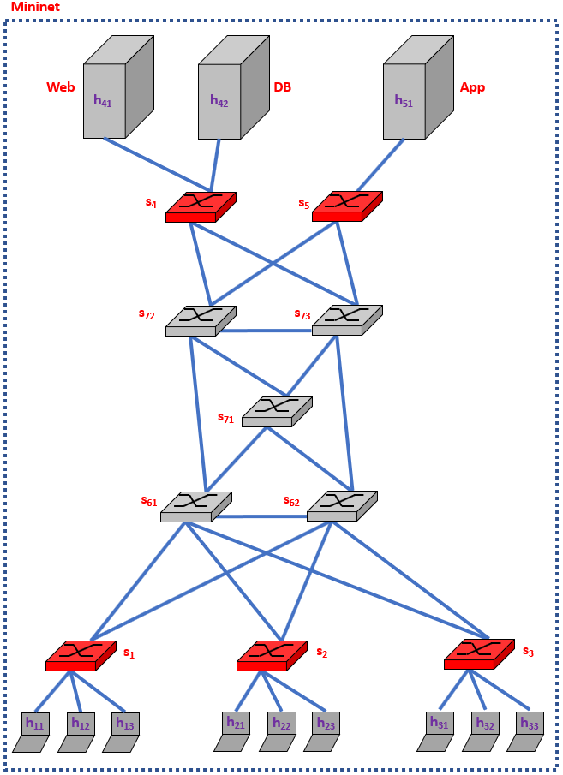
Traffic and Network Generation
The Mininet topology used is similar to a real-world topology.
9 hosts that are users with laptops (h₁₁ – h₃₃)
Can send HTTP requests to Web Server.
Can send ICMP Pings to any host or server.
Can send data via TCP to App Server.
Can send data via TCP to another user laptop.
Web Server (h₄₁) that contains a webpage (index.html)
Responds to HTTP requests from hosts.
Can send data via TCP to DB Server.
DB Server (h₄₂)
Responds to messages sent from Web Server via TCP.
Web Server is only server to communicate with DB Server.
App Server (h₅₁)
Responds to messages sent from users via TCP.
5 Access Open vSwitches that have NetFlow enabled.
5 Core Open vSwitches that do not have NetFlow.
We used Python scripts to configure the network topology and generate traffic.
Python scripts included randomness to emulate “Normal” network traffic.

Slide 9
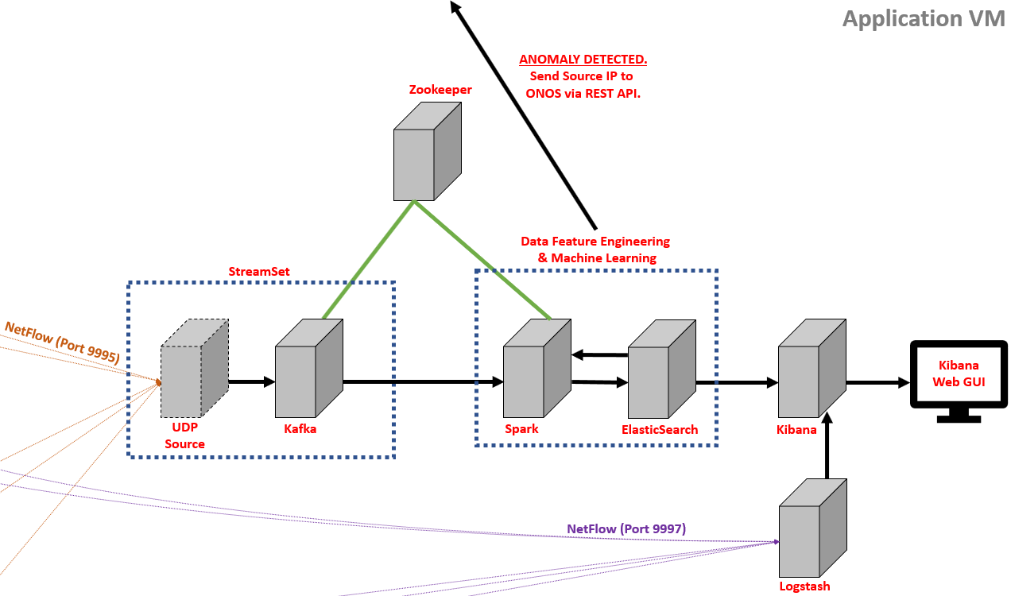
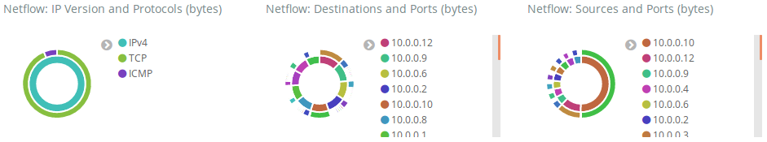
Big Data Infrastructure
Zookeeper is a tool that manages other Apache products.
StreamSet is a tool that allows user to create a pipeline containing various products.
UDP Source converts NetFlow messages into form Kafka accepts.
Apache Kafka buffers the data.
Apache Spark performs feature engineering and Machine Learning
ElasticSearch stores the feature data.
Logstash reads raw NetFlow data and sends to Kibana.
Kibana provides a Web GUI to view the data.

Slide 10

Feature Engineering
Apache Spark captures data in intervals lasting X seconds. We chose X = 60 seconds.
From 0 to 60 seconds Spark collects the NetFlow data received during that interval.
After that interval is finished:
It begins the next interval (60 to 120 seconds).
And it passes the data collected to our Spark application for feature engineering and processing.
For each interval we engineered the following features from the NetFlow data:
Sum of Bytes sent
Number of unique destination IP addresses
Number of unique destination Ports

Slide 11
Capturing Data for Training
We captured and stored 36 hours’ worth of “Normal” network traffic data in ElasticSearch.
The data was:
Generated by the Python scripts in Mininet simulating “normal” network traffic.
Engineered in Spark to get the 3 features we were capturing.
Stored in ElasticSearch.

Slide 12
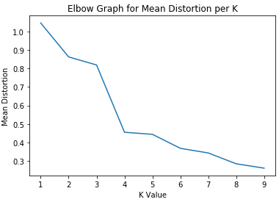
K-Means Machine Learning Algorithm
We used the data stored in ElasticSearch to train our Machine Learning clustering algorithm.
Clustering-based algorithms group similar objects into clusters.
K-Means algorithm splits the training data into ‘K’ clusters where each observation belongs to the cluster with the closest center.
We used an elbow graph to determine the optimal number of clusters to be K = 3.

Slide 13
Standardizing the Data
We standardized each feature by subtracting the mean and dividing by the standard deviation. We did this when:
Training the K-Means Algorithm.
Testing New Data to determine if “Normal” or “Anomaly”.
Before standardizing, different features can have different scales.
For example:
Sum of Bytes could have a max value of 10,000 and min value of 50.
Number of Unique Destination Ports could have a max of 100 and a min of 3.
The feature with the larger values is treated as “more important” by the algorithm.
Standardizing the data places all the features on a similar scale so the algorithm does not treat one feature as more important than another.

Slide 14
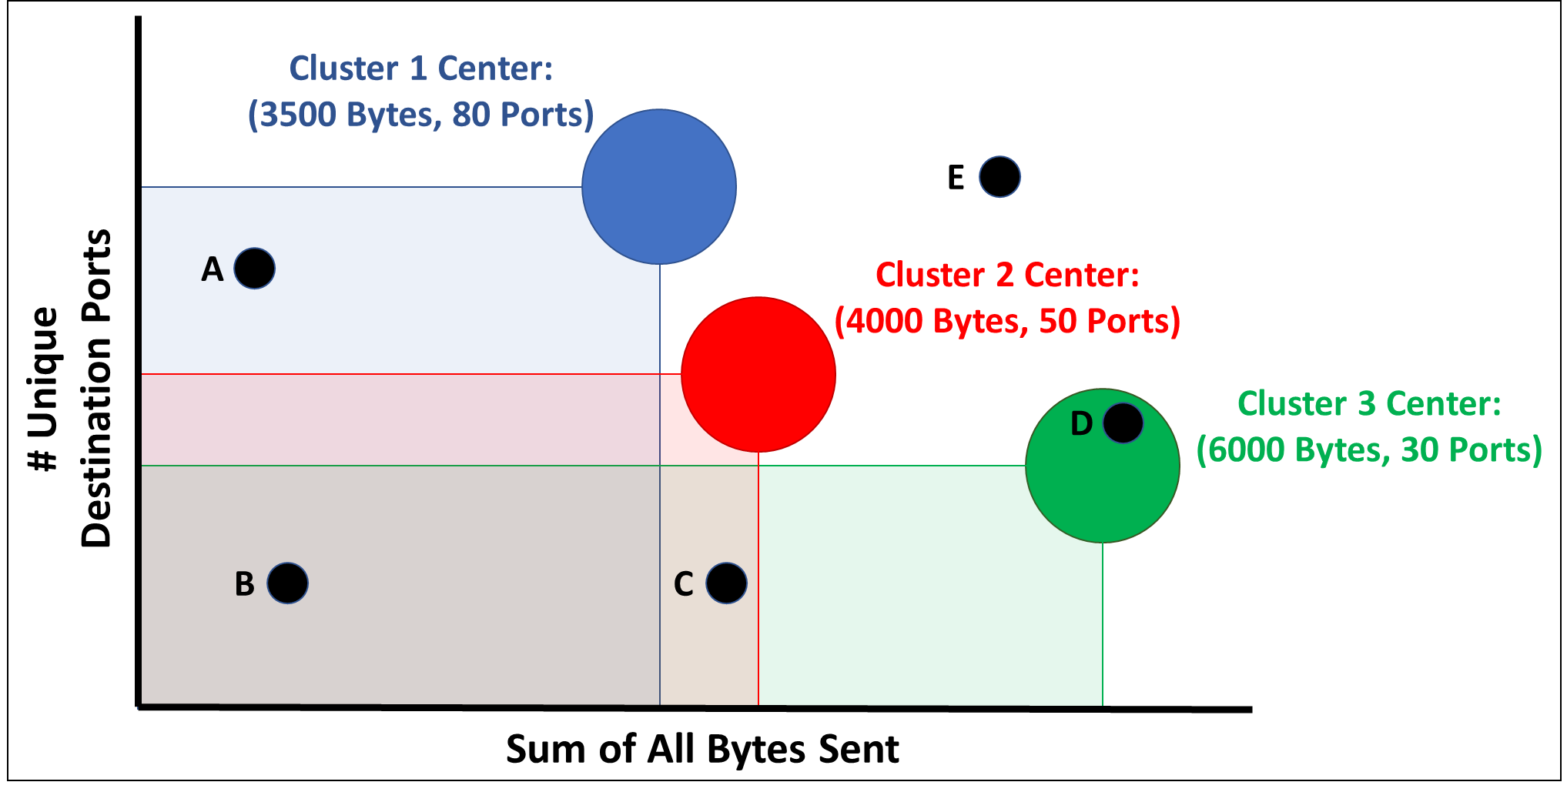
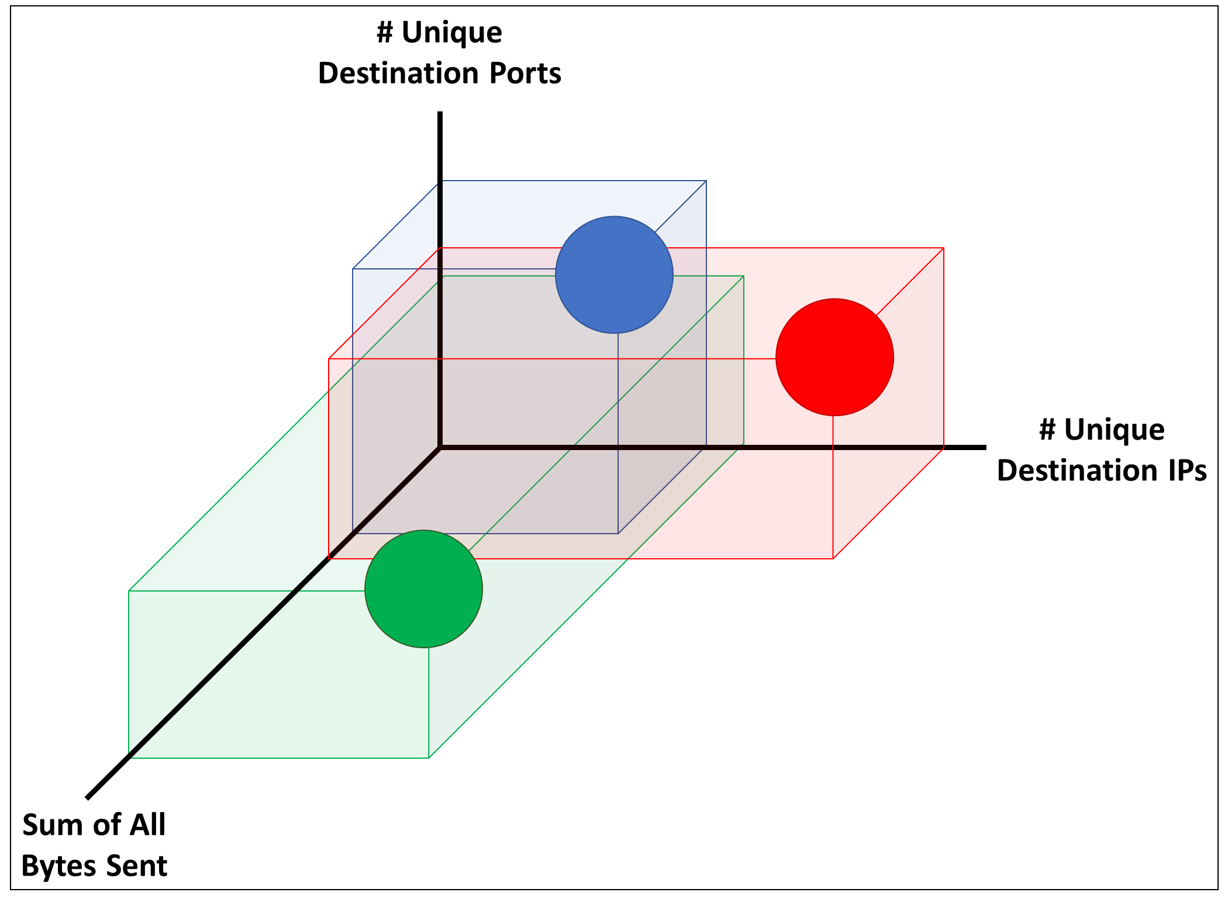
Threshold Implementation
The circles are the clusters found plus an additional 2 standard deviations past the maximum value in that cluster. Anything in the circles is “Normal”.
The squares represent an important concept that network traffic can always be less than normal.
Example: A user normally sends 3500 bytes to 80 ports. Maybe they go on vacation and for one interval only send 1000 bytes to 10 ports.
1000 bytes and 10 ports is outside any known cluster, so should this be considered an anomaly?
No! It is still “Normal”. The user just used the network less than normal.
Anything in a square or a circle is still considered “Normal”.
Only point E in the above right diagram is an “Anomaly”.
Note: The above diagrams are both example data.

Slide 15
Anomalies Tested
We used Python’s Scapy library to perform a UDP port scan.
A port scan attempts to initiate a conversation from the attacking device to the victim device on every port from port 1 up to port 65535.
We used hping3 to send a flood of 100,000 packets from the attacking device to the victim device.
Our algorithm successfully detected both of these attacks as “Anomalies” and blocked the traffic.
One side effect in our current implementation is that sometimes the victim device is also blocked. The victim tries to respond to all of the attacker’s messages and may send an “anomalous” amount of responses.

Slide 16
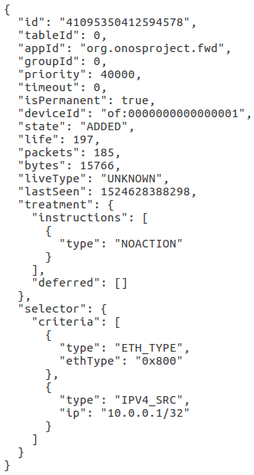
ONOS REST API Call
When an anomaly is detected, our Spark application:
Queries ONOS via REST API to determine which Open vSwitch the attacking device is connected to.
Sends a REST API Call to ONOS providing:
The IP address of the attacking device.
The Open vSwitch that the attacking device is connected to.
ONOS receives the REST API call and adds a Flow to the Open vSwitch to block all traffic with source IP of the attacking device.
The flow entry to the right was sent by ONOS to drop all traffic at Open vSwitch of:0000000000000001 from source IPv4 address 10.0.0.1

Slide 17
Project Demo Video
Timestamps to point out:
20:53 - Start hping3 flood.
22:27 - Ping stopped and can see message in Spark. h11 blocked.
23:42 - Also blocked h12.
25:34 - Start Port scan.
26:28 - Ping stopped. h21 blocked.
28:06 - ONOS Flow entries.
40:00 - pingall results.

Slide 18
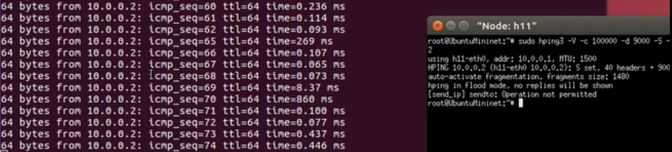
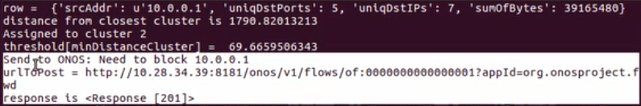
Screenshots from Demo
Traffic blocked after ICMP Ping Flood from 10.0.0.1 to 10.0.0.2
Output of PySpark for detected Anomaly

Slide 19
Future Scope
Instead of our Spark Application sending a REST API call to ONOS to immediately block the traffic, an alert should be sent to a group to investigate the anomaly.
With our current implementation sometimes both the attacker and the victim were blocked, due to the victim trying to respond to all of the attacker’s messages.
When new types of “normal” traffic are added to our network, they could be detected as “anomalous”. Our “normal” network data is very limited.
We could try other Machine Learning algorithms and compare them with our implementation.
Once we captured the 36 hours of initial data, we never put new data into ElasticSearch. Ideally we would continue to store new “normal” traffic and periodically update our model.

Slide 20
Lessons Learned
How to configure ONOS.
The documentation on the website is out-of-date and information is not all in one location. It took many hours to find the necessary resources and commands to configure ONOS.
We initially created an internal application for ONOS. We had to learn how to build the application using Maven and load and enable the application into ONOS.
StreamSets
We found StreamSets to solve the problem of getting NetFlow data into Apache Kafka.
Apache Spark (PySpark)
We had to learn how to perform feature extraction, feature engineering, and Machine Learning in PySpark.
Big Data Infrastructure
We had to learn the necessary components to form a Big Data architecture.

Slide 21

Questions and Feedback !!!

Slide 22
Links
Source code and other files:
https://github.com/blynotes/CS6301_SDN

Slide 23
Appendix A – Sources of Randomness in Python Network Traffic Generation
Hosts (Users with Laptops):
Sleep for random time between 1-10 seconds.
Choose one of the following 4 tasks at random:
1) Send data (random amount between 1 and 1024 bytes) to other host.
- Choose host to send to at random (other than self).
2) Ping another IP.
- Choose host or server to send to at random (other than self).
3) Send HTTP request to Web Server.
4) Send data (random amount between 1 and 1024 bytes) to App Server.
Web Server:
Sleep for random time between 1-10 seconds.
Send data (random amount between 1 and 1024 bytes) to DB Server.
DB & App Server only respond to requests.

Slide 24
Appendix B – Python Scripts
setup_topo.py – Setup Mininet topology, configure Open vSwitches with NetFlow, call Client.py and Server.py for each Mininet host.
Client.py – Generates random “Normal” traffic.
Server.py – Receives messages from Client.py from other hosts and responds.
sparkKafka.py – Perform feature engineering to get our features and send to ElasticSearch.
sparkMachineLearning.py – Train K-Means algorithm on data in ElasticSearch, perform feature engineering on new data, standardize new data and check if anomaly. If anomaly detected, send REST API call to ONOS.
scapyPortScan.py – Use Python library Scapy to perform a UDP port scan from port 1 to port 65535 on the target device.

Slide 25
Appendix C - Elasticsearch Index Creation
Elasticsearch is a distributed document store.
It can store and retrieve complex data structures—serialized as JSON documents—in real time.
In other words, as soon as a document has been stored in Elasticsearch, it can be retrieved from any node in the cluster.
# the index created in Elasticsearch using Kibana Dev Tool
PUT /netflowrepo/entry/_mapping
{
"entry" : {
"properties" : {
"sumOfBytes" : { "type" : "long" },
"uniqDstIPs" : { "type" : "integer" },
"uniqDstPorts" : { "type" : "integer" }
}
}
}

Slide 26
Appendix D - Supervised vs. Unsupervised Machine Learning
Supervised Machine Learning is used when you have labeled data.
You give the Machine Learning algorithm examples of “Normal” traffic and examples of “Attack” traffic, and it learns how to recognize them. After being trained, when shown a previously unseen example the algorithm should be able to correctly identify if the new traffic is “Normal” or if it is an “Attack.”
This would work for Signature-based IDS.
Unsupervised Machine Learning is used when you do not have labeled data.
We chose Unsupervised Machine Learning since we only had examples of “Normal” network traffic data to train from.
This is typically used when looking for anomalies.

