Slide 1
Machine Learning Approach for Real Time Intrusion Detection using ONOS
Project Team
Stephen Blystone (smb032100)
Taniya Riar (txr170430)
Juhi Bhandari (jxb161830)
Ishwank Singh (ixs170930)

Slide 2
Introduction
The project focuses on implementing Intrusion Detection using ONOS controller in real time. It is divided into following parts:
Creation of a miniatured network to simulate traffic which is controlled by the ONOS Controller.
Extraction and loading the real time traffic log using NetFlow on a Big Data Architecture for further visualization and processing.
Implementing statistical models on the processed data to detect anomalies in non-signature attacks.
Sending control to ONOS to block traffic from the anomaly device

Slide 3
Problem Statement
With the increasing popularity and implementation of Software Defined Networks and powerful controllers, we hosted a customized application on them to perform intrusion detection for non-signature attacks.
The real-time implementation will detect the attack immediately and hence blocking the traffic from the anomaly device via ONOS Controller.
Since, the data is semi-structured and Big Data, we had to include the Big Data architecture to process and visualize it.

Slide 4
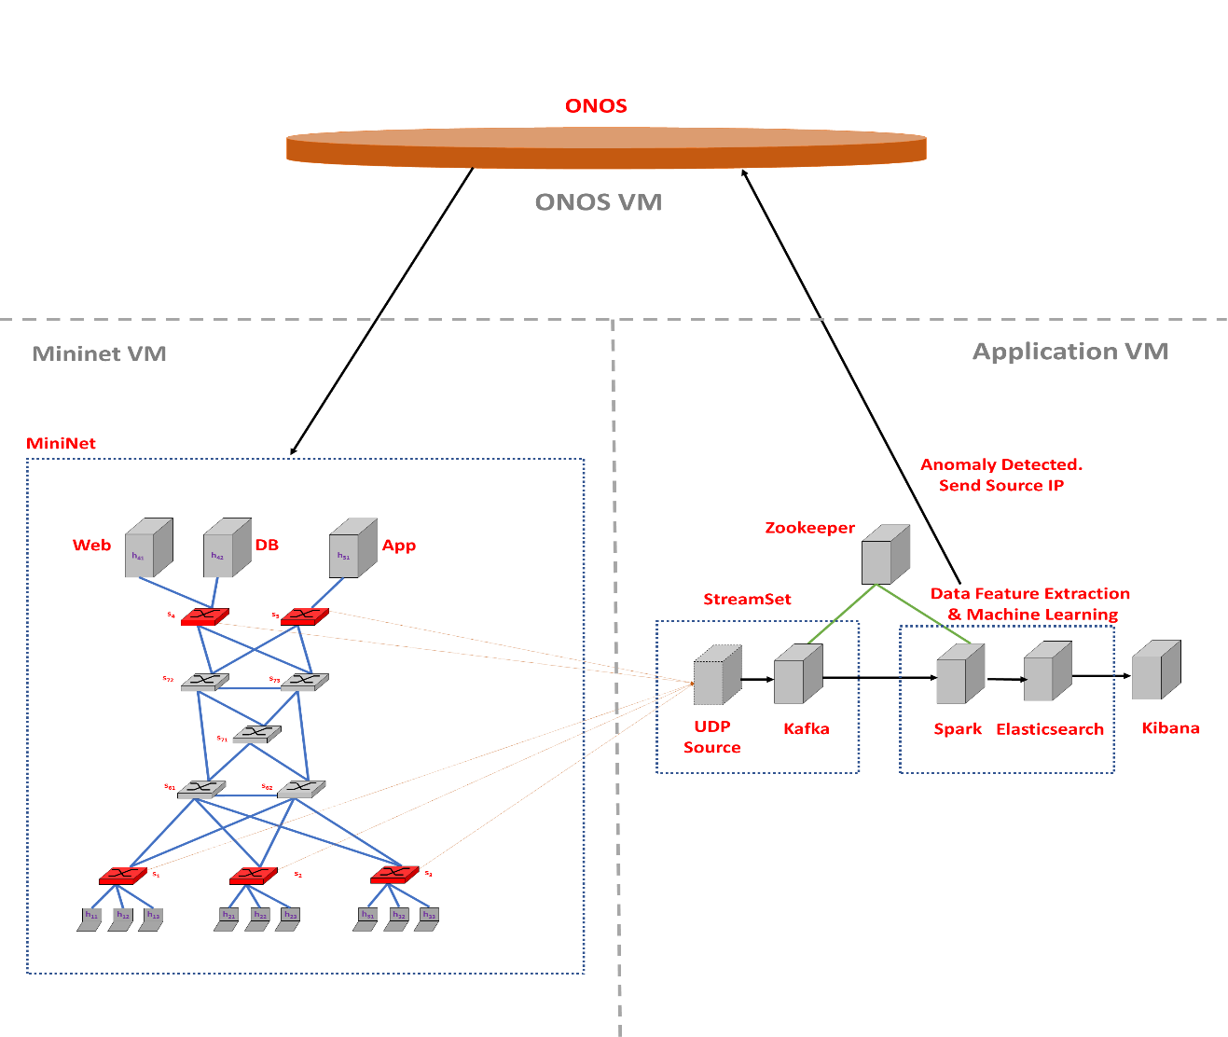
Architecture
ONOS Controller – communicates with the miniatured network and the Big Data Infrastructure.
Miniatured Network – It consists of hosts, switches and the servers. Few of the switches are NetFlow enables and thus connecting to the Big Data Infrastructure.
Big Data Infrastructure – It consists of Stream Sets which connects the NetFlow switches via a UDP port to Apache Kafka. Further, it connects to Data Feature and Machine Learning module consisting of Apache Spark and Elasticsearch Data Storage. Kibana is then connected via Elasticsearch for the visualization of the real-time data.

Slide 5




Tools Used
ONOS Controller
MiniNet
NetFlow Collector
Stream Set
Apache Kafka
Apache Spark
Elasticsearch
Kibana
Logstash

Slide 6

Implementation
Traffic and Network Generation
Big Data Framework
Elasticsearch Index Creation
Machine learning approach to Intrusion Detection

Slide 7
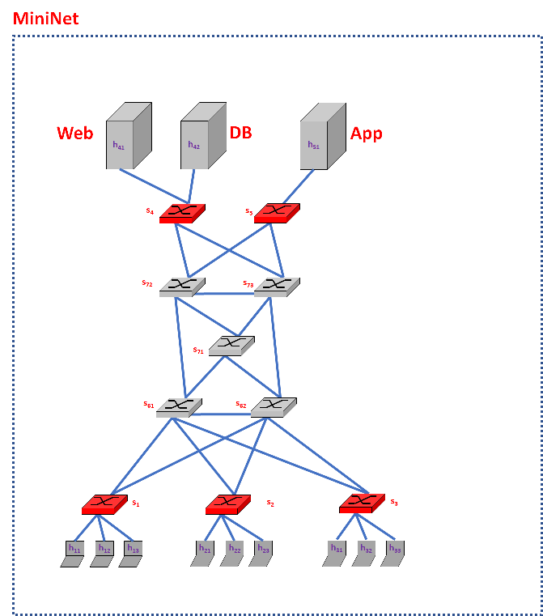
Traffic and Network Generation
The miniatured network topology used is very close to a “Realistic Scenario”
setup_topo.py creates the network topology
client.py sets up the hosts and assigns IPs to the servers and the clients
Server.py creates and sets up the servers like Web ,App and Database servers.
Maintains the randomness in the traffic generation
Using simplified network protocols like TCP and ICMP.

Slide 8
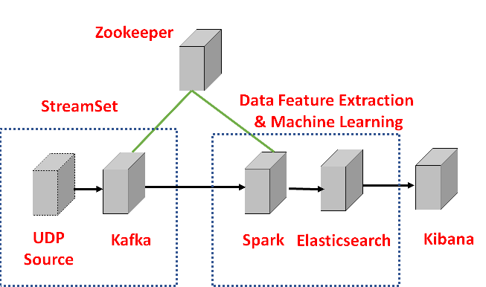
Big Data Framework
We will have several components in our architecture:
Data Sources
These are the Open vSwitch nodes sending NetFlow data.
Real-time Message Ingestion
Performs Stream Buffering, providing the “Stream Processing” block enough time to process the stream data without being overrun with data.
We will use Apache Kafka.
Stream Processing
This component filters, aggregates, and prepares the data for analysis.
We will use Apache Spark Streaming.
Analytical Data Store
This is where the data is stored after being processed.
We will use Elasticsearch.
The Machine learning part is done using PySpark.

Slide 9
Elasticsearch Index Creation
Elasticsearch is a distributed document store.
It can store and retrieve complex data structures—serialized as JSON documents—in real time.
In other words, as soon as a document has been stored in Elasticsearch, it can be retrieved from any node in the cluster.
# the index created in Elasticsearch using Kibana Dev Tool
PUT /netflowrepo/entry/_mapping
{
"entry" : {
"properties" : {
"sumOfFlows" : { "type" : "long" },
"sumOfBytes" : { "type" : "long" },
"uniqDstIPs" : { "type" : "integer" },
"uniqDstPorts" : { "type" : "integer" }
}
}
}

Slide 10
Machine learning approach to Intrusion Detection
There are mainly two intrusion detection methods:
Misuse Detection: identifies intrusions based on known patterns for the malicious activity, known patterns are referred to as signatures that represents specific threat. But has limitation to detect new threats whose signatures are not yet identified.
Anomaly Detection: identifies intrusions based on deviations from established normal behavior. Anomaly detection builds models of normal network events and detects the events that deviate from these models. This method can detect new types of attack events because it only relies on known normal events but has high false positive rate.
FOCUS…. on anomaly detection and apply machine learning approaches to automatically investigate attacks without human intervention, resist attacks or circumvent them.

Slide 11

Feature Engineering
Following statistics are calculated for the recorded data to ensure that the machine learning algorithm learns the parameters appropriately:
Sum of flow
Sum of Bytes
Unique destination IP
Unique Destination Ports
Parameters allow us to identify:
any potential of an infected IP
statistics are calculated based on these parameters.

Slide 12
Statistical Analysis and Model Implementation
In statistical analysis, based on input data we calculate the following parameters:
Mean
Standard deviation
Median
Inter-quartile range
Maximum value in the data
It must lie outside 1.5 times inter-quartile range.
When a new data arrives, the following parameters are calculated for that data and then we check if it is within the defined boundary.
If it is then we treat the data as benign else, we classify it as a possible intrusion.
n case of potential intrusion, ONOS makes a RESTFUL API call to block all traffic from that harmful IP address.

Slide 13
Unsupervised learning Approach
Grouping the similar objects together in a cluster and grouping the dissimilar objects in a different cluster
K-Means algorithm splits the number of observation into ‘K’ clusters where every observation belongs to the cluster with the nearest mean
The performance of this algorithm largely depends on the value of K’
To efficiently choose the value of ‘K’, silhouette measure is used
Silhouette plot is used to identify the number of clusters in the algorithm
The value of ‘K’ with highest average silhouette width is chosen for the data set
In our case the silhouette value comes to be highest for K = 3, i.e. the number of clusters comes out to be 3

Slide 14
STEPHEN PLEASE ADD the graphs for unsupervised learning approach and other material that you think will suit

Slide 15
Add the material for connection to rest API of ONOS for blocking

Slide 16
Add a hyperlink for the Demo video

Slide 17

Future Scope
Implementation of such an architecture and usage of terabytes of data can bring in limelight great predictions for the automation of the technology.
The implementation of this project on massive scale can offer the best of convenience and support to consumers and industries globally.
Various amazing reporting tools can be added to the architecture for the advent of the an Enterprise and Analytical Data Warehousing.

Slide 18

Future Scope
Furthermore, we can work on the use cases where we can detect any anomaly in the links in a network.
This project can be worked to include recommendation for the various paths to choose in a network to reach from host A to B.
Various classification and clustering models can be implemented to bring the accuracy of the prediction to almost real.

Slide 19

Questions and Feedback !!!

