Slide 1
EEL 5661 MATLAB Project on accelerometers, combined with gyroscopes and sensor fusion.
Brandon Lyons
Project number 14

Slide 2
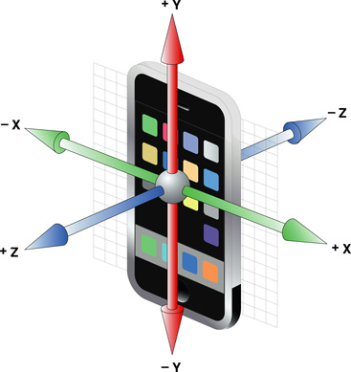
What is an accelerometer?
An accelerometer at its most basic level is a small system that consists of a weight that is called the proof mass, the housing space where the system operates and a spring that the mass manipulates by expanding and contracting based on the movement of the object to measure acceleration. When not moving, accelerometers will still account for the pressure of gravity and would return the value of gravity, g in the upwards direction because g pressure will always be downwards. Moreover, accelerometers are only able to read the acceleration from one axis at a time so you need three total oriented in the right way to get the x, y and z axes of the item that the inertial navigation is for. This is shown in the illustration below with a modern smartphone showing the directions of the axis's and which way each one would measure. It is important to note though that these phones contain a newer type
of accelerometer with a system called MEMS, or
Micro Electro-Mechanical System, that is extremely
small and is made with silicon and acid, specifically
potassium hydroxide.

Slide 3
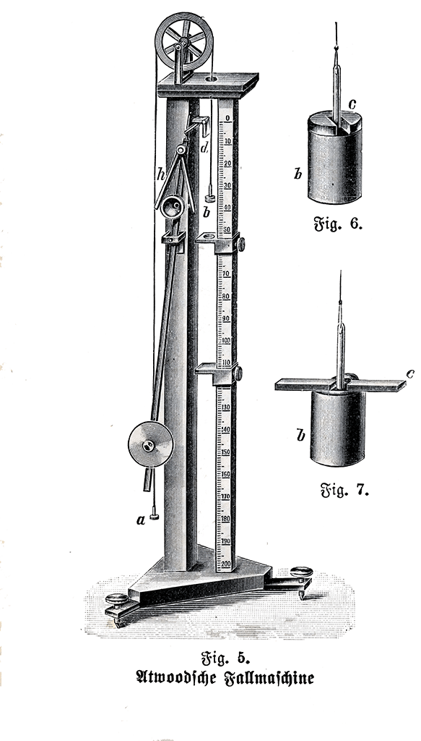
History of accelerometers
The first accelerometer was made by George Atwood in 1783 and was called the
Atwood machine and was much, much larger then today’s choices. This
accelerometer measured linear acceleration of something like a falling object
and was able to be put in anything. This changed though because of the
improvements by people like Charles Stark Draper who is called the “father of
inertial navigation”. He used his more accurate accelerometers and
gyroscopes in American land sea and air guidance systems and eventually in
the Apollo missions. To show how far we have come the MEMS accelerometers
now are so incredibly small that it cant be made by man or machine, but by
a extremely thought out series of acid placements that eventually gets to be
the shape we are looking for.

Slide 4
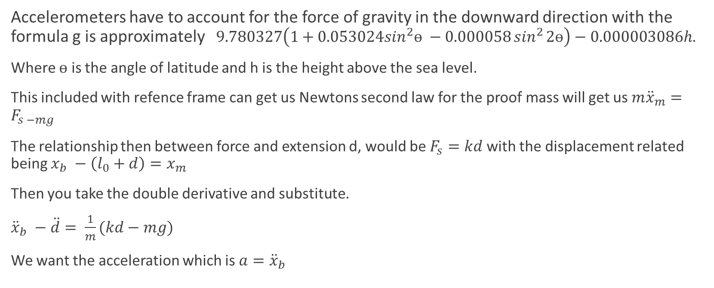
Math behind the Accelerometer
Accelerometers have to account for the force of gravity in the downward direction with the formula g is approximately $9.780327\left(1+0.053024\sin^{2}ѳ −0.000058\sin^{2}{2ѳ}\right)−0.000003086h$.
Where $ѳ$ is the angle of latitude and h is the height above the sea level.
This included with refence frame can get us Newtons second law for the proof mass will get us $m{\ddot{x}}_{m}=F_{s −mg}$
The relationship then between force and extension d, would be $F_{s}=kd$ with the displacement related being $x_{b} −\left(l_{0}+d\right)=x_{m}$
Then you take the double derivative and substitute.
${\ddot{x}}_{b} −\ddot{d}= \frac{1}{m}(kd−mg)$
We want the acceleration which is $a={\ddot{x}}_{b}$

Slide 5
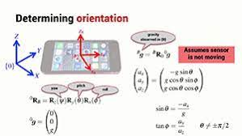
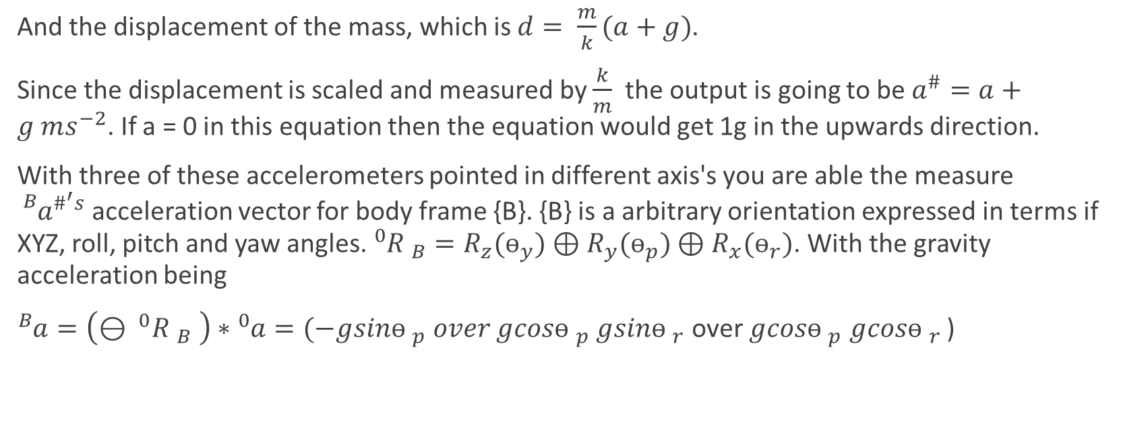
Math behind the Accelerometer
And the displacement of the mass, which is $d= \frac{m}{k}(a+g)$.
Since the displacement is scaled and measured by $\frac{k}{m}$ the output is going to be $a^{\#}=a+g ms^{−2}$. If a = 0 in this equation then the equation would get 1g in the upwards direction.
With three of these accelerometers pointed in different axis's you are able the measure ${{}_{}^{B}a}^{\#^{′}s}$acceleration vector for body frame {B}. {B} is a arbitrary orientation expressed in terms if XYZ, roll, pitch and yaw angles. ${}_{ }^{0}{R _{B}=R_{z}(ѳ_{y})⊕R_{y}(ѳ_{p})⊕R_{x}(ѳ_{r})}$. With the gravity acceleration being
${}_{ }^{B}{a=\left(⊖ ^{0}R _{B} \right)∗{}_{ }^{0}{a=(−gsinѳ _{p}}} over gcosѳ _{p}$ $gsinѳ _{r}$ over $gcosѳ _{p}$ $gcosѳ _{r}$ )

Slide 6
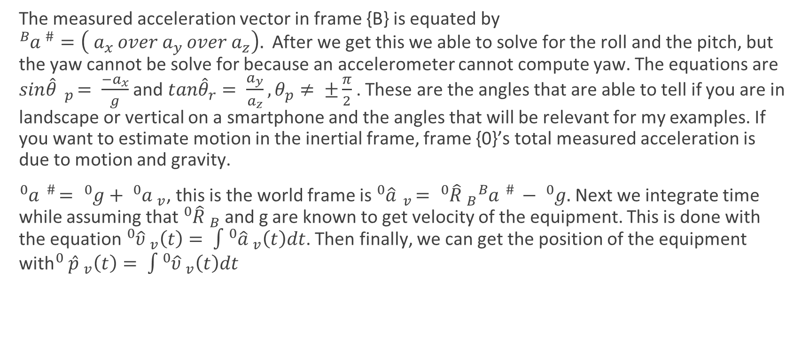
Math behind the Accelerometer
The measured acceleration vector in frame {B} is equated by ${}_{ }^{B}{a ^{\#}=\left( a_{x }over a_{y }over a_{z}\right). }$After we get this we able to solve for the roll and the pitch, but the yaw cannot be solve for because an accelerometer cannot compute yaw. The equations are $sin\hat{θ} _{p}= \frac{{−a}_{x}}{g}$ and $tan{\hat{θ}}_{r}= \frac{a_{y}}{a_{z}}, θ_{p}≠ ±\frac{π}{2}$. These are the angles that are able to tell if you are in landscape or vertical on a smartphone and the angles that will be relevant for my examples. If you want to estimate motion in the inertial frame, frame {0}’s total measured acceleration is due to motion and gravity.
${}_{ }^{0}a ^{\#}= {}_{ }^{0}{g+ {}_{ }^{0}a _{v}}$, this is the world frame is ${}_{ }^{0}{\hat{a}} _{v}= {}_{ }^{0}{\hat{R}} _{B}{}_{ }^{B}a ^{\#} − {}_{ }^{0}{g. }$Next we integrate time while assuming that ${}_{ }^{0}{\hat{R}} _{B}$ and g are known to get velocity of the equipment. This is done with the equation ${}_{ }^{0}{\hat{υ}} _{v}\left(t\right)= \int{{}_{ }^{0}{\hat{a} _{v}\left(t\right)dt}}$. Then finally, we can get the position of the equipment with${}_{ }^{0} {\hat{p} }_{v}\left(t\right)= \int{{}_{ }^{0}{\hat{υ} _{v}\left(t\right)dt}}$

Slide 7
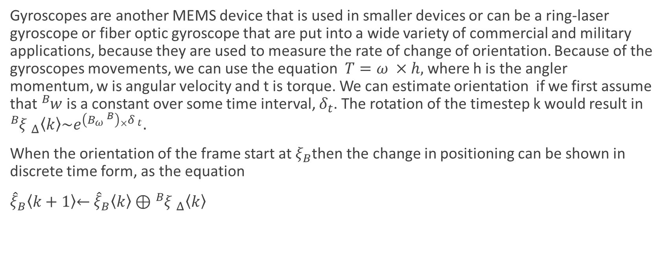
Accelerometer and the gyroscope
Gyroscopes are another MEMS device that is used in smaller devices or can be a ring-laser gyroscope or fiber optic gyroscope that are put into a wide variety of commercial and military applications, because they are used to measure the rate of change of orientation. Because of the gyroscopes movements, we can use the equation $T=ω ×h,$where h is the angler momentum, w is angular velocity and t is torque. We can estimate orientation if we first assume that ${}_{ }^{B}w$ is a constant over some time interval, $δ_{t}$. The rotation of the timestep k would result in ${}_{ }^{B}{ξ _{Δ}\left\langle k\right\rangle \sim e^{\left(B_{ω} ^{B}\right){}_{×}^{ }{δ _{t}}}}.$
When the orientation of the frame start at $ξ_{B}$then the change in positioning can be shown in discrete time form, as the equation
${\hat{ξ}}_{B}\left\langle k+1\right\rangle \overset{←}{ } {\hat{ξ}}_{B}\left\langle k\right\rangle ⊕{}_{ }^{B}{ξ _{Δ}\left\langle k\right\rangle }$

Slide 8
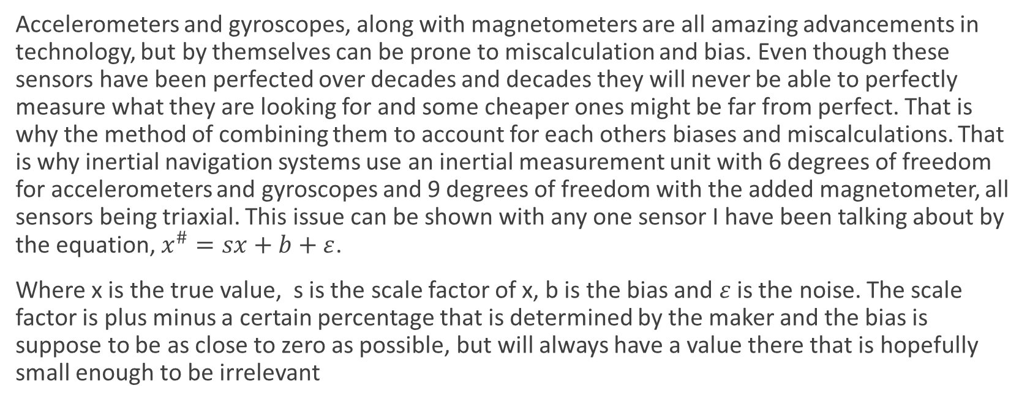
Sensor Fusion
Accelerometers and gyroscopes, along with magnetometers are all amazing advancements in technology, but by themselves can be prone to miscalculation and bias. Even though these sensors have been perfected over decades and decades they will never be able to perfectly measure what they are looking for and some cheaper ones might be far from perfect. That is why the method of combining them to account for each others biases and miscalculations. That is why inertial navigation systems use an inertial measurement unit with 6 degrees of freedom for accelerometers and gyroscopes and 9 degrees of freedom with the added magnetometer, all sensors being triaxial. This issue can be shown with any one sensor I have been talking about by the equation, $x^{\#}=sx+b+ε$.
Where x is the true value, s is the scale factor of x, b is the bias and $ε$ is the noise. The scale factor is plus minus a certain percentage that is determined by the maker and the bias is suppose to be as close to zero as possible, but will always have a value there that is hopefully small enough to be irrelevant

Slide 9
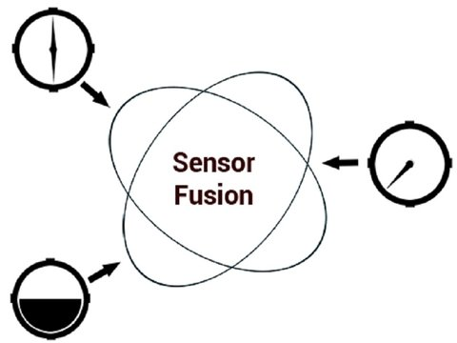
Sensor Fusion
Furthermore, bias can be hard to deal with because there miscalculation can actually grow overtime and create a vast change of data from the true value. Lastly, the noise is in the equation is just random. To combat these problems in these individual sensors, we can use sensor fusion to make the sensors compliment the other readings to get a much more accurate measurement of the position and orientation, or pose, of the machine. The unique characteristics of each sensor can be used to create a fusion between them and account for many factors. One way of doing this is referred to as the extended Kalman filter and is described in Peter Corke’s book as “Given a full nonlinear mathematical
model that relates the sensor signals and their biases to the
vehicle pose and knowledge about the noise (uncertainty) on
the sensor signals, the filter gives an optimal estimate of the
pose and bias that best explain the sensor signal”.

Slide 10
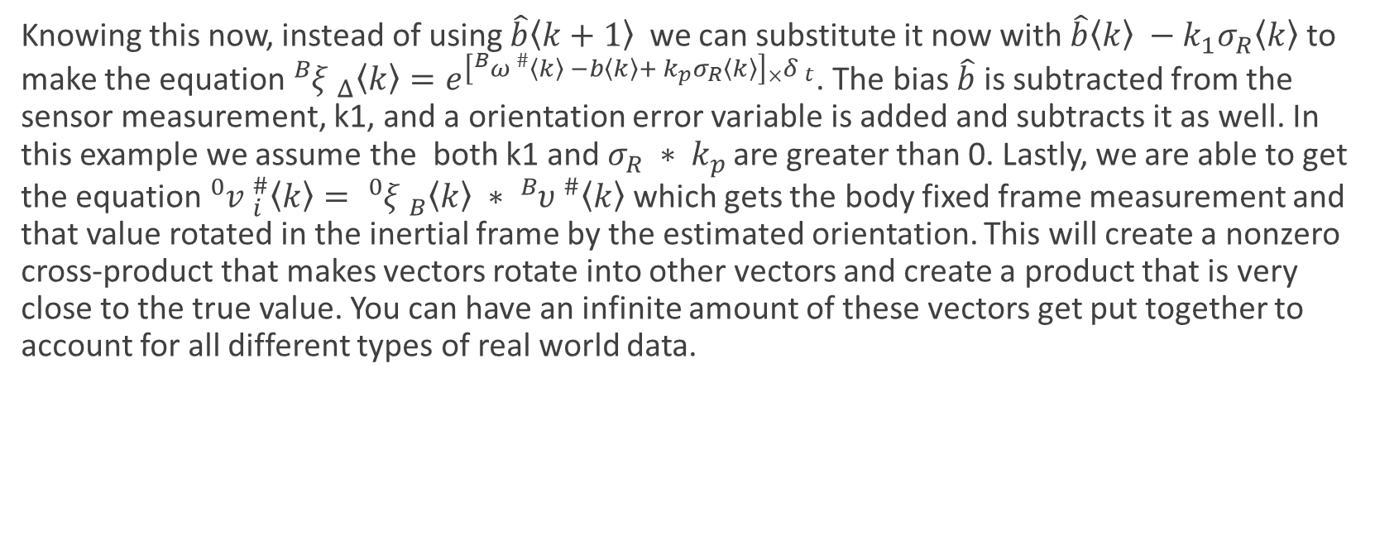
Sensor Fusion
Knowing this now, instead of using $\hat{b}\left\langle k+1\right\rangle$ we can substitute it now with $\hat{b}\left\langle k\right\rangle −k_{1}σ_{R}\left\langle k\right\rangle$ to make the equation ${}_{ }^{B}{ξ _{Δ}\left\langle k\right\rangle =e^{\left[{}_{ }^{B}{ω ^{\#}\left\langle k\right\rangle −b\left\langle k\right\rangle }+ k_{p}σ_{R}\left\langle k\right\rangle \right]{}_{×}^{ }{δ _{t}}}}$. The bias $\hat{b}$ is subtracted from the sensor measurement, k1, and a orientation error variable is added and subtracts it as well. In this example we assume the both k1 and $σ_{R} ∗ k_{p }$are greater than 0. Lastly, we are able to get the equation ${}_{ }^{0}v _{i}^{\#}\left\langle k\right\rangle = {}_{ }^{0}ξ _{B}^{ }\left\langle k\right\rangle ∗ {}_{ }^{B}υ _{ }^{\#}\left\langle k\right\rangle$ which gets the body fixed frame measurement and that value rotated in the inertial frame by the estimated orientation. This will create a nonzero cross-product that makes vectors rotate into other vectors and create a product that is very close to the true value. You can have an infinite amount of these vectors get put together to account for all different types of real world data.

Slide 11
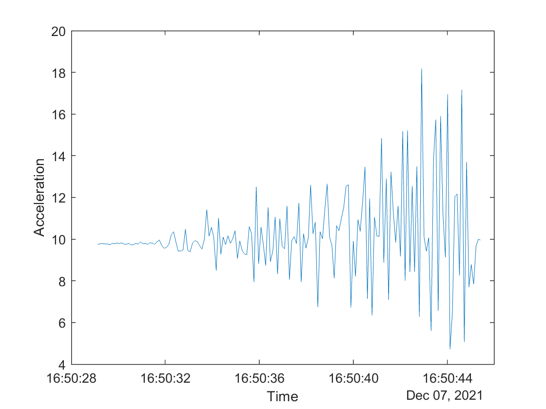
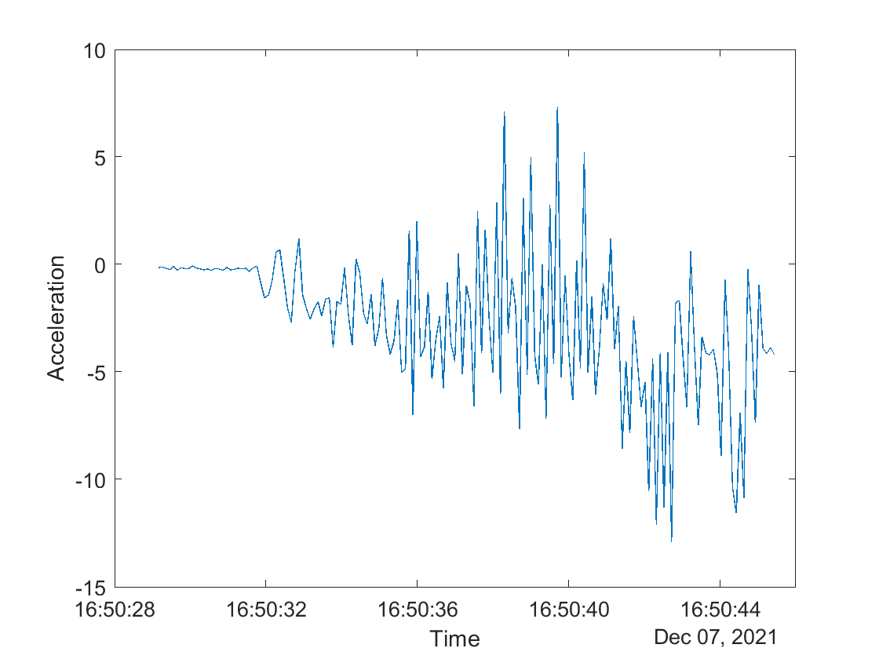
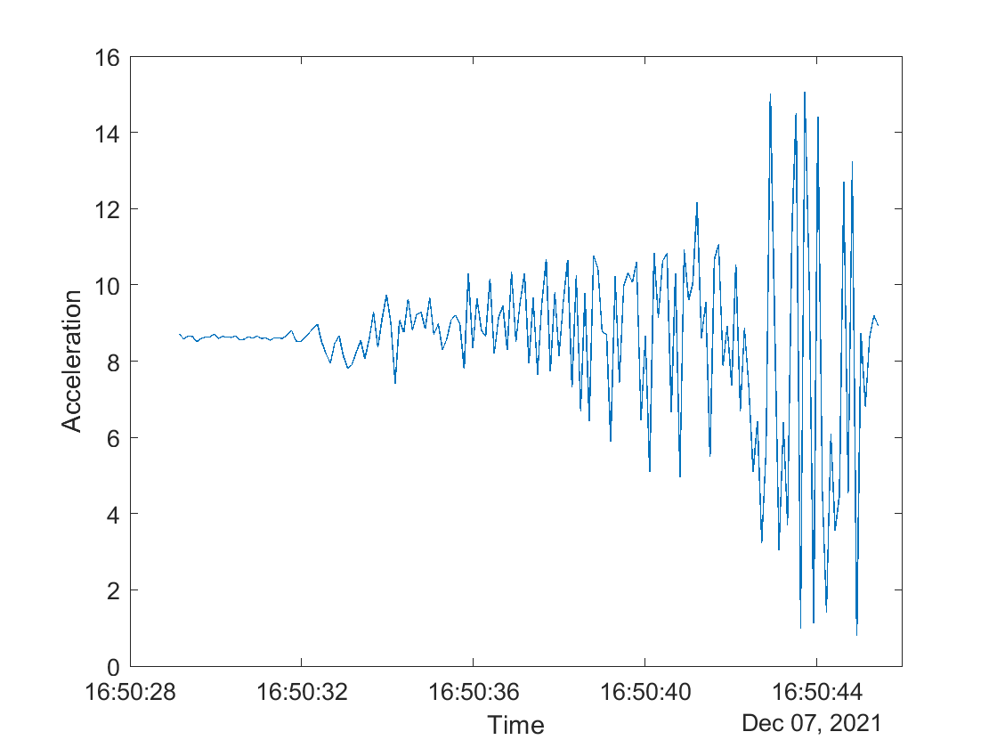
MATLAB Example
MATLAB makes showing acceleration with smart phones very easy. There is a MATLAB drive app that can be downloaded that will takes the readings from your phone and put them in a .mat file so that it can be graphed in a computer. In this example I start off by not moving the phone at all and then gradually move it more and more over time. This is what the resulting acceleration graph looks like with time being the x-axis and acceleration being the y-axis.
As you can see, when the phone was not moving the acceleration sat and 10
and when the phone started to get shaken then it made big moves in both
directions. The x-axis graph in the bottom middle and the y-axis graph in the
bottom right both have random outputs as I was not shaking the phone in any
particular way.

Slide 12
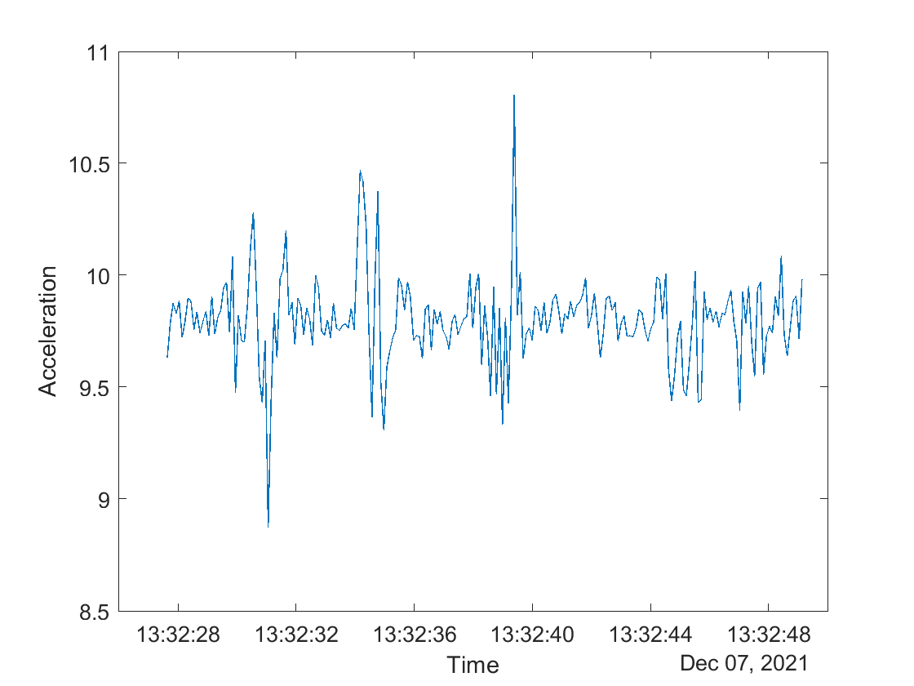

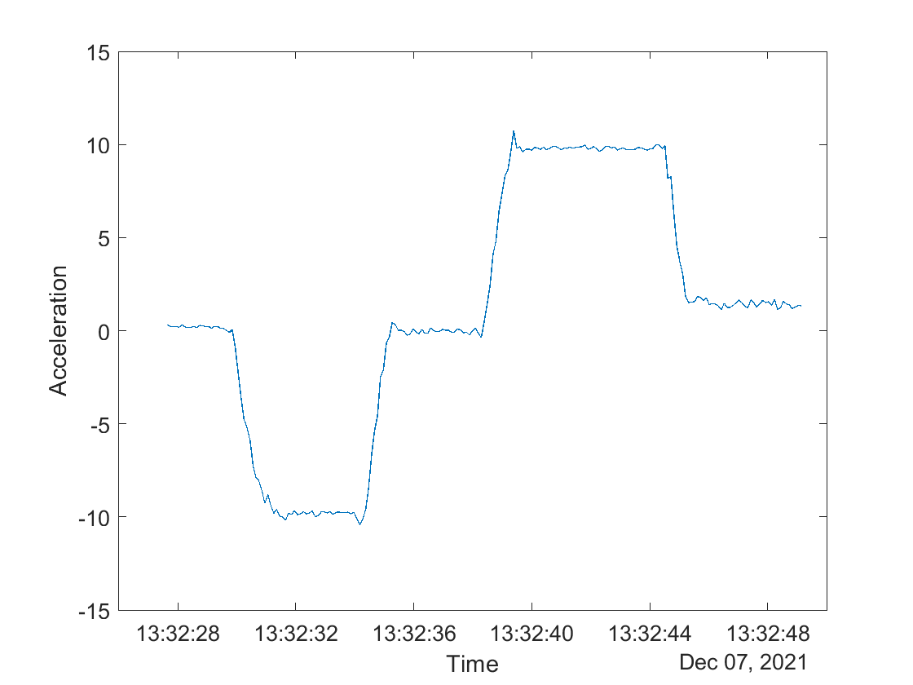
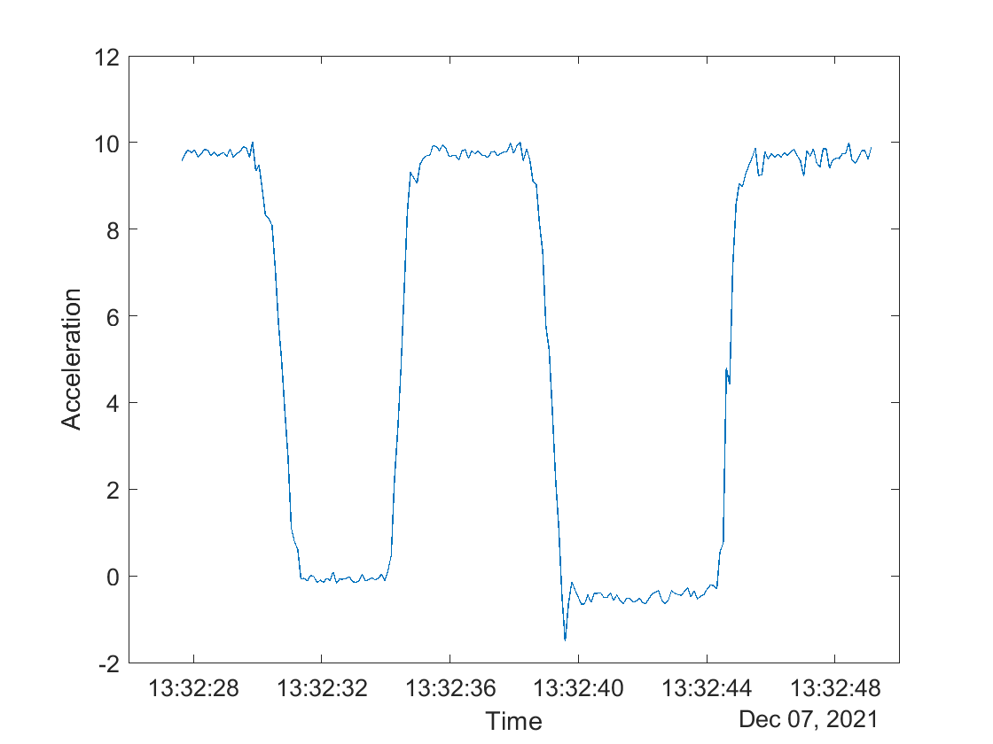
MATLAB Example
In this example, I start the phone in an upright position then tip the orientation right to landscape. Then I put in back to an upright position and tip it to the left landscape position. From the acceleration graph there are spikes going in both directions because of the flipping, but the line is mostly around 10. The x-axis and y-axis graphs are where the
interesting data is because if you look at the x- axis graph you can see when
the phone was tilted right landscape then it read -10, but if you flipped it left
landscape in the other direction then it was positive 10. The y-axis graph
showed 10 when it was vertically oriented and 0 when it was landscape in
either direction.
Then

