Slide 1
Simple ¹⁴C modelling in Matlab

Slide 2
Models of terrestrial biosphere carbon
Atmospheric CO₂
Atmospheric CO₂
Non-Wood
(leaves, roots)
Wood
Biospheric carbon
Litter and Soil Carbon

Slide 3
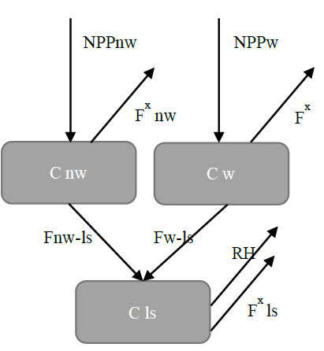
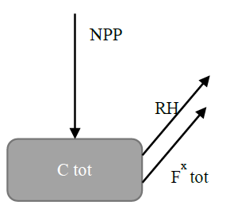
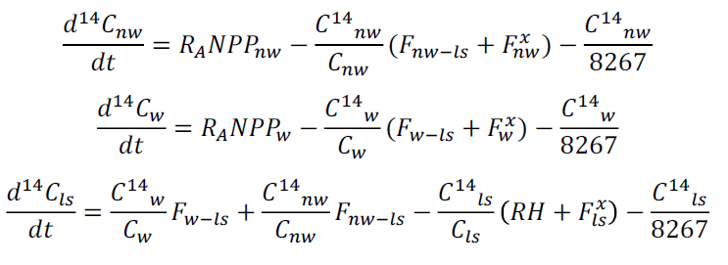

Models of terrestrial biosphere carbon

Slide 4
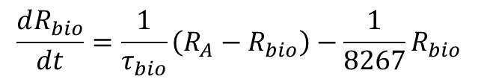




Models of terrestrial biosphere carbon
If the carbon pool size is not changing then this can be simplified
Carbon inputs = carbon outputs
NPP = RH + F^{x}
$$C_{bio}$$
$$C_{bio}$$
$$C_{bio}$$
$$C_{bio}$$
Define τ_{bio} = C_{bio}/NPP = C_{bio}/(RH + F^{x})
$$\frac{dR_{bio}}{dt}=\frac{1}{τ_{bio}}\left(R_{A}−R_{bio}\right)−\frac{1}{8267}R_{bio}$$

Slide 5
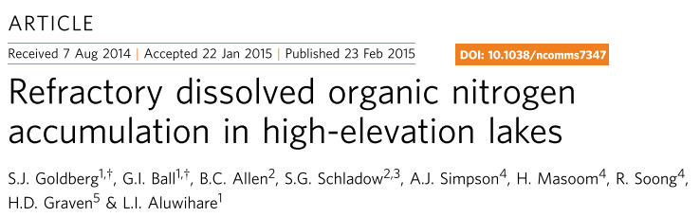
Atmospheric Δ¹⁴CO₂
Determine “age” of carbon in dissolved inorganic and dissolved organic forms in Lake Tahoe using Δ¹⁴C observations in 2010
Construct a simple model and fit the data
Lake DIC
Lake DOC

Slide 6
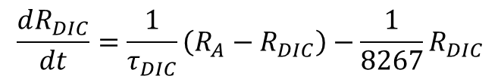
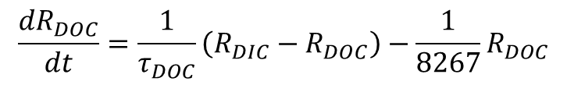
Construct a simple model and fit the data
Atmospheric Δ¹⁴CO₂
$$\frac{dR_{DIC}}{dt}=\frac{1}{τ_{DIC}}\left(R_{A}−R_{DIC}\right)−\frac{1}{8267}R_{DIC}$$
Lake DIC
$$\frac{dR_{DOC}}{dt}=\frac{1}{τ_{DOC}}\left(R_{DIC}−R_{DOC}\right)−\frac{1}{8267}R_{DOC}$$
Lake DOC
R_{DIC} and R_{DOC} indicate the ratio Δ¹⁴C/1000‰+1 in DIC and DOC. R_{A} indicates the corresponding ratio in Northern Hemisphere atmospheric CO₂ which was specified using atmospheric observations (Graven et al. 2012; Levin et al. 2010). The turnover timescale parameters for each reservoir (τ_{DIC} and τ_{DOC}) were found by fitting the model to the observations of 124 ‰ in DIC and -5 to 28 ‰ in DOC in 2010.

Slide 7
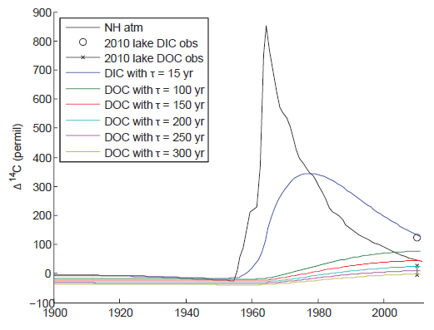
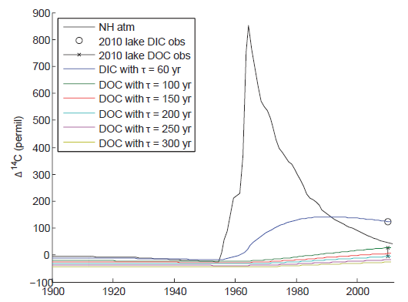

Slide 8
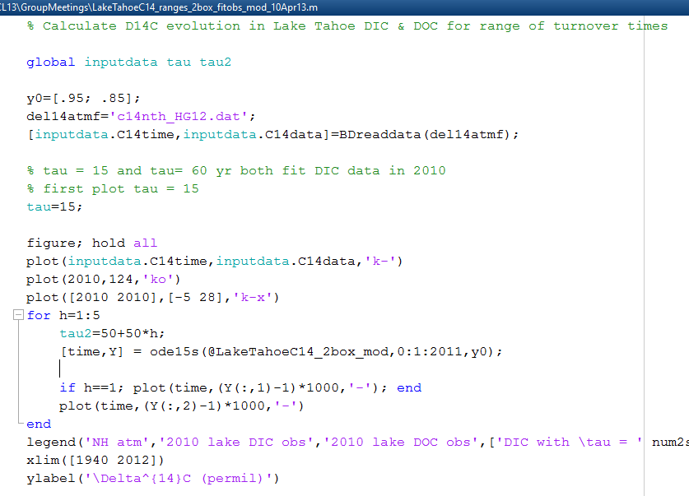
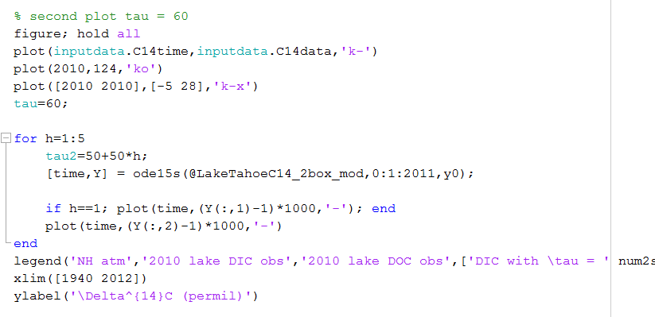

Slide 9
