Slide 1
Book1
File created on: 9/7/2023 7:39:24 PM

Slide 2
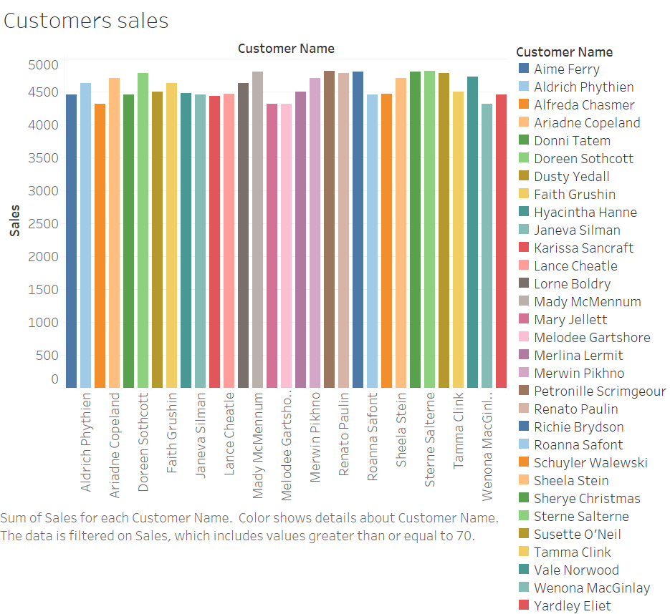

Slide 3


Slide 4
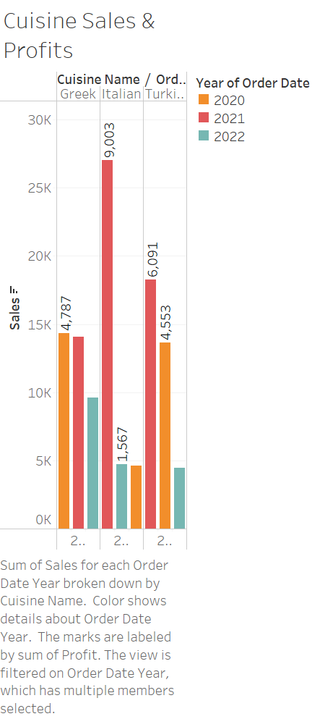

Slide 5
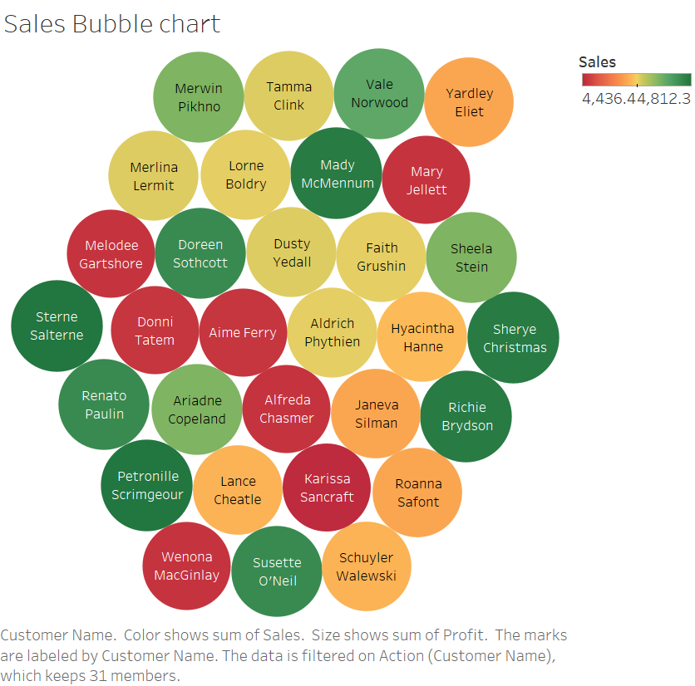

Slide 6
