Slide 1
Book1
File created on: 9/7/2023 7:41:25 PM

Slide 2
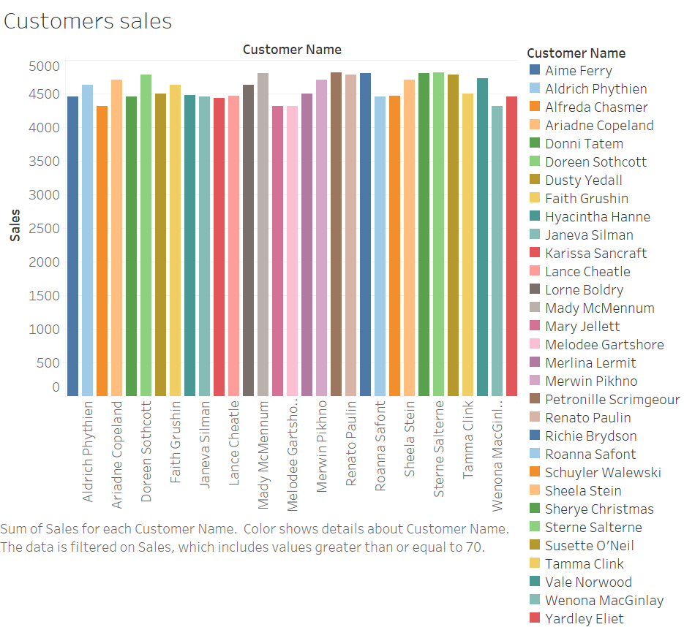

Slide 3
