Slide 1
Analysis of Parallel QuickSort
Andrew B Carrell
Ernest Ledo
Bruce Miller

Slide 2
General Considerations for Quicksort
Serial Implementation using recursion
Runtime for Serial Quicksort
General problems with serial approach
  recursive memory use
  n becomes large, depth of recursion becomes large (n log n)
sequential algorithm
QuickSort (A, p, r)
while p < r
do // partition and sort left subarray
q = Partition(A, p, r)
QuickSort(A, p, q-1)
p = q+1

Slide 3
Parallel Quicksort
General considerations for parallel implementation
  Topology
    hypercube
    binary/n-ary tree
    pipeline
  reasons for choosing binary tree
    partition divides into 2 sublists
    tree structure can be used to remerge sorted sublists

Slide 4
Parallel Quicksort
  binary tree considerations
    pivot retention or multiple sublists
    pivot retention problems
      when p = n, parallel runtime equivalent
      when p < n, retention of pivots drops concurrent processing
    multiple sublists
      send right sublist to right child
      retain and sort or further partition left sublist
      call sequential quicksort at leaf nodes
      remerge sorted sublists on departure from leaf nodes

Slide 5
Quicksort – Tree Allocation of Processes
4
2
7
8
5
1
3
6
3
2
1
4
5
7
8
6
2
1
3
4
5
7
8
6
1
2
3
6
7
8

Slide 6
Quicksort – Pivot withheld in process
4
2
7
8
5
1
3
6
3
2
1
5
7
8
6
1
2
7
8
6
2
6
8

Slide 7
Parallel Quicksort
problems with binary tree approach to sorting
  idle nodes
  communication problems
    multiple instances of simultaneous communication
    sending of dynamically sized sublists require list size to be sent
    double the communication costs, when remerging the sublists.
  as a result of communication costs, improved runtime should only be apparent when n is very large

Slide 8
(insert ABC stuff here)

Slide 9
pqsort.c
{
// algorithm for partitioning data and sending to subnodes in tree
// calls sequential qsort at leaves
for(i = levels - 1 ; i >= 0; i--) // iterate on num levels remaining
{
  if (i == 3) // top level
  {
    if (!(myid % 2) && !(myid % 4) && !(myid % 8)) // node 0
    {
      numelem = numdigits;
      pivotindex = partition(arr, 0, numelem);
      list1 = malloc(sizeof(int) * pivotindex + 1);
      list2 = malloc(sizeof(int) * numelem - (pivotindex + 1));
      k = 0;
      for(j = 0; j < numelem; j++) {
        if (j <= pivotindex)
        list1[j] = arr[j];
        else {
        list2[k] = arr[j]; k++;
        }
      }
      // store length of list1
      numdigits = pivotindex + 1;
      if (!(myid % 2) && !(myid % 4) && !(myid % 8))
      { // send list2 size to rchild
        arrsize = numelem - (pivotindex + 1);
        send(&arrsize); send(list2);
        //free arr and set it to list1
        loadarray(arr, list1);
      }
    }
  }

Slide 10
pqsort.c (cont’d)
  else if (i == 2)
  {
    if (!(myid % 2) && !(myid % 4)) // nodes mult of 4
    {
      if (myid % 8) // node 4
      {// get sublist length
        recv(&arrsize); numelem = arrsize;
        // get sublist
        recv(arr);
        numdigits = numelem;
      }
      else
        numelem = numdigits;
      pivotindex = partition(arr, 0, numelem);
      list1 = malloc(sizeof(int) * pivotindex + 1);
      list2 = malloc(sizeof(int) * numelem - (pivotindex + 1));
      k = 0;
      for(j = 0; j < numelem; j++) {
        if (j <= pivotindex)
        list1[j] = arr[j];
        else {
        list2[k] = arr[j]; k++;
        }
      }

Slide 11
pqsort.c (cont’d)
      // store length of list1
      numdigits = pivotindex + 1;
      if (!(myid % 2) && !(myid % 4))
      {// send list2 size to rchild
        arrsize = numelem - (pivotindex + 1);
        send(&arrsize); send(list2);
        //free arr and set it to list1
        loadarray(arr, list1);
      }
    }
  }

Slide 12
pqsort.c (cont’d)
  else if (i == 1)
  {
    if (!(myid % 2)) // nodes of even id
    {
      if (!(myid % 2) && (myid % 4)) // nodes 2, 6
      {// get sublist length
        recv(&arrsize); numelem = arrsize;
        // get sublist
        recv(arr);
        numdigits = numelem;
      }
      else
        numelem = numdigits;
      pivotindex = partition(arr, 0, numelem);
      list1 = malloc(sizeof(int) * pivotindex + 1);
      list2 = malloc(sizeof(int) * numelem - (pivotindex + 1));
      k = 0;
      for(j = 0; j < numelem; j++) {
        if (j <= pivotindex)
        list1[j] = arr[j];
        else {
        list2[k] = arr[j]; k++;
        }
      }

Slide 13
pqsort.c (cont’d)
      // store length of list1
      numdigits = pivotindex + 1;
      if (!(myid % 2))
      {
        // send list2 size to rchild
        arrsize = numelem - (pivotindex + 1);
        send(&arrsize); send(list2);
        //free arr and set it to list1
        loadarray(arr, list1);
      }
    }
  }

Slide 14
pqsort.c (cont’d)
  else // i == 0
  {
    if (myid % 2)
    {// get sublist length
      recv(&arrsize); numelem = arrsize;
      // get sublist
      recv(arr);
      numdigits = numelem;
    }
    else
      numelem = numdigits;
    if (numelem > 1)
    {
      nelems = sizeof (int) * numelem;
      qsort(arr, numdigits); //this is the c qsort routine
    }
  }
}

Slide 15
pqsort.c (cont’d)
// remerge up the tree
for(i = 0; i <= levels - 1; i++) // iterate on num levels above
{
  if (i == 0)
  {
    // odd nodes, send data
    if (myid % 2) // odd num nodes – send arr size to parent
      send(&arrsize); send(arr);
  }

Slide 16
pqsort.c (cont’d)
  else if (i == 1)
  {
    // if even, recv
    if (!(myid % 2))
    {
      recv(&l2size); recv(list2);
      // calc numdigits in both arrays
      arrsize = numdigits;
      numdigits = arrsize + l2size;
      // copy arr back to list1
      for (j = 0; j < arrsize; j++) list1[j] = arr[j];
      // free arr and resize it to numdigits
      // combine the arrays
      k = 0;
      for (j = 0; j < numdigits; j++) {
        if (j < arrsize)
        arr[j] = list1[j];
        else {
        arr[j] = list2[k]; k++;
        }
      }
      arrsize = numdigits;
    }
    // 2 & 6 send
    if (!(myid % 2) && (myid % 4)) // send arr size to parent
      send(&arrsize); send(arr);
  }

Slide 17
pqsort.c (cont’d)
  else if (i == 2)
  {
    // 0 & 4 recv
    if (!(myid % 2) && !(myid % 4))
    {
      recv(&l2size); recv(list2);
      // calc numdigits in both arrays
      arrsize = numdigits;
      numdigits = arrsize + l2size;
      // copy arr back to list1
      for (j = 0; j < arrsize; j++) list1[j] = arr[j];
      // free arr and resize it to numdigits
      // combine the arrays
      k = 0;
      for (j = 0; j < numdigits; j++) {
        if (j < arrsize)
        arr[j] = list1[j];
        else {
        arr[j] = list2[k]; k++;
        }
      }
      arrsize = numdigits;
    }
    // 4 send
    if (!(myid % 2) && !(myid % 4) && (myid % 8)) // send arr size to parent
      send(&arrsize); send(arr);
  }

Slide 18
pqsort.c (cont’d)
  else // i == 3
  {
    // 0 recvs
    if (!(myid % 2) && !(myid % 4) && !(myid % 8))
    {
      recv(&l2size);
      list2 = malloc(sizeof(int) * l2size);
      // get sublist
      recv(list2);
      // calc numdigits in both arrays
      arrsize = numdigits;
      numdigits = arrsize + l2size;
      // copy arr back to list1
      for (j = 0; j < arrsize; j++) list1[j] = arr[j];
      // free arr and resize it to numdigits
      // combine the arrays
      k = 0;
      for (j = 0; j < numdigits; j++) {
        if (j < arrsize)
        arr[j] = list1[j];
        else {
        arr[j] = list2[k]; k++;
        }
      }
      arrsize = numdigits;
    }
  }
}
// node 0 outputs result
if (myid == 0)
  writeresults(arr);
}

Slide 19

Analysis of Parallel Quicksort
Theoretical Case
  Time complexity of sequential quicksort

Slide 20
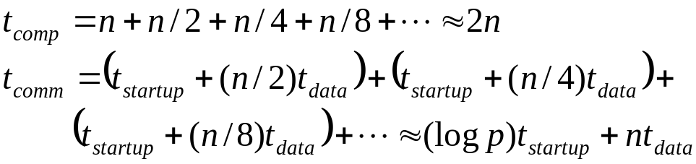
Analysis of Parallel Quicksort
  Time complexity of parallel implementation of quicksort
    Tree Implementation

Slide 21
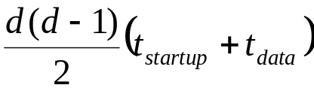
Analysis of Parallel Quicksort
  Time complexity of parallel implementation of quicksort
    Hypercube Implementation
      Computation – Pivot Selection = O(1)
      Communication – Pivot Broadcast
      Computation – Data Split = log x

Slide 22

Analysis of Parallel Quicksort
  Time complexity of parallel implementation of quicksort
    Hypercube Implementation
      Communication – Data From Split
      Computation – Data Merge = x

Slide 23
Analysis of Parallel Quicksort
  Efficiency of parallel implementation

Slide 24
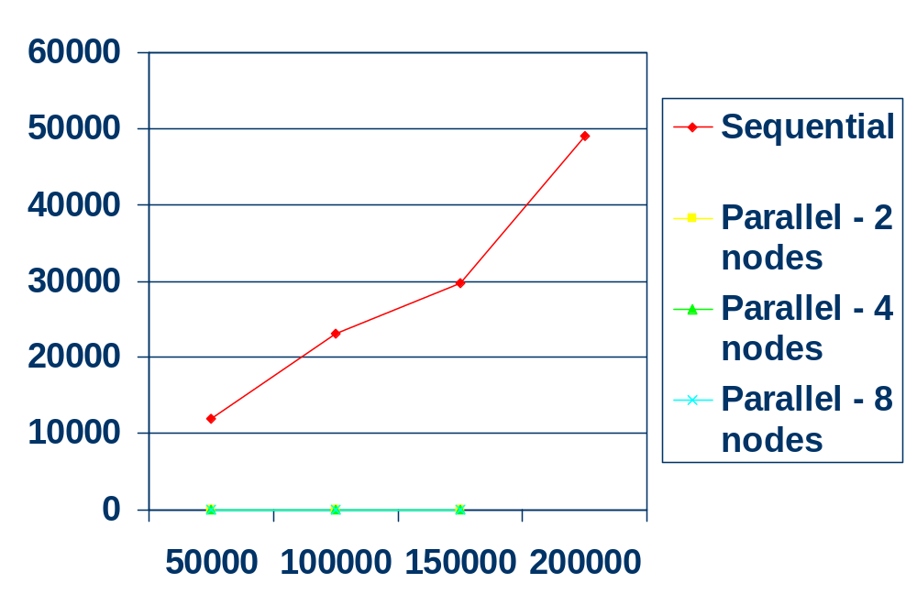
Analysis of Parallel Quicksort

