Slide 1
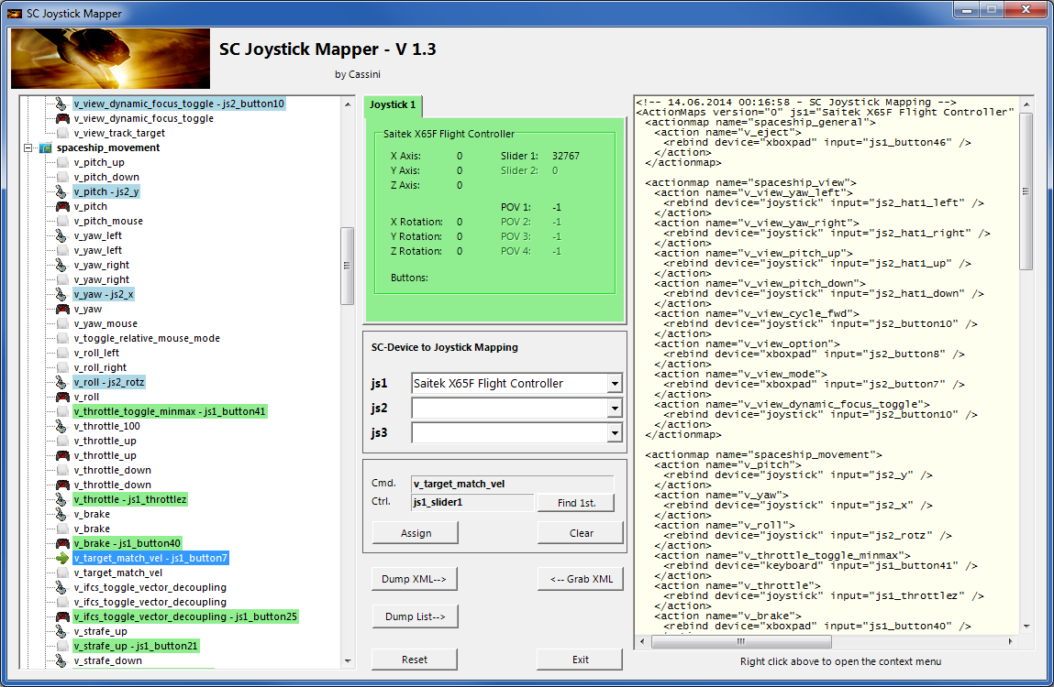
SC Joystick Mapper Quick Reference Guide V 1.3
20140614 – Cassini
ChangeLog: see ReadMe.txt
Disclaimer:
Usual stuff – no warranty whatsoever..
Freeware – made for the SC community
Hope it helps and does not suck.
Have fun in the verse …

Slide 2
Updating from V 1.2 to V 1.3:
As the action list can now be derived from CIGs original profile you have to manually remove the ‘MappingVars.csv’ file if it exists in the same folder as the program file. If the program finds it there it is taken before the defaultProfile (which is may be not what you wanted)
You may however use it to create you own list – see last page

Slide 3
Workflow
Connect the joystick devices to the PC
Start from scratch or load an existing map from a file
Make or refine mappings
Save the new map to an XML file
Use it in the game: e.g. pp_rebindkeys C:\maps\Layout_hotas_x65_Cyb_T
Note: the predefined actions are the ones found in the AC game default profile – it is likely that some of them will not work at all as the game is not finished. There is no proper description for which one does what – you may get help in SC Forums.
As I had my issues with missiles here a finding..
To reallocate the missile fire command you should map the following 2 actions to the same joystick button:
v_target_missile_lock_selected
v_weapon_launch_missile

Slide 4
The GUI …
Action tree and mappings
XML dump of the mappings used
Detected Joystick devices
(up to 8 are shown)
Joystick properties
(greyed out ones are not available)
Joystick device map
(the default is usually OK)
Current mapping
Action Mapping Buttons
XML Area Buttons
Dump nice List
Other Buttons…

Slide 5
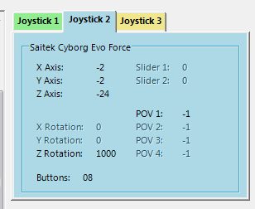
The Joystick Area…
Here I pressed the Button 8 on the Cyborg Evo Joystick while capturing the image
The tabs represent the joystick devices found connected to the PC also the number 1..8 shows the order the PC reports them which is crucial to the mapping as this will result in the js_1, js_2 .. Names used to build the command name.
The elements are the ones the joystick seems to support – greyed ones are not available for this device.
The SC-Device to Joystick Mapping can be used if the default assignment “Joystick 1 -> js_1” does not match what the CryEngine is using. – Usually the default should work. You may only remap js1..js3 - 4..8 will remain as detected.
Just hit any button, Axis and see how things are changing.

Slide 6
The Action Tree …
The tree is initially built from the known actions which are grouped along ‘actionmaps’ e.g. ‘spaceship_movement.
Each action is either a predefined joystick or keyboard action – this is given by the SC default profile.
By ‘rebinding’ or mapping and action with a different controls one does replace the default one i.e. overwriting keyboard actions will result in not having them available on the keyboard once you load the map in the game!
However no damage is done! This mapping is only valid until you exit the game.
If actions are mapped (as shown) the color indicates to which joystick the mapping goes.
v_pitch – js2_y then means that the action v_pitch (joystick per default) is rebound to the joystick 2 (blue) and there the Y-axis control.
If the background is white - there is no current mapping given.
Unmapped actions are ignored.
Click on any action to make it the used action in the mapping area. Once selected it is marked with the green arrow.

Slide 7
The Mapping Area…
Whenever you click on an action in the Action Tree it is copied into Cmd. and can be mapped to a Control.
The Control (Ctrl.) is the last joystick item you activated on the currently shown joystick tab.
I.e. if you want to map it for a control on the second joystick you have to select the “Joystick 2” Tab first.
Once you have a mapping that should be used, hit the “Assign” button.
The new mapping will be shown in the Action Tree – where it gets the back color of the joystick it is assigned to.
To clear a mapping – select it in the ActionTree and Click “Clear” - it gets a neutral color and no control in the ActionTree – it is now unmapped.
You may use “Find 1st” to find the first action where the currently shown Ctrl. (js_slider1) is mapped.
To clear all mappings and start from scratch hit the ‘Reset’ button!

Slide 8
The XML Area…
Mappings are sent to the game using XML formatted files.
The XML Area is where you may find the mapping after hitting the ‘Dump’ button.
Rightclick opens a menu where you may choose from:
Copy, Paste, PasteAll, Select All, Open…, Save As…
The usage is rather common here. Once you dumped the mapping you want to “Save” it as “filename.xml” somewhere.
To refine any mapping “Open” the file – the content is shown in the XML Area, then “Grab” it into the ActionTree.
Once the refinement is finished – again Save it to a file.
Note: only use properly formatted ActionMaps here. The program may just break if it encounters something unexpected!

Slide 9
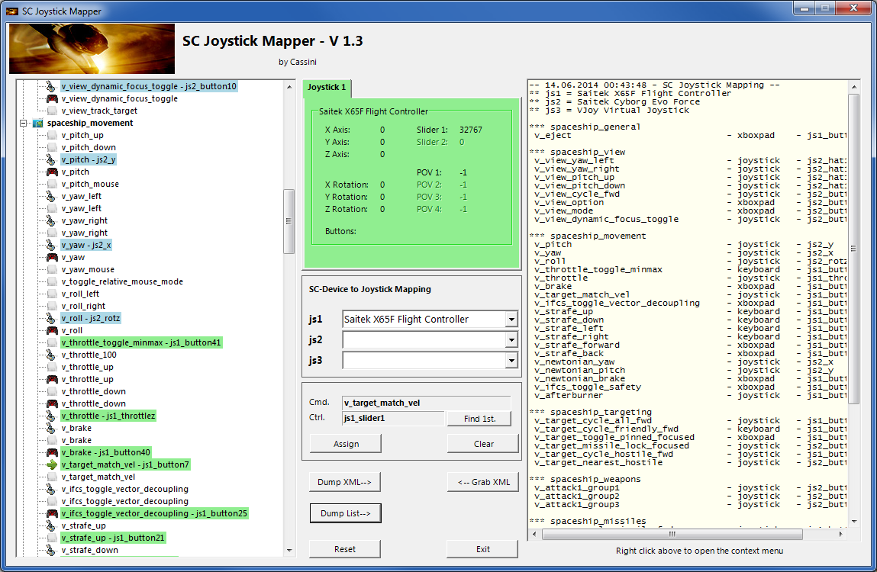
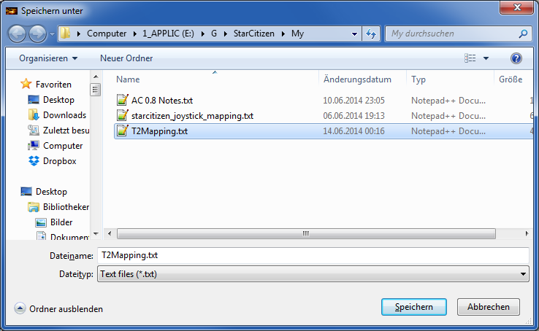
The XML Area…
If you hit “Dump List” a formatted list of the mapped actions is written into the XML area.
You may use the “Save As..” menu to save it e.g. as TXT file.

Slide 10
MappingVars.csv file
NOTE: from V 1.3 the priority order to build the action tree has changed
1st the MappingVars.csv file if it exists in the app.exe folder – if you wish to make your own list
2nd the defaultProfile.xml file if it exists in the app.exe folder – the one CIG provides as default (Build 12.2)
3rd the built in Mapping list – to have at least something…
The file contains the list of actions to rebind which are loaded into the ActionTree when the program starts
Items are separated by a semicolon (;) or a comma (,)
For each ‘actionmap’ there is one line
The first item is the ‘actionmap’ name
Further items are built from a single uppercase letter following the command as given in the defaultProfile
The first uppercase letter is from J,K,P,X which is the actual binding to use J = joystick, K=keyboard, P=ps3pad, X=xboxpad
The second part is e.g. “v_attack1_group1” the action name given in the defaultProfile
A complete item is then “Jv_attack1_group1” means that the program rebinds the joystick command for “v_attack1_group1”
There are no Blanks, Tabs etc. allowed but semicolons or commas at the end don’t harm.
I use Excel to maintain the list and save the Sheet as CSV file

