Slide 1
X Plane Virtual Traffic Scratchpad
20200712/bm98

Slide 2
S-ID REG T E-ID REG T D HL BAS TOP Segs
DEF K2 3 KLMNO K2 11 F 2 180 450 J13-J14-J15
LAT LON IDENT APT REG Type
46.646819444 -123.722388889 AAYRR KSEA K1 4530263
C LAT LON ELE FRQ CLS VAR IDENT APT REG NAME+SUFFIX
12 47.434333333 -122.306300000 369 11030 25 0.000 ISNQ KSEA K1 SEATTLE-TACOMA INTL DME-ILS
S-ID REG LAT LON E-ID REG LAT LON HL BAS TOP (Mid)LAT LON
DEF-K2 KLMNO-K2 2 180 450

Slide 3
IFR enroutes
High
IFR enroutes
Low
GenRange:
100 nm
ReGen:
1/4 Range
VFR
artificial
Acft Loc:
Lat / Lon / Alt
Gen Pool
Update Pool
Virt Acfts
Loc: Lat / Lon / Alt
HDG: degm
TAS: kts
Route: ID
Send
Pool
Check
Pool
Out of range

Slide 4
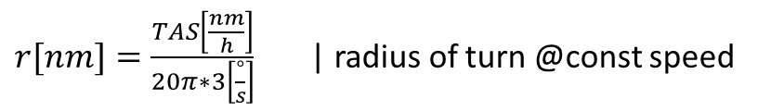



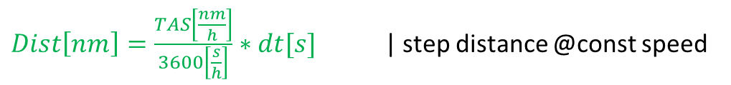
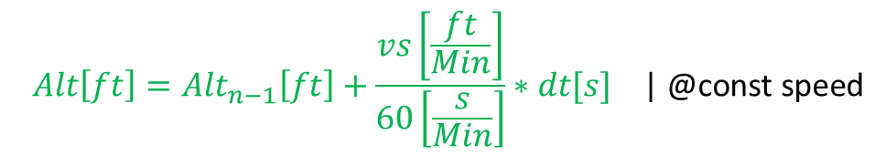
Virtual Traffic Aircraft Model
1 StdTurnRate = 3° per second turn
$Dist\left[nm\right]=\frac{TAS\left[\frac{nm}{h}\right]}{3600\left[\frac{s}{h}\right]}∗dt[s]$ | step distance @const speed
Circles
$r[nm]=\frac{TAS\left[\frac{nm}{h}\right]}{20π∗3\left[\frac{°}{s}\right]}$ | radius of turn @const speed
Dist
c
$α[°]=\frac{Dist[nm] ∗180[°]}{r[nm] ∗ π}$ | turn angle @const speed = 3°/sec
r
$$α$$
$$Trk[°]={Trk}_{n−1}[°]+α[°]$$
$$TAS\left[\frac{nm}{h}\right]={TAS}_{n−1} \left[\frac{nm}{h}\right] \text{| @}\text{const} \text{speed}$$
Acft ID:
Hex / CallSign / Reg
Type
From / To
$$Loc={Loc}_{n−1}.DestPt\left(Dist[nm],{Trk}_{n−1}+\frac{α}{2}\right) \text{| }\text{linear} \text{motion}$$
Linear Approx Test for dt = 1 sec:
Dist@100kt ~51m / => r=983m -> c~ 51m
Acft Loc:
Lat / Lon / Alt
$$Alt\left[ft\right]={Alt}_{n−1}\left[ft\right]+\frac{vs\left[\frac{ft}{Min}\right]}{60\left[\frac{s}{Min}\right]}∗dt[s] \text{| @}\text{const} \text{speed}$$
Acft Para:
Trk / VS / TAS

Slide 5
Virtual Traffic Flights
Type1 - Runway Start:
Flights are created from random chosen scripts at random airports within the observed range, at the start of a random runway using the rwy heading, the initial altitude is given by the runway elevation.
Scripts may have a preferred runway to start from but get a random one if the preferred one is not in range.
Scripts can be tied to the start runway, however if the runway is not in range such scripts are ignored.
Type 2 - Airborne Start – Airway based :
Flights are created from ad hoc scripts created from the Airway Database, the initial altitude is randomly created from the airway level limits, initial speed as well. The route is created by connected segments at reasonable turns (<150°), circular loops are avoided.
Airborne Start – AITraffic recording based – relative and absolute:
A list of AITraffic messages can be translated and stored as a script route.
Such flights are created from random chosen scripts, the altitude and speed profile is set by the recorded messages. The initial alt and speed and track is set from the first recorded message.
Type 3 - Relative routes are translated into Turn and Heading commands to create a track. The initial position is created from a randomly chosen runway position.
Type 4 - Absolute routes are translated into Goto commands to create an absolute track following the original messages. If the origin (first message location) is not in range such scripts are ignored.
A=AcftType;Runway[;Pref.Runway[;Strict]] # Type 1 – default Alt Mode => AGL based
A=AcftType;Airway # Type 2 – default Alt Mode => MSL based
A=AcftType;MsgRelative;Alt;GS # Type 3 – default Alt Mode => MSL based; StartPos random;
A=AcftType;MsgAbsolute;Alt;GS;Lat;Lon;Hdg # Type 4 – default Alt Mode => MSL based; StartPos defined;
Route Init:
Runway : define Start-Pos, -Heading, -Altitude from Runway record, initial GS zero
Airway: define Start-Pos, -Heading from Airway record, initial -Altitude, -GS are created artificially
MsgRelative: define Start-Pos, -Heading from Runway record, initial -Altitude, -GS from messages (CmdA props)
MsgAbsolute: define Start-Pos, -Heading, -Altitude, -GS from messages (CmdA props)

Slide 6
Virtual Traffic VFR Aircraft Model
Commands
Example Script
A=PC6T; LSZH_RW14 # a new PC6, starting at LSZH RWY14
S=95 # init at 95 kts
V=1000;500 # for the next segment climb to 500agl@1000ft/min
D=2 # straight for 2nm
T=180 # right turn of 180°
V=800;1000 # for the next segment climb to 1000agl@800ft/min
D=10 # straight for 10 nm
S=120 # speed up ; note this is instantaneous (simple model)
V=500;3000 # for the next segment climb to 3000agl@500ft/min
T=-30 # left turn of 30°
D=5 # straight for 5 nm
H=225 # now turn to HDG 225°
D=100 # straight for another 100 nm – just let it fly..
… once the acft reaches the end of the last segment it will be removed
Create aircraft
A=AcftType;[runway_ID] # an acft type and an optional runway id
Conditions
S=knots # new TAS [kt] starting at next segment (default 100kt)
V=[+-]vs;agl # ascent or descent @vs starting at next segment (def 0ft/Min)
Segments
D=dist # a straight segment [nm]
T=[+-]angle # a turn segment [°] (abs <=360)
H=hdg # new heading [°] (<=360)
VFR Aircrafts are created from random scripts at random airports within
the observed range, at the start of a random runway using the rwy heading
The initial altitude (ground level) is given by the runway elevation.
V= command accepts a positive relative altitude (agl) where the reference is the runway elevation (can still hit rocks though)
Turns are relative to the current track, and start with the rwy heading
H= command goes to an absolute heading

Slide 7
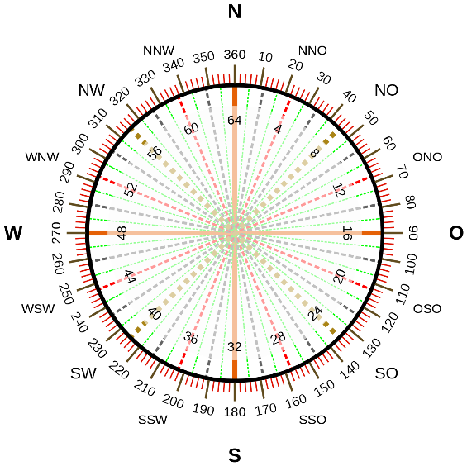
A=PC6T;LSZH_RW14 # a new PC6
S=95 # init at 95 kts
V=1000;1000
D=3
T=180
V=800;1500
D=6
T=120
S=140 # speed up
D=6
V=500;2000
D=6
T=120
V=500;3000
D=18
T=60
D=6
T=180
V=-800;2200
D=6
T=-60
V=300;3000
D=26
T=-150
V=-400;2800
D=100
120°
6nm
18nm
240°
3000@300
6nm
180°
300°
2200@-800
3000@500
26nm
60°
3nm
180°
0°
1500@800
6nm
2000@500
6nm
1000@1000
95kt
6nm
300°
140kt
90°
100nm
2800@-400

Slide 8
A=C172;LSZH_RW14
S=95 # init at 95 kts
V=500;1000
D=2
T=180
D=4
T=180
S=60
V=400;0
D=2
S=1
D=1
180°
2nm
0°
1000@500
95kt
1nm
4nm
1kt
2nm
60kt
000@400
180°

Slide 9
A=C172;LSZH_RW14
S=95 # init at 95 kts
V=500;1000
D=2
T=180
D=4
T=180
S=60
V=400;0
D=2
S=1
D=1
3nm
120°
2000ft
360°
2.5nm
1.5nm
2000ft@1000
1000ft@500
120°
0°
1nm
1nm
100ft@1000
90°
2nm
120kt
95kt
1.5nm
2000ft@1000
500ft@200
1nm
1000ft
90kt
10kt
3nm
2nm
60kt
90°
90°
000ft@400
1.5nm
180°
1000ft

