Slide 1
X Plane Virtual Traffic Scratchpad
20200712/bm98

Slide 2
S-ID REG T E-ID REG T D HL BAS TOP Segs
DEF K2 3 KLMNO K2 11 F 2 180 450 J13-J14-J15
LAT LON IDENT APT REG Type
46.646819444 -123.722388889 AAYRR KSEA K1 4530263
C LAT LON ELE FRQ CLS VAR IDENT APT REG NAME+SUFFIX
12 47.434333333 -122.306300000 369 11030 25 0.000 ISNQ KSEA K1 SEATTLE-TACOMA INTL DME-ILS
S-ID REG LAT LON E-ID REG LAT LON HL BAS TOP (Mid)LAT LON
DEF-K2 KLMNO-K2 2 180 450

Slide 3
IFR enroutes
High
IFR enroutes
Low
GenRange:
100 nm
ReGen:
1/4 Range
VFR
artificial
Acft Loc:
Lat / Lon / Alt
Gen Pool
Update Pool
Virt Acfts
Loc: Lat / Lon / Alt
HDG: degm
TAS: kts
Route: ID
Send
Pool
Check
Pool
Out of range

Slide 4
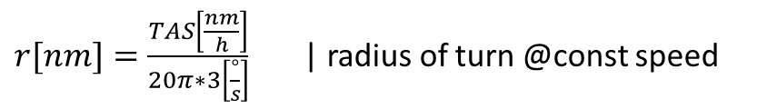



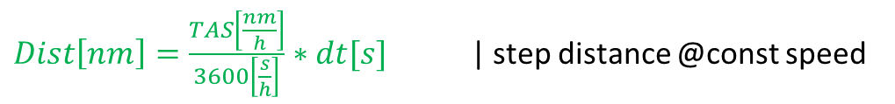
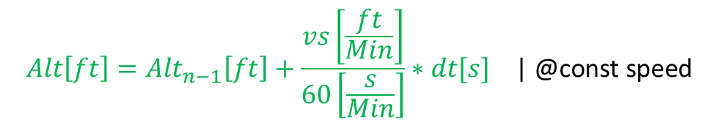
Virtual Traffic VFR Aircraft Model
1 StdTurnRate = 3° per second turn
$Dist\left[nm\right]=\frac{TAS\left[\frac{nm}{h}\right]}{3600\left[\frac{s}{h}\right]}∗dt[s]$ | step distance @const speed
Circles
$r[nm]=\frac{TAS\left[\frac{nm}{h}\right]}{20π∗3\left[\frac{°}{s}\right]}$ | radius of turn @const speed
Dist
c
$α[°]=\frac{Dist[nm] ∗180[°]}{r[nm] ∗ π}$ | turn angle @const speed = 3°/sec
r
$$α$$
$$Trk[°]={Trk}_{n−1}[°]+α[°]$$
$$TAS\left[\frac{nm}{h}\right]={TAS}_{n−1} \left[\frac{nm}{h}\right] \text{| @}\text{const} \text{speed}$$
Acft ID:
Hex / CallSign / Reg
Type
From / To
$$Loc={Loc}_{n−1}.DestPt\left(Dist[nm],{Trk}_{n−1}+\frac{α}{2}\right) \text{| }\text{linear} \text{motion}$$
Linear Approx Test for dt = 1 sec:
Dist@100kt ~51m / => r=983m -> c~ 51m
Acft Loc:
Lat / Lon / Alt
$$Alt\left[ft\right]={Alt}_{n−1}\left[ft\right]+\frac{vs\left[\frac{ft}{Min}\right]}{60\left[\frac{s}{Min}\right]}∗dt[s] \text{| @}\text{const} \text{speed}$$
Acft Para:
Trk / VS / TAS

Slide 5
Virtual Traffic VFR Aircraft Model
Commands
Example Script
A=PC6T; LSZH_RW14 # a new PC6, starting at LSZH RWY14
S=95 # init at 95 kts
V=1000;500 # for the next segment climb to 500agl@1000ft/min
D=2 # straight for 2nm
T=180 # right turn of 180°
V=800;1000 # for the next segment climb to 1000agl@800ft/min
D=10 # straight for 10 nm
S=120 # speed up ; note this is instantaneous (simple model)
V=500;3000 # for the next segment climb to 3000agl@500ft/min
T=-30 # left turn of 30°
D=5 # straight for 5 nm
H=225 # now turn to HDG 225°
D=100 # straight for another 100 nm – just let it fly..
… once the acft reaches the end of the last segment it will be removed
Create aircraft
A=AcftType;[runway_ID] # an acft type and an optional runway id
Conditions
S=knots # new TAS [kt] starting at next segment (default 100kt)
V=[+-]vs;agl # ascent or descent @vs starting at next segment (def 0ft/Min)
Segments
D=dist # a straight segment [nm]
T=[+-]angle # a turn segment [°] (abs <=360)
H=hdg # new heading [°] (<=360)
VFR Aircrafts are created from random scripts at random airports within
the observed range, at the start of a random runway using the rwy heading
The initial altitude (ground level) is given by the runway elevation.
V= command accepts a positive relative altitude (agl) where the reference is the runway elevation (can still hit rocks though)
Turns are relative to the current track, and start with the rwy heading
H= command goes to an absolute heading

Slide 6
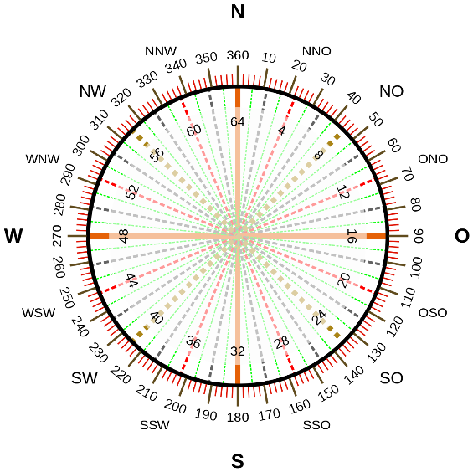
A=PC6T;LSZH_RW14 # a new PC6
S=95 # init at 95 kts
V=1000;1000
D=3
T=180
V=800;1500
D=6
T=120
S=140 # speed up
D=6
V=500;2000
D=6
T=120
V=500;3000
D=18
T=60
D=6
T=180
V=-800;2200
D=6
T=-60
V=300;3000
D=26
T=-150
V=-400;2800
D=100
120°
6nm
18nm
240°
3000@300
6nm
180°
300°
2200@-800
3000@500
26nm
60°
3nm
180°
0°
1500@800
6nm
2000@500
6nm
1000@1000
95kt
6nm
300°
140kt
90°
100nm
2800@-400

Slide 7
A=C172;LSZH_RW14
S=95 # init at 95 kts
V=500;1000
D=2
T=180
D=4
T=180
S=60
V=400;0
D=2
S=1
D=1
180°
2nm
0°
1000@500
95kt
1nm
4nm
1kt
2nm
60kt
000@400
180°

Slide 8
A=C172;LSZH_RW14
S=95 # init at 95 kts
V=500;1000
D=2
T=180
D=4
T=180
S=60
V=400;0
D=2
S=1
D=1
3nm
120°
2000ft
360°
2.5nm
1.5nm
2000ft@1000
1000ft@500
120°
0°
1nm
1nm
100ft@1000
90°
2nm
120kt
95kt
1.5nm
2000ft@1000
500ft@200
1nm
1000ft
90kt
10kt
3nm
2nm
60kt
90°
90°
000ft@400
1.5nm
180°
1000ft

