Slide 1
The History of Unix
And
Unix Like Systems

Slide 2
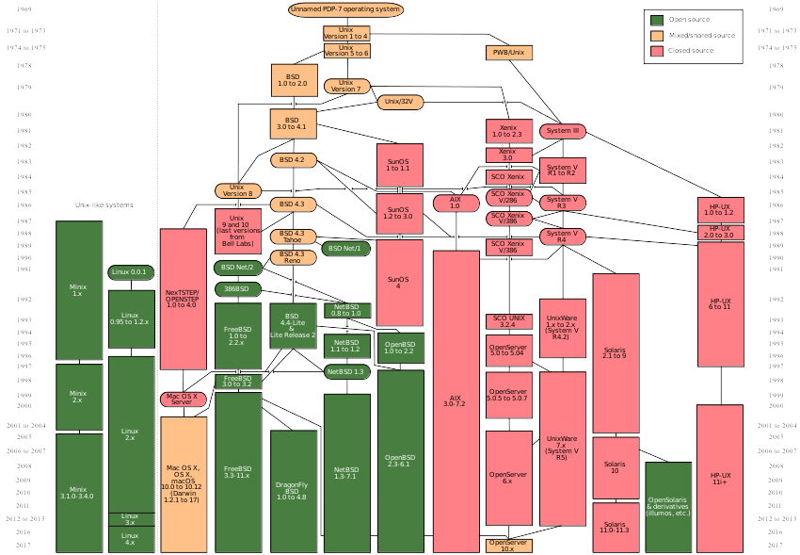
By Eraserhead1, Infinity0, Sav_vas - Levenez Unix History Diagram

Slide 3
In the beginning…..
1956 - antitrust decree against Bell Phone company forbidding them from having patents and commercial products related to computer systems.
http://www.cptech.org/at/ibm/ibm1956cd.html

Slide 4
After the beginning….
1969 - Inital release of Unix at Bell Labs
1970 - Unix was named by Brian Kernighan as UNICS (Uniplexed Information and Computer Service). No one remembers who came up with the final spelling UNIX
November 3, 1971 - The Unix Programmers Manual was published in the “man page” format that is still in use today

Slide 5
And the grail appeared….
1973 – Unix was rewritten from machine langage to C langage, in spite of common knowledge at the time that operating sytems HAVE to be in machine langage
1975 – AT&T released Unix Version 5
1977 – BSD (Berkley System Distribution) was founded
1978 - UNIX/32V released for DEC Vax

Slide 6
More Ancient Scrolls…..
1979 - Unix Version 7, the last version of Research Unix was released
1980 - Zilog Z8000 the first commercially available microcomputer Unix by Onyx Systems
1980 - Xenix released by Microsoft
1982 - Unix System III with binary licences (Based on Unix Version 7

Slide 7
And Siths come in pairs...
1982 - Sun Microsystems founded by Bill Joy and created Sun OS, based on Unix
1983 - Santa Cruz Operation (SCO) was founded and ported Xenix to the 8086 processor
1983 – System V by Computer Research Group, Unix System Group and another group merge to become Unix System Development lab. 45000 computers in the install base

Slide 8
In A Galaxy Far, Far, Away..
1984 – U of Berkley released 4.2BSD including tcp/ip and X/open formed
1984 – System V v2 released. There are 100,000 Unix systems worldwide
1986 – 4.3BSD released including Internet Name Server, and NFS
1986 – IBM announces AIX
1987 – Minix 1.x was released

Slide 9
And they traveled from afar...
1988 – The first full release of NextStep / OpenStep which used a unix mach kernel, along with other BSD code
1991 – Linus Torvalds starts Linux with the famous Usenet post about his kernel
1992 – Unix System Laboratories sued Berkley System Distribution over intellectual property infringement

Slide 10
Then became the Jedi…
1993 – FreeBSD and NetBSD both started and derived from 4.3BSD
1994 – 4.4BSD released in both Lite and Encumbered versions due to lawsuit
1995 – The last version of NeXtStep, version 3.3 released
1997 – Minix 2.x, IRIX 6.4, AIX 4.3, and HP-UX 11 all shipped

Slide 11
The more things change...
1998 – Unix 98 brand was created by the Open Group with products by Sun, IBM and NCR
1999 – Mac OS X server released
1999 – Linux Kernel 2.2 released and the first LinuxWorld Conference
1999 – Unix is 30yo, and Tru64 Unix shipped

Slide 12
Then it was dark times...
2000 – SCO as a company and a product was sold, and Novell bought it
2003 – Novell spun off SCO with an evil person running it and SCO became the most hated computer company in history with lawsuits against ALL Linux users
2003 – Solaris 9.0 shipped, and Linux Kernel 2.6 was released by Linus Torvalds

Slide 13
And then there was light..
2005 – Minix 3.1.0 released
2007 – Judge ruled against SCO
2007 – Mac OS X was certified Unix 3
2009 – SCO jury trial for SCO vs Novell
2010 – Jury found unamiously that Novell owned Unix / Unixware NOT SCO
2010 – Oracle buys Sun and rapidly destroys it

Slide 14
And life is good now….
2010 – Unix on the desktop, 50 million computers running Mac OS X on the desktop
TODAY – to much happening in the *nix world to list them all. BSD is still vibrant and viable, even though Linux gets all the publicity and most of the money from companies.

Slide 15
BSD History Timeline
1986 – 4.3BSD moved away from VAX and towards portability
1989 – June of that year saw the release of NET/1 and was freely distributible under BSD licence
1991 – June saw the release of NET/2 with all AT&T code removed

Slide 16
BSD History Timeline (con’t)
1993 – FreeBSD forked from traditional BSD
1993 – NetBSD forked from traditional BSD
1995 – Last ever release of BSD, 4.4-Lite2
1995 – OpenBSD forked from NetBSD
2003 – DragonFly BSD forked from FreeBSD 4.11

Slide 17
FreeBSD Free Products
Darwin
DesktopBSD
DragonFly BSD
FreeSBIE
GhostBSD
TrueNAS
FreeNAS
TrueOS
MidnightBSD
M0n0wall
OPNSense
pfSense
NAS4Free
CloneOS

Slide 18
Various BSD O/S
1982 – SunOS
1984 – Ultrix
1988 – RISCiX
1992 – 386BSD
1993 – True64 Unix
1993 – BSD/OS(386)
1993 – FreeBSD
1993 - NetBSD
1996 – OpenBSD
1998 – JunOS
2001 – Darwin
2001 – macOS
2002 – m0n0wall
2004 – DragonFly BSD
2004 – BSDeviant

Slide 19
BSD O/S con’t
2005 – DesktopBSD
2005 – FreeNAS
2006 – CellOS
2006 – pfSense
2006 – TrueOS(PC-BSD)
2007 – iOS
2007 – Midnight BSD
2007 – NAS4Free
2009 – GhostBSD
2013 – Oribis OS (playstation 4 OS)
2014 – Hardened BSD

Slide 20
Non-Free FBSD products
MacOS
iOS
Blue Coat Systems
Borderware
Checkpoint IPSO
Citrix Systems NetScalar
Comp VPN Gateways
Coyote Point Load Balancers
Dell Compellent Storage Systems
Halon SMTP server

Slide 21
Non-Free FBSD products
Hobnob Wireless WAN
IronPort AsyncOS
Isilon Systemns OneFS Clustered Storage
Juniper Networks JunOS
KACE Networks Kbox Appliances
McAfee SecurOS (aka sidewinder)
NetApp Filers
Netflix Open Connect Appliances

Slide 22
Non-Free FBSD products
Panasas parallel network storage
Panasonic Viera TVs
QNAP QES O/S
Sandvines network control products
Silicon Graphics Disk Arrays
Surgate Labs Mail Gateway
Sony Computer Entertainment
Sophos Email Appliance
Spectra Logic Backup Appliances

Slide 23
Non-Free FBSD products
Symmetricom Timing Solutions
The Weather Channel’s IntelliStar forecast computer
Wheel Systems Fudo and Lynx Security Appliances
Xinuos OpenServer 10
Many others that do not publicly list FreeBSD as being used !!!

Slide 24
OpenBSD Products
ePipe by Stallion Technologies
nCircle Network Security
RTMX a version of OpenBSD O/S
Syscall Network Solutions Net Sec Appliance
RedHat’s Stronghold Secure Web Server
PowerCrypt by GTGI
Open Sound System by 4Front
Core Systems InSite WE Statistics
Software2Go Motif development tools

Slide 25
More OpenBSD Products
Zeus Web Server
Apple OS X uses PF
OpenSSH is used in almost all systems
Genua IT Security Firewalls
Fox-IT Government Sec and intell systems
Esdenera Networks security technologies
Capyptix Security Firewalls for SMB networks
M:Tier thin clients
Mercedes Benz

Slide 26
NetBSD Software Products
Apple’s Darwin
Arcapos Point-of-sale and Infokiosks
Castle Tech ltd : USB software and network stack
CentreCOM WR54-ID
Champaign-Urbana Community Wireless Network
FSMLabs RTCore/BSD
Fdgw
Ghost for Unix
NetBSD/i386 Firewall

Slide 27
More NetBSD products
NetBSD Live ! CD
Precedence Technologies NetManager and ThinIT
SEIL Routing Software
WifiBSD
Wasabi Storage Builder64
QNX
The OSKit

Slide 28
NetBSD Hardware
Avocent SwitchView IP KVM
Broadcom Corp – BCM91250A Eval Board
Brocade Rhapsody Switch
DYNARC optical IP networks
Simtec Electronics – CATS ATX 233 Mhz StrongARM mobo
Endgadget – Palm sized NEC WNX Server
EZF-1500E development kit for embedded fingerprint systems

Slide 29
More NetBSD hardware
Force10 Networks
Liberouter
Ricoh Printers
SEIL Series light weight routers for 128k/T1/DSL/ATM connections
SEIL/X Series high performance routers for gigabit
SGI ViewRanger
SiNic ‘router on a card’
Speecys ‘Humanoid Robotics Technology’
MmEye ‘multifunction multimedia server’
Panasonic BL-C10 and KX-TGP550 (camera and phone)

Slide 30
BSD vs Linux
BSD
BSD is a full operating system
Installing port or pkg will never break base
BSD Board of Directors
Linux
Linux is just a kernel
Install a package can break base system
Linux kernel is owned by Linus Torvalds (the dictator)

Slide 31
BSD vs Linux
BSD
There are 3 major strains of BSD with some variants
All funded by user supported donations, including some companies.
BSD License
Per distrowatch, Freebsd is the most downloaded at 22nd for the last 6 months
Linux
DistroWatch shows well over a 100 Linux distros
IBM alone poured a ton of money into Linux
GPL + ???? licences
More users and downloads for probably the top 2 linux downloads than all bsds combined

Slide 32
Why BSD Rules ?
Linus is a dictator
Beastie is cool !!
BSD License even though Richard Stallman hates it and talks trash about it repeatedly
Stable base system
NO systemd !!!! any dumb questions on that one ?
The Community, The Community, The Community !!!!!!!

