Slide 1
Firewalls, Routers and Packets!
OH MY!!!
(part 1)

Slide 2
Barry McCormick
MS in Chemical Engineering
20+ years of network/admin/devops experince
Former Trustee Utah Open Source Foundation (2009 and 2011)
Board of Directors of Salt Lake City DevOps Conference
Former Educator:
  Dean of Eduction
  Associate Academic Dean
  CS Department Chair
  Dean of Computer Science
Caffiene addict, music junkie, biker
FreeBSD user since ver 2.1.5 December of 1996

Slide 3
Contact Info
barry.mccormick1961@gmail.com
snarfingcode666@gmail.com
@bmac2 on twitter
On freenode.net irc, either bmac2 or bmac666
On meetup.com
This presentation is dedicated to the memory of
D3caf (Deven) who developed one of the original versions
of this presentation. Some of the slides were resused in their
original format, with his dry humor included. RIP my friend!

Slide 4
Why not just use a commercial fw/router?
Poor updates
  How often is there even an update to linksys / TP-Link / Netgear router available?

Slide 5
Why not just use a commercial fw/router?
Poor updates
  How often is there even an update to linksys / TP-Link / Netgear router available?
Weak Hardware
  Off the shelf home/small business routers are very weak and limited to resources.

Slide 6
Why not just use a commercial fw/router?
Poor updates
  How often is there even an update to linksys / TP-Link / Netgear router available?
Weak Hardware
  Off the shelf home/small business routers are very weak and limited to resources.
Build your own and scale your hardware as needed

Slide 7
Why not just use a commercial fw/router?
Poor updates
  How often is there even an update to linksys / TP-Link / Netgear router available?
Weak Hardware
  Off the shelf home/small business routers are very weak and limited to resources.
Build your own and scale your hardware as needed
Poor web interfaces, some functions are not even available to configure

Slide 8
Why not just use a commercial fw/router?
Poor updates
  How often is there even an update to linksys / TP-Link / Netgear router available?
Weak Hardware
  Off the shelf home/small business routers are very weak and limited to resources.
Build your own and scale your hardware as needed
Poor web interfaces, some functions are not even available to configure
Poor ( or non-existent) logging and debugging
  DNS/DHCP/Traffic/hardware utilization

Slide 9
Why not just use a commercial fw/router?
Poor updates
  How often is there even an update to linksys / TP-Link / Netgear router available?
Weak Hardware
  Off the shelf home/small business routers are very weak and limited to resources.
Build your own and scale your hardware as needed
Poor web interfaces, some functions are not even available to configure
Poor ( or non-existent) logging and debugging
  DNS/DHCP/Traffic/hardware utilization
Lack of hardware and software customization
  No ability to add interfaces or features, memory, etc

Slide 10
Why not just use a commercial fw/router? (con’t)
Security
  No IDS / IPS available
  Backdoors (just read the news on the web of all the known backdoors to commercial home products)
  https://tech.slashdot.org/story/14/04/22/001239/intentional-backdoor-in-consumer-routers-found
  http://securityaffairs.co/wordpress/20941/hacking/netgear-linkys-routers-backdoor.html
  https://www.wired.com/2013/09/nsa-router-hacking/
  https://www.wired.com/2015/12/juniper-networks-hidden-backdoors-show-the-risk-of-government-backdoors

Slide 11
What is a firewall?
A firewall is a system designed to prevent unauthorized access to or from a private network. You can implement a firewall in either hardware or software form, or a combination of both. Firewalls prevent unauthorized internet users from accessing private networks connected to the internet, especially intranets. (in other words it keeps the bad guys out!)

Slide 12
History of Firewalls
The first type of firewalls were packet filters and was first created by engineers at DEC in 1988
The second generation of firewalls was developed at AT&T Bell Labs in 1989 and were stateful firewalls. Layer 4 operation that uses packets to determine the state
The third generation is application layer firewalls. The first one of these was the Firewall Toolkit (FWTK) in 1994. This implementation was the first to use ports and applications.

Slide 13
Two Types of Firewalls
Network based – dedicated hardware sitting on the edge of your network (think Cisco, Juniper, pfSense, etc)
Host based – software installed on your computer (think iptables, ufw, windows firewall)

Slide 14
Common *nix/*BSD Firewalls
M0n0Wall – one of the original bsd firewalls, still used, but no updates in quite a while
pfSense – now supported by Rubicon (Netgate). Commercial and Community editions
OPNSense – a fork off of pfSense, not as many features, much younger project
OpenBSD PF (https://www.openbsd.org/faq/pf/) the standard for packet filtering
DD-WRT ( mainly for wireless routers, Linux Based)
At least 10 other various Linux based firewalls

Slide 15
PfSense (www.pfsense.org)
The pfSense project started in 2004 as a fork of the m0n0wall project by Chris Buechler and Scott Ullrich and the first release was in 2006. The name was derived from the fact that the software uses the packet-filtering tool, PF
Current editions only support 64 bit hardware.
There are USB memstick images, ISO cdrom images, and embedded (nanobsd) images

Slide 16
PfSense demonstration

Slide 17
OPNSense (https://opnsense.org)
OPNSense is a fork of pfSense currently based on FreeBSD 11. it is in the middle of transitioning to use Hardened BSD as its base rather than vanilla FreeBSd. It started in 2015 when a group wanted to take pfSense in a different direction.
OPNSense has its’ own firmware / package / plugins to add additional functionality.
https://opensense.org/about/features to get a complete list of all of the features they offer.

Slide 18
OPNSense Demonstration

Slide 19
Building an OpenBSD
Firewall/Router
(no GUI)

Slide 20
Why OpenBSD?
Solid Network Stack
Awesome security
PF ( Packet Filter – Traffic Filtering, NAT/PAT, Qos, and more!)
Can use standard hardware with as much power as you wish

Slide 21
Minimum Hardware
Recommended Miniminums
Dual Core Atom 800mhz
1GB DDR3
At least 2x 100Mbps NICS
Verify that the chipset is supported
100 GB Disk Space
Spindle Disks will work great
Low Power / Low Noise is a plus!
A managed network switch is always nice (but not required)

Slide 22
Build OpenBSD Firewall / Router
Install OpenBSD

Slide 23
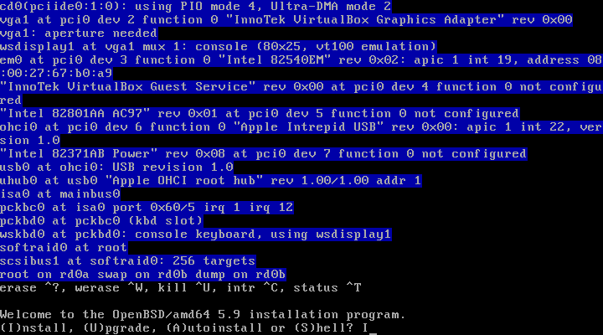

Slide 24
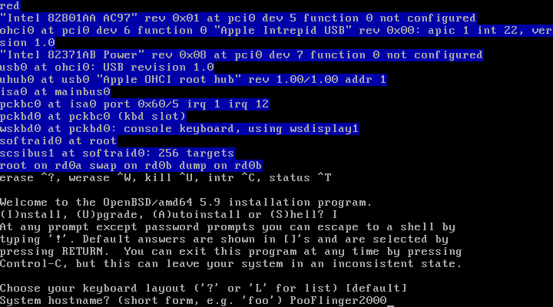

Slide 25
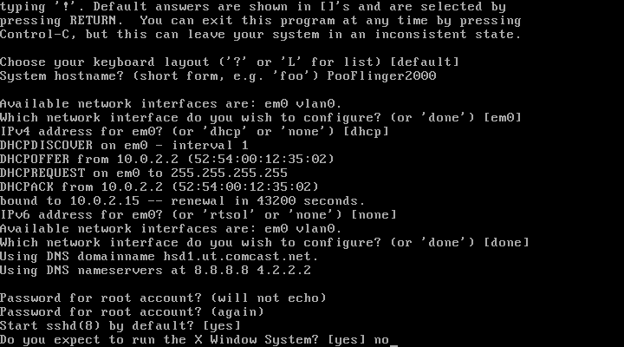

Slide 26
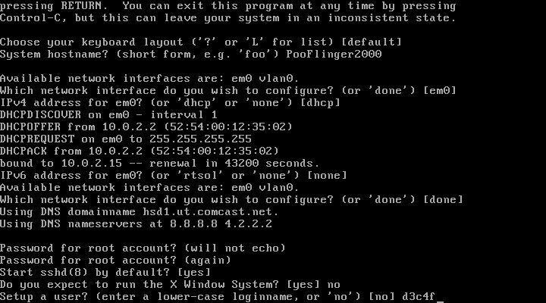

Slide 27
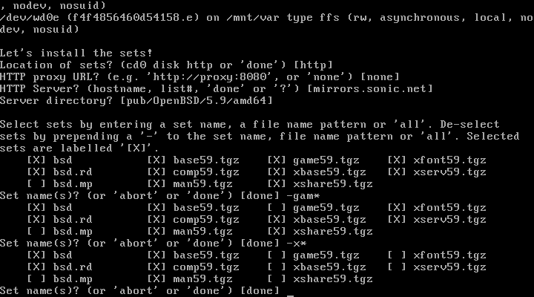

Slide 28
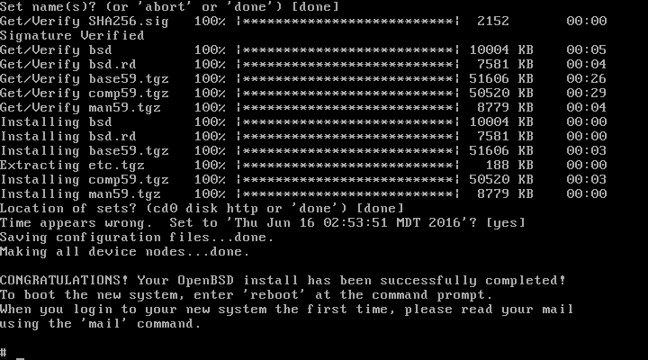

Slide 29
Build OpenBSD Firewall / Router
Install OpenBSD
Install packages
  pkg_add -iv vim
  pkg_add -iv dnsmasq
  pkg_add -iv vnstat

Slide 30
Build OpenBSD Firewall / Router
Dnsmasq provides network infrastructure for small networks: DNS, DHCP, router advertisement and network boot. It is designed to be lightweight and have a small footprint, suitable for resource constrained routers and firewalls. It has also been widely used for tethering on smartphones and portable hotspots, and to support virtual networking in virtualisation frameworks. Supported platforms include Linux (with glibc and uclibc), Android, *BSD, and Mac OS X. Dnsmasq is included in most Linux distributions and the ports systems of FreeBSD, OpenBSD and NetBSD. Dnsmasq provides full IPv6 support.
vnStat is a network utility for the *nux operating systems. It uses a command line interface. vnStat command is a console-based network traffic monitor. It keeps a log of hourly, daily and monthly network traffic for the selected interface(s) but is not a packet sniffer. The traffic information is analyzed from the proc filesystem. That way vnStat can be used even without root permissions.

Slide 31
Build OpenBSD Firewall / Router
Install OpenBSD
Install packages
  pkg_add -iv vim
  pkg_add -iv dnsmasq
  pkg_add -iv vnstat
Kernel Module – Enable routing

Slide 32
net.inet.ip.forwarding=1
# vim /etc/sysctl.conf

Slide 33
Build OpenBSD Firewall / Router
Install OpenBSD
Install packages
  pkg_add -iv vim
  pkg_add -iv dnsmasq
  pkg_add -iv vnstat
Kernel Module – Enable routing
Setup Network Interfaces

Slide 34
dhcp
# vim /etc/hostname.em0

Slide 35
inet 10.10.10.1 255.255.255.0 10.10.10.255
# vim /etc/hostname.em1

Slide 36
Configure DHCP Daemon
Make DHCPD start on boot

Slide 37
dhcp_flags=””
# vim /etc/rc.conf.local

Slide 38
Configure DHCP Daemon
Make DHCPD start on boot
Configure DHCPD options

Slide 39
subnet 10.10.10.0 netmask 255.255.255.0
{
default-lease-time 604800;
option domain-name “PooFlinger2000”;
option domain-name-servers 4.2.2.2, 4.4.4.4;
option routers 10.10.10.1;
option subnet-mask 255.255.255.0;
option broadcast-address 10.10.10.255;
range 10.10.10.50 10.10.10.254;
}
# vim /etc/dhcpd.conf

Slide 40
Configuring DNSMasq
Make DNSMasq start on boot

Slide 41
if [ -x /usr/local/sbin/dnsmasq ]; then
echo ‘ starting: dnsmasq ‘; /usr/local/sbin/dnsmasq
fi
# vim /etc/rc.local

Slide 42
Configuring DNSMasq
Make DNSMasq start on boot
Configure DNSMasq options

Slide 43
no-poll
no-resolv
no-hosts
server=75.75.75.75
server=8.8.8.8
cache-size=9001
local-ttl=90
auth-ttl=120
max-ttl=90
max-cache-ttl=90
log-queries
log-facility=/var/log/dnsmasq_queries.log
# LOCAL DNS REWRITES
address=/bing.com/10.10.10.5
address=/.bing.com/10.10.10.5
# vim /etc/dnsmasq.conf

Slide 44
Configuring PF
Make PF start on boot (does by default)

Slide 45
Configuring PF
Make PF start on boot (does by default)
Configure PF

Slide 46
set limit states 1000000 # one million states! Bwahahaha
set skip on lo0 # skip processing on loopback device
match out on em0 inet from em1:network nat-to (em0) # enable NAT
block quick inet6 # kill all IPv6 traffic. Dead. Bam.
block all # default block rule. no “quick” so last matching rule wins
pass from { self, em1:network }
# rewrite DNS requests to local DNSMasq Service
pass in quick on em1 proto udp from any to port 53 \
rdr-to 127.0.0.1 tag dns
pass inet proto icmp icmp-type echoreq # allow ping requests
# Allow external->internal SSH from tcp port 2222, translated to tcp port 22
pass in on egress inet proto tcp from any to (egress) port 2222 \
rdr-to 10.10.10.5 port 22
# vim /etc/pf.conf

Slide 47
Monitoring your new firewall / router
CPU / Memory Utilization
  TOP
  HTOP
Network
  IFTOP
  NLOAD
  VNSTAT
System stats
  Collectd / Grafana
DHCP Leases
  tail -f /var/db/dhcpd.leases
DNS Queries
  tail -f /var/log/dnsmasq_queries.log
PF Information
  pfctl -ss ; pfcfl -si ; pfctl -sr

