Slide 1
Effective Team
Presentation Pointers
Adapted from Barbara Rice Interpersonal
Communications

Slide 2
Team Presentations
Done separately and stuck together ?
Or, done as a team ?
How Do You Tell the Difference?

Slide 3
Today….Team Presentations
Explain your Team Presentation Rubric
Tips to make yours a more professional
Team Presentation
Not just speaking …. convincing

Slide 4
Plan Your Presentation Structure
Determine the purpose of the presentation
Use ideas to create an outline
Match players with pieces
Avoid “patchwork”
Shape the message to the audience

Slide 5
First 4 Parts….Presentation Structure
Introduction
    Catch their attention
    Tell them what you’re going to tell them
    Introduce members of team
    Ask them to hold questions
Body of Presentation
    Tell them
    Use name and topic transitions
Summary
    Tell them what you told them
    Key take-aways
    End on Positive Note
Questions
    Ask for questions
    Turn on lights / get rid of distractions
    Stand (if seated)

Slide 6
Transitions
  Verbal
    Quick summary of completed section
    Next presenter’s name
    Introduction to next part
  Visual
    Independent slides
    Agenda with next topic highlighted

Slide 7
Tell them what you are going
to Tell Them
Tell Them
Tell Them What You Told Them

Slide 8
Mechanics
Let’s move from flow of presentation to more of the mechanics…

Slide 9

5. Tips - Staging
Smooth orchestration is key
  Practice, practice, practice
  Visit site and try it out
Where will the speaker stand?
  Watch your back
  Connect to visuals
  Where are the other members positioned?
    No talking – everyone is on the stage

Slide 10

5. Tips - Staging
Handle lights and equipment professionally
Don’t walk in front of the overhead or projector
Blank screen when not in use
Think about lighting in room
Run through presentation as if for real!

Slide 11
5. Tips - Staging
Know your equipment
Handouts effectively distributed
  Timely
  No pass arounds
Be prepared with backups

Slide 12
Equipment…
DVP remotes generally don’t allow you to advance slides…and now Pixie added
No way to blank screen with new Pixie
Know how to blank/darken screen
HINT: On slide show, hit right mouse button and HELP to show list

Slide 13
Wireless Presentation Remotes
Relatively inexpensive
Plug into USB then start presentation
No need to point at it….it’s wireless
Available to borrow from LRC

Slide 14
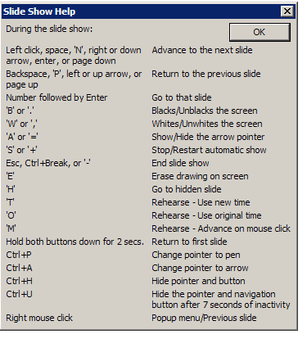

Slide 15
6. Tips – Visual Aids
Key ideas ONLY
  Support verbal presentation
  Use phrases not sentences
  Handy rule….
      6 x 6 (six points, 6 words per point…or fewer)

Slide 16
6. Example: Interview Strategies
Create a confident first impression by introducing yourself, smiling, offering a firm handshake, and using the recruiter’s name.
Be as specific as possible in your answers to questions. Include details about why you may have acted as you did in specific circumstances.
Be comfortable with a few seconds of silence if you want a little time to think about an answer to one of the questions. You don’t have to have all the answers immediately ready!
Explain what you can do for the company and why you’re interested in that specific company.

Slide 17
Example: Interview Strategies
Create positive first impression
Give detailed answers
Use pauses if necessary
Show interest in the company

Slide 18
6. Side-by-Side Comparison
Interview Strategies
Create a confident first impression by introducing yourself, smiling, offering a firm handshake, and using the recruiter’s name.
Be as specific as possible in your answers to questions. Include details about why you may have acted as you did in specific circumstances.
Be comfortable with a few seconds of silence if you want a little time to think about an answer to one of the questions. You don’t have to have all the answers immediately ready!
Explain what you can do for the company and why you’re interested in that specific company.
Interview Strategies
Create positive first impression
Give detailed answers
Use pauses if necessary
Show interest in the company

Slide 19
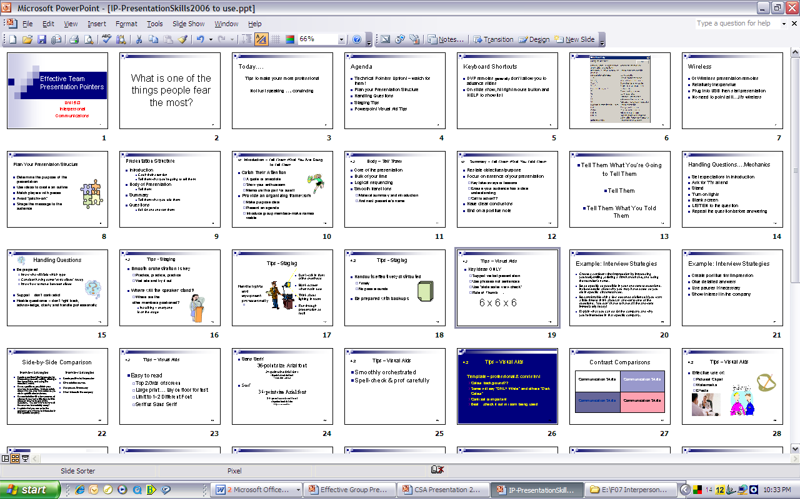
6. Use Slide Sorter to View

Slide 20
6. Tips – Visual Aids
Spel-check & prof carefully
Easy to read
  Top 2/3rds of screen
  Large print … go 3 feet from computer to test
  Limit to 1-2 Different Fonts

Slide 21
Sans Serif (without embellishments on letters…this is preferred font)
36-point size Arial font
24-point size Arial font
16-point size Arial font
12-point size Arial font
Serif (has embellishments on letters, can be difficult to read)
36-point size Times New Roman font
24-point size Arial font
16-point size Arial font
12-point size Arial font
Notes:
Difference between sans serif (without feet) and serif
Different sizes
Also, put on ground and if you can read it then okay.

Slide 22
Contrast Comparisons
Communication Skills | Communication Skills
Communication Skills | Communication Skills

Slide 23
6. Tips – Visual Aids
Template – professional & consistent
  Colour background??
  Some will say “ONLY White” and others “Dark Colour”
  Contrast is important
  Best….check it out in room being used

Slide 24

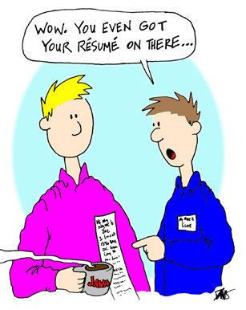

6. Tips – Visual Aids
Effective use of:
  Pictures/ Clipart
  Watermarks
  Effects

Slide 25

Watermarks
Be careful of backgrounds
May distract from print
Becomes hard to read
Notes:
To put a watermark in:
Format
Picture
Picture tab
Colour: Washout
And
Make the watermark a background object by right-clicking on the object, clicking on “order,” and then clicking on “send to back”

Slide 26
Transitions or Animations
Do they detract or add?

Slide 27



Slide 28
7. Tips – Maintaining Audience Attention
Connect to Visuals
Engage the audience
  Rhetorical questions
  Get them thinking
Use of humour
Unique strategies…caution, watch time!!
Vary media

Slide 29
7. Tips – Maintaining Audience Attention
Studies show:
  PowerPoint more professional than overheads
  Expect more from PowerPoint user
  But is it overdone?
  Some companies have “banned it”
  Takes away from presenter!!

Slide 30

8. Tips – Dress / Appearance
First impressions are critical
Professionally dressed
  Consistent among team members
No gum chewing
No candy
No hats

Slide 31
9. Tips – Confidence Level / Body Language
Check posture and stance and positioning
Avoid reading …. Talk to points
Don’t apologize
  “I see we’re almost out of time….”
  “Should have made handouts for you…”
Use natural and effective gestures
  Casual arm/hand movements
  Hands out of your pockets
  Smile

Slide 32




It’s alright to have butterflies…..

Slide 33
Just learn to make them fly in formation!

Slide 34
10. Tips – Voice / Language
Vary your voice
Emphasize important words
Try this…..
Now is the time to move!

Slide 35
10. Voice
Avoid letting your voice trail UP at the end of a sentence
And this is what we want to implement.

Slide 36
10. Tips – Voice / Language
Avoid use of slang, jargon, repetitive phrases
Good volume & pace
Reflect confidence
  Don’t stumble
  Don’t use “um, ah, like”
  Silence / Pause is better
Choose words that are suitable for the audience
  Easy to understand
  Be positive and enthusiastic

Slide 37
11. Research
Fact based not opinion based
Adds credibility
  Show sources if direct quotes (bottom/small)
  Work it into the phrasing
    “As we found in an interesting article in the Harvard Business Review…”
Have a list / slide of main sources at end in case you’re asked

Slide 38
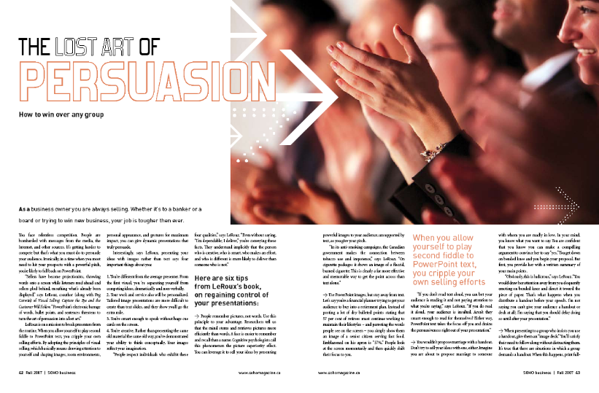
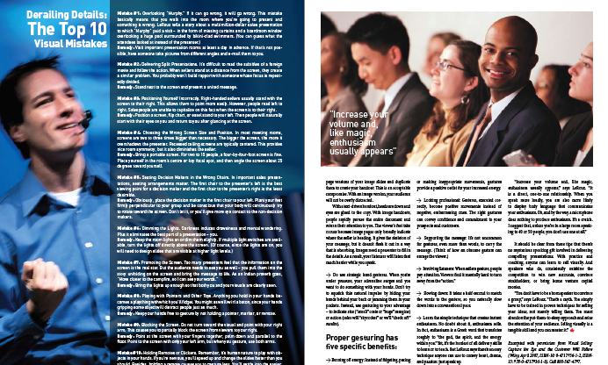
Excellent Article
Canada’s SOHO Business
Fall 2007

Slide 39

Time
“Time is money” in the business world
Practice to fit time frame given
For class presentations you will be given 2 minute warning
When time is up, you are asked to stop
But in real world you need to be your own time keeper

Slide 40

We’ve Reached the End….
Wrap it up…Put a Bow on it!!
  Restate Objectives
  Make Sure Main “Take aways” are clear
  End positively

Slide 41
Effective Group
Presentation Pointers
Any Questions??

