Slide 1
Github Tour

Slide 2
Git compared to Subversion
What git is good at
branching/merging
cooperation (simultaneous edits to the same files)
working locally and offline
What svn is good at
centralization
access control
large file support

Slide 3
Commands
svn | git
checkout | clone
update | fetch/pull
commit | commit
copy | branch/tag
switch | switch/checkout
revert | restore/checkout
Interesting podcast from co-creator of svn about rcs -> cvs -> svn -> git

Slide 4
More comparison
Where is the repository?
Local vs remote
Branching and merging
Learning curve

Slide 5
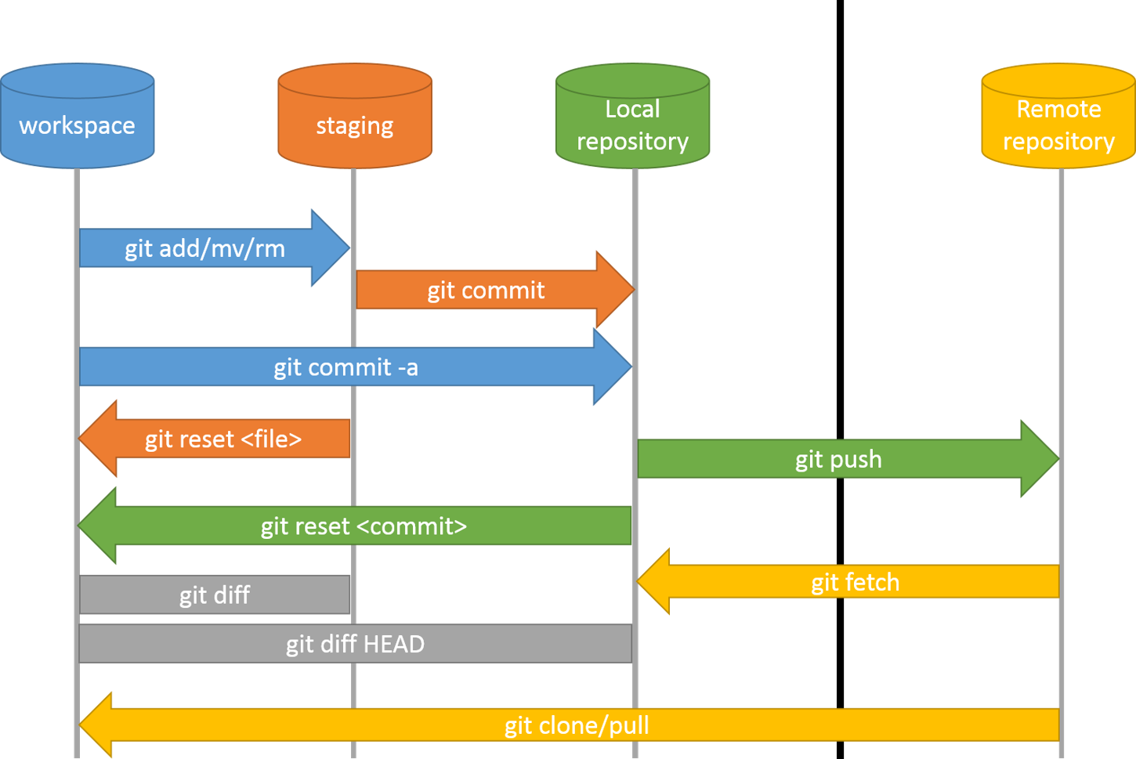
Image Source

Slide 6
Demo

Slide 7
Sample repository
https://github.com/bmaden/git-demo

Slide 8
Github desktop
A more user friendly approach to git
Provides many git features while hiding the complexity

Slide 9
Documentation
Supports markdown throughout
Create documents anywhere in the repository (for example, try "README.md" in the root of the repository) and they will be rendered as html when viewed on github.com
Basic writing and formatting syntax - GitHub Docs

Slide 10
Conflicts
Start with main branch
Merge branch bmaden-usds/test-add-operator
Merge branch bmaden-usds/divide-operator
Use github.com tools to resolve the merge conflict
Viewing diffs on github.com: https://github.com/[user|org]/[repo]/compare

Slide 11
End of session 1

Slide 12
PR Review
[user1] Look at a pull request that is awaiting review
[user1] Comment, request changes
[user2] Update PR to address changes
[user1] Approve
[user2] Merge the changes into the target branch

Slide 13
PR review
https://github.com/bmaden/git-demo/pull/8
PR has a review already already
Address the comments
Complete review
Tip: Filter PRs by "awaiting review by you"
Filtered pull request list

Slide 14
Automation
Now there are some tests in our repository
Run them when certain events occur in the repository
merge branch bmaden-usds/run-tests
This was done at the end of session 1
Workflow syntax for GitHub Actions
Example: Run NBS tests

Slide 15
Dependency vulnerability scanning
Enable Dependabot
https://github.com/[user|org]/[repo]/settings/security_analysis
Add a github workflow that schedules it
Pull request that sets schedule
Example of a finding:
https://github.com/CDCgov/prime-reportstream/pull/5329

Slide 16
Reducing diffs
Formatting (for example) by using spotless
Then check formatting when pull requests occur
Merge branch bmaden-usds/add-spotless
Automate local check with a pre-commit hook

Slide 17
3rd-party integrations
SonarCloud (SAST)
Snyk (alternative to dependabot)
Jira

Slide 18
SonarCloud
Sample project provided by Sonar
Includes a sample for a maven project
No functioning demo on this project
Integration with Github requires a Github Organization
Caveats
This particular service requires Java 11+

