Slide 1
Github Tour

Slide 2
Git compared to Subversion
What git is good at
branching/merging
cooperation (simultaneous edits to the same files)
working locally and offline
What svn is good at
centralization
access control
large file support

Slide 3
Commands
svn | git
checkout | clone
update | fetch/pull
commit | commit
copy | branch/tag
switch | switch/checkout
revert | restore/checkout

Slide 4
More comparison
Where is the repository?
Local vs remote
Branching and merging
Learning curve

Slide 5
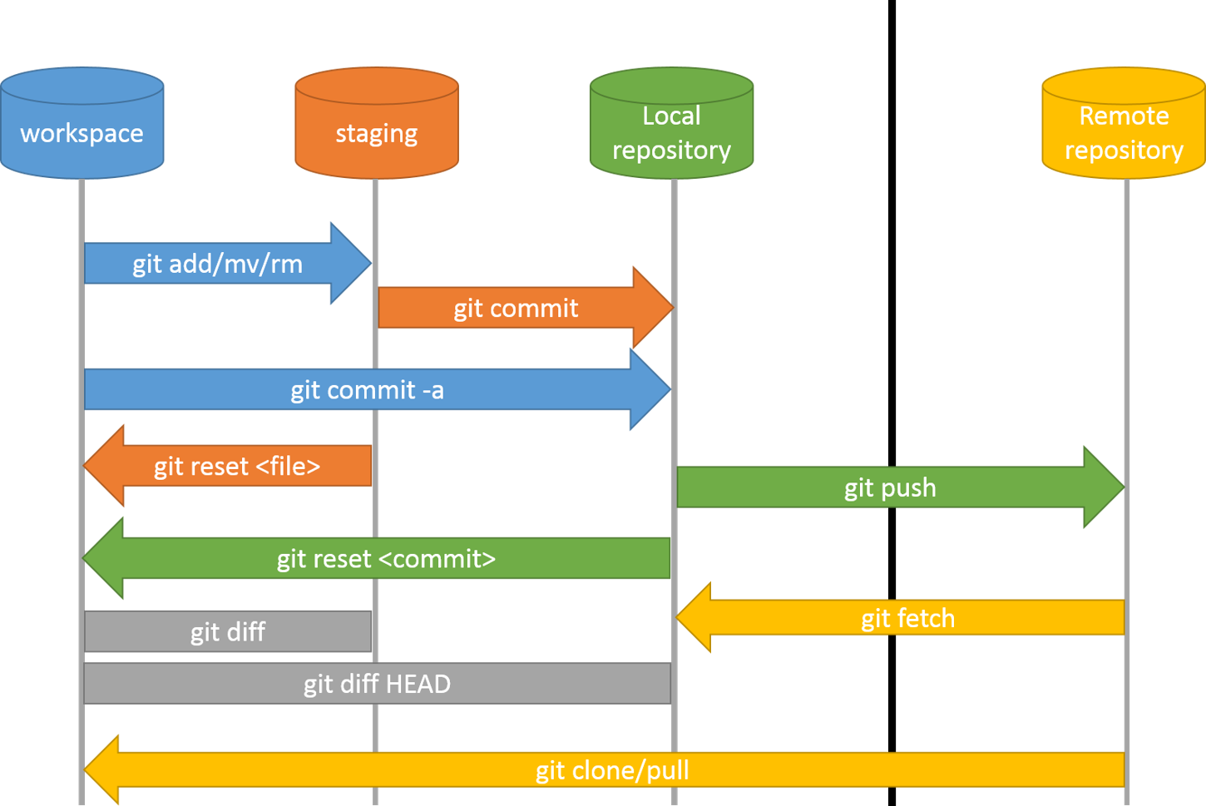
Image Source

Slide 6
Demo

Slide 7
Sample repository
https://github.com/bmaden/git-demo

Slide 8
Github desktop
A more user friendly approach to git
Provides many git features while hiding the complexity

Slide 9
Documentation
Supports markdown throughout
Basic writing and formatting syntax - GitHub Docs

Slide 10
Conflicts
main
merge branch bmaden-usds/test-add-operator
merge branch bmaden-usds/divide-operator

Slide 11
Automation
Now there are some tests in our repository
Run them when certain events occur in the repository
merge branch bmaden-usds/run-tests

Slide 12
Dependency vulnerability scanning
enable dependabot
example: https://github.com/CDCgov/prime-reportstream/pull/5329

Slide 13
Reducing diffs
formatting, for example using spotless
then check for it when pull requests occur
merge branch bmaden-usds/add-spotless

