Slide 1

Software Technology Parks of India
Department of Information Technology
Ministry of Communications and Information Technology
Government of India
SOFTWARE TECHNOLOGY PARKS OF INDIA

Slide 2

Software Technology Parks of India
Bhubaneswar
Welcomes
Shri P.K Mohaptra, IAS
Commissioner-cum-Secretary
IT Department,
Govt. of Orissa

Slide 3
STPI Mandate
An Autonomous Organization set up by Department of Information Technology (DIT), Ministry of Communications and Information Technology (MCIT), Government of India .
Established in 1991
Mandate to promote export of IT Software & IT Services from the nation by providing conducive environment, policy support and Infrastructure facilities.
Acting as a ONE STOP SHOP for needs of software exporters.
Areas of Achievements
Growth of IT exports
Support to SMEs
Dispersal of Industry
Shift towards Offshore
model
Employment Generation

Slide 4
Roles of STPI
Policy modification
Collaboration with Govt. agencies for promotion of software/IT industry
Interface between Govt. & Industry
Facilitation
Single Window Clearances
1. Implementation of STP & EHTP Schemes
Statutory Role
ONE
STOP
SHOP
1. Incubation space
2. Seminars, handholding
3. Dispersal of industry in secondary
cities.
Infrastructure provisioning and promotion
Incubation Services, Promotional services
Internet leased lines
Datacom
Services,
Connectivity provider

Slide 5
STPI centers
STPI centers
Srinagar
Noida
Allahabad
Bhillai
Dehradun
Indore
Jaipur
Kanpur
Lucknow
Mohali
Srinagar
Shimla
Bangalore
Hubli
Mangalore
Manipal
Mysore
Hyderabad
Vijaywada
Vizag
Warangal
Tirupati
Navi Mumbai
Guwahati
Imphal
Gangtok
Thiruvananthapuram
Gandhinagar
Kolkata
Durgapur
Kharagpur
Bhubaneswar
Rourkela
Ranchi
Chennai
Coimbatore
Madurai
Pondicherry
Tirunaveli
Trichy
Pune
Nasik
Kolhapur
Nagpur
Aurangabad
Mohali
Shimla
Dehradun
STPI-HQ
New Delhi
Lucknow
Gangtok
Guwahati
Noida
Imphal
Jaipur
Kanpur
Allahabad
Ranchi
Kharagpur
Gandhi Nagar
Indore
Kolkata
Nashik
Durgapur
Navi Mumbai
Bhilai
Aurangabad
Rourkela
Pune
Nagpur
Bhubaneswar
Kolhapur
Wanrangal
Vizag
Vijayawada
Hubli
Hyderabad
Manipal
Thirupati
47 STPI Centres
Mangalore
Bangalore
Chennai
Mysore
Coimbatore
Trichy
Pondicherry
Madurai
Thiruvananthapuram
Thirunelveli
MAP NOT TO SCALE

Slide 6


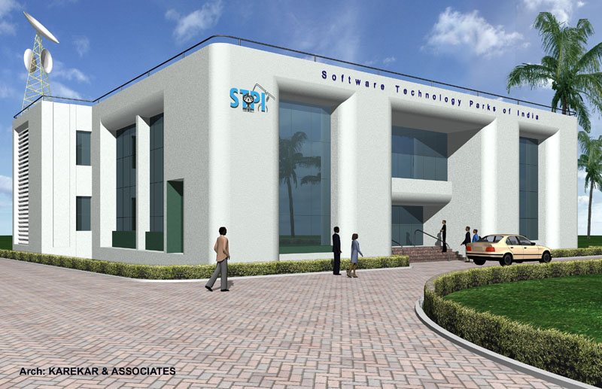

Major Functions of STPI
* Statutory Services: Implementation of STP & EHTP Scheme
*Data-communication services
*Interface between Industry
and Government
*Incubation Facilities for
Start-up companies
*Technology trainings

Slide 7
STPI-Regulatory Role
The Govt. Of India , with the main object of augmenting the foreign exchange resources of the country, has, in the exercise of the powers contained in section 3 of the Foreign Trade
( Development & Regulation) act 1992, formulated the SOFTWARE TECHNOLOGY PARK Scheme.
The Scheme is administered by Ministry of Communication & Information Technology (MCIT), Govt. of India through STPI
STPI is the implementing agency for the following schemes:
STP Scheme -- for Software Exports
EHTP Scheme -- for Electronics Hardware
and Components Exports.

Slide 8

Benefits of STP Scheme
Benefits
Complete duty free imports
Exempted from payment of Local duties and taxes
Up to100% foreign equity permitted
No corporate income tax up to March 2010
Single window Government clearance
Custom bonding and export certification provided at single point
Permission for DTA sales upto 50% of exports

Slide 9
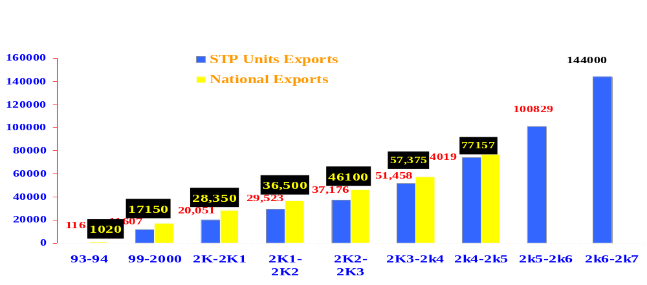
Exports by STP Units
34.28 billion US$ in 2006-07
  More than 7000 software exporting units
  95% of the total national software export through STPI
  Total Software exports by STPI units for FY 2006-07 is Rs 144000 Crs.

Slide 10
State wise Exports through STPI units under STP Scheme
Name of the State | Exports in FY 2004-05 | Exports in FY 2005-06 | Exports in FY 2006-07 | % Growth | State Contribution in %
Karnataka | 27600 | 37000.00 | 48700.00 | 32 | 36.65
Tamilnadu | 10790 | 15500.00 | 20745.30 | 34 | 15.35
Maharastra | 11542 | 13960.00 | 27625.00 | 98 | 13.83
Andhra Pradesh | 8270 | 12500.00 | 18582.00 | 49 | 12.38
Haryana | 5953 | 8358.00 | 9287.00 | 11 | 8.28
Uttar Pradesh | 3825 | 5476.00 | 8452.79 | 54 | 5.42
Delhi | 2453 | 3520.00 | 4146.00 | 18 | 3.49
West Bengal | 2000 | 2500.00 | 3500.00 | 40 | 2.48
Orissa | 400 | 465.00 | 732.00 | 57 | 0.46
Punjab | 125 | 182.00 | 195.00 | 7 | 0.18

Slide 11
State wise Exports through STPI units under STP Scheme
Name of the State | Exports in FY 2004-05 | Exports in FY 2005-06 | Exports in FY 2006-07 | % Growth | State Contribution in %
Chandigrath | 225 | 294.00 | 345.15 | 17 | 0.29
Kerala | 270 | 452.00 | 750.42 | 66 | 0.45
Madhya Pradesh | 140 | 189.00 | 220.22 | 17 | 0.19
Gujarat | 187 | 247.00 | 563.78 | 128 | 0.24
Rajasthan | 200 | 271.00 | 312.00 | 15 | 0.27
Chattisgarh | 1.0 | 1.00 | 1.56 | 56 | 0.00
Pondicherry | 30 | 40.00 | 43.58 | 9 | 0.04
Himachal Pradesh | 0.60 | 1.00 | 0.94 | -6 | 0.00
Uttranchal | 6.2 | 8.00 | 9.27 | 16 | 0.01
Jammu Kashmir | 1.0 | 1.00 | 1.56 | 56 | 0.00
Total | 74019 | 100965.00 | 144213.57 | 43 | 100.00

Slide 12
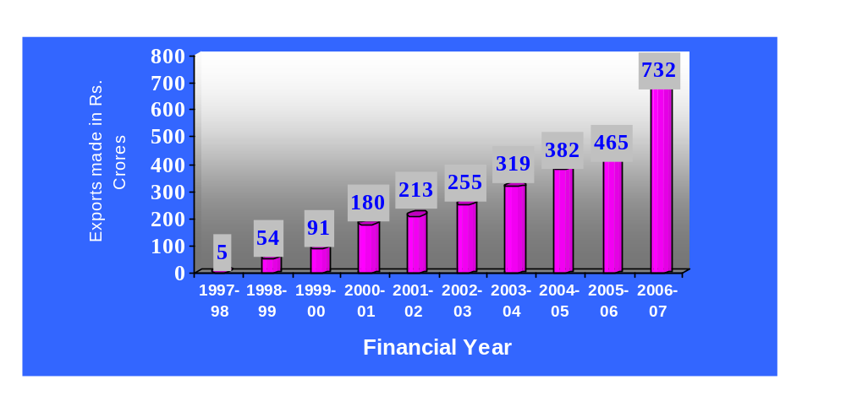
Software Exports from the State
    The STP units operating under Bhubaneswar have reported software export of Rs. 732 Crores during the year 2006-2007.

Slide 13
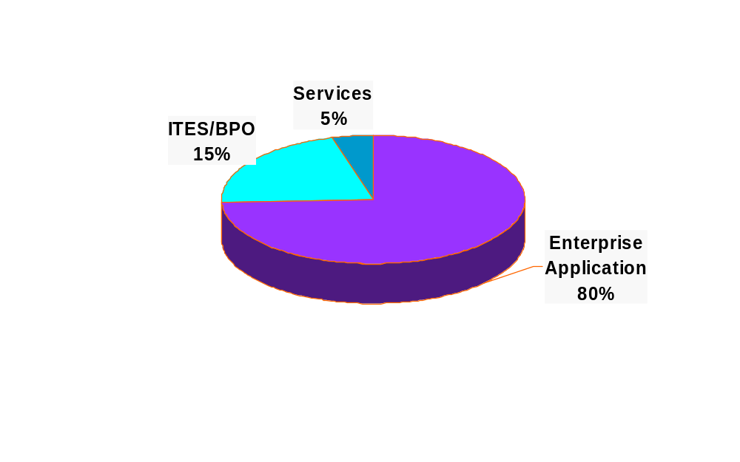
Software Exports – Segment wise
2006-07
SOFTWARE TECHNOLOGY PARKS OF INDIA

Slide 14
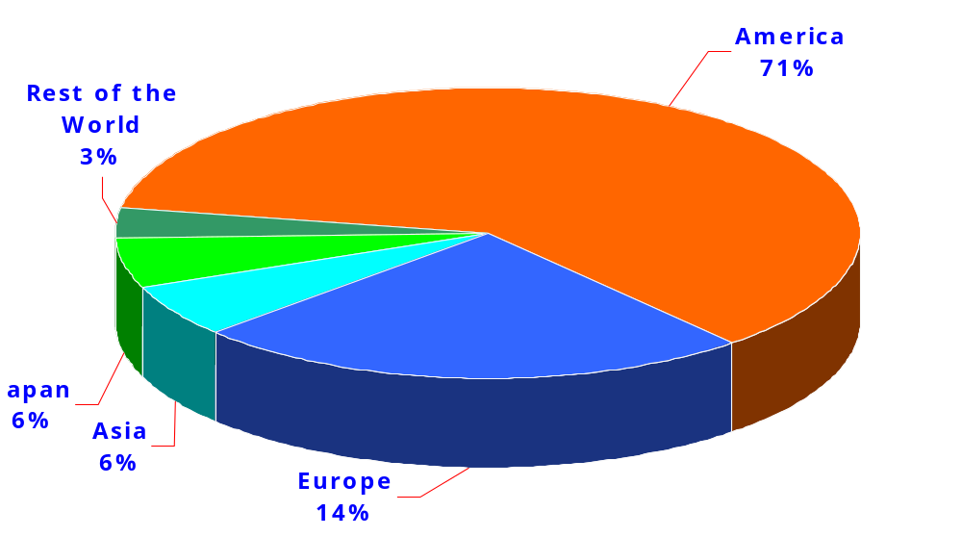
Software Exports Destination

Slide 15
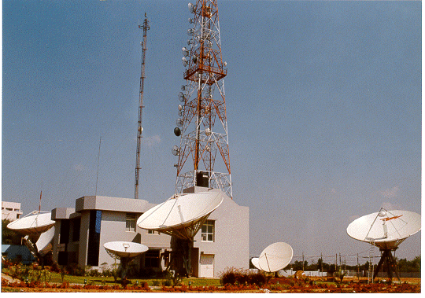
STPI - an International Carrier
First Commercial Internet Provider in India - Started in 1993
Operates 49 Gateways across the country

Slide 16
International Communication Services
First Commercial Internet Service Provider in the Country
Leading International Datacom service provider of India
49 International gateways across the country
Datacommunication Services, IT Services, Captive Networks
Operational relationships with more than 24 International carriers
with global presence

Slide 17
Technology Services of STPI
Datacom Services – IPLC, Internet, IPVPN
IT Services – Web hosting, Collocation, DNS, Mail
Disaster Recovery Services – Storage, Business Continuity
Consultancy and Project Management Services
Remote IT Management Services

Slide 18
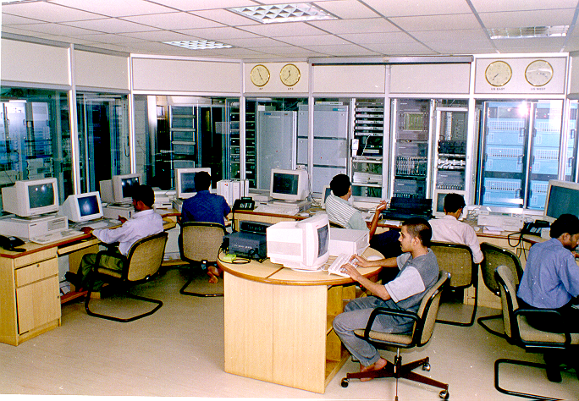
SoftNET Services
High Speed Data Communication Services, which is the life line for Software Export Industry

Slide 19
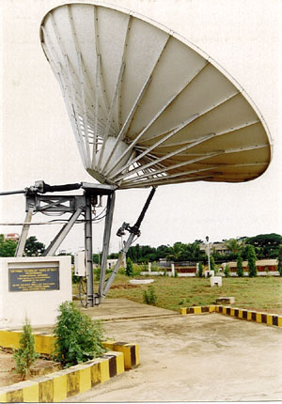

SoftNET Service Offering
SoftPOINT - International Private Leased Circuit (IPLC) offering
SoftLINK - High Speed Internet Access
SoftCONF - Video quality conferencing for SMES
SoftGATE - Roof top Gateway support to industry
PMC-Captive Network+ SoftPOINT and/or SoftLINK + VSAT Offering

Slide 20


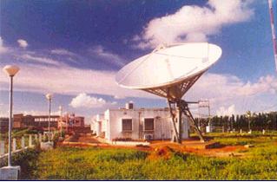


STPI will reach you where ever you are located ...
Presently more than 50 Radio Installations
INTELSAT
STPI BASE
STATION
Wide Band Internet Gateway
Infosys
International
Fiber
Satyam
STPI Complex
Customer n

Slide 21
STPI - Technology Incubators
….towards the Nurturing Paradigm

Slide 22
Support for SME sector and start-up units
Incubation Facility:
    Ready to use built up space
    Internet Enabled Workstation.
    Internet and datacom connectivity
    Software Library.
    Market Information
    Network infrastructure

Slide 23

Incubating Facilities of STPI-Bhubaneswar
16,500 sq.Ft. Built up space at PD Market & Fortune Towers ( 100 % occupancy)
25 rentable modules
Leased Internet connectivity
Central Air-conditioning facility at Fortune Towers
Un-interrupted Power Supply with stand-by Gen. Set.
Conference Hall equipped with latest presentation aids.
EPABX with Call center application
Access Control

Slide 24





STPI – Incubation Program Futute
Support
Mentoring
Government
Industry
Knowhow
Funding
Academia
Venture Capital

Slide 25
Project Management & Consultancy (PMC)
e-Sishu Project – VSAT Network for OPEPA
  Project Conceptualization, Design and Implementation
  Management of 30 Districts and State H.Q through VSAT network
  24/7 Tech Support for the complete network
  NOC Management includes Support Infrastructure
  Bandwidth Utilization Monitoring
  Co-ordination with Application Service Providers and IT Infrastructure Management

Slide 26
Project Management & Consultancy (PMC)
Go Live Project – VSAT Network for OMC
Network Design and implementation
  24/7 Tech Support
  Round the clock support
  Bandwidth monitoring and Uptime Management
  With the automated process with built-in escalation
Others
  Captive network of BJB College, NCTE
  Office Automation Project of CRRI
  Server Co-location service to IPICOL, Govt. of Orissa, NALCO & Panchayati Raj

Slide 27

Strength
30 Mbps Global Backbone
Independent of BSNL/VSNL infrastructure.
Highly reliable and efficient Data Comm architecture for Software Exporters.
High customer satisfaction.
Single window concept which facilitate speedy implementation.

Slide 28

Impact of STPI-Bh.
The Export contribution from SMEs are continuously increasing.
STP units are performing excel than their foreign exchange earning commitment.
Shifting the focus of industry from on site to off shore project due to reliable data comm. facilities.
Large STP units are expanding their operation due to the favorable condition.
New Units and other IT majors are also choosing BBSR for their destination
The STP scheme is penetrating to the remote places of the state.

Slide 29
Issues & Difficulties
Lease Period of existing NOC land has been expired. Renewal is pending at GA Deptt.
Allotment of 2 Acres of land which was decided by GA and IT Department is pending. This is barely required for extension of NOC and creating hi-tech Incubation facility.
Lease issue with BDA for PD Market Incubation Complex.

Slide 30

Vision
To contribute more and more to national target of 60 Billion US$ Software Exports by 2010 projected set by Govt. of India.

Slide 31

Thank You

