Slide 2

AST
JJtree /JavaCC parser
Golo
Store contextual information
Name changed and contextual information
IR
ParseTreeToGoloIrVisitor
Modify name of the function if contextual

Slide 3
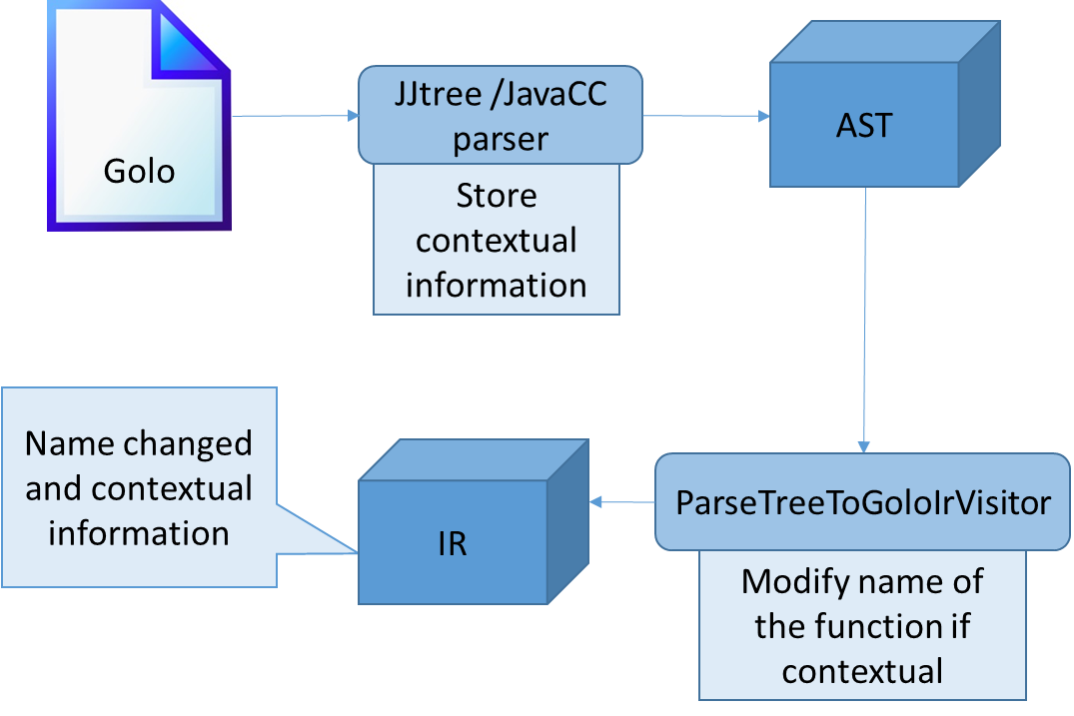

Slide 4
Runtime
…
foo()
…
ContextProxy.invoke(…)
Link generated at compilation
Send
foo||@(context1)
Decision Maker
FunctionInvocationEvent
foo||@(context2)
foo||@(context3)
Context

Slide 5
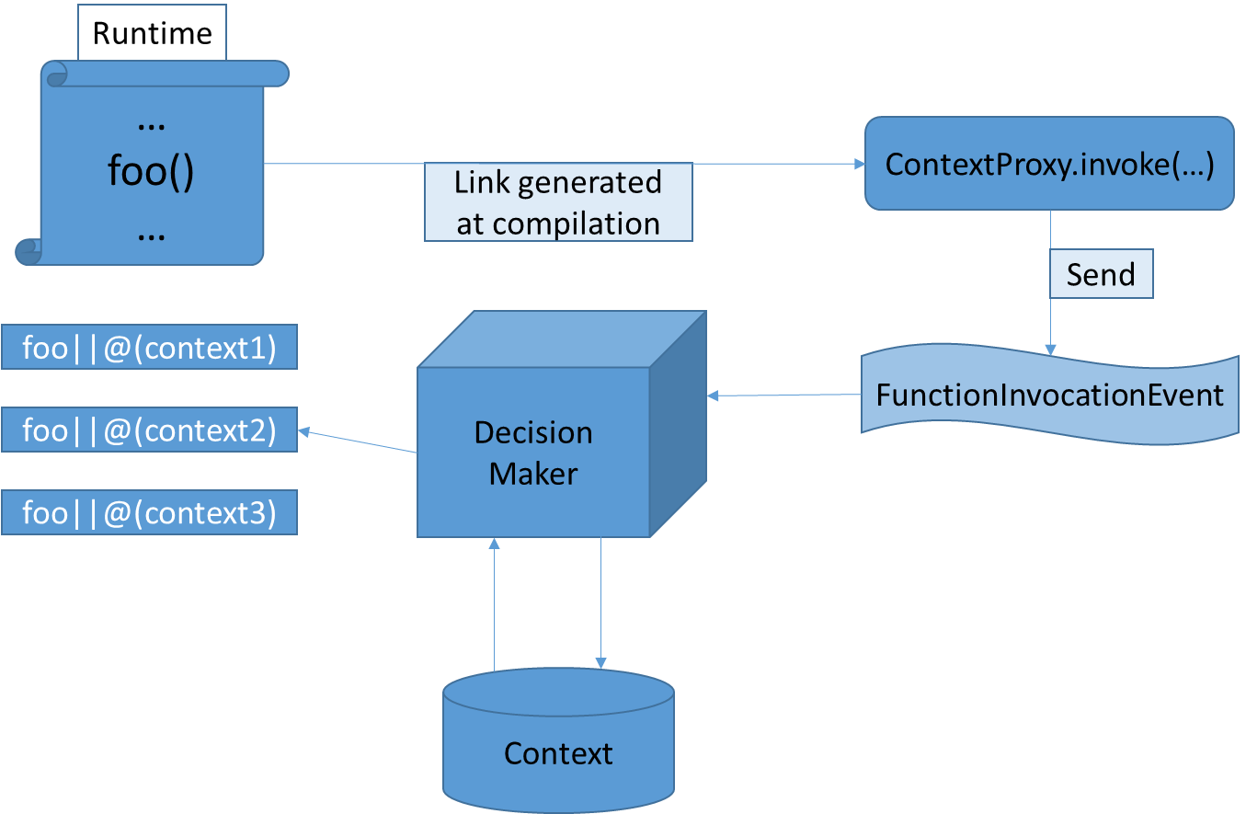

Slide 6


Send temperature information
Adjust the heater/cooler
Internet
Decision-making server
Decide the action to be taken based on the current context (temperature) and possibly external information (such as weather for instance)

Slide 7
