Slide 1
Geology 101 for Strontium Isoscapes: from rocks to rivers

Slide 2
What is geology?
The study of Earth’s materials — rocks, minerals, and the processes that shape them over time
Geology = source code, sets chemical background of rivers
Water moves through / over rocks, dissolves their mineral components, and carries those fingerprints downstream

Slide 3
Three rock families
Igneous rocks form from cooled magma
Basalt, granite, rhyolite — they set the foundational crust.
Their chemistry often reflects mantle and crustal origins
Sedimentary rocks form from compressed sediments
Sandstone, shale, limestone
They often record past environments like oceans, rivers, or deserts
Metamorphic rocks: transformed by heat and pressure
Schist, gneiss, marble
They carry the chemistry of their parent rocks, but altered

Slide 4
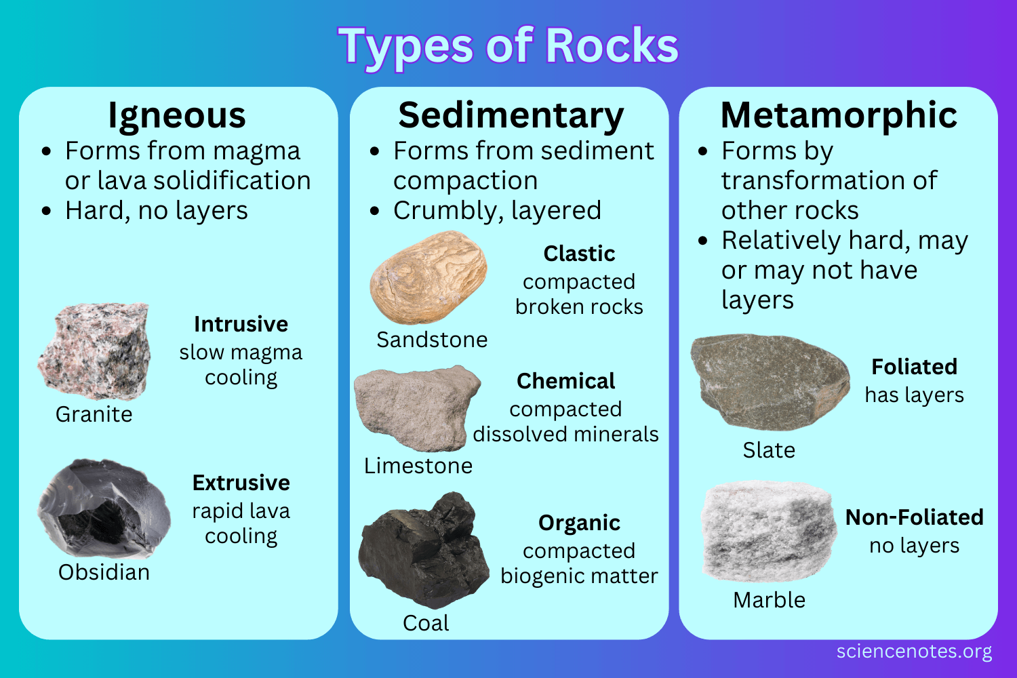

Slide 5
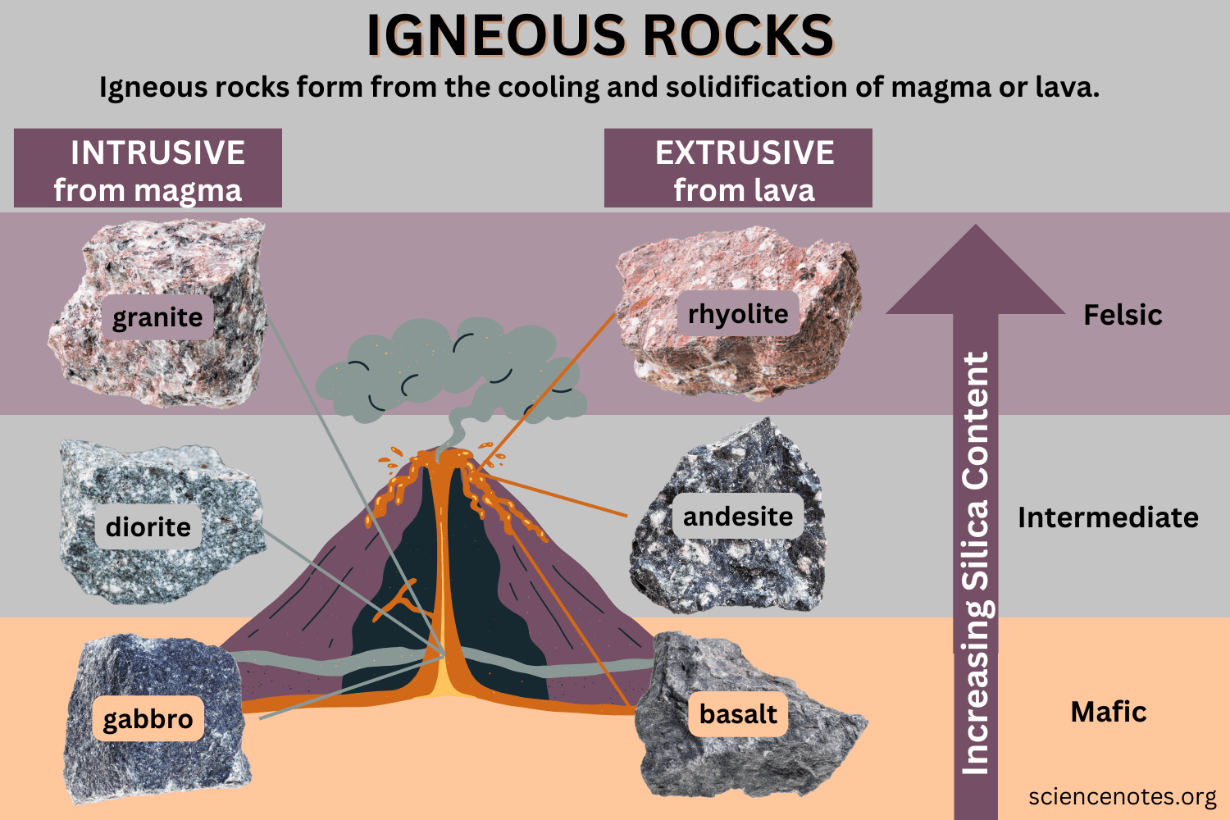
Igneous rocks
Fire-formed → crystallize from molten material (magma/lava)
Earth’s original building blocks
Formation separates 2 types:
Volcanic / extrusive
Plutonic / intrusive
Texture tells the story:
Slow cooling = coarse-grained granite
Fast cooling = fine-grained basalt

Slide 6
Igneous rocks: chemistry and Sr
Strontium substitutes for calcium in feldspar and other minerals.
The ^87Sr/^86Sr ratio reflects rock age and source.
Young mantle-derived basalts → low ratios (~0.703–0.705).
Old granitic continental crust → high ratios (~0.710+).
Intermediate volcanic rocks (andesite, rhyolite) → middle ground.
Analogy: basalts are “youthful voices” with a simple tone, granites are “older storytellers” with layered resonance.

Slide 7
Igneous rocks: context for rivers
Central Idaho geology = strong igneous influence.
Idaho Batholith (Cretaceous granites) → radiogenic, high ^87Sr/^86Sr.
Challis Volcanics (Tertiary volcanics) → younger, lower Sr ratios.
Tributaries draining these units carry distinct chemical fingerprints → those signatures are archived in salmon otoliths.
Pathway: Rock → Water → Otolith.

Slide 8
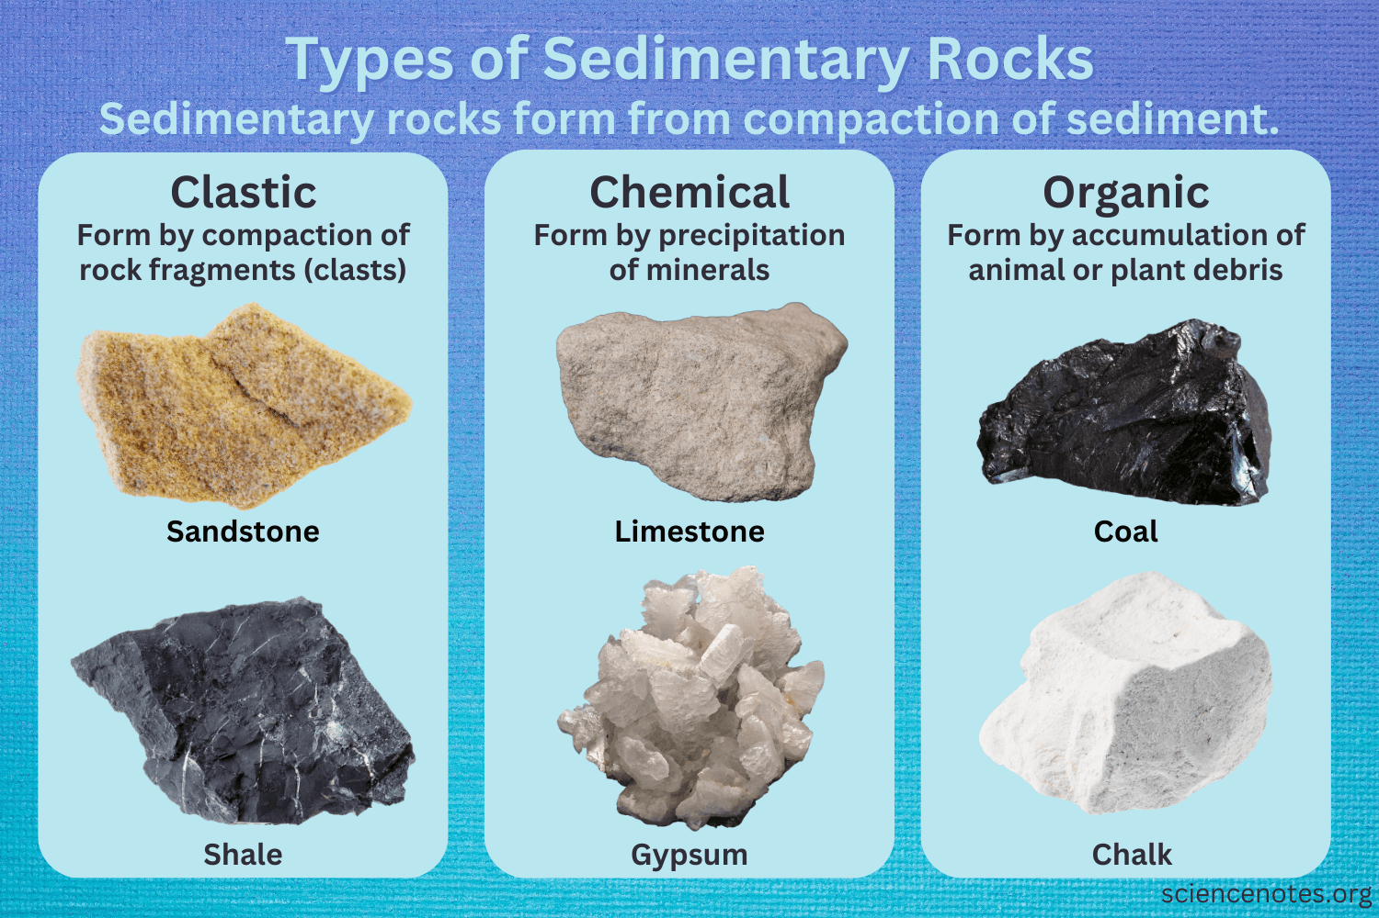
Sedimentary rocks
Formed from layers of deposited material (sand, mud, shells, dissolved ions)
Built in environments like oceans, rivers, deserts, floodplains.
Analogy: Earth’s history books — each layer a page of past environments.
Common types:
Sandstone → cemented sand
Shale → compacted mud
Limestone → precipitated carbonates

Slide 9
Sedimentary rocks: chemistry and Sr
Often chemically diverse, reflecting source materials.
Carbonates (limestones, dolomites): can dominate local water chemistry, often buffering pH and Sr content.
Shales/sandstones: inherit Sr from eroded parent rocks → variable isotopic signatures.
Sr ratios tend to mirror the age and type of sediment source rather than simple “young vs. old” rule.
Analogy: sedimentary rocks are “editors” — remixing older material into a new narrative.

Slide 10
Sedimentary rocks: context for rivers
Sedimentary units in Idaho are patchy but important:
Limestones can dampen isotopic extremes, producing more stable Sr signatures.
Shales/sandstones provide mixed signals, especially in multi-source watersheds.
Where rivers cut through sedimentary layers, you may see distinct local chemical shifts, even if igneous dominates regionally

Slide 11
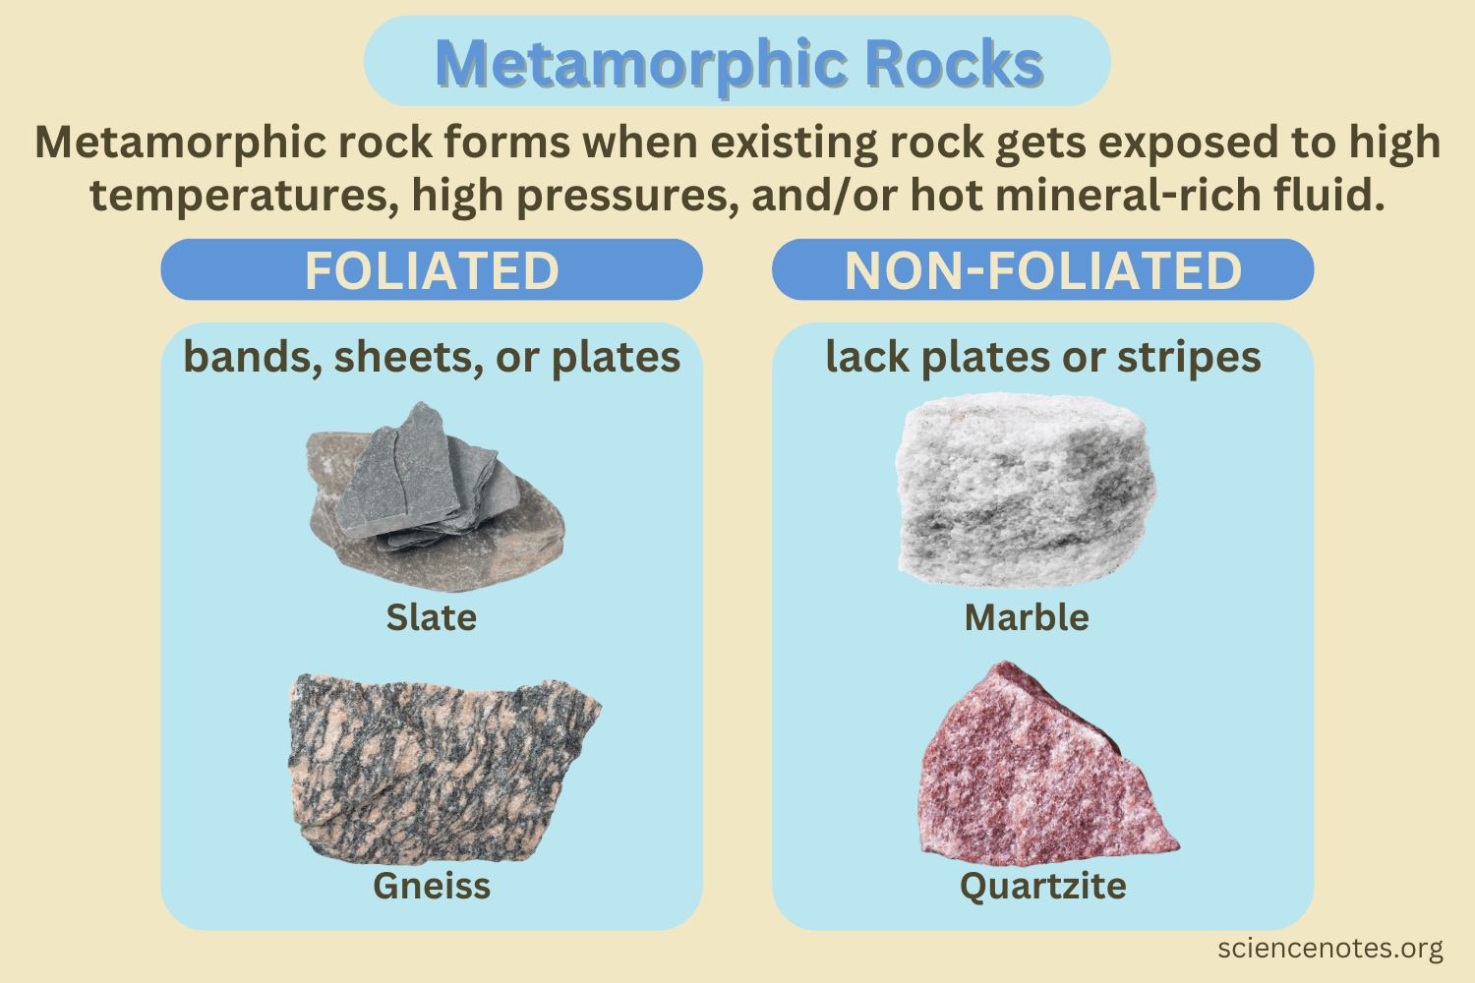
Metamorphic rocks
Formed when existing rocks are transformed by heat and pressure deep in Earth’s crust.
Analogy: metamorphic rocks are “recycled veterans” — older rocks re-forged into new forms under stress.
Common examples:
Schist → shiny, flaky, mineral-rich.
Gneiss → banded, layered appearance.
Marble → metamorphosed limestone.

Slide 12
Metamorphic rocks: chemistry and Sr
Sr signature depends on parent rock + metamorphic history.
Ancient crustal metamorphics → often very radiogenic (high ^87Sr/^86Sr).
Metamorphism reshuffles minerals but doesn’t “reset” the isotopic clock → old sources stay old.
Analogy: like rewriting a novel but keeping the original language — the story is rearranged, but the words (isotopes) are still there.

Slide 13
Metamorphic rocks: context for rivers
In central Idaho, metamorphic terrains include very old Precambrian rocks.
These contribute high Sr ratios, distinct from younger volcanic neighbors.
Tributaries draining metamorphics often stand out isotopically → useful “anchors” for your isoscape.
Mixing zones (igneous + metamorphic inputs) can create sharp isotopic contrasts.

Slide 14
Geology of Idaho and the MFSR
Idaho sits at the crossroads of ancient crust, massive intrusions, and fiery volcanism
The Middle Fork Salmon River (MFSR) cuts right through this geologic patchwork → giving you a natural lab for strontium isoscapes
Analogy: Idaho geology is like a layered orchestra — old instruments, new instruments, and remixes all playing at once

Slide 15
The Big Players in Central Idaho
Idaho Batholith (Cretaceous granites)
Challis Volcanics (Eocene volcanism)
Precambrian Metamorphic Rocks
Sedimentary Sequences

Slide 16
Idaho Batholith (Cretaceous granites)
Enormous body of intrusive igneous rock (~100 million years old)
Composed mostly of granite → feldspar-rich, radiogenic Sr signatures
Forms much of the central Idaho wilderness (including Middle Fork headwaters)
Expect: elevated ^87Sr/^86Sr ratios compared to younger volcanic terrains

Slide 17
Challis Volcanics (Eocene volcanism)
Tertiary volcanic province (~45–50 million years old)
Andesites, rhyolites, tuffs → more mantle influence
Typically yield lower Sr isotope ratios than the batholith
Common in northern and eastern parts of MFSR watershed

Slide 18
Precambrian Metamorphic Rocks
Some of the oldest crust in North America (>1.4 billion years)
Schists, gneisses → highly radiogenic Sr signatures
Occur as inliers and upland belts in central Idaho
Provide ancient “anchors” for isotopic variation

Slide 19
Sedimentary Sequences
Some of the oldest crust in North America (>1.4 billion years)
Schists, gneisses → highly radiogenic Sr signatures
Occur as inliers and upland belts in central Idaho
Provide ancient “anchors” for isotopic variation

Slide 20
What This Means for the Middle Fork
Spatial heterogeneity → tributaries draining different lithologies will carry distinct Sr isotope ratios.
Batholith-fed streams: higher, more evolved Sr signatures.
Volcanic-fed streams: lower, mantle-like Sr ratios.
Metamorphic-fed streams: very radiogenic “outliers”.
Sedimentary patches: localized influences, sometimes dampening variation.
The Middle Fork is not geologically uniform → it’s a mosaic of rock types, each imprinting its chemical signature onto the river.
This complexity is exactly what makes strontium isoscapes powerful:
Tributaries become chemically “distinct voices” in the watershed.
Fish otoliths can be matched back to those voices.
Analogy: Think of the Middle Fork as a choir — granite baritones, volcanic tenors, metamorphic basses, and sedimentary altos, all blending into the river’s song.

Slide 21
Why strontium matters
Strontium substitutes for calcium in minerals and dissolves readily into water
Importantly, the isotopic ratio (^87Sr/^86Sr) is not fractionated by biological processes
That means a fish’s otolith records the isotopic signature of the water it lived in, giving you a natural tracer of habitat use
So: geology → water chemistry → otolith chemistry
So: lithosphere → hydrosphere → biosphere
For strontium, what matters is the mineral content and especially the age of the rocks. Old continental crust tends to have high ^87Sr/^86Sr ratios, while younger volcanic rocks trend lower.

Slide 22
Covariates
Rock type (lithology)
Rock age
Land cover type

