Slide 1
Mokelumne Pumped Hydro Storage Project

Slide 2
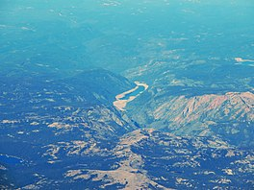
Salt Springs Reservoir
975 surface acres, 141,900 acre-foot storage reservoir formed by Salt Springs Dam on the North Fork Mokelumne River
332 feet (101 m) tall and was completed in 1931 (92 years ago)
Purpose: hydroelectricity production
Pipeline conveys water to the 44 MW Salt Springs Powerhouse
Some of the water is returned to the river downstream, but much of it flows into the Tiger Creek Conduit, a concrete flume that moves water downstream for use in other powerhouses in PG&E's Mokelumne River Project
region is hotspot for wild trout fishing in Sierra Nevadas, but reservoir supports warmwater fishery
Brook trout
Brown trout
Rainbow trout
Sacramento pikeminnow
Rainbow trout
Green sunfish
Lahontan redside
Sacramento sucker

Slide 3
NF Mokelumne River
Above dam
rainbow trout
by July, low water flows put stress on fish
Below dam
brown trout and rainbow trout
flows influences by dam operations

Slide 4
Cole Creek
small, moderately fished creek with wild rainbows
Heavy runoff in early Spring and flows are quite thin by mid-July

Slide 5
Bear reservoirs
Lower Bear River Reservoir is a 727 acre lake. This is a deep lake where maximum depths are close to 200 feet near the dam and typical depths in the center of the lake are close to 100 feet.
The lower lake is stocked with 13,000 rainbows and 7,200 Browns annually by DFG. The Bear River Resort adds 1000 lbs of trophy sized rainbows, 3-10 lbs., in early June and another 1000 lbs. in September. The upper lake is stocked with Kamloop Rainbow fingerlings.
Lower Bear Reservoir gets most of the attention with all types of water activity including water skiing and sailing.

Slide 6
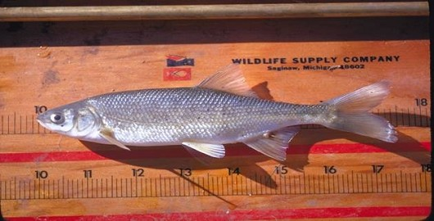
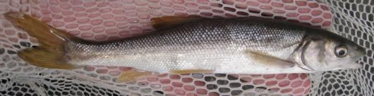
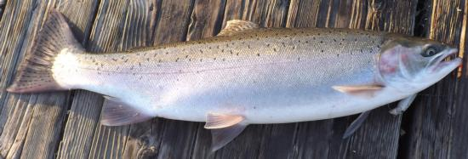
Species of conservation concern
Sacramento Hitch
Hardhead
Steelhead. Caught and released in the South Fork Mokelumne River, San Joaquin County, CA, 18 Oct 2013. Photo by Gary Riddle.

