Slide 1
Patchy Environments II
Today’s Agenda:
Quiz
Patchy Environments

Slide 2
Patchy Environments
Patches: suitable habitat, surrounded by unsuitable habitat.
Metapopulation: collection of connected populations
Multiple patches connected by dispersal

Slide 3
Levins Metapopulation Model
Model:
c = per-patch colonization rate
P = Proportion occupied patches
m = per-patch extinction rate
dP/dt = cP(1 - P) - mP
Notes:
Colonization rate ~ birth rate, m ~ death rate

Slide 4
Levins Metapopulation Model and habitat loss
Model:
c = per-patch colonization rate
P = Proportion occupied patches
m = per-patch extinction rate
D = Proportion of patches destroyed
dP/dt = cP(1 - D - P) - mP
at D = 1 - m/c
Extinction occurs
Notes:
Note that this means that if you destroy patches equivalent to the equilibrium proportion occupied, extinction will occur.

Slide 5
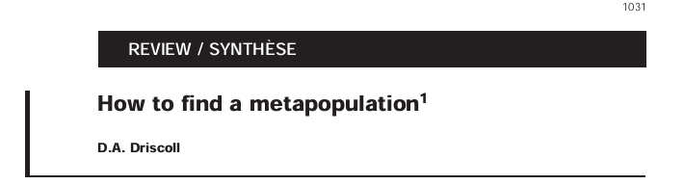
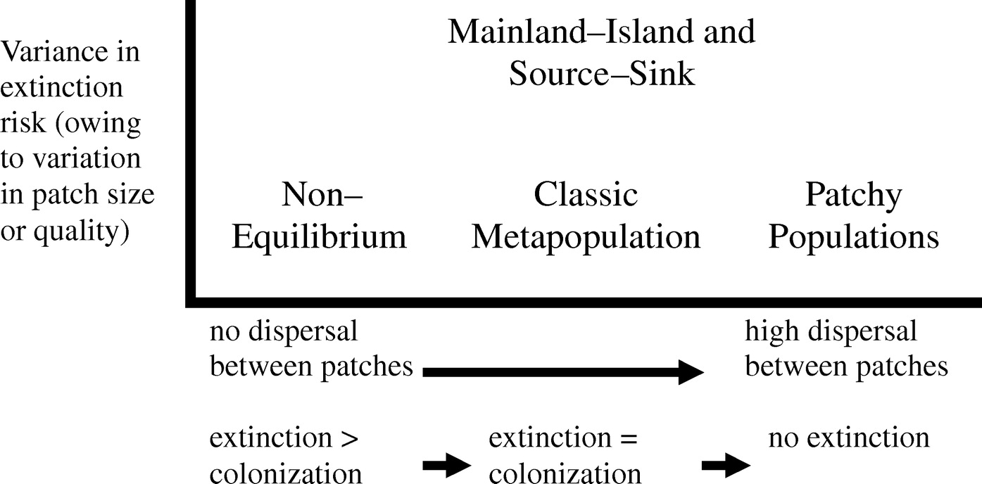
Types of metapopulation structure

Slide 6
Competition-Colonization Trade-off
For competing species to coexist:
a_{ii} > a_{ji}
Requires trade-offs

Slide 7
Competition-Colonization Trade-off
Dispersal Ability
Competitive Ability

Slide 8
Competition-Colonization Trade-off
Superior colonizer: gets to patches first
Superior competitor: arrives later, but displaces the superior colonizer
Superior colonizer species are concentrated in recently-disturbed patches
Superior competitor species are concentrated in older patches
Increases a_{ii} relative to a_{ji}

Slide 9
Competition-Colonization Trade-off
= Better colonizer
= Better competitor

Slide 10
Competition-Colonization Trade-off
= Better colonizer
= Better competitor

Slide 11
Competition-Colonization Trade-off
= Better colonizer
= Better competitor

Slide 12
Competition-Colonization Trade-off
= Better colonizer
= Better competitor

Slide 13
Competition-Colonization Trade-off
= Better colonizer
= Better competitor

Slide 14
Competition-Colonization Trade-off
= Better colonizer
= Better competitor

Slide 15
Competition-Colonization Trade-off
= Better colonizer
= Better competitor

Slide 16
Competition-Colonization Trade-off
Idea can be generalized to more than two species:
A
A arrives first
B arrives next, displaces A
C arrives last, displaces B
Patch extinction occurs (go to 1)
Dispersal Ability
B
C
Competitive Ability

Slide 17
Competition-Colonization Trade-off
dP/dt = cP(1 - P) - mP

Slide 18
Competition-Colonization Trade-off
dP_{i}/dt = c_{i}P_{i}(1 - P_{i}) - mP_{i}
dP_{j}/dt = c_{j}P_{j}(1 - P_{j}) - mP_{j}

Slide 19
Competition-Colonization Trade-off
dP_{i}/dt = c_{i}P_{i}(1 - P_{i}) - mP_{i}
dP_{j}/dt = c_{j}P_{j}(1 - P_{j} - P_{i}) - mP_{j} - c_{i}P_{i}P_{j}
Species i = Better competitor
Species j = Better colonizer

Slide 20
Competition-Colonization Trade-off
dP_{i}/dt = c_{i}P_{i}(1 - P_{i}) - mP_{i}
To get coexistence conditions:
Assume equilibrium (dP/dt = 0)
Both species present (P_{j} > 0)
Solve for c_{i}
c_{j} > c_{i}²/m
dP_{j}/dt = c_{j}P_{j}(1 - P_{j} - P_{i}) - mP_{j} - c_{i}P_{i}P_{j}
Species i = Better competitor
Species j = Better colonizer

Slide 21
Competition-Colonization Trade-off
dP_{i}/dt = c_{i}P_{i}(1 - P_{i}) - mP_{i}
To get coexistence conditions:
Assume equilibrium (dP/dt = 0)
Both species present (P_{j} > 0)
Solve for c_{i}
c_{j} > c_{i}²/m
dP_{j}/dt = c_{j}P_{j}(1 - P_{j} - P_{i}) - mP_{j} - c_{i}P_{i}P_{j}
Species i = Better competitor
Species j = Better colonizer
Higher patch extinction rate, lower c_{j} needed
More patches available to colonize

Slide 22
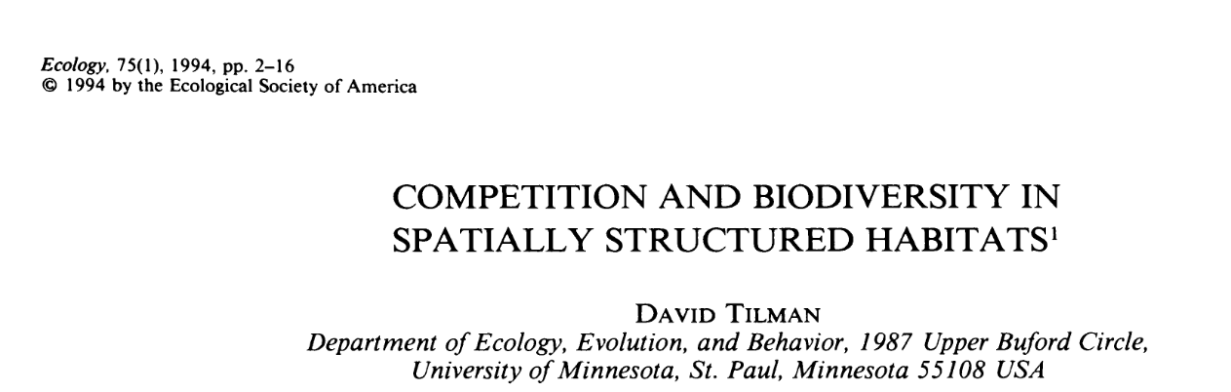
Competition-Colonization: Example
Tilman looked at this in both experimental and theoretical systems
(Remember the grassland plots we discussed a while back?)

Slide 23
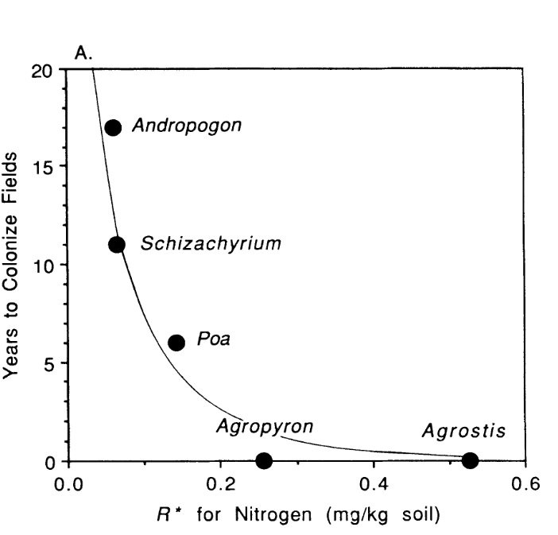
Competition-Colonization: Example

Slide 24
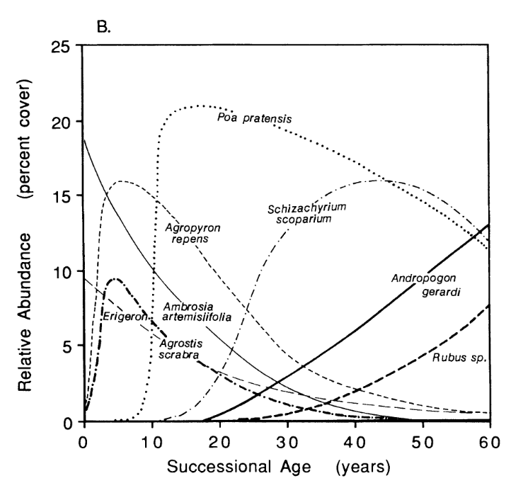
Competition-Colonization: Example

Slide 25
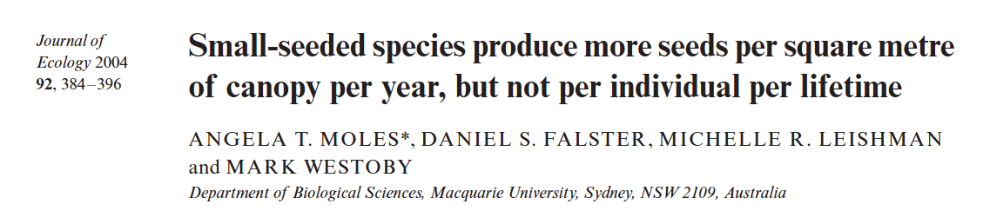
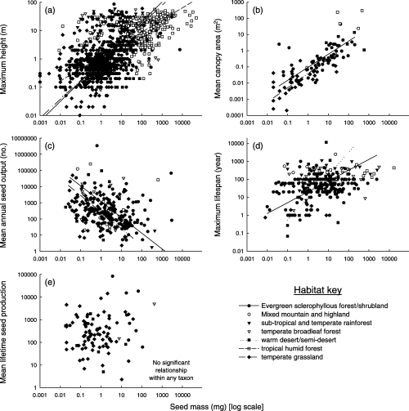
Competition-Colonization and Seed Traits

Slide 26
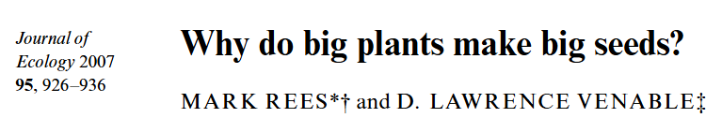
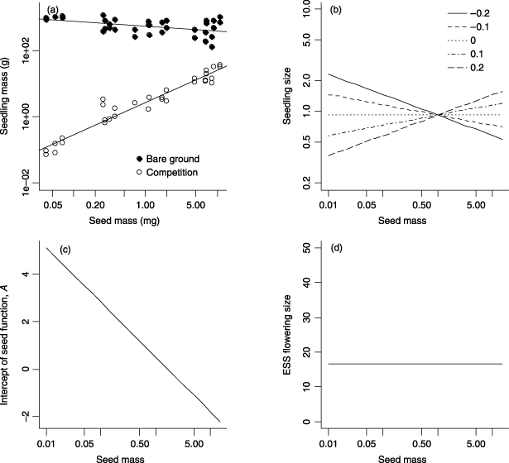
Competition-Colonization and Seed Traits

Slide 27
Competition-Colonization: Evidence
Mixed evidence
May be more important in some systems than others
Interacts with other coexistence mechanisms

Slide 28
Patch Heterogeneity
So far, we’ve assumed that patches are identical
However, this isn’t going to be the case in reality
Patch differences will also impact coexistence

Slide 29
Patch Heterogeneity - Distances
Different distances between patches
Coexistence via dispersal/fecundity trade-off
Dispersal Ability
Fecundity
Notes:
-more spatio-temporal than competition-colonization

Slide 30
Patch Heterogeneity - Distances
Superior disperser: does better in low-density patches
Superior reproducer: does better in high-density patches
Superior colonizer species are concentrated in low-density patches
Superior competitor species are concentrated in high-density patches
Increases a_{ii} relative to a_{ji}

Slide 31
Patch Heterogeneity - Distances
= Better disperser
= More fecund

Slide 32
Patch Heterogeneity - Quality
Different patch qualities
Coexistence via tolerance/fecundity trade-off
Tolerance
Fecundity

Slide 33
Patch Heterogeneity - Quality
Superior tolerator: does better in low-quality patches
Superior reproducer: does better in high-quality patches
Superior tolerator species are concentrated in low-quality patches
Superior reproducer species are concentrated in high-quality patches
Increases a_{ii} relative to a_{ji}

Slide 34
Patch Heterogeneity - Quality
Stress
= More tolerant
= More fecund

Slide 35
Patches and Coexistence
Tolerance
Dispersal
Dispersal
Fecundity
Fecundity
Competitive Ability
Notes:
You could also get competition via a tolerance-competitive ability trade-off

Slide 36
Patches and Coexistence
Tolerance
Competitive Ability
Tolerance
Dispersal
Dispersal
Fecundity
Fecundity
Competitive Ability

Slide 37
Patches and Coexistence
Tolerance
Common feature: trade-offs allow species to be concentrated in different patches.
Competitive Ability
Tolerance
Dispersal
Dispersal
Fecundity
Fecundity
Competitive Ability

Slide 38
Patches and conservation
These coexistence mechanisms may require disturbance to create empty patches
Thus the disturbance regime is critical
Too much OR too little disturbance can cause extinctions
Complicates management decisions

Slide 39
Next class: Metacommunities

