Slide 1
Species Interaction Networks
Tanya Strydom
University of Sheffield

Slide 2
Themes
Why Networks?
Networks 101
Constructing Food Webs
Measuring Networks
Information about the Part
Trophic Cascades
Where to next?

Slide 3
Why Networks?

Slide 4
What can we learn?
Population -> Community -> Ecosystem
How does a part fit into the whole
Invasive species (rewilding)
Extinctions
Diets
Dynamics: no species is an island
Propagation of change/stress
Top-down/bottom-up control
Species persistence/co-existence (stability)
Notes:
Insights as to the bigger picture - link between population and ecosystem level processes
Idea that there is information at a ‘static scale’ that is still meaningful e.g. what is the diet breadth of a spp?
But there is also power in the dynamics -> which is sort of the goal in ecology?

Slide 5
Networks 101

Slide 6
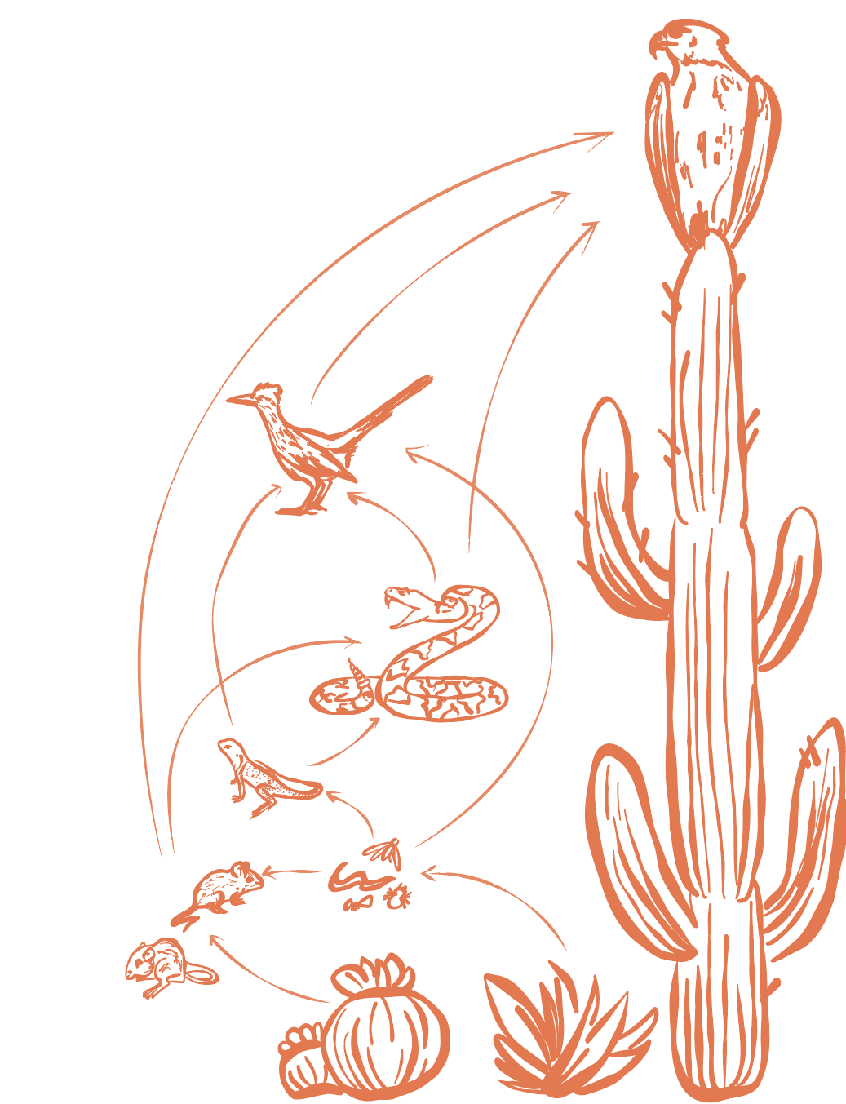
Node
(species/
individual/
trophic species)
Edge
(interaction)
Adjacency Matrix
Networks 101

Slide 7
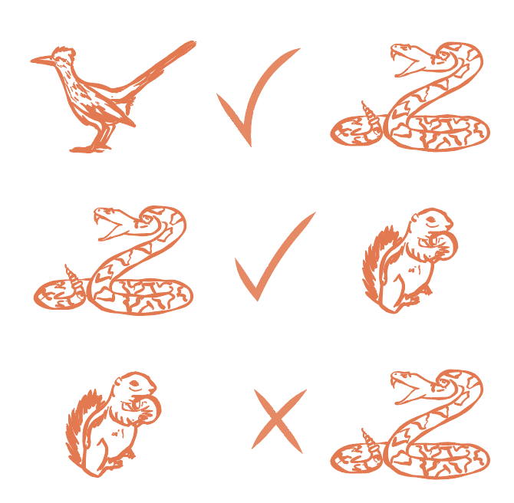
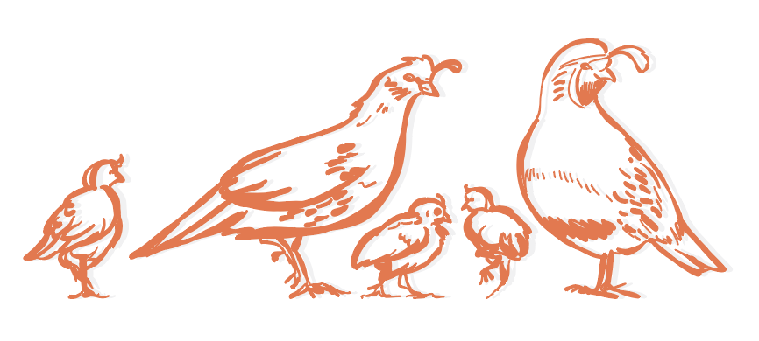
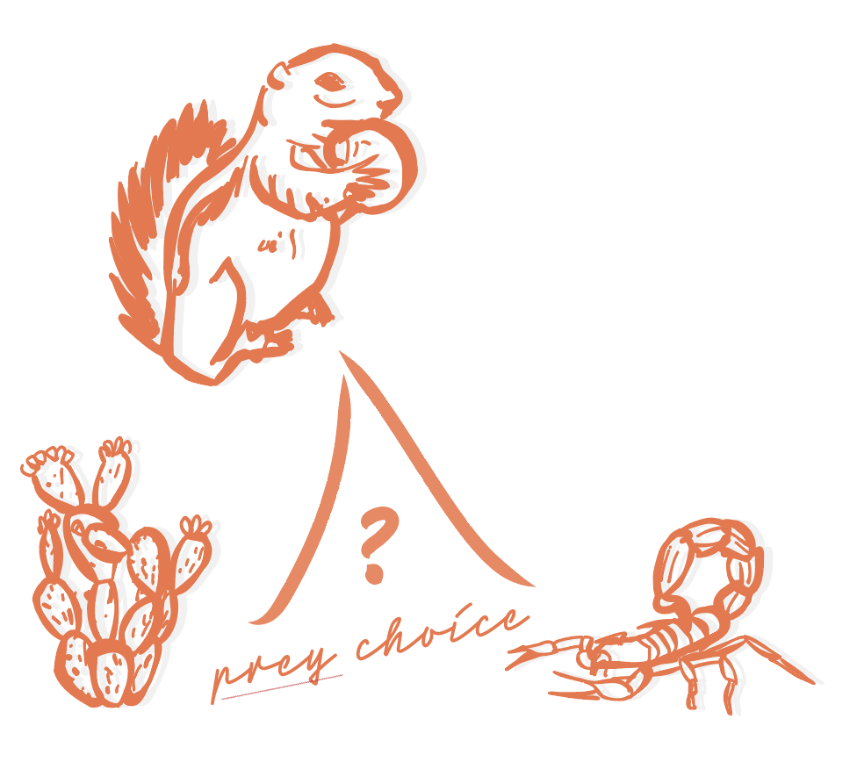

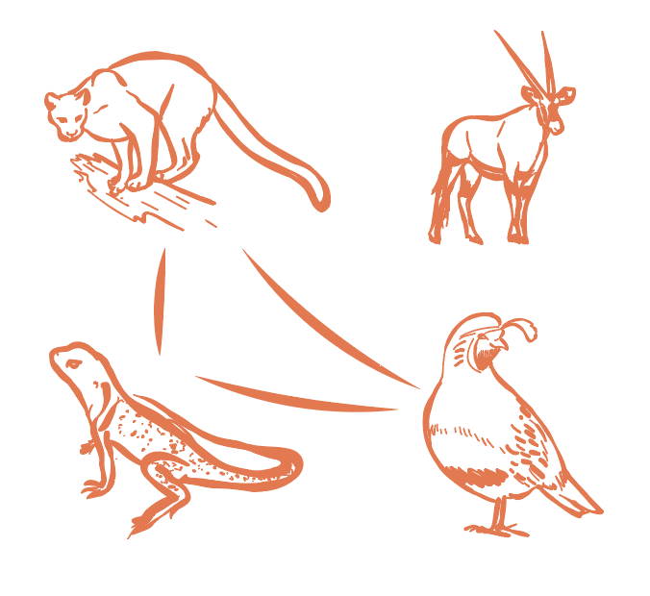
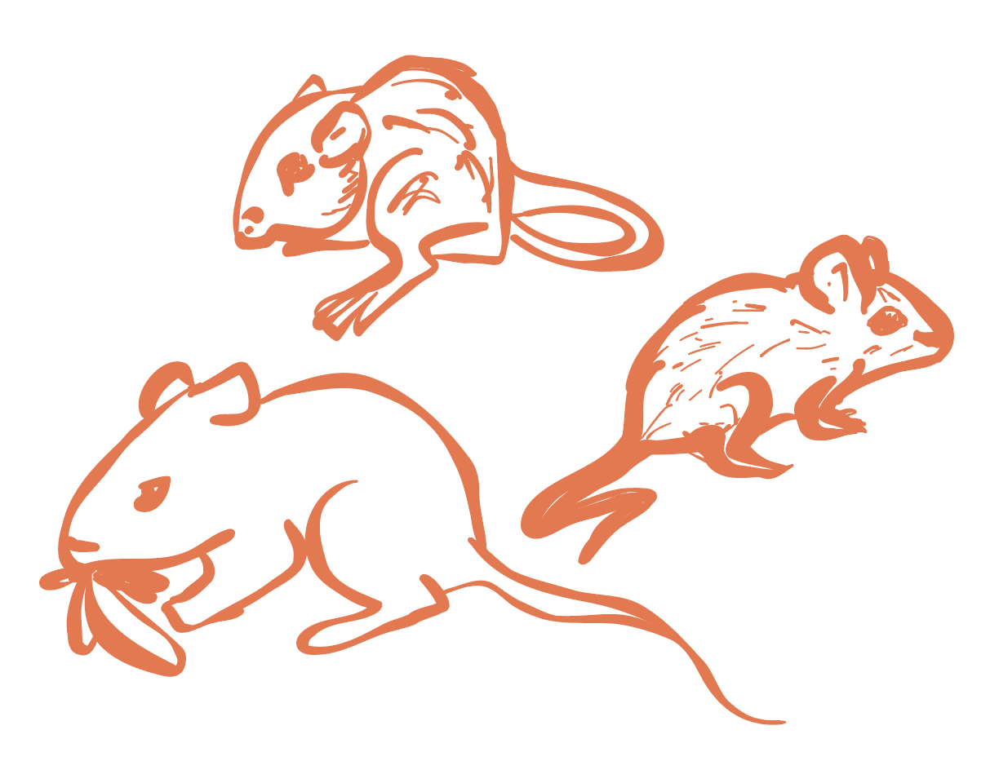
NODES
EDGES
Potential
feeding
links
Species
Quantifying an edge
Binary
Probabilistic
Quantitative
Feeding
preference
Individuals
Trophic
species
Spatial
associations
Same predators and prey
Co-occurrence networks
Networks 101

Slide 8
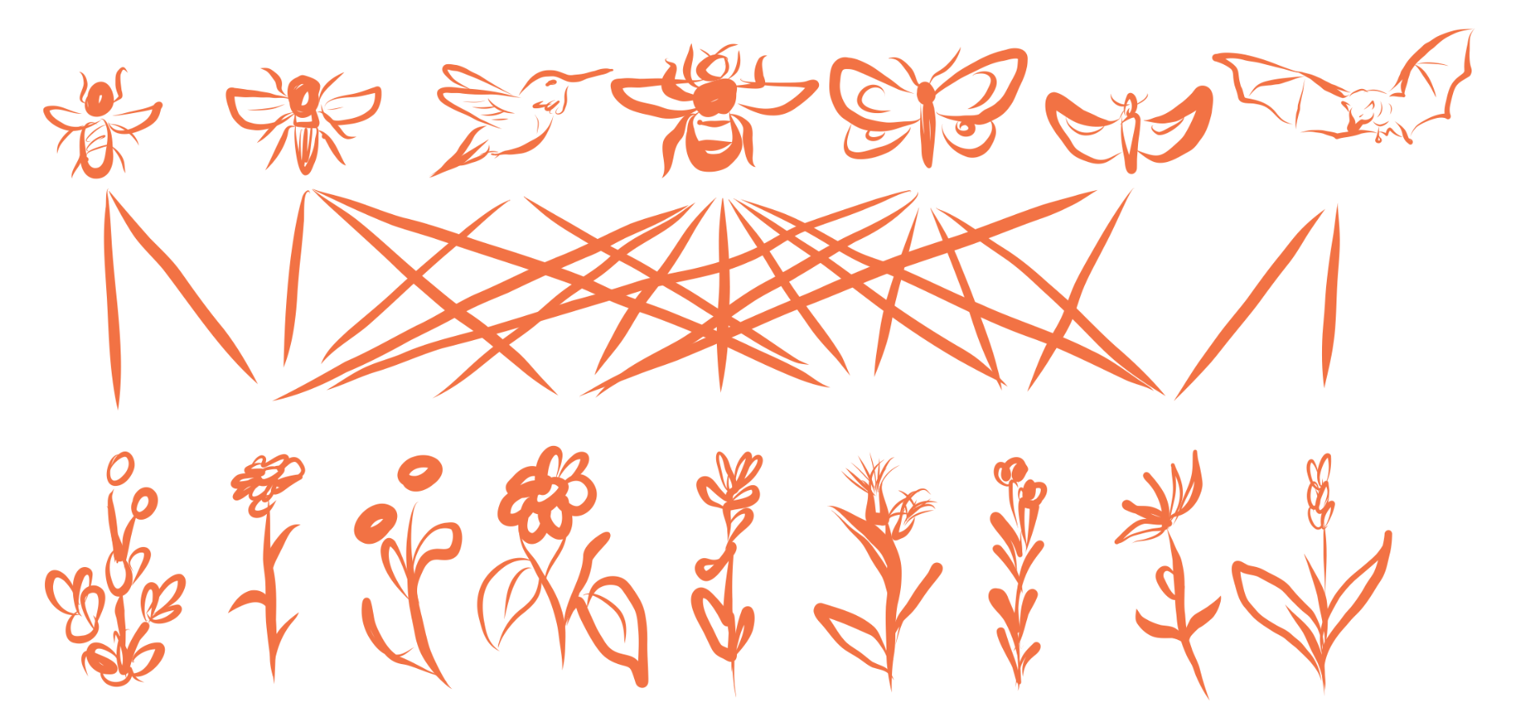
Types of Networks
FOOD WEBS
NON TROPHIC
Plant-pollinator, host-parasite, plant-herbivore
Networks 101

Slide 9
Types of Networks
FOOD WEBS
UNIPARTITE
NON TROPHIC
Plant-pollinator, host-parasite, plant-herbivore
BIPARTITE
Networks 101

Slide 10
Types of Networks
FOOD WEBS
METAWEB
NON TROPHIC
Who can eat who?
Plant-pollinator, host-parasite, plant-herbivore
REALISED WEB
What does a predator choose to eat
Networks 101

Slide 11
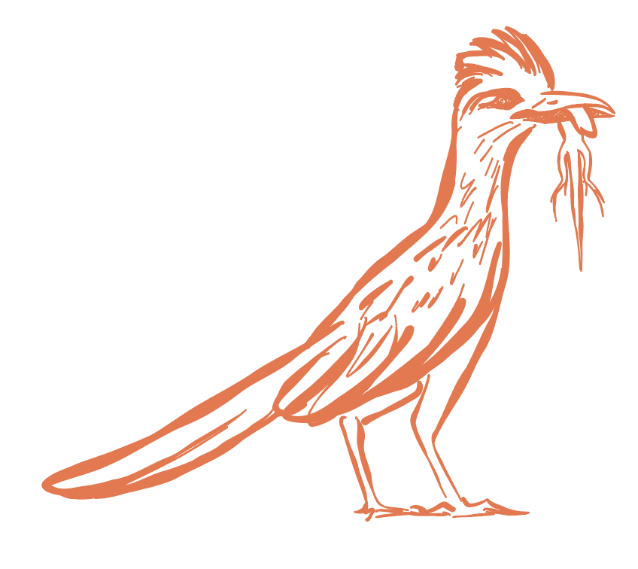
Takeaways
It is possible to encode completely different processes within a network

Slide 12
Constructing Food Webs

Slide 13
A two-body problem
A need for real world data
The development of theory and concepts
Notes:
Mismatch between me and Andrew - its not opposing theories but different lines of query

Slide 14
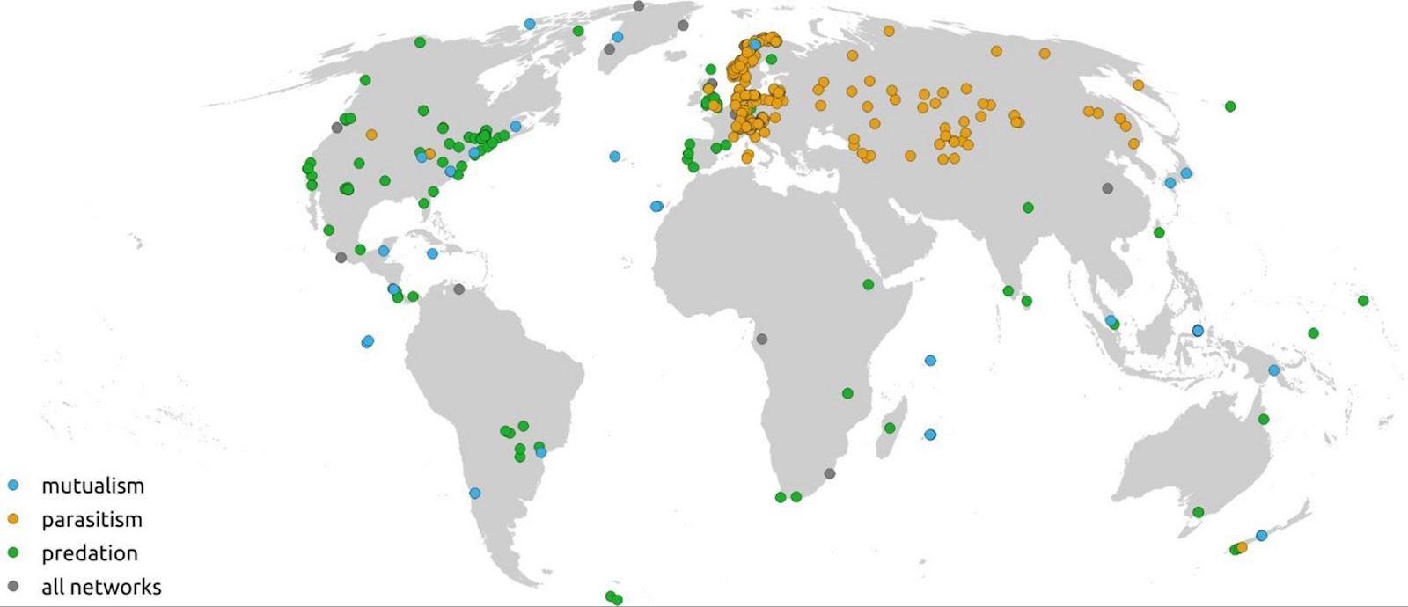
The Challenge: Observing interactions is hard!
Poisot et al. (2021) Global Change
Constructing Food Webs

Slide 15
Predicting Interactions: Mechanistic Models
Construct metawebs
Does sp_{a} have the capacity to eat sp_{b}?
Assumption that ‘feeding rules’ determine interactions
Rules can be defined a priori^{[1]}
Inferred from known networks^{[2,3]}
Use of ecological proxies (e.g., phylogeny)^{[4,5]}
Constructing Food Webs

Slide 16
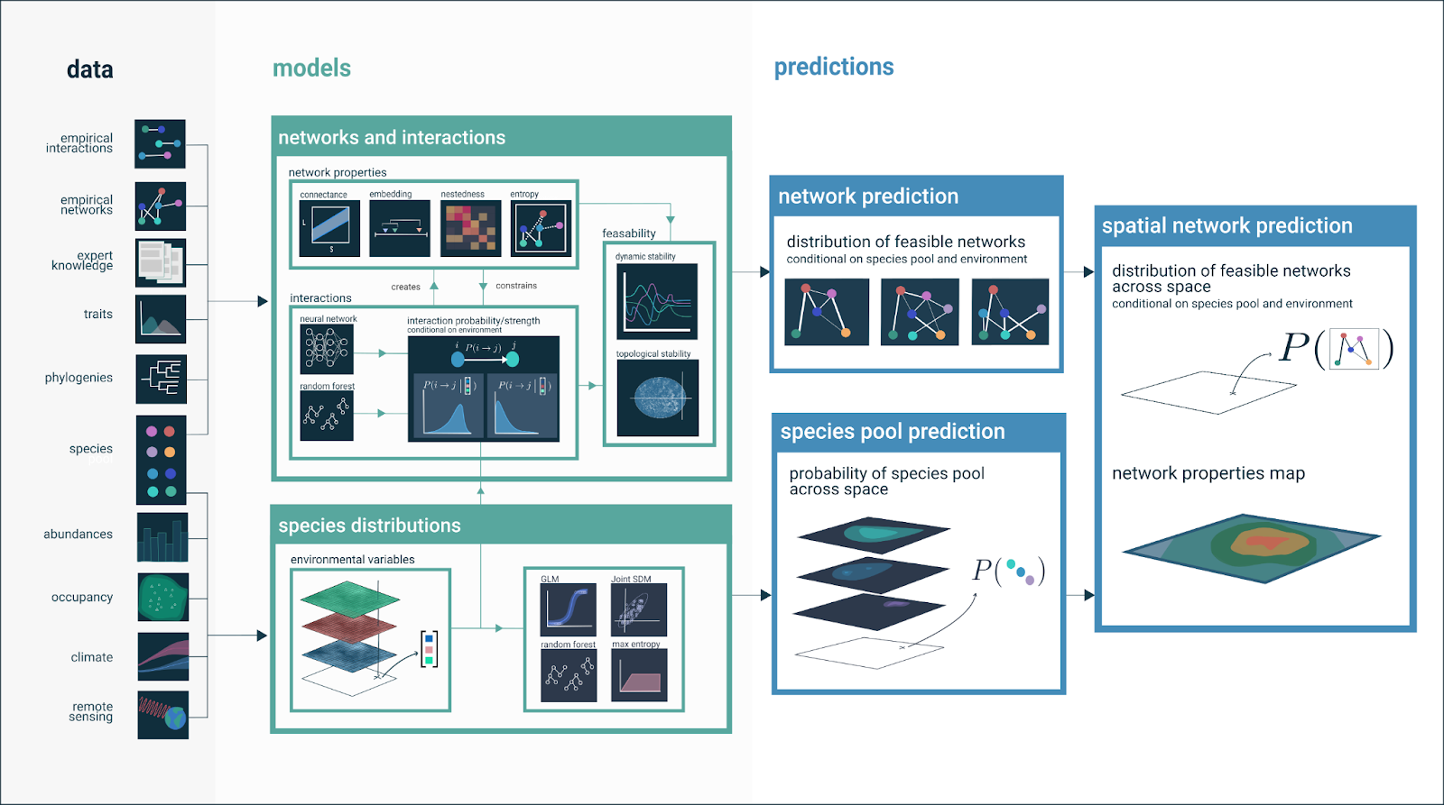
Strydom & Catchen et al. (2021) Phil. Trans. B
Constructing Food Webs

Slide 17
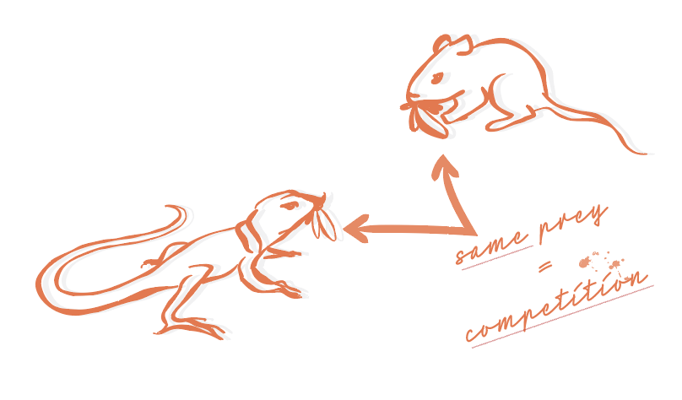
Predicting Interactions: Deductive Models
Construct realised webs
Reflect the realisation of feasible links
Intersection of profitability, abundance, non-consumptive interactions
Foraging ecology^{[6,7]}
Allometry (body size)^{[8]}
Dynamic
Constructing Food Webs

Slide 18
Predicting Structure
Construct topologies
Assumptions of expected structure of a network (distribution of links)
Random
Neutral (abundance)
Stochastic^{[9]}
Constructing Food Webs

Slide 19
Predicting Networks: The Divergence
Structure = ‘real’
Interaction
= ‘real’
Currencies
Use: Theory v. applied
Scale: Realised v. bigger picture
‘Accuracy’: Model v. reality
OK but who should we ‘believe’?
Constructing Food Webs

Slide 20
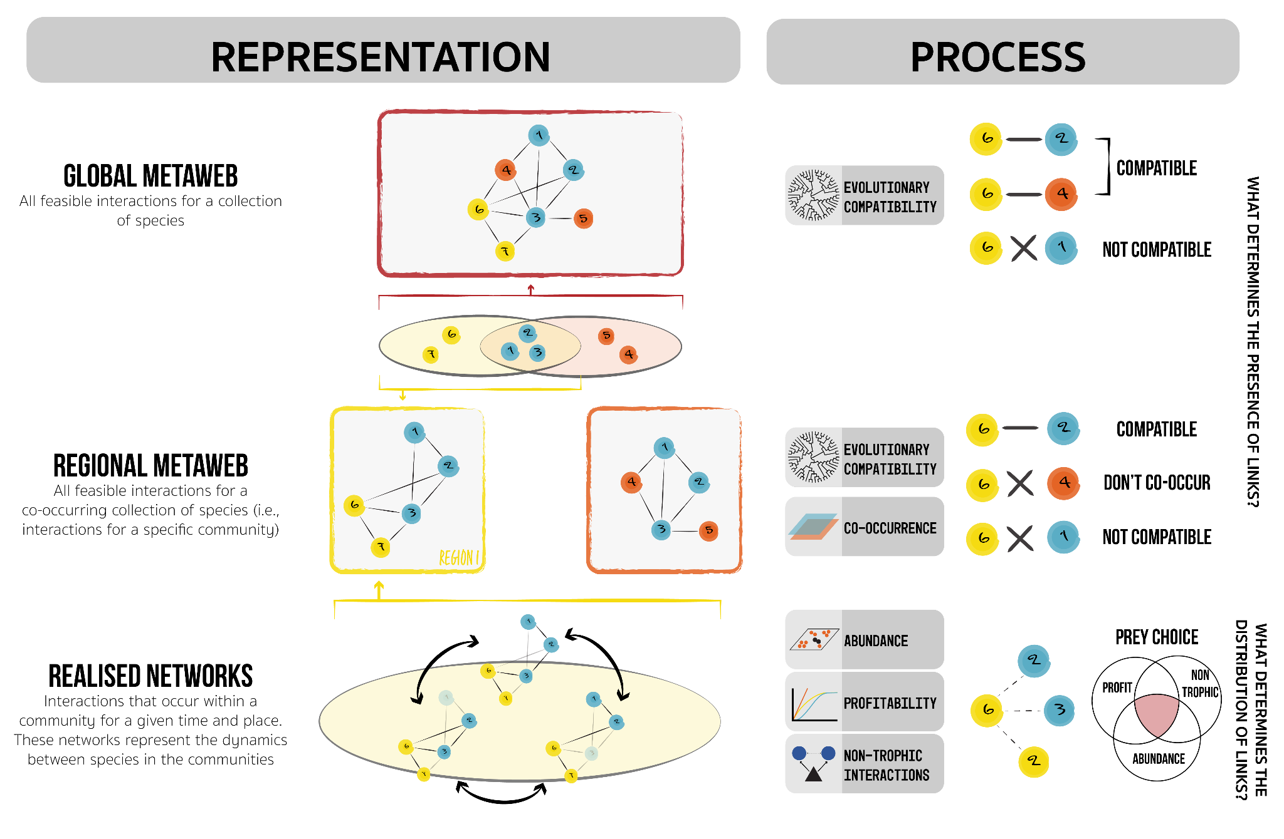
Constructing Food Webs

Slide 21
What are the opportunities that different network representations afford us?
Metawebs | Realised webs | Topological webs
‘Global overview’ Who *could* eat who? ‘Condition invariant’ Full breadth - fundamental niche On the ground applications? Data light, easy to obtain | Here and now Who *chooses* to eat who Dynamic - depends on bigger community/environment context ‘Realized niche’ Structure realistic - actual energy flows/pathways && species info | Useful in theoretical scenarios/contexts Real world abstraction - operate in synthetic space Structure = informative -> ecosystem level processes
Constructing Food Webs

Slide 22
Takeaways
Prediction vs Modelling
Different families/approaches
Different end uses

Slide 23
Measuring Networks^{[10]}
Notes:
Mental shift as if we didn’t just have an existential crisis over network definitions

Slide 24

It’s not just about diets
What can we learn from network structure?
The role of species?
Notes:
Mismatch between me and Andrew - its not opposing theories but different lines of query

Slide 25
Macro
(Whole network)
Connectance
Diameter
Trophic levels
Nestedness
Modularity
Complexity
Redundancy
Micro
(Species)
Specificity
Centrality
Degree
Generality
Vulnerability
Meso
(‘Units’)
Motifs^{[Stouffer]}
Path length
Measuring Networks

Slide 26
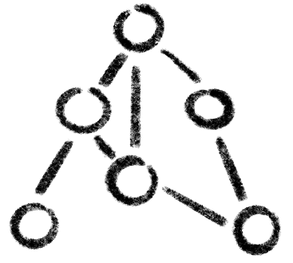
Structure = ‘real’
Interaction
= ‘real’
Are certain properties only relevant for certain types of networks?
Measuring Networks

Slide 27
Takeaways
Information at different scales
Properties inform on behaviour of system

Slide 28
From networks to the ‘real world’

Slide 29
Information about the part

Slide 30
Propagation of change
Change
Changes in one node propagate through the network.
Information about the part

Slide 31
Extinctions
Primary Extinction
Secondary Extinctions
Information about the part

Slide 32
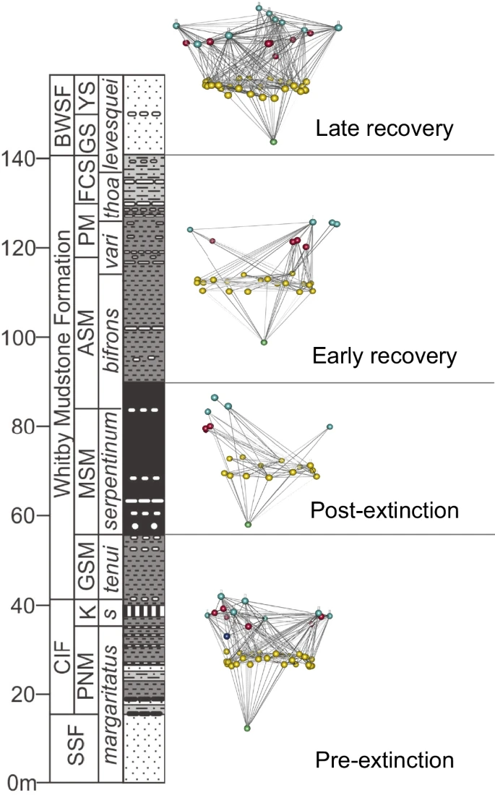
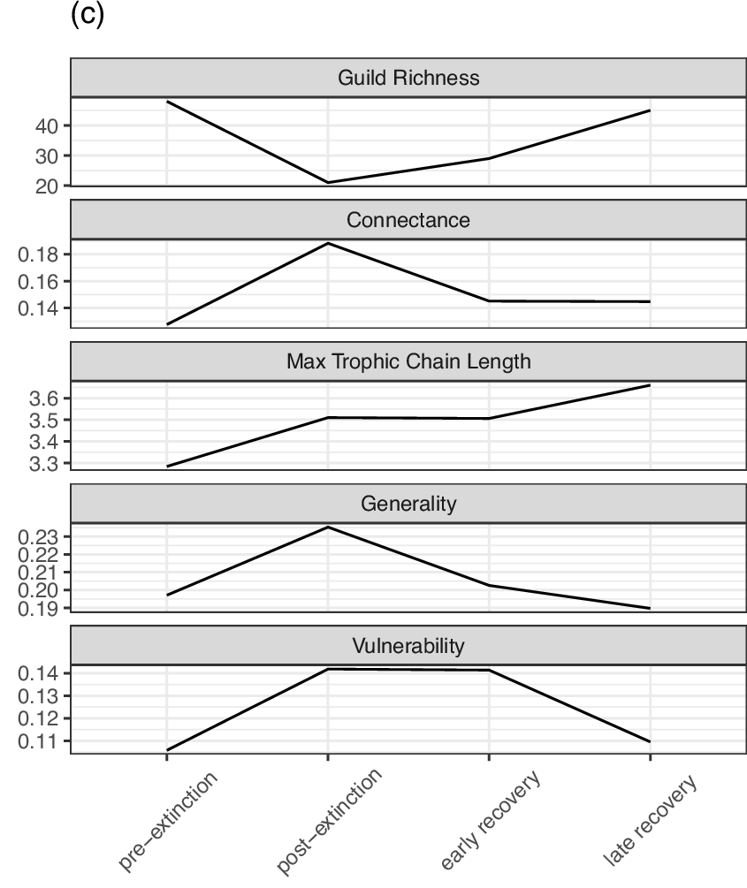
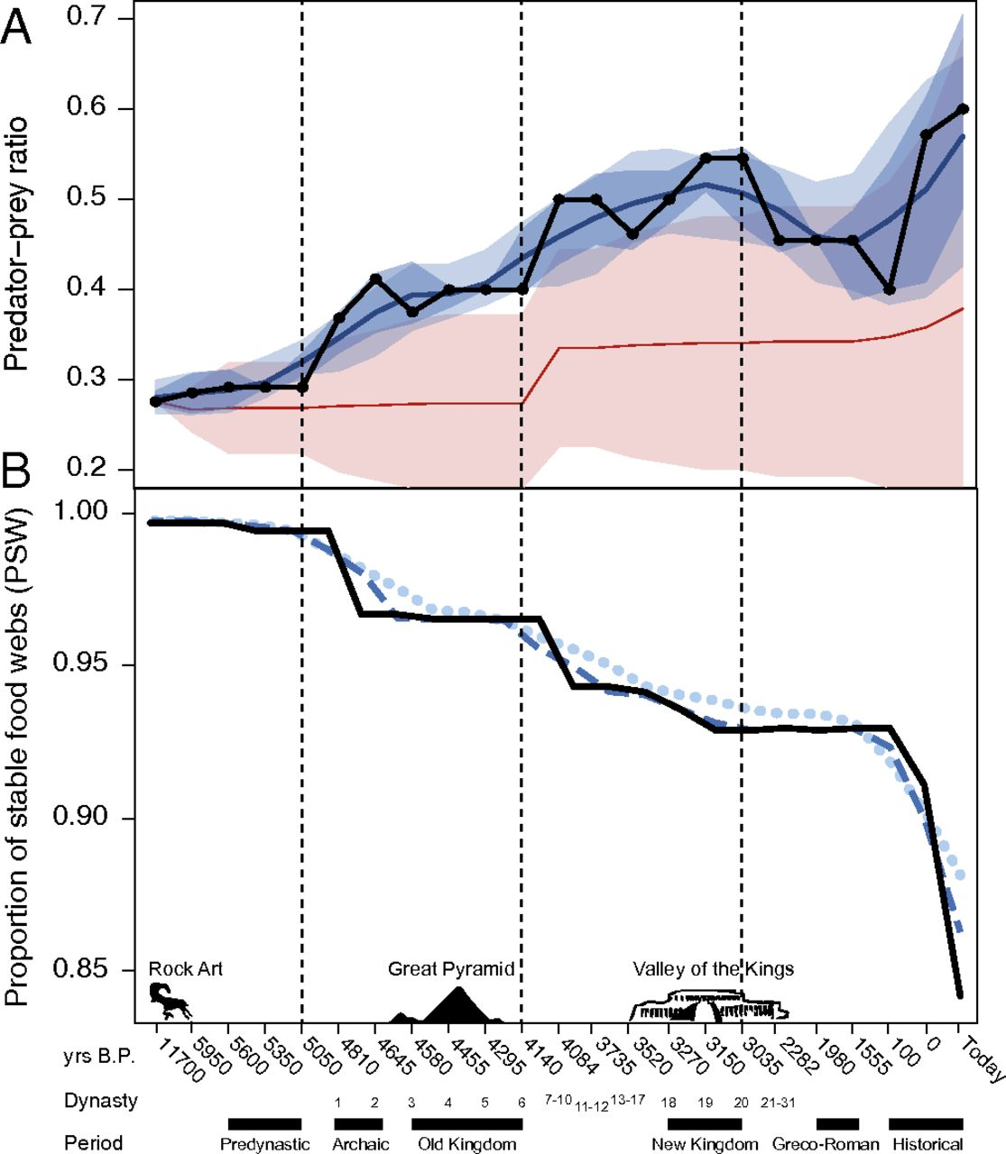
Extinctions
Community collapse
Mass extinctions
Yeakel et al. (2014) PNAS
Dunhill et al. (2024) Nat. Comms.
Information about the part

Slide 33
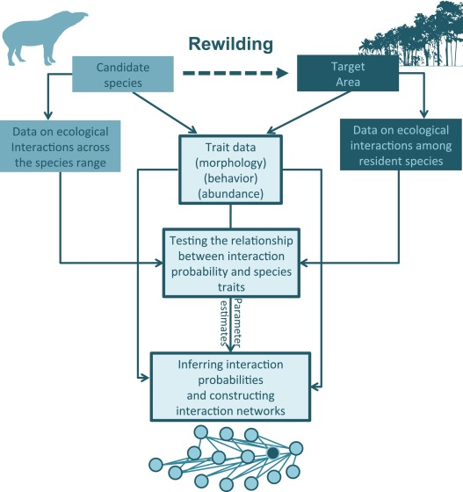
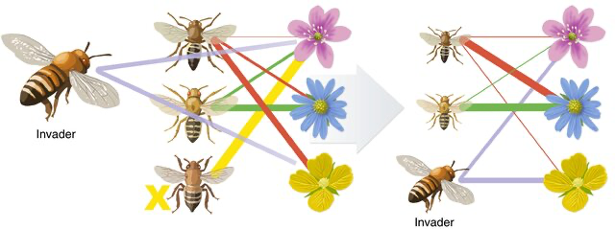
‘Invasions’
Adding species to a community
What are the knock-on effects?
Pires. (2017) Perspectives Eco & Cons
Valdovinos (2019) Eco. Lett.
Information about the part
Notes:
Also worth mentioning biotic control of invasions. Things can go wrong…

Slide 34
Trophic Cascades

Slide 35
Checks and balances
Top-down (Hairston Smith Slobodkin, 1960)
Carnivores
Herbivores
Plants
Who keeps who in line. Changes in the part leads to changes in the whole.
Bottom-up (Elton, 1927)
Trophic Cascades

Slide 36
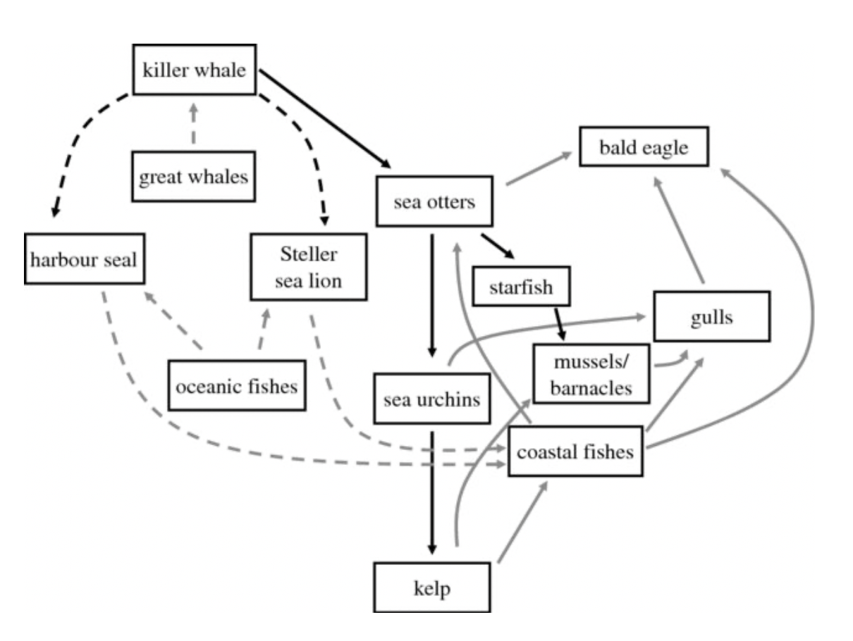
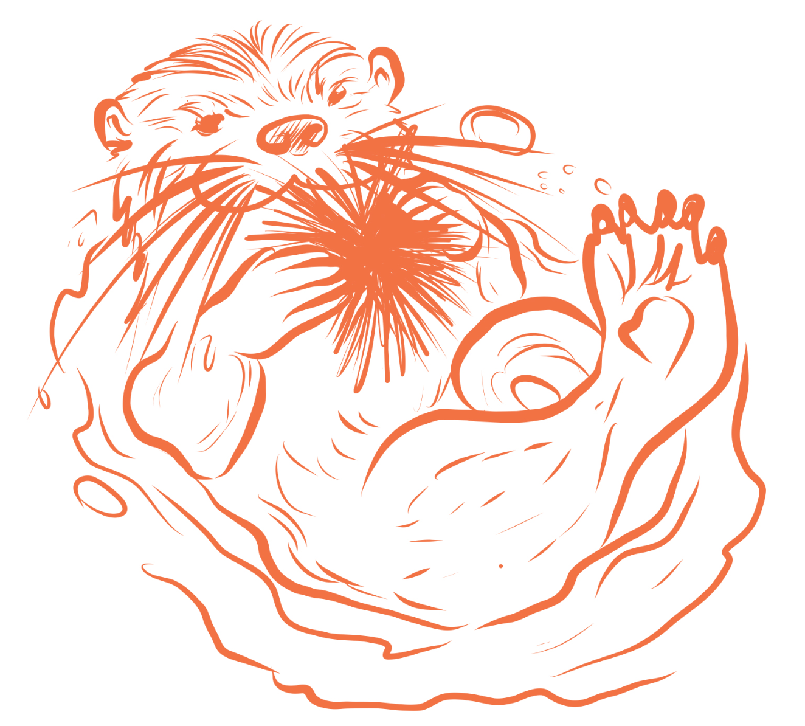
Kelp forests and sea otters
Estes et al. (2009) Phil. Trans. B
Trophic Cascades

Slide 37
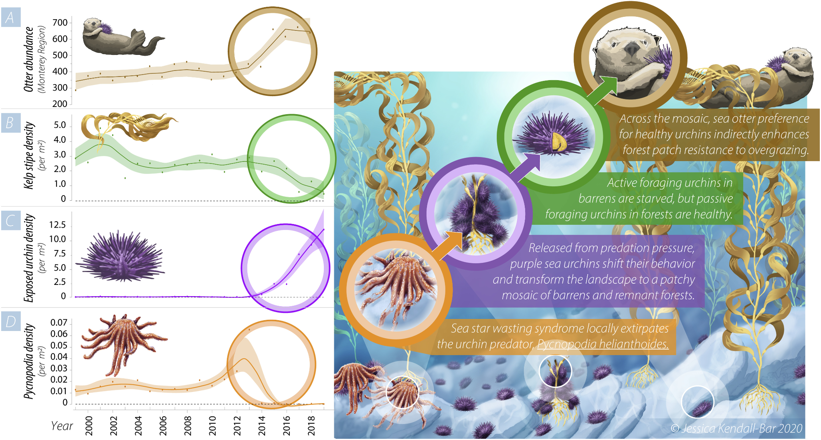
Foraging behaviour
Trophic Cascades
Smith et al. (2021) PNAS

Slide 38
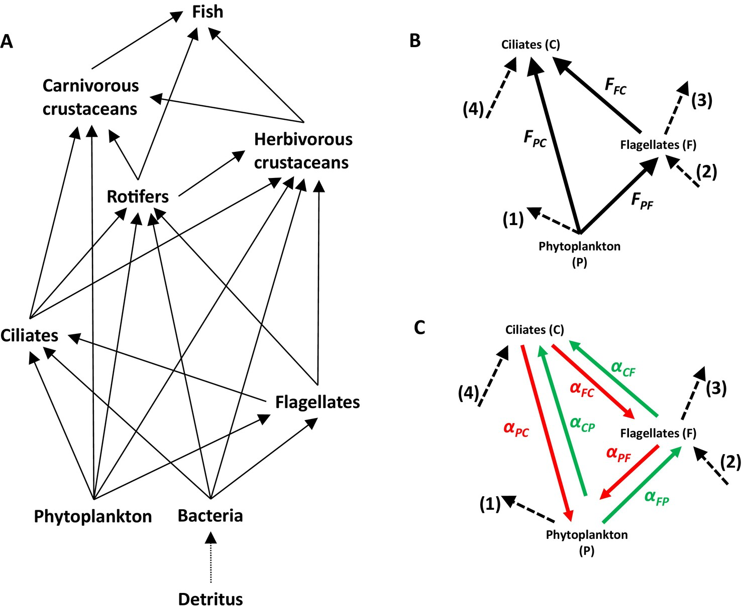
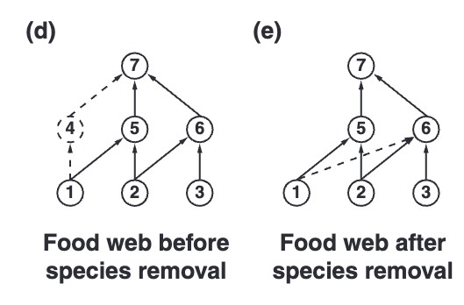
If dynamic why are networks stable?
Rewiring
Changes in interaction strength
Gaedke et al. (2025) Eco. Lett.
Staniczenko et al. (2010) Eco. Lett.
Trophic Cascades

Slide 39
Takeaways
Networks give multi-species insights on populations
Populations are dynamic but networks remain stable

Slide 40
Where to next?

Slide 41
Methodological Development
Estimating both feasibility and realisation of links
Incorporating interaction strength
Appropriate unit of scale?
How do we validate our models or predictions?
Making networks more tractable in an applied space - what can ‘boots on the ground’ conservation use?
Networks in other facets of ecology -> joint SDMS, biogeography
Where to next?

Slide 42
Theoretical development
Reinforcing old questions in ecology: coexistence, top-down v. bottom up
Scaling up the stability-diversity-productivity discussion to complex communities
Novel communities under climate change - the role of ‘invasions’ and re-wiring
COmbining socioeconomic and biological networks
Where to next?

Slide 43
References
Morales-Castilla, Ignacio, Miguel G. Matias, Dominique Gravel, and Miguel B. Araújo. 2015. “Inferring Biotic Interactions from Proxies.” Trends in Ecology & Evolution 30 (6): 347–56. https://doi.org/10.1016/j.tree.2015.03.014
Stock, Michiel, Timothée Poisot, Willem Waegeman, and Bernard De Baets. 2017. “Linear Filtering Reveals False Negatives in Species Interaction Data.” Scientific Reports 7 (April): 45908. https://doi.org/10.1038/srep45908.
Poisot, Timothée, Marie-Andrée Ouellet, Nardus Mollentze, Maxwell J. Farrell, Daniel J. Becker, Liam Brierley, Gregory F. Albery, Rory J. Gibb, Stephanie N. Seifert, and Colin J. Carlson. 2023. “Network Embedding Unveils the Hidden Interactions in the Mammalian Virome.” Patterns 4 (6): 100738. https://doi.org/10.1016/j.patter.2023.100738.
Caron, Dominique, Luigi Maiorano, Wilfried Thuiller, and Laura J. Pollock. 2022. “Addressing the Eltonian Shortfall with Trait-Based Interaction Models.” Ecology Letters 25 (4): 889–99. https://doi.org/10.1111/ele.13966.
Strydom, Tanya, Salomé Bouskila, Francis Banville, Ceres Barros, Dominique Caron, Maxwell J. Farrell, Marie-Josée Fortin, et al. 2022. “Food Web Reconstruction Through Phylogenetic Transfer of Low-Rank Network Representation.” Methods in Ecology and Evolution 13 (12): 2838–49. https://doi.org/10.1111/2041-210X.13835.
Petchey, Owen L., Andrew P. Beckerman, Jens O. Riede, and Philip H. Warren. 2008. “Size, Foraging, and Food Web Structure.” Proceedings of the National Academy of Sciences 105 (11): 4191–96. https://doi.org/10.1073/pnas.0710672105.
Beckerman, Andrew P., Owen L. Petchey, and Philip H. Warren. 2006. “Foraging Biology Predicts Food Web Complexity.” Proceedings of the National Academy of Sciences 103 (37): 13745–49. https://doi.org/10.1073/pnas.0603039103.
Brose, Ulrich, Richard J. Williams, and Neo D. Martinez. 2006. “Allometric Scaling Enhances Stability in Complex Food Webs.” Ecology Letters 9 (11): 1228–36. https://doi.org/10.1111/j.1461-0248.2006.00978.x.
Williams, Richard J., and Neo D. Martinez. 2000. “Simple Rules Yield Complex Food Webs.” Nature 404 (6774): 180–83. https://doi.org/10.1038/35004572.
Delmas, Eva, Mathilde Besson, Marie-Hélène Brice, Laura A. Burkle, Giulio V. Dalla Riva, Marie-Josée Fortin, Dominique Gravel, et al. 2019. “Analysing Ecological Networks of Species Interactions.”Biological Reviews 94 (1): 16–36. https://doi.org/10.1111/brv.12433.

