Slide 1
Trait-based Ecology IV
Today’s Agenda:
Quiz
Traits and global change

Slide 2
Why focus on traits?
Generality:
Rather than focusing on particular species in particular systems, we can say things about all species in all systems (or at least a larger subset of species/systems).
Quantitative:
We move from species (categorical) to continuous measurements
Links to mechanism
We can focus on traits that are linked to particular mechanisms
E.g., if we want to work on predation, mouth size might be useful.
More predictive
Allow us to say something about potential future scenarios

Slide 3
Why focus on traits?
Generality:
Rather than focusing on particular species in particular systems, we can say things about all species in all systems (or at least a larger subset of species/systems).
Quantitative:
We move from species (categorical) to continuous measurements
Links to mechanism
We can focus on traits that are linked to particular mechanisms
E.g., if we want to work on predation, mouth size might be useful.
More predictive
Allow us to say something about potential future scenarios

Slide 4
Traits and global change
Overview
What traits?
How will species respond to climate change?
Fire regime shifts?
Which species are humans impacting?

Slide 5
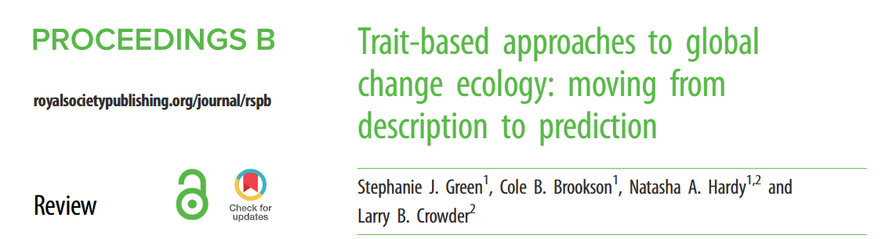
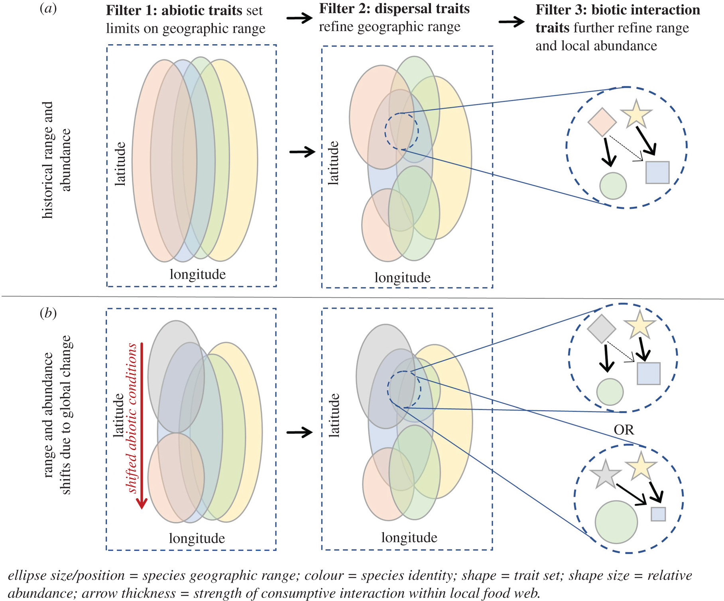
Traits and global change

Slide 6
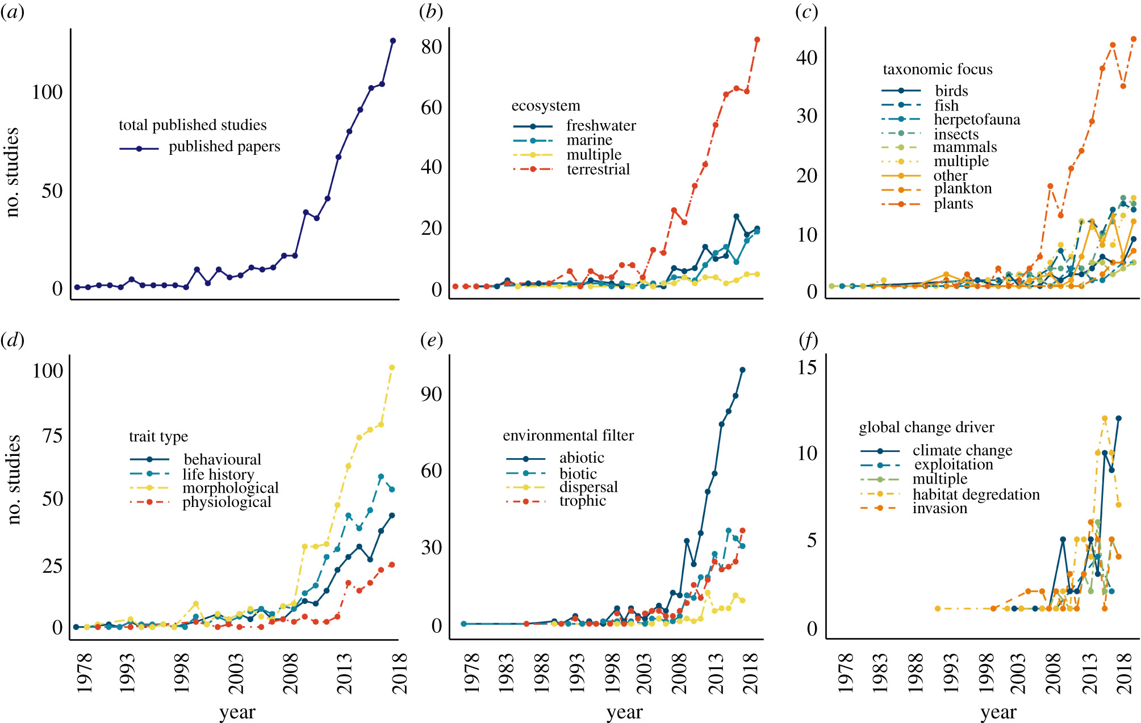
Traits and global change

Slide 7
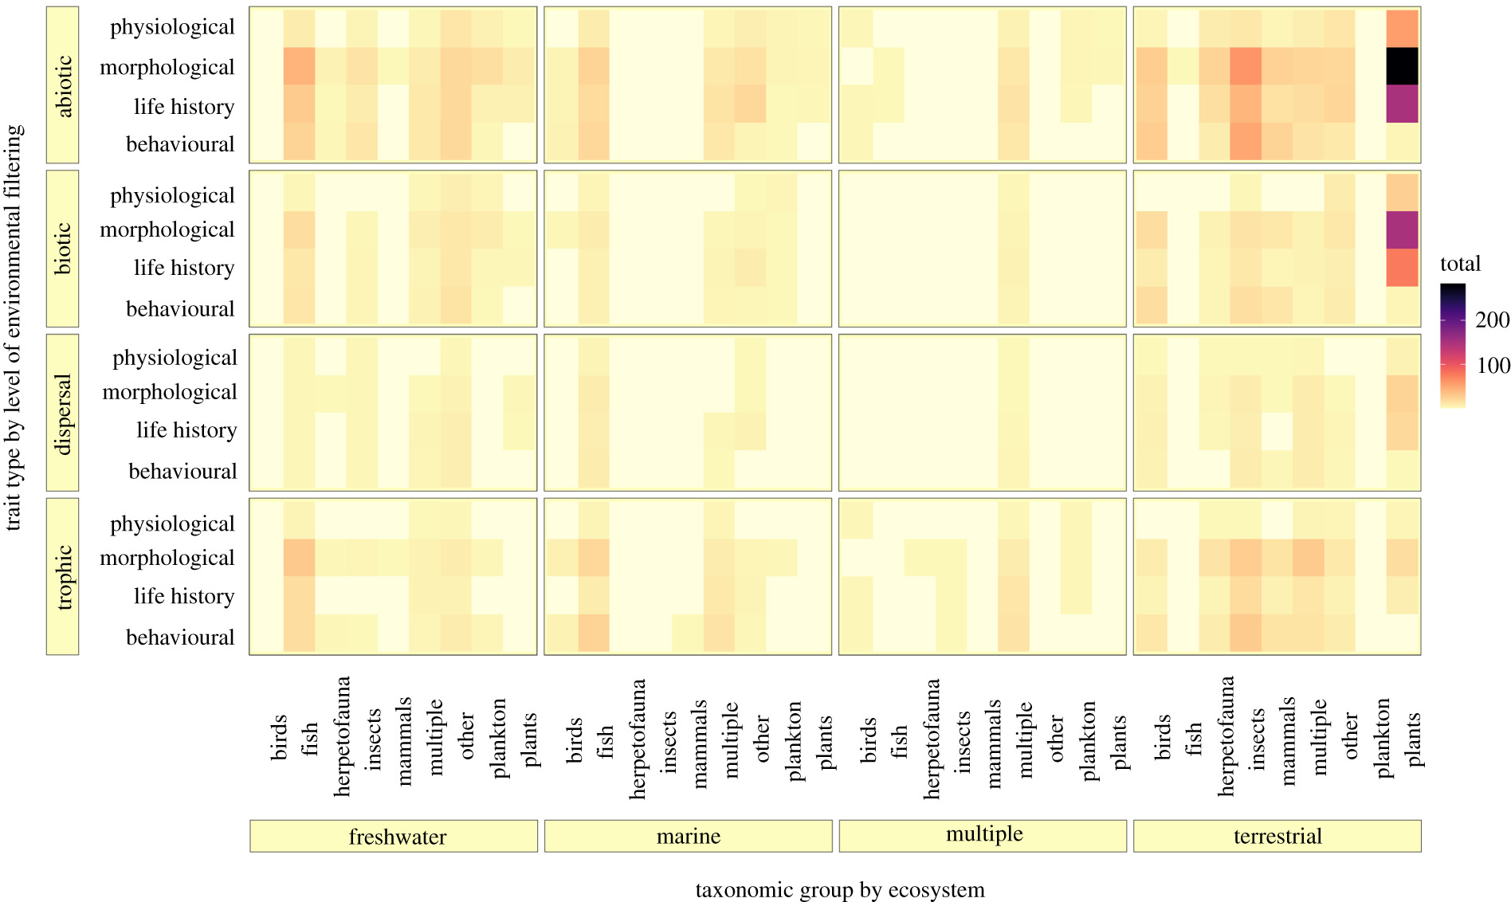
Traits and global change

Slide 8
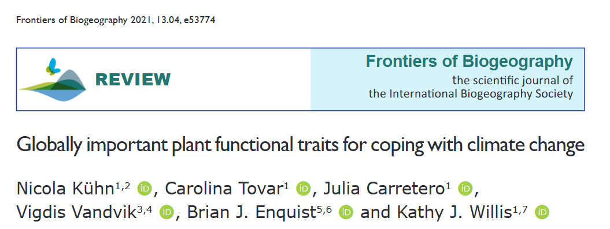
What traits should we measure?
Literature review of 10 years worth of papers

Slide 9
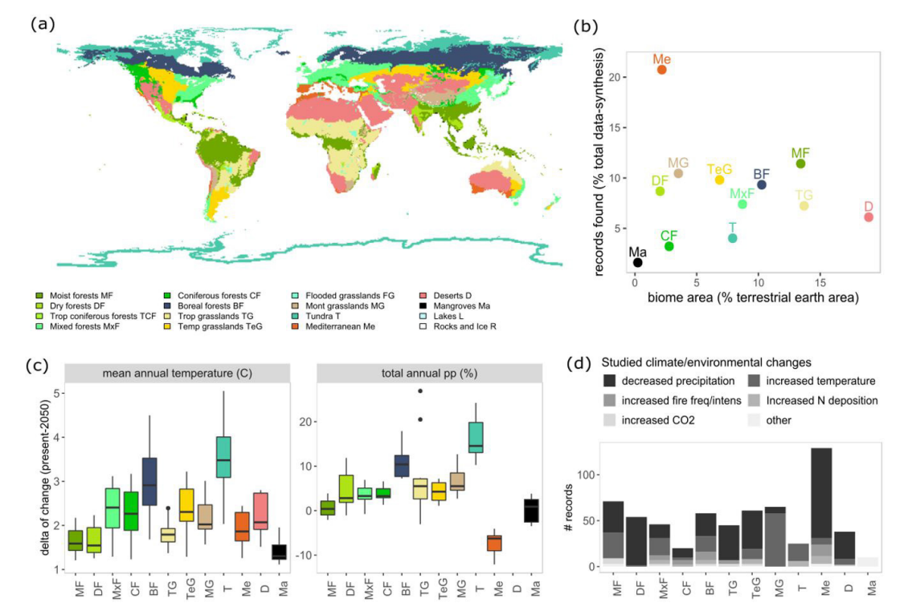
What traits should we measure?
Biases in what we’re studying

Slide 10
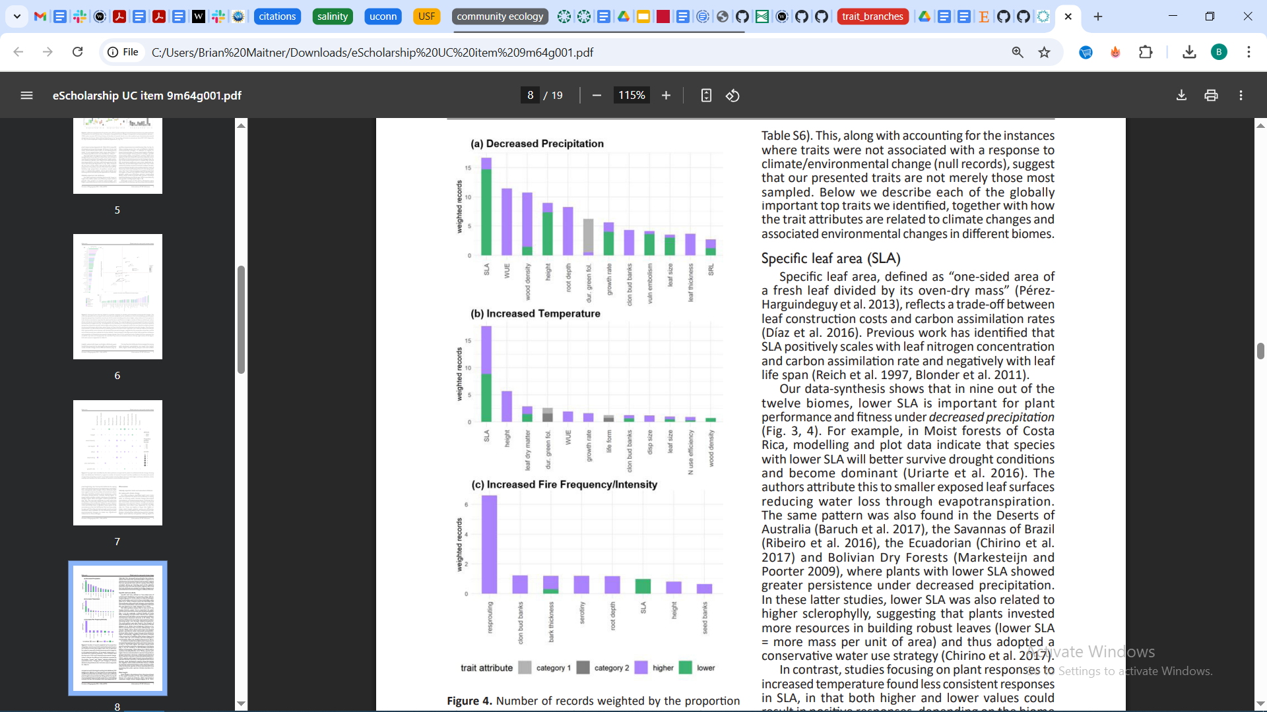
What traits should we measure?

Slide 11
What traits should we measure?

Slide 12
What traits should we measure?

Slide 13
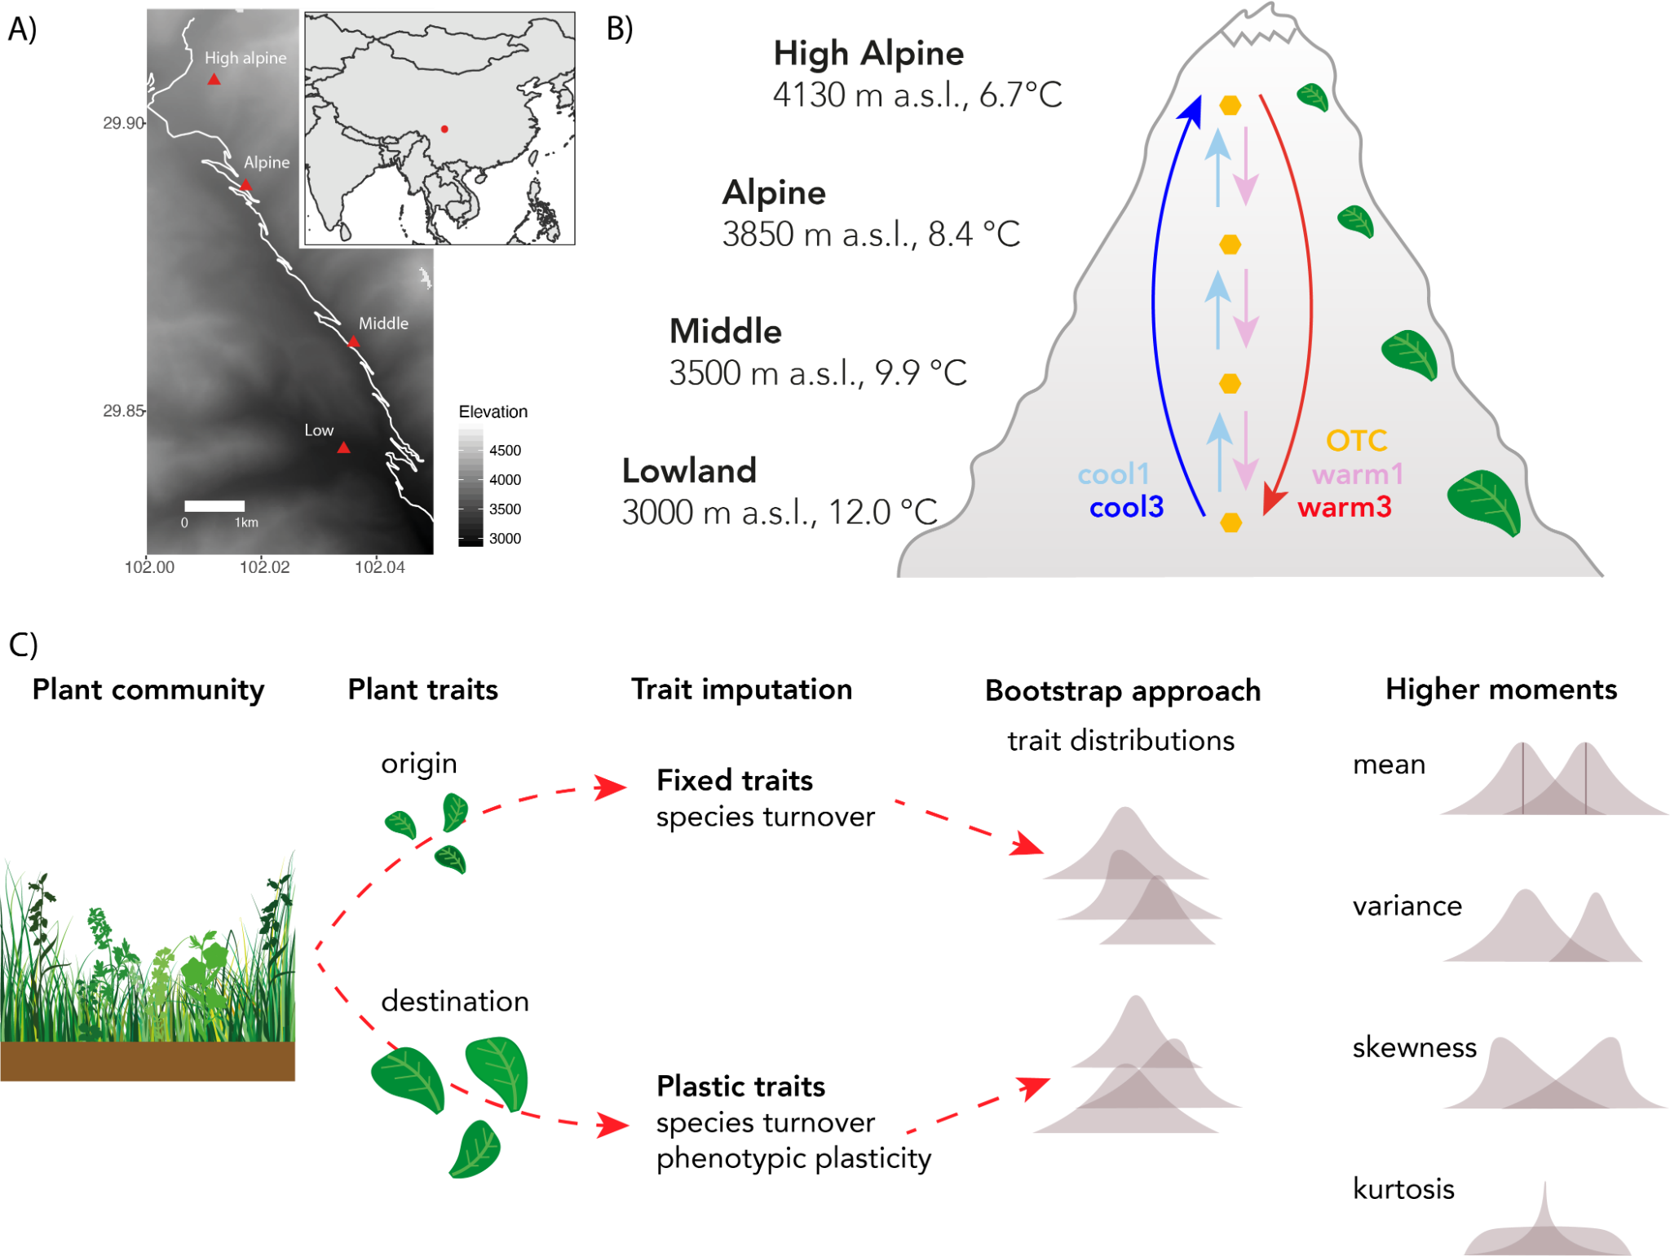
Predicting traits

Slide 14
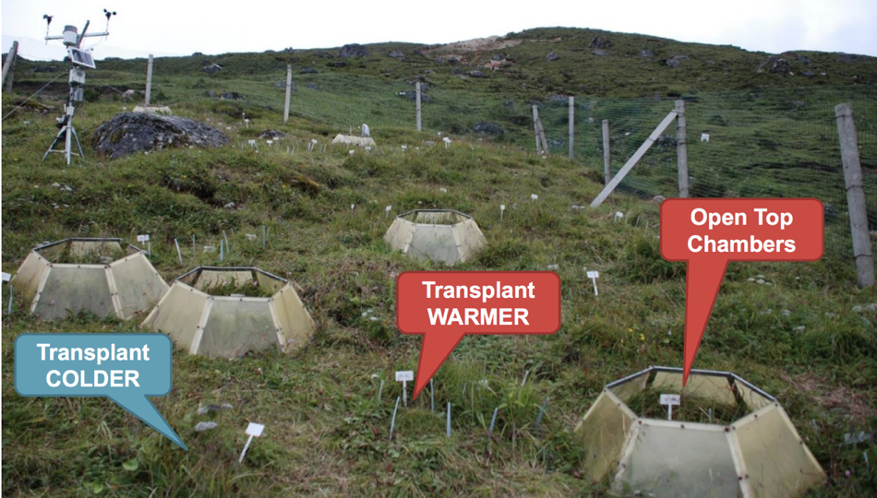
Predicting traits

Slide 15
Predicting traits
Compared three approaches:
Gradients
Transplants
OTCs

Slide 16
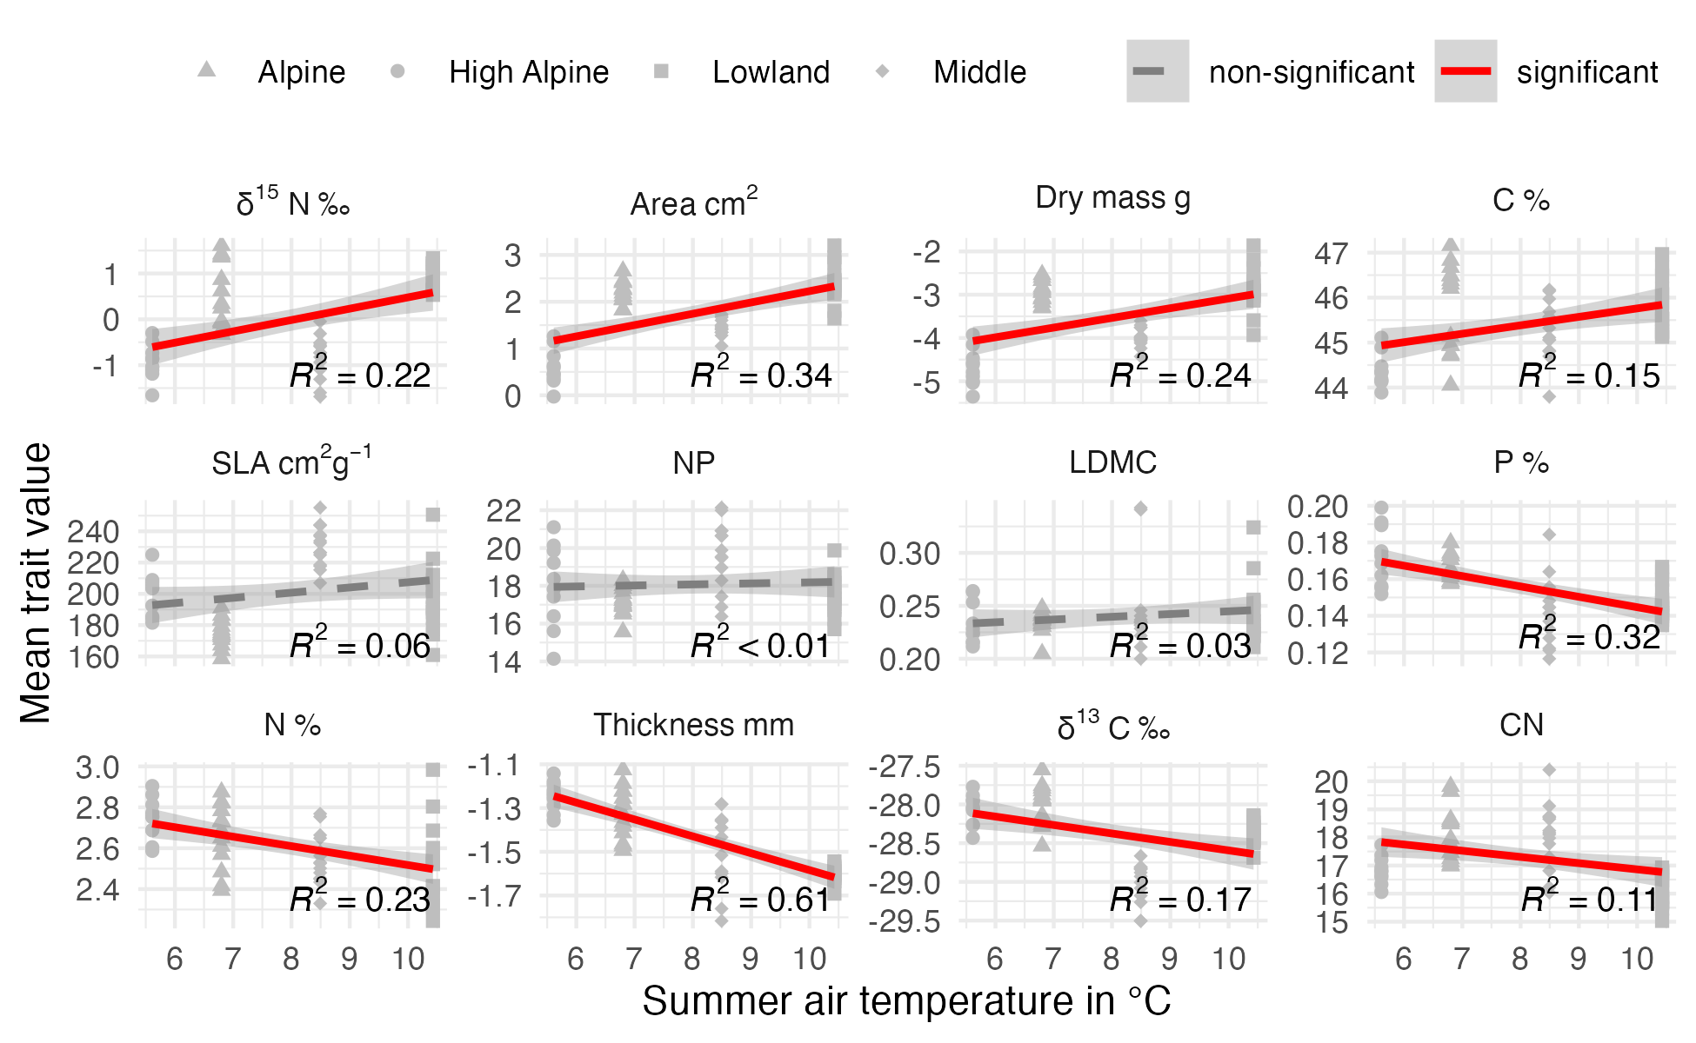
Predicting traits
Gradient patterns:

Slide 17
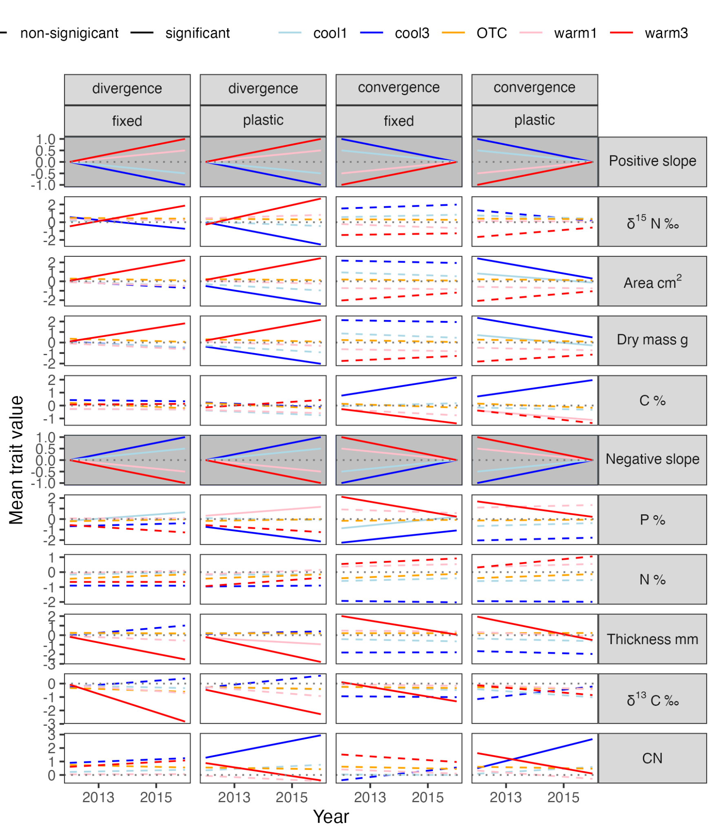
Predicting traits
Expected patterns from gradient

Slide 18
Predicting traits

Slide 19
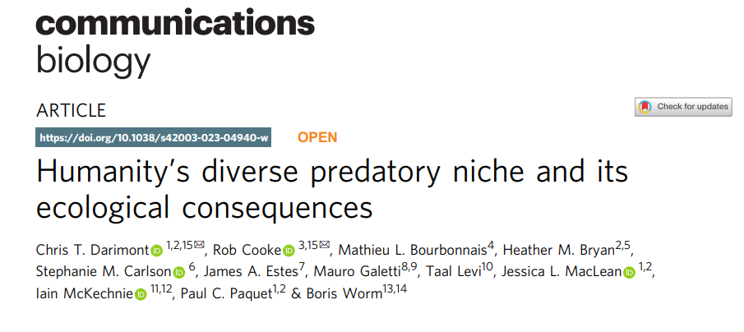
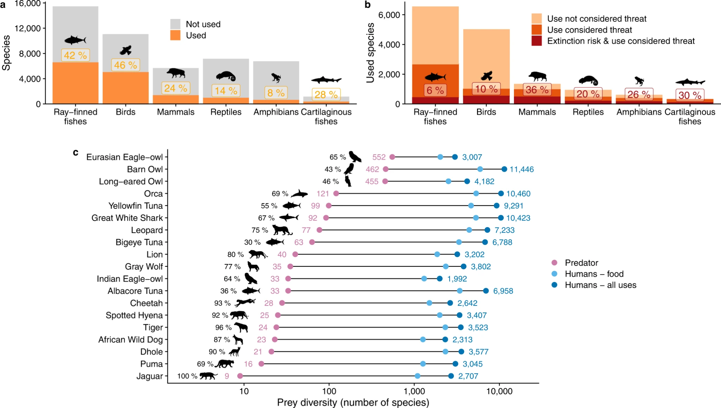
Traits and humans

Slide 20
Traits and humans
Notes:
Note: human usage is constrained by the animal ranges for this

Slide 21
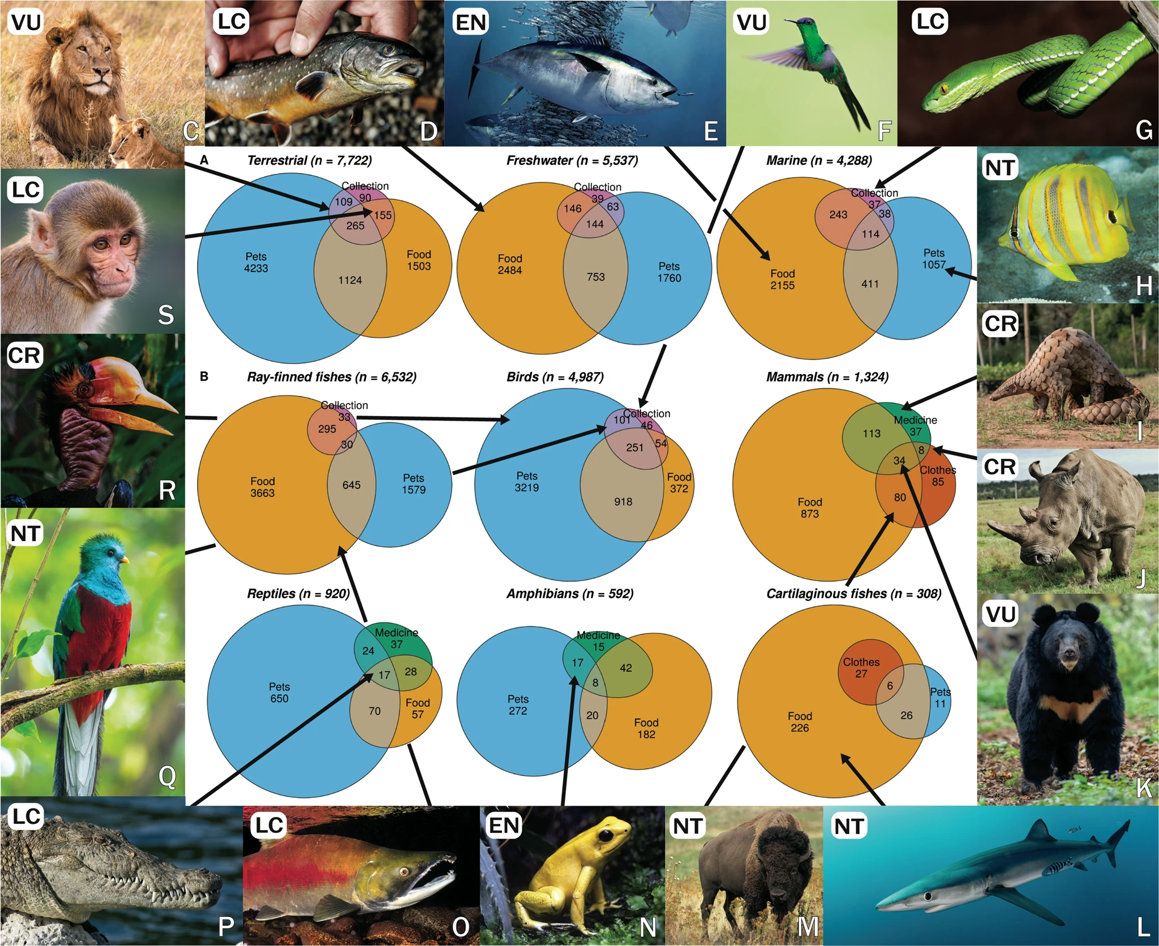
Traits and humans

Slide 22
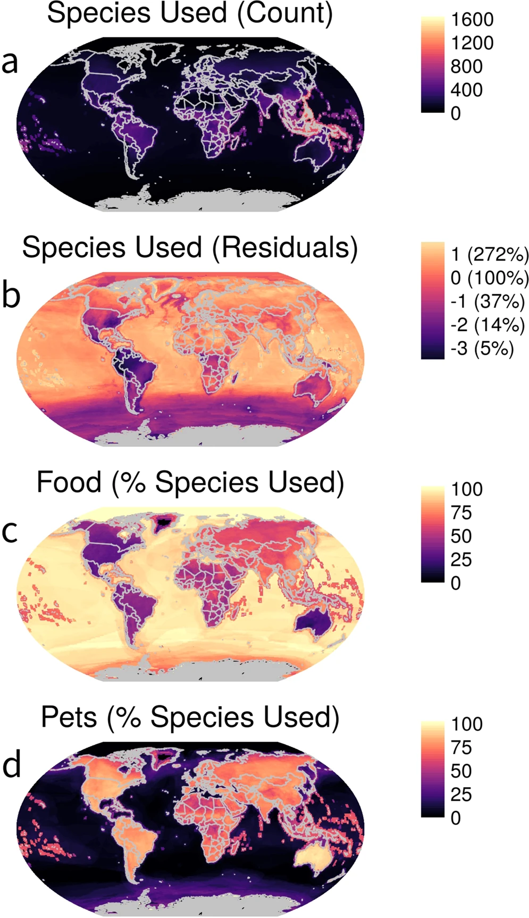
Traits and humans

Slide 23
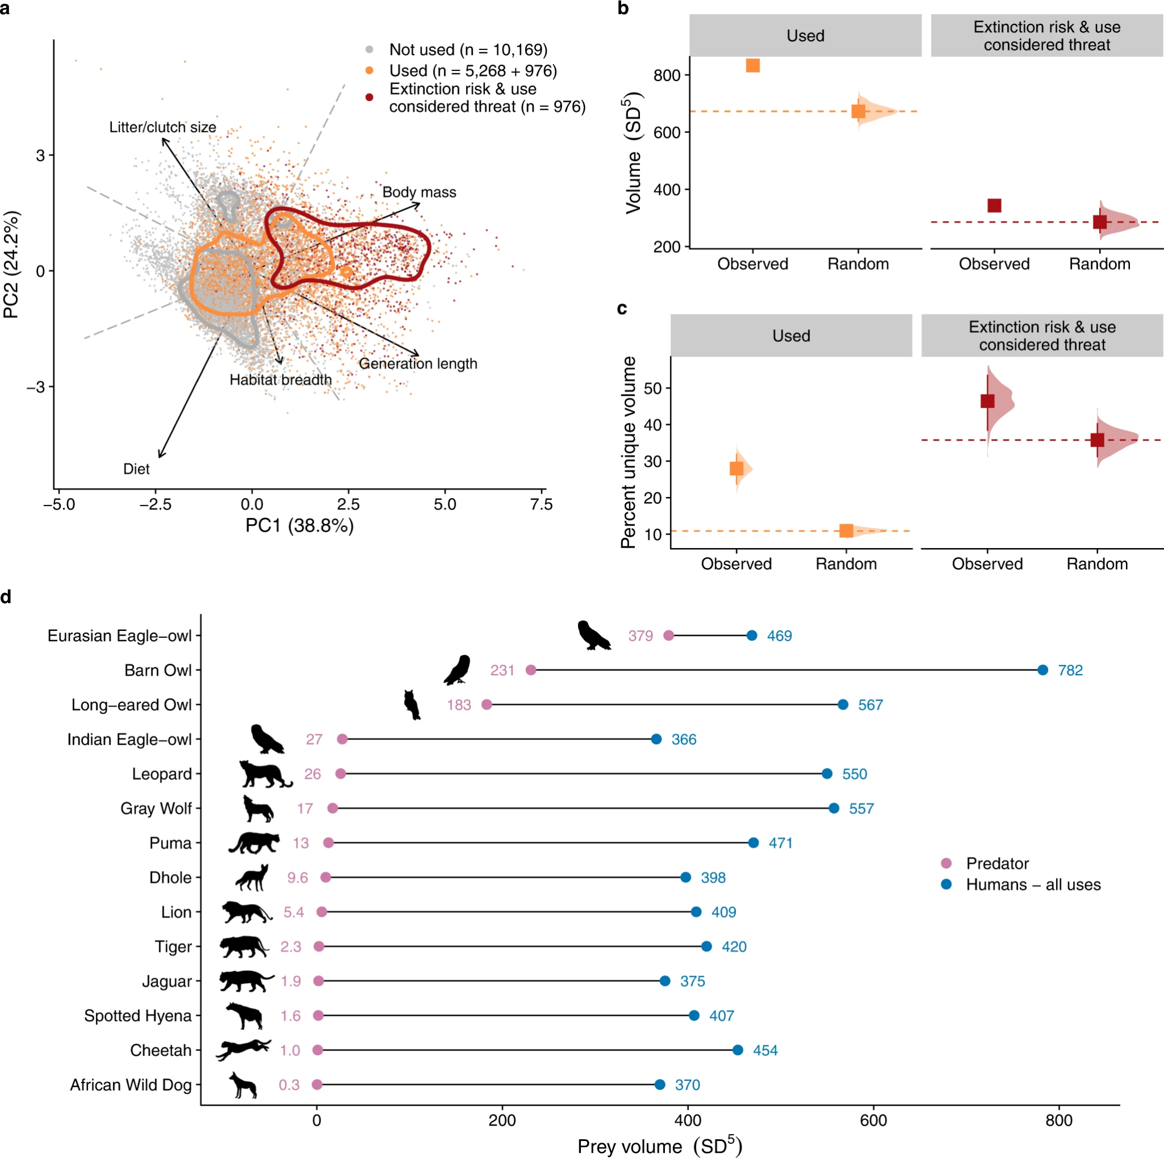
Traits and humans

Slide 24
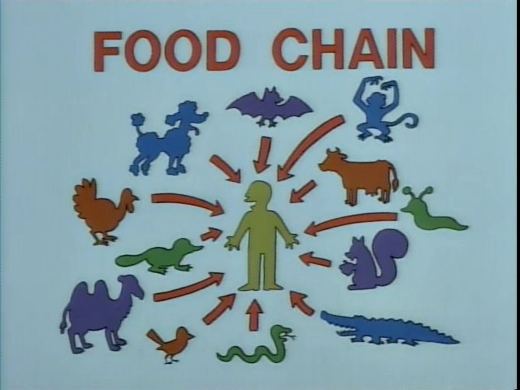
Traits and humans

Slide 25
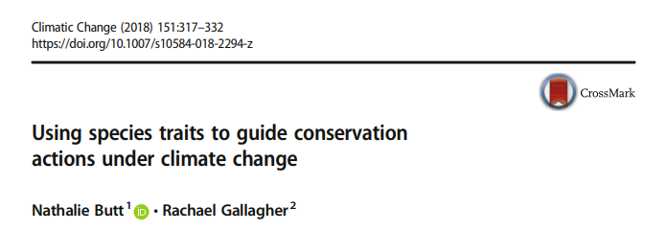
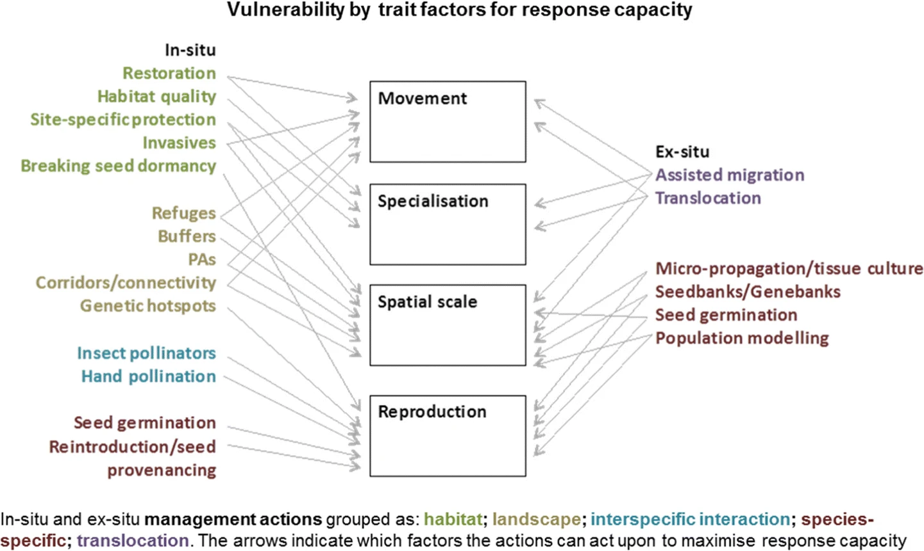
Traits and conservation

Slide 26
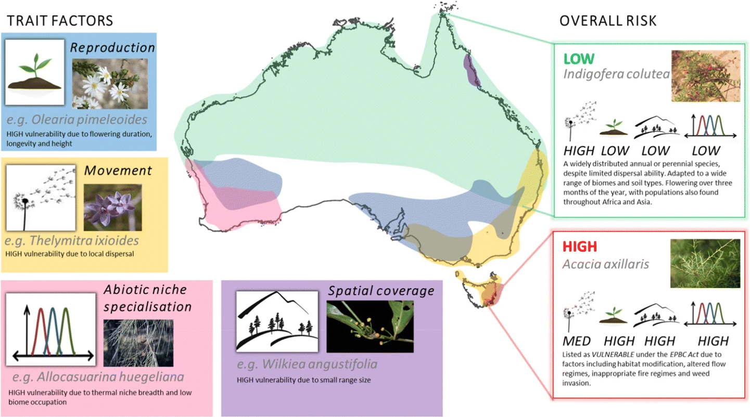
Traits and conservation

Slide 27
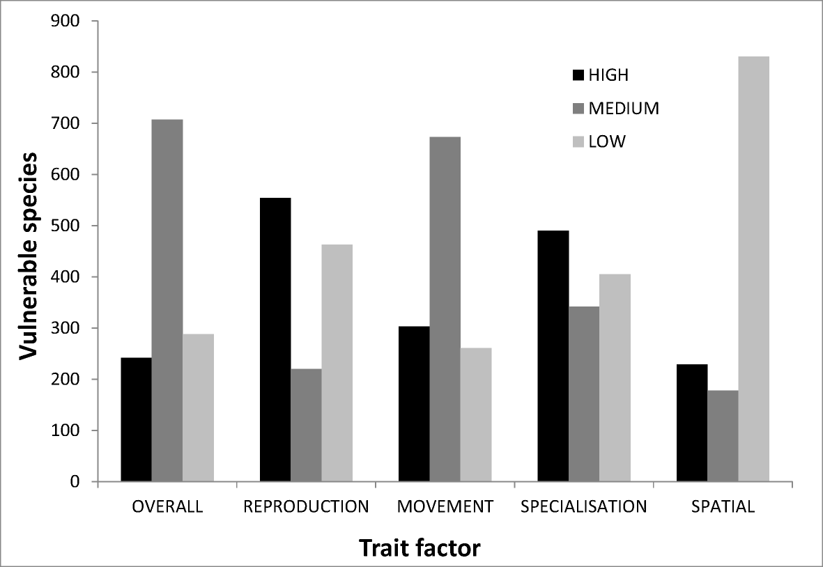
Traits and conservation

Slide 28
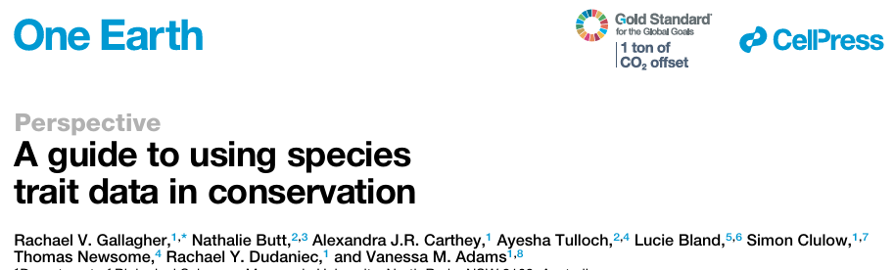
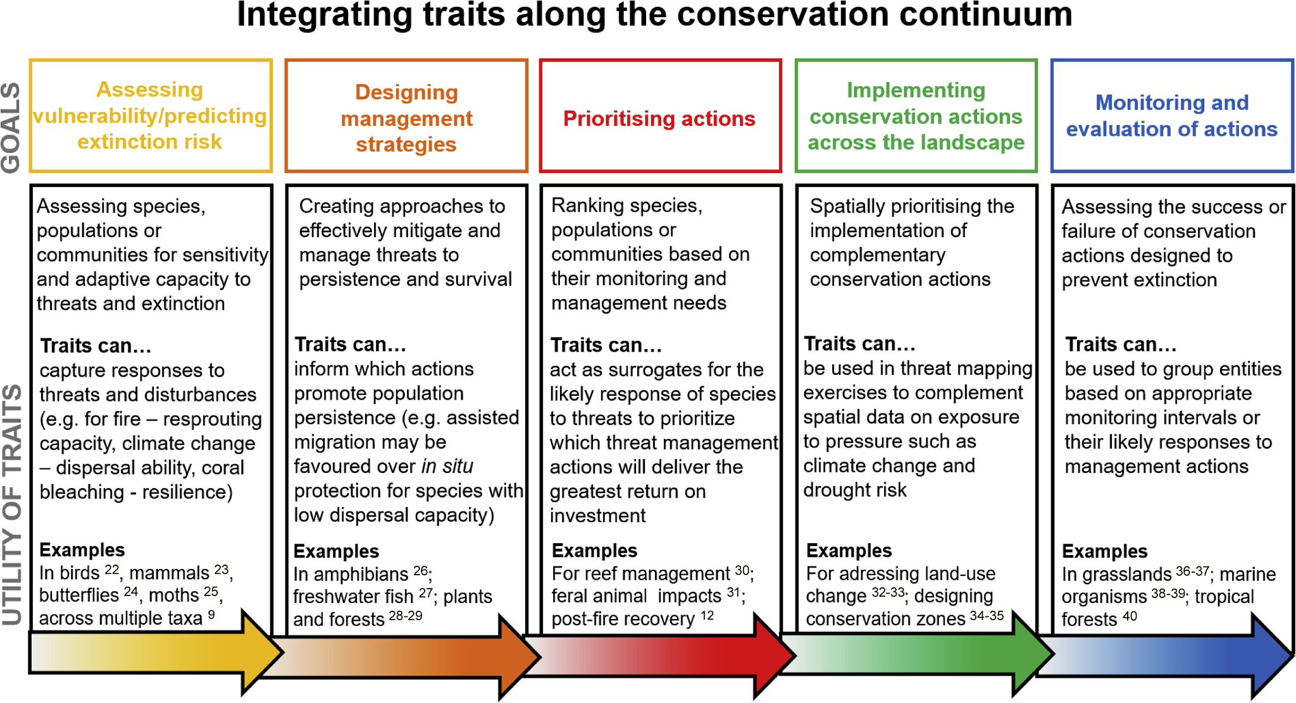
Traits and conservation

Slide 29
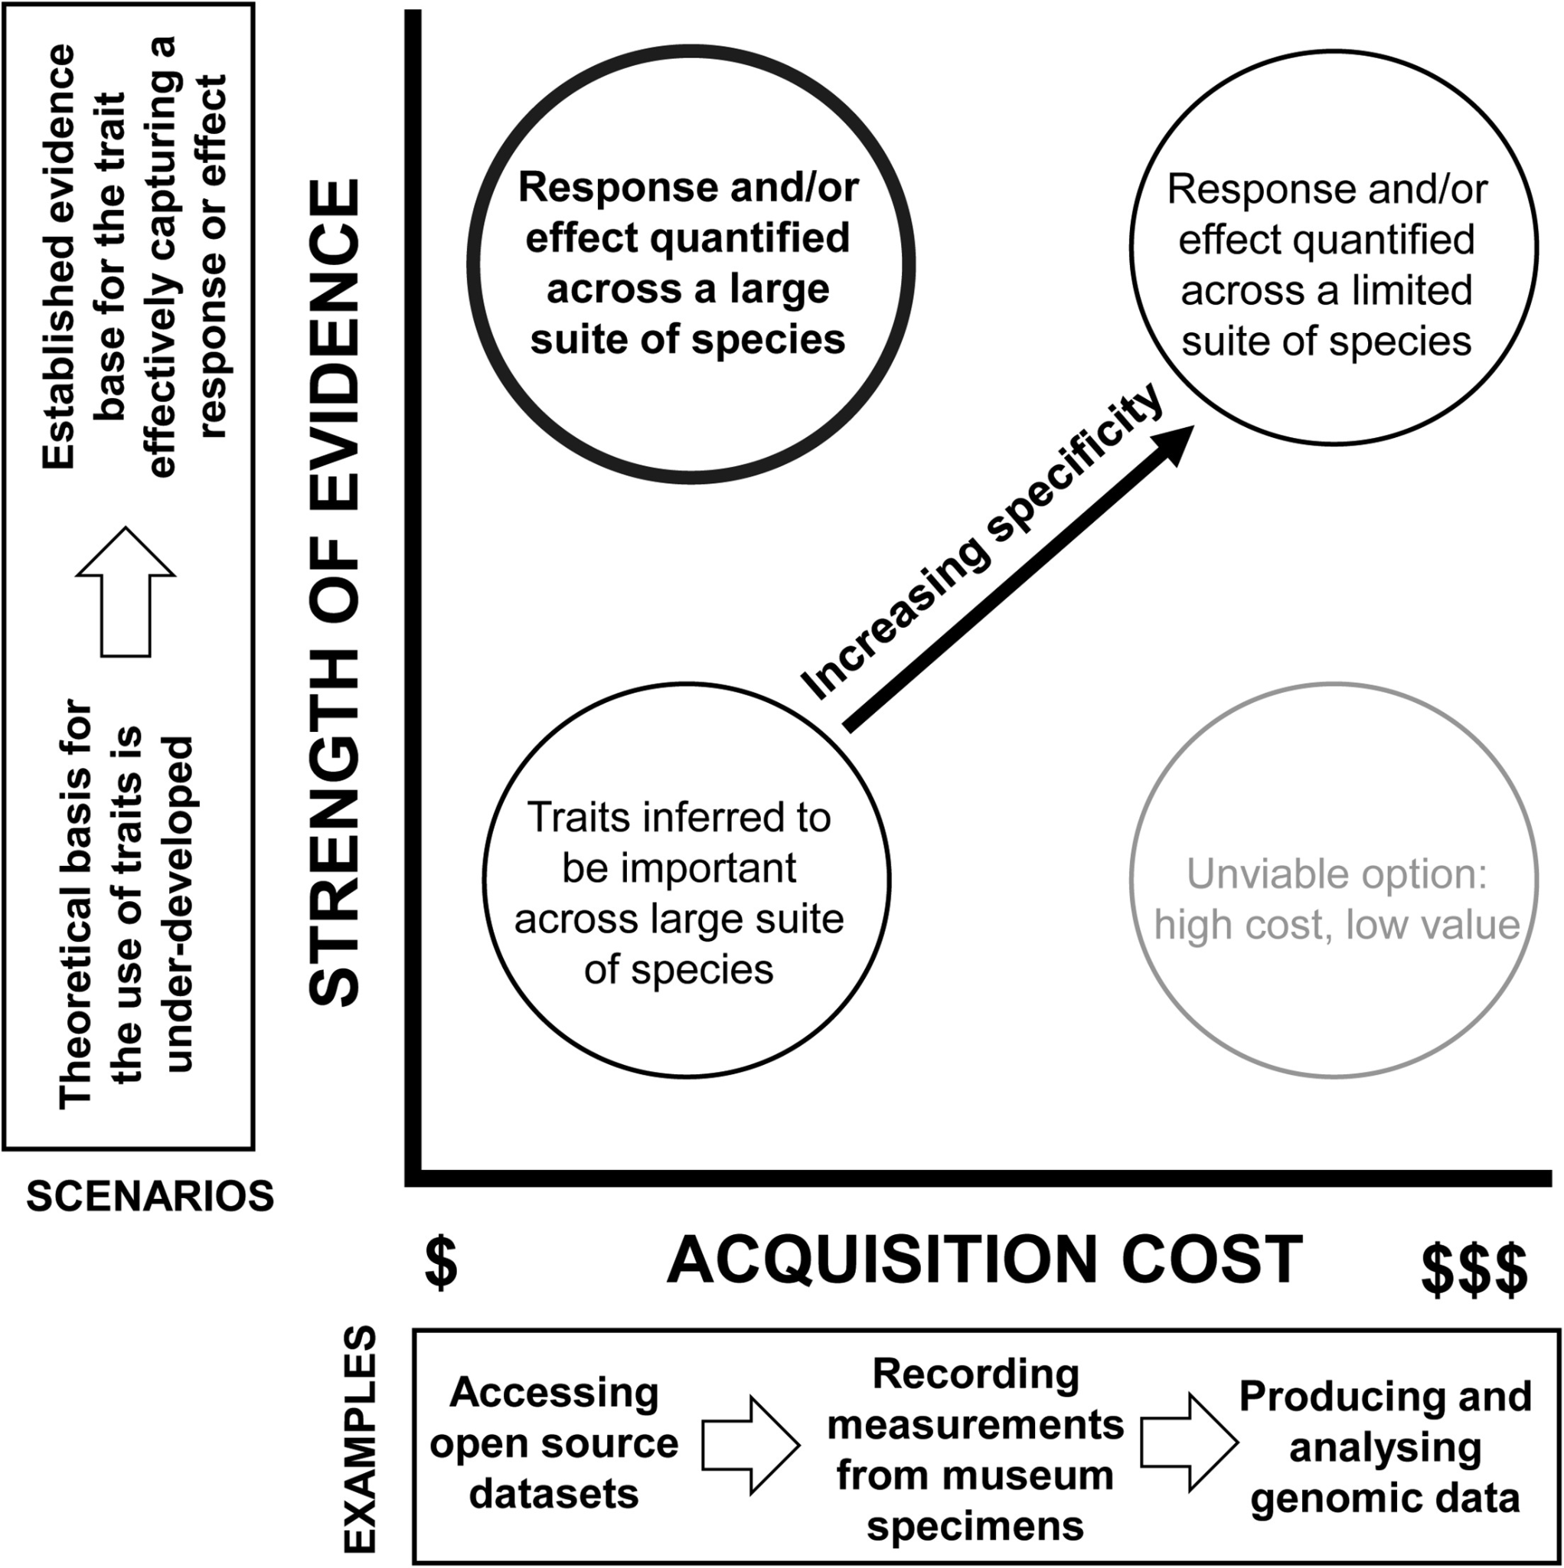
Traits and conservation

Slide 30
Next class: Patchy environments

