Slide 1
Diversity Patterns II
Today’s Agenda:
Quiz
Species-Area Relationship
Island Biogeography
Species-Abundance Distribution

Slide 2
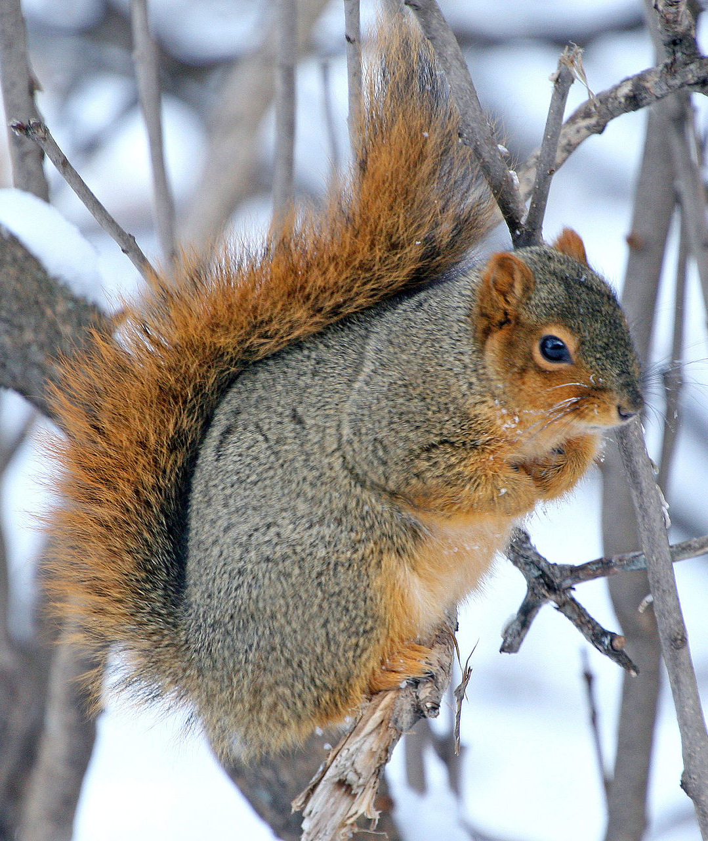
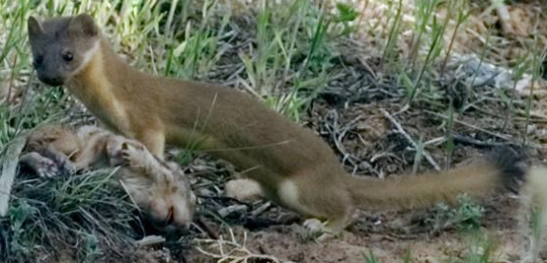
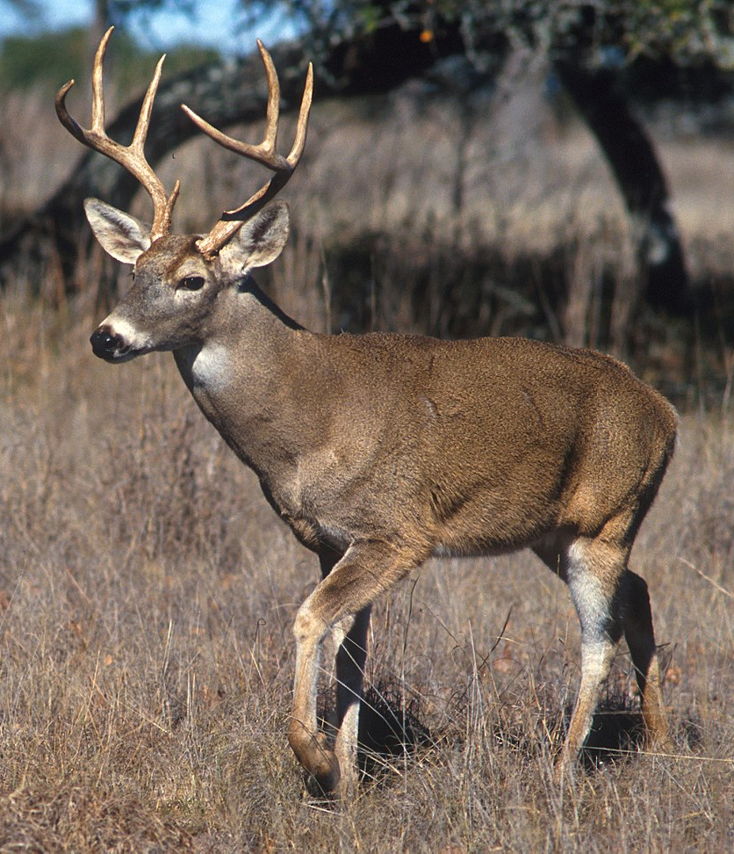
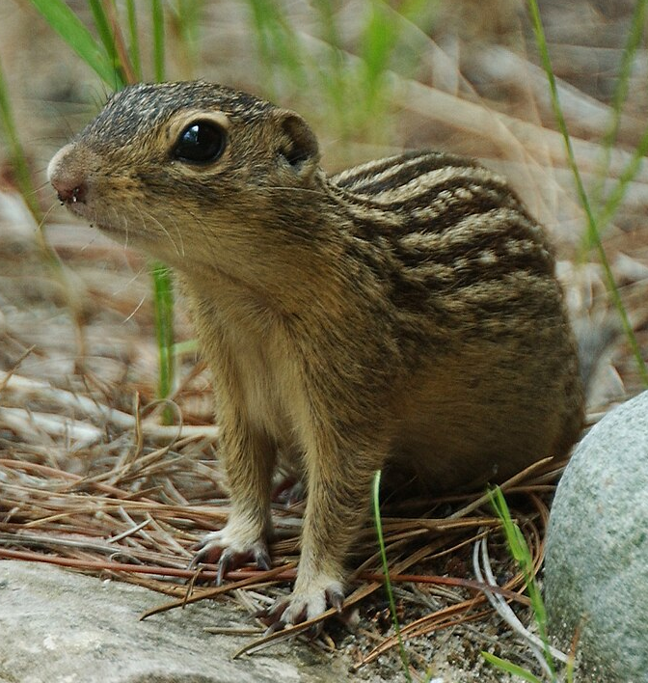
How to we measure diversity?
Species Richness = 4
Notes:
Plot size matters

Slide 3
How to we measure diversity?
Species Richness = 4
Notes:
Plot size matters

Slide 4
Species-Area Relationship

Slide 5
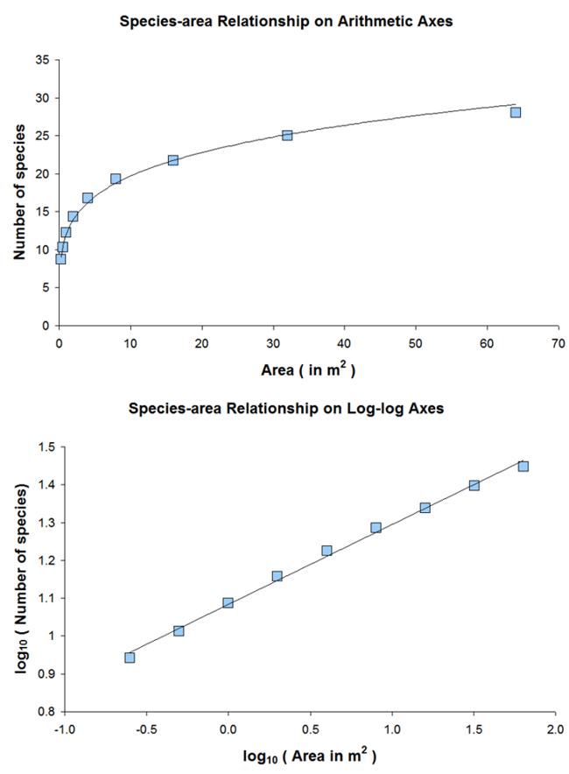
Species-Area Relationship
Notes:
Stress why it is a decelerating function

Slide 6
Species-Area Relationship
A general pattern in ecology
Can be used to standardize measurements (or can use similar-sized plots)
Why might you NEED to use different sized plots?
Notes:
Can either use similar

Slide 7
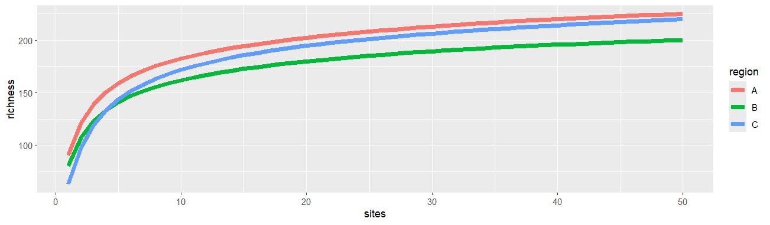
SARs - What can they tell us?
Notes:
Diversity in a plot, diversity across region, rates of accumulation of diversity

Slide 8
SARs - What can they tell us?
Q: Why does the curve level out as sample size increases?

Slide 9
SARs - What can they tell us?
Q: How does this relate to alpha and gamma diversity?

Slide 10
SARs - What can they tell us?
Q: How does this relate to beta diversity?

Slide 11
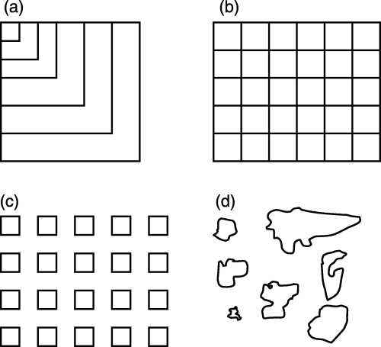
6 types of SAR
Scheiner, S.M. (2003), Six types of species-area curves. Global Ecology and Biogeography, 12: 441-447
Notes:
Note that b and c have both spatial and non-spatial versions

Slide 12
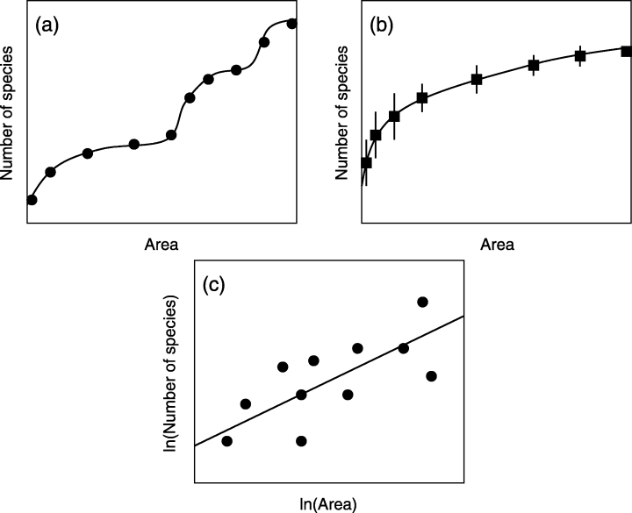
6 types of SAR
Scheiner, S.M. (2003), Six types of species-area curves. Global Ecology and Biogeography, 12: 441-447

Slide 13
Modelling the SAR
Often fit using the equation:
S = cA^{z}
S = # Species
A = Area
c = fitted parameter
z = fitted parameter

Slide 14
Modelling the SAR
Often fit using the equation:
S = cA^{z}
Or, on a log-scale:
log(S) = z* log(A) + log(c)

Slide 15
Modelling the SAR
Often fit using the equation:
S = cA^{z}
Or, on a log-scale:
log(S) = z* log(A) + log(c)
y = mx + b
So, on a log scale, z = slope, c = intercept

Slide 16
Modelling the SAR

Slide 17
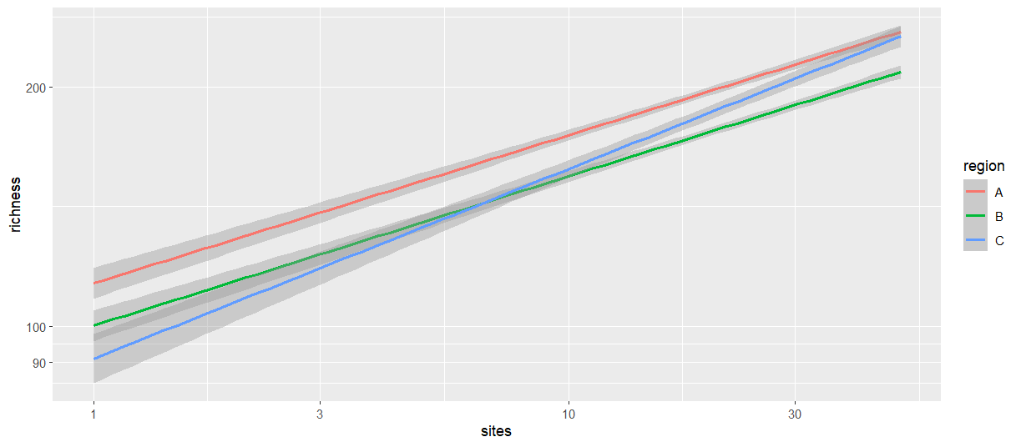
Modelling the SAR
Notes:
Note these are bad examples as the curves are poorly fit by a linear equation

Slide 18
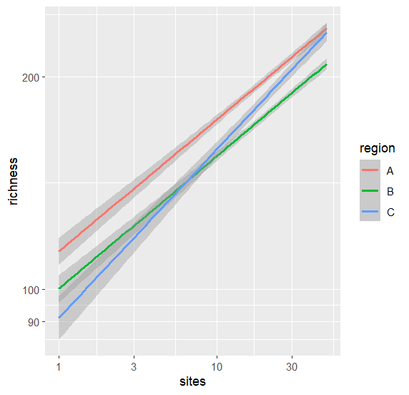
Interpreting the SAR
Or, on a log-scale:
log(S) = z* log(A) + log(c)
y = mx + b
So, on a log scale, z = slope, c = intercept
z = related to beta diversity
c = related to alpha diversity

Slide 19
Causes of the SAR
Why might larger areas (or larger samples) contain more species?

Slide 20
Causes of the SAR
Why might larger areas (or larger samples) contain more species?
More habitats
Lower likelihood of extinction
Higher colonization rate
By chance

Slide 21
Causes of the SAR: habitat diversity
Nearby areas tend to have similar habitats (= spatial autocorrelation)
A larger area increases the variation within the sample

Slide 22
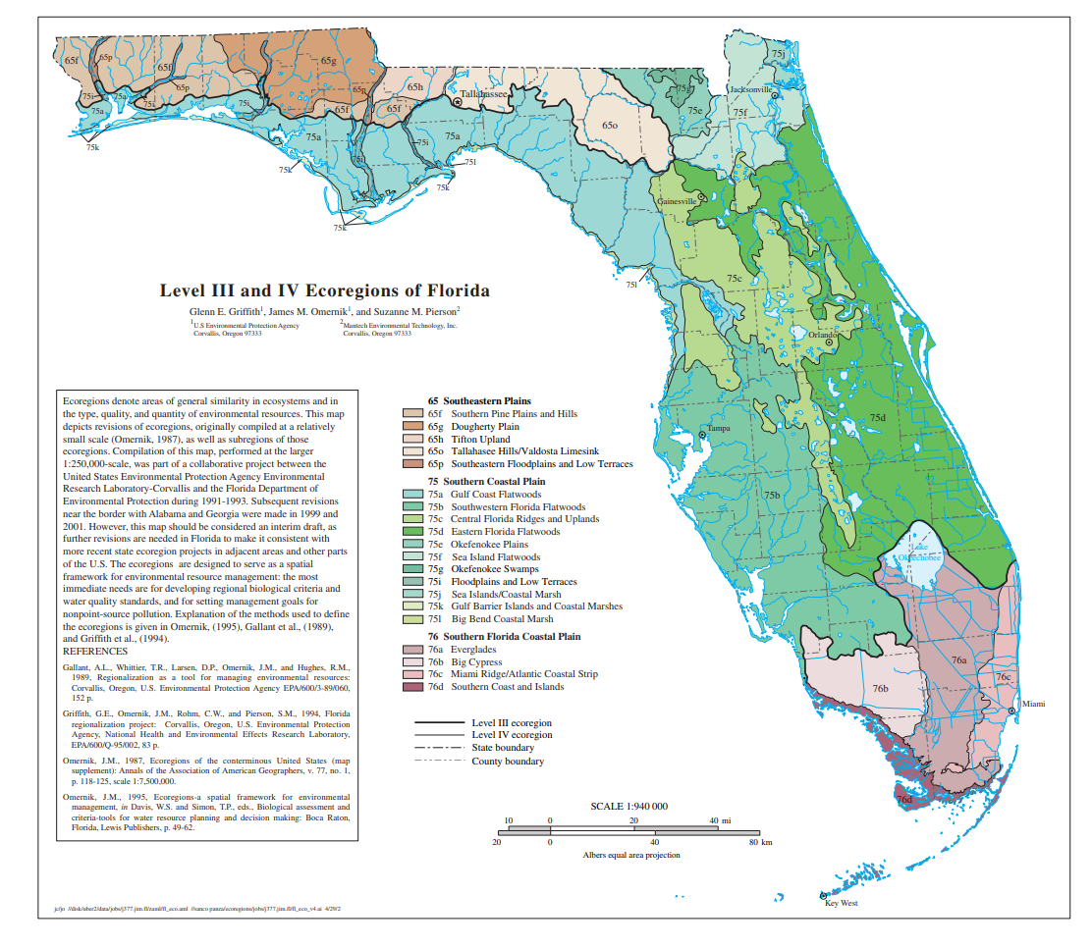
Causes of the SAR: habitat diversity
Nearby areas tend to have similar habitats (= spatial autocorrelation)
A larger area increases the variation within the sample

Slide 23
Causes of the SAR: habitat diversity
Nearby areas tend to have similar habitats (= spatial autocorrelation)
A larger area increases the variation within the sample

Slide 24
Causes of the SAR: habitat diversity
Nearby areas tend to have similar habitats (= spatial autocorrelation)
A larger area increases the variation within the sample

Slide 25
Causes of the SAR: habitat diversity
Nearby areas tend to have similar habitats (= spatial autocorrelation)
A larger area increases the variation within the sample
Notes:
Note: the same thing works at smaller scales!

Slide 26
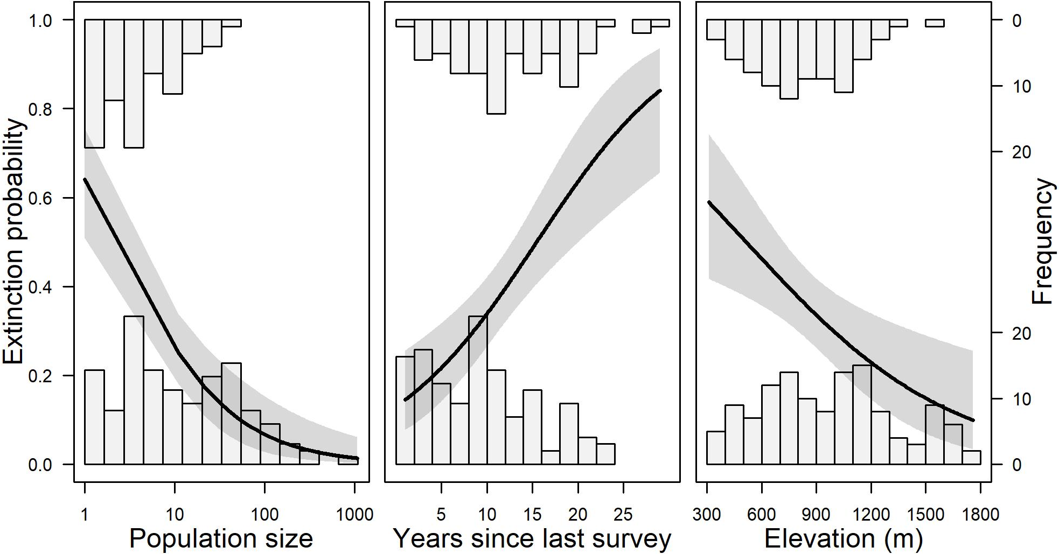
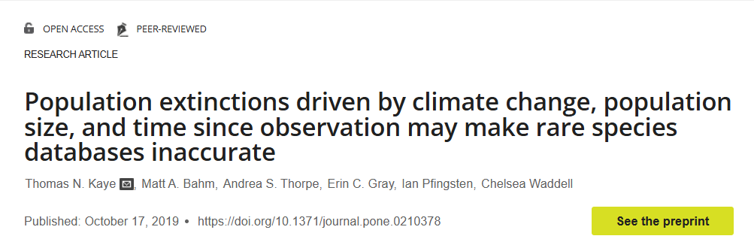
Causes of the SAR: Extinctions
Larger areas = larger population sizes
Population size = major predictor of extinction risk
Notes:
Ask students why larger populations reduce risk.

Slide 27
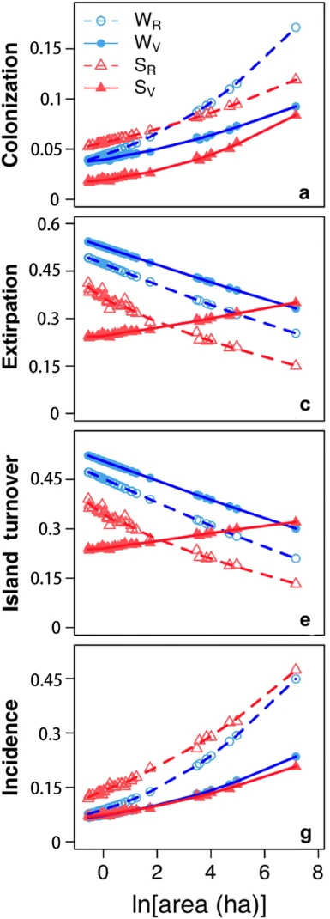
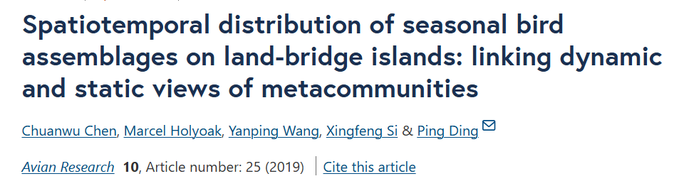
Causes of the SAR: Colonization
Larger areas = bigger targets
Notes:
W = winter, s= summer, r= residents, v = vagrants

Slide 28
Causes of the SAR: Chance
Species are not uniformly distributed in suitable habitats
A particular species may be missed due to chance
We’ll see an example of this later

Slide 29
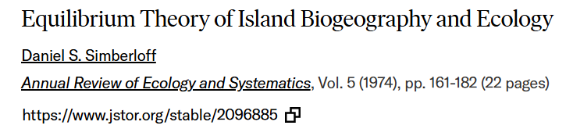
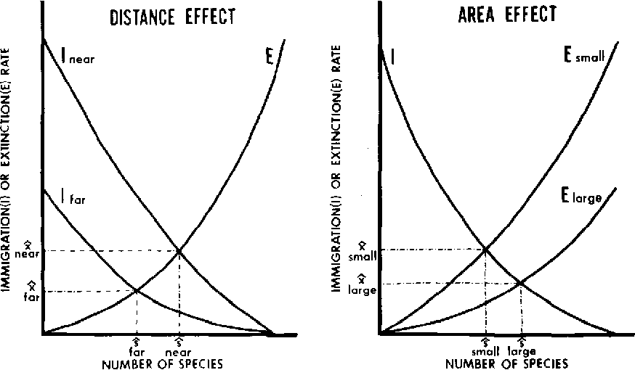

Theory of Island Biogeography
Notes:
Simberloff forgot to account for the area effect on immigration, which is analogous to the distance effect (see demo)

Slide 30
Island Biogeography Demo
https://www.netlogoweb.org/launch#https://raw.githubusercontent.com/bmaitner/Community_ecology_course/refs/heads/main/NetLogo_demos/island_biogeo.nlogo

Slide 31
Variation in SARs
Or, on a log-scale:
log(S) = z* log(A) + log(c)
y = mx + b
So, on a log scale, z = slope, c = intercept
z = related to beta diversity
c = related to alpha diversity

Slide 32
Variation in SARs
Or, on a log-scale:
log(S) = z* log(A) + log(c)
y = mx + b
So, on a log scale, z = slope, c = intercept
z = related to beta diversity
c = related to alpha diversity

Slide 33
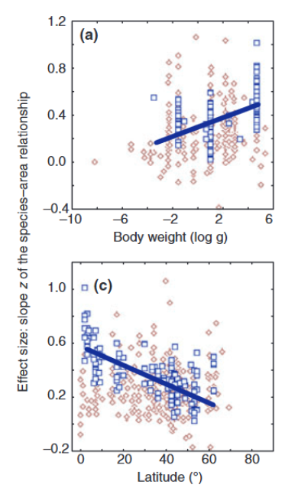
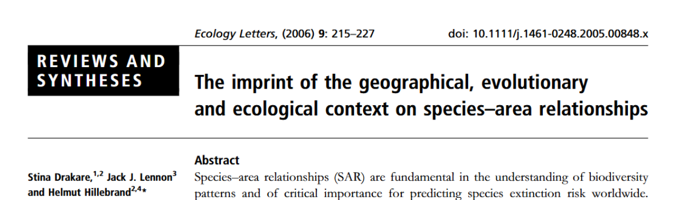
Variation in SARs
Closer to the equator, species accumulate relatively faster
Larger species accumulate relatively faster
Small species have flat SARs
Tied to species abundance distributions

Slide 34
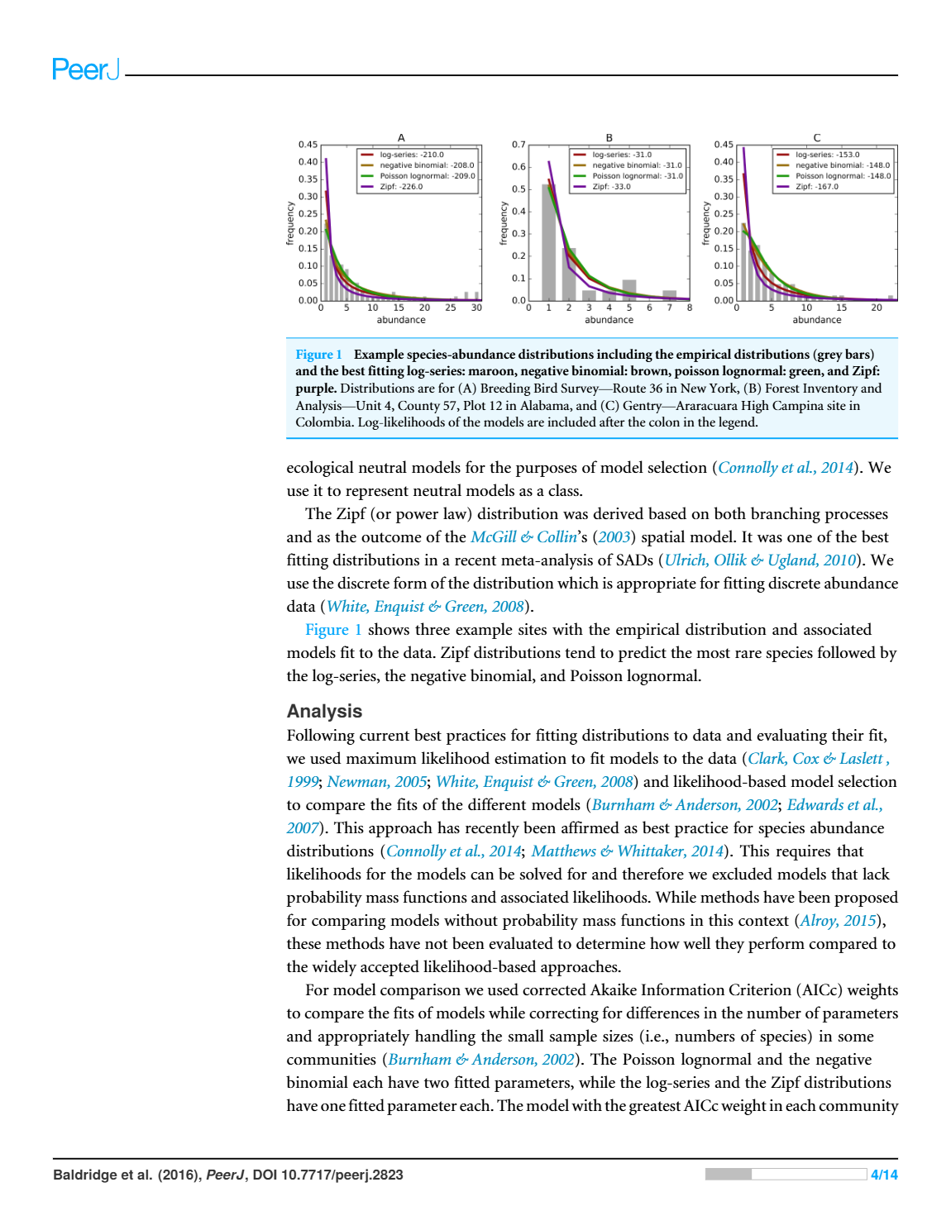
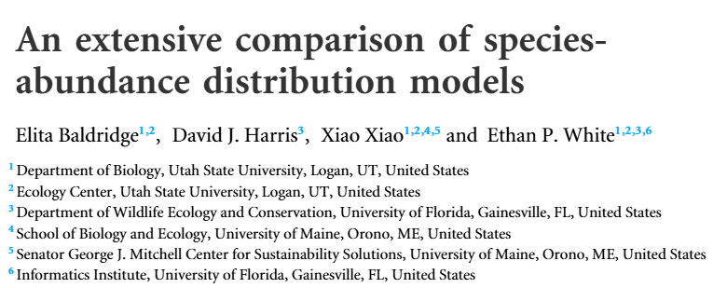
Species Abundance Distribution
Another general pattern in ecology

Slide 35
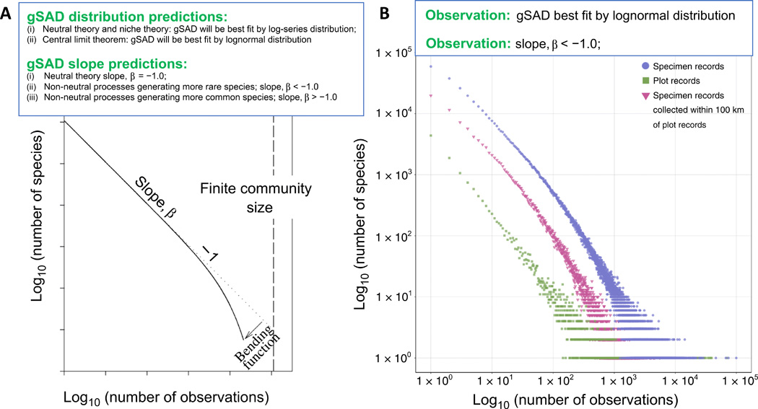
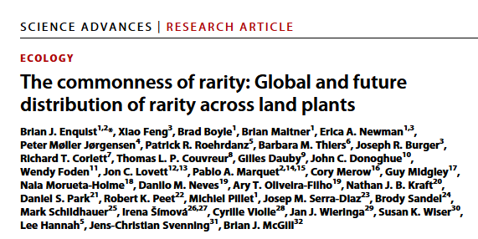
Species Abundance Distribution
Holds at large taxonomic/spatial scales as well

Slide 36
SAD in brief
Common species are rare, rare species are common

Slide 37
Impact of SADs

Slide 38
Impact of SADs
Present in many plots

Slide 39
Impact of SADs
Present in one/few plots
Present in many plots

Slide 40
Impact of SADs
Variation in abundance (evenness) will correspond to rate of encountering species and hence the shape of the SAR
Present in one/few plots
Present in many plots

Slide 41
SAD and SAR demo
https://www.netlogoweb.org/launch#https://raw.githubusercontent.com/bmaitner/Community_ecology_course/refs/heads/main/NetLogo_demos/SAR_SAD.nlogo

Slide 42
Next Class: Drivers of Diversity

