Slide 1
Diversity Patterns III
Today’s Agenda:
Quiz
Drivers of Diversity

Slide 2
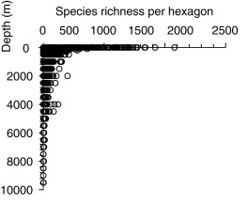
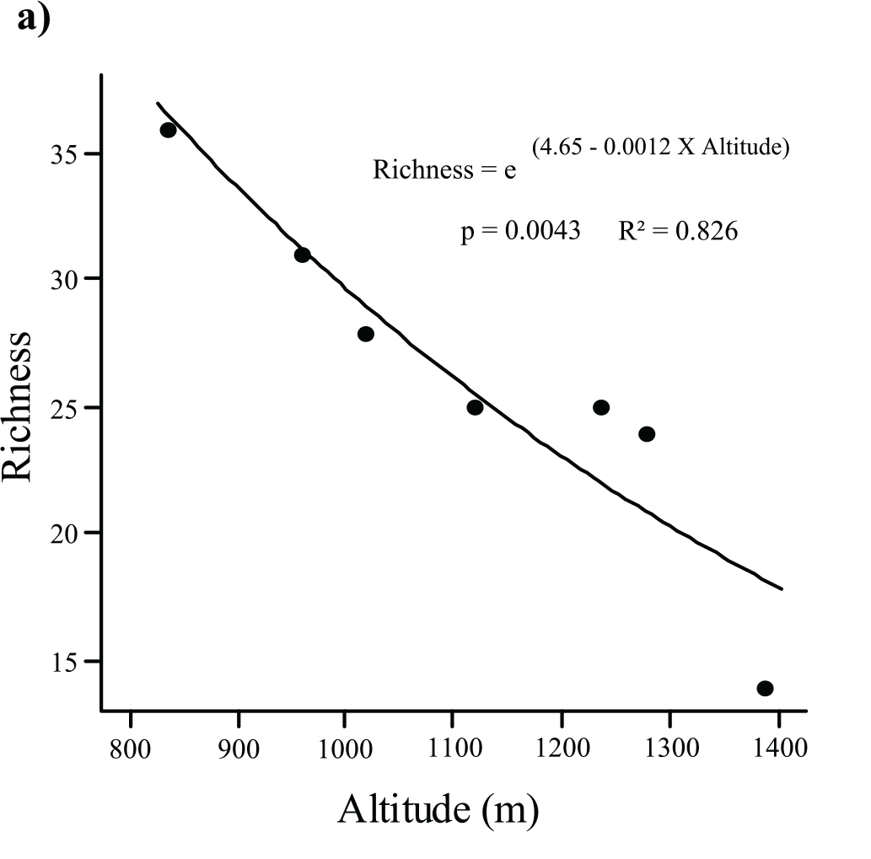
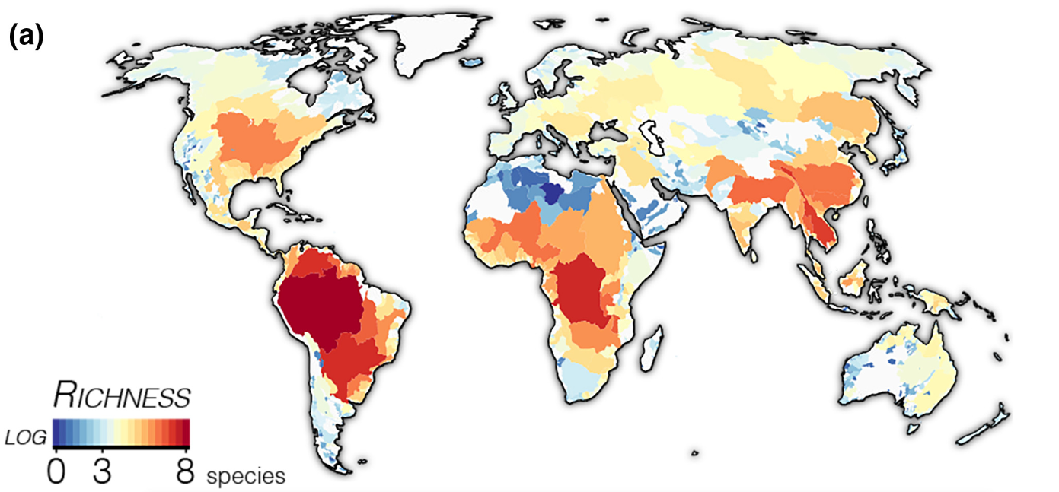
Diversity patterns
We’ve spent the last few classes discussing patterns of diversity, but…
What drives differences in diversity? Any thoughts?
Miller EC, Román-Palacios C. 2021; Nunes et al. 2016 ; Costella and Chaudhary, 2017

Slide 3
Groups of hypothesized drivers
Your book splits hypothesized drivers in 4 groups:
Null model explanations
Ecological explanations
Historical explanations
Evolutionary explanations

Slide 4
Groups of hypothesized drivers
Your book splits hypothesized drivers in 4 groups:
Null model explanations
Ecological explanations
Historical explanations
Evolutionary explanations
Note that although these are discussed in terms of the latitudinal diversity gradient, they can be applied to other diversity patterns

Slide 5
Null explanations of diversity
What do we mean by “null model”?
Notes:
Ask the class

Slide 6
Null explanations of diversity
What do we mean by “null model”?
“The null model is used as a term of comparison, to verify whether the object in question displays some non-trivial features (properties that wouldn't be expected on the basis of chance alone or as a consequence of the constraints), such as community structure” - Wikipedia

Slide 7
Null explanations of diversity
What do we mean by “null model”?
“The null model is used as a term of comparison, to verify whether the object in question displays some non-trivial features (properties that wouldn't be expected on the basis of chance alone or as a consequence of the constraints), such as community structure” - Wikipedia
Note that null models can differ widely in how much biology is included!

Slide 8
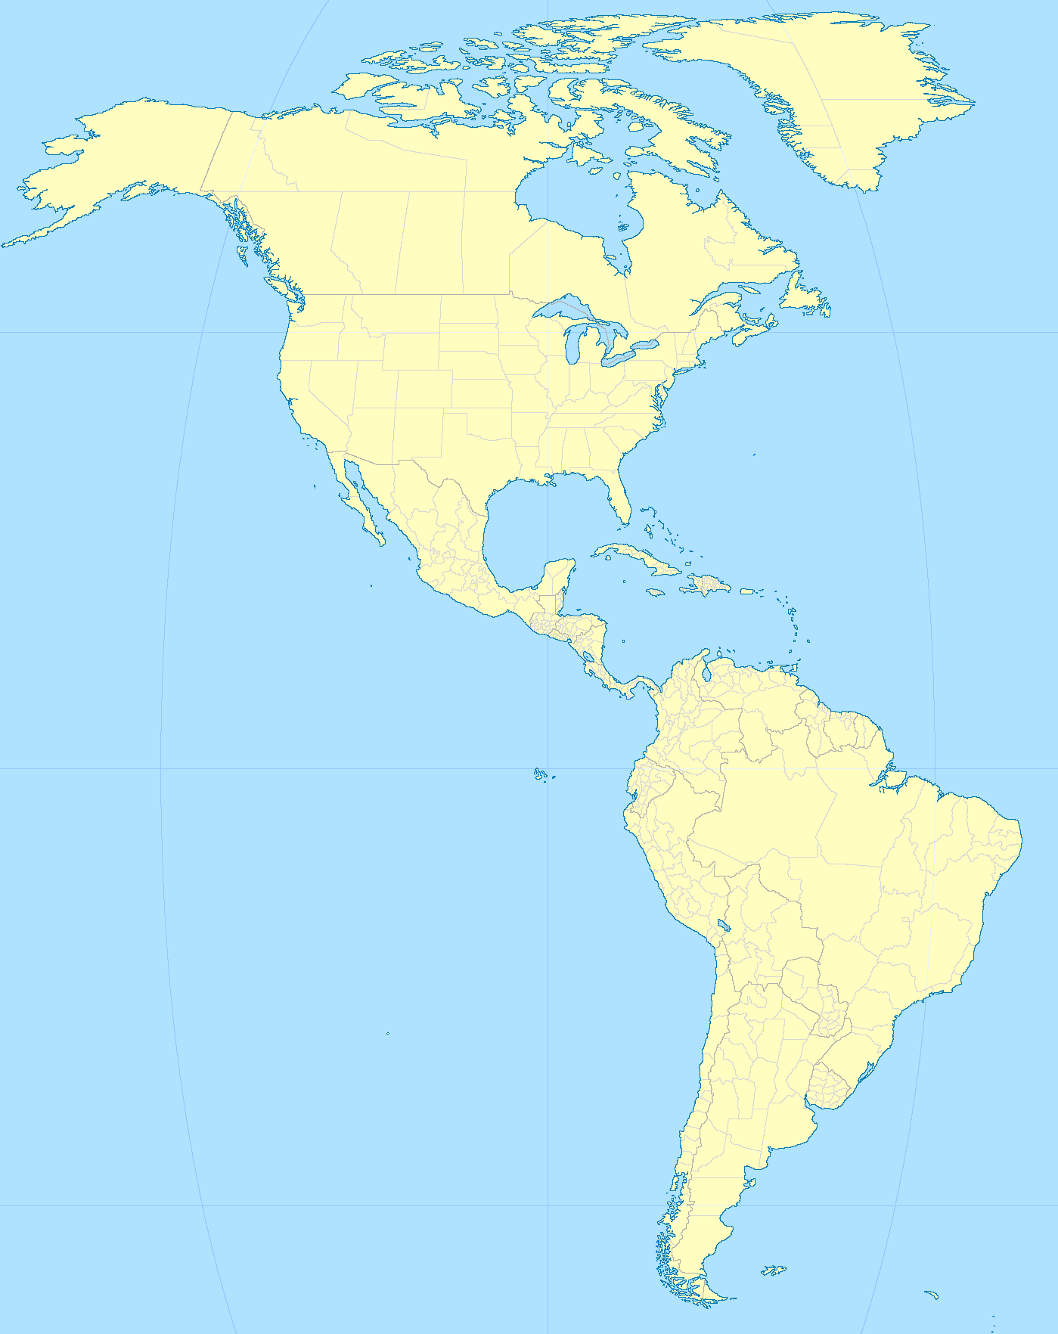
Null expectations: the mid-domain
Species randomly added to a bounded region will tend to overlap more in the center
Notes:
Note: would be a good netlogo simulation

Slide 9
Null expectations: the mid-domain
Species randomly added to a bounded region will tend to overlap more in the center
Notes:
Note: would be a good netlogo simulation

Slide 10
Null expectations: the mid-domain
Species randomly added to a bounded region will tend to overlap more in the center
Notes:
Note: would be a good netlogo simulation

Slide 11
Null expectations: the mid-domain
Species randomly added to a bounded region will tend to overlap more in the center
Notes:
Note: would be a good netlogo simulation

Slide 12
Null expectations: the mid-domain
Species randomly added to a bounded region will tend to overlap more in the center
Notes:
Note: would be a good netlogo simulation

Slide 13
Null expectations: the mid-domain
Species randomly added to a bounded region will tend to overlap more in the center
Randomly placing species might give you a latitudinal diversity gradient

Slide 14
Problems with the mid-domain hypothesis
It should apply to ANY bounded regions (e.g., enters of continents, islands, etc.) in ANY direction (i.e., longitudinal as well as latitudinal)
Is a globe really a bounded region?
Inconsistent support when tested

Slide 15
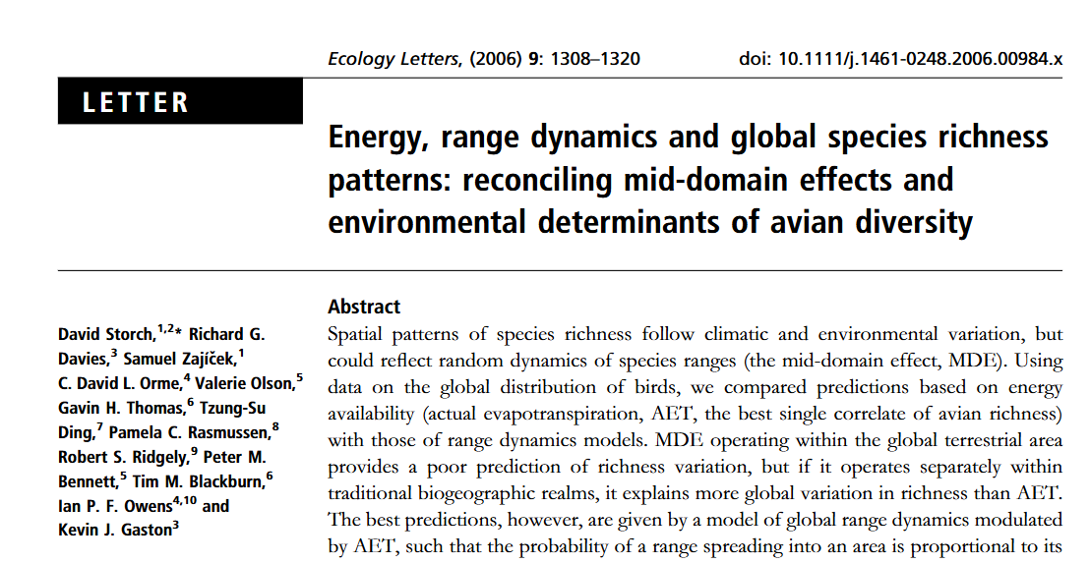
Testing the mid-domain hypothesis
Storch et al. tested this idea
Randomly placed species using a spreading-dye algorithm
For each species, a random point was selected
then, adjacent areas were added until reaching the size of the species actual range
Replicated 100 times

Slide 16
Testing the mid-domain hypothesis
Storch et al. tested this idea
Tested different models:
Species were randomly placed globally
Species were placed/expanded within ecoregions
Species were placed randomly, but preferentially expanded toward more productive regions

Slide 17
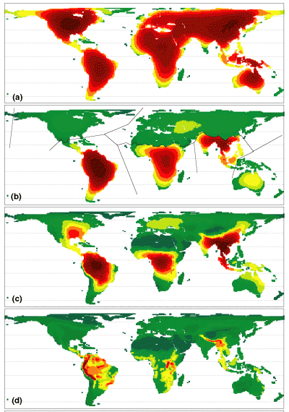
Testing the mid-domain hypothesis
Global Model
Ecoregion Model
Productivity-biased Model
Species richness
Notes:
-relatively weak support for MDE, but does suggest that the a bit of “null” dynamics (ie geographic constraints) may be important in conjunction with other drivers

Slide 18
Testing the mid-domain hypothesis
Global Model
Ecoregion Model
Does not strongly support the MDE, but does suggest some neutral dynamics may be important
Productivity-biased Model
Species richness
Notes:
-relatively weak support for MDE, but does suggest that the a bit of “null” dynamics (ie geographic constraints) may be important in conjunction with other drivers

Slide 19
Ecological hypotheses for diversity
Climate-related hypotheses
Productivity-related hypotheses
Note that there is some overlap between these!

Slide 20
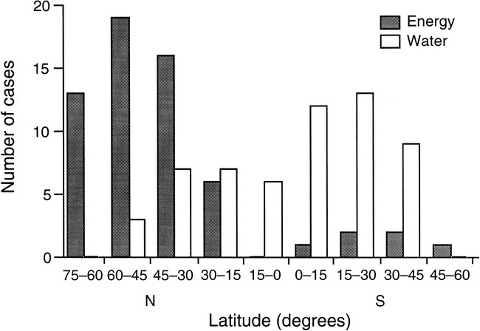
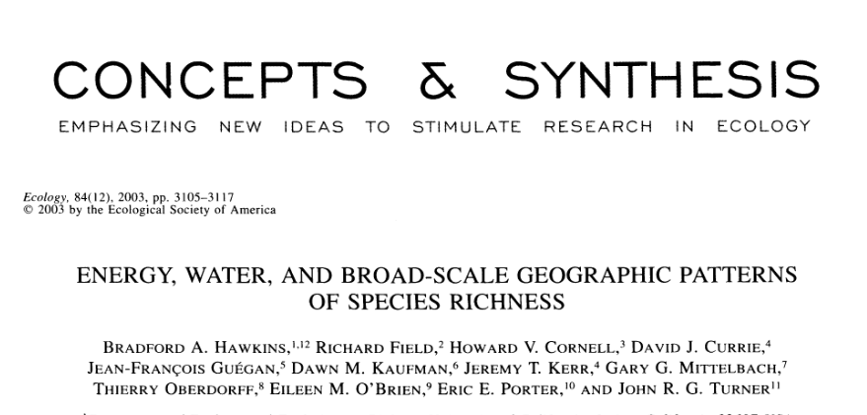
Climatic Drivers of Diversity
Climate correlated with richness
Animals: driver varies by latitude
Plants: usually water, or water + energy

Slide 21
Climate and Diversity
… but WHY?

Slide 22
Climate and Diversity
… but WHY?
More Individuals Hypothesis:
Assumes more individuals can be supported where there is higher productivity
Assumes more individuals translates to more species
Hence, high productivity should yield more species

Slide 23
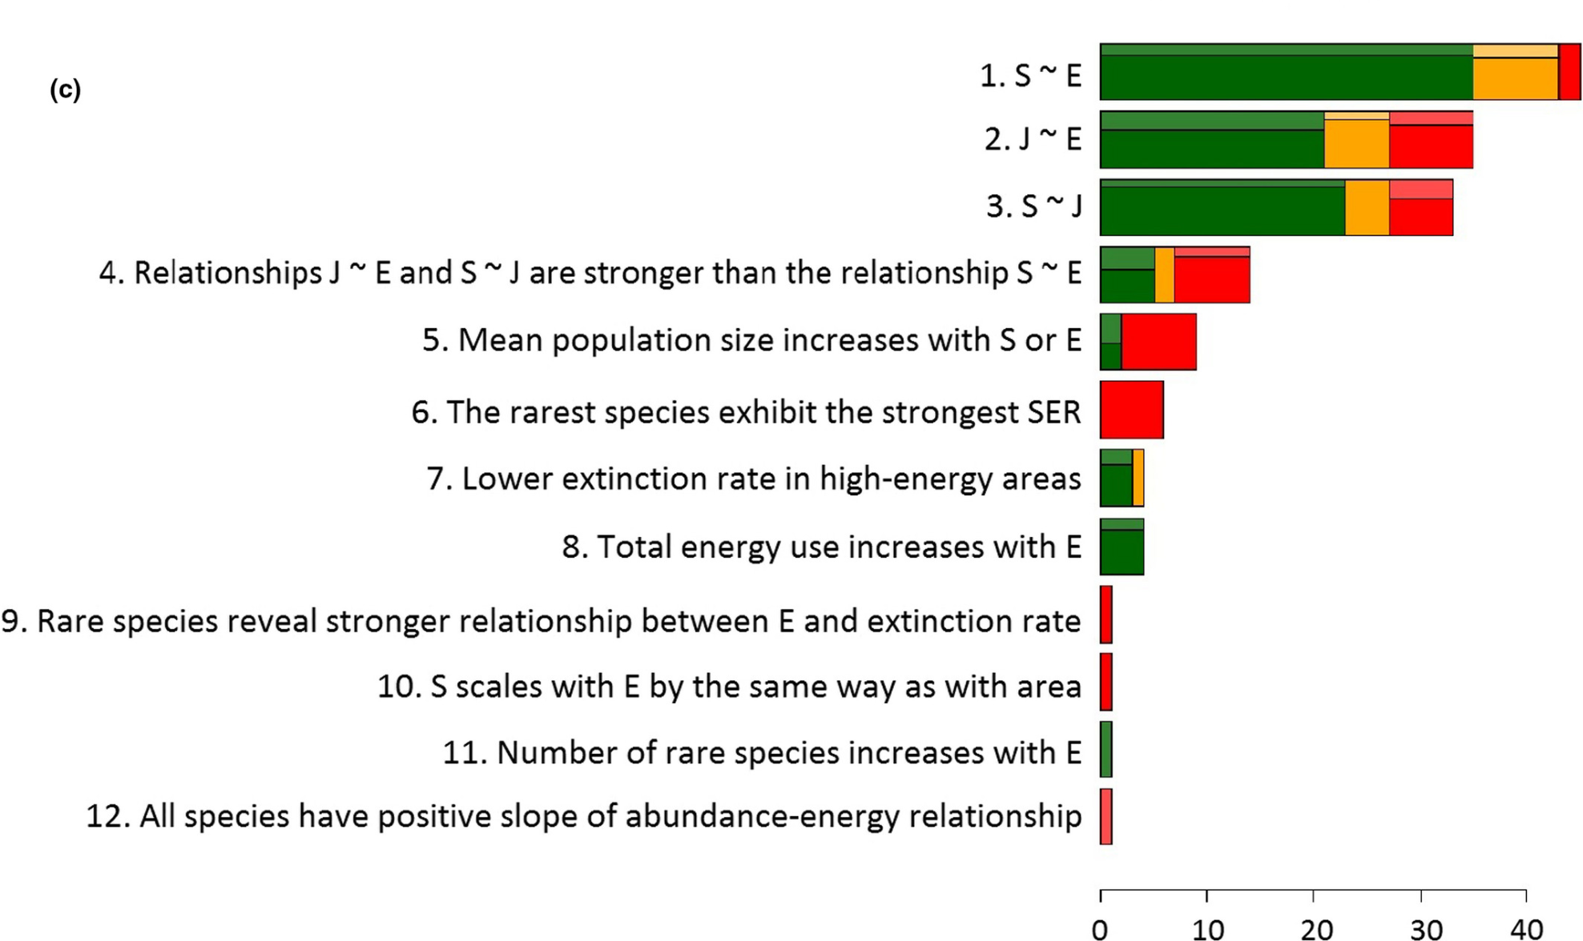
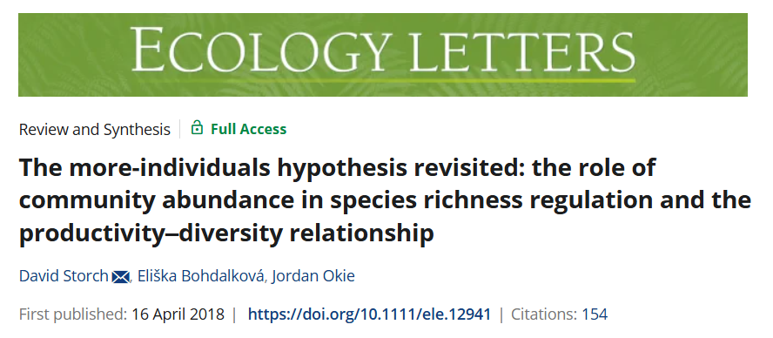
Testing the More Individuals Hypothesis
Energy
(E)
Individuals
(J)
Species
(S)

Slide 24
Testing the More Individuals Hypothesis
Energy
(E)
Individuals
(J)
Species
(S)
Relationships between E,J,S have mixed support
Poor support when considering relative strengths

Slide 25
Issues with MIH
Confounding relationships between species richness and productivity
Plants often fail to show the pattern
Quantitative analyses don’t stand up well
Recent work suggests that variation in abundances may also play a role

Slide 26
Productivity and Diversity
We’ll spend time on this when we cover Biodiversity and Ecosystem Functioning

Slide 27
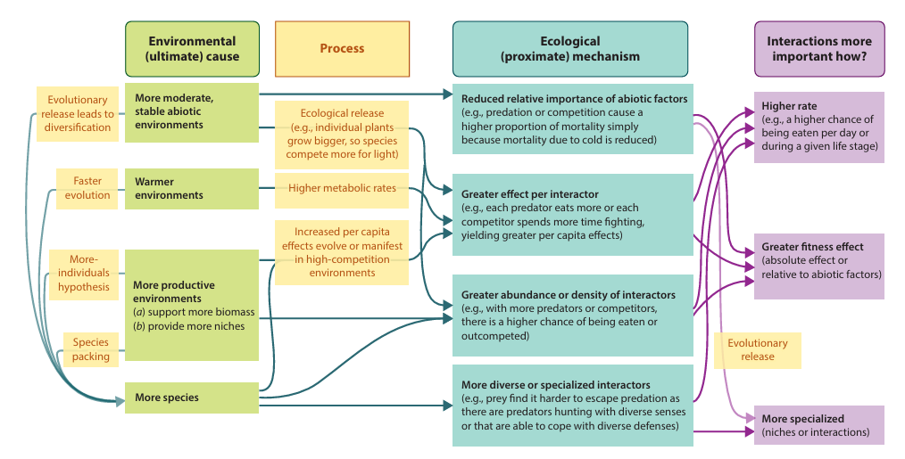
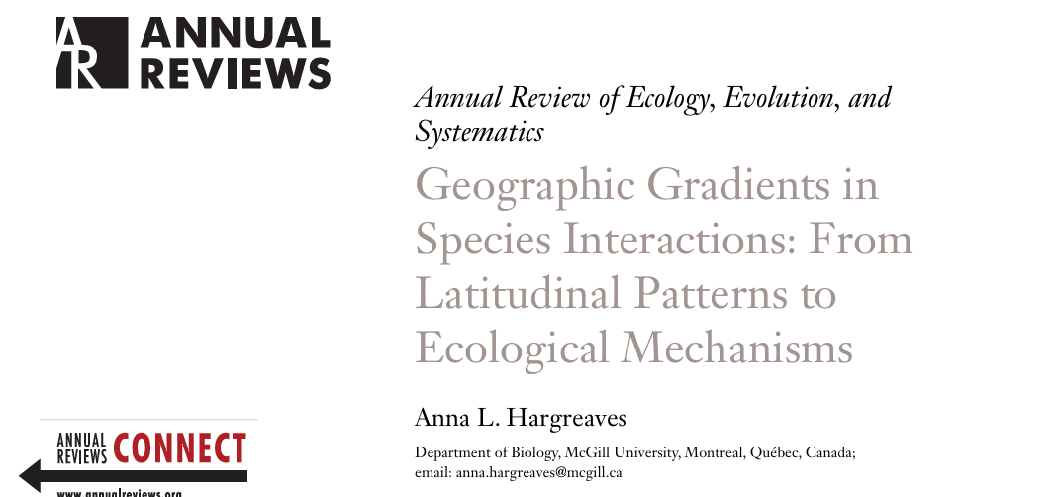
Other ecological hypotheses
Species interactions
E.g., a greater role of natural enemies or mutualists in the tropics

Slide 28
Historical Explanations

Slide 29
Historical Explanations
Time-integrated area hypothesis

Slide 30
Historical Explanations
Time-integrated area hypothesis
Larger area have more species
Higher speciation rates
Lower extinction rates
etc.
Older areas have more species
More time to accumulate diversity

Slide 31
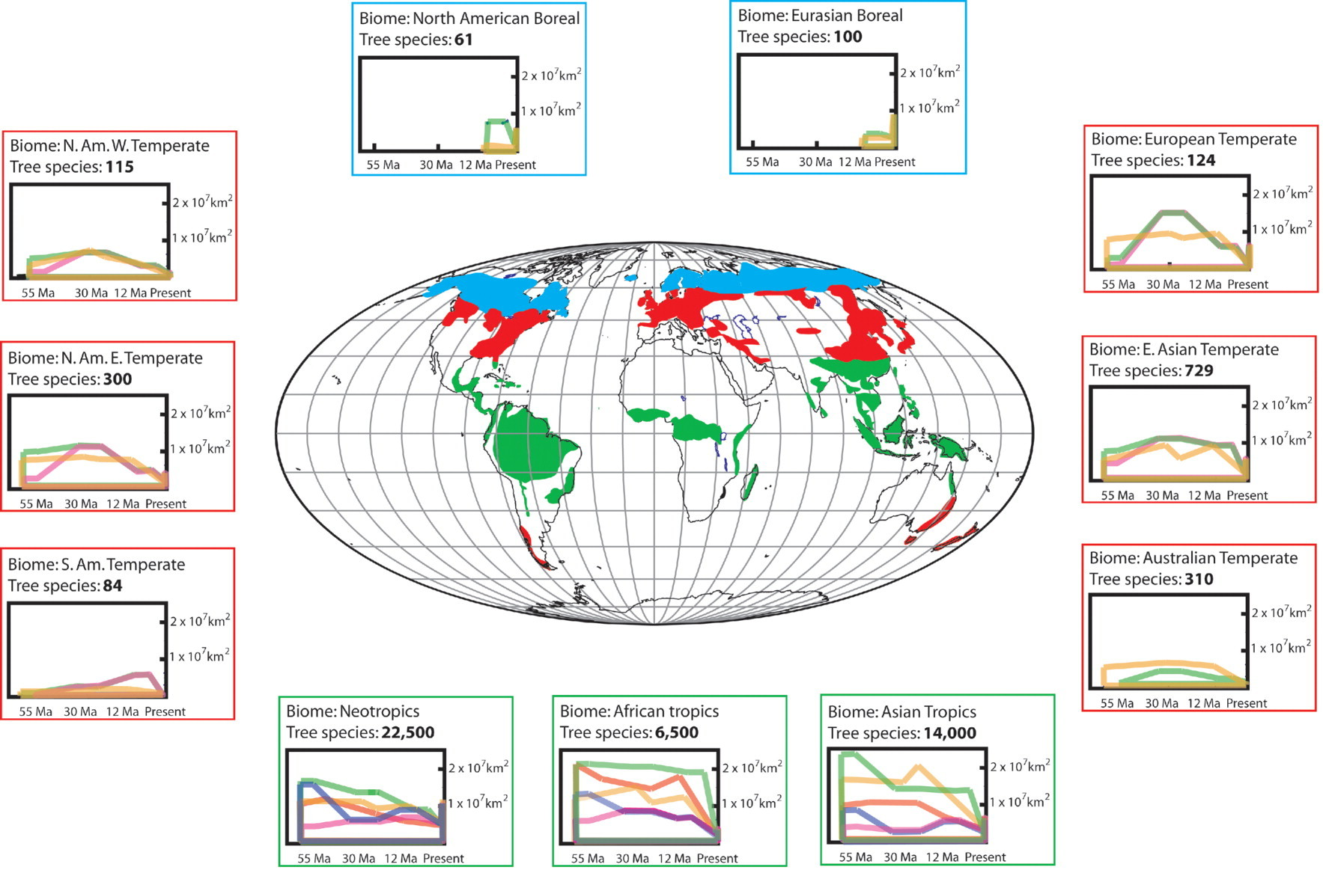
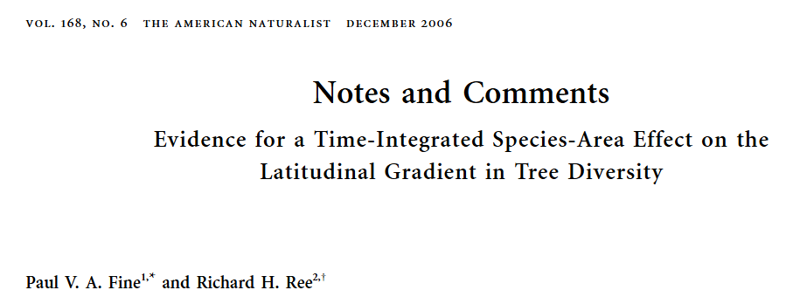
Time-integrated area hypothesis
Notes:
Different lines = different climate models

Slide 32
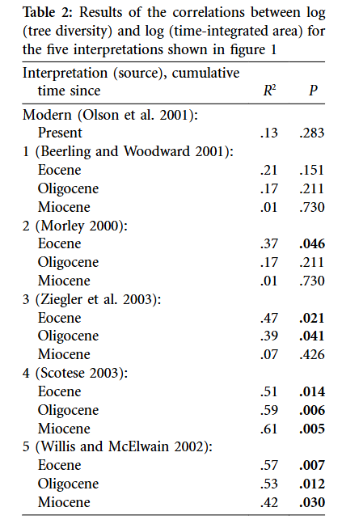
Time-integrated area hypothesis
Notes:
Different lines = different climate models

Slide 33
Evolutionary Explanations

Slide 34
Evolutionary Explanations
Variation in speciation rates
Variation in extinction rate
Tropical niche conservatism

Slide 35
Cradles vs Museums
Diversification (speciation - extinction) rates may vary with latitude
Could play a role in latitudinal diversity patterns
However, this could be due to either
More speciation
Less extinction
A combination of the two

Slide 36
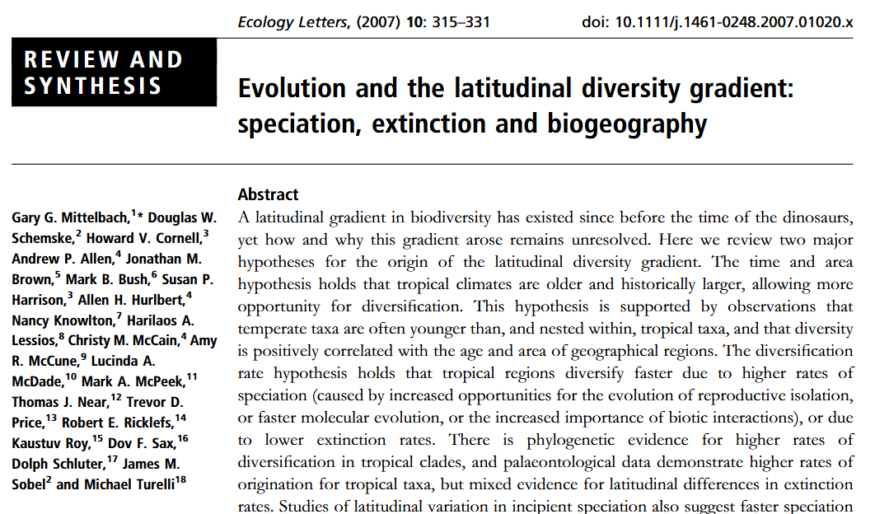
Cradles vs Museums: Proposed mechanisms
Speciation:
Genetic Drift (higher in tropics, increases speciation)
Climatic variation (higher in temp, decreases speciation)
Speciation mechanisms (differ between temp and tropical)
Geographic area (larger area = more speciation…or less)
Evolutionary speed (higher in tropics, increases speciation)
Biotic interaction (higher in tropics, increases speciation)

Slide 37
Cradles vs Museums: Proposed mechanisms
Extinction:
Climatic variation (more stable climate in tropics, lower extinction rate)
Geographic area (more area in tropics, lower extinction rate)

Slide 38
Cradles vs Museums: Testing with Phylogeny

Slide 39
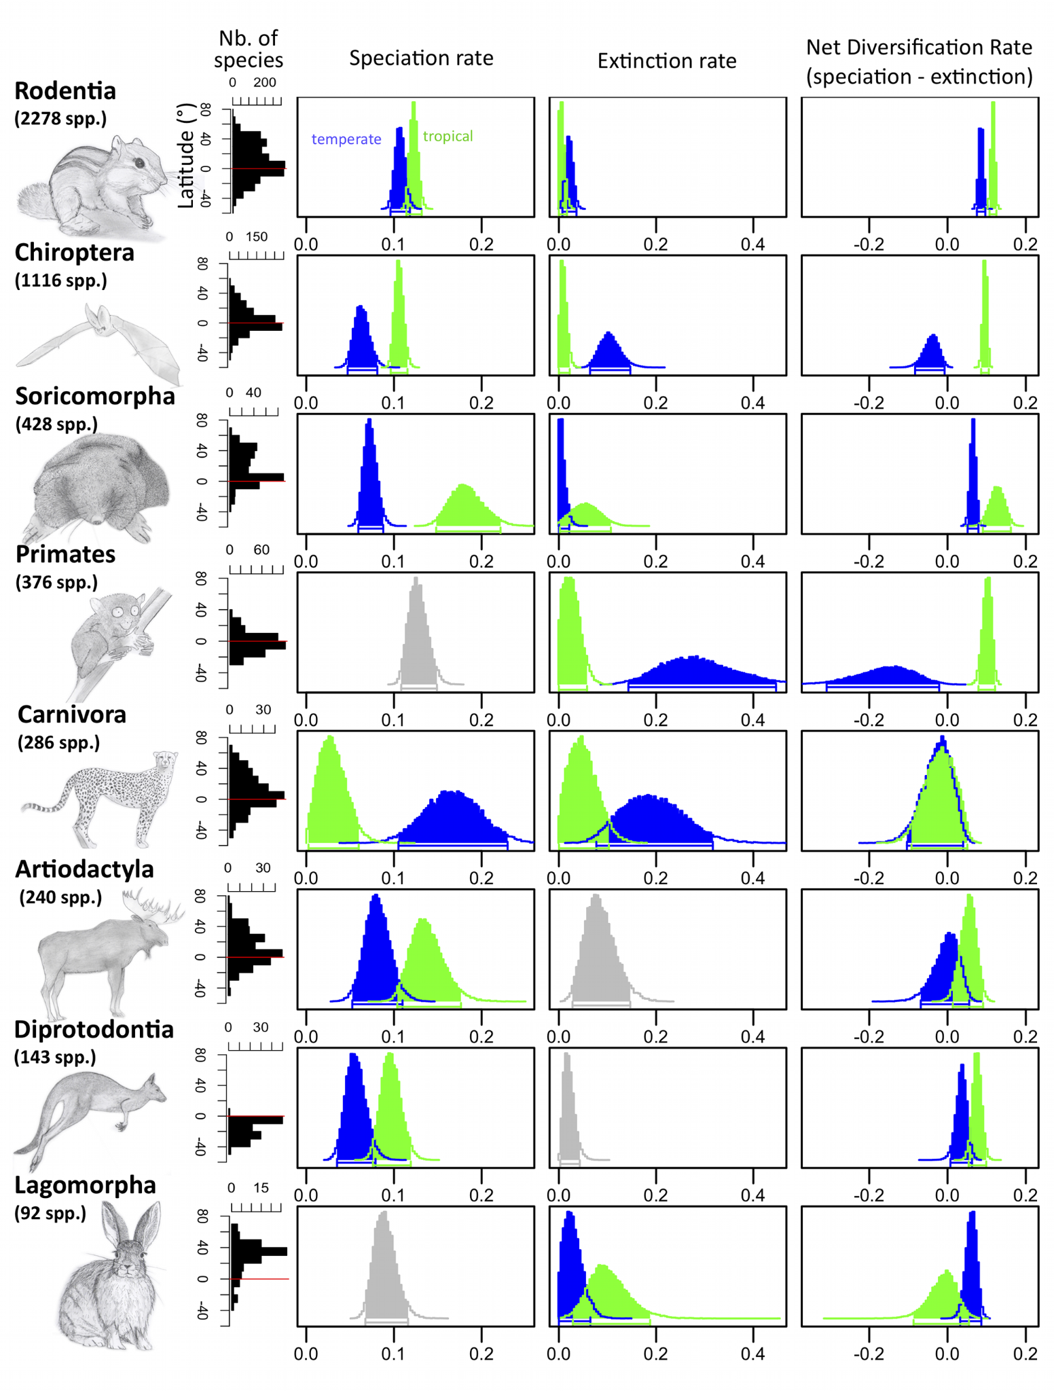
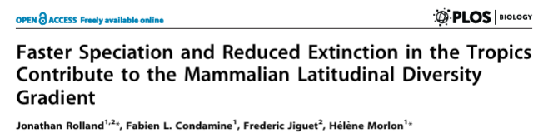
Cradles vs Museums: Testing with Phylogeny

Slide 40
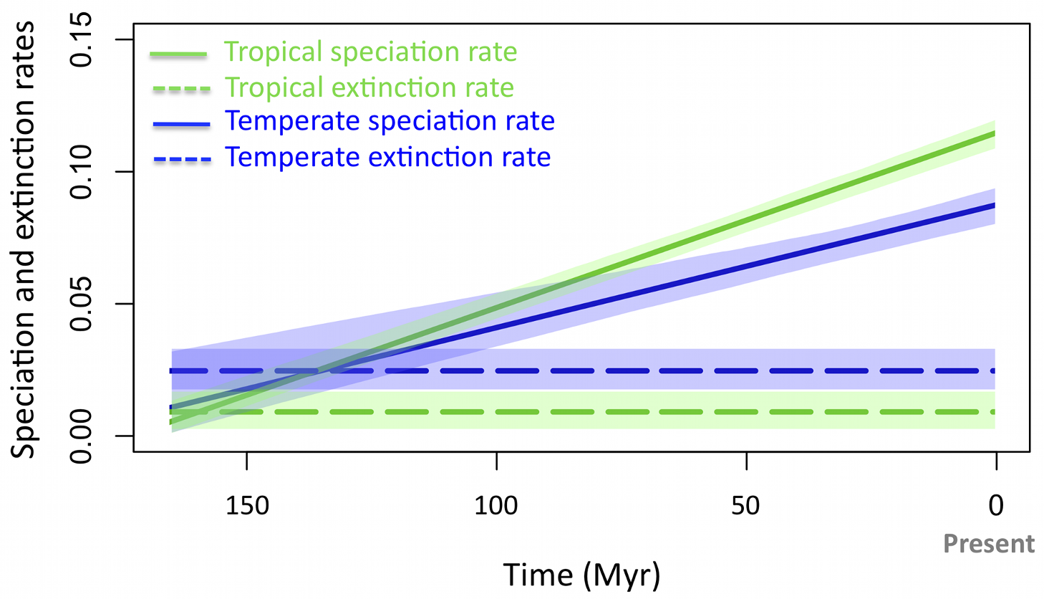
Cradles vs Museums: Testing with Phylogeny

Slide 41
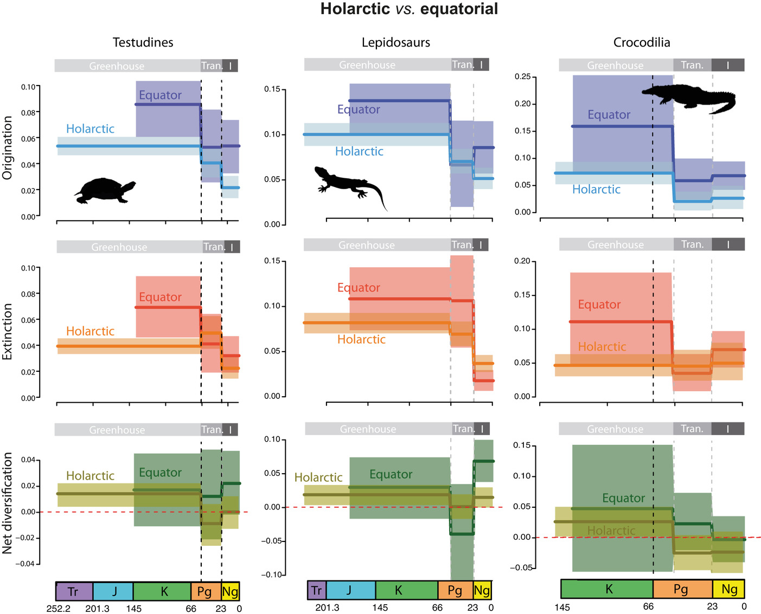
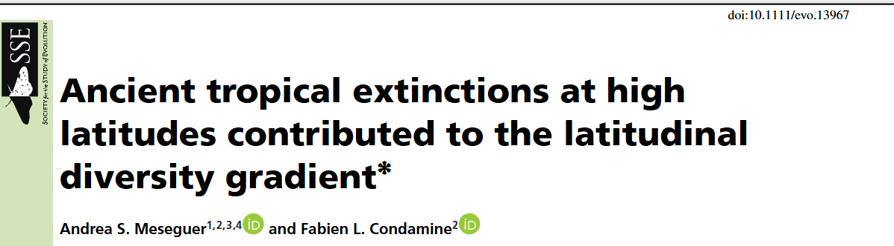
Cradles vs Museums: Testing with Fossils

Slide 42
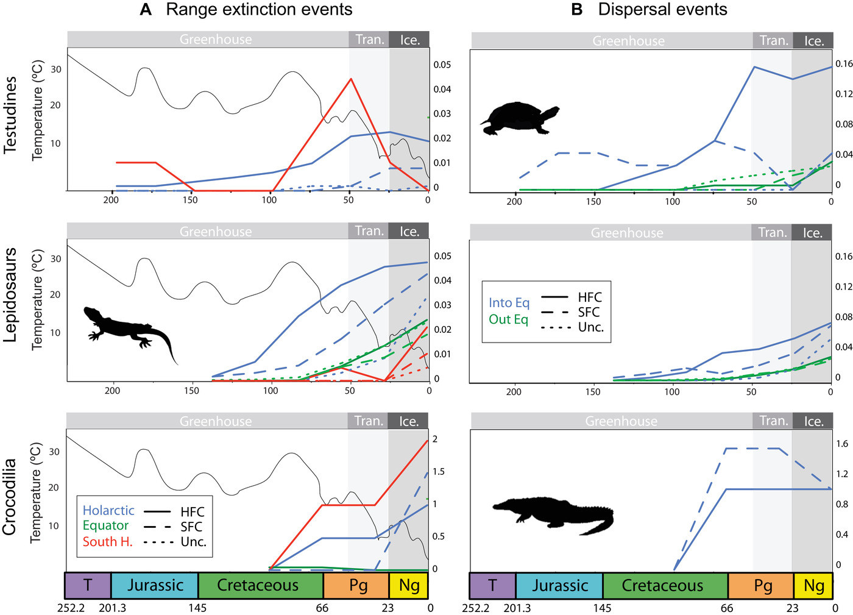
Cradles vs Museums: Testing with Fossils

Slide 43
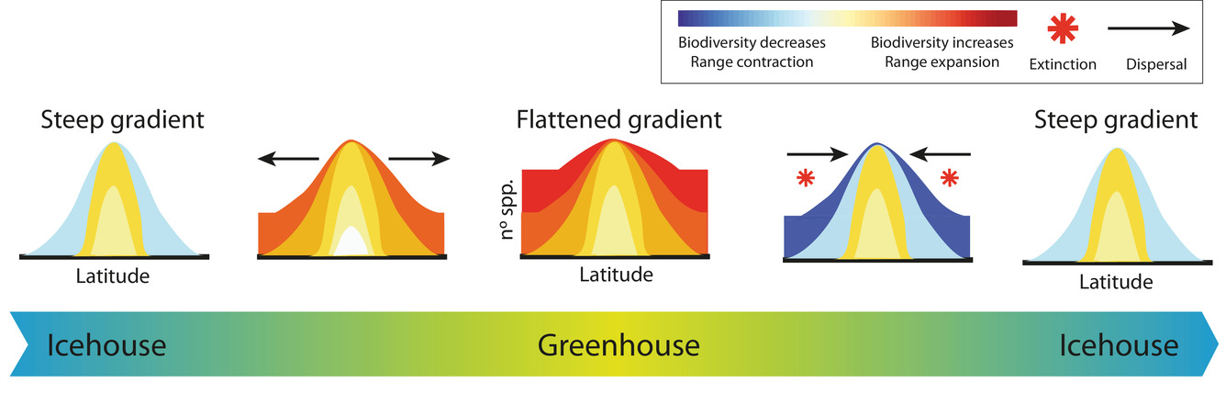
Cradles vs Museums: Testing with Fossils

Slide 44
Evolutionary Explanations: Tropical Niche Conservatism

Slide 45
Evolutionary Explanations: Tropical Niche Conservatism
Niche conservatism: tendency for niches to remain unchanged

Slide 46
Evolutionary Explanations: Tropical Niche Conservatism
Niche conservatism: tendency for niches to remain unchanged
Phylogenetic niche conservatism: tendency for niches to remain unchanged along evolutionary lineages

Slide 47
Evolutionary Explanations: Tropical Niche Conservatism
Niche conservatism: tendency for niches to remain unchanged
Phylogenetic niche conservatism: tendency for niches to remain unchanged along evolutionary lineages
Tropical niche conservatism hypothesis:
Its relatively difficult to evolve traits needed to persist in temperate areas
Due to asymmetry of colonization and historical dominance of tropics, most species today are tropical with only fewer, younger lineages in temperate areas

Slide 48
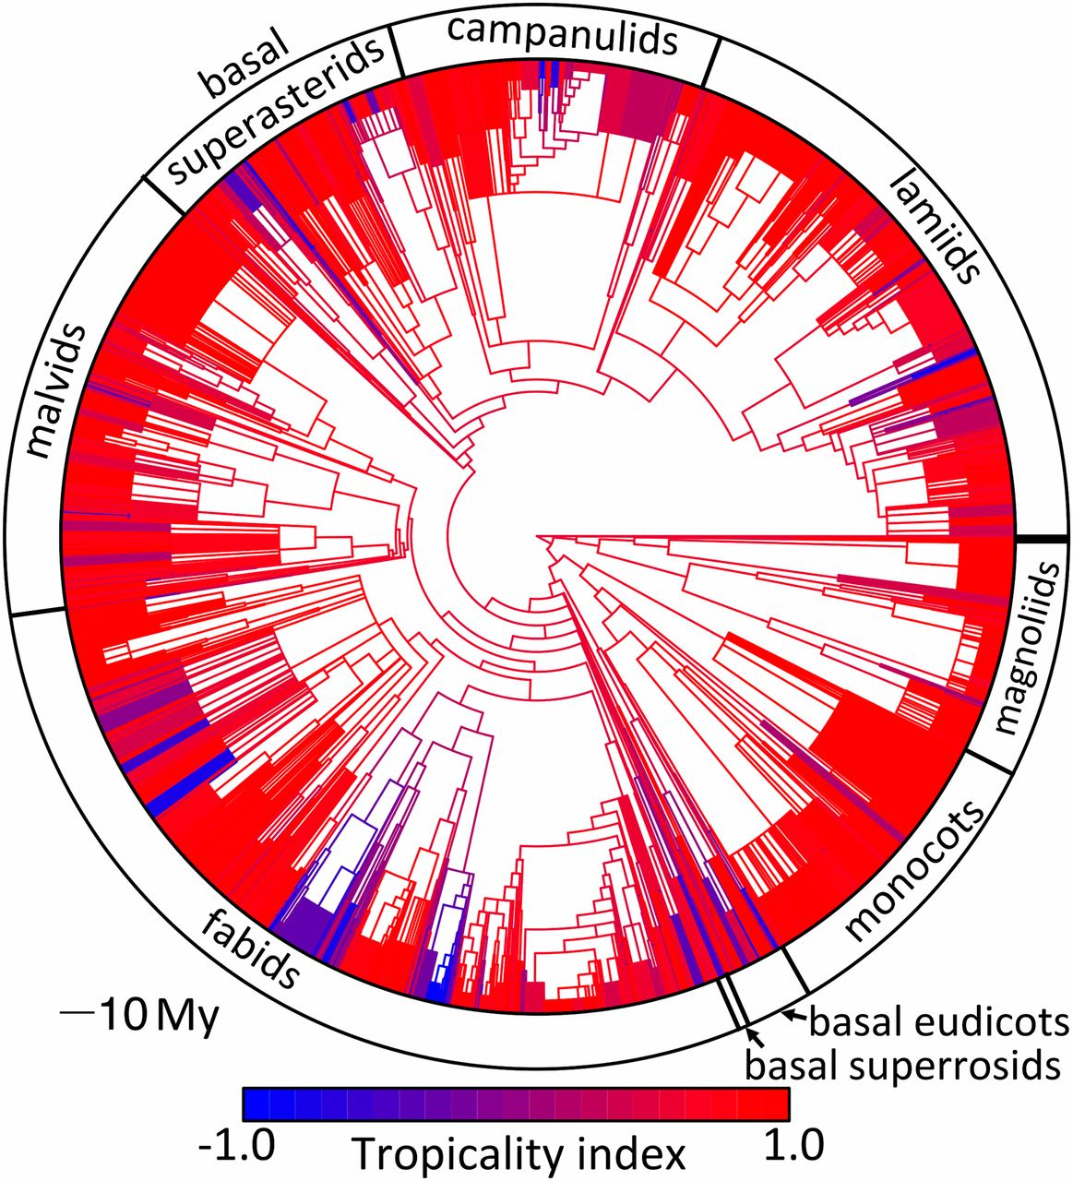
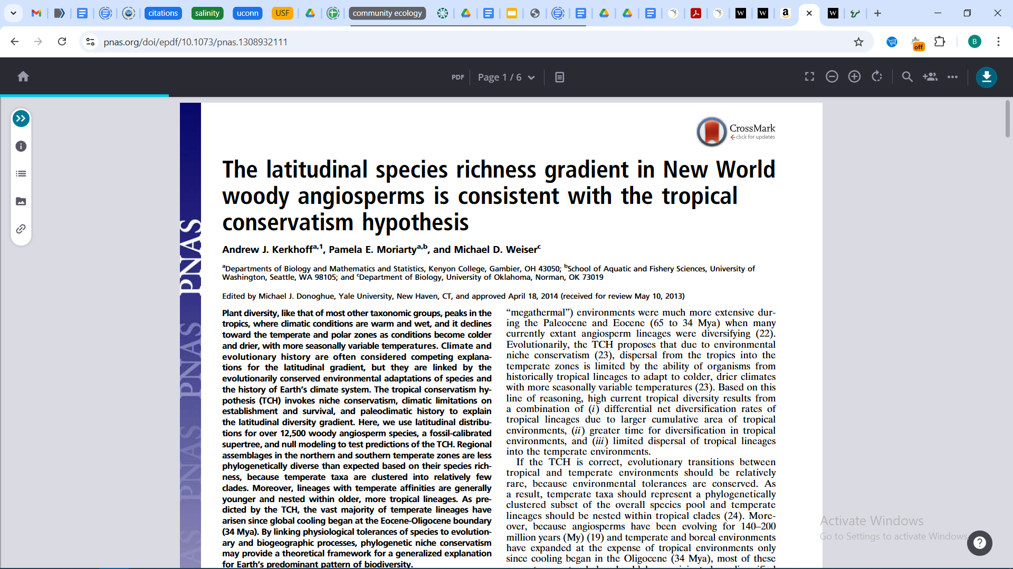
Evolutionary Explanations: Tropical Niche Conservatism
Notes:
Diagram of ancestral–descendent transitions among different latitudinal zones. Circles are proportional to the log of the number of lineages (nodes + tips) in each zone, and the pie sectors represent the fractional ancestry of descendent lineages in that zone (i.e., the fraction of transitions to that zone from each zone). The size of the arrows and the percentages represent the fraction of transitions from that zone to each zone. Thin dashed arrows represent only 1–4% of transitions out of the respective zones. Zones are defined by ranges of tropicality values: tropical (red): 0.5 ≤ TI ≤ 1.0, semitropical (dark red): 0 ≤ TI < 0.5, semitemperate (dark blue): −0.5 ≤ TI < 0, temperate (blue): −1 ≤ TI < −0.5.

Slide 49
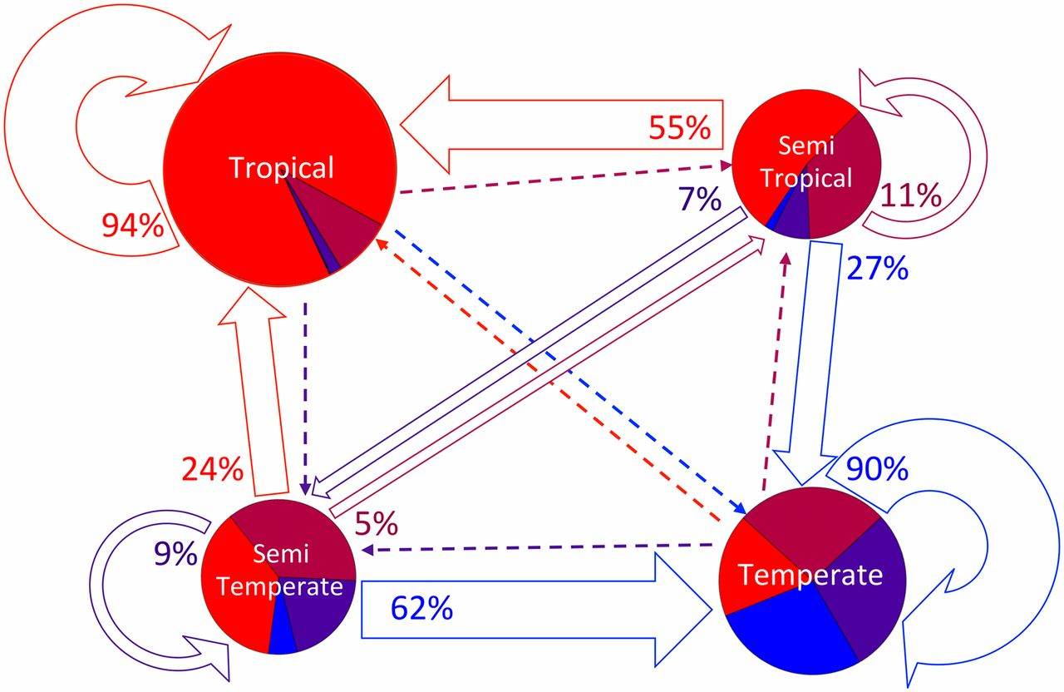
Evolutionary Explanations: Tropical Niche Conservatism
Notes:
Diagram of ancestral–descendent transitions among different latitudinal zones. Circles are proportional to the log of the number of lineages (nodes + tips) in each zone, and the pie sectors represent the fractional ancestry of descendent lineages in that zone (i.e., the fraction of transitions to that zone from each zone). The size of the arrows and the percentages represent the fraction of transitions from that zone to each zone. Thin dashed arrows represent only 1–4% of transitions out of the respective zones. Zones are defined by ranges of tropicality values: tropical (red): 0.5 ≤ TI ≤ 1.0, semitropical (dark red): 0 ≤ TI < 0.5, semitemperate (dark blue): −0.5 ≤ TI < 0, temperate (blue): −1 ≤ TI < −0.5.

Slide 50
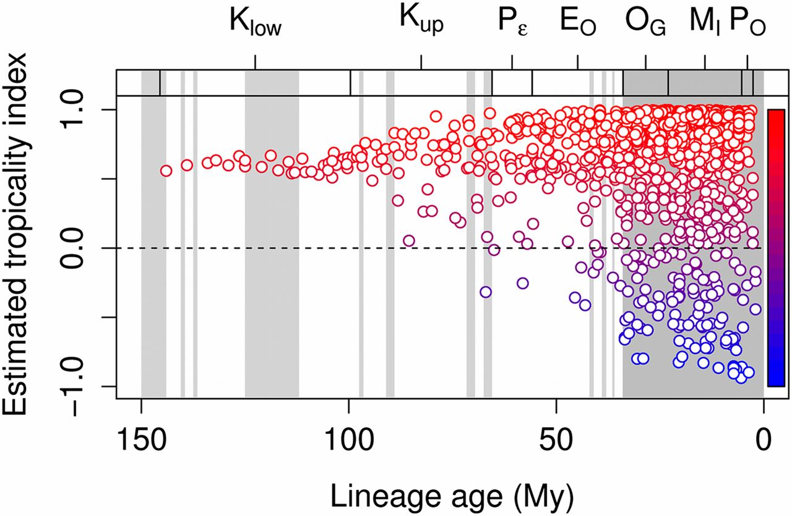
Evolutionary Explanations: Tropical Niche Conservatism
Notes:
Ancestral estimates for the TI as a function of the crown age (My) of the lineage. Partitions at the top delineate geological epochs [lower (Klow) and upper (Kup) Cretaceous, Paleocene (Pε), Eocene (EO), Oligocene (OG), Miocene (MI), and Pliocene (PO)], whereas the gray bands represent cool periods in the paleoclimate record (49).

Slide 51
Which one is it?

Slide 52
Which one is it?
Probably a combination
Studies that test multiple mechanisms are useful

Slide 53
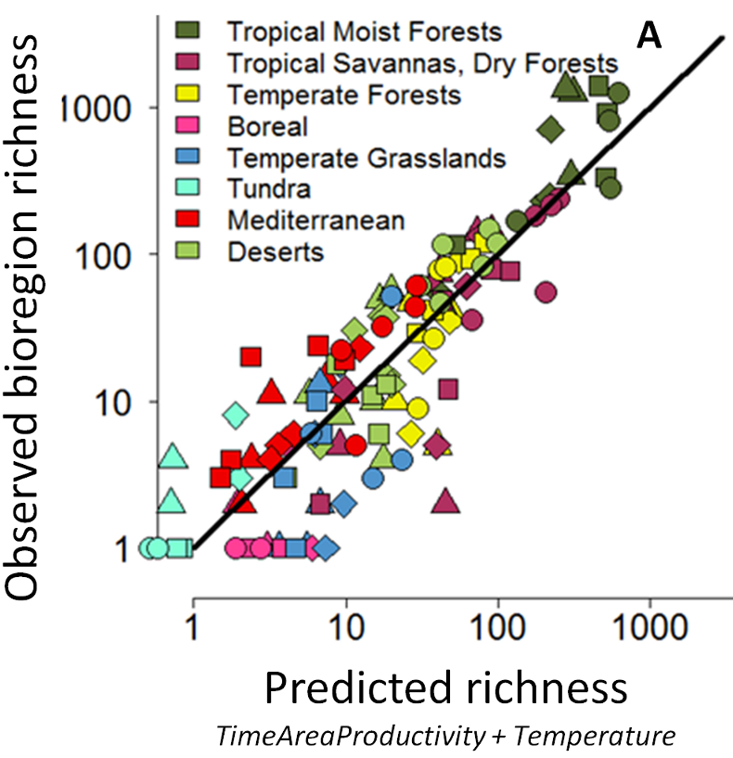
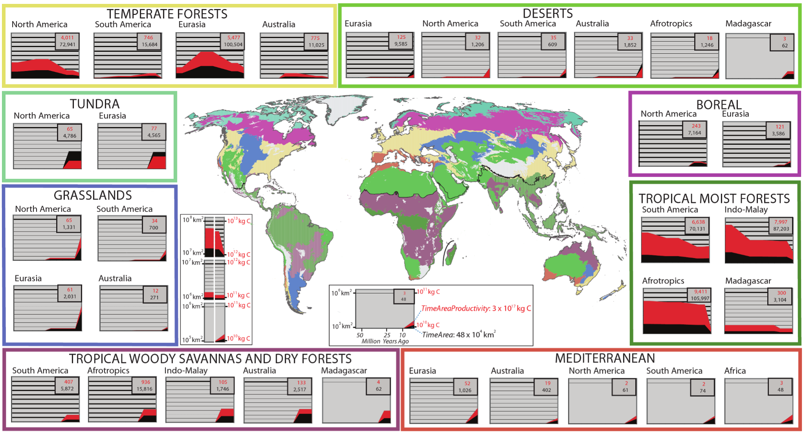
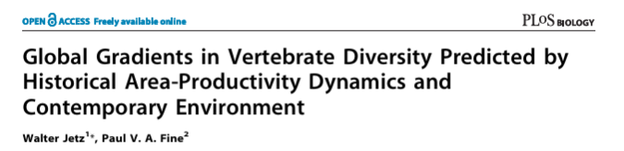
Combinations of factors

Slide 54
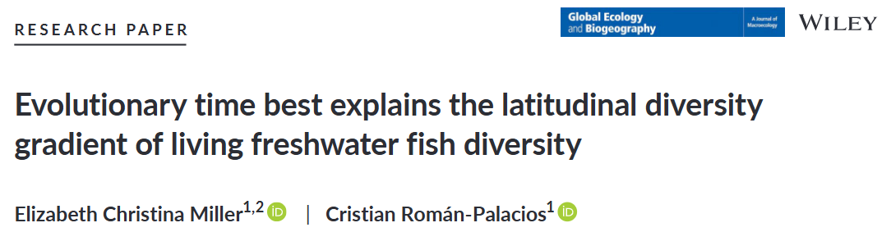
Testing Competing Mechanisms
Tested for relative importance of diversification rates vs. diversification time

Slide 55
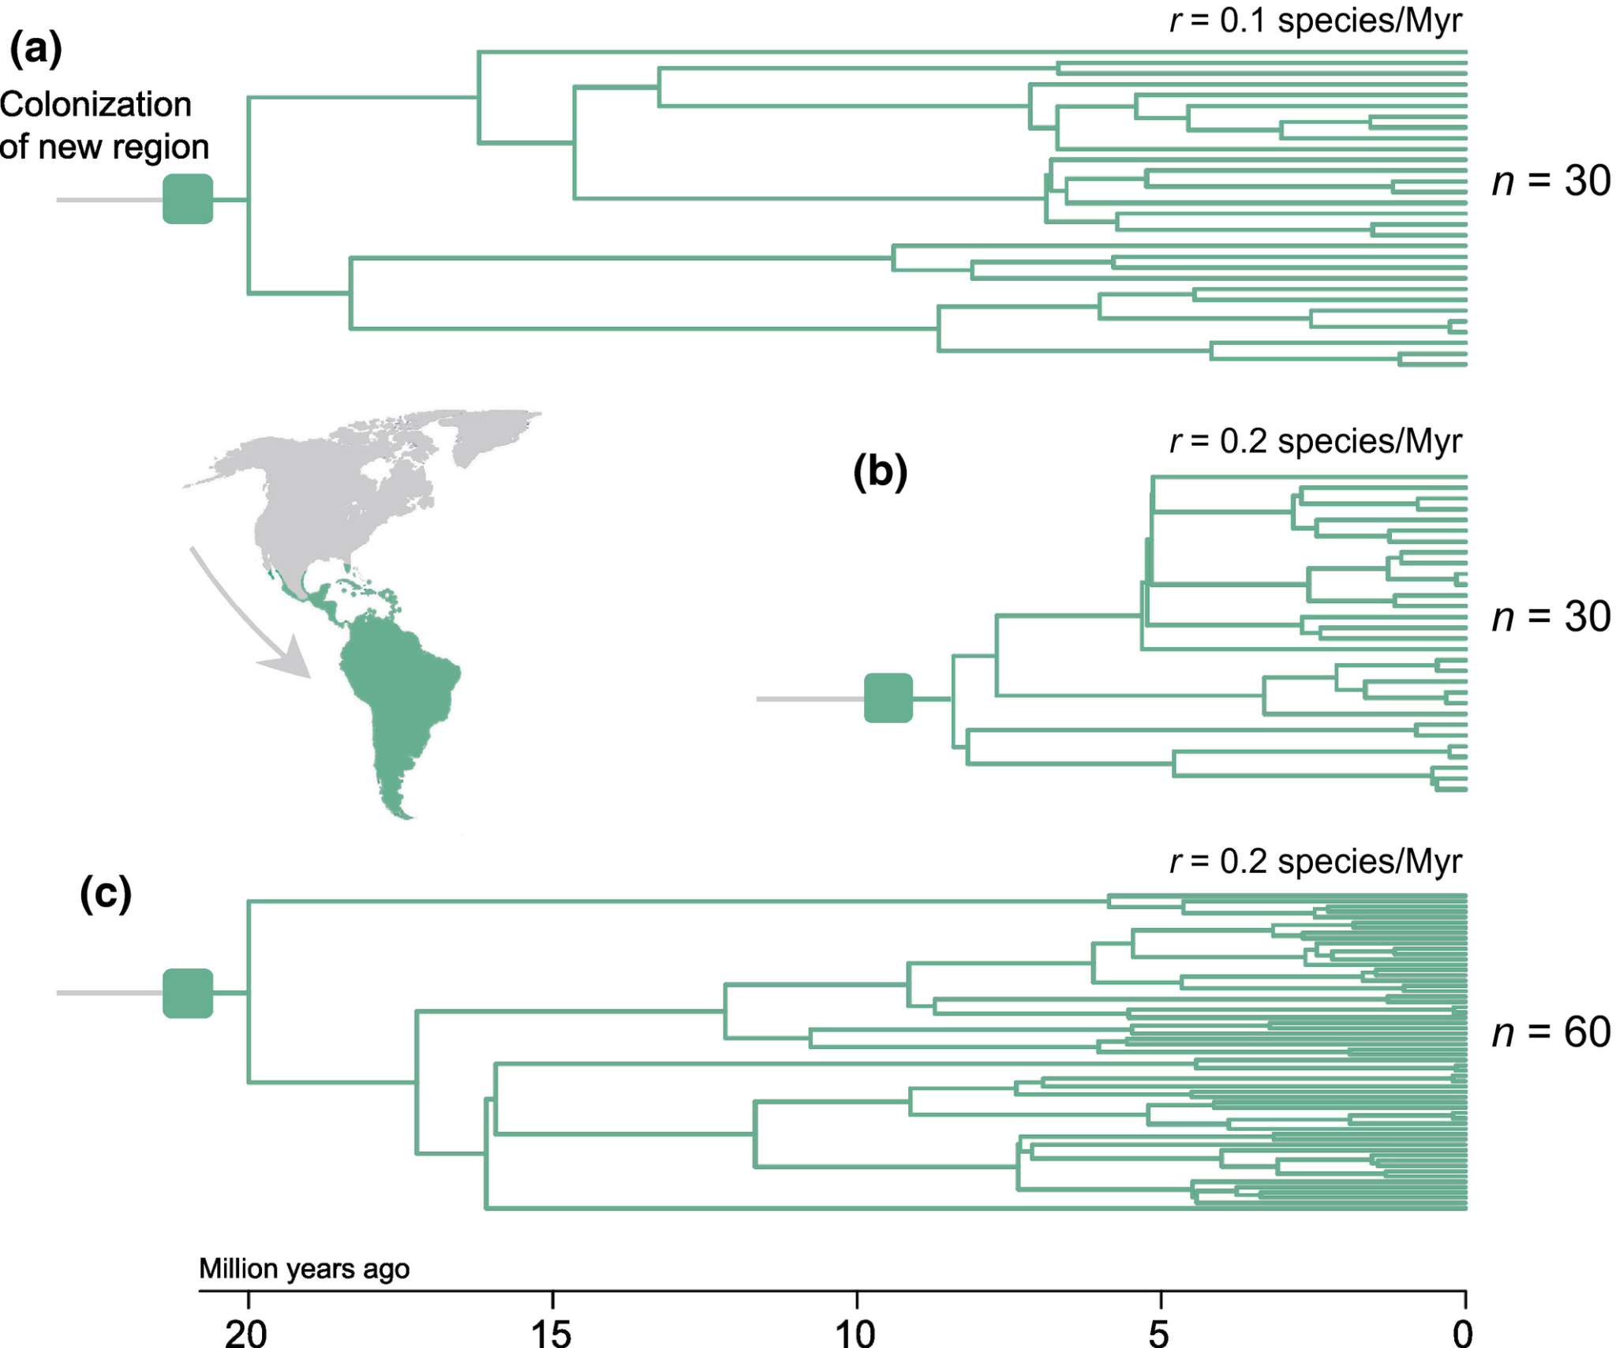
Testing Competing Mechanisms

Slide 56
Testing Competing Mechanisms

Slide 57
Testing Competing Mechanisms

Slide 58
Testing Competing Mechanisms

Slide 59
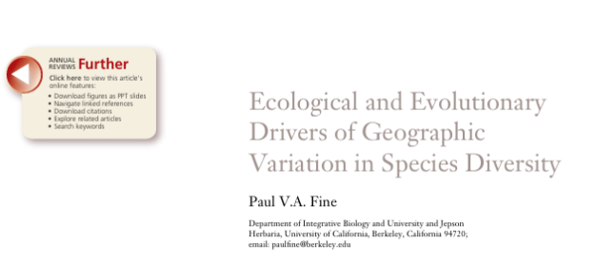
Further reading

Slide 60
These hypotheses apply beyond latitudinal patterns
Examples:
Older vs. younger habitat types and resources
Older vs. younger islands
Productivity variation in aquatic environments
Niche conservatism of other traits

Slide 61
Next class: Student presentations!

