Slide 1
Biodiversity and Ecosystem Functioning
Today’s Agenda:
Quiz
Ecosystem Functions and Services
Biodiversity and Ecosystem Functioning
BEF examples

Slide 2
Ecosystem Functioning
The biological and chemical processes that occur in ecosystems
Functions that benefit people are called “ecosystem services”
Also referred to as “nature’s contributions to people”

Slide 3
Ecosystem Services
What examples can folks think of?

Slide 4
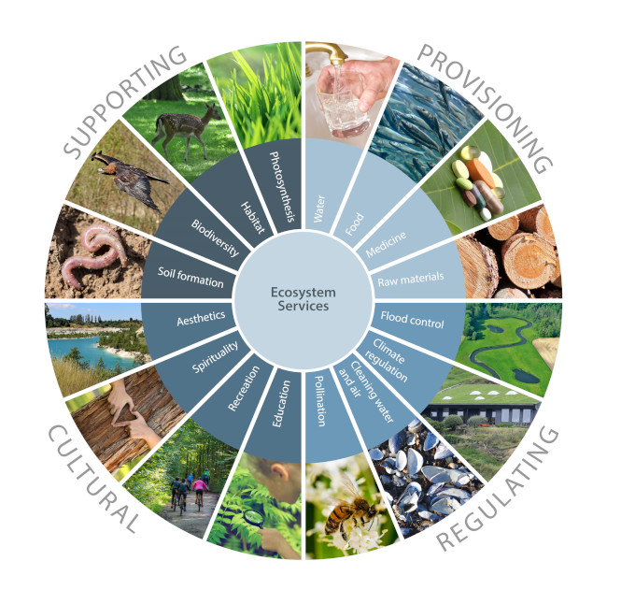
Ecosystem Services
Figure: https://envs.au.dk/en/research-areas/society-environment-and-resources/biodiversity-and-ecosystem-services

Slide 5
Ecosystem Services
Supporting
maintain fundamental ecosystem processes
Figure: https://envs.au.dk/en/research-areas/society-environment-and-resources/biodiversity-and-ecosystem-services; definitions: https://www.climatehubs.usda.gov/ecosystem-services

Slide 6
Ecosystem Services
Supporting
maintain fundamental ecosystem processes
Provisioning
Material and energy
Figure: https://envs.au.dk/en/research-areas/society-environment-and-resources/biodiversity-and-ecosystem-services; definitions: https://www.climatehubs.usda.gov/ecosystem-services

Slide 7
Ecosystem Services
Supporting
maintain fundamental ecosystem processes
Provisioning
Material and energy
Regulating
moderation or control of ecosystem processes
Figure: https://envs.au.dk/en/research-areas/society-environment-and-resources/biodiversity-and-ecosystem-services; definitions: https://www.climatehubs.usda.gov/ecosystem-services

Slide 8
Ecosystem Services
Supporting
maintain fundamental ecosystem processes
Provisioning
Material and energy
Regulating
moderation or control of ecosystem processes
Cultural
non-material/energy benefits to human societies
Figure: https://envs.au.dk/en/research-areas/society-environment-and-resources/biodiversity-and-ecosystem-services; definitions: https://www.climatehubs.usda.gov/ecosystem-services
Notes:
Note also mental health benefits, which are cultural

Slide 9
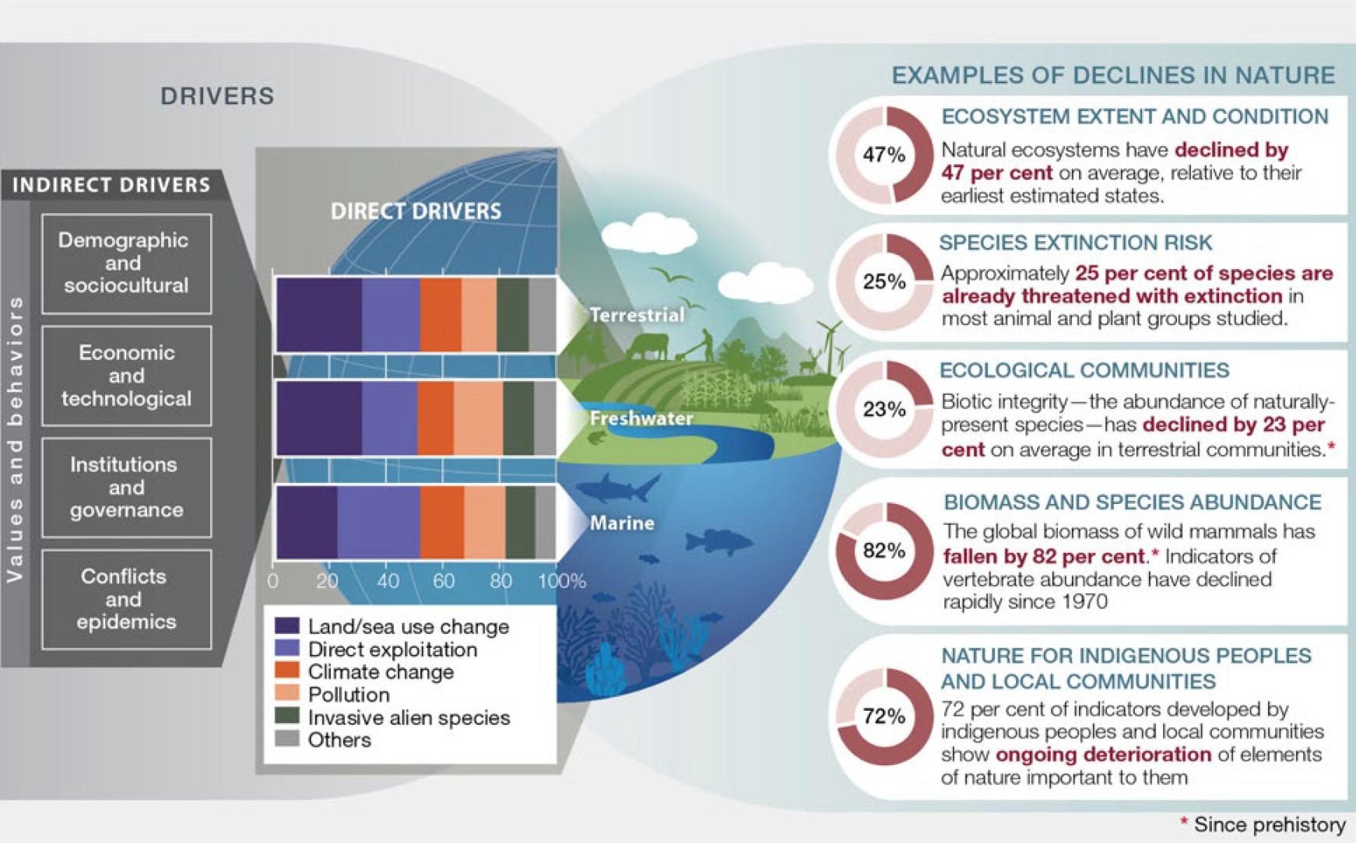
Global Change
IPBES

Slide 10
How much biodiversity do we need?
Biodiversity provides things we need
We’re destroying nature at mass extinction rates
Need to predict impacts of our actions

Slide 11
How much biodiversity do we need?
Biodiversity provides things we need
We’re destroying nature at mass extinction rates
Need to predict impacts of our actions
?
Ecosystem
Functioning
Biodiversity

Slide 12
How much biodiversity do we need?
Biodiversity provides things we need
We’re destroying nature at mass extinction rates
Need to predict impacts of our actions
?
Ecosystem
Functioning
Biodiversity

Slide 13
How much biodiversity do we need?
Biodiversity provides things we need
We’re destroying nature at mass extinction rates
Need to predict impacts of our actions
Ecosystem
Functioning
?
Biodiversity

Slide 14
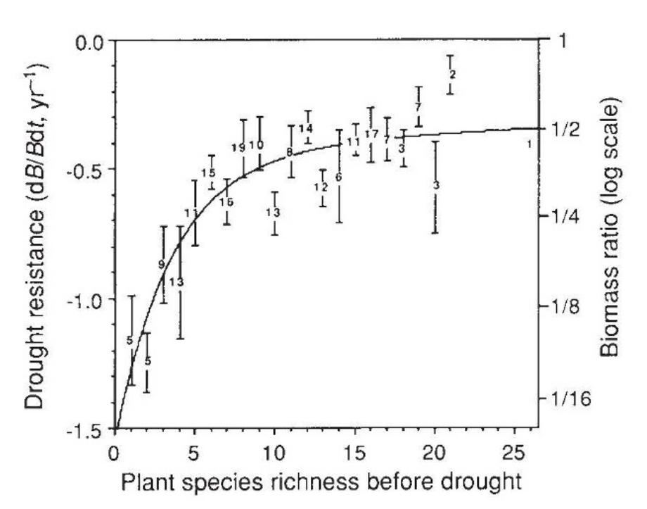
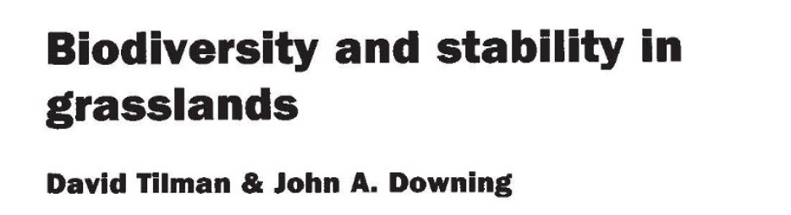
Early Experimental Evidence
Grassland system
Suggestive, but diversity was altered by fertilizer, confounding things
Notes:
Drought resistance was measured as dB/Bdt (yr-1 ), that is, as 0.5 (In [biomass1988/biomass1986]), where biomass1988 is at the height of drought and biomass1986 is for the year preceding drought.

Slide 15
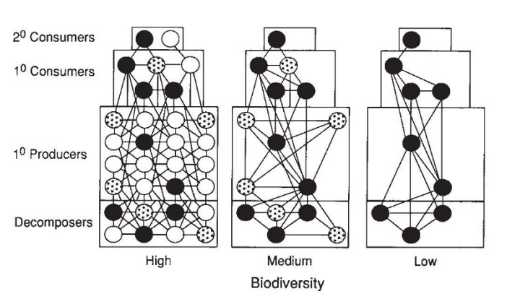
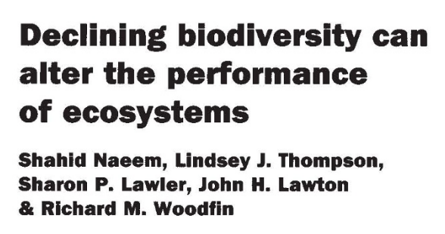
Early Experimental Evidence
Fancy environmental chambers
Manipulated species directly
Manipulated multiple trophic levels

Slide 16
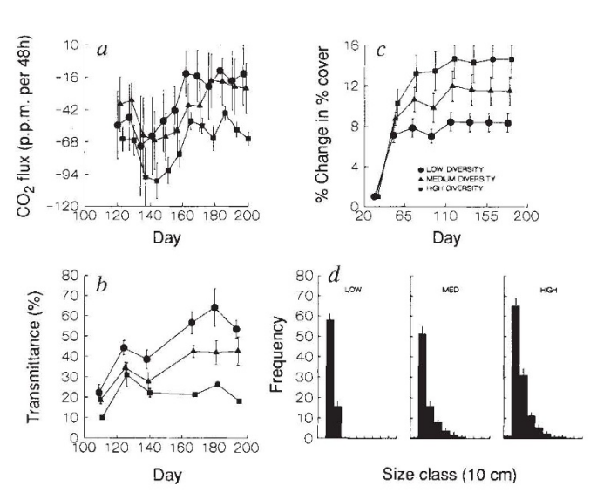
Early Experimental Evidence
Fancy environmental chambers
Manipulated species directly
Manipulated multiple trophic levels

Slide 17
Focal ecosystem functions
Your book focuses on four types of ecosystem functions:
Productivity
Nutrient cycling
Community stability
Invasibility

Slide 18
Focal ecosystem functions
Your book focuses on four types of ecosystem functions:
Productivity
Nutrient cycling
Community stability
Invasibility

Slide 19
Diversity and Productivity
Investigated by 3, high-profile, long-term, experiments
Cedar Creek (US)
Jena (Germany)
BIODEPTH (Europe)
In all, species diversity was experimentally manipulated

Slide 20
Diversity and Productivity
Investigated by 3, high-profile, long-term, experiments
Cedar Creek (US)
Jena (Germany)
BIODEPTH (Europe)
In all, species diversity was experimentally manipulated
Across all 3, diversity was positively correlated with productivity

Slide 21
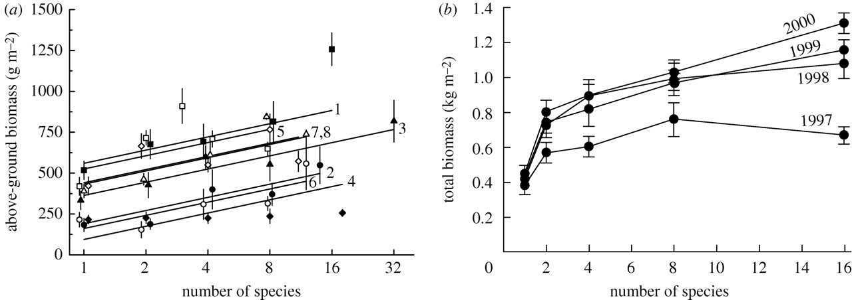
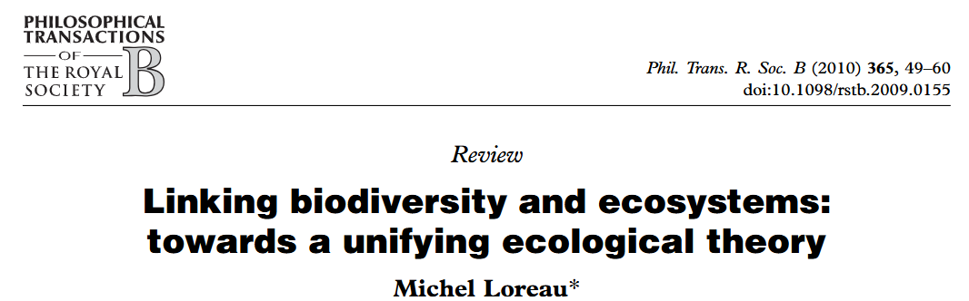
Diversity and Productivity
Investigated by 3, high-profile, long-term, experiments
Cedar Creek (US)
Jena (Germany)
BIODEPTH (Europe)
In all, species diversity was experimentally manipulated
Across all 3, diversity was positively correlated with productivity
a: BIODEPTH,
b: Cedar Creek

Slide 22
Diversity and Productivity
Strong evidence that diversity drives productivity…but why?

Slide 23
Why Does Diversity Impact Productivity?
Two main hypotheses:
Niche complementarity
Species differ in resources, predators, impacts on environment, etc.
Sampling Effect (aka species selection)
More species, more likely to include highly-productive species

Slide 24
Testing complementarity vs sampling effects
How can we tease apart these hypotheses that make similar predictions about diversity-productivity relationships?

Slide 25
Testing complementarity vs sampling effects
How can we tease apart these hypotheses that make similar predictions about diversity-productivity relationships?
Monoculture vs polyculture experiments!

Slide 26
Testing complementarity vs sampling effects
Measure services provided by a species alone
Measure services provided by different assemblages
Sampling effect: polyculture results should equal monoculture results weighted by abundance
Complementarity effect: polyculture results should be more than monoculture effects
Can partition the relative composition of these

Slide 27
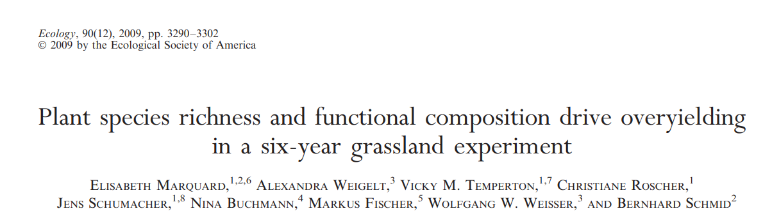
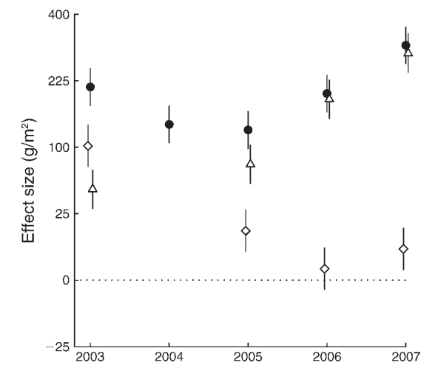
Complementarity vs sampling
Circles = Net Effect of Biodiversity
Diamonds = Selection
Triangles = Complementarity

Slide 28
Complementarity vs sampling
Complementarity effects increase,
Selection effects decrease
Circles = Net Effect of Biodiversity
Diamonds = Selection
Triangles = Complementarity

Slide 29
Focal ecosystem functions
Your book focuses on four types of ecosystem functions:
Productivity
Nutrient cycling
Community stability
Invasibility

Slide 30
Focal ecosystem functions
Your book focuses on four types of ecosystem functions:
Productivity
Nutrient cycling
Community stability
Invasibility

Slide 31
Diversity and Nutrients
If species have complementary niches, they should use more of the available resources
More diverse communities are more likely to contain species that use resources more efficiently
So again, sampling and complementarity effects

Slide 32
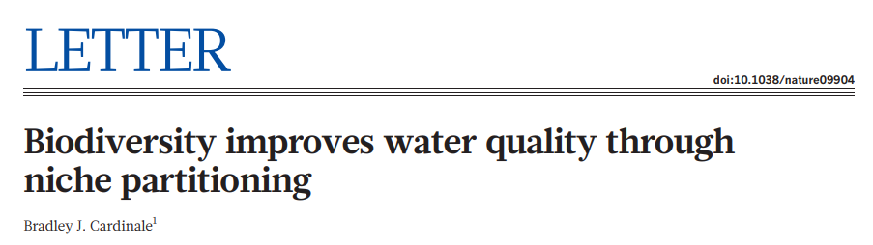
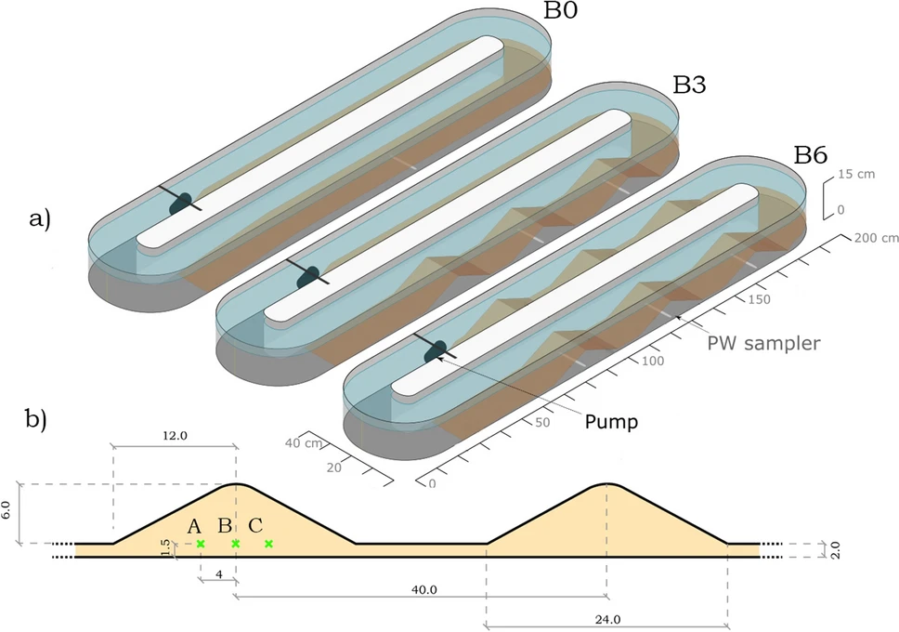
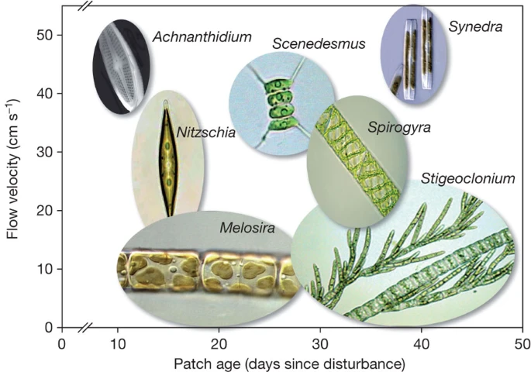
Diversity and Nutrients
Image: Betterle, A., Jaeger, A., Posselt, M. et al. Hyporheic exchange in recirculating flumes under heterogeneous bacterial and morphological conditions. Environ Earth Sci 80, 234 (2021). https://doi.org/10.1007/s12665-021-09472-2

Slide 33
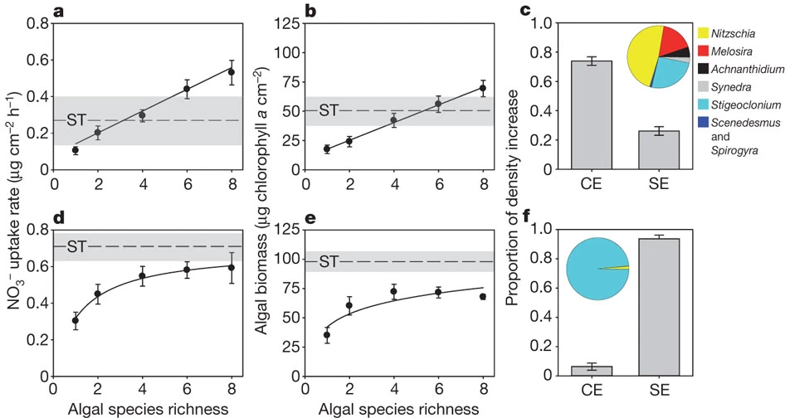
Diversity and Nutrients
Heterogeneous
streams
Homogeneous
streams
Notes:
NO3 = nitrate. The horizontal line and the grey shaded area show mean ± s.e.m. for Stigeoclonium, which achieved the highest values of all of the monocultures.

Slide 34
Focal ecosystem functions
Your book focuses on four types of ecosystem functions:
Productivity
Nutrient cycling
Community stability
Invasibility

Slide 35
Focal ecosystem functions
Your book focuses on four types of ecosystem functions:
Productivity
Nutrient cycling
Community stability
Invasibility

Slide 36
Diversity and Stability
How do we quantify stability?
Variation in a quantity of interest over time
Usually measured as the inverse of the coefficient of variation (CV)
CV = Standard Deviation/Mean
Stability = 1/CV = Mean/Standard Deviation

Slide 37
Diversity and Stability
Mean Abundance
Stability =
SD Abundance

Slide 38
Diversity and Stability
More individuals, more stability
Mean Abundance
Stability =
SD Abundance

Slide 39
Diversity and Stability
Less variation in abundance, more stability
Mean Abundance
Stability =
SD Abundance

Slide 40
Diversity and Stability
Less variation in abundance, more stability
Mean Abundance
Stability =
SD Abundance
Sp B
Positive covariance INCREASES SD
Sp A

Slide 41
Diversity and Stability
Less variation in abundance, more stability
Mean Abundance
Stability =
SD Abundance
Sp B
Negative covariance DECREASES SD
Sp A

Slide 42
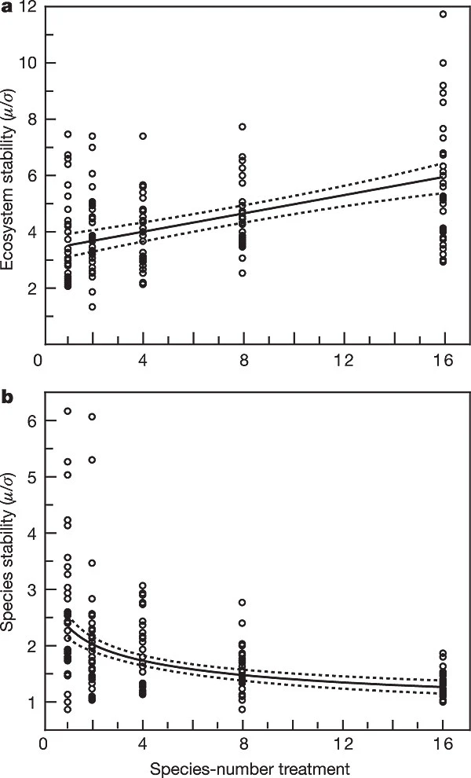
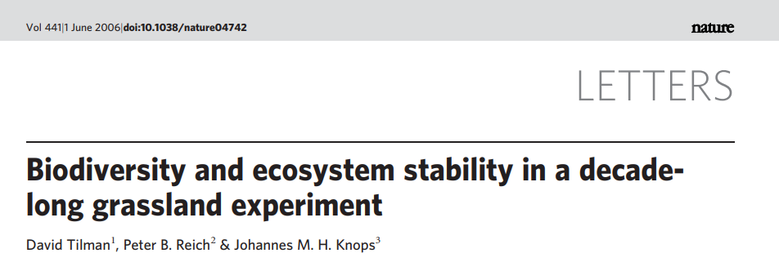
Diversity and Stability

Slide 43
Focal ecosystem functions
Your book focuses on four types of ecosystem functions:
Productivity
Nutrient cycling
Community stability
Invasibility

Slide 44
Focal ecosystem functions
Your book focuses on four types of ecosystem functions:
Productivity
Nutrient cycling
Community stability
Invasibility

Slide 45
Diversity and Invasibility

Slide 46

Diversity and Invasibility
More diverse = more competitors, niche overlap
Selection effects possible - more diverse communities more likely to contain species that resist invasion

Slide 47
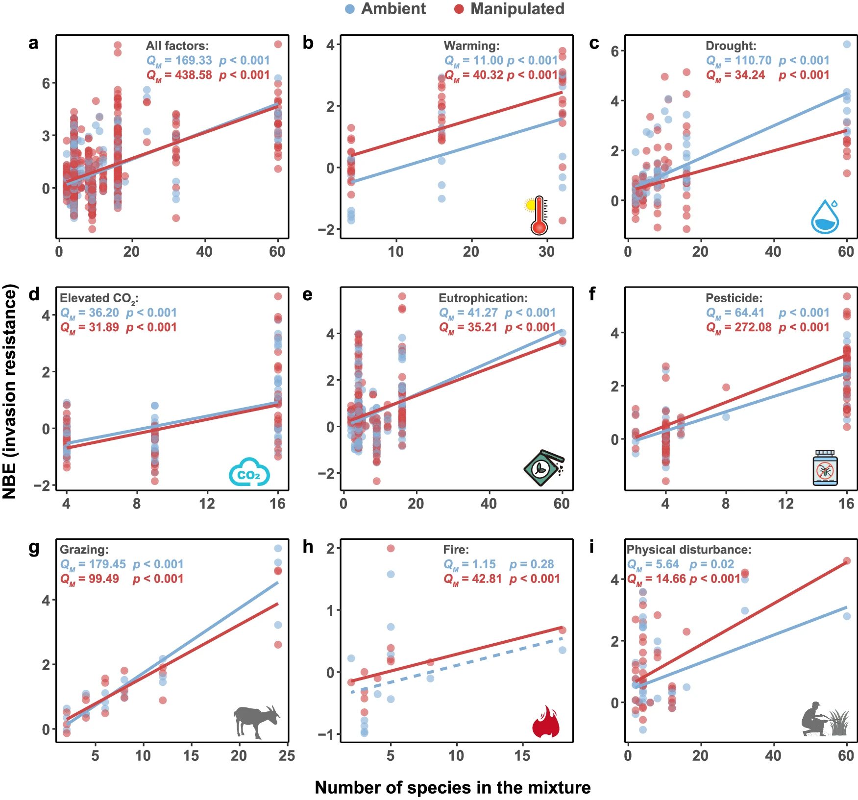
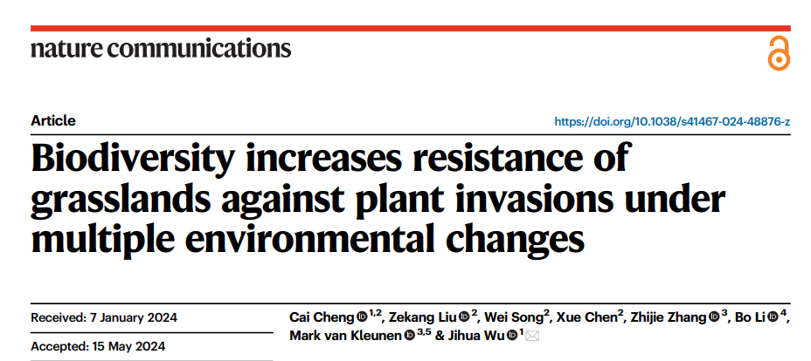
Diversity and Invasibility
Meta-analysis of 25 studies

Slide 48
Focal ecosystem functions
Your book focuses on four types of ecosystem functions:
Productivity
Nutrient cycling
Community stability
Invasibility

Slide 49
Focal ecosystem functions
Your book focuses on four types of ecosystem functions:
Productivity
Nutrient cycling
Community stability
Invasibility
… but ecosystems provide MANY services at once…

Slide 50
Ecosystem Multifunctionality
Provision of multiple functions/services by ecosystems
Different ways of calculating
Standardized averages
Number of functions that exceed some threshold value (e.g., 50% of max functioning)

Slide 51
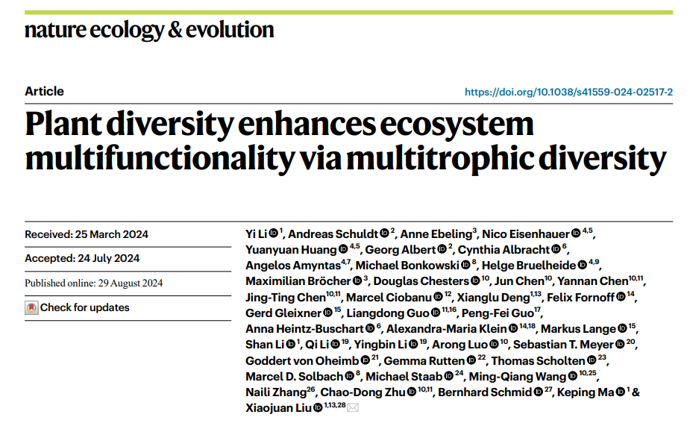
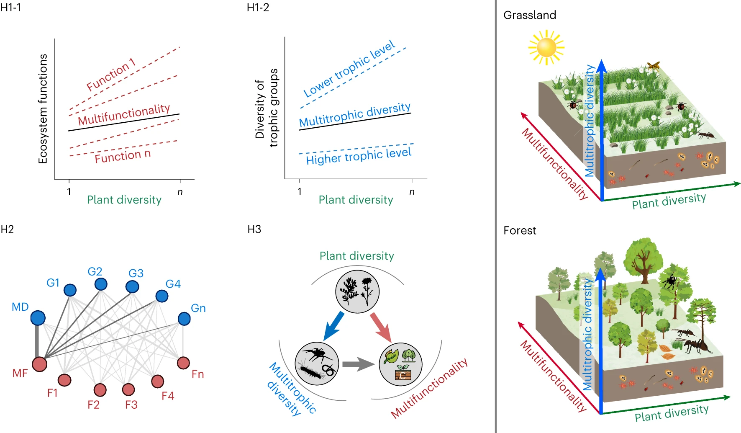
Ecosystem Multifunctionality
Notes:
Conceptual figure

Slide 52
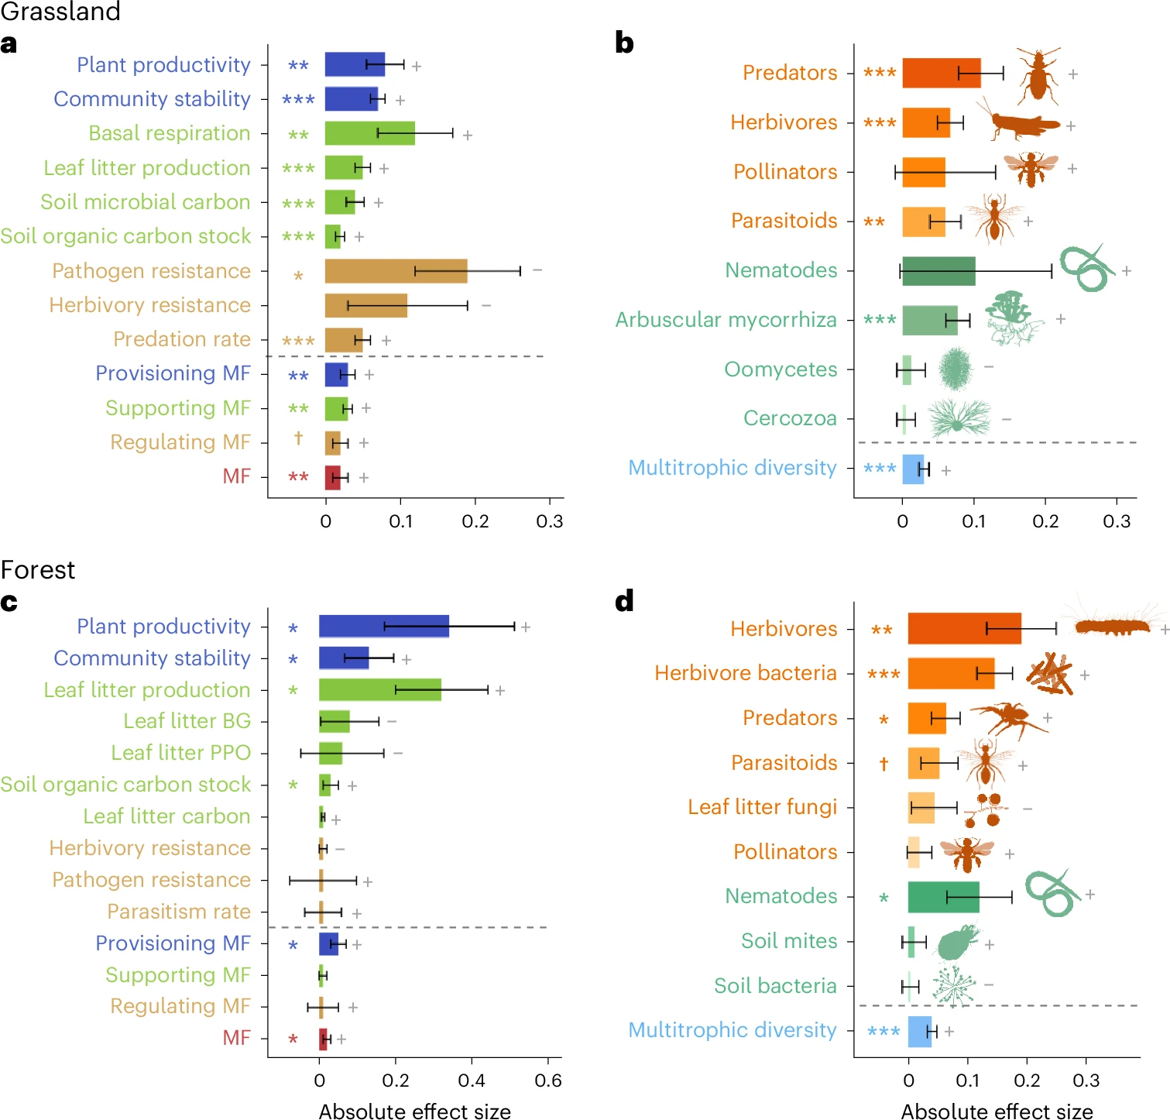
Ecosystem Multifunctionality - Plant diversity effects

Slide 53
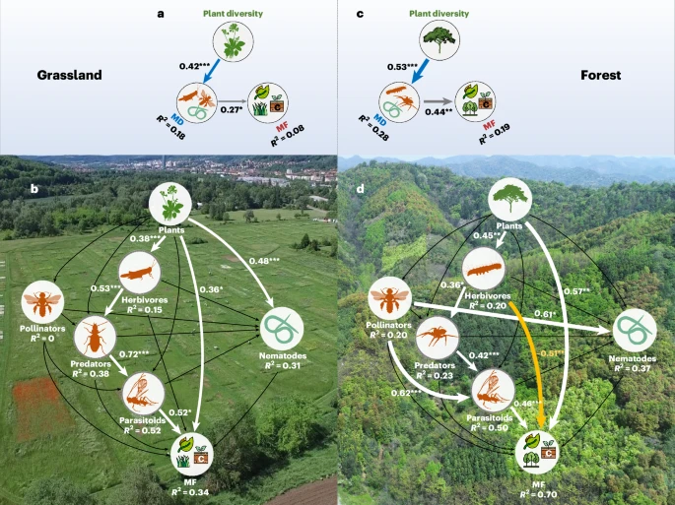
Ecosystem Multifunctionality - Trophic effects

Slide 54
Next class: More Biodiversity and Ecosystem Functioning!

