Slide 1
Predator-Prey Interactions
Today’s Agenda:
Quiz
Predator-Prey Interactions

Slide 2
Predation
We’re going to start by focusing on one-predator, one-prey
(note this is relatively rare in nature)

Slide 3
Predation
One way of quantifying predation is with the feedinging rate
Feeding rate = # prey eaten per unit time

Slide 4
Predation
One way of quantifying predation is with the feedinging rate
Feeding rate = # prey eaten per unit time
We might imagine this as something like:
Feeding rate = aN
a = attack rate
N= # prey

Slide 5
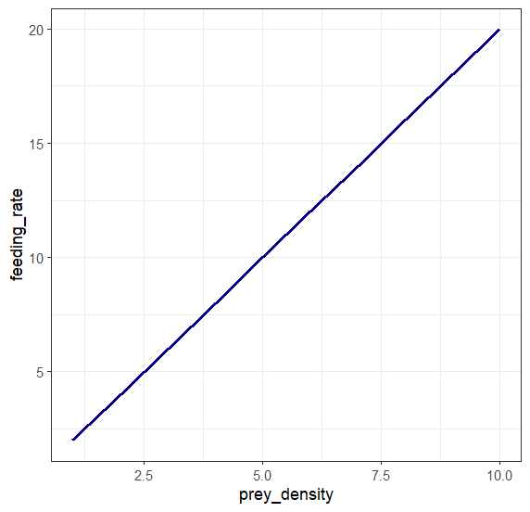
Type I functional response
Feeding rate = aN
a = attack rate
N= # prey

Slide 6
Type I functional response
Feeding rate = aN
a = attack rate
N= # prey
Not realistic in most scenarios!

Slide 7
Type II Functional Response
Predators can only eat so quickly!
Feeding rate =
a = attack rate
N = # prey
aN

Slide 8
Type II Functional Response
Predators can only eat so quickly!
Feeding rate =
a = attack rate
N = # prey
h = handling time
aN
1 + ahN

Slide 9
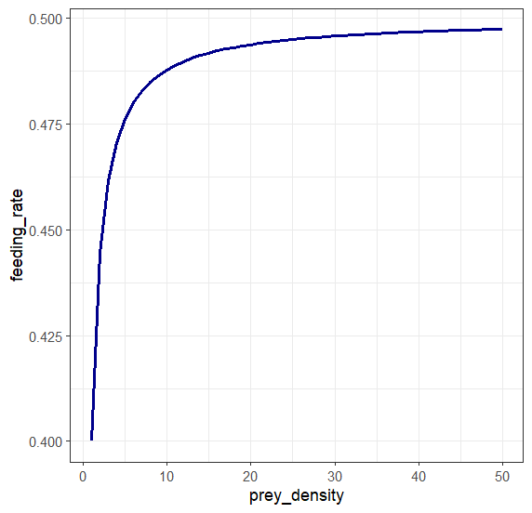
Type II Functional Response
Predators can only eat so quickly!
Feeding rate =
a = attack rate
N = # prey
h = handling time
aN
1 + ahN

Slide 10
Type II Functional Response
Maximum feeding rate is 1/h
Predators can only eat so quickly!
Feeding rate =
a = attack rate
N = # prey
h = handling time
aN
1 + ahN

Slide 11
Type III Functional Response
… but what if predators ignore prey at low densities?
Feeding rate =
N = # prey
c = 1/handling time = max. feeding rate
d = 1/attack rate * handling time
cN²
d² + N²

Slide 12
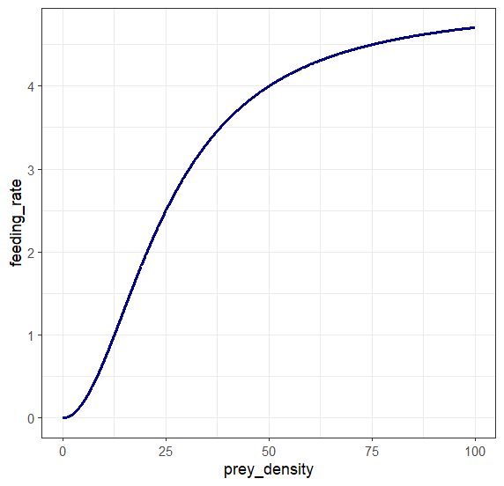
Type III Functional Response
… but what if predators ignore prey at low densities?
Feeding rate =
N = # prey
c = 1/handling time = max. feeding rate
d = 1/attack rate * handling time
cN²
d² + N²

Slide 13
Type III Functional Response
Maximum feeding rate is 1/h
… but what if predators ignore prey at low densities?
Feeding rate =
N = # prey
c = 1/handling time = max. feeding rate
d = 1/attack rate * handling time
cN²
d² + N²
Notes:
Note s-shaped curve

Slide 14
Lotka-Volterra
We’ve covered different ways that prey density impacts consumption rate
BUT we haven’t yet talked about how the populations are impacted by this

Slide 15
Lotka-Volterra
We’ve covered different ways that prey density impacts consumption rate
BUT we haven’t yet talked about how the populations are impacted by this
Lotka-Volterra model is a simple model of predation
Good starting point

Slide 16
Lotka-Volterra
dN/dt = rN − aNP
N = number prey
P = number of predator
r = prey per-capita growth rate
a= predator per-capita attack rate

Slide 17
Lotka-Volterra
dN/dt = rN − aNP
N = number prey
P = number of predator
r = prey per-capita growth rate
a= predator per-capita attack rate
dP/dt = faNP - qP
f = predator efficiency of converting prey to more predators
q = predator per-capita mortality

Slide 18
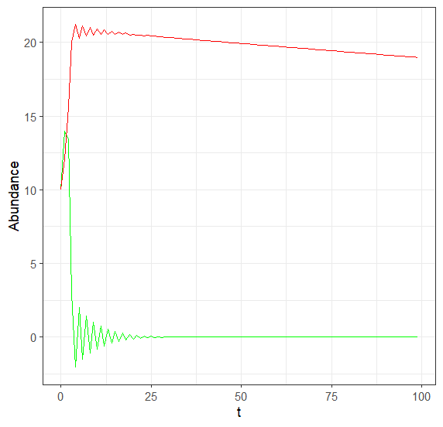
Lotka-Volterra

Slide 19
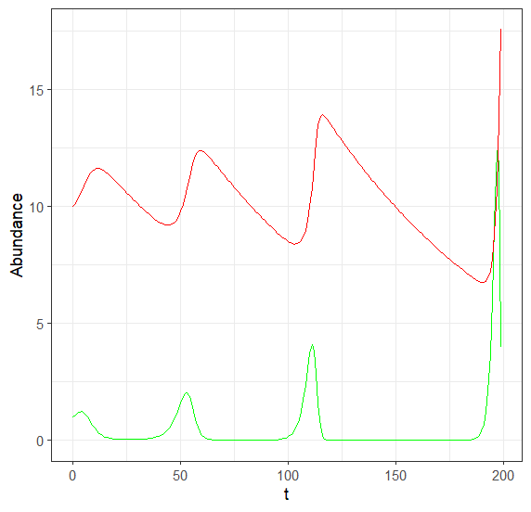
Lotka-Volterra

Slide 20
Lotka-Volterra
Oscillations of predator and prey
Oscillations can increase or decrease over time
Can also have stable oscillations
Can easily get one species going to (or below) zero

Slide 21
Lotka-Volterra
Very basic model
Ignores self-limitation by prey or predator
Type I functional response

Slide 22
Lotka-Volterra
Very basic model
Ignores self-limitation by prey or predator
Type I functional response
Can modify by
adding in prey density dependence
Using a Type II predator response

Slide 23
Rosenzweig-MacArthur
dN/dt = rN(1- (N/k) ) − aNP
N = number prey
P = number of predator
r = prey per-capita growth rate
a= predator per-capita attack rate
k= carrying capacity
dP/dt = faNP - qP
f = predator efficiency of converting prey to more predators
q = predator per-capita mortality
h = handling time
1 + ahN

Slide 24
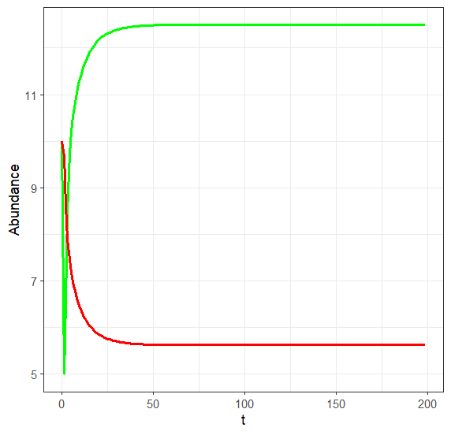
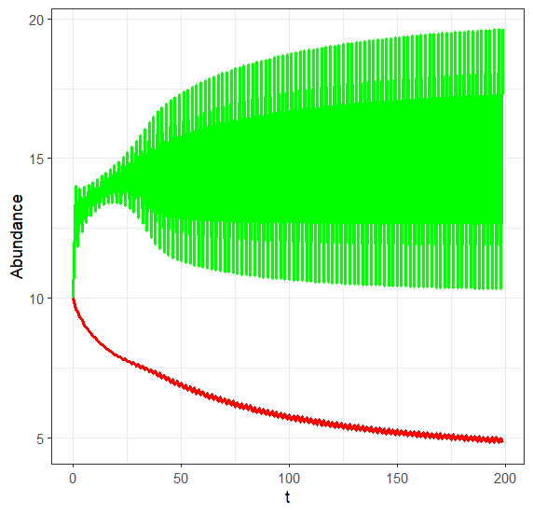
Rosenzweig-MacArthur
dN/dt = rN(1- (N/k) ) − aNP
dP/dt = faNP - qP
1 + ahN

Slide 25
Rosenzweig-MacArthur
dN/dt = rN(1- (N/k) ) − aNP
dP/dt = faNP - qP
1 + ahN
By adding in a bit more realism, coexistence is easier

Slide 26
Other modifications to Lotka-Volterra
LV is based on predator-prey interactions, but can be modified!
Herbivory
Whole individuals aren’t eaten
Model is re-framed in terms of biomass rather than individuals

Slide 27
Other modifications to Lotka-Volterra
LV is based on predator-prey interactions, but can be modified!
Herbivory
Whole individuals aren’t eaten
Model is re-framed in terms of biomass rather than individuals
Disease
Model can likewise be modified to focus on disease
Alternatively, it can handle disease AND e.g., predation, herbivory

Slide 28
Multiple Prey
We’ve been assuming 1 predator, 1 prey systems.
What happens when you have multiple prey?

Slide 29
Optimal Foraging Theory
Predators often have options!
What are some of the reasons why predators might select different prey?

Slide 30
Optimal Foraging Theory
Predators often have options!
What are some of the reasons why predators might select different prey?
Availability
Energy content
Safety
Time (to catch, eat, etc.)

Slide 31
Optimal Diet Model
E/T = energy gained per unit time
𝜆_{i} = # prey species i encountered per unit time
E_{i} = energy gain from prey species i
p_{i} = probability of pursuit, capture of species i
h_{i} = handling time of prey species i
E
𝛴_{i}^{k} 𝜆_{i}E_{i}p_{i}
=
T
1 + 𝛴_{i}^{k} 𝜆_{i}h_{i}p_{i}

Slide 32
Optimal Diet Model
Handling time slows things down, so prey with high h values should only be eaten in they have a high E value
E
𝛴_{i}^{k} 𝜆_{i}E_{i}p_{i}
=
T
1 + 𝛴_{i}^{k} 𝜆_{i}h_{i}p_{i}
E/T = energy gained per unit time
𝜆_{i} = # prey species i encountered per unit time
E_{i} = energy gain from prey species i
p_{i} = probability of pursuit, capture of species i
h_{i} = handling time of prey species i

Slide 33
Optimal Diet Model
Can increase E/T by improving capture rates
But only if the E_{i}:h_{i} ratio is profitable
E
𝛴_{i}^{k} 𝜆_{i}E_{i}p_{i}
=
T
1 + 𝛴_{i}^{k} 𝜆_{i}h_{i}p_{i}
E/T = energy gained per unit time
𝜆_{i} = # prey species i encountered per unit time
E_{i} = energy gain from prey species i
p_{i} = probability of pursuit, capture of species i
h_{i} = handling time of prey species i

Slide 34
Optimal Diet Model
Reducing handling time improves E/T
E
𝛴_{i}^{k} 𝜆_{i}E_{i}p_{i}
=
T
1 + 𝛴_{i}^{k} 𝜆_{i}h_{i}p_{i}
E/T = energy gained per unit time
𝜆_{i} = # prey species i encountered per unit time
E_{i} = energy gain from prey species i
p_{i} = probability of pursuit, capture of species i
h_{i} = handling time of prey species i

Slide 35
Optimal Diet Model
Overall, a relatively simple model
BUT it makes testable predictions!
E
𝛴_{i}^{k} 𝜆_{i}E_{i}p_{i}
=
T
1 + 𝛴_{i}^{k} 𝜆_{i}h_{i}p_{i}
E/T = energy gained per unit time
𝜆_{i} = # prey species i encountered per unit time
E_{i} = energy gain from prey species i
p_{i} = probability of pursuit, capture of species i
h_{i} = handling time of prey species i

Slide 36
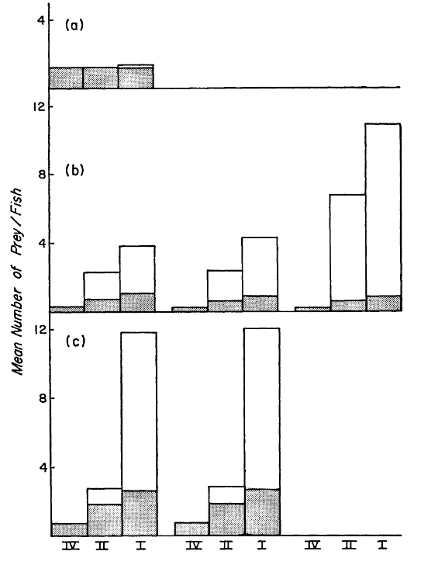
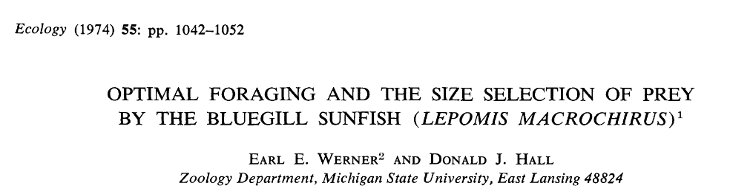
Testing the Optimal Diet Model
Predators:
Class I = biggest
Class IV = smallest
Low Prey Density
White: prey eaten
Grey: null expectation
High Prey Density

Slide 37
Optimal Foraging Theory
Predators also often have an option of WHERE they forage

Slide 38
Optimal Foraging Theory
Predators also often have an option of WHERE they forage
Marginal Value Theorem
Choice to stay or leave depends on:
Rate of gain of resources
Average resource amount per patch
Travel time between patches

Slide 39
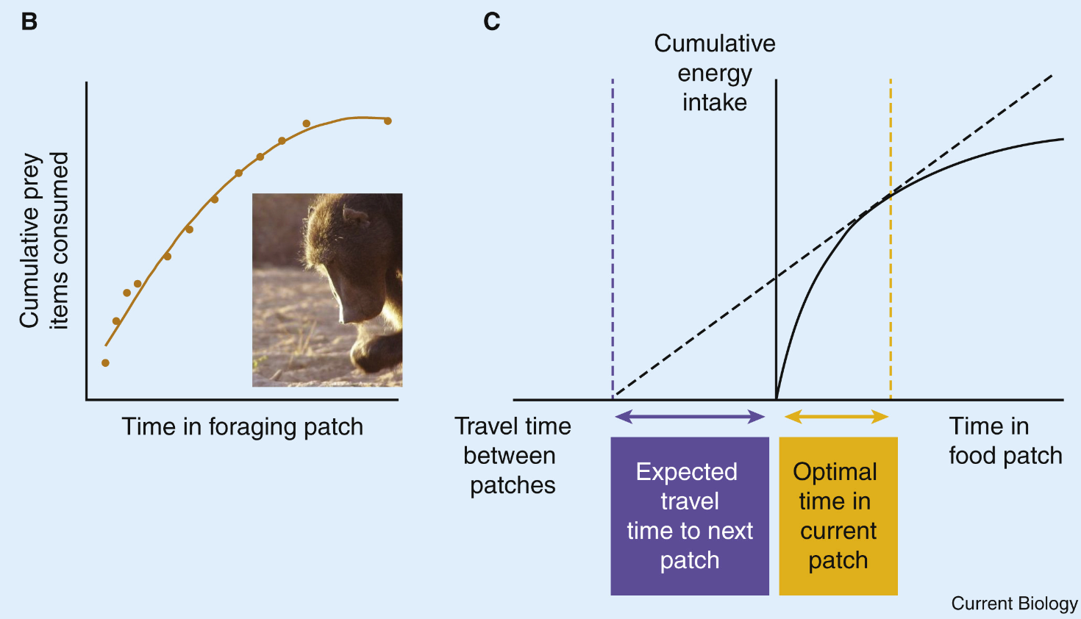
Marginal Value
Rate of energy gain
E/T
King, Andrew J. et al. Current Biology, Volume 32, Issue 12, R680 - R683

Slide 40
Marginal Value
As with Optimal Foraging, the marginal value theorem has received support
… and not just with animals!

Slide 41
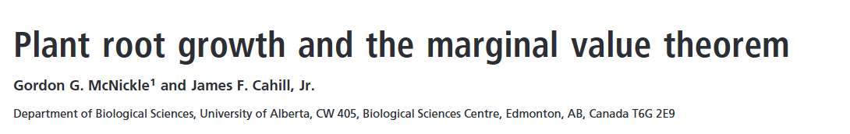
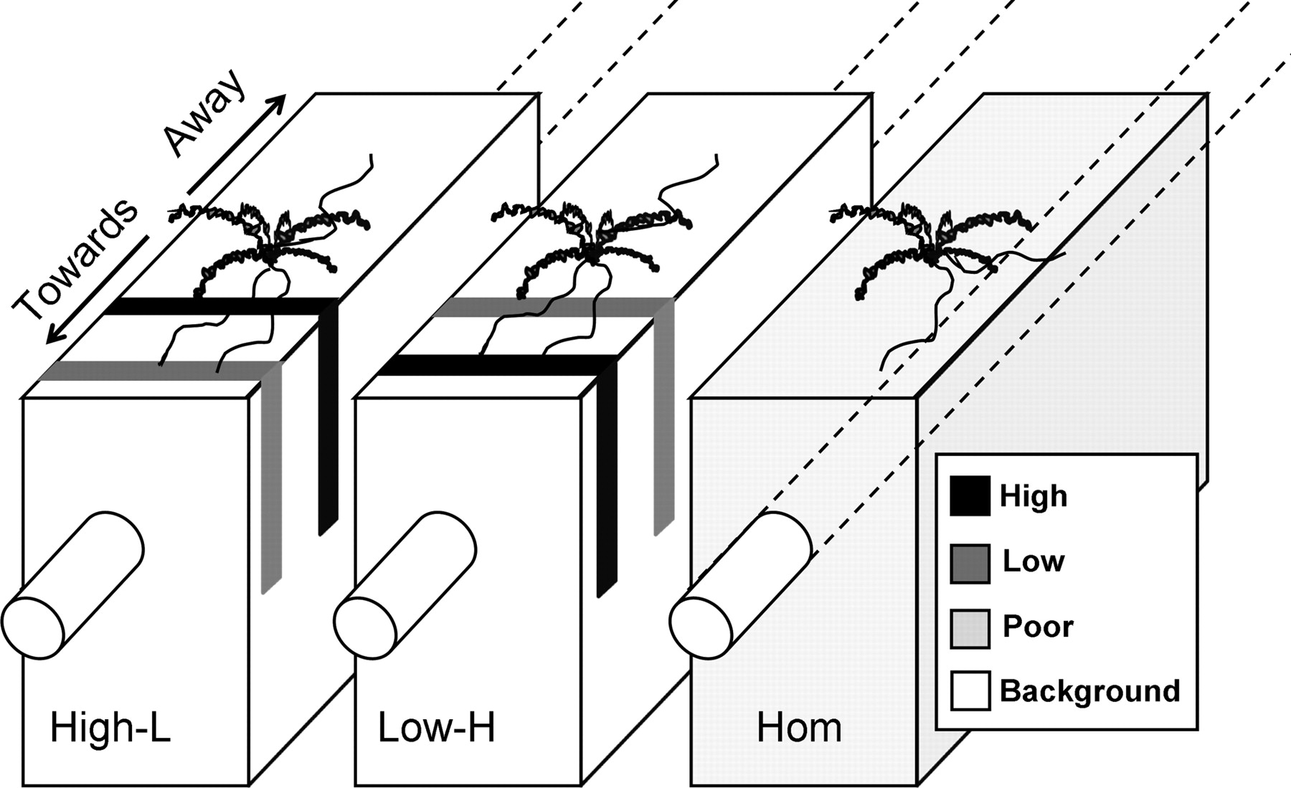
Marginal Value in Plants
Root length is analogous to time foraging

Slide 42
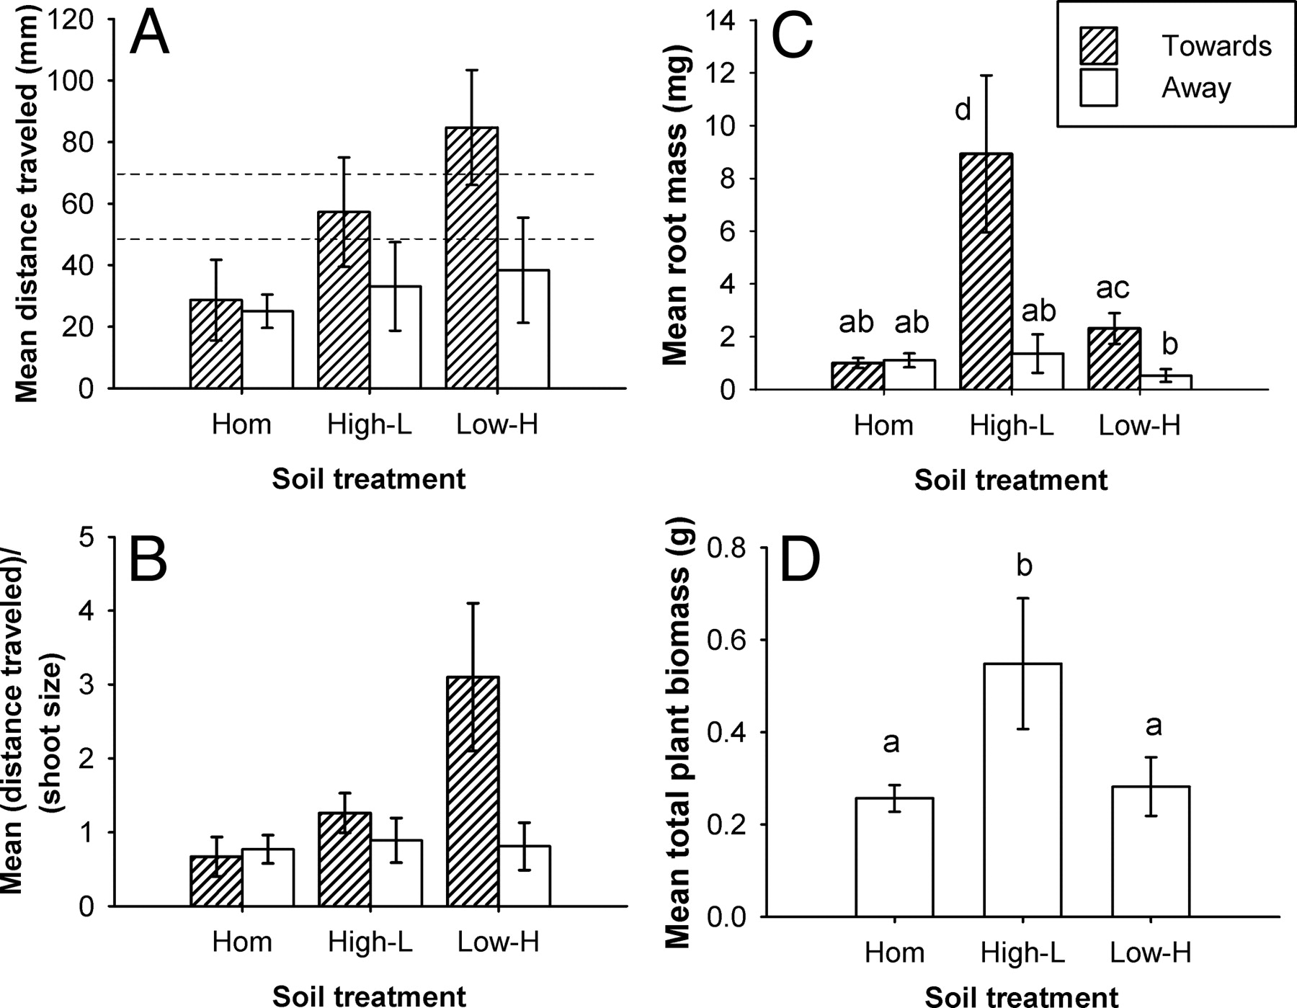
Marginal Value in Plants

Slide 43
Non-consumptive Effects
Predators can also have impacts on prey other than eating them!
Can you think of examples?

Slide 44
Non-consumptive Effects
Predators can also have impacts on prey other than eating them!
Can you think of examples?
Stress
Life history changes
Habitat usage
Behavioral changes
Morphology

Slide 45
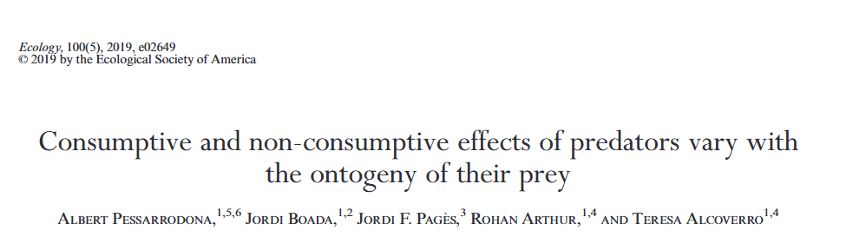
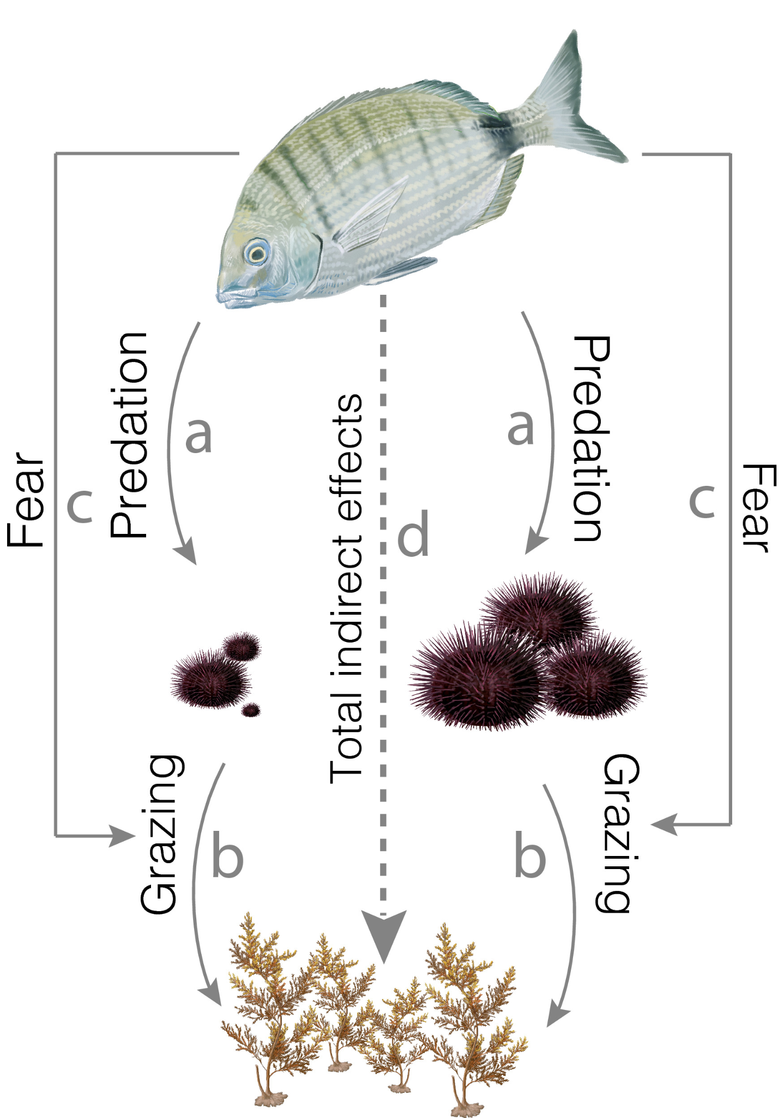
Nonconsumptive Effects

Slide 46
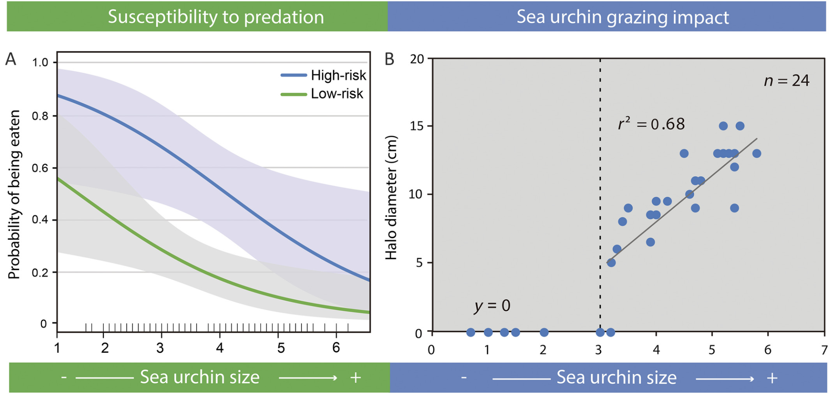
Nonconsumptive Effects
Notes:
Larger sea urchins = more impact, less risk

Slide 47
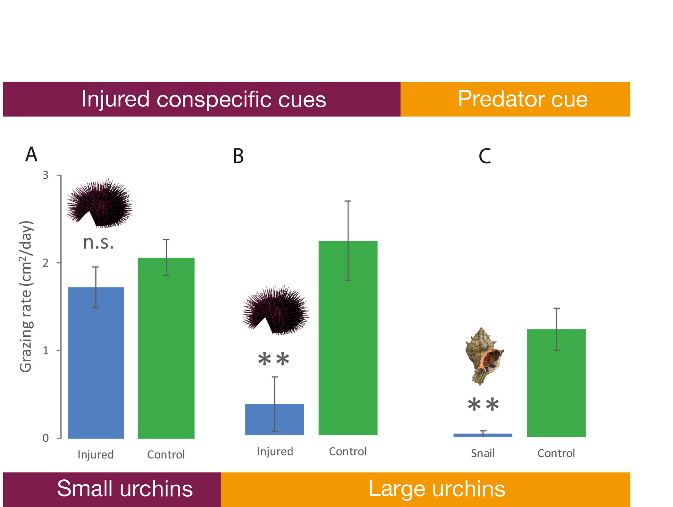
Nonconsumptive Effects
Notes:
Larger sea urchins = more impact, less risk

Slide 48
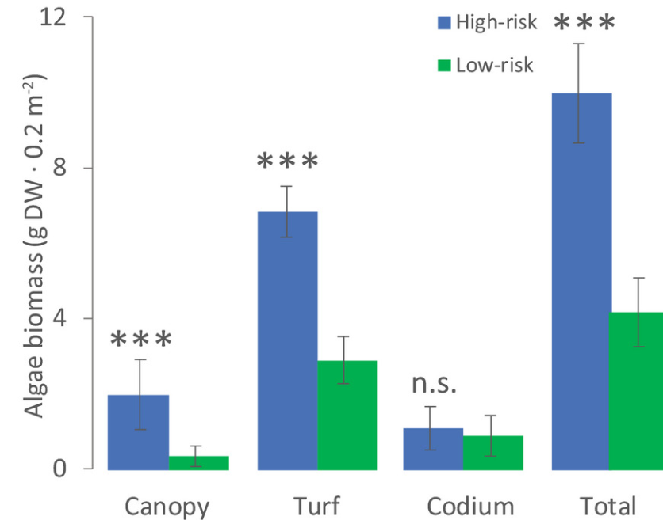
Nonconsumptive Effects
Notes:
Larger sea urchins = more impact, less risk

Slide 49
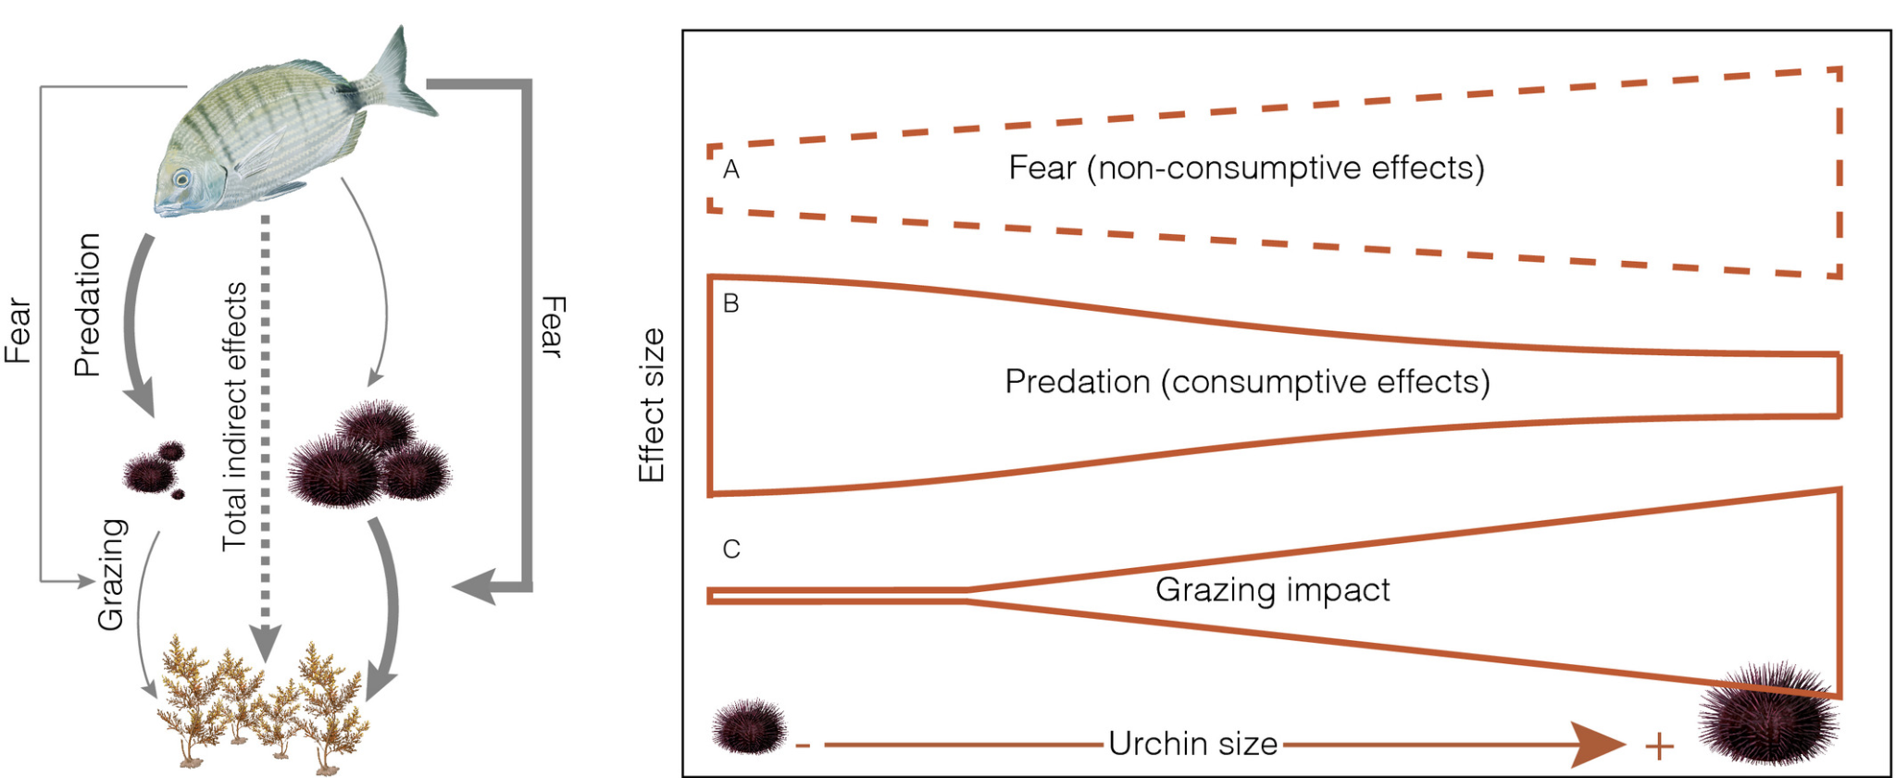
Nonconsumptive Effects
Notes:
Larger sea urchins = more impact, less risk

Slide 50
Next class: Competition

