Slide 1
Metacommunities II
Today’s Agenda:
Quiz
Neutral theory

Slide 2
Patchy Environments
Patches: suitable habitat, surrounded by unsuitable habitat.
Metapopulation: collection of connected populations
Multiple patches connected by dispersal
Metacommunity: collection of connected communities
Multiple patches connected by dispersal of one or more species

Slide 3
Metacommunities
4 Main perspectives:
Patch dynamics - extension of metapopulation stuff to more species
Species sorting - community assembly-ish, species differ in abiotic niches
Mass effects - species sorting-ish, w/ source-sink and rescue effects
Neutral theory - assumes species are identical, environment irrelevant

Slide 4
Metacommunities
4 Main perspectives:
Patch dynamics - extension of metapopulation stuff to more species
Species sorting - community assembly-ish, species differ in abiotic niches
Mass effects - species sorting-ish, w/ source-sink and rescue effects
Neutral theory - assumes species are identical, environment irrelevant

Slide 5

Neutral Theory
Published 2001
Hubbell
Tropical ecologist
BCI in Panama
Forest plot mapping

Slide 6
Neutral Theory
Key assumptions:
Individuals of different species are equivalent in terms of:
Birth rate
Death rate
Dispersal rate
These factors don’t vary with environment

Slide 7
Neutral Theory
Key assumptions:
Individuals of different species are equivalent in terms of:
Birth rate
Death rate
Dispersal rate
These factors don’t vary with environment
What do you think of these assumptions?
When might they be true?

Slide 8
Neutral Theory: Initial formulation
Initial assumptions:
Number of individuals constant
Space is limiting
All space is occupied
Species are equally likely to colonize (proportional to abundance)
Death occurs at a constant rate

Slide 9
Neutral Theory: Initial formulation
Initial assumptions:
Number of individuals constant
Space is limiting
All space is occupied
Species are equally likely to colonize (proportional to abundance)
Death occurs at a constant rate
Model cannot allow stable coexistence
Species slowly go extinct over time

Slide 10
Neutral Theory: Initial formulation
Initial assumptions:
Number of individuals constant
Space is limiting
All space is occupied
Species are equally likely to colonize (proportional to abundance)
Death occurs at a constant rate
Model cannot allow stable coexistence
Species slowly go extinct over time
What do you think of these assumptions?
When might they be true?

Slide 11
Neutral Theory: Later formulation
Book changes:
Incorporated metacommunities and dispersal
Patches can be re-colonized, slowing extinction

Slide 12
Neutral Theory: Later formulation
Book changes:
Incorporated metacommunities and dispersal
Patches can be re-colonized, slowing extinction
Incorporated speciation
Species emerge at a fixed, per-capita rate.
Can counteract extinctions

Slide 13
Testing Neutral Theory
Neutral theory makes some very testable predictions
Different aspects of ecology
Species abundance distributions (and how they change)
Species-area relationships
Coexistence
Community assembly

Slide 14
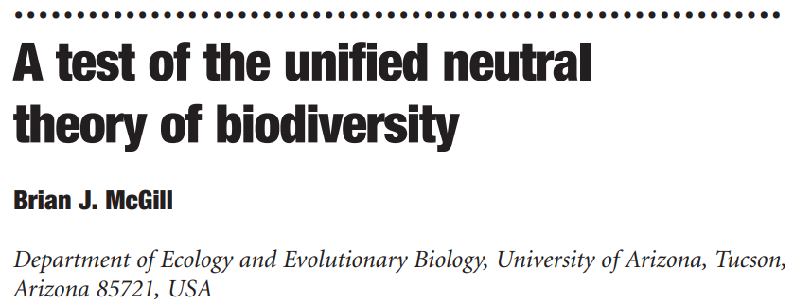
Testing Neutral Theory
Neutral theory predicts a certain form of SAD
Involves fitting a model with 3 parameters
However, other models exist for other theories (METE, MST, etc).
McGill compared the performance of neutral model with null models
Null models fit better
Null models used fewer parameters (more parsimonious)

Slide 15
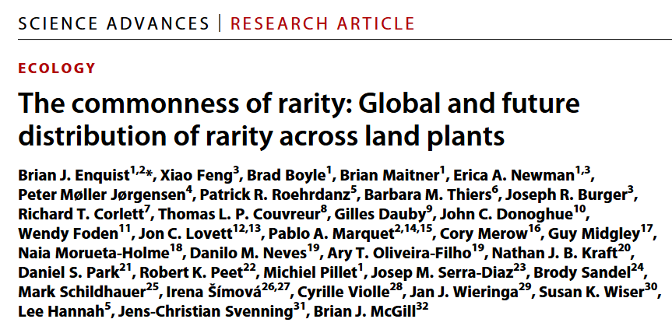
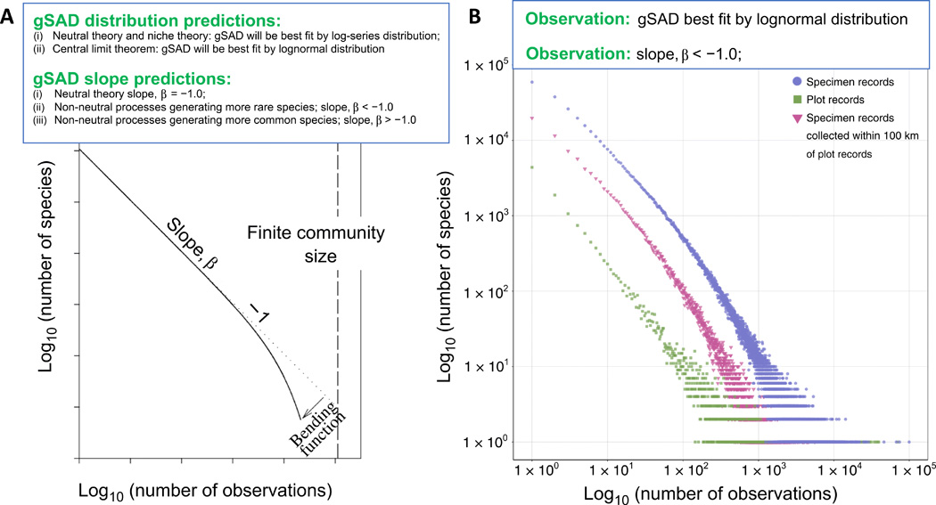
Testing Neutral Theory

Slide 16
Testing Neutral Theory

Slide 17
Testing Neutral Theory

Slide 18
Testing Neutral Theory
Test using intertidal organisms
12 year record
Lots of 60 x 60 cm quadrats
Parameterized neutral model using field data

Slide 19
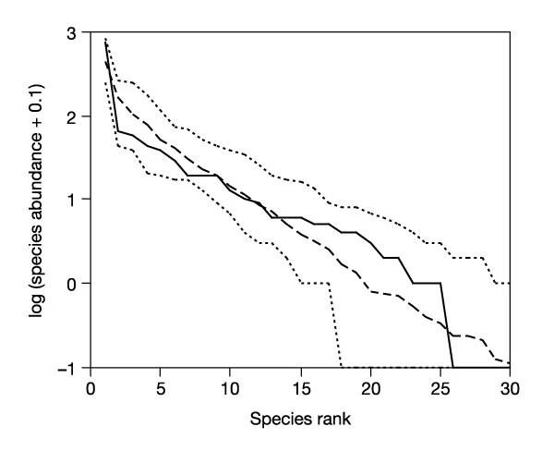
Testing Neutral Theory
-
Observed SAD matched prediction
95% CI
Observed
Predicted

Slide 20
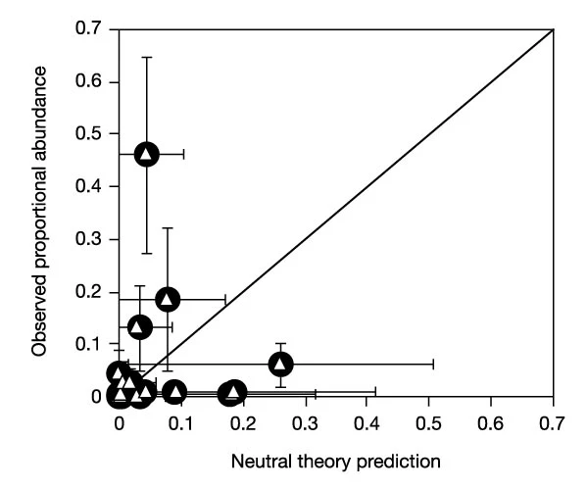
Testing Neutral Theory
However, deviations observed when predictions looked at dynamics over time
So even when neutral theory gets the distribution correct, it can still get other things quite wrong

Slide 21
Neutral theory and coexistence
What needs to occur for species to coexist?
Can this happen under neutral theory?

Slide 22
Neutral theory and coexistence
What needs to occur for species to coexist?
Can this happen under neutral theory?
α_{ii} > α_{ji}
α_{jj} > α_{ij}

Slide 23
Neutral theory and coexistence
What needs to occur for species to coexist?
Can this happen under neutral theory?
α_{ii} > α_{ji}
α_{jj} > α_{ij}
α_{ii} = α_{ji} = α_{jj} = α_{ij}

Slide 24
Neutral theory and coexistence
What needs to occur for species to coexist?
Can this happen under neutral theory?
α_{ii} > α_{ji}
α_{jj} > α_{ij}
α_{ii} = α_{ji} = α_{jj} = α_{ij}
But, under coexistence theory, even small differences can lead to competitive exclusion!

Slide 25
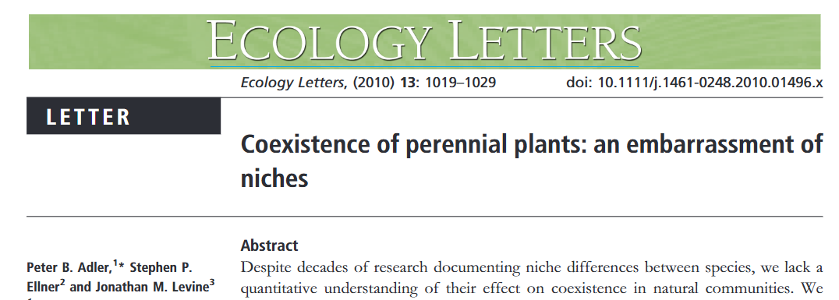
Neutral theory and coexistence
Data set of experiment focusing on sheep grazing
Grazing vs no grazing
22 years of data
Spatial data of individual plants recorded

Slide 26
Neutral theory and coexistence
Used data to parameterize a model of competition
Model parameters can be altered to make species neutral
Effects on heterospecifics set to equal effect on conspecifics
Allows “experimenting” on things you couldn’t actually manipulate!

Slide 27
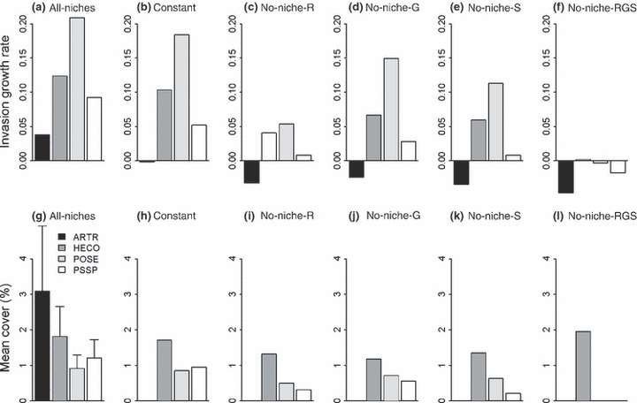
Neutral theory and coexistence

Slide 28
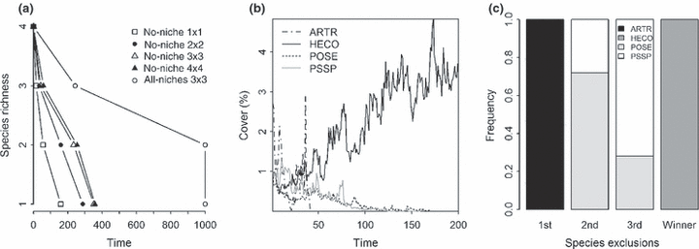
Neutral theory and coexistence

Slide 29
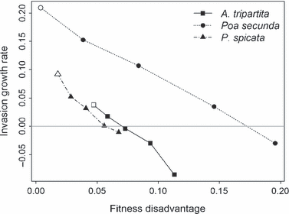
Neutral theory and coexistence
Notes:
White = field observed

Slide 30
Neutral theory and coexistence
Strong support for niches
Relatively strong
May even underestimate niche strength
Notes:
White = field observed

Slide 31
Neutral Theory
Valuable as a null model
Gets some things right, some things wrong
Important in driving theory forward

Slide 32
Next class: Variable environments

