Slide 1
Community Assembly II
Today’s Agenda:
Quiz
Check-in
Community Assembly Examples

Slide 2
Check-in
Just wanted to touch base and see how the class is going.
Anything that isn’t working? Anything that IS working?
Feel free to email me as well.

Slide 3
Abiotic
Filter
Biotic
Filter
Communities
Species pool
Dispersal
Communities
Metacommunity
Speciation, Extinction, Dispersal

Slide 4
What does this look like in practice?

Slide 5
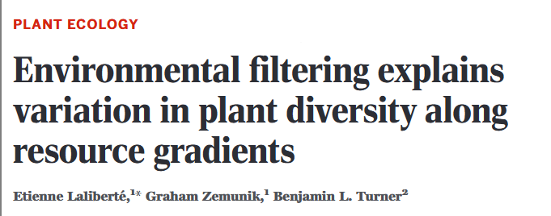
Environmental Filtering of Plants
Studied a chronosequence of soil ages
“Space-for-time” substitution
Dunes in Australia

Slide 6
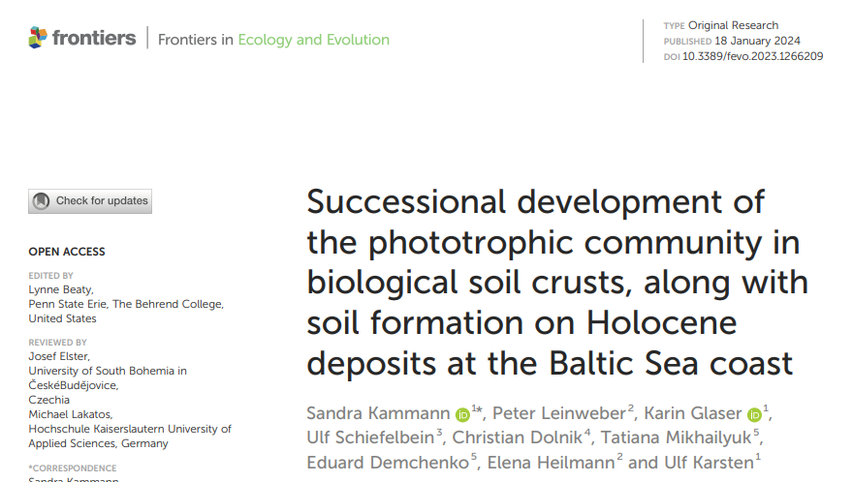
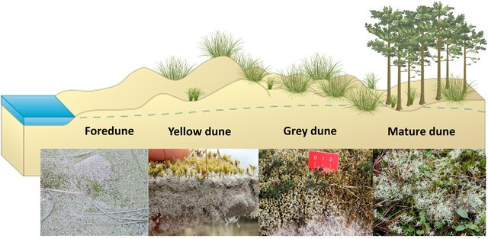
Aside: space for time substitutions
Note: this figure depicts Baltic dunes
Dune Age
Notes:
We can’t go back in time, or wait for dunes to change, but space-for-time approaches give us a reasonable alternative

Slide 7
Environmental Filtering of Plants
Studied a chronosequence of soil ages
“Space-for-time” substitution
Dunes in Australia
Really cool system!
2 million year gradient of soil ages
Sites within 10 km (assume the same regional species pool)
Comparable climate
Open ecosystem (not light-limited)

Slide 8
Environmental Filtering of Plants
Hypotheses tested
More heterogeneous soils, more species - why?
Species Richness
Soil heterogeneity

Slide 9
Environmental Filtering of Plants
Hypotheses tested
More heterogeneous soils, more species (niche partitioning)
Species Richness
Soil heterogeneity

Slide 10
Environmental Filtering of Plants
Hypotheses tested
Unimodal response with soil fertility - why might we expect this?
Species Richness
Soil fertility

Slide 11
Environmental Filtering of Plants
Hypotheses tested
Unimodal response with soil fertility - why might we expect this?
Few species can tolerate
fertility
Competitive exclusion excludes some species
Species Richness
Soil fertility

Slide 12
Environmental Filtering of Plants
Hypotheses tested
Higher diversity where nutrients aren’t limiting
Species Richness
Nutrient Availability (N + P)

Slide 13
Environmental Filtering of Plants
Hypotheses tested
Higher diversity where multiple forms of nutrients exists (partitioning)
Species Richness
Diversity of N+P forms

Slide 14
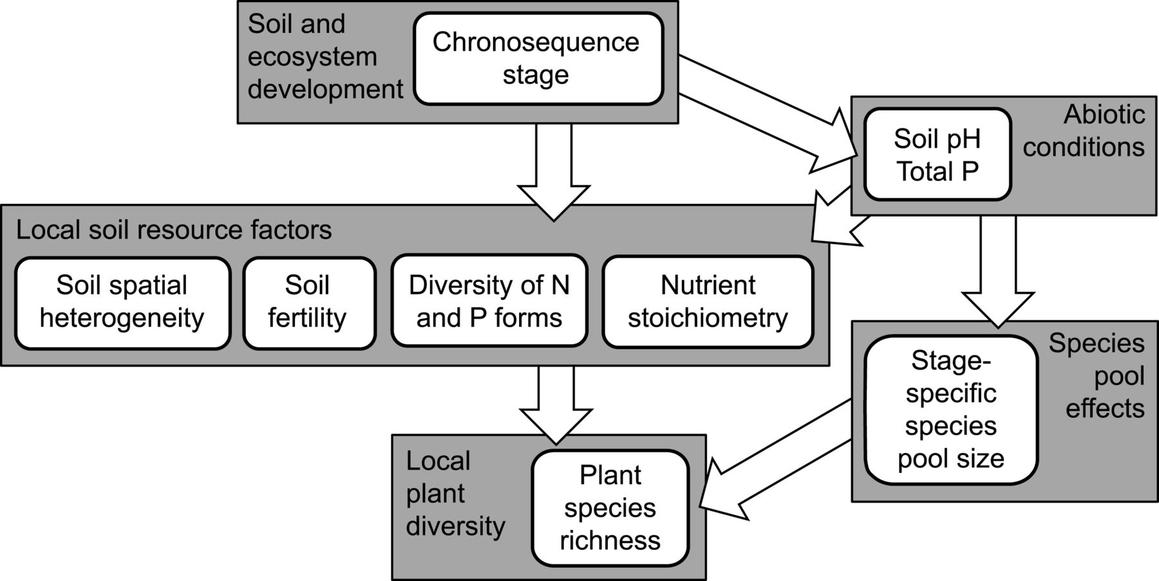
Environmental Filtering of Plants

Slide 15
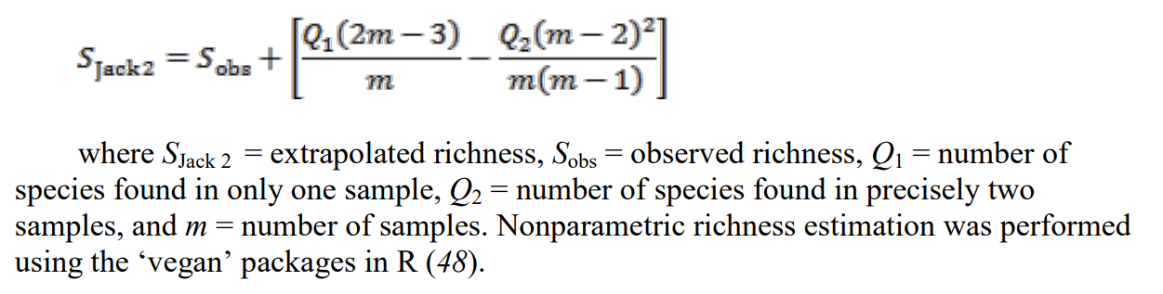
Environmental Filtering of Plants
Methods
60 plots (10 m x 10 m)
6 age classes (10 plots each)
In each plot
Species
Density
Cover
Soil samples (nutrients and fertility analyses)
Leaf sample (for nutrient analyses)
Species pool estimated:

Slide 16
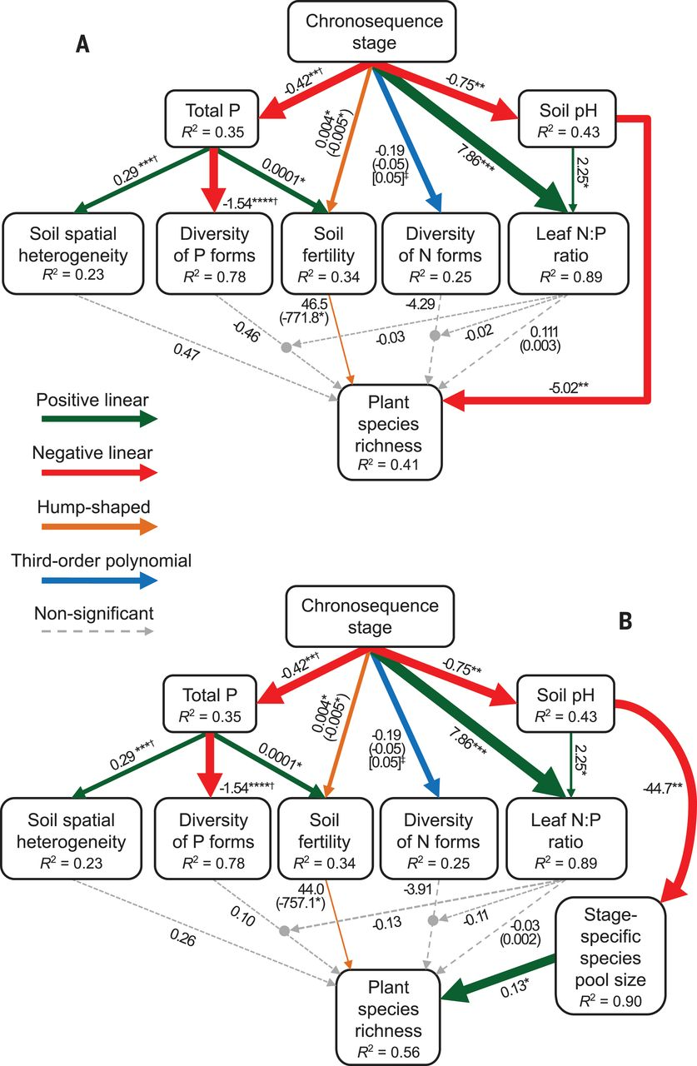
Environmental Filtering of Plants
Results

Slide 17
Environmental Filtering of Plants
Plot-level properties didn’t explain plot richness very well
Instead:
Soil aging changed soil pH
Different pools of species were specialized on different pH values

Slide 18
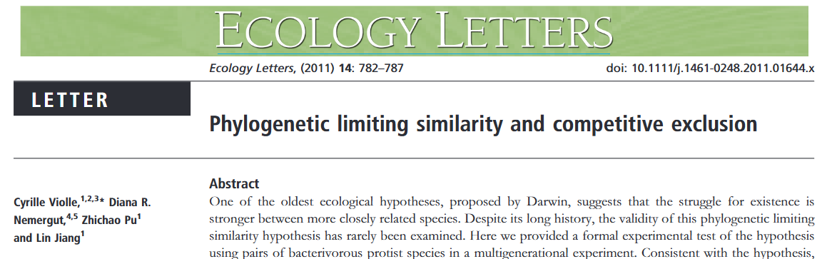
Competition and ciliates

Slide 19
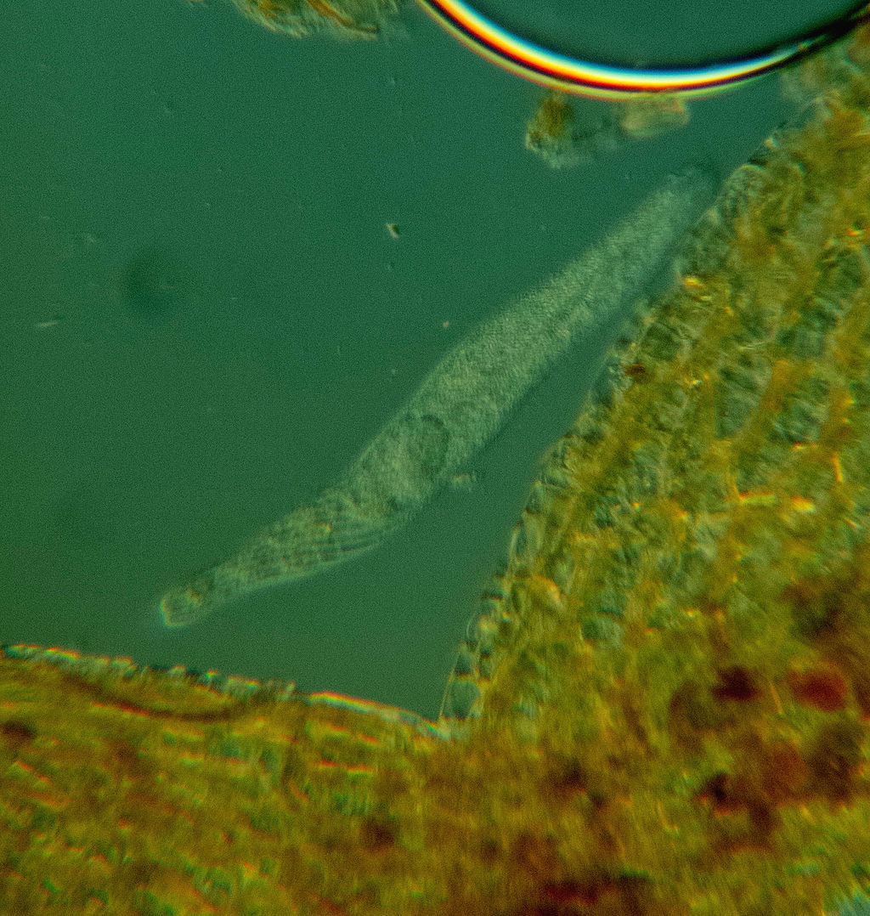
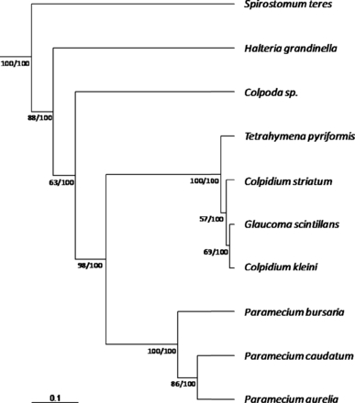
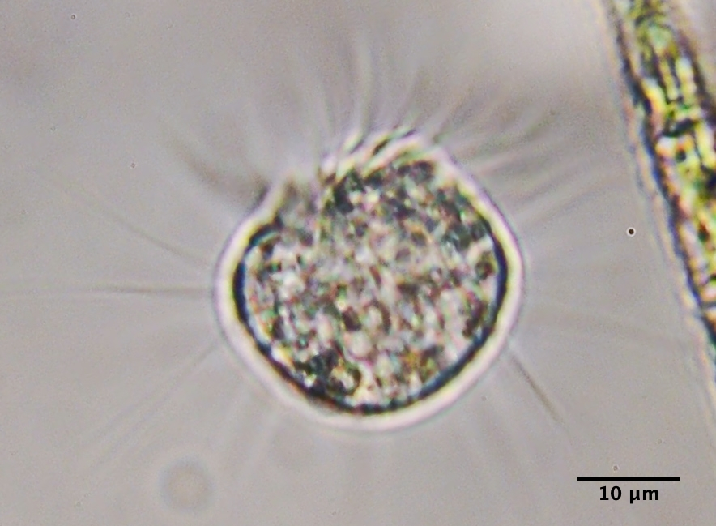
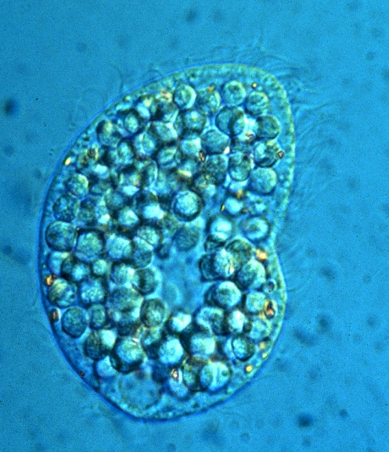
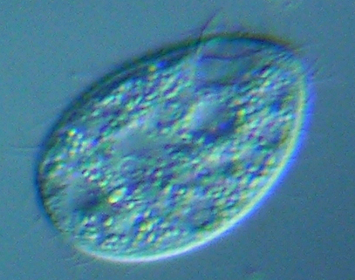
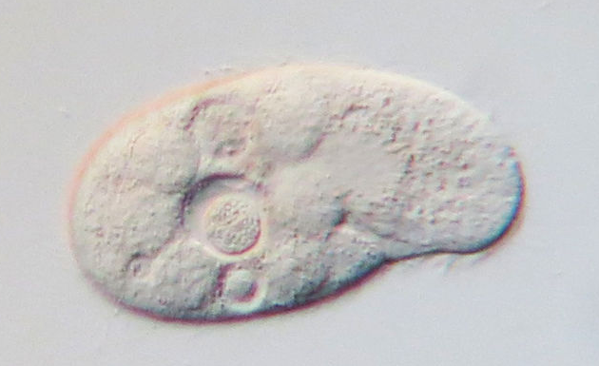
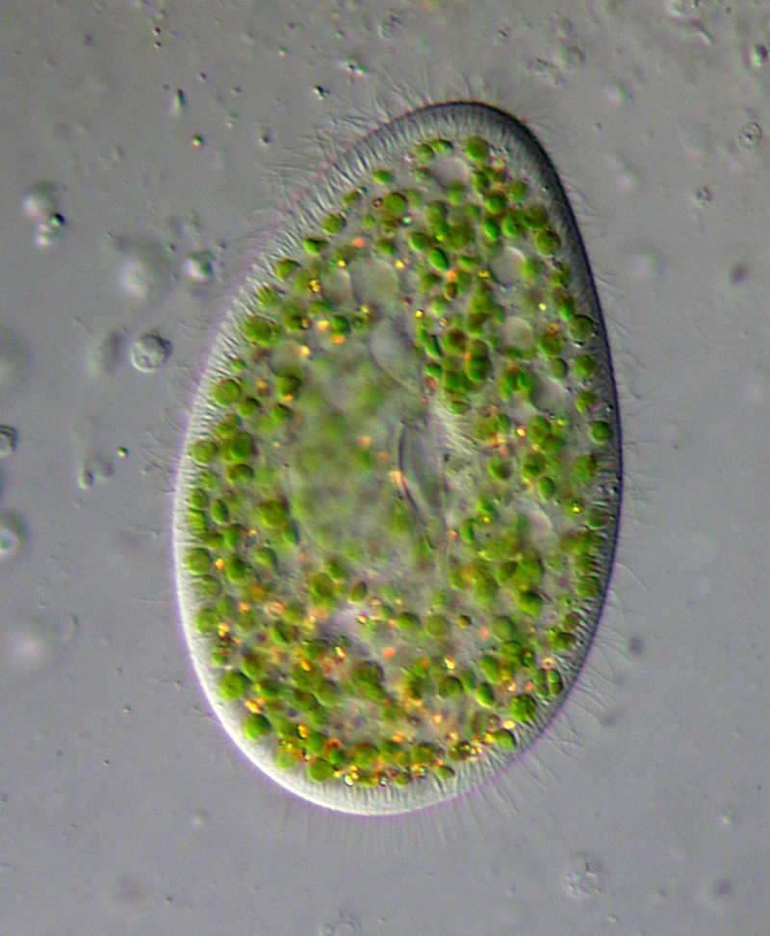
Competition and ciliates
By Picturepest - Spirostomum teres - 160x, CC BY 2.0, https://commons.wikimedia.org/w/index.php?curid=39164961; By Don Loarie - https://www.inaturalist.org/photos/107300954, CC BY 4.0, https://commons.wikimedia.org/w/index.php?curid=114636926; By Dr. Eugen Lehle - Eigenes Werk (own work) http://bodenlabor.de, CC BY-SA 3.0, https://commons.wikimedia.org/w/index.php?curid=4992616;
By Picturepest - Tetrahymena pyriformis - 400x - Oralapparat, CC BY 2.0, https://commons.wikimedia.org/w/index.php?curid=39164918;
By Picturepest - Paramecium bursaria - 400x, CC BY 2.0, https://commons.wikimedia.org/w/index.php?curid=39164773;

Slide 20
Competition and ciliates
Methods
Grew populations in pairs and alone
Grown with 3 different bacteria species (= food)
Tracked population sizes over time

Slide 21
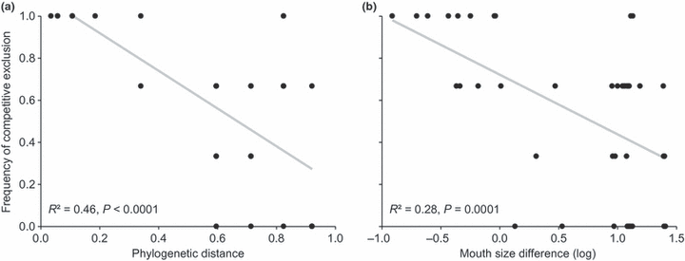
Competition and ciliates
Close relatives less likely to coexist - suggests competitive exclusion

Slide 22
Competition and ciliates
Trait analysis suggests mouth size might play a role

Slide 23
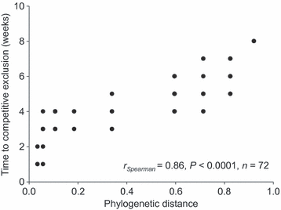
Competition and ciliates
Competitive exclusion happens faster with close relatives

Slide 24
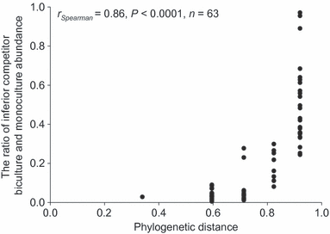
Competition and ciliates
Smaller effects relative to monoculture at larger distances

Slide 25
Competition and ciliates
Provides strong, experimental test of competition driving assembly of ciliate communities
Phylogeny served as a useful predictor
Seems to be driven by feeding niches
Close relatives
Faster exclusion
More likely to exclude each other
Larger impact on population sizes

Slide 26
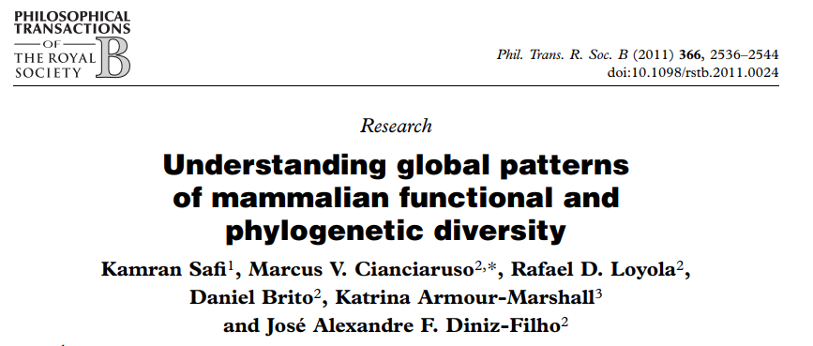
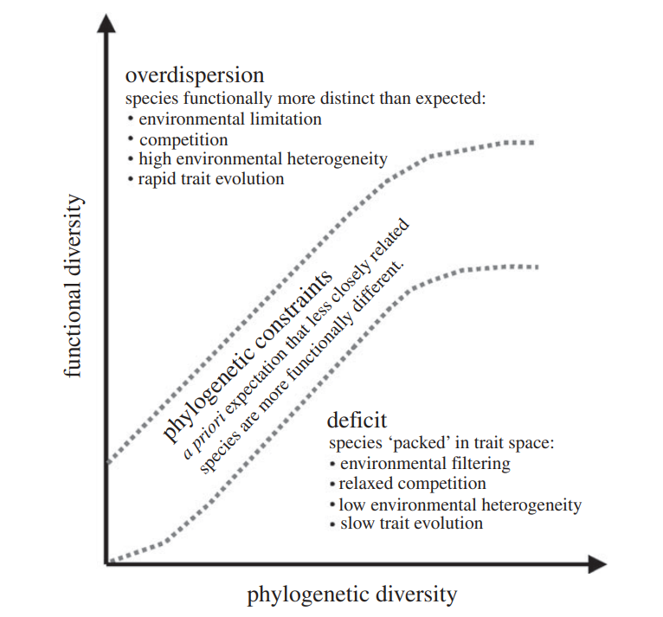
Mammal assembly
Notes:
Note that the assumptions here are slightly different from what others may focus on

Slide 27
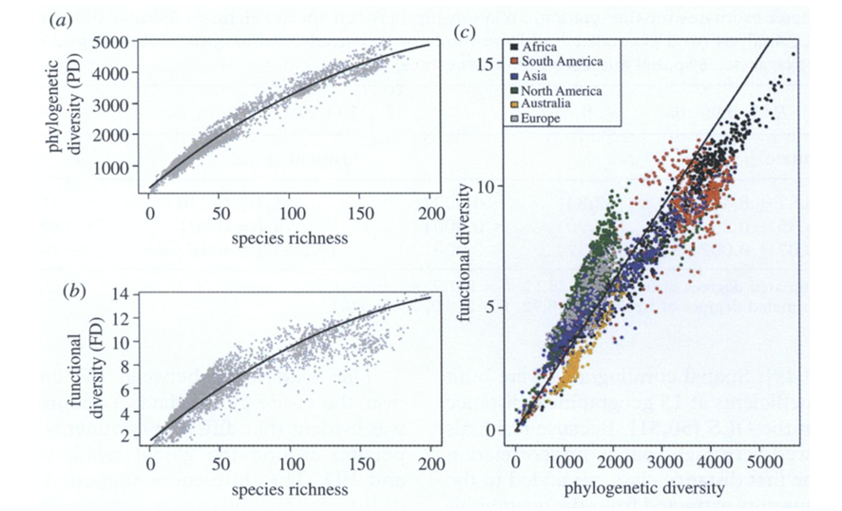
Mammal assembly

Slide 28
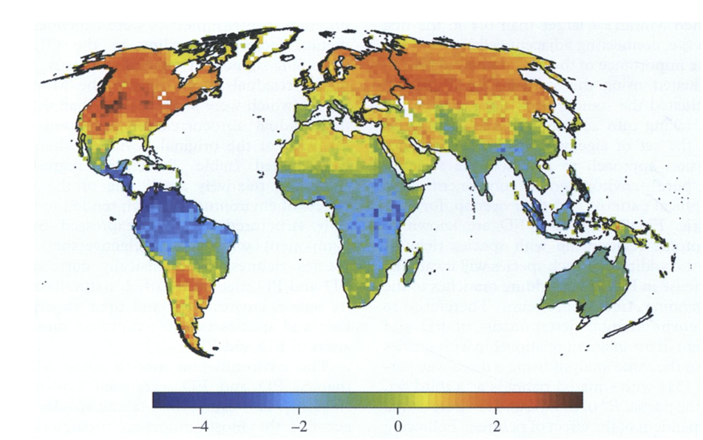
Mammal assembly

Slide 29
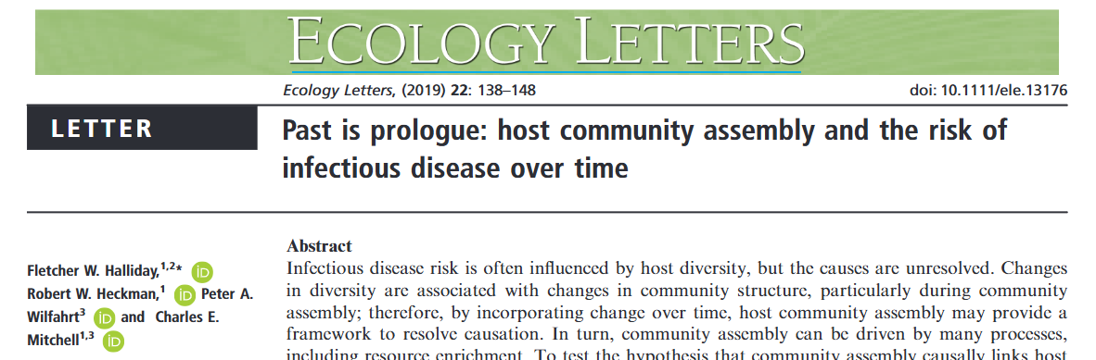
Disease dynamics

Slide 30
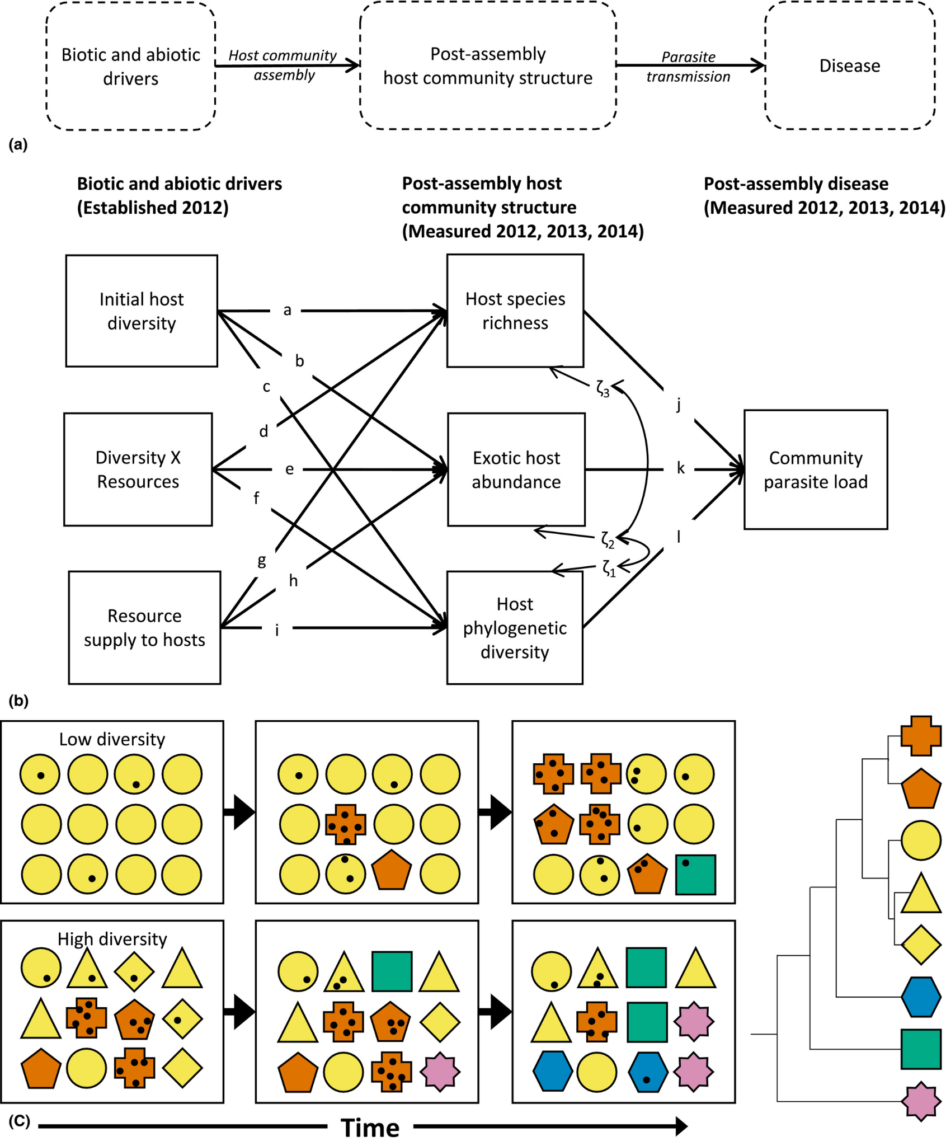
Disease dynamics

Slide 31
Disease dynamics
Methods:
Hosts = plants
120 plots (1m x 1 m)
Treatments:
1 vs 5 species (6 different treatment sets of species each)
High vs low resource supply (fertilized vs unfertilized)
Disease:
Subsets of leaves sampled per plot per species
Parasites identified by symptoms, DNA
Calculated parasite load as total leaf area damaged per plot
Native vs Exotic
Followed USDA categorization

Slide 32
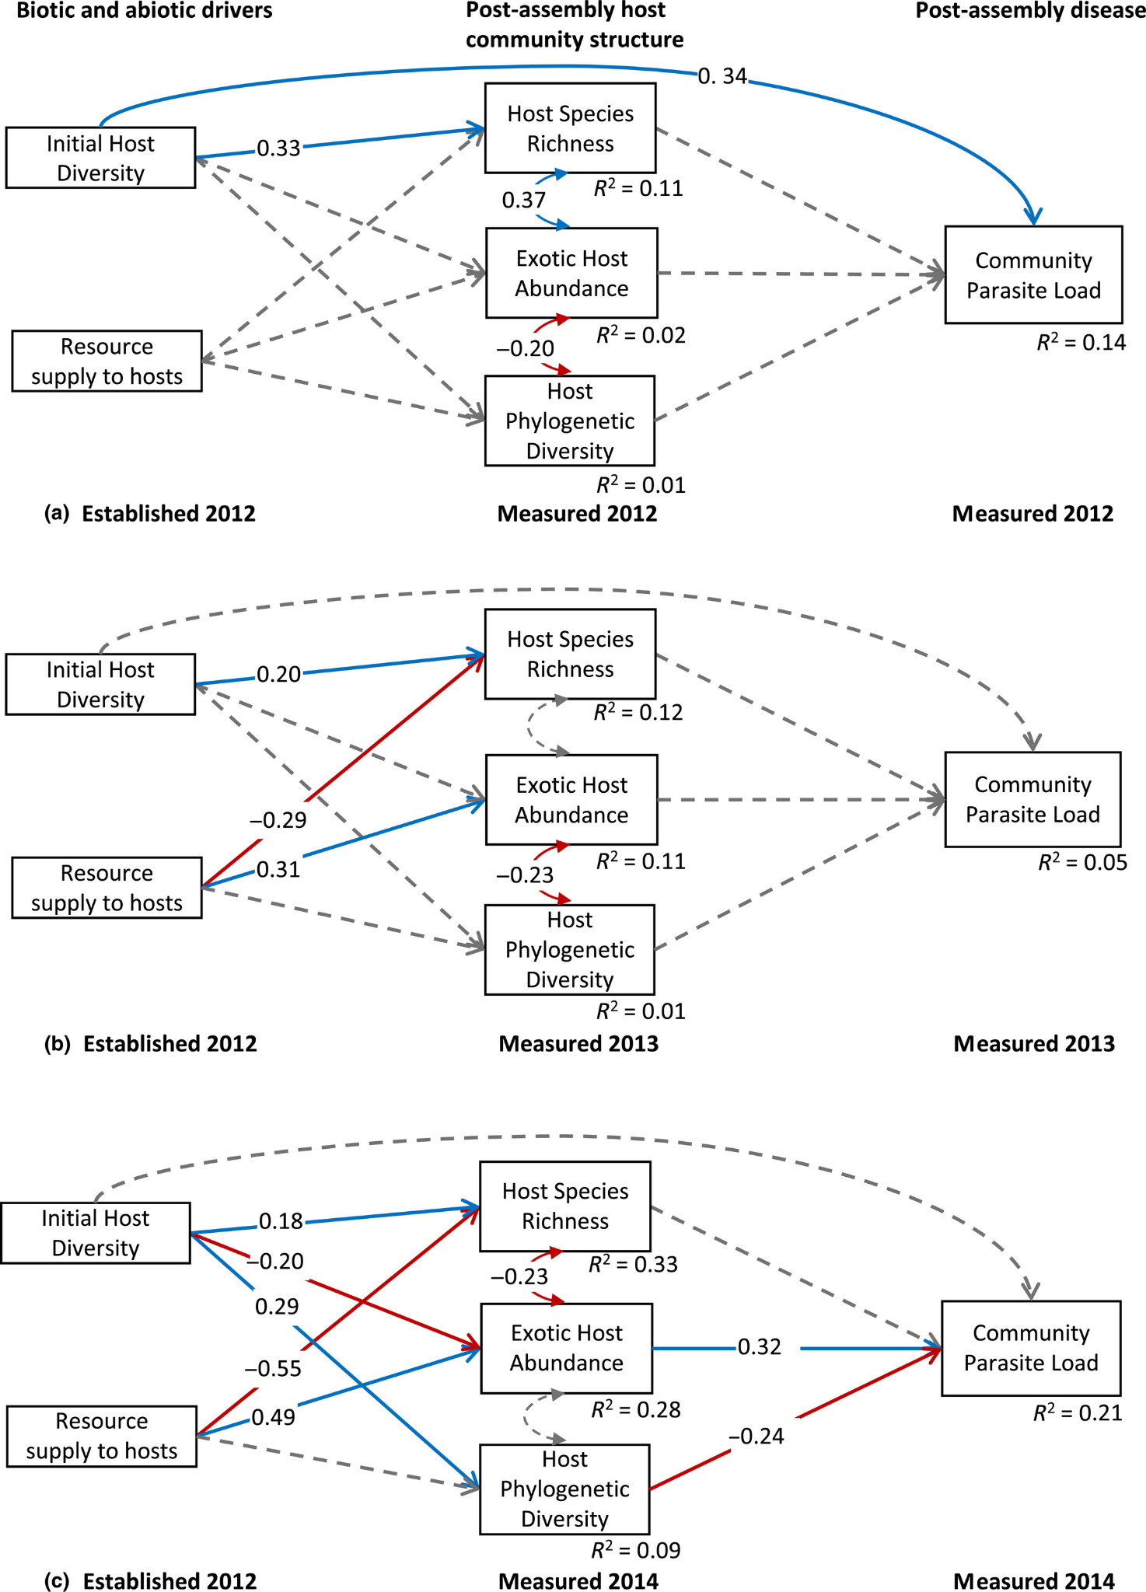
Disease dynamics

Slide 33
Disease dynamics

Slide 34
Disease dynamics

Slide 35
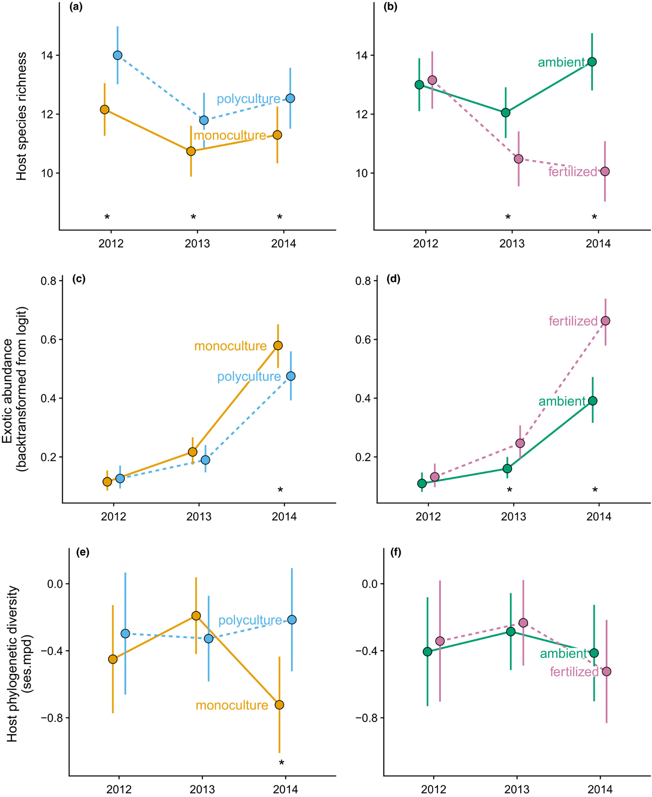
Disease dynamics

Slide 36
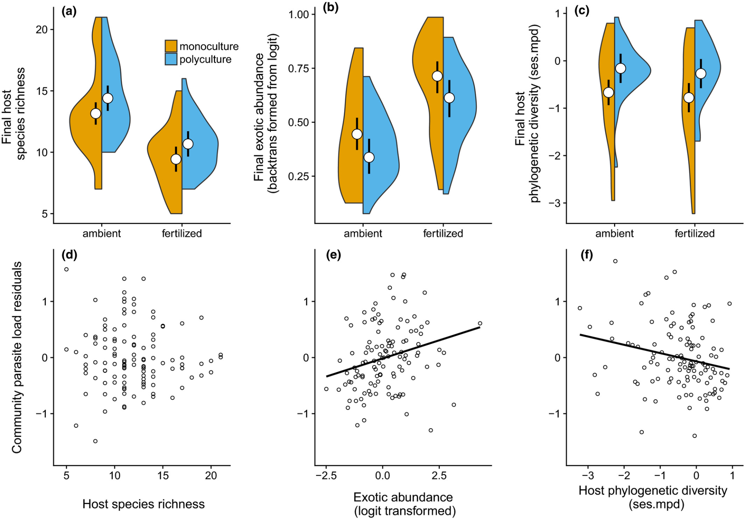
Disease dynamics

Slide 37
Disease dynamics
Community assembly mechanisms can change over time!
Importance of considering temporal dynamics.
Just because you don’t find evidence of something doesn’t mean it won’t be important at another time!

Slide 38
Next class: Community assembly and global change

