Slide 1
Trait-based Ecology I
Today’s Agenda:
Quiz
Project 3: Trait-based ecology
Trait-based ecology overview

Slide 2
Project 3
Due April 11th
Similar to previous projects and can hopefully build upon them
Inspired by grant proposals
2-4 (ish) pages, references don’t count against that

Slide 3
Project 3
You’ll propose a hypothesis and how you’ll test it using trait-based methods
First 1-2 pages: Lay out a hypothesis you propose to test
Related to things we’ve covered in class
Why is it important? Why study it in this system?
Can re-use old text and references
Last 1-2 pages: Describe how you plan on testing it
Should involve at least 5 new references relating to traits
Make sure to clarify what traits are being measured and why
Write as though this WILL happen. “We will measure ….”

Slide 4
Project 3
Questions?

Slide 5
Haiku sharing
Does anyone want to share what they wrote?

Slide 6
Trait-based ecology
What is a trait?
Lots of variation, with different researchers choosing definitions that often are most applicable to their use cases

Slide 7
Trait-based ecology
What is a trait?
I would argue that the best definition is something like:
“A measurable property of something”

Slide 8
Trait-based ecology
Trait observations have 4 critical pieces of information:
Entity: What is the thing being measured (e.g., an individual of a species)
Observation: The context of the measuring (e.g., location and time)
Measurement: The actual measurement itself (e.g., 10 g)
Trait: What is being measured? This should be defined. (e.g., dry mass…)
https://traitecoevo.github.io/traits.build-book/database_metadata.html

Slide 9
Trait-based ecology
So, traits might include things like:
The species range size of Loxodonta africana in Africa in 2011, measured as the alpha-hull of all observations that year.
The mass of an individual of Numida meleagris at a given point and time, measured by bagging the individual and weighing them on some scale.
The leaf mass of a single leaf of a single individual of Sabal palmetto measured at a given point and time, taken as fresh weight.
The length of a particular stomate on a particular leaf of a particular species, measured at some point and time, using a particular method.

Slide 10
Trait-based ecology
So there is a lot of flexibility in the term “trait”!
Important to be clear about the entity, observation, measurement, and trait
Lack of clarity can be a big issues
E.g., the mass of Taxodium distichum
Leaf mass? Whole plant mass? Above-ground mass? Mass of all individuals?

Slide 11
Is it a trait?
Plant growth form (e.g., tree, shrub, etc.)
Photosynthetic rate
Maximum lifespan
Genome size
Taxonomic Order
Body size
Growth rate
Temperature range occupied
Molecular sequence data
Habitat type

Slide 12
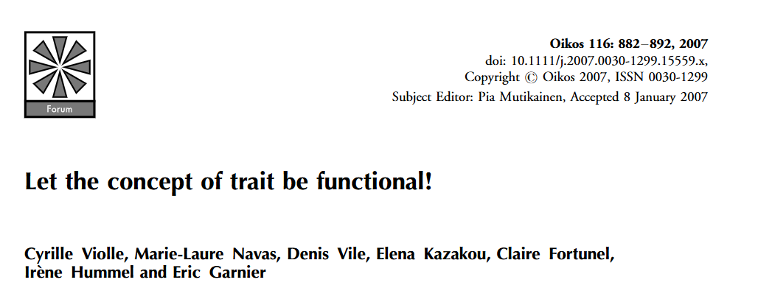
Functional traits
Often, scientists will talk about “functional” traits
These are traits that “impact fitness indirectly via their effects on growth, reproduction and survival, the three components of individual performance”

Slide 13
Non-functional traits?
Can we think of any traits that aren’t functional?
I.e., those that don’t impact growth, survival, or reproduction?

Slide 14
Why focus on traits?
Generality:
Rather than focusing on particular species in particular systems, we can say things about all species in all systems (or at least a larger subset of species/systems).
Quantitative:
We move from species (categorical) to continuous measurements
Links to mechanism
We can focus on traits that are linked to particular mechanisms
E.g., if we want to work on predation, mouth size might be useful.
More predictive
Allow us to say something about potential future scenarios

Slide 15
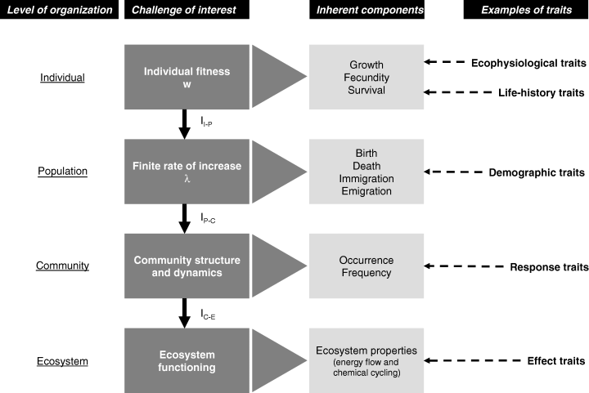
How traits are used
Notes:
Notice that different traits are useful at different levels.

Slide 16
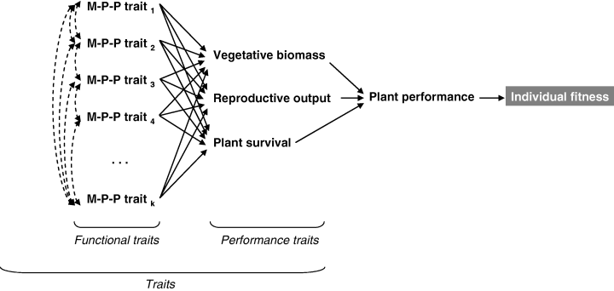
How traits are used
Notes:
MPP- morhpo-physio-phenological

Slide 17
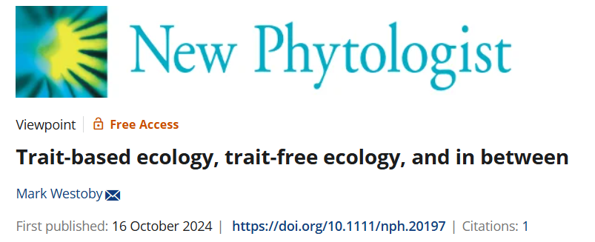
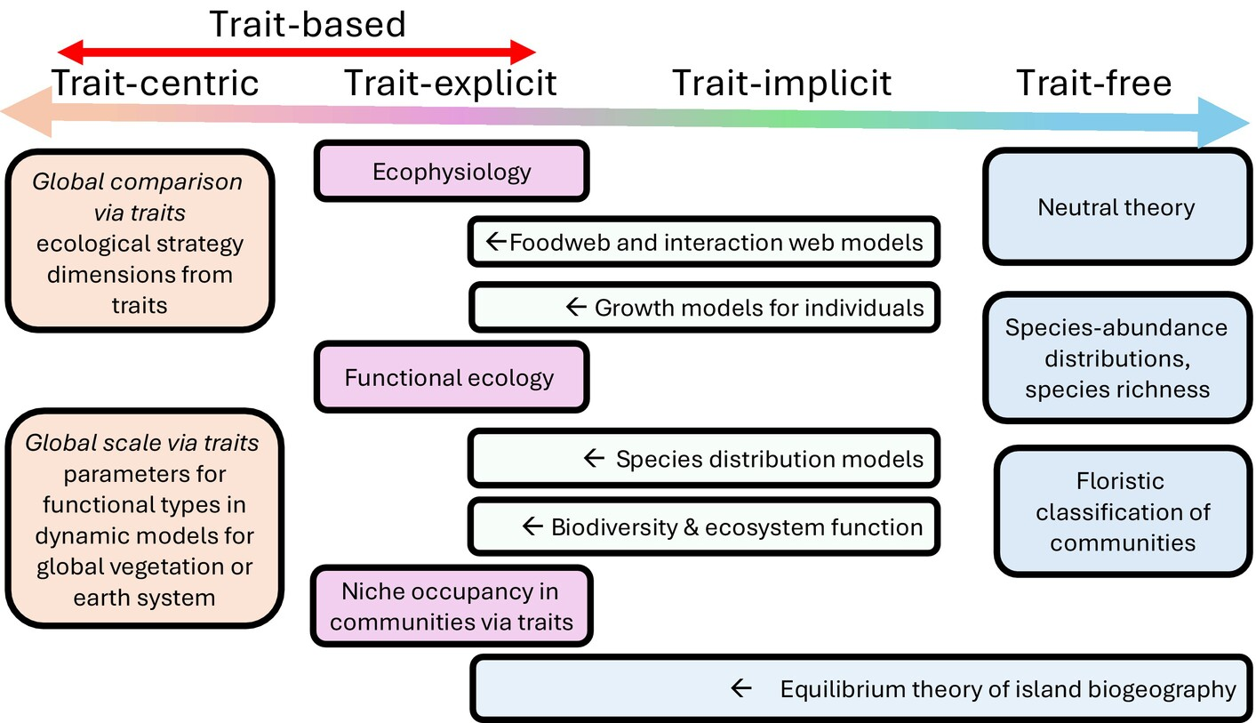
Trait-based to trait-free spectrum

Slide 18
Traits we use
What traits are people in the class working on?
Are they functional?
What are traits are commonly measured in your field? Why?
Any non-functional traits?

Slide 19
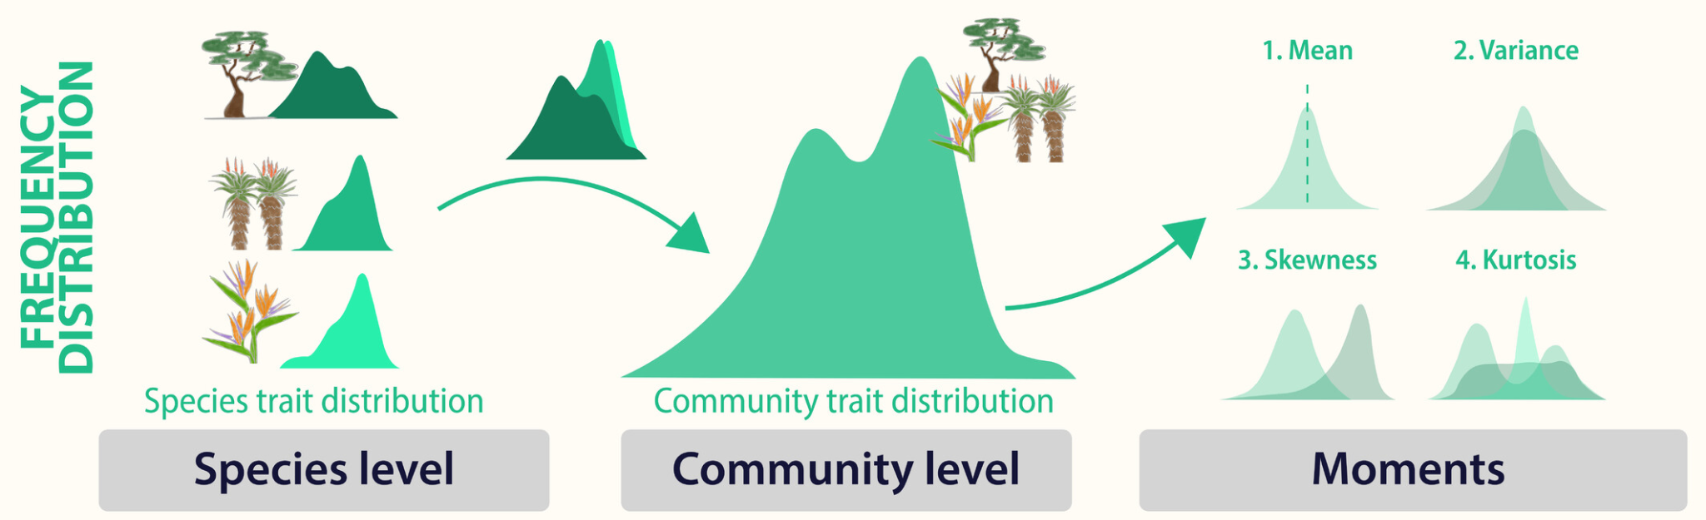
Trait distributions
Traits vary!

Slide 20
Next class: More traits

