Slide 1
Density Dependence
Today’s Agenda:
Quiz
Project 2: Species Interactions
Population growth
Density Dependence

Slide 2
Project 2: Species Interactions: Due Feb 28
Step 1: Select type(s) of species interactions relevant for your study system
Step 2: Find and read 5-10 relevant papers
Step 3: Write around 3 pages about it (double spaced)
~ Pages 1-2: Focus on interactions
~ Page 3: Focus on impact of interactions on diversity patterns
Introduction format, references don’t count against page limit

Slide 3
Project 2: Species Interactions: Due Feb 28
Potential things to include:
Predation
Competition
Mutualism
Coexistence (with linkages to e.g., predation, competition, etc.)
How things are tested
Gaps in our knowledge
Spatial variation in interaction strength

Slide 4
Project 2: Species Interactions: Due Feb 28
Grade Breakdown:
At least five papers were referenced in the text 30%
One or more interaction types were discussed 30%
Impact of the interaction on diversity patterns was discussed 20%
One or more additional aspects (e.g., testing, competition) discussed 10%
Writing quality 10%
Up to 10% will be deducted for excessive length -10%

Slide 5
Project 2: Species Interactions: Due Feb 28
Questions?

Slide 6
Population Growth

Slide 7
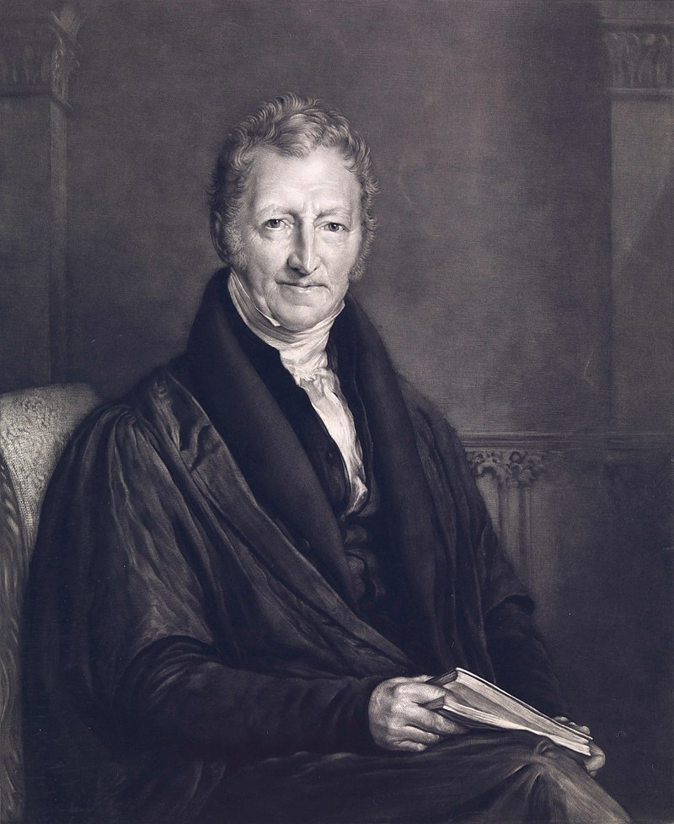
Population Growth
Thomas Malthus
Economist who is critical for ecology and evolution
By John Linnell -https://wellcomecollection.org/works/f4ep87xc CC-BY-4.0, CC BY 4.0, https://commons.wikimedia.org/w/index.php?curid=38203021

Slide 8
Population Growth
Thomas Malthus
Economist who is critical for ecology and evolution
Focused on population growth
By John Linnell -https://wellcomecollection.org/works/f4ep87xc CC-BY-4.0, CC BY 4.0, https://commons.wikimedia.org/w/index.php?curid=38203021

Slide 9
Population Growth
Thomas Malthus
Economist who is critical for ecology and evolution
Focused on population growth
Inspired the Exponential (a.k.a. Malthusian) Growth Model
N_{t} = N₀e^{rt}
By John Linnell -https://wellcomecollection.org/works/f4ep87xc CC-BY-4.0, CC BY 4.0, https://commons.wikimedia.org/w/index.php?curid=38203021

Slide 10
Population Growth
Thomas Malthus
Economist who is critical for ecology and evolution
Focused on population growth
Inspired the Exponential (a.k.a. Malthusian) Growth Model
N_{t} = N₀e^{rt}
N_{t} = # at time t,
N₀= initial population size,
r = intrinsic population growth rate
t = time
By John Linnell -https://wellcomecollection.org/works/f4ep87xc CC-BY-4.0, CC BY 4.0, https://commons.wikimedia.org/w/index.php?curid=38203021

Slide 11
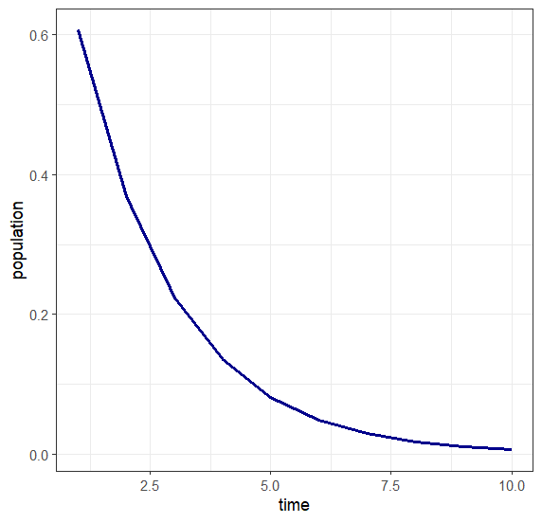
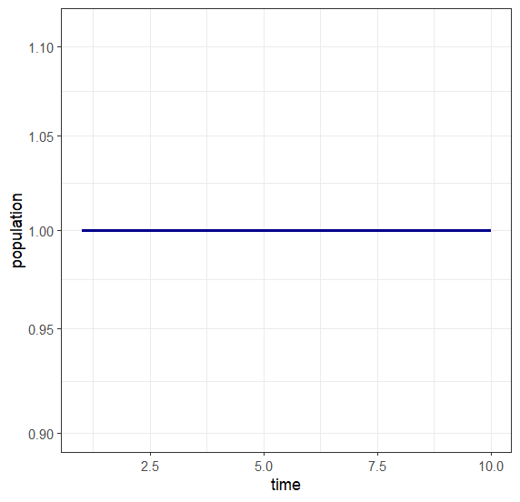
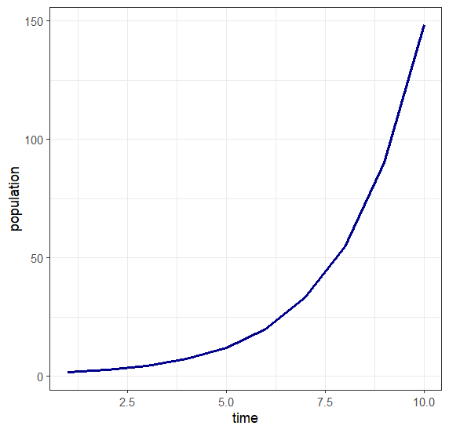
Exponential Growth
N_{t} = N₀e^{rt}
r = -0.5
r = 0.0
r = 0.5

Slide 12
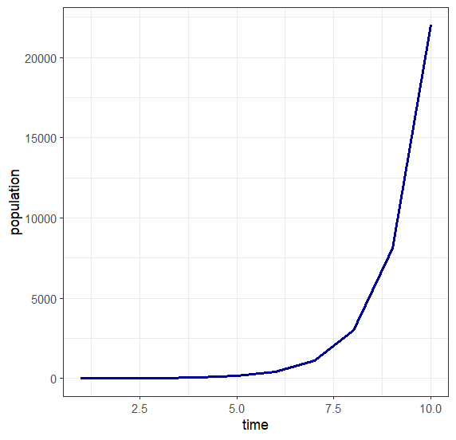
Exponential Growth
N_{t} = N₀e^{rt}
r = 0.5
r = 1

Slide 13
Exponential Growth
What is the growth rate for a population that doubles every 20 years?
N_{t} = N₀e^{rt}

Slide 14
Exponential Growth
What is the growth rate for a population that doubles every 20 years?
N_{t} = N₀e^{rt}
2=1*e^{r*20}

Slide 15
Exponential Growth
What is the growth rate for a population that doubles every 20 years?
N_{t} = N₀e^{rt}
2=1*e^{r*20}
ln(2)=20r

Slide 16
Exponential Growth
What is the growth rate for a population that doubles every 20 years?
N_{t} = N₀e^{rt}
2=1*e^{r*20}
ln(2)=20r
r = ln(2)/20 = 0.03465736

Slide 17
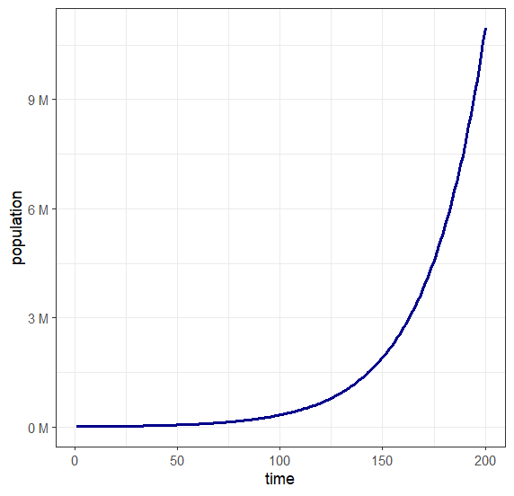
Exponential Growth
Our book gives 20,000 humans as an estimate for 70k bce
Assuming populations doubled in ~ 20 years…

Slide 18
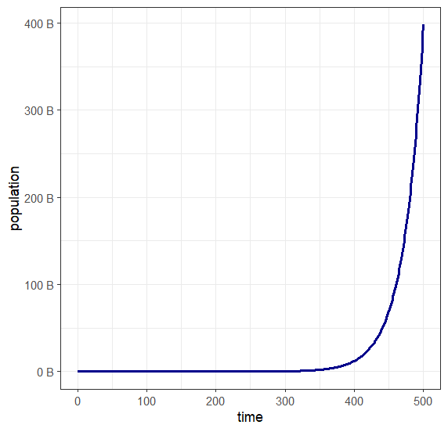
Exponential Growth
Our book gives 20,000 humans as an estimate for 70k bce
Assuming populations doubled in ~ 20 years…

Slide 19
Exponential Growth
Our book gives 20,000 humans as an estimate for 70k bce
Assuming populations doubled in ~ 20 years…
Obviously, 400 billion humans is unrealistic…

Slide 20
Density Dependence
As populations increase, growth rates decrease
What factors drive this?

Slide 21
Density Dependence
As populations increase, growth rates decrease
What factors drive this?
Competition
Aggression
Disease
Predation
Accumulation of waste

Slide 22
Density Dependence
As populations increase, growth rates decrease
Creates a feedback between population size and growth rate
Often modelled using a logistic growth model

Slide 23
Logistic Growth
K
N_{t} = N₀
(K - N₀)e^{-rt} + N₀
N_{t} = # at time t,
N₀= initial population size,
r = intrinsic population growth rate
t = time
K = carrying capacity

Slide 24
Logistic Growth
K
N_{t} = N₀
(K - N₀)e^{-rt} + N₀
N_{t} = # at time t,
N₀= initial population size,
r = intrinsic population growth rate
t = time
K = carrying capacity

Slide 25
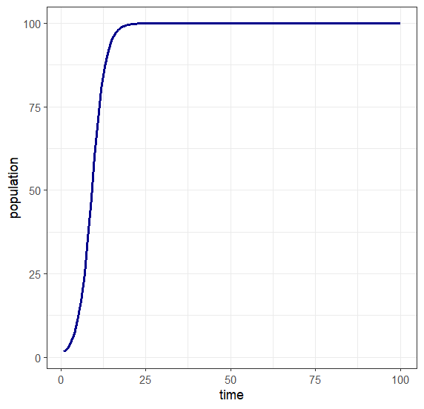
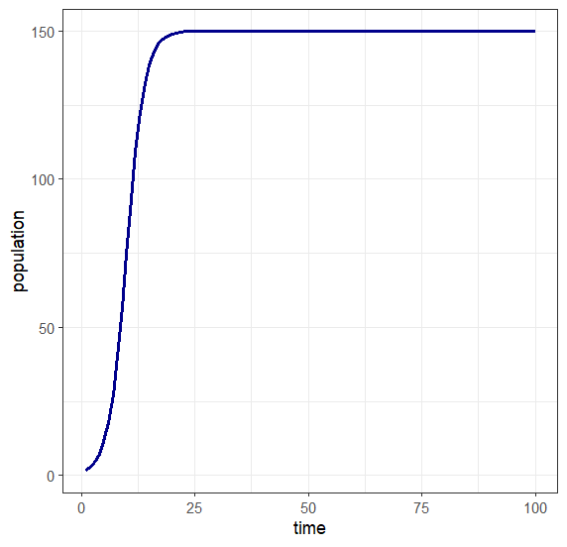
Logistic Growth
K
N_{t} = N₀
(K - N₀)e^{-rt} + N₀
K = 100
r = 0.5
K = 150
r = 0.5
N_{t} = # at time t,
N₀= initial population size,
r = intrinsic population growth rate
t = time
K = carrying capacity

Slide 26
Logistic Growth
K
N_{t} = N₀
(K - N₀)e^{-rt} + N₀
K = 100
r = 0.5
K = 150
r = 0.5
N_{t} = # at time t,
N₀= initial population size,
r = intrinsic population growth rate
t = time
K controls maximum population size, that is, the carrying capacity
K = carrying capacity

Slide 27
Assumptions of Logistic Growth
Makes some assumptions, which are unlikely to hold:
Per capita growth rate is a linear function of the number of individuals
Changes to growth rate are instantaneous
External environment doesn’t matter (e.g., resources, climate)
All individuals are equivalent

Slide 28
Why use logistic growth?
Given the unrealistic assumptions, why use it?
Good starting point
Can add other features to it
Often best to start with a simple model and only add parameters as needed
Useful as a tool for thinking about population dynamics

Slide 29
Causes of Density dependence
Earlier we discussed some factors that could lead to density dependence.
Lots of focus on competition
But, as we discussed, other factors can play a role!

Slide 30
Janzen-Connell Hypothesis
Focuses on specialist natural enemies (e.g., herbivores, pathogens)
The impact of enemies is related to distance to others of your species
So, as an area fills up, there are fewer places free of enemies
Thus, populations are kept in check by enemies

Slide 31
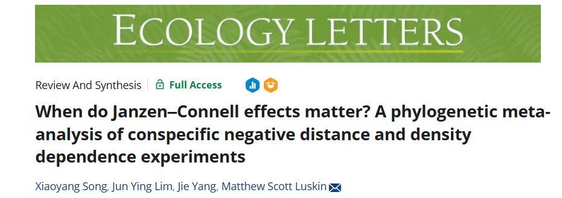
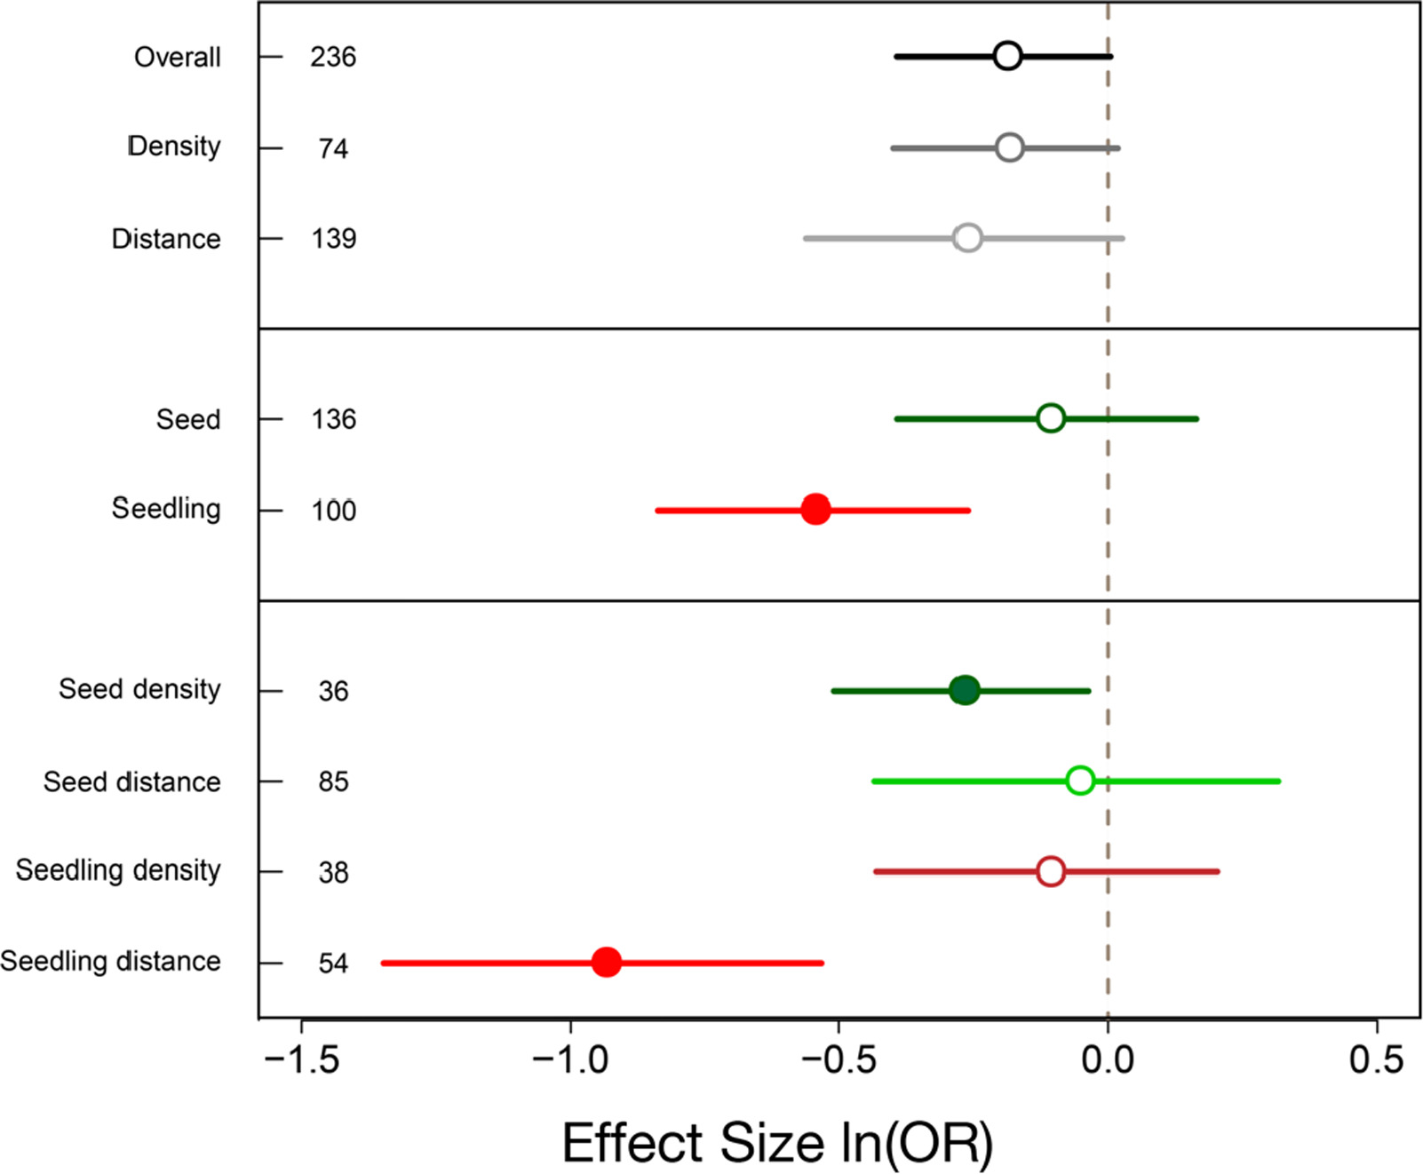
Janzen-Connell Hypothesis

Slide 32
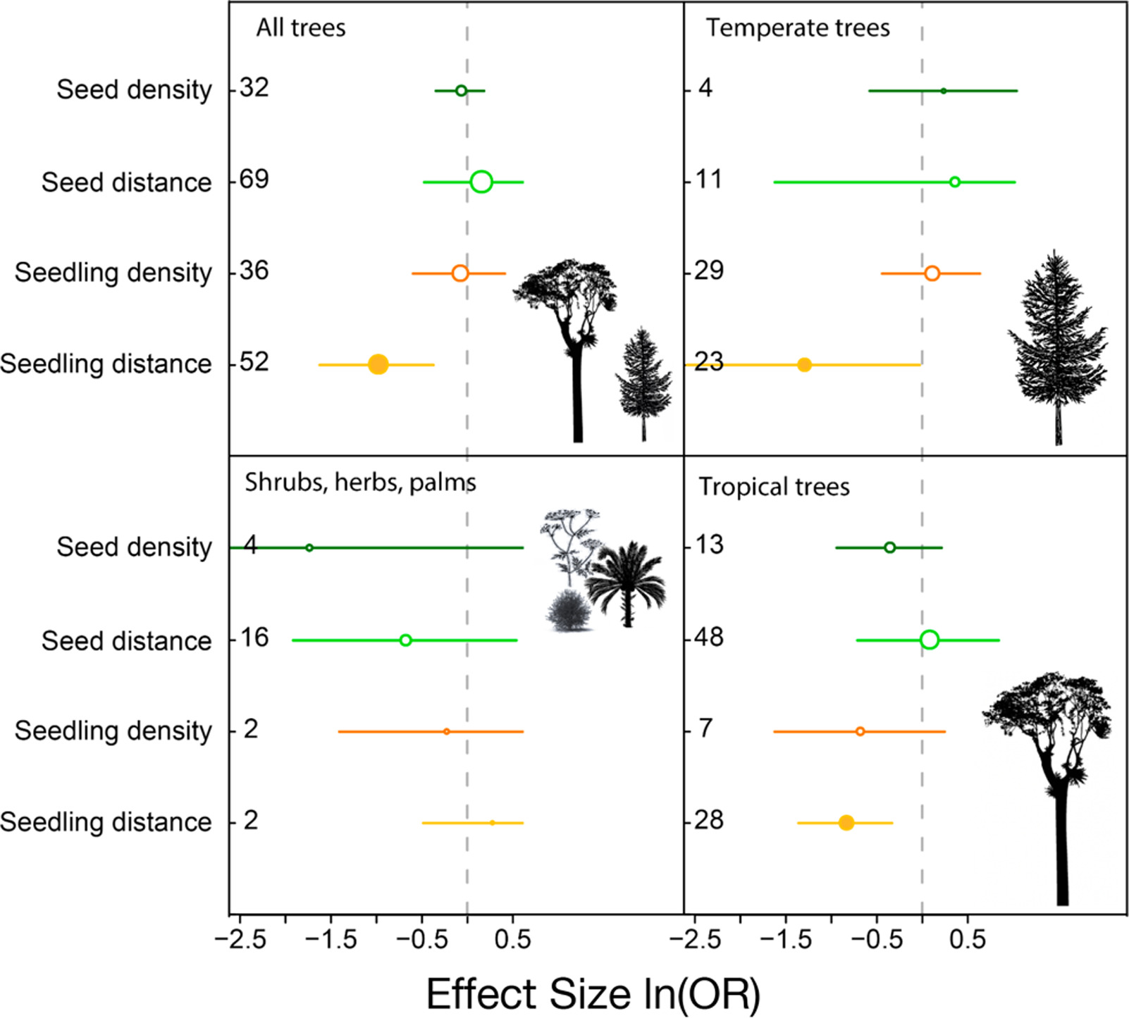
Janzen-Connell Hypothesis

Slide 33
Positive density dependence?
Why might the growth rate of a species INCREASE with population size?

Slide 34
Positive density dependence?
Why might the growth rate of a species INCREASE with population size?
Ease of finding a mate
Predator defense
Offspring survival
Greater foraging efficiency
Environmental modification
Some of these are particularly important for social species

Slide 35
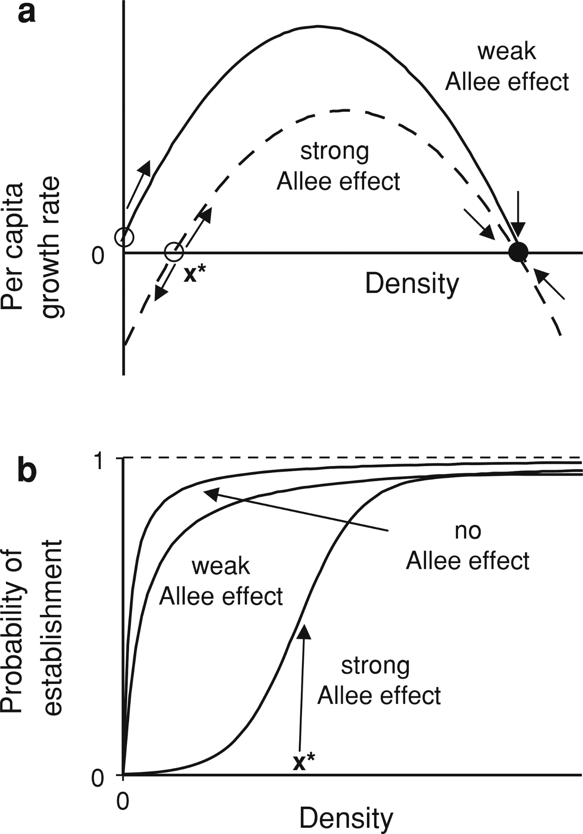
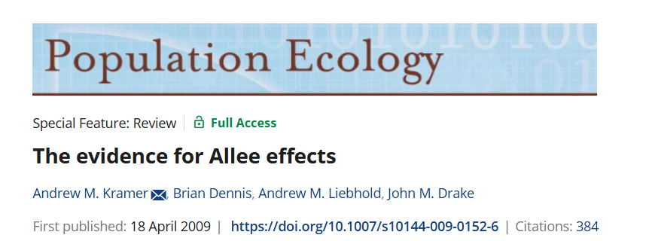
Allee Effects
Positive relationship between growth rate and population size

Slide 36
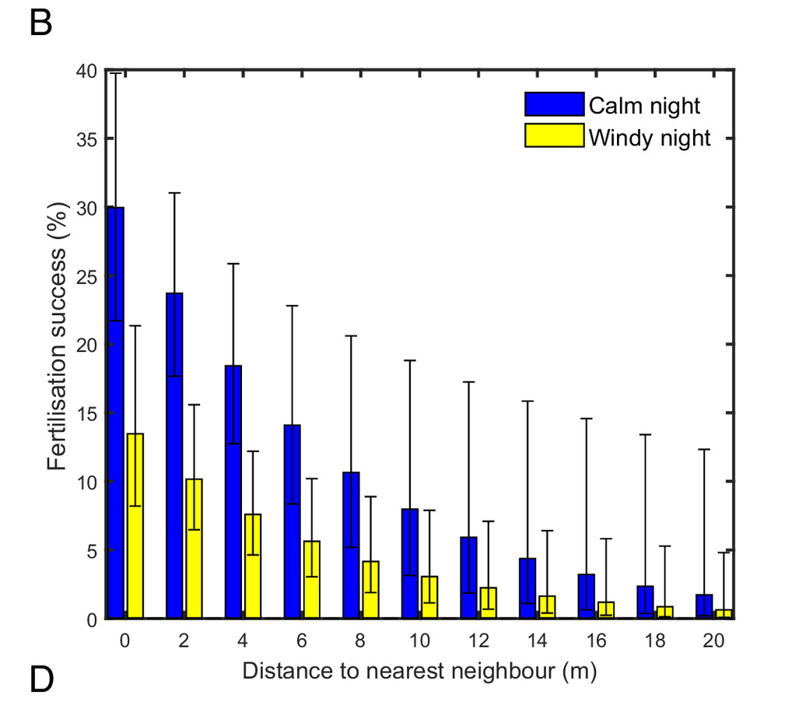
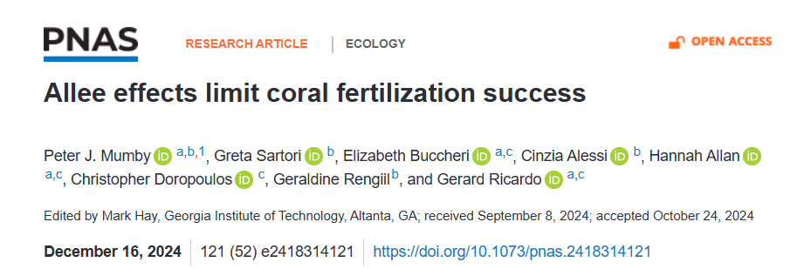
Allee Effects
Positive relationship between growth rate and population size

Slide 37
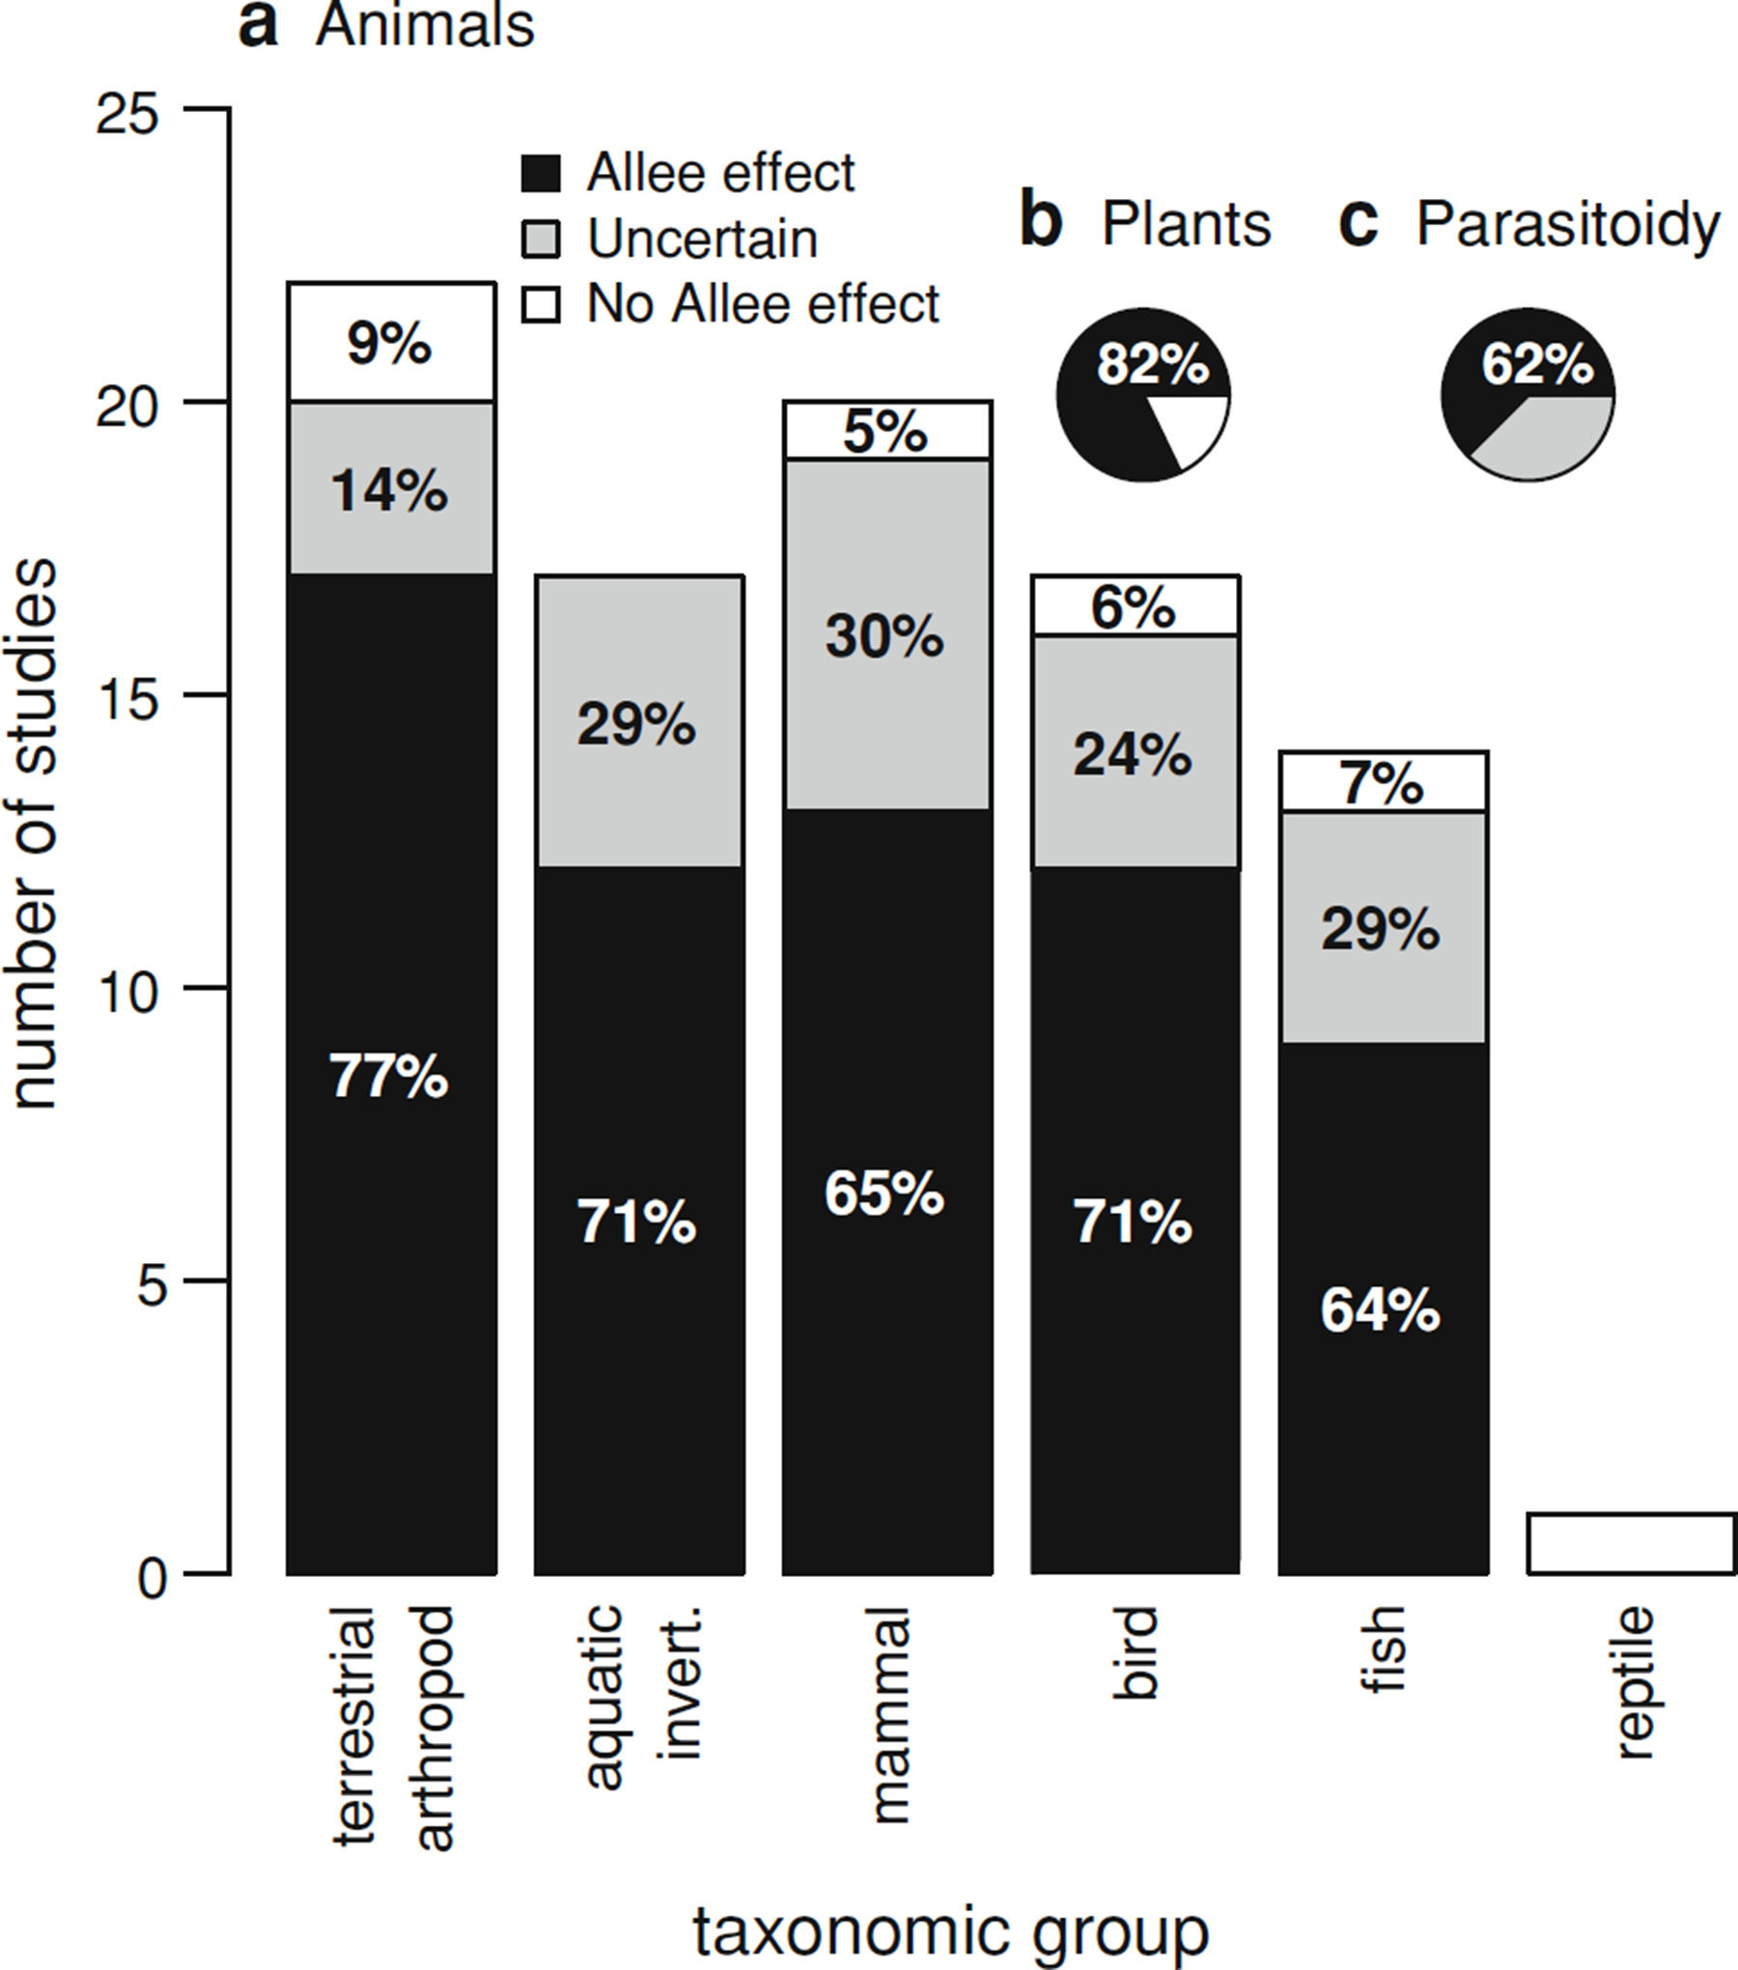
Allee Effects

Slide 38
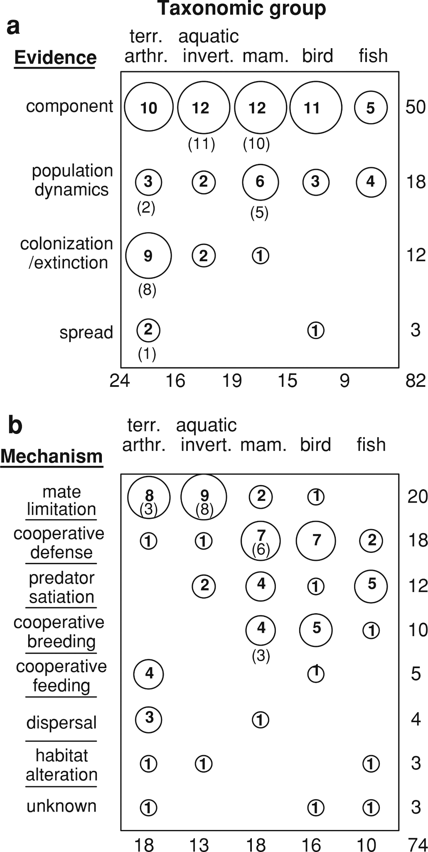
Allee Effects

Slide 39
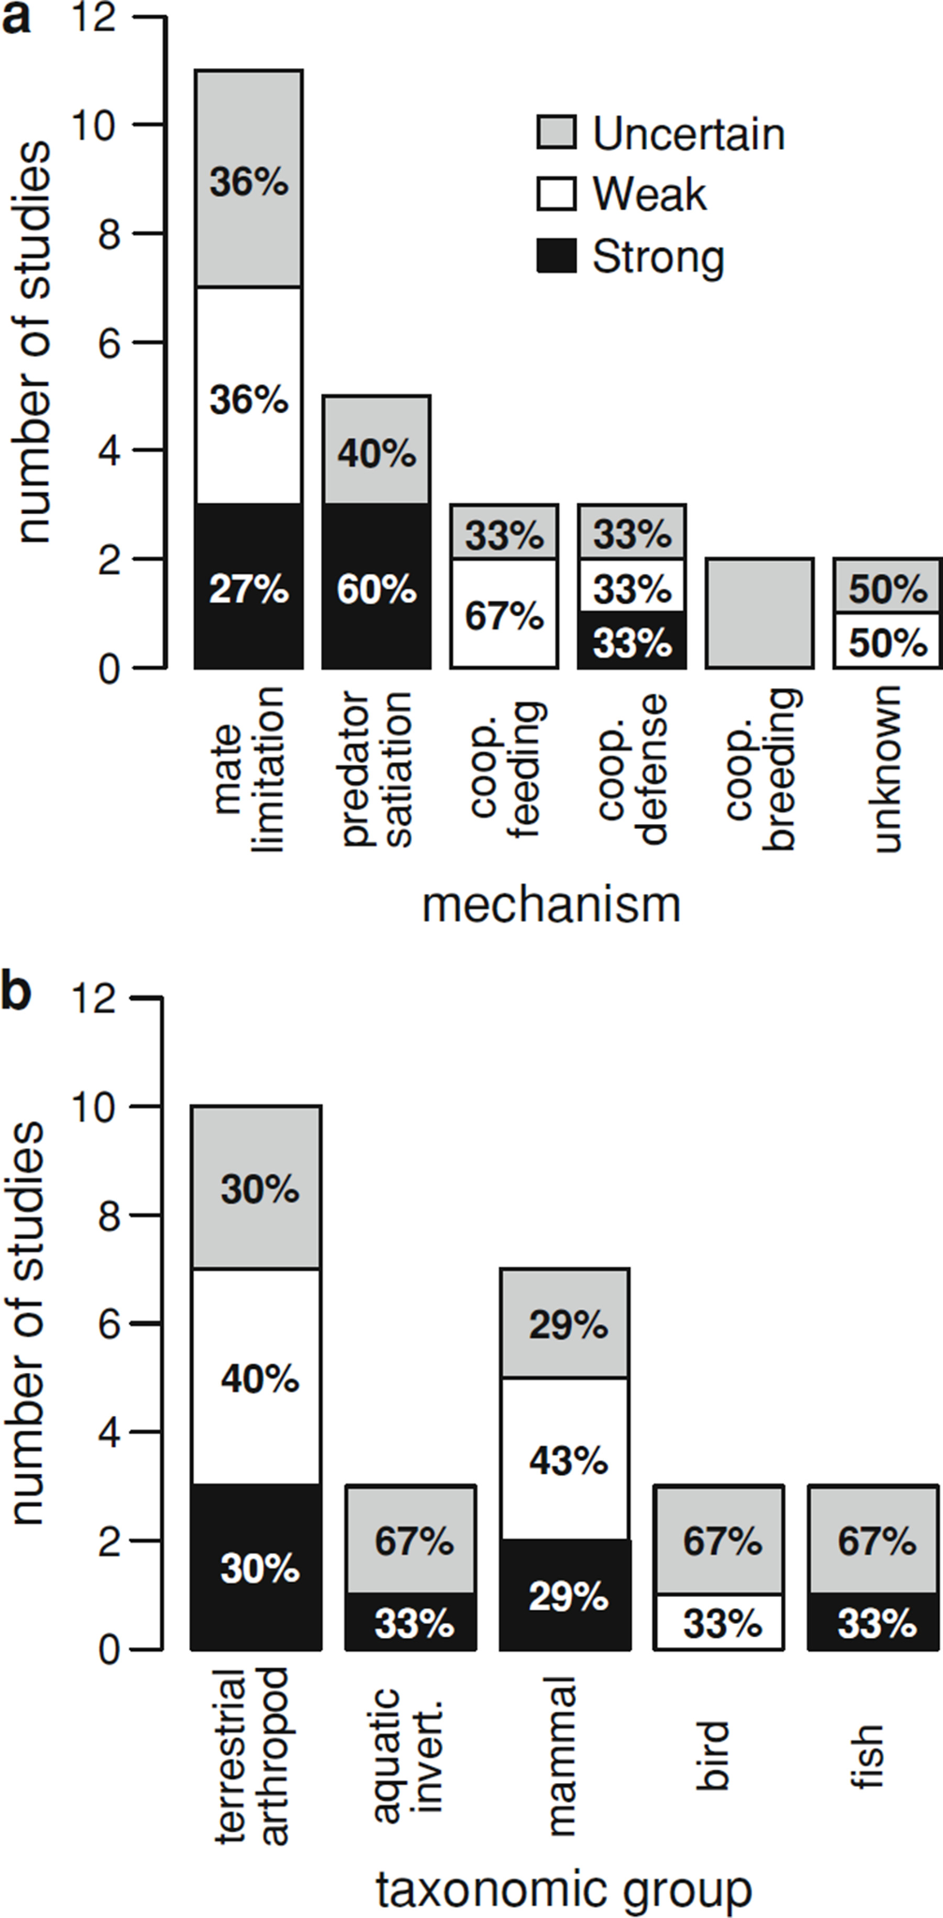
Allee Effects

Slide 40
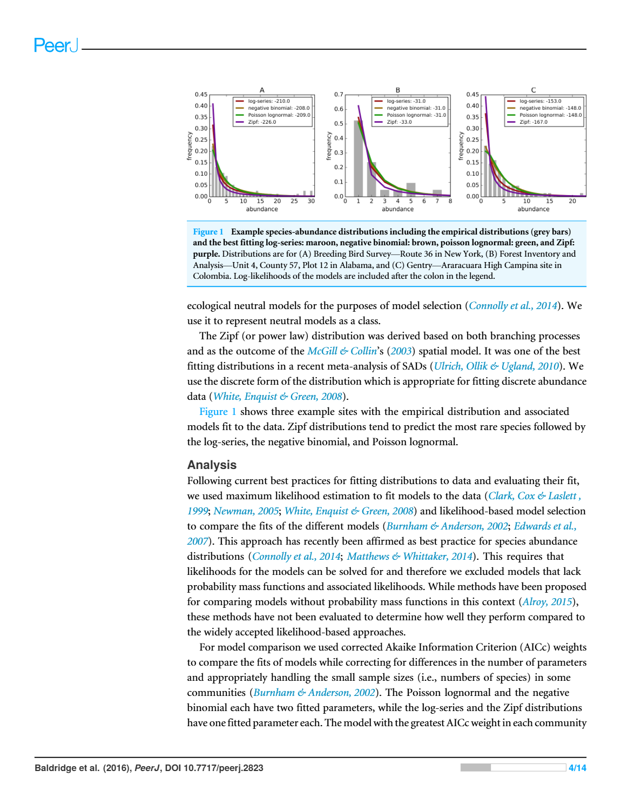
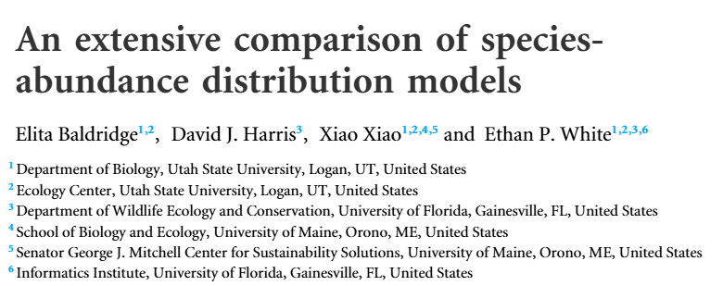
Density Dependence and Rarity
Remember SADs?

Slide 41
Density Dependence and Rarity
Remember SADs?

Slide 42
Density Dependence and Rarity
Remember SADs?
Differences driven by density dependences?

Slide 43
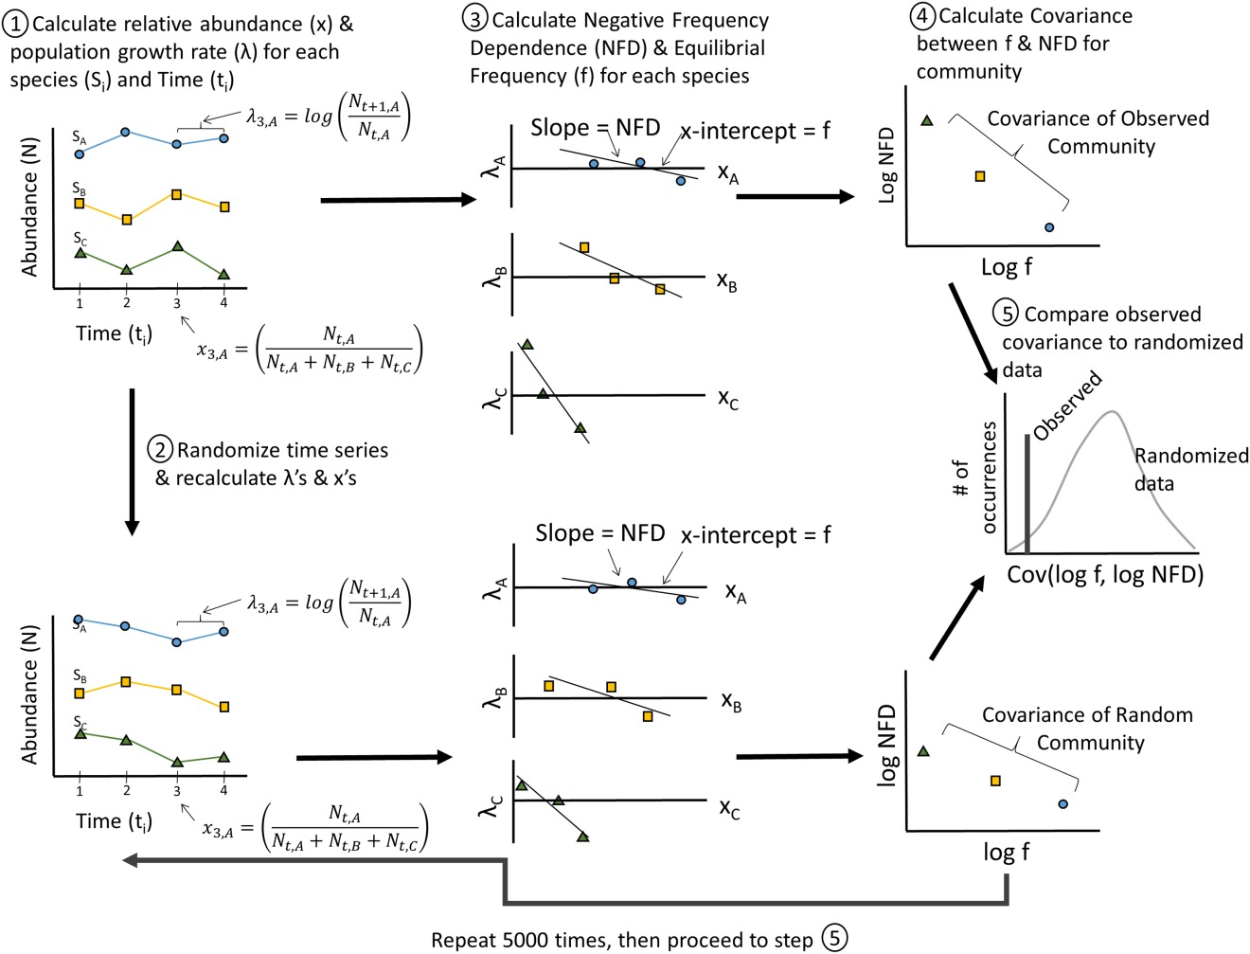
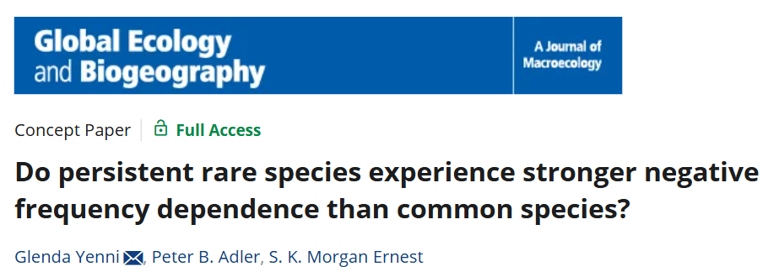
Density Dependence and Rarity
Rare species should experience stronger density dependence than common species

Slide 44
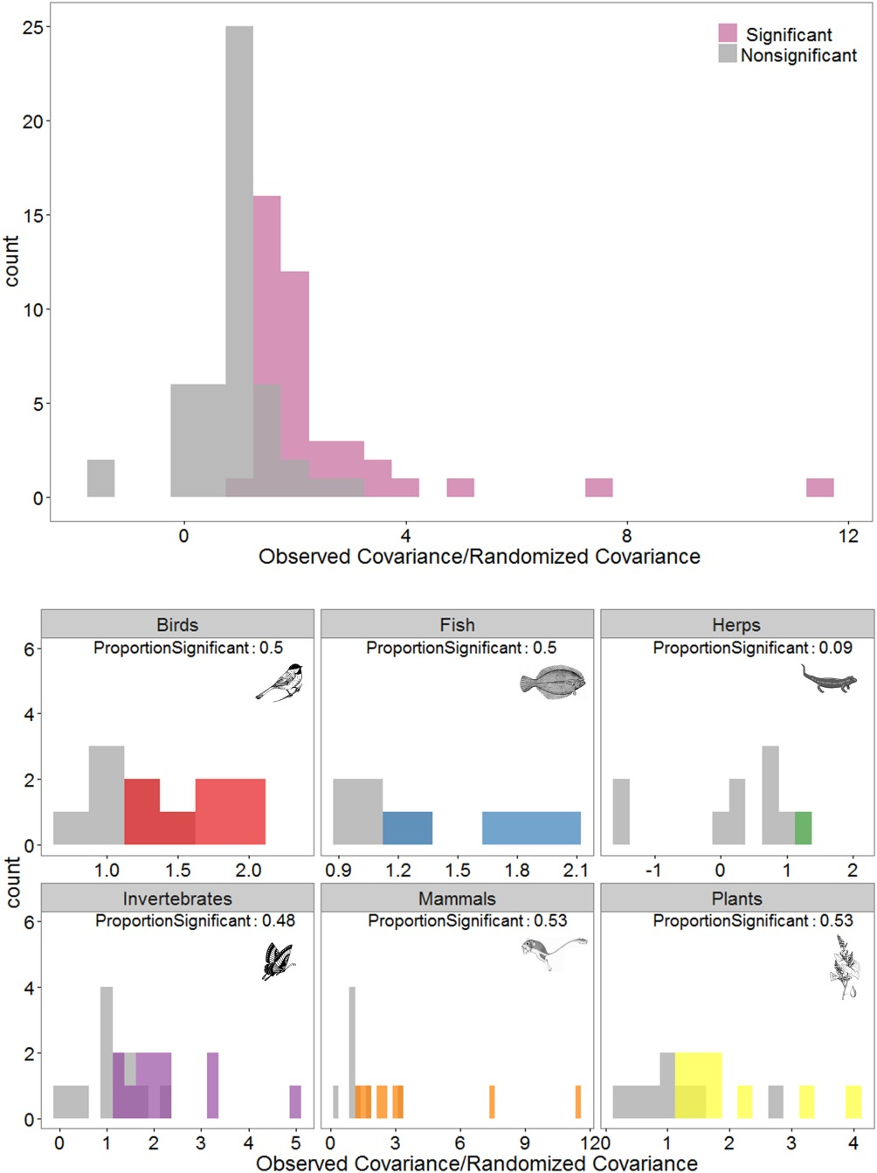
Density Dependence and Rarity
Rare species should experience stronger density dependence than common species

Slide 45
Density Dependence and Rarity
Hypothesized that differences in density dependence may help buffer rare species
Essentially improve growth rates when rare
Small drop in population size is a big increase in growth rate

Slide 46
Density dependence and richness
If there is variation in density dependence, does this impact richness?
More DD, smaller populations
Smaller populations, more species

Slide 47
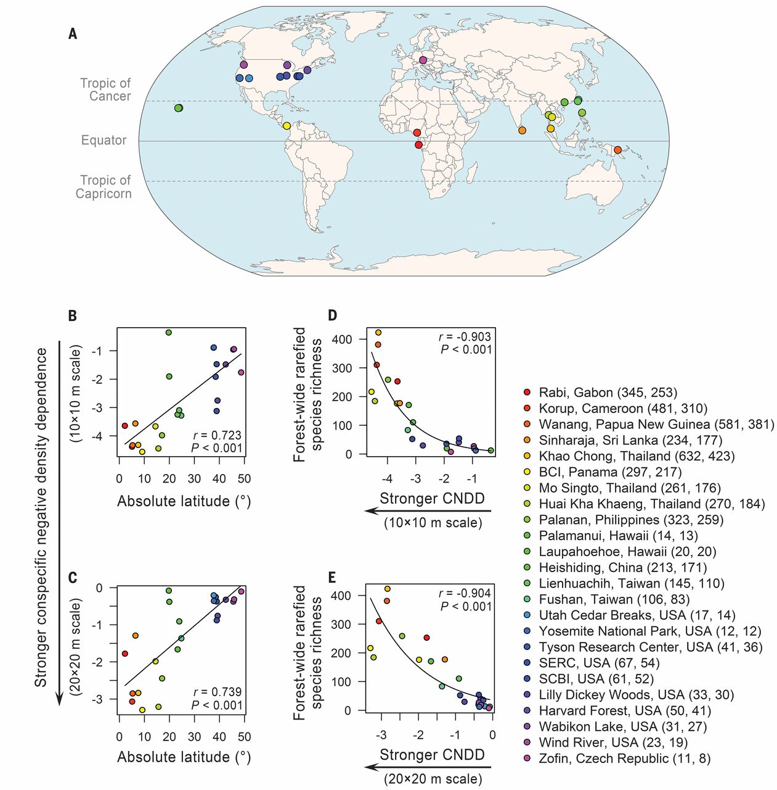
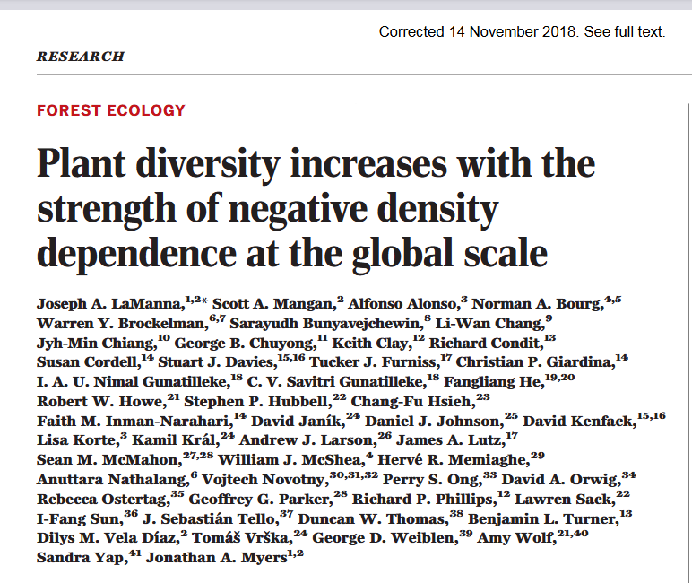
Density dependence and richness
Notes:
“To quantify CNDD for each species in each plot, we measured the degree to which increasing adult conspecific densities suppress local recruitment of saplings, independent from the effects of heterospecific densities.”

Slide 48
Next class: Predator-Prey Interactions

