Slide 1
Community Assembly
Today’s Agenda:
Network assignment reminder
Paper presentation 2
Quiz
Community Assembly

Slide 2
Network assignment
Reminder: Network assignment is due Friday (14 March) by midnight

Slide 3
Paper presentation 2: Community Assembly (26 March)
Step 1: Find a paper on community assembly in your system (or one you pick)
Step 2: Make 2 slides explaining the paper
Slide 1) graphics made by you that explain what was done in the study
Slide 2) what they found (should include results figure(s) from paper)
Step 3: Present the paper using those two slides (5 minute max)

Slide 4
Paper presentation 2: Community Assembly (26 March)
Grade Breakdown:
Graphics made by student help convey key information 20%
Minimal text 20%
Overall slide quality 10%
Understanding and explanation of the chosen paper 20%
Focus on key findings 20%
Overall presentation quality 10%

Slide 5
Questions on assignments?

Slide 6
Community assembly
Why do these particular species occur in this community?
Essentially the core question of community assembly theory

Slide 7
Community assembly
Community assembly focuses on a few key concepts:
Regional species pool
Notes:
What species exist?

Slide 8
Community assembly
Community assembly focuses on a few key concepts:
Regional species pool
Dispersal
Notes:
What species can get there?

Slide 9
Community assembly
Community assembly focuses on a few key concepts:
Regional species pool
Dispersal
Environmental filtering
Notes:
What species can tolerate the environment?

Slide 10
Community assembly
Community assembly focuses on a few key concepts:
Regional species pool
Dispersal
Environmental filtering
Biotic filtering
Notes:
What species can find prey and mutualists and survive predators?

Slide 11
Species pool

Slide 12
Species pool
Dispersal
Communities

Slide 13
Abiotic
Filter
Species pool
Dispersal
Communities
Notes:
Abiotic excludes round stuff, biotic excludes anything that isn’t blue or green

Slide 14
Abiotic
Filter
Species pool
Dispersal
Communities
Notes:
Abiotic excludes round stuff, biotic excludes anything that isn’t blue or green

Slide 15
Abiotic
Filter
Biotic
Filter
Species pool
Dispersal
Communities
Notes:
Abiotic excludes round stuff, biotic excludes anything that isn’t blue or green

Slide 16
Abiotic
Filter
Biotic
Filter
Species pool
Dispersal
Communities
Notes:
Abiotic excludes round stuff, biotic excludes anything that isn’t blue or green

Slide 17
Abiotic
Filter
Biotic
Filter
Communities
Species pool
Dispersal
Communities
Notes:
Abiotic excludes round stuff, biotic excludes anything that isn’t blue or green

Slide 18
Abiotic
Filter
Biotic
Filter
Communities
Species pool
Dispersal
Communities
Metacommunity
Notes:
Abiotic excludes round stuff, biotic excludes anything that isn’t blue or green

Slide 19
Abiotic
Filter
Biotic
Filter
Communities
Species pool
Dispersal
Communities
Metacommunity
Speciation, Extinction, Dispersal
Notes:
Abiotic excludes round stuff, biotic excludes anything that isn’t blue or green

Slide 20
Abiotic
Filter
Biotic
Filter
Communities
Species pool
Dispersal
Communities
Metacommunity
Speciation, Extinction, Dispersal
Notes:
Abiotic excludes round stuff, biotic excludes anything that isn’t blue or green

Slide 21
Community assembly
Community assembly focuses on a few key concepts:
Regional species pool
Dispersal
Environmental filtering
Biotic filtering
Notes:
What species can find prey and mutualists and survive predators?

Slide 22
Community assembly
Community assembly focuses on a few key concepts:
Regional species pool
Dispersal
Environmental filtering
Biotic filtering
Notes:
What species can find prey and mutualists and survive predators?

Slide 23
Species Pool
The species that could potentially get to a region
How might you decide on what is in a species pool?

Slide 24
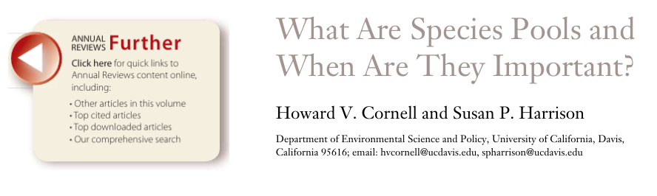
Species Pool
The species that could potentially get to a region
How might you decide on what is in a species pool?
Biogeographic regions - e.g., ecoregions, rivers, islands,
Fixed distance - e.g., 100 km of a given plot
Dispersal abilities - e.g., all species that can disperse to the site
Sample/plot data - e.g., all species observed in any plot/sample

Slide 25
Species Pool
Why do we care?

Slide 26
Species Pool
Why do we care?
We need to know the potential species that can get to a location
To know what is being excluded, we need to know our options

Slide 27
Community assembly
Community assembly focuses on a few key concepts:
Regional species pool
Dispersal
Environmental filtering
Biotic filtering
Notes:
What species can find prey and mutualists and survive predators?

Slide 28
Community assembly
Community assembly focuses on a few key concepts:
Regional species pool
Dispersal
Environmental filtering
Biotic filtering
Notes:
What species can find prey and mutualists and survive predators?

Slide 29
Dispersal
Really hard to measure empirically
What we really need to know is the dispersal kernel

Slide 30
Dispersal
Really hard to measure empirically
What we really need to know is the dispersal kernel
Dispersal Kernel: distribution of dispersal distances

Slide 31
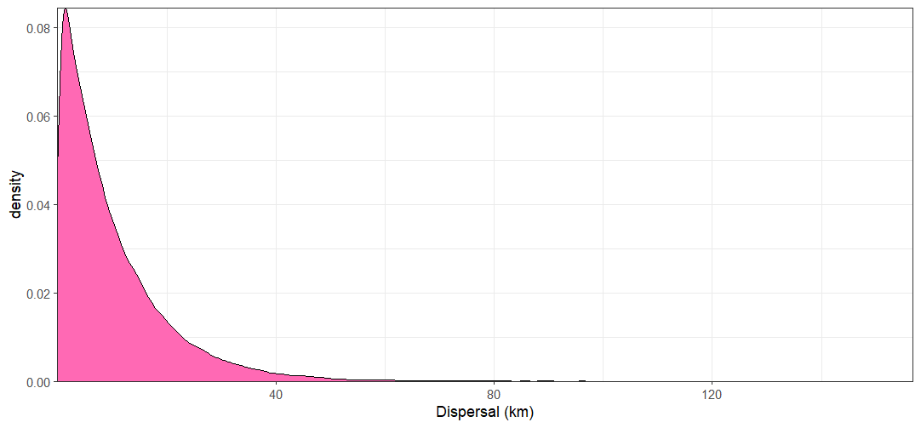
Dispersal
Really hard to measure empirically
What we really need to know is the dispersal kernel
Dispersal Kernel: distribution of dispersal distances

Slide 32
Dispersal
Really hard to measure empirically
What we really need to know is the dispersal kernel
Dispersal Kernel: distribution of dispersal distances
These rare dispersal events are very hard to sample!
Notes:
Note to self: this would be a good place to add a netlogo demo in the future.

Slide 33
Dispersal
If long-distance dispersal events are so rare, why is it a problem?
Notes:
Note to self: this would be a good place to add a netlogo demo in the future.

Slide 34
Long Distance Dispersal
If long-distance dispersal events are so rare, why is it a problem?
Incorrect species pools
Long distance dispersal can be very important in dynamics
Rescue effects, range expansion, etc.

Slide 35
Long Distance Dispersal
Likelihood of suitable habitat
Dispersal Distance

Slide 36
Long Distance Dispersal
Likelihood of suitable habitat
Fitness
Dispersal Distance
Population Density

Slide 37
Long Distance Dispersal
Probably suitable, but lots of intraspecific competition
High risk/high reward,
Can accelerate range expansion

Slide 38
Dispersal in practice
We usually don’t have good dispersal data
Have to make assumptions and do the best we can
Most often involves assuming that anything in some spatial area or set of sites could disperse

Slide 39
Community assembly
Community assembly focuses on a few key concepts:
Regional species pool
Dispersal
Environmental filtering
Biotic filtering
Notes:
What species can find prey and mutualists and survive predators?

Slide 40
Community assembly
Community assembly focuses on a few key concepts:
Regional species pool
Dispersal
Environmental filtering
Biotic filtering
Notes:
What species can find prey and mutualists and survive predators?

Slide 41
Environmental Filtering
Can a species survive the abiotic conditions?

Slide 42
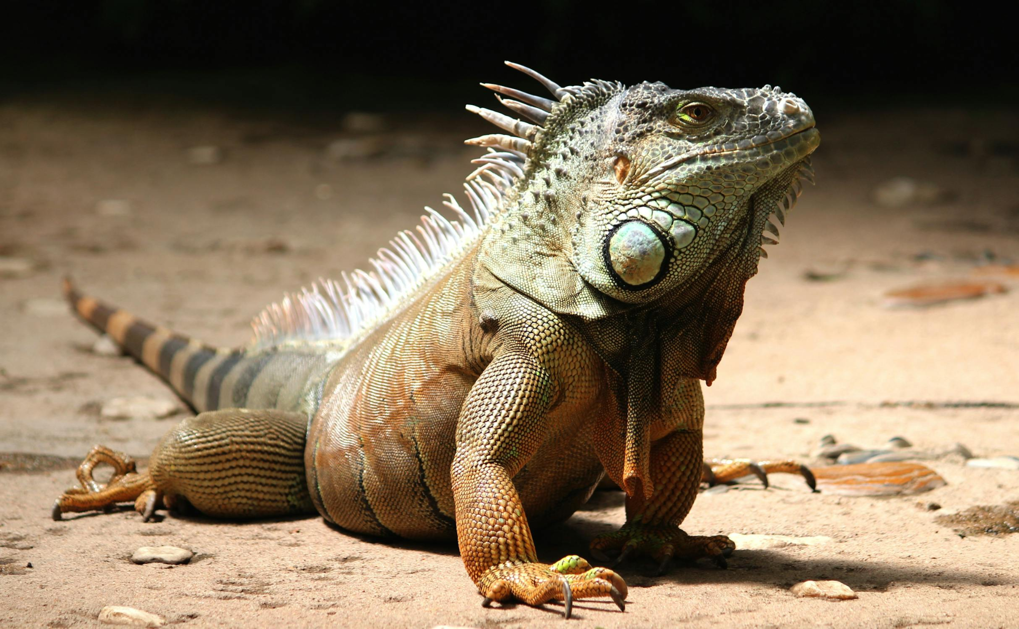
Environmental Filtering
Can a species survive the abiotic conditions?
Images: Vladimir Kudinov, Pixabay, Mario Rojas

Slide 43
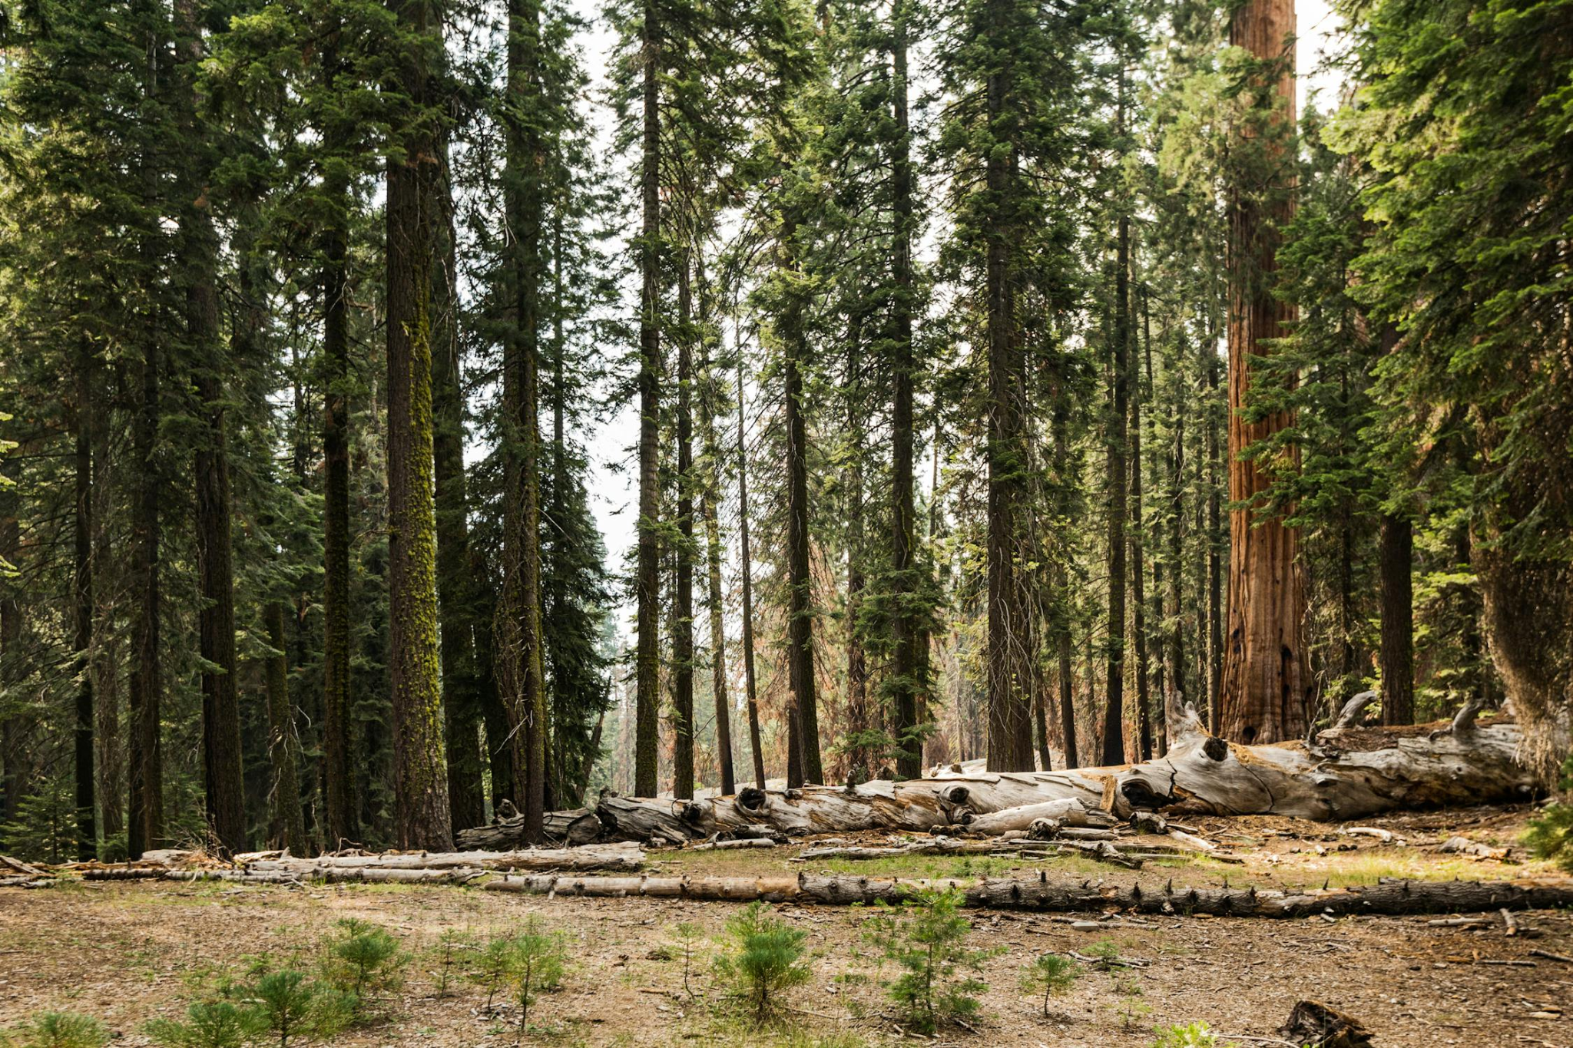
Environmental Filtering
Can a species survive the abiotic conditions?
Images: Vladimir Kudinov, Pixabay, Mario Rojas

Slide 44
Environmental Filtering
Can a species survive the abiotic conditions?
Images: Vladimir Kudinov, Pixabay, Mario Rojas

Slide 45

Environmental Filtering
Can a species survive the abiotic conditions?
Images: Vladimir Kudinov, Pixabay, Mario Rojas

Slide 46
Environmental Filtering
Can a species survive the abiotic conditions?
✔
Images: Vladimir Kudinov, Pixabay, Mario Rojas

Slide 47
Environmental Filtering
Seems easy, right?
Not always

Slide 48
Inferring Environmental Filtering
Multiple approaches
Correlative: e.g, are species similar to existing species?
Mechanistic: e.g., can the species survive there?
Experimental: e.g., can the species survive if we increase temperature?

Slide 49
Inferring Environmental Filtering
Correlative approaches: Traits
Species in community A
Species in community B
Trait 2
Trait 1

Slide 50
Inferring Environmental Filtering
Correlative approaches: Traits
Species in community A
?
Species in community B
In species pool, but missing in A and B
Trait 2
Trait 1

Slide 51
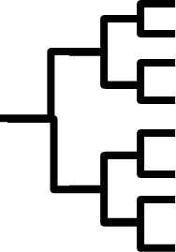
Inferring Environmental Filtering
Correlative approaches: Phylogeny
Species in community A
Species in community B
Time

Slide 52
Inferring Environmental Filtering
Correlative approaches: Phylogeny
Species in community A
Species in community B
In species pool, but missing in A and B
?
Time

Slide 53
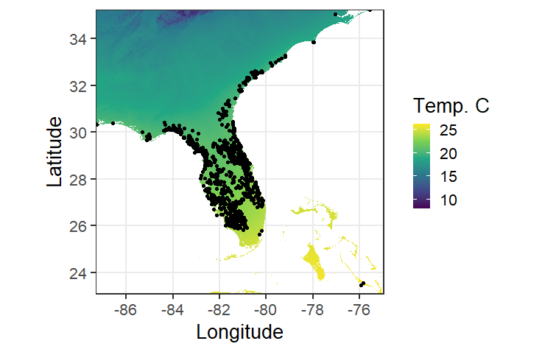
Inferring Environmental Filtering
Correlative approaches: Environmental data

Slide 54
Inferring Environmental Filtering
Correlative approaches: Environmental data
SDM

Slide 55
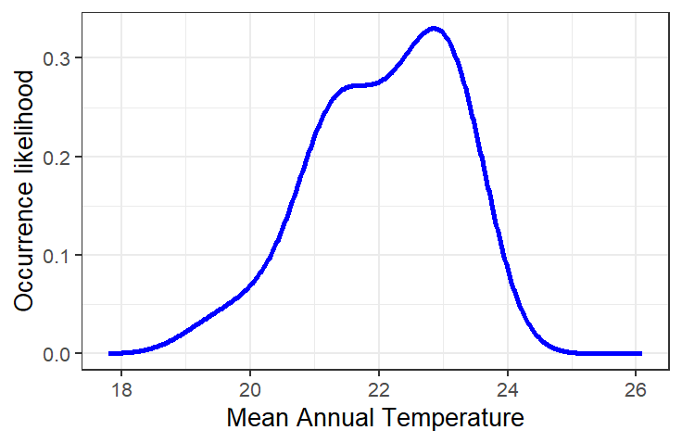
Inferring Environmental Filtering
Correlative approaches: Environmental data
SDM
Relative Occurrence Rate

Slide 56
Inferring Environmental Filtering
Correlative approaches: Environmental data
Relative Occurrence Rate

Slide 57
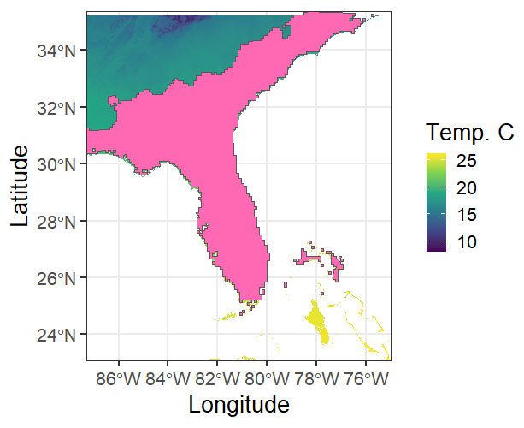
Inferring Environmental Filtering
Correlative approaches: Environmental data
Relative Occurrence Rate

Slide 58
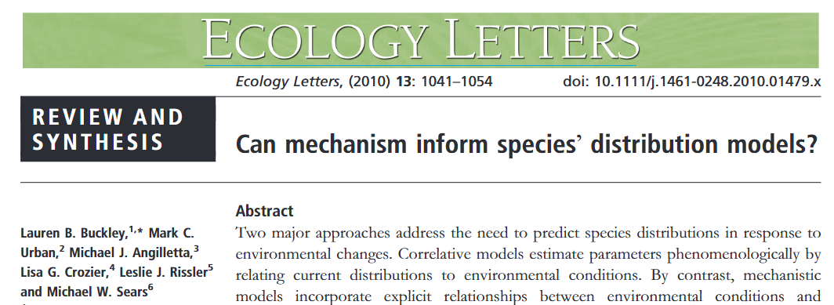
Inferring Environmental Filtering
Mechanistic approaches
Measure important variables in a controlled setting
E.g., hatching success vs temperature, salinity vs growth rate
Build a complicated model that is appropriate for a particular species
For reptiles, this might involve behavioral changes as well as physiology
For plants, this might involve photosynthesis temperature-response curves
Much more data-intensive, but may not give better predictions

Slide 59
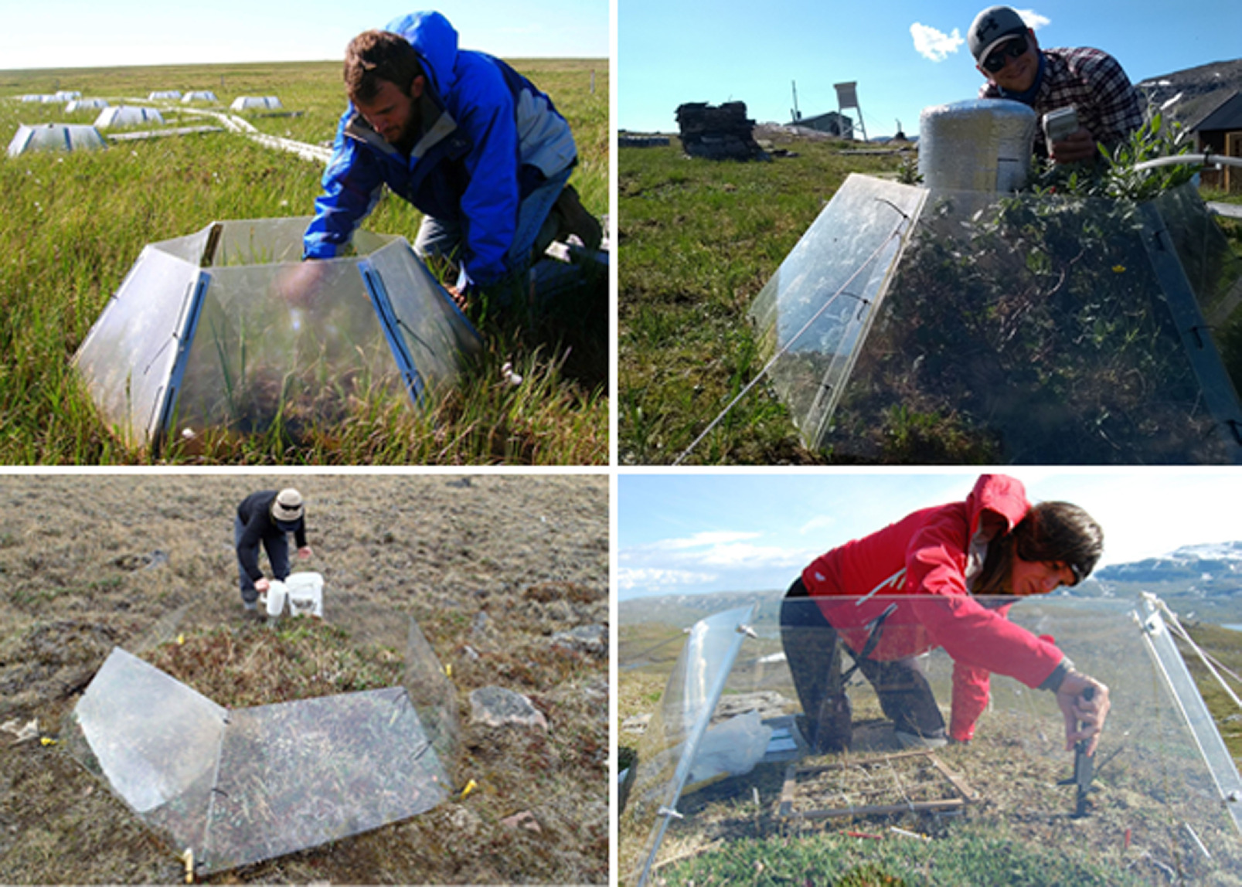
Inferring Environmental Filtering
Experimental approaches
Manipulate environmental conditions and see how species respond
E.g., warming experiments, drought experiments
https://doi.org/10.1139/as-2022-0030

Slide 60
Inferring Environmental Filtering
Challenges:
Species absence from an environment may not be due to a lack of suitability
Mechanistic models require a lot of data we don’t have
Experiments are hard and expensive

Slide 61
Community assembly
Community assembly focuses on a few key concepts:
Regional species pool
Dispersal
Environmental filtering
Biotic filtering
Notes:
What species can find prey and mutualists and survive predators?

Slide 62
Community assembly
Community assembly focuses on a few key concepts:
Regional species pool
Dispersal
Environmental filtering
Biotic filtering
Notes:
What species can find prey and mutualists and survive predators?

Slide 63
Biotic Filtering
Can a species tolerate the biotic interactions?
Predation/Herbivory/Parasitism/Disease
Prey availability
Mutualist availability
Commensalism

Slide 64
Biotic Filtering
Multiple approaches
Correlative: E.g., are co-occurring species different?
Experimental: can species survive when competitors are removed?

Slide 65
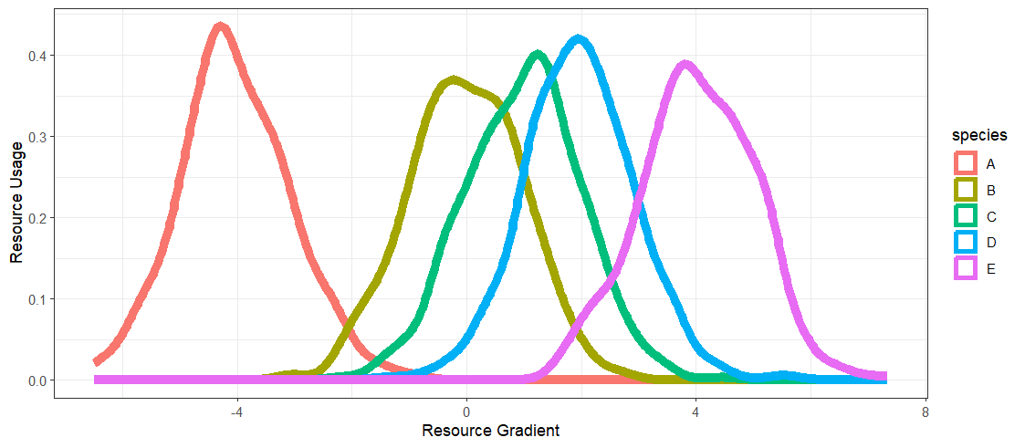
Inferring Biotic Filtering
Correlative: Are assemblages more different that you’d expect by chance?

Slide 66
Inferring Biotic Filtering
Correlative: Are assemblages more different that you’d expect by chance?
Trait 2
Trait 1

Slide 67
Inferring Biotic Filtering
Correlative: Are assemblages more different that you’d expect by chance?
Observed
Null
vs.

Slide 68
Inferring Biotic Filtering
Experimental: Add/remove species and see what happens
Can a species survive in the absence of a competitor?
Can it survive in the presence on a competitor?

Slide 69
Community assembly
Community assembly focuses on a few key concepts:
Regional species pool
Dispersal
Environmental filtering
Biotic filtering
Notes:
What species can find prey and mutualists and survive predators?

Slide 70
Community assembly
Community assembly focuses on a few key concepts:
Regional species pool
Dispersal
Environmental filtering
Biotic filtering
Notes:
What species can find prey and mutualists and survive predators?

Slide 71
Big Caveat: These aren’t actually independent!
Abiotic
Filter
Biotic
Filter
Communities
Species pool
Dispersal
Communities
Metacommunity
Speciation, Extinction, Dispersal

Slide 72
Lots of work to be done
Most studies infer these processes based on pattern
More experimental work needed
More work integrating with theory

Slide 73
Next class: Community assembly examples

