Slide 1
Trait-based Ecology III
Today’s Agenda:
Quiz
Traits and ecosystem function

Slide 2
Syllabus update
Major things remaining:
Project 3 (Due Friday)
Group project (due Wed, April 29th in class)
Final: Wed, May 6th from 12:30 to 2:30.
Project 4 (due May 7th, end of semester)

Slide 3
Group Assignment
Focus: variable/changing ecosystems in Florida
E.g., variation due to:
Ecological succession
Temporally fluctuating environments
Global changes
Some obvious examples might be:
Fire-dependent ecosystems
Tidal systems
Hurricanes as successional drivers
Ephemeral water bodies

Slide 4
Group Assignment
Pick your own group (Groups can be of one person)
Everyone in a group gets the same grade
Do/make something that explains your your chosen system to lay people
Can be anything that can convey a message
Possibly bonus points for creativity

Slide 5
Group Assignment
Products will be presented in class on April 29th
Show off what you created to the class (and me)
Your group should briefly explain:
what you did/created
rationale behind the approach you took
how it conveys the underlying concepts

Slide 6
Questions so far?

Slide 7
Project 4
Due May 7th before midnight
University policies force me to be a bit stricter about the deadlines on this one
Feel free to submit early to avoid the end-of-semester crunch!

Slide 8
Project 4
Pick a research question about community ecology
Propose alternative research approaches
Three parts:
Intro (1-2 pages, 4 max)
Methods (funded version, 1-2 pages)
Methods (free version, 1-2 pages)

Slide 9
Project 4
Ecology is cool because it can often be done for free
BUT you can usually do even better work with some funding
Goal here is to think about different approaches to a question

Slide 10
Project 4
No set number of references to read
Re-use as much old text as you like
Remember to cite where you need to
Worth 15 points (other projects were 10)

Slide 11
Questions on Project 4?

Slide 12
Next week:
I’ll be out of town, so no class.
I’ll be cutting the lectures on Metacommunities
But they’re posted if you really want to read them…
Full points to everyone for next week’s quizzes
I recommend you use the time to work on the group project

Slide 13
Questions?

Slide 14
Why focus on traits?
Generality:
Rather than focusing on particular species in particular systems, we can say things about all species in all systems (or at least a larger subset of species/systems).
Quantitative:
We move from species (categorical) to continuous measurements
Links to mechanism
We can focus on traits that are linked to particular mechanisms
E.g., if we want to work on predation, mouth size might be useful.
More predictive
Allow us to say something about potential future scenarios

Slide 15
Why focus on traits?
Generality:
Rather than focusing on particular species in particular systems, we can say things about all species in all systems (or at least a larger subset of species/systems).
Quantitative:
We move from species (categorical) to continuous measurements
Links to mechanism
We can focus on traits that are linked to particular mechanisms
E.g., if we want to work on predation, mouth size might be useful.
More predictive
Allow us to say something about potential future scenarios

Slide 16
Traits and ecosystem function
Which organisms?
Which traits map onto which services?
How much do traits vs environment matter?

Slide 17
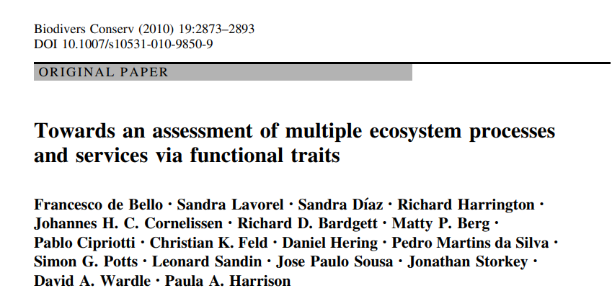
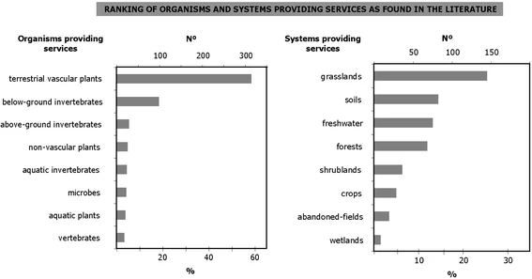
What are people studying?

Slide 18
What are people studying?
Why might these be what people are studying?

Slide 19
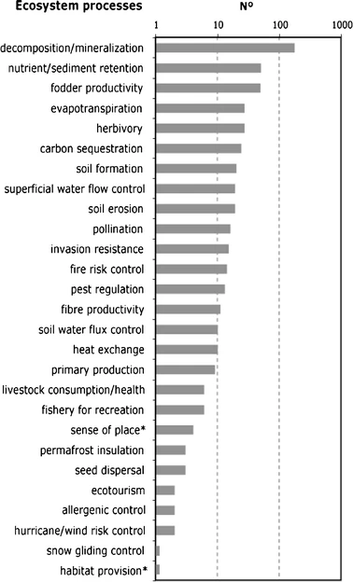
What are people studying?

Slide 20
What are people studying?
Why might these be what people are studying?

Slide 21
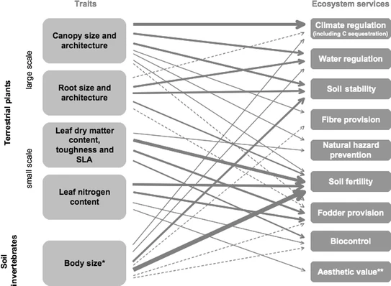
What are people studying?

Slide 22
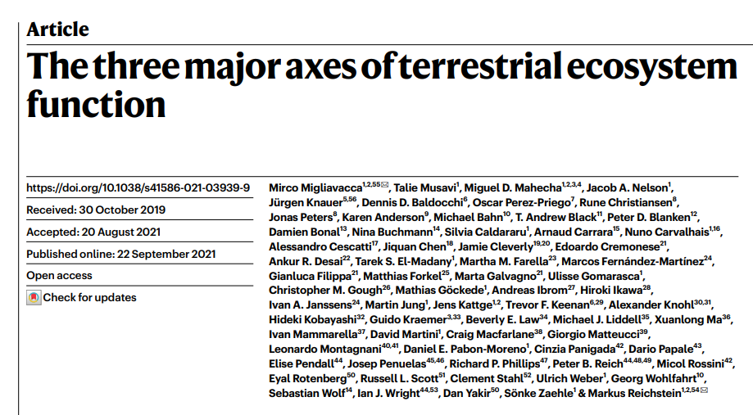
Ecosystem function axes
Lots of ecosystem functions we might study
Some correlated
Wanted to understand major variation

Slide 23
Ecosystem function axes
Ecosystem services measured:
WUEt, variant of water-use efficiency, but based on transpiration estimates
underlying water-use efficiency (uWUE)
maximum and mean basal ecosystem respiration (Rbmax and Rb, respectively)
maximum net ecosystem productivity (NEPmax),
maximum dry canopy surface conductance (Gsmax)
maximum gross CO2 uptake at light saturation (GPPsat)

Slide 24
Ecosystem function axes
Continued:
stomatal slope at ecosystem scale (G1)
maximum evapotranspiration (ETmax),
EF amplitude (EFampl)
evaporative fraction (EF) (that is, the ratio between latent heat flux and available energy, indicative of energy partitioning)
apparent carbon-use efficiency (aCUE) (that is, the remaining fraction of carbon entering the ecosystem).

Slide 25
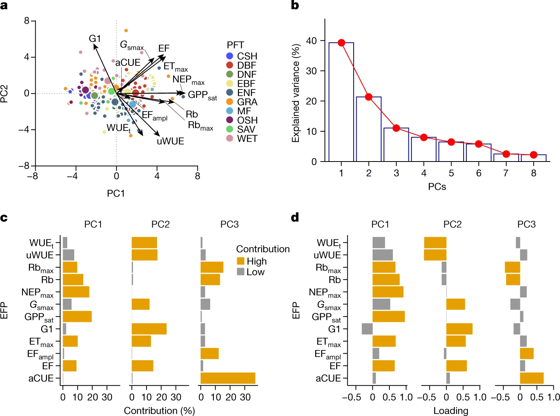
Ecosystem function axes

Slide 26
Ecosystem function axes
PC1 = maximum ecosystem productivity
PC2 = ecosystem water-use strategies
PC3 = ecosystem carbon-use efficiency

Slide 27
Ecosystem function axes
Water use strategy
CSH =closed shrublands
DBF = deciduous broadleaved forest
DNF = deciduous needleleaf forests
EBF =evergreen broadleaved forest
ENF =evergreen needleleaf forest
GRA =grasslands
MF =mixed forest
OSH =open shrublands
SAV = savannah
WET = wetlands
Max productivity
Notes:
Note that PFTs make sense: broadleaf in upper right, gramminoid systems in the upper left, needleleaves in the bottom, etc.

Slide 28
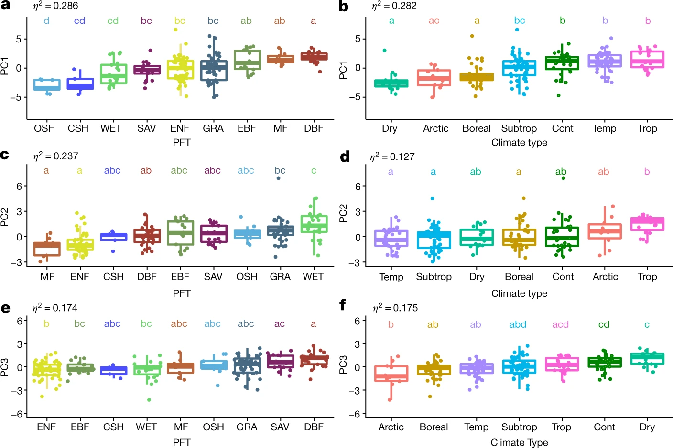
Ecosystem function axes
Max productivity
CSH =closed shrublands
DBF = deciduous broadleaved forest
DNF = deciduous needleleaf forests
EBF =evergreen broadleaved forest
ENF =evergreen needleleaf forest
GRA =grasslands
MF =mixed forest
OSH =open shrublands
SAV = savannah
WET = wetlands
Water use
Carbon use

Slide 29
Ecosystem function axes
What traits best explain this variation?
Compared plant traits vs climate traits

Slide 30
Ecosystem function axes
Plant traits:
Nitrogen content (N%)
maximum leaf area index (LAImax)
maximum canopy height (Hc)
above-ground biomass (AGB)

Slide 31
Ecosystem function axes
Climate traits:
cumulative soil water availability index (CSWI),
mean annual precipitation (P)
mean shortwave incoming radiation (SWin)
mean air temperature (Tair)
mean vapour pressure deficit (VPD)

Slide 32
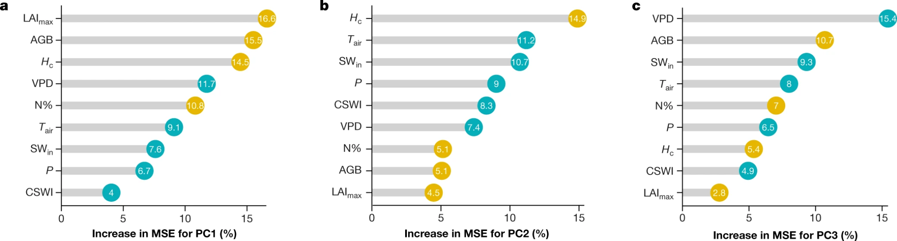
Ecosystem function axes
PC1 = maximum ecosystem productivity PC2 = ecosystem water-use strategies PC3 = ecosystem carbon-use efficiency

Slide 33
Ecosystem function axes
Note:
These types of studies are always sensitive to which traits, which services, etc.
Still, shows how important traits can be for linking with function

Slide 34
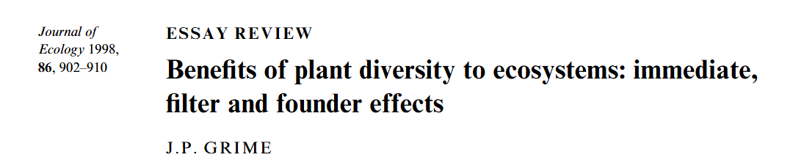
Which organisms are most important?
Mass ratio hypothesis:
The traits of the species that account for most of the biomass drive functioning
Grime noted that that this only refers to autotrophs

Slide 35
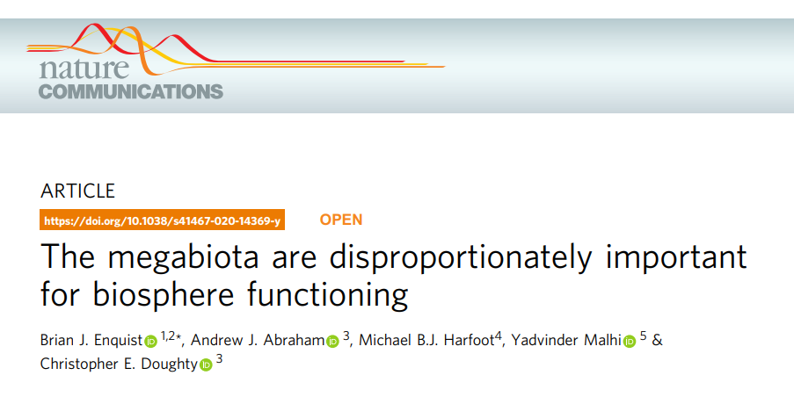
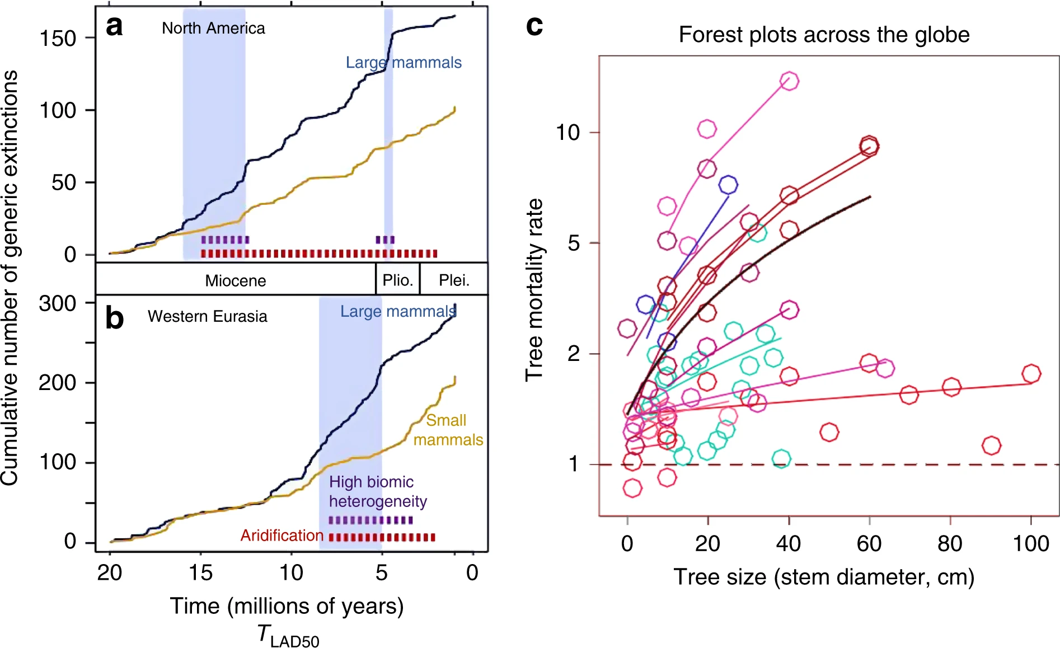
Which organisms are most important?
The big things drive functions

Slide 36
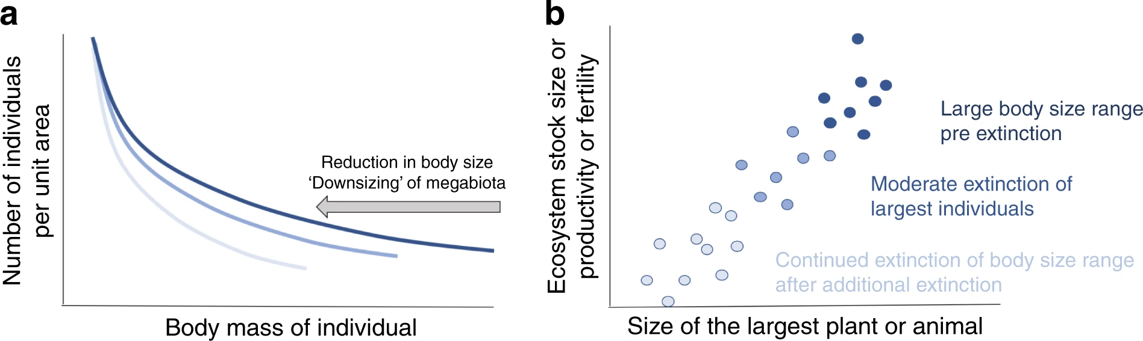
Which organisms are most important?
The big things drive functions

Slide 37
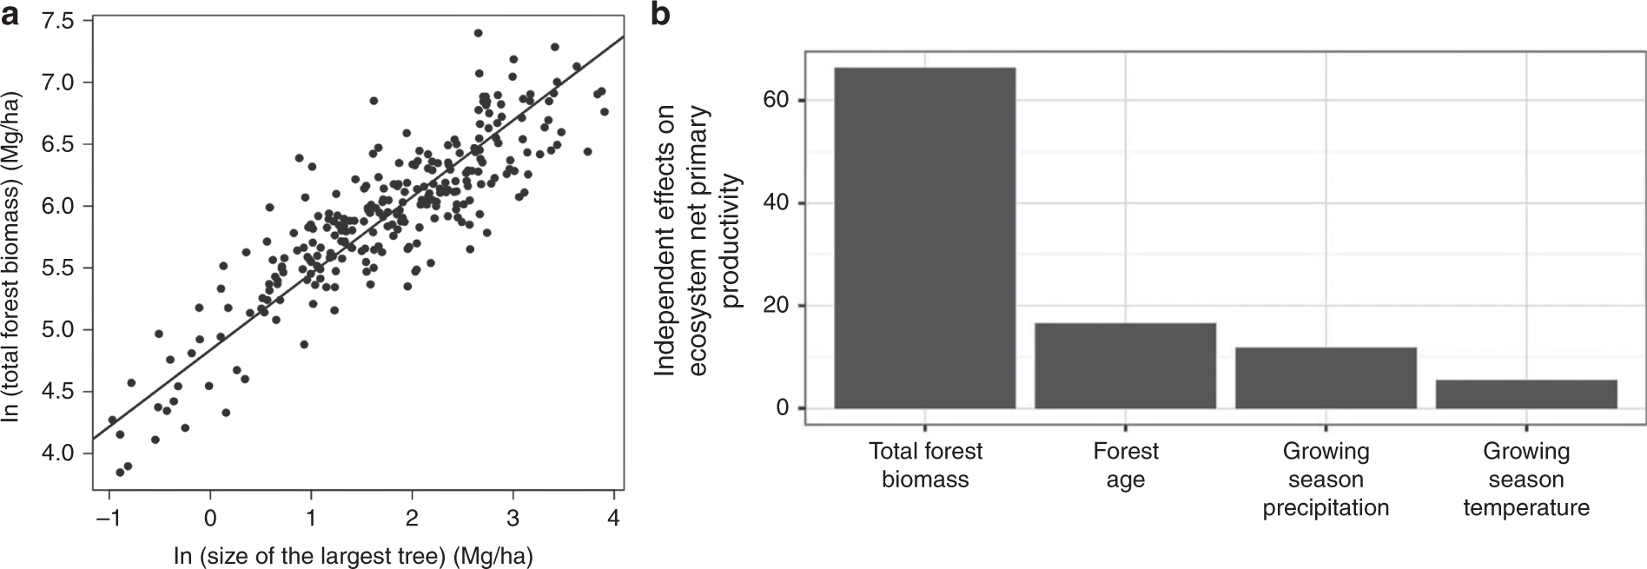
Which organisms are most important?
The big things drive functions

Slide 38
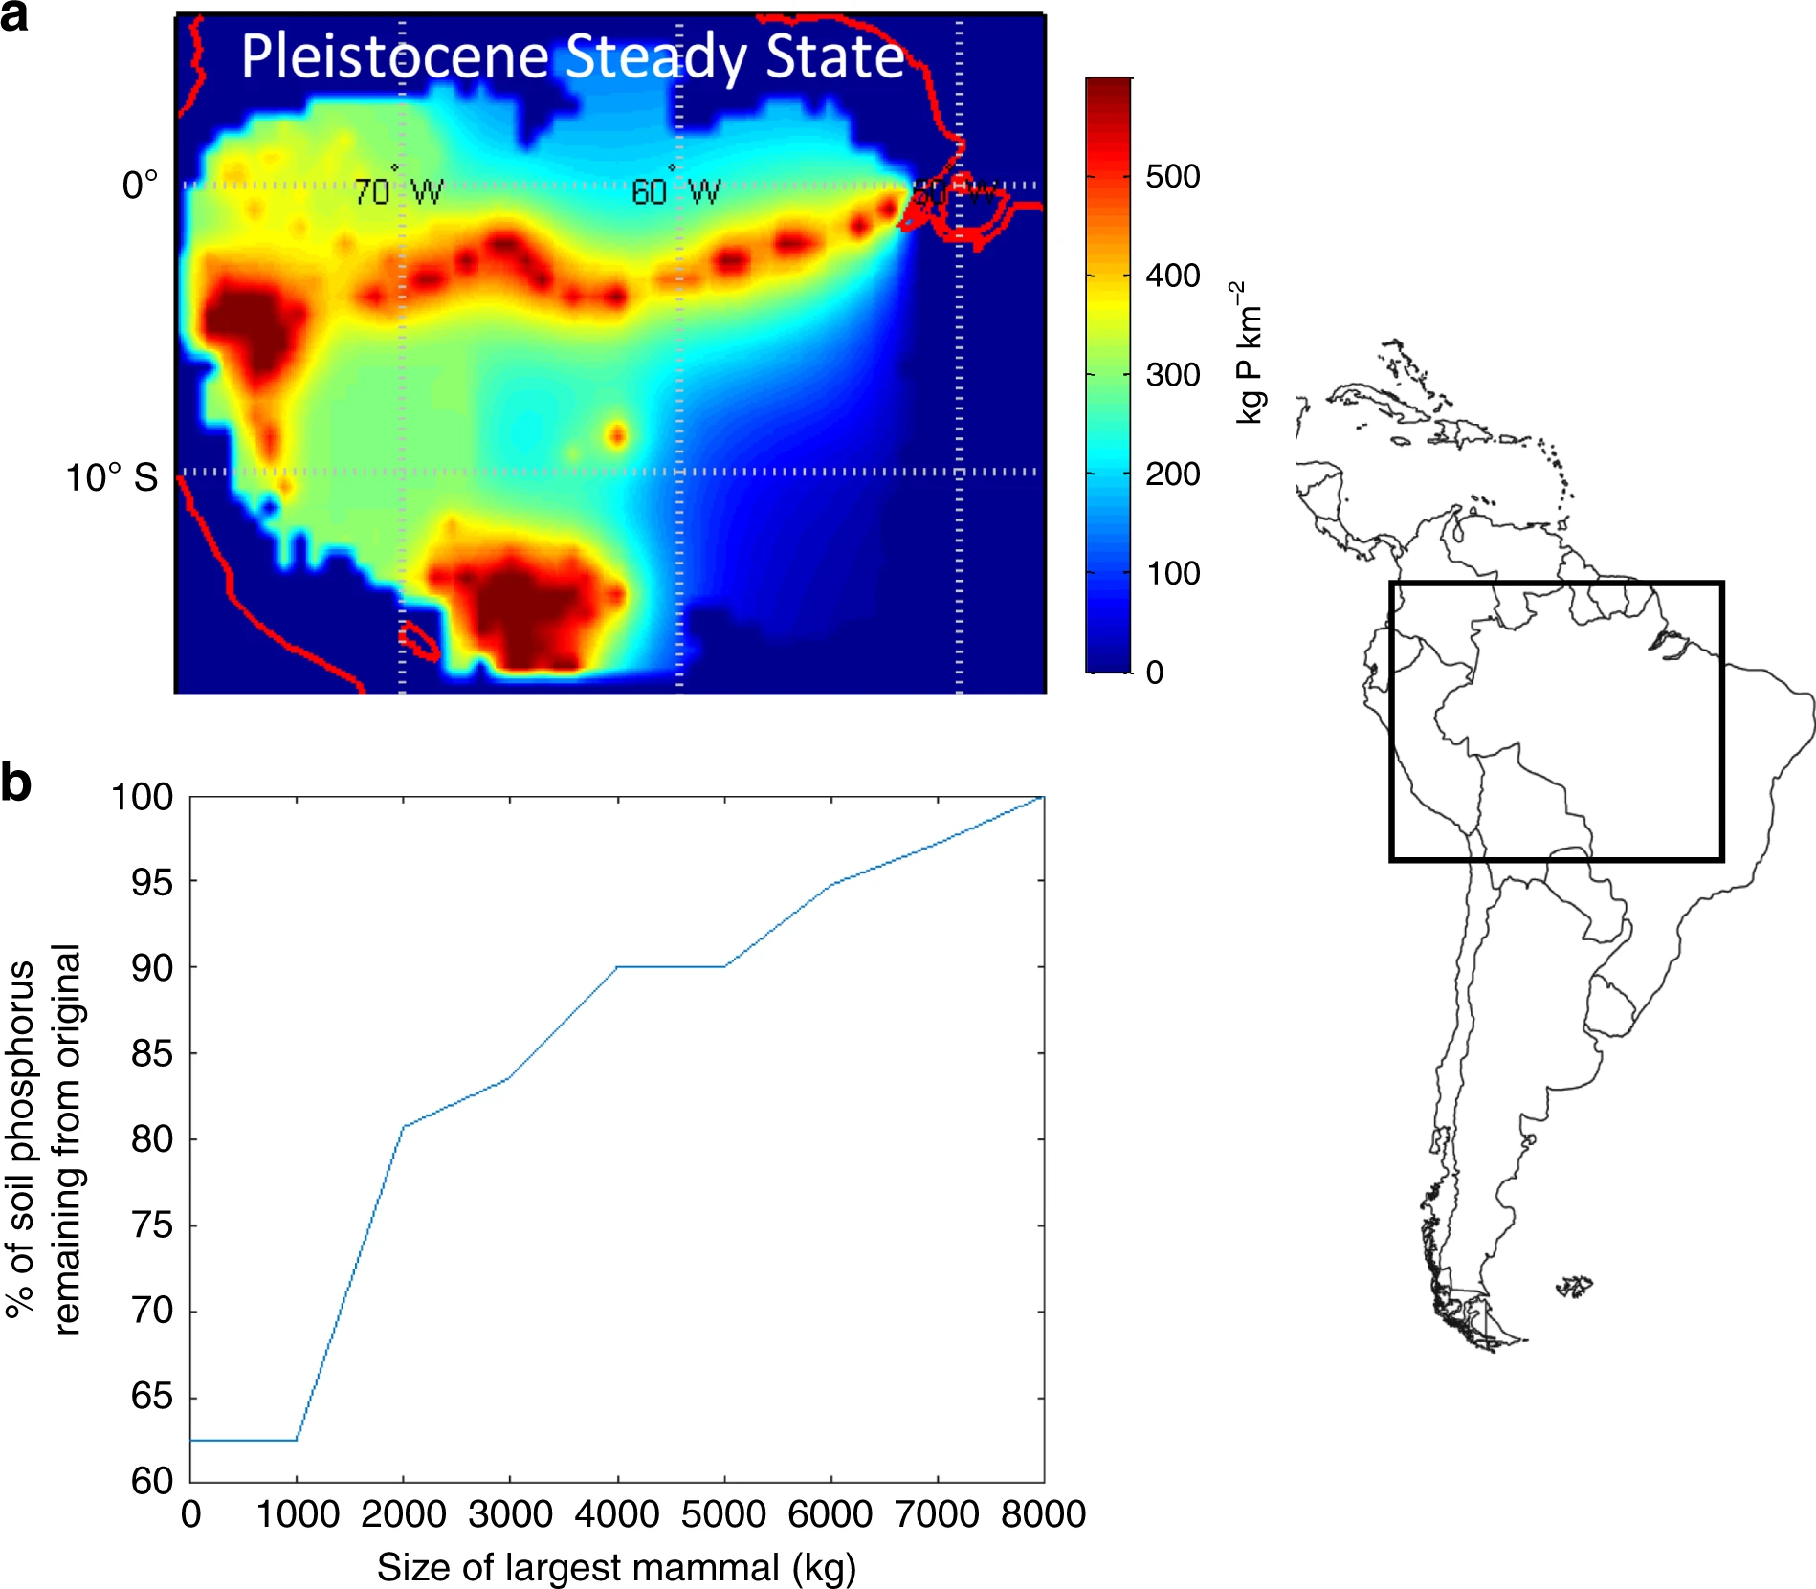
Which organisms are most important?
The big things drive functions

Slide 39
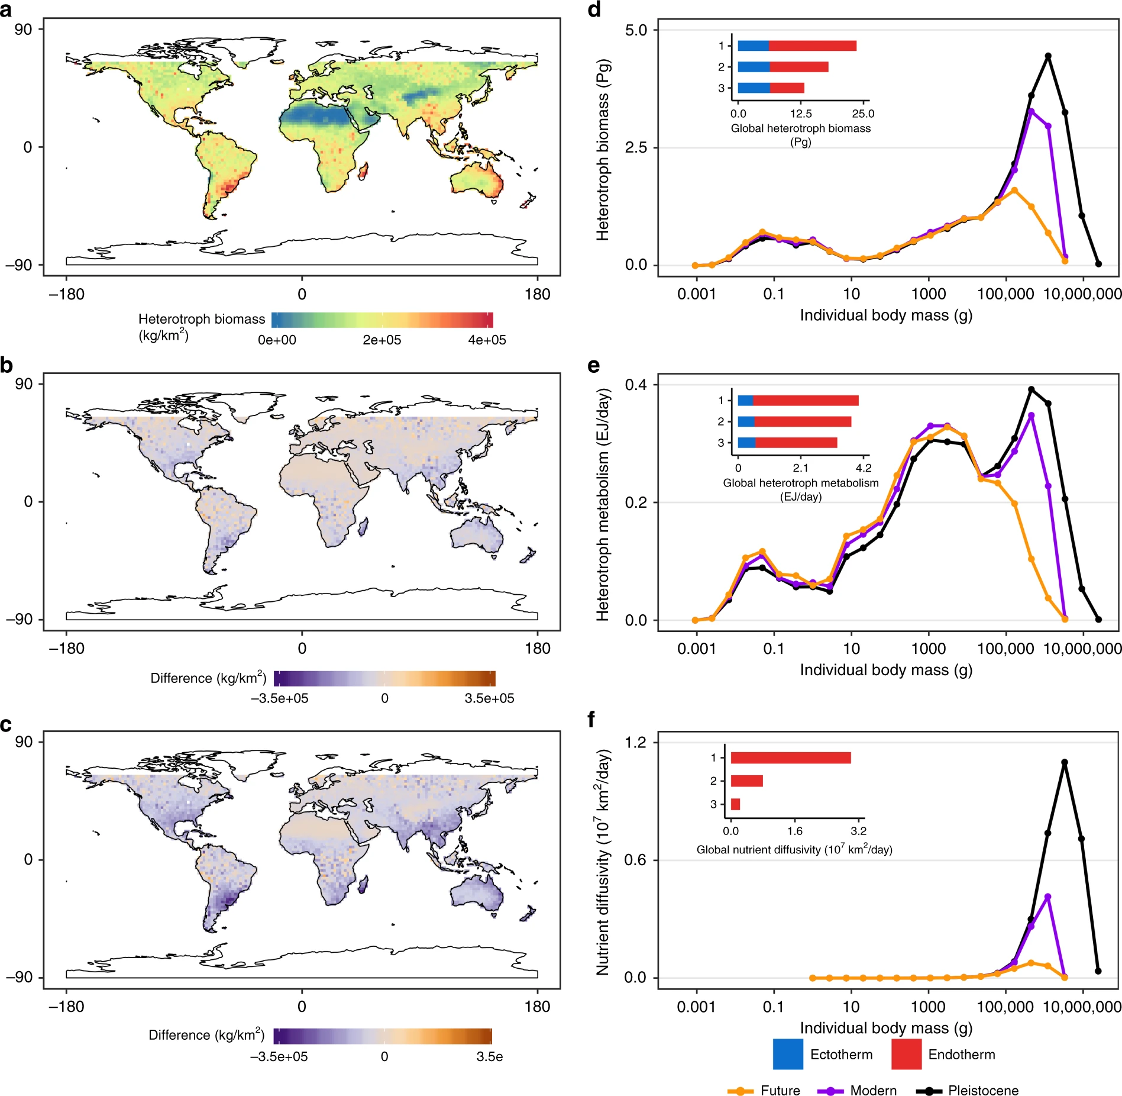
Which organisms are most important?
The big things drive functions
Notes:
A = past, B = difference past vs present, C= difference, past vs future

Slide 40
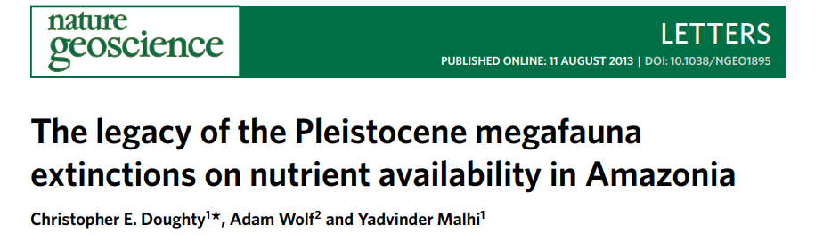
Megafauna services
Q: How has megafauna loss impacted nutrients?
Notes:
B = how much they spread around P

Slide 41
Megafauna services
Q: How has megafauna loss impacted nutrients?
Approach: models based on traits
Traits used:
Body size (M)
Range size (DD)
Metabolic rate (MR)
Population density (PD)
Food passage time (PR)
Total plant biomass (B)
Edible fraction of plant biomass (α)
Notes:
B = how much they spread around P

Slide 42
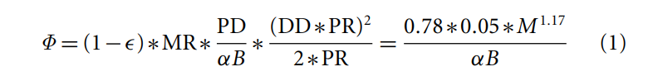
Megafauna services
Q: How has megafauna loss impacted nutrients?
Approach: models based on traits
Traits used:
Body size (M)
Range size (DD)
Metabolic rate (MR)
Population density (PD)
Food passage time (PR)
Total plant biomass (B)
Edible fraction of plant biomass (α)
Notes:
Note: part of the equation basically controls the amount of food being fluxed, the other part how far its spread out. Note also that aside from alpha and beta, everything is correlated with mass, allowing the equation to be simplified as a fx of mass.

Slide 43
Megafauna services
Q: How has megafauna loss impacted nutrients?
Approach: models based on traits
Traits used:
Body size (M)
Range size (DD)
Metabolic rate (MR)
Population density (PD)
Food passage time (PR)
Total plant biomass (B)
Edible fraction of plant biomass (α)
Note: superlinear scaling means bigger things are disproportionately important!
Notes:
B = how much they spread around P

Slide 44
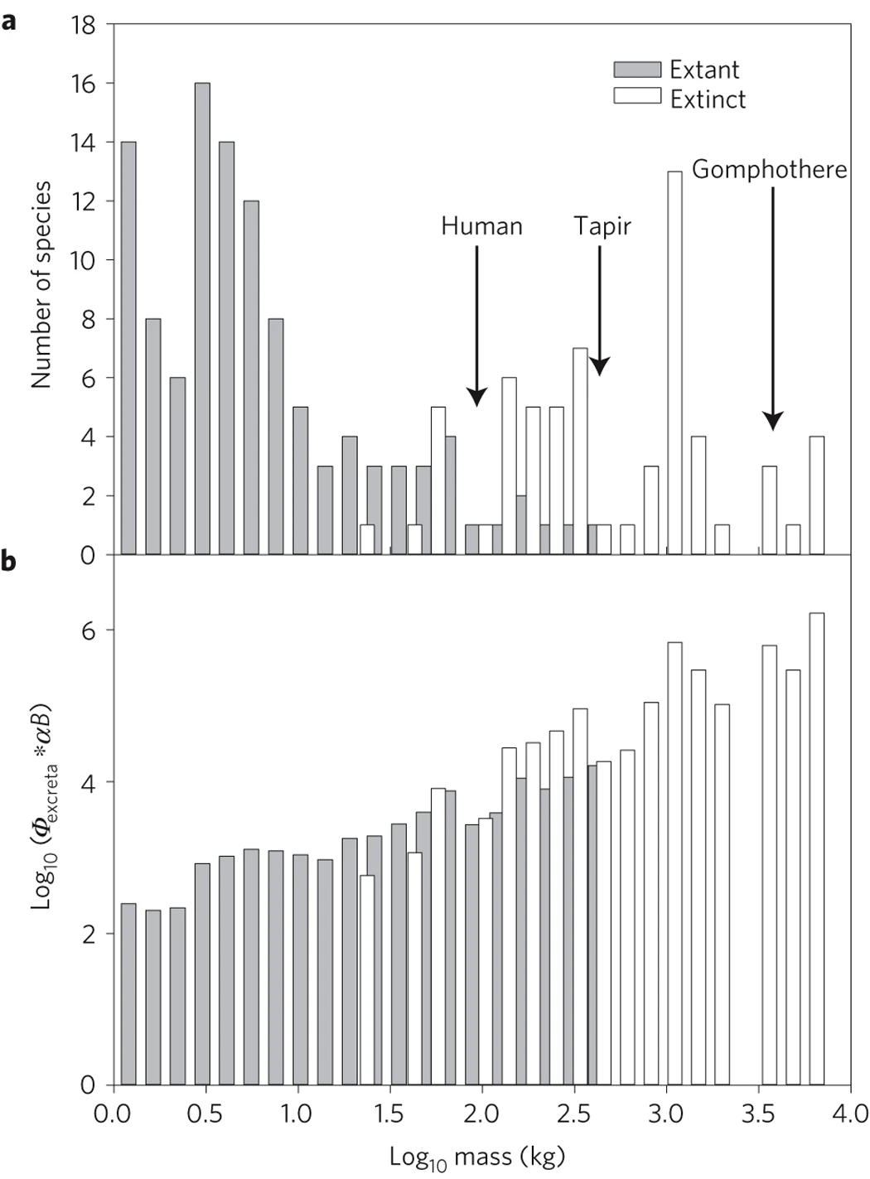
Megafauna services
Notes:
B = how much they spread around P

Slide 45
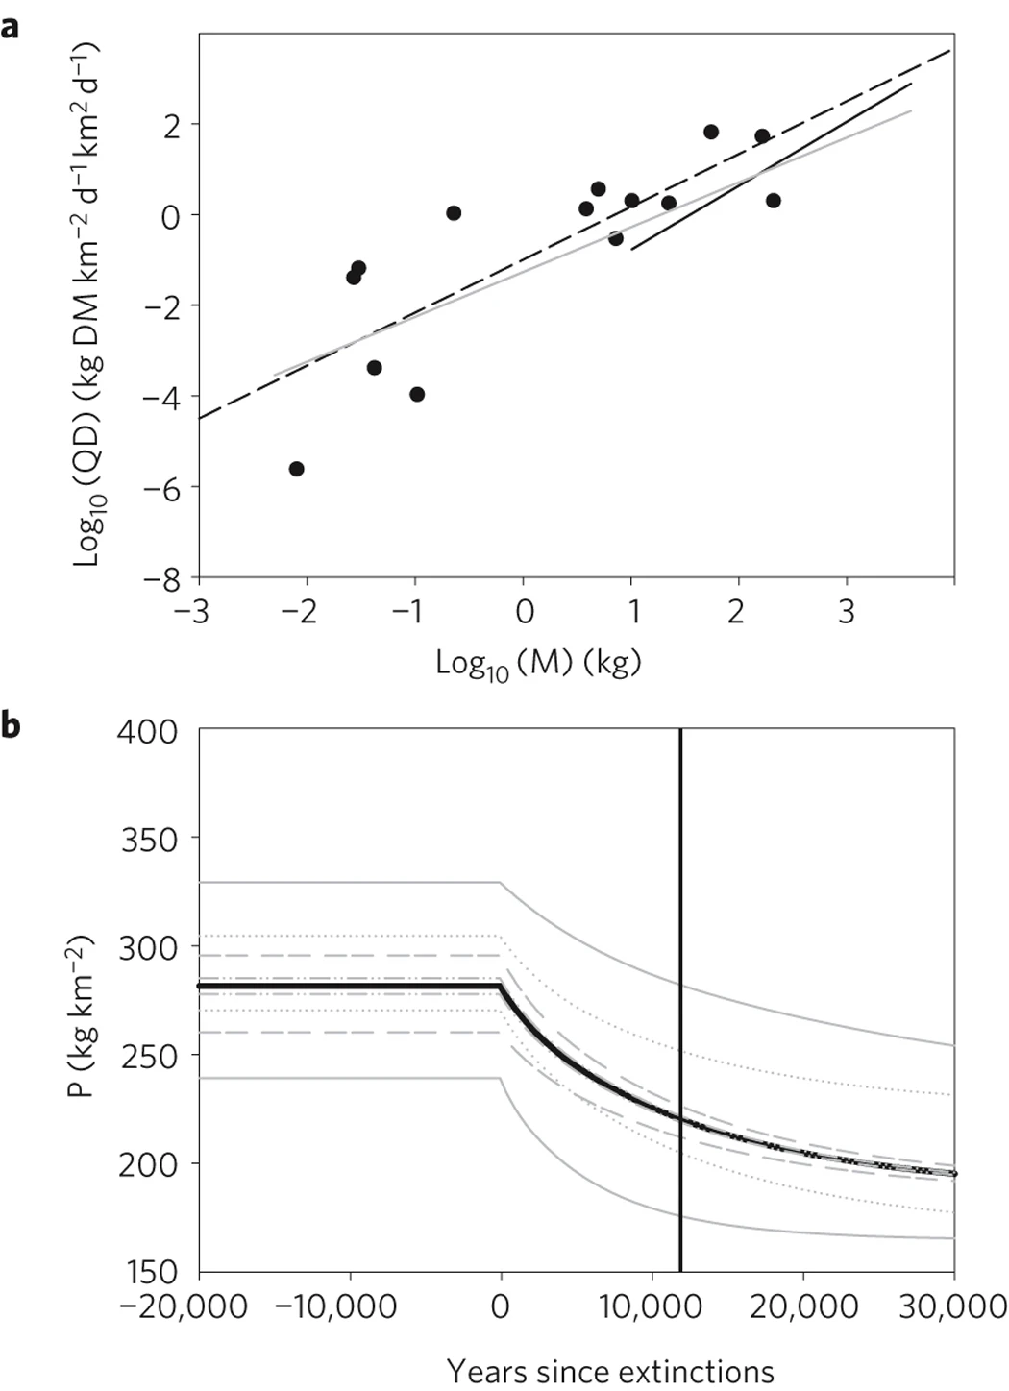
Megafauna services
Notes:
A = diffusivity data, B = mean P across amazon basic

Slide 46
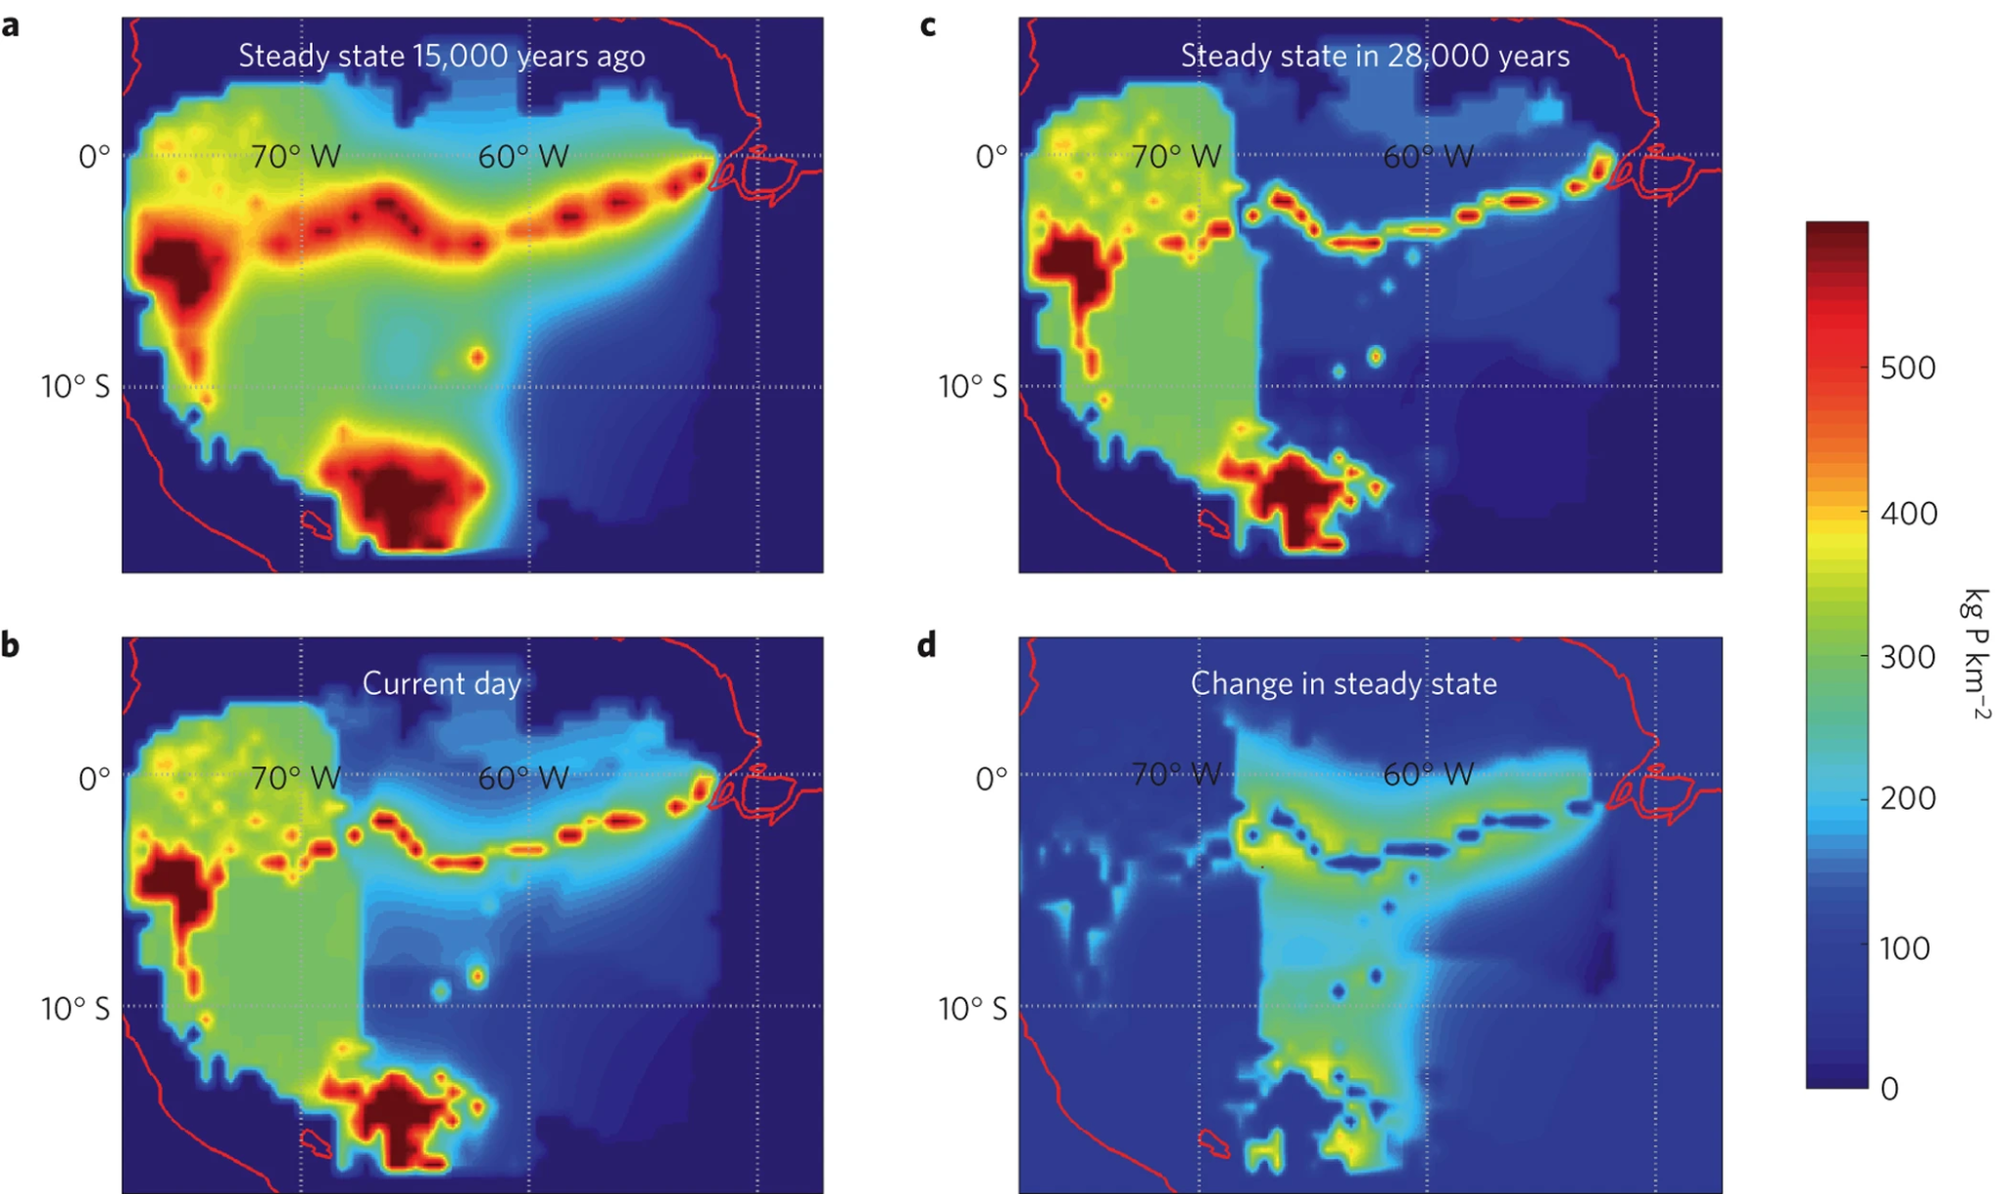
Megafauna services

Slide 47
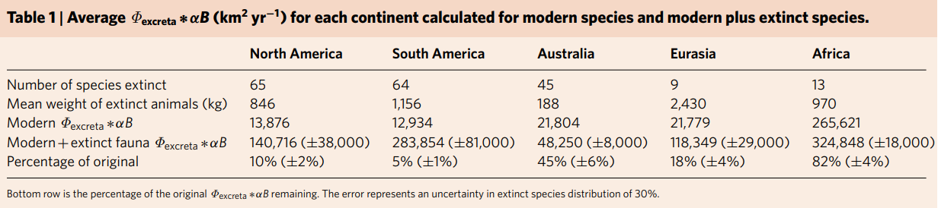
Megafauna services

Slide 48
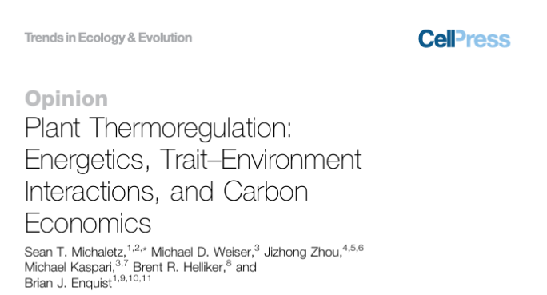
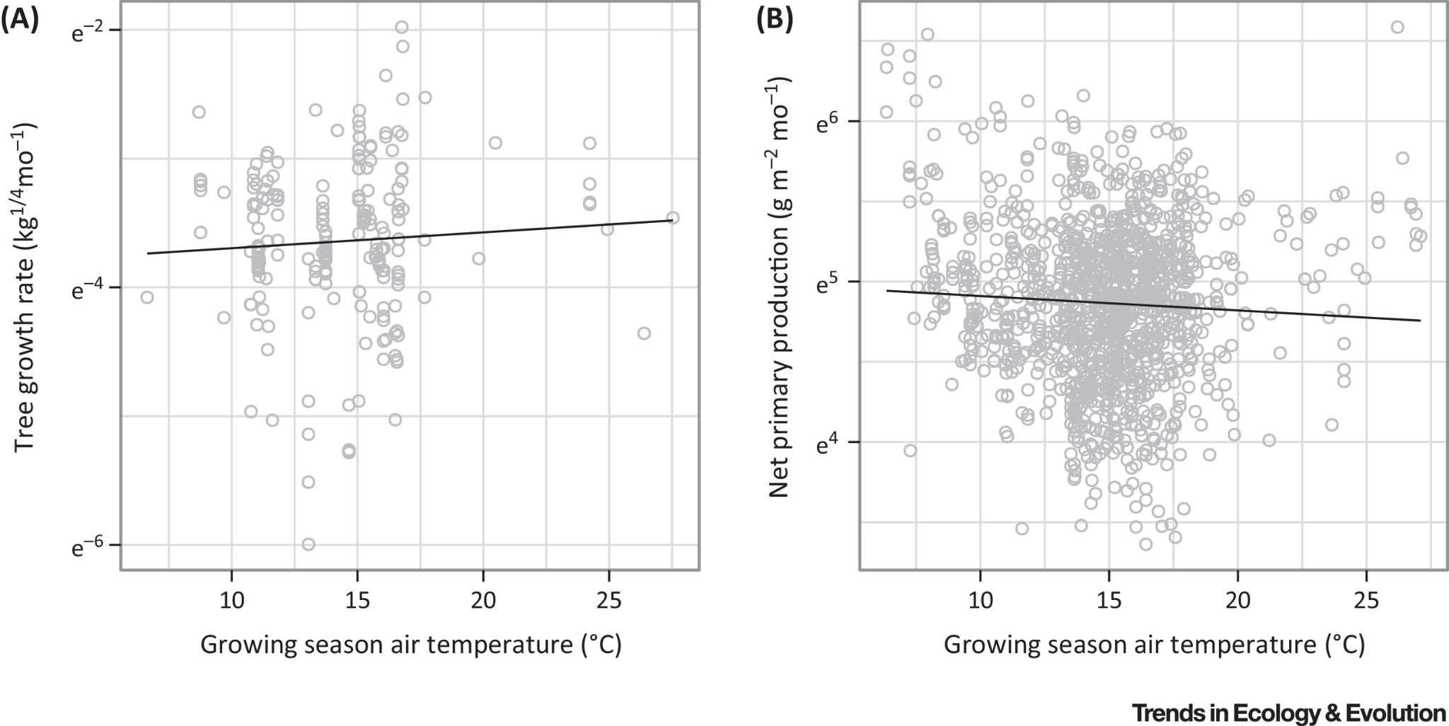
Traits and temp and photosynthesis
Photosynthesis is temp-dependent, but not much global signal of temperature

Slide 49
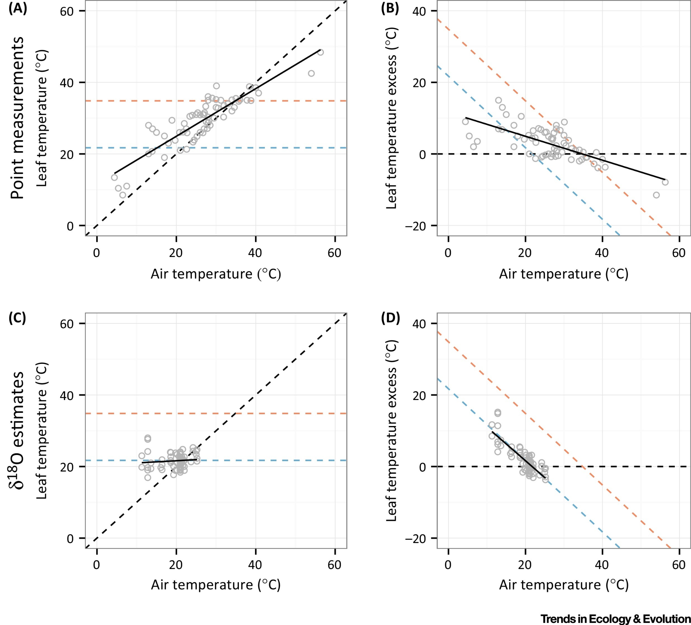
Traits and temp and photosynthesis
Notes:
Note: d180 provides an estimate of the avg temp when photosynthesis occurs

Slide 50
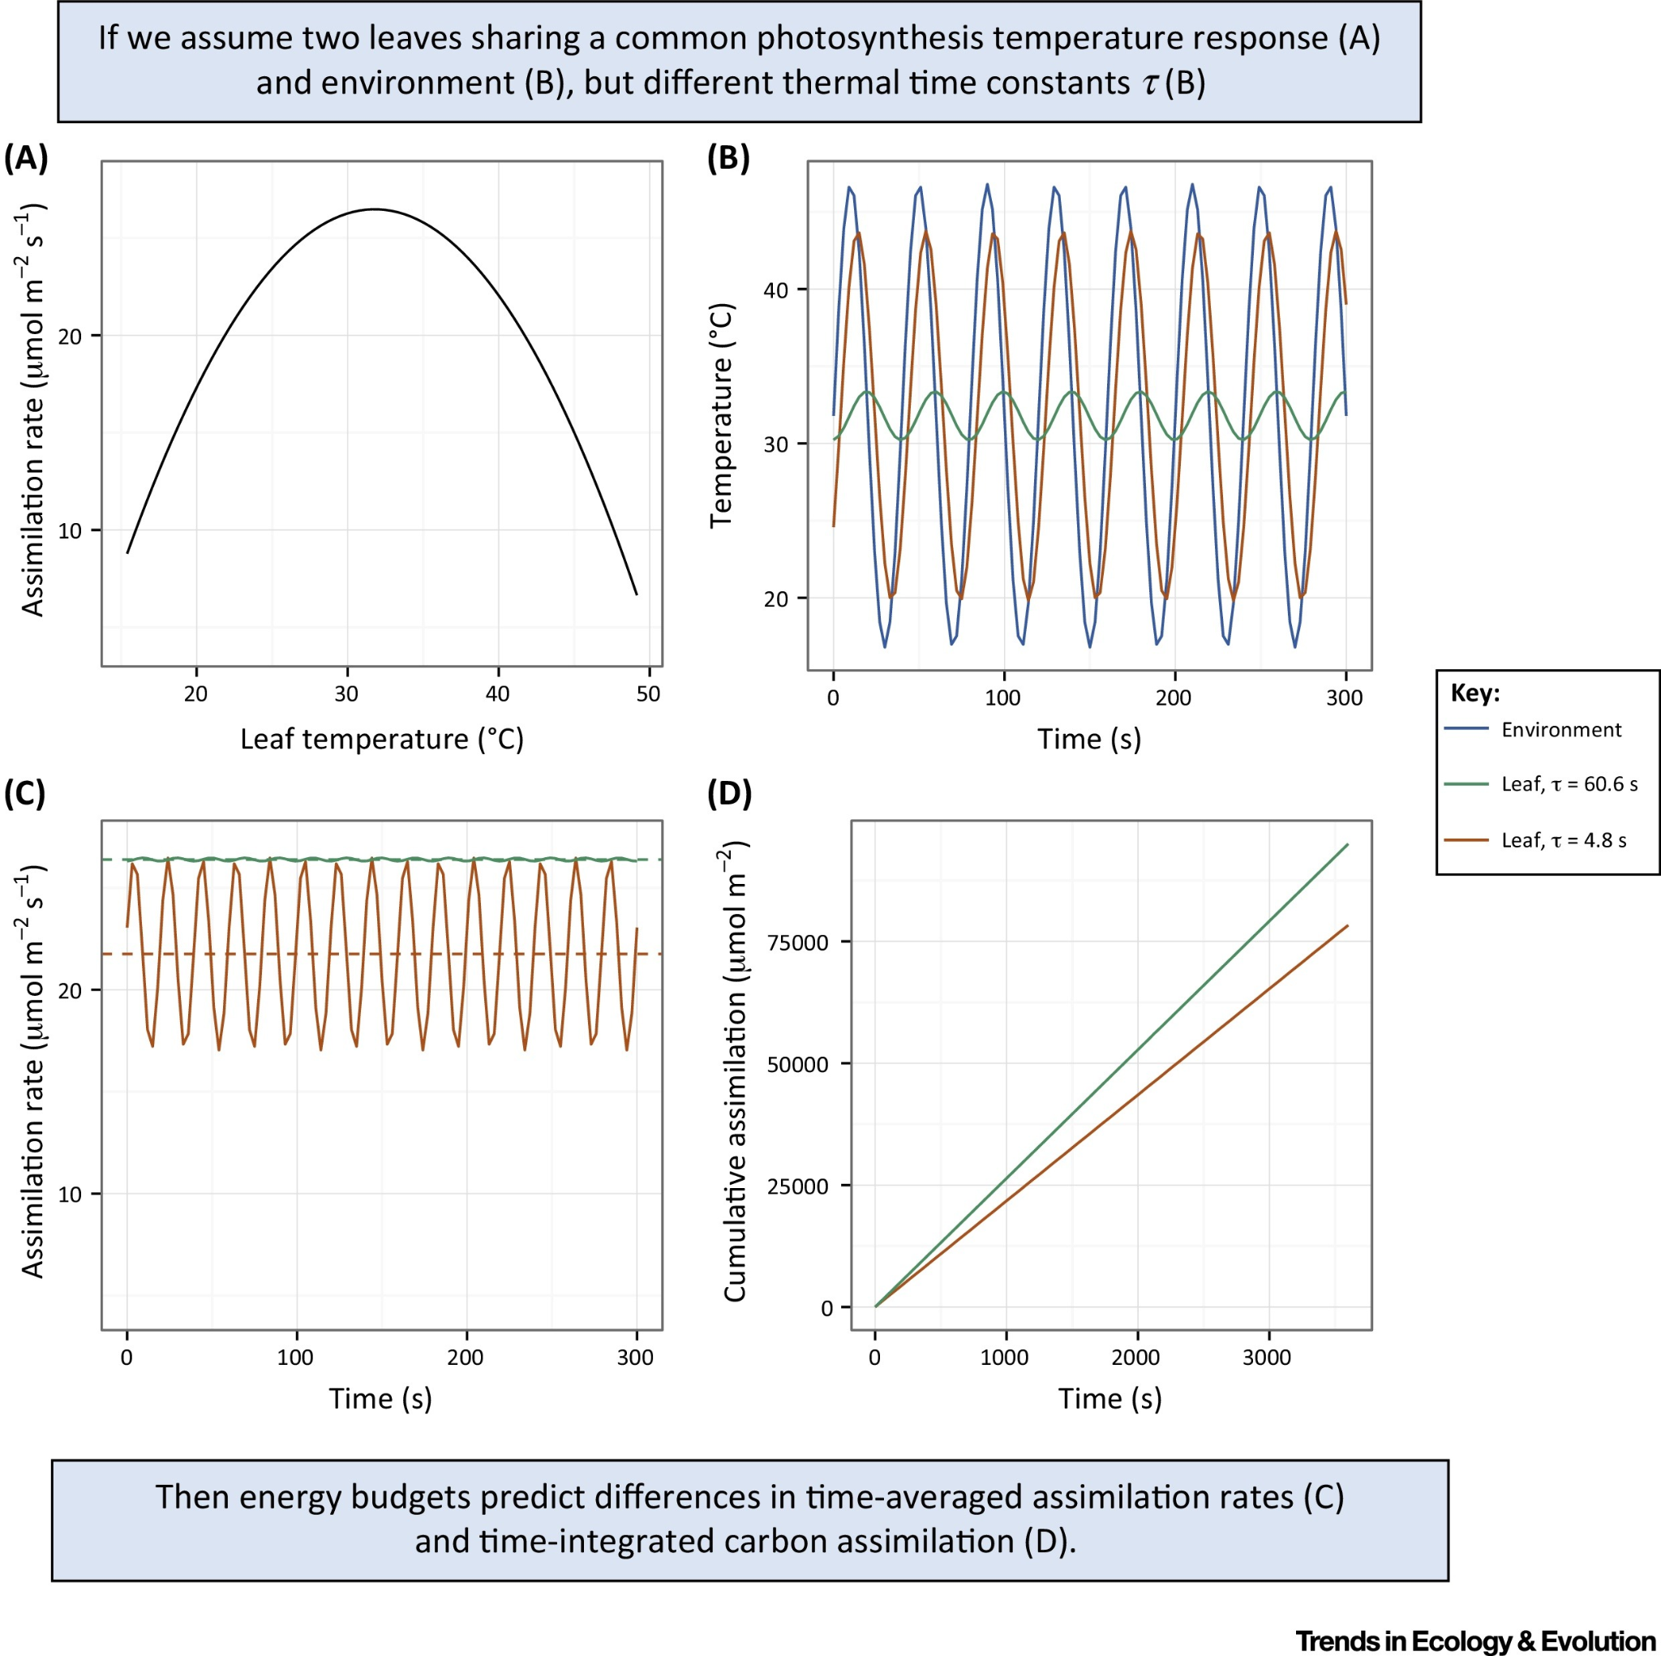
Traits and temp and photosynthesis
Notes:
Note: d180 provides an estimate of the avg temp when photosynthesis occurs

Slide 51
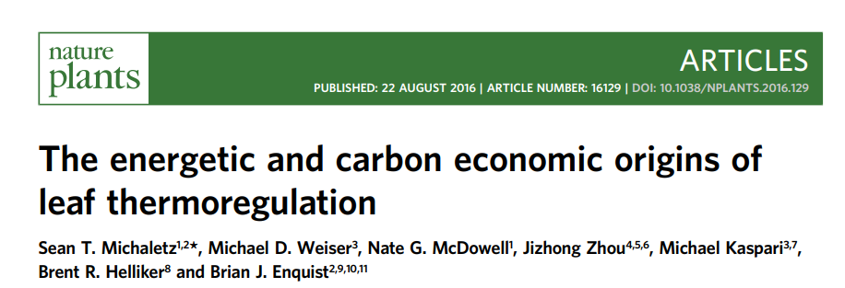
Traits and temp and photosynthesis
We need to predict photosynthetic rate
Photosynthetic rate depends on temperature
Leaf temperature can’t be predicted from air temp
How do we get at leaf temp?
Notes:
Note: d180 provides an estimate of the avg temp when photosynthesis occurs

Slide 52
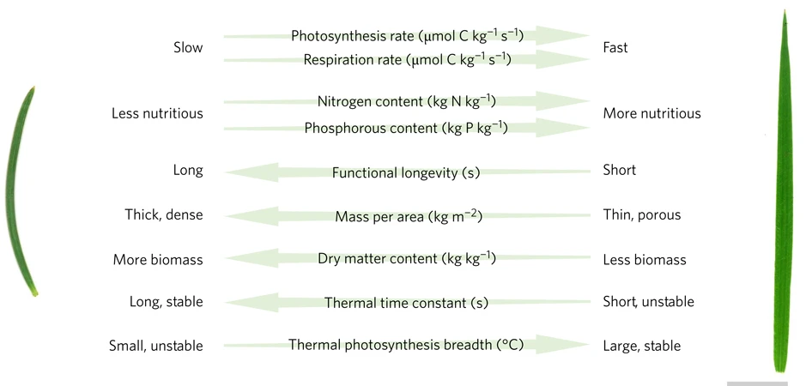
Traits and temp and photosynthesis
Notes:
These traits are use to understand leaf economics, but can also be used to understand temperature response!

Slide 53
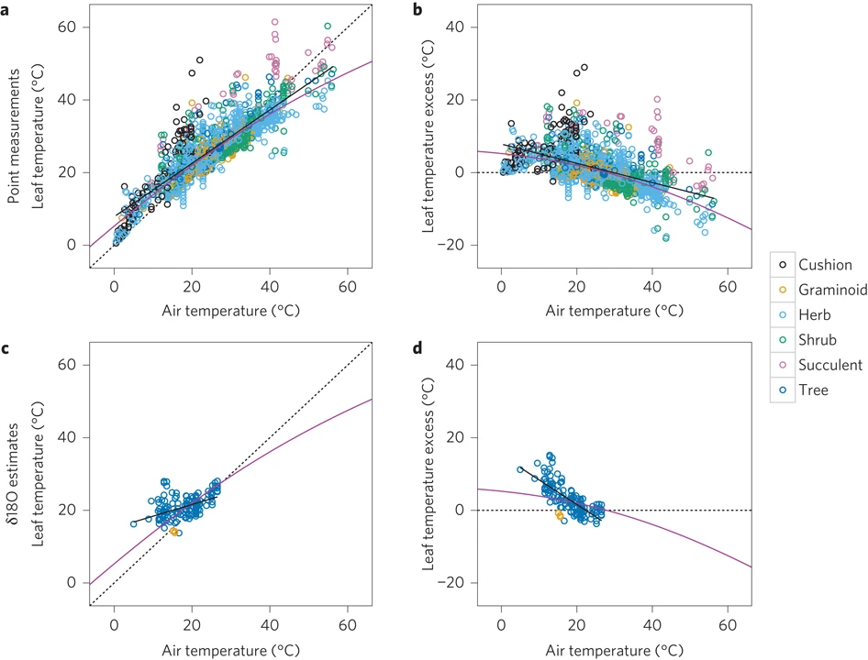
Traits and temp and photosynthesis
Pink = prediction from trait-based model
Black = best fit regression

Slide 54
Traits and temp and photosynthesis
Studies and theory like this represent major advances in linking form and function

Slide 55
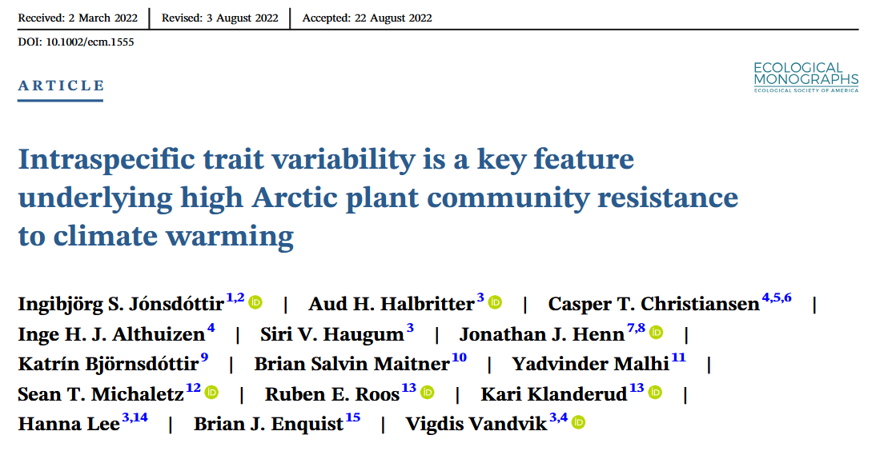
Intraspecific variation matters
Many studies use species level mean trait values
Turns out, this is a bad idea for estimating functioning

Slide 56
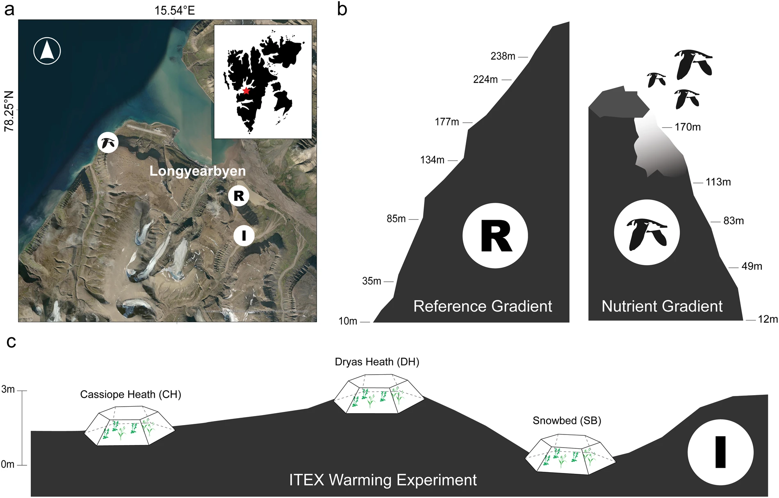
Intraspecific variation matters
Overview:
Measured CO₂ fluxes
Measured traits (including intraspecific variation)
Measured environment

Slide 57
Intraspecific variation matters
To estimate the magnitude of ITV:
Compare trait estimates using species mean vs those with ITV

Slide 58
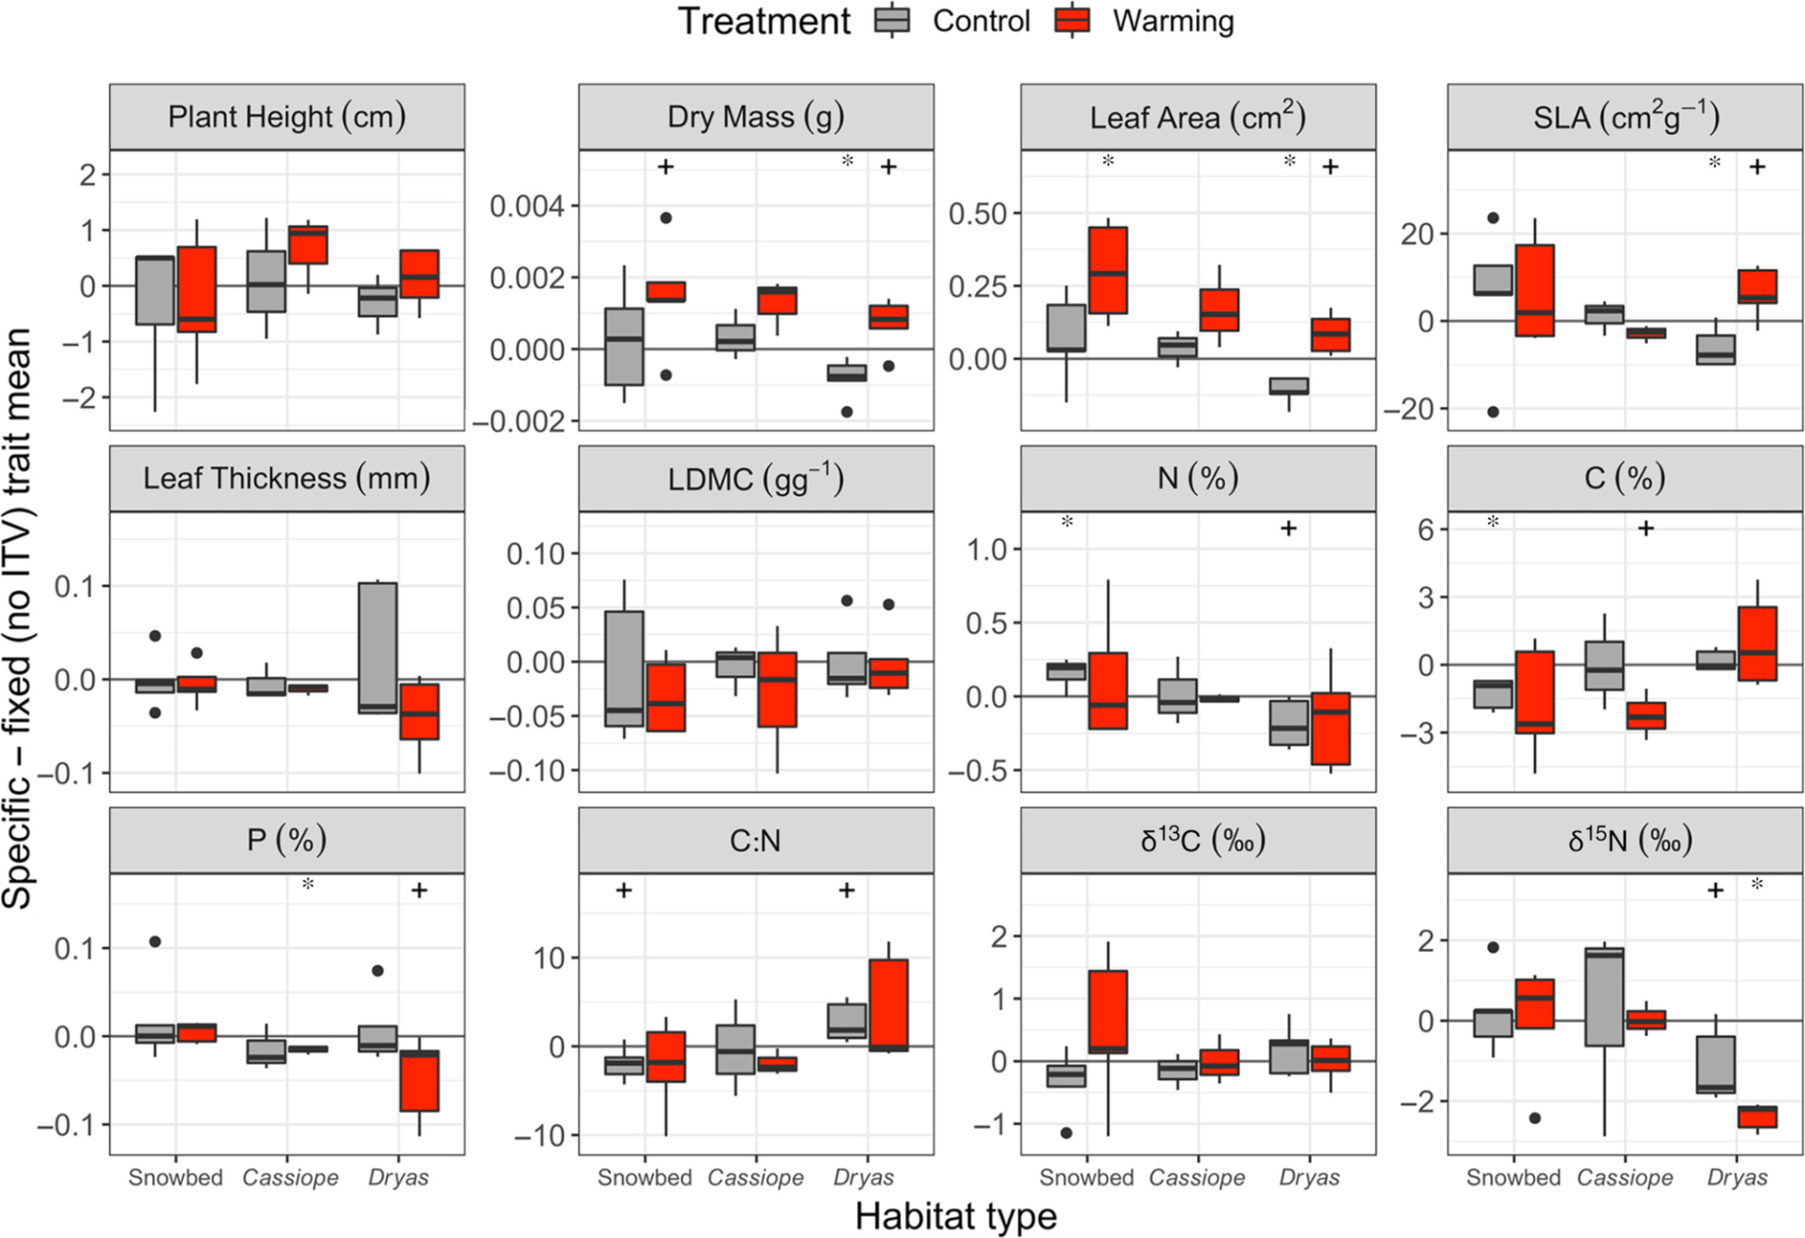
Intraspecific variation matters
Notes:
Note that most of the differences were due to ITV

Slide 59
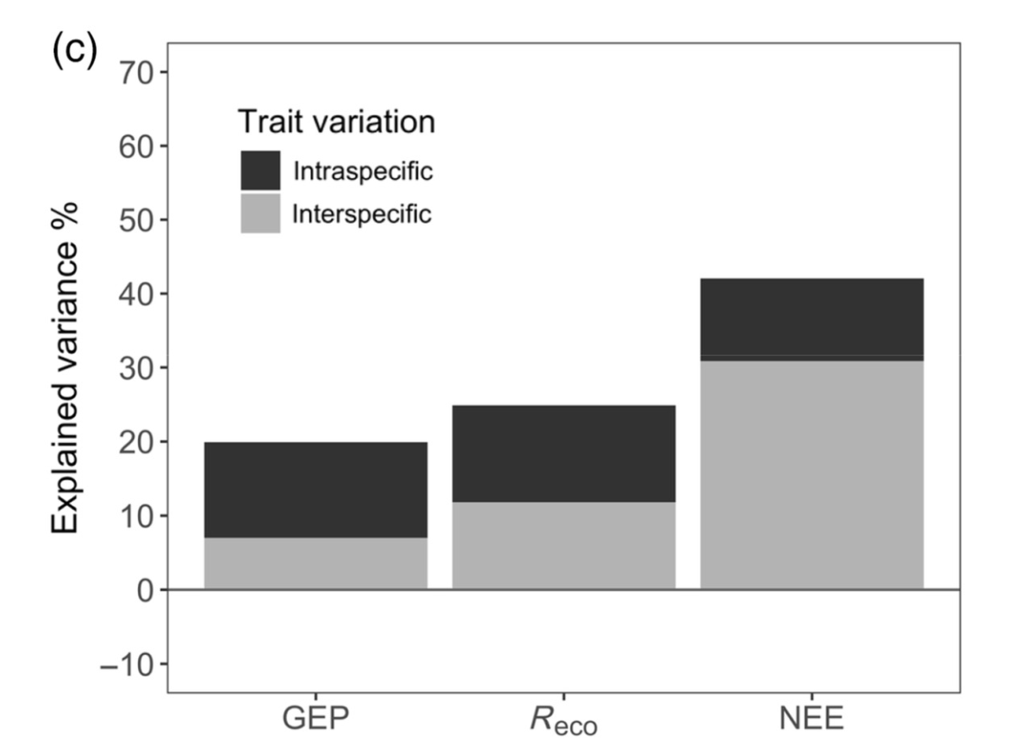
Intraspecific variation matters
GEP = gross ecosystem productivity
R_{eco} = ecosystem respiration
NEE = net ecosystem CO₂ exchange
GEP = NEE + R_{eco}
Notes:
Note: due to the large amount of variation explained by ITV, neglecting it would lead to much worse models!

Slide 60
Takeaways
Traits help us understand variation in ecosystem services
Traits - environment interactions can be important
Mechanistic trait models can provide important insights
Intraspecific trait variation is super important
Some species are more important than others

Slide 61
Next class: Traits and global change

