Slide 1
Metacommunities I
Today’s Agenda:
Quiz
Metacommunities

Slide 2
Patchy Environments
Patches: suitable habitat, surrounded by unsuitable habitat.
Metapopulation: collection of connected populations
Multiple patches connected by dispersal

Slide 3
Patchy Environments
Patches: suitable habitat, surrounded by unsuitable habitat.
Metapopulation: collection of connected populations
Multiple patches connected by dispersal
Metacommunity: collection of connected communities
Multiple patches connected by dispersal of one or more species

Slide 4
Metacommunities
4 Main perspectives:
Patch dynamics - extension of metapopulation stuff to more species
Species sorting - community assembly-ish, species differ in abiotic niches
Mass effects - species sorting-ish, w/ source-sink and rescue effects
Neutral theory - assumes species are identical, environment irrelevant

Slide 5
Metacommunities
4 Main perspectives:
Patch dynamics - extension of metapopulation stuff to more species
Species sorting - community assembly-ish, species differ in abiotic niches
Mass effects - species sorting-ish, w/ source-sink and rescue effects
Neutral theory - assumes species are identical, environment irrelevant

Slide 6
Patch Dynamics Perspective
This is what we covered last week
Metacommunity studies focus on multiple species, and hence coexistence
Various trade-offs and coexistence mechanisms
A
A arrives first
B arrives next, displaces A
C arrives last, displaces B
Patch extinction occurs (go to 1)
Dispersal Ability
B
C
Competitive Ability

Slide 7
Metacommunities
4 Main perspectives:
Patch dynamics - extension of metapopulation stuff to more species
Species sorting - community assembly-ish, species differ in abiotic niches
Mass effects - species sorting-ish, w/ source-sink and rescue effects
Neutral theory - assumes species are identical, environment irrelevant

Slide 8
Metacommunities
4 Main perspectives:
Patch dynamics - extension of metapopulation stuff to more species
Species sorting - community assembly-ish, species differ in abiotic niches
Mass effects - species sorting-ish, w/ source-sink and rescue effects
Neutral theory - assumes species are identical, environment irrelevant

Slide 9
Species sorting perspective
Notes:
Community assembly stuff

Slide 10
Species sorting perspective
Abiotic
Filter
Biotic
Filter
Communities
Species pool
Dispersal
Communities
Metacommunity
Speciation, Extinction, Dispersal
Notes:
Community assembly stuff

Slide 11
Species sorting perspective
Species performance varies with environment
Dispersal is high enough for species to reach all patches
Dispersal low enough that it doesn’t override performance differences

Slide 12
Sorting perspective
Fitness
Environment
Outside
Notes:
Species can only survive in the optimal environment

Slide 13
Species sorting perspective
Repeated dispersal and filtering allows tracking of changes
E.g., shifts due to changing climate
Allows abiotic filters to shift overtime, or even interact

Slide 14
Species sorting perspective
Allows us to partition variation in community membership/abundance
How much beta diversity is due to environment?
How much is due to dispersal?

Slide 15
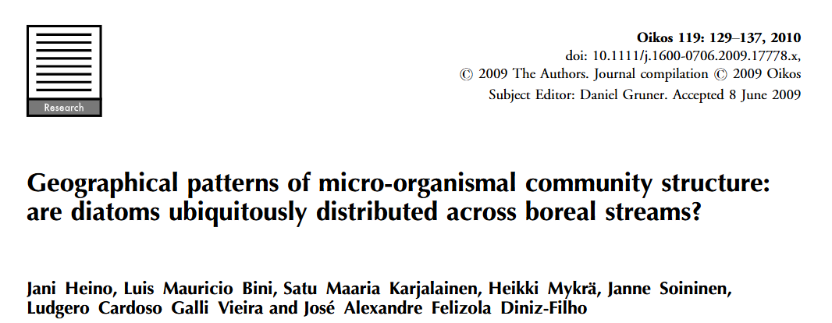
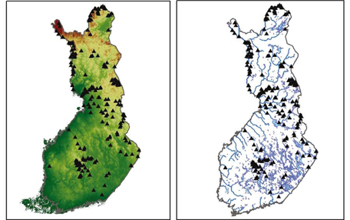
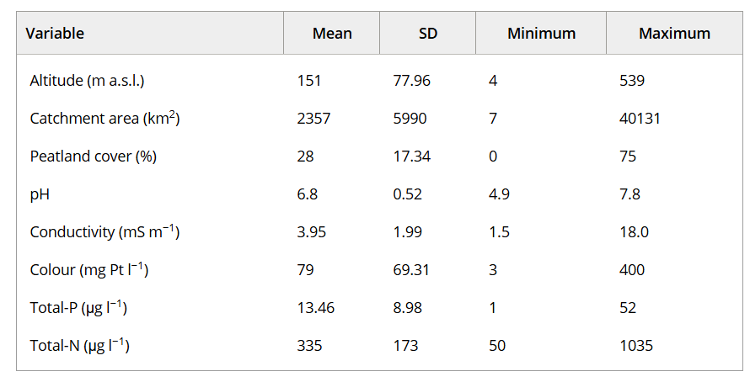
Species sorting perspective
Diatoms in Finland
488 species of diatom
Notes:
Left: altitude, right: rivers

Slide 16
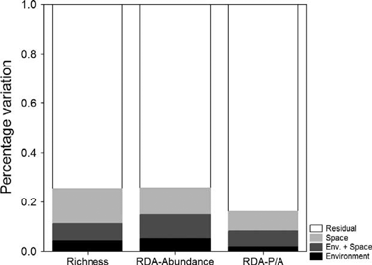
Species sorting perspective
Notes:
Left: altitude, right: rivers

Slide 17
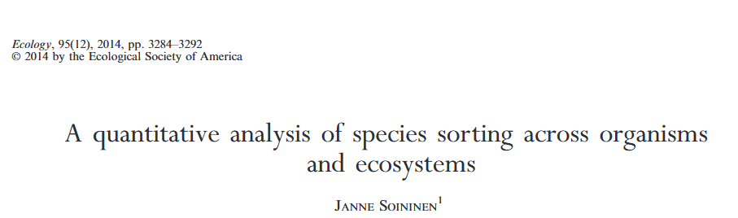
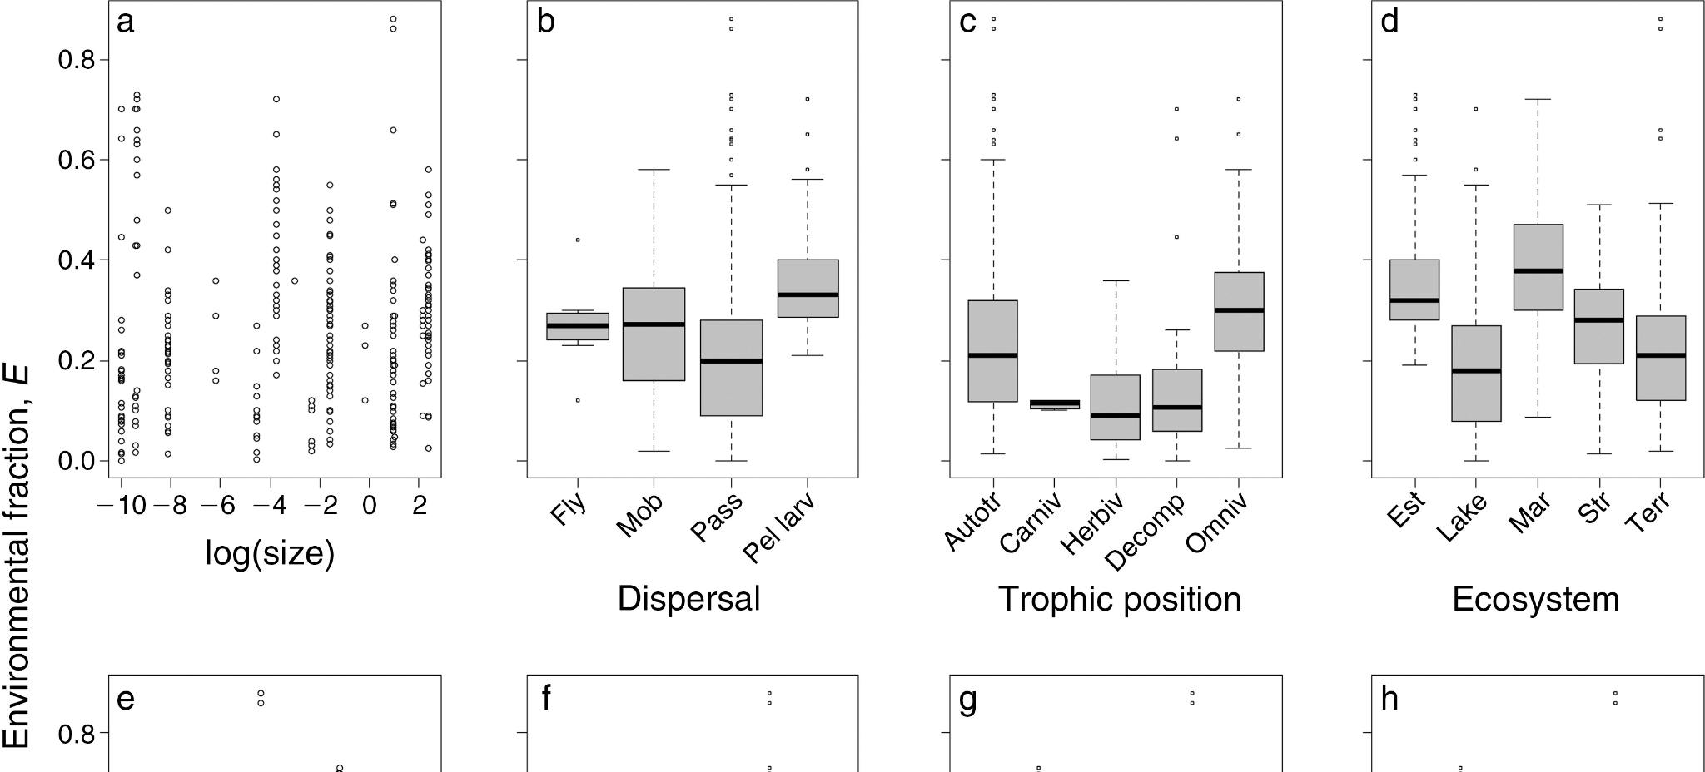
Species sorting perspective
Meta-analysis
Only 26% of variation attributable to environment
Notes:
No strong patterns

Slide 18
Species sorting perspective
The relative importance of environment is still an open question
More mechanistic, trait-based perspective may help
Notes:
No strong patterns

Slide 19
Metacommunities
4 Main perspectives:
Patch dynamics - extension of metapopulation stuff to more species
Species sorting - community assembly-ish, species differ in abiotic niches
Mass effects - species sorting-ish, w/ source-sink and rescue effects
Neutral theory - assumes species are identical, environment irrelevant

Slide 20
Metacommunities
4 Main perspectives:
Patch dynamics - extension of metapopulation stuff to more species
Species sorting - community assembly-ish, species differ in abiotic niches
Mass effects - species sorting-ish, w/ source-sink and rescue effects
Neutral theory - assumes species are identical, environment irrelevant

Slide 21
Mass-effects
Similar to species sorting
Species have different niches
Assumes patches will differ
Species do well/poorly in different patches based on niches and environment
Differences
High-quality patches can serve as “sources”
Low-quality patches can serve as “sinks”

Slide 22
Sorting perspective
Relative Fitness
Environment
Notes:
Species can only survive in the optimal environment

Slide 23
Mass effect
Species can survive, but aren’t self-sustaining
Relative Fitness
Environment
Notes:
Species can only survive in the optimal environment

Slide 24
Mass effect
Species can survive, but aren’t self-sustaining
Relative Fitness
Environment
Notes:
Species can survive in suboptimal environment, but persist only because of other patches

Slide 25
Mass effects
Absolute Fitness
Environment
Notes:
Line = break even.

Slide 26
Mass effects
Orange species “wins”
Absolute Fitness
Environment
Notes:
Line = break even.

Slide 27
Mass effects
Orange species “loses”, but can persist due if immigration occurs
Absolute Fitness
Environment
Notes:
Line = break even.

Slide 28
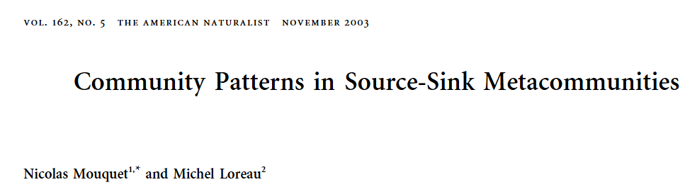
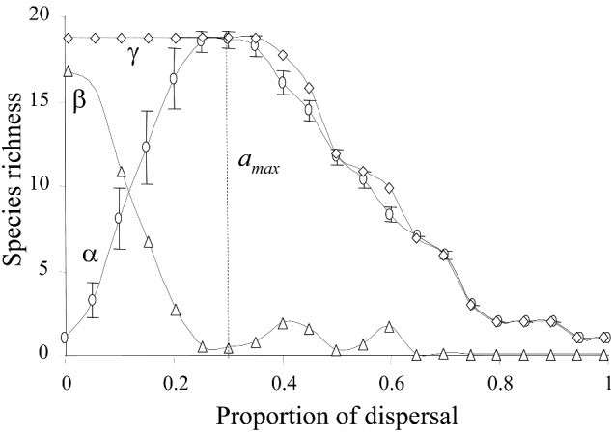
Mass effect simulation
Species differ in niches, but have identical dispersal
Varied dispersal and studied diversity effects

Slide 29
Mass effect simulation
Species differ in niches, but have identical dispersal
Varied dispersal and studied diversity effects
No dispersal:
one species dominates each patch
Lots of dispersal:
One species dominates all patches

Slide 30
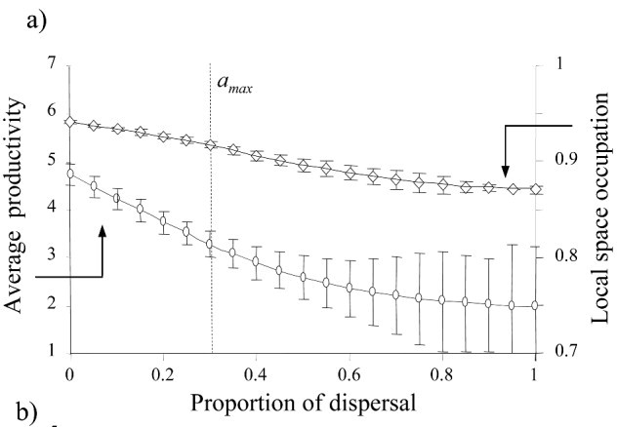
Mass effect simulation
Notes:
Why might this happen?

Slide 31
Empirical mass effect work
Some field research that examines this
E.g., different connectivity due to dispersal mode or patch connectivity
Some cool experiments that manipulate dispersal between patches
E.g., mesocosms that are connected for varying lengths of time

Slide 32
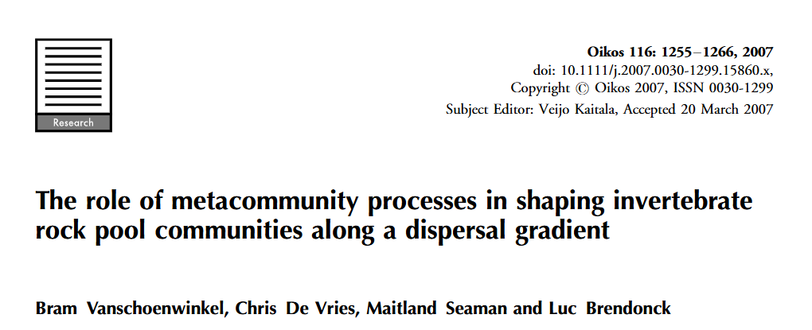
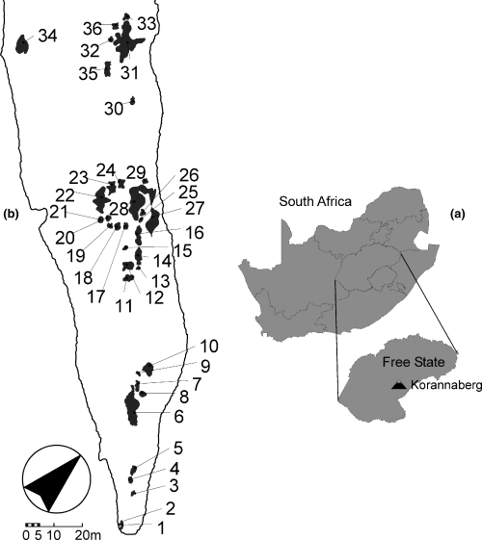
Mass effect in the field
Sampled invertebrates in temporary pools
Categorized as active vs passive dispersers

Slide 33
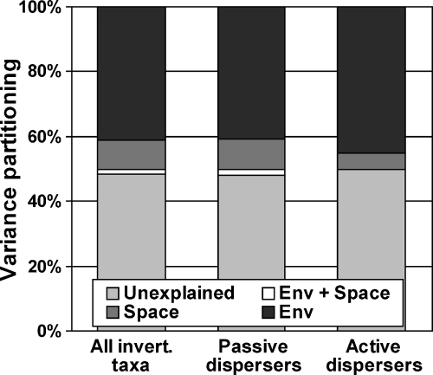
Mass effect in the field
Notes:
Note: pretty good compared to other species sorting studies (~40% vs 26%)

Slide 34
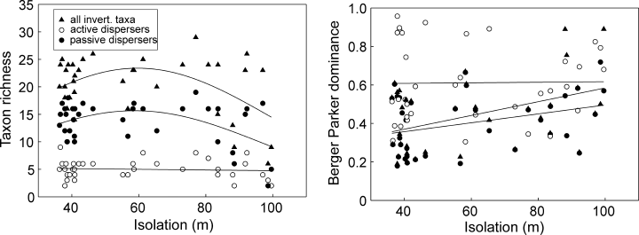
Mass effect in the field
Notes:
No distance decay for active dispersers. No unimodal relationship for active dispersers

Slide 35
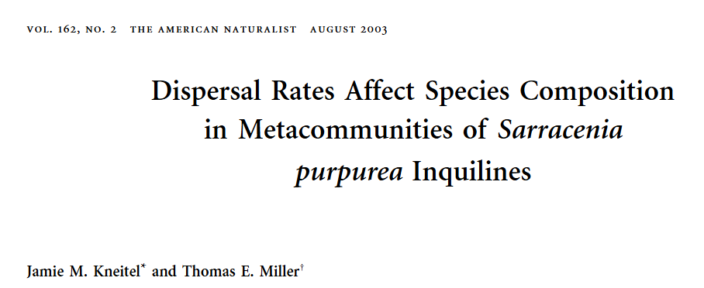
Mass effect experiments
Focused on communities in pitcher plants
Manipulated:
resources (dead ants)
Predation (mosquito larvae)
dispersal

Slide 36
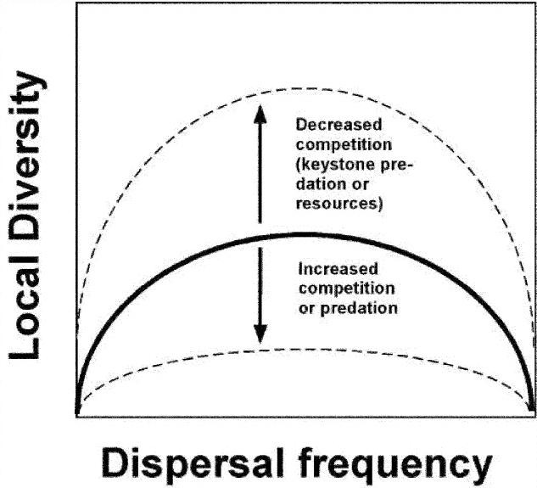
Mass effect experiments
Focused on communities in pitcher plants
Manipulated:
resources (dead ants)
Predation (mosquito larvae)
dispersal

Slide 37
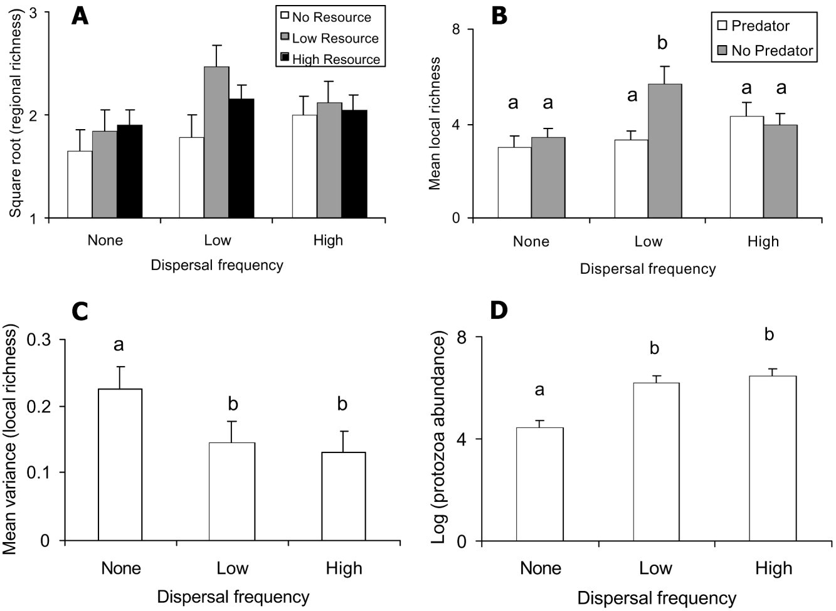
Mass effect experiments
Focused on communities in pitcher plants
Manipulated:
resources (dead ants)
Predation (mosquito larvae)
dispersal

Slide 38
Metacommunities
4 Main perspectives:
Patch dynamics - extension of metapopulation stuff to more species
Species sorting - community assembly-ish, species differ in abiotic niches
Mass effects - species sorting-ish, w/ source-sink and rescue effects
Neutral theory - assumes species are identical, environment irrelevant

Slide 39
Metacommunities
4 Main perspectives:
Patch dynamics - extension of metapopulation stuff to more species
Species sorting - community assembly-ish, species differ in abiotic niches
Mass effects - species sorting-ish, w/ source-sink and rescue effects
Neutral theory - assumes species are identical, environment irrelevant
Next time!

Slide 40
Next class: More metacommunities

