Slide 1
Patchy Environments I
Today’s Agenda:
Quiz
Group Assignment
Project 4
Course Eval Reminder
Patchy Environments

Slide 2
Group Assignment
Focus: variable/changing ecosystems in Florida
Variation due to:
Ecological succession
Temporally fluctuating environments
Global changes
Some obvious examples might be:
Fire-dependent ecosystems
Tidal systems
Hurricanes as successional drivers
Ephemeral water bodies

Slide 3
Group Assignment
Pick your own group (Groups can be of one person)
Everyone in a group gets the same grade
Do/make something that explains your your chosen system to lay people
Can be anything that can convey a message
Possibly bonus points for creativity

Slide 4
Group Assignment
Products will be presented in class on April 29th
Show off what you created to the class (and me)
Your group should briefly explain:
what you did/created
rationale behind the approach you took
how it conveys the underlying concepts

Slide 5
Questions so far?

Slide 6
Project 4
Due May 8th before midnight
University policies force me to be a bit stricter about the deadlines on this one
Feel free to submit early to avoid the end-of-semester crunch!

Slide 7
Project 4
Pick a research question about community ecology
Propose alternative research approaches
Three parts:
Intro (1-2 pages, 4 max)
Methods (funded version, 1-2 pages)
Methods (free version, 1-2 pages)

Slide 8
Project 4
Ecology is cool because it can often be done for free
BUT you can usually do even better work with some funding
Goal here is to think about different approaches to a question

Slide 9
Project 4
No set number of references to read
Re-use as much old text as you like
Remember to cite where you need to
Worth 15 points (other projects were 10)

Slide 10
Questions on Project 4?

Slide 11
Course Evaluations
Going out soon apparently
Feedback is helpful (particularly for a new course like this)

Slide 12
Patchy Environments
Patches: suitable habitat, surrounded by unsuitable habitat.
Metapopulation: collection of connected populations
Multiple patches connected by dispersal

Slide 13
Levins Metapopulation Model
Assumptions:
Environment composed of identical patches
Patches connected by dispersal
Patches are either at carrying capacity or empty
Patches have a constant extinction rate
Colonization rate depends on number of patches occupied

Slide 14
Levins Metapopulation Model
Model:
c = per-patch colonization rate
P = Proportion occupied patches
m = per-patch extinction rate
dP/dt = cP(1 - P) - mP
Notes:
Colonization rate ~ birth rate, m ~ death rate

Slide 15
Levins Metapopulation Model
Model:
c = per-patch colonization rate
P = Proportion occupied patches
m = per-patch extinction rate
dP/dt = cP(1 - P) - mP
0 = cP(1 - P) - mP
Notes:
Colonization rate ~ birth rate, m ~ death rate

Slide 16
Levins Metapopulation Model
Model:
c = per-patch colonization rate
P = Proportion occupied patches
m = per-patch extinction rate
dP/dt = cP(1 - P) - mP
0 = cP(1 - P) - mP
mP = cP(1 - P)
Notes:
Colonization rate ~ birth rate, m ~ death rate

Slide 17
Levins Metapopulation Model
Model:
c = per-patch colonization rate
P = Proportion occupied patches
m = per-patch extinction rate
dP/dt = cP(1 - P) - mP
0 = cP(1 - P) - mP
mP = cP(1 - P)
m/c = (1 - P)
Notes:
Colonization rate ~ birth rate, m ~ death rate

Slide 18
Levins Metapopulation Model
dP/dt = cP(1 - P) - mP
0 = cP(1 - P) - mP
mP = cP(1 - P)
m/c = (1 - P)
P = 1 - m/c
Model:
c = per-patch colonization rate
P = Proportion occupied patches
m = per-patch extinction rate
Notes:
Colonization rate ~ birth rate, m ~ death rate

Slide 19
Levins Metapopulation Model
dP/dt = cP(1 - P) - mP
0 = cP(1 - P) - mP
mP = cP(1 - P)
m/c = (1 - P)
P = 1 - m/c
Model:
c = per-patch colonization rate
P = Proportion occupied patches
m = per-patch extinction rate
Patches occupied at equilibrium
Notes:
Colonization rate ~ birth rate, m ~ death rate

Slide 20
Levins Metapopulation Model
At equilibrium:
P = 1 - m/c
Model:
c = per-patch colonization rate
P = Proportion occupied patches
m = per-patch extinction rate
M decreases occupancy
C increases occupancy
Notes:
Colonization rate ~ birth rate, m ~ death rate

Slide 21
Levins Metapopulation Model and habitat loss
Model:
c = per-patch colonization rate
P = Proportion occupied patches
m = per-patch extinction rate
D = Proportion of patches destroyed
dP/dt = cP(1 - D - P) - mP
Notes:
Colonization rate ~ birth rate, m ~ death rate

Slide 22
Levins Metapopulation Model and habitat loss
Model:
c = per-patch colonization rate
P = Proportion occupied patches
m = per-patch extinction rate
D = Proportion of patches destroyed
dP/dt = cP(1 - D - P) - mP
at D = 1 - m/c
Extinction occurs
Notes:
Note that this means that if you destroy patches equivalent to the equilibrium proportion occupied, extinction will occur.

Slide 23
Levins Metapopulation Model and habitat loss
Model:
c = per-patch colonization rate
P = Proportion occupied patches
m = per-patch extinction rate
D = Proportion of patches destroyed
dP/dt = cP(1 - D - P) - mP
at D = 1 - m/c
Extinction occurs
Note that we can make extinction harder by increasing colonization or decreasing patch-level extinction
Notes:
Note that this means that if you destroy patches equivalent to the equilibrium proportion occupied, extinction will occur.

Slide 24
Levins Metapopulation Model and habitat loss
Other implications:
Empty patches are always expected
Even destroying an unoccupied patch can cause extinction
Extinction may not occur immediately
Occupied patches may persist, even if metapop can’t persist
“Extinction debt”
BIG concern in conservation biology
Notes:
Note that this means that if you destroy patches equivalent to the equilibrium proportion occupied, extinction will occur.

Slide 25
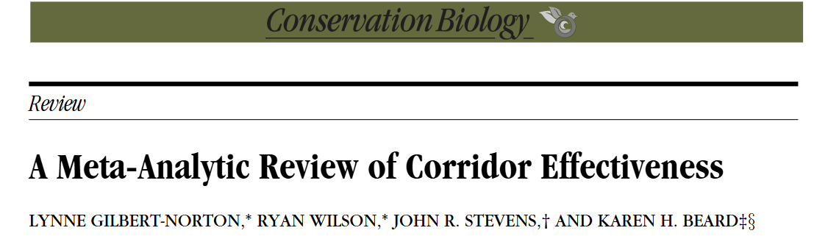
Levins Metapopulation Model and dispersal
Dispersal corridors:
Increase colonization (reducing extinction)
Meta-analyses suggest 50% increase in colonization

Slide 26
Improving dispersal
How else might we improve dispersal?

Slide 27
Assisted Migration
AKA assisted dispersal, assisted colonization
Rationale:
Environment changing faster than species can disperse naturally
Even if they could disperse fast enough, barriers may hinder this
We can help disperse species where needed

Slide 28
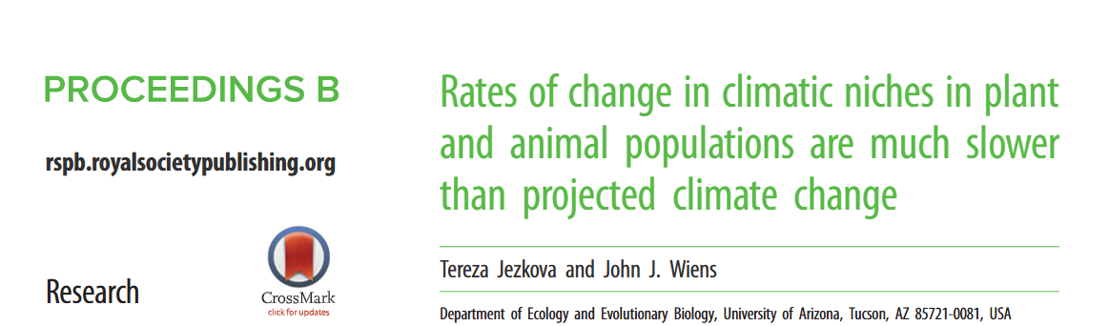
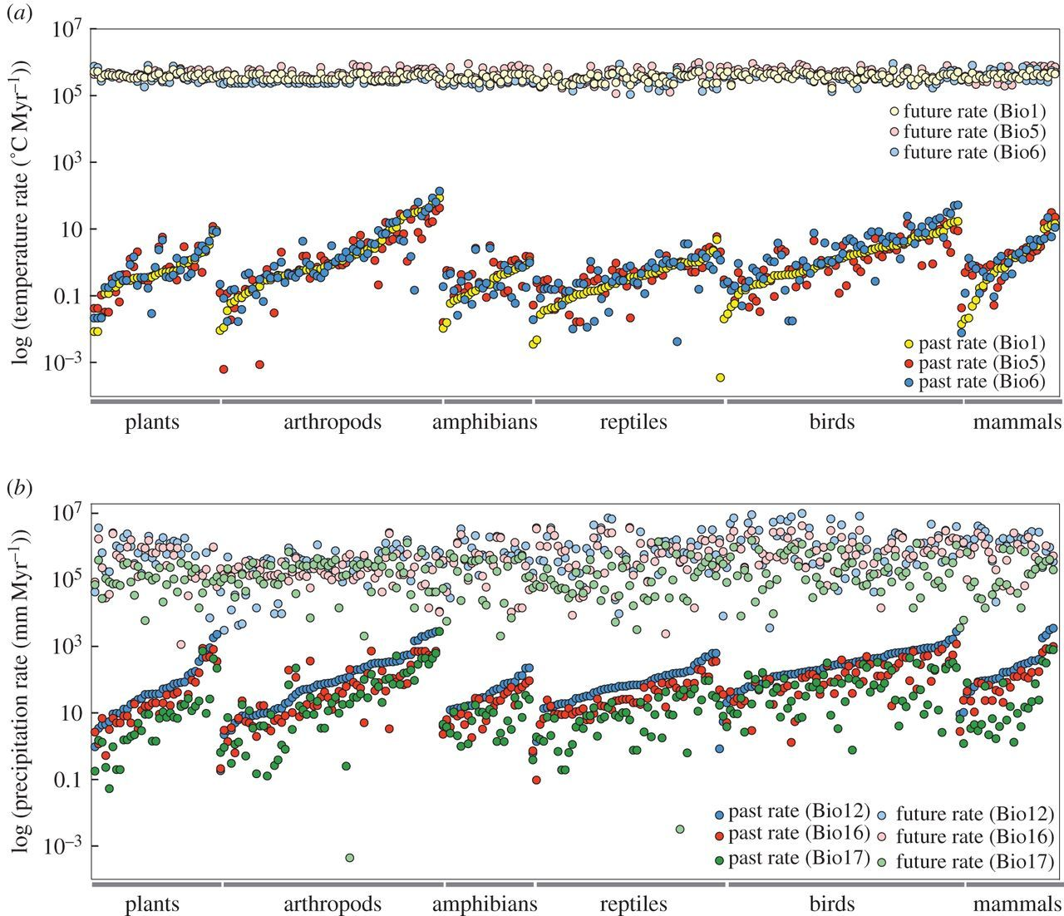
Assisted Migration
Niche evolution is much slower than projected climate change

Slide 29
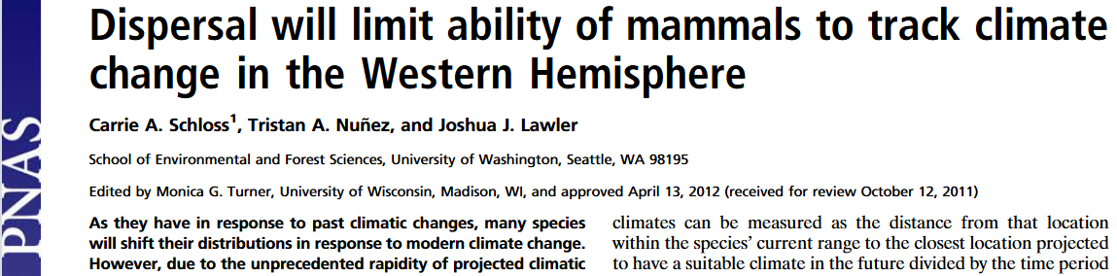
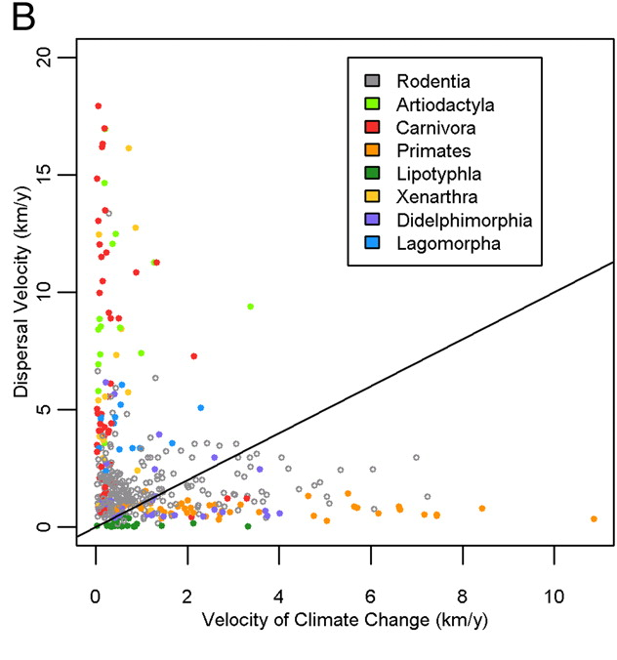
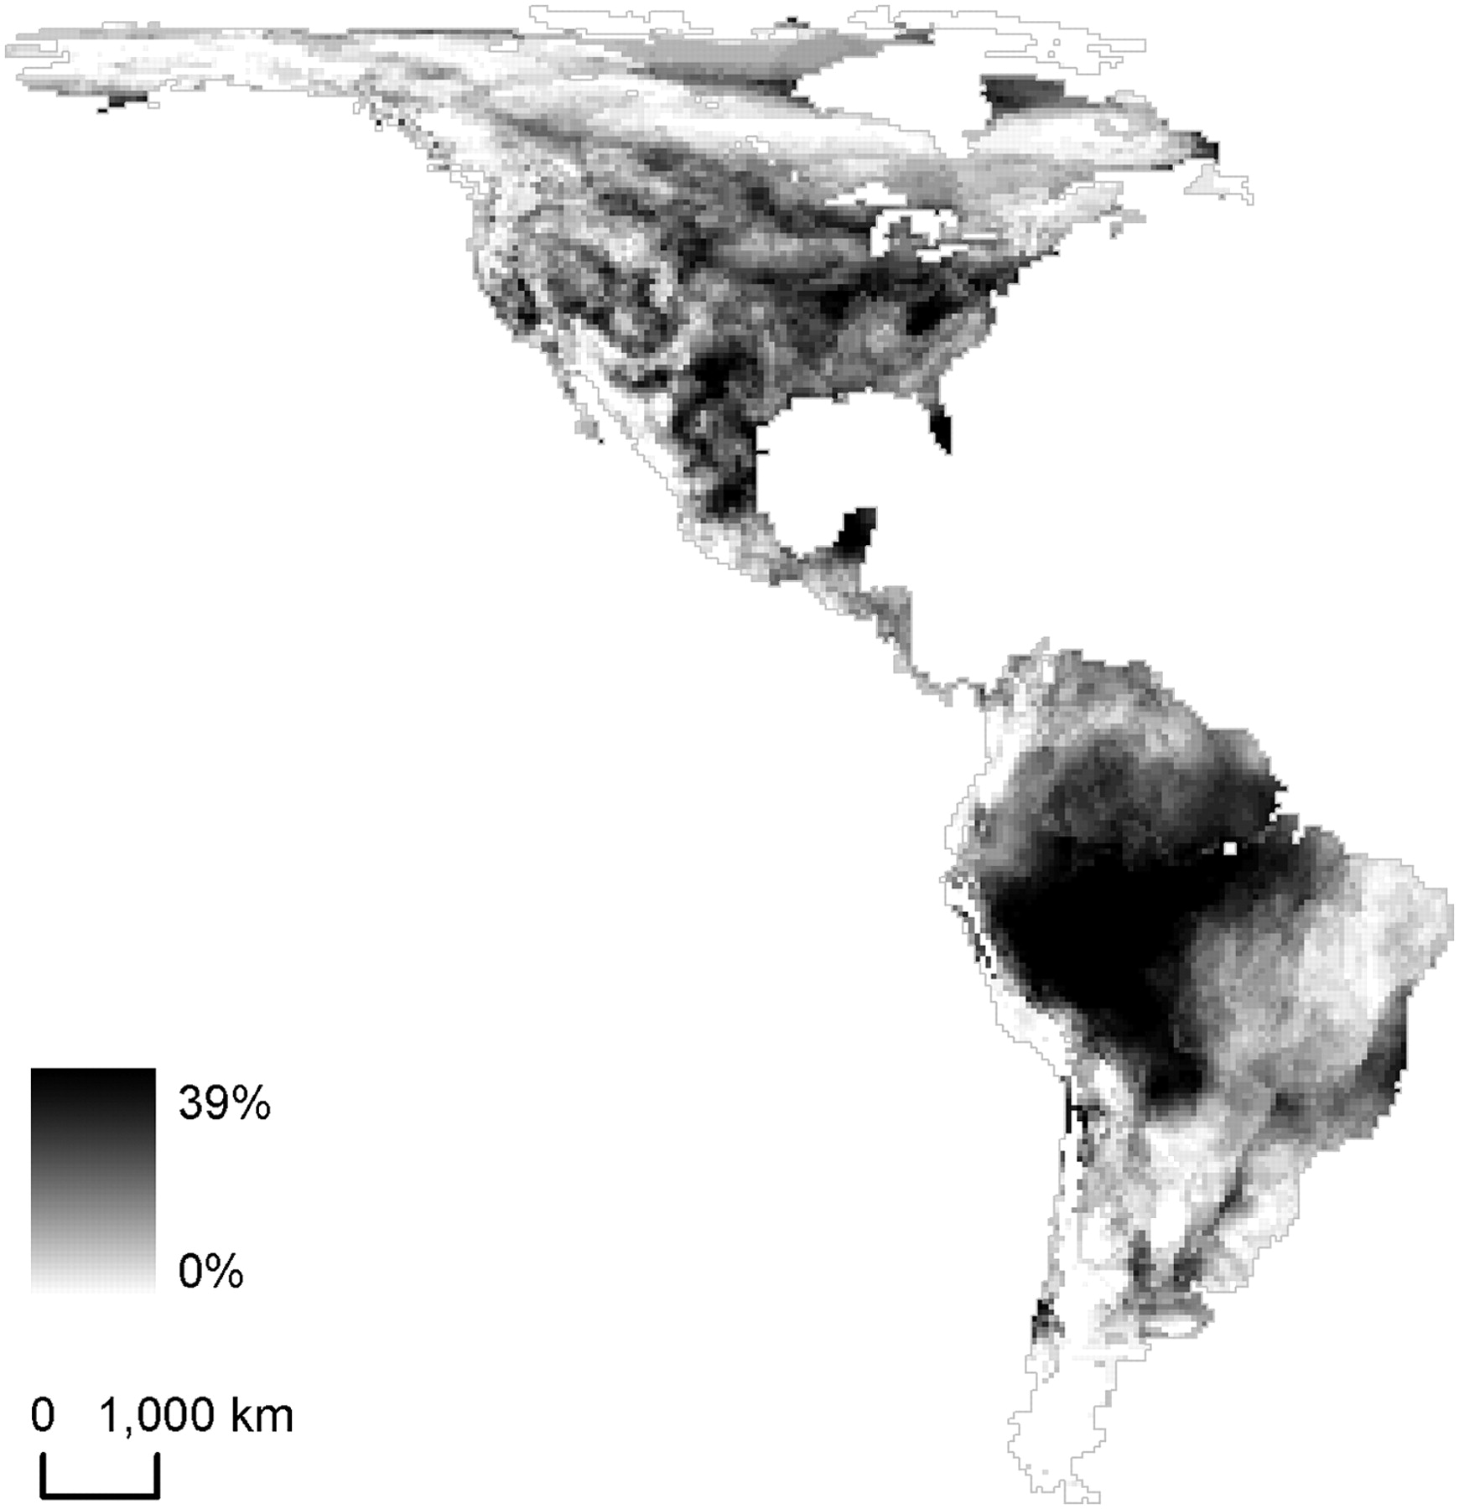
Assisted Migration
Species unable to track climate

Slide 30
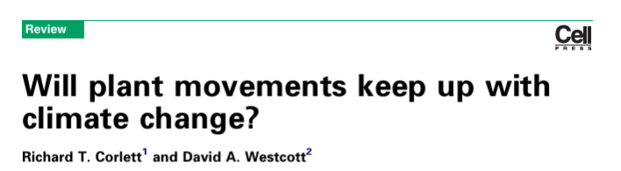
Assisted Migration
Mean rate of temperature change: 0.42 km/yr
Mean of rate of precipitation change: 0.22 km/yr
Plant dispersal (high estimates) 1.7 m/yr - 1.5 km.yr
BUT actually likely lower because long dispersal is correlated with large size (long generations)
Most plants won’t be able to keep up

Slide 31
Assisted Migration
Sometimes opposed due to parallels with introduced species
Runs counter to managing ecosystems by NOT changing them

Slide 32
Assisted Migration
Sometimes opposed due to parallels with introduced species
Runs counter to managing ecosystems by NOT changing them
BUT:
Introductions aren’t usually bad
These aren’t being introduced into entirely new communities
Traits identifying a candidate for A.M. are the opposite of those of an invasive species
Slow spread, low population densities, etc.
The real concerns are with logistics

Slide 33
Metapopulation models and epidemiology
Metapopulation models similar to infection models
Hosts = patches
Infection = colonization
Recovery = patch extinction
Host death = patch destruction
Vaccination = patch destruction

Slide 34
Metapopulation models and epidemiology
Diseases require a sufficient number of infections to persist
Comparable to metapopulation dynamics
Just need to vaccinate 1–m/c proportion of people!

Slide 35
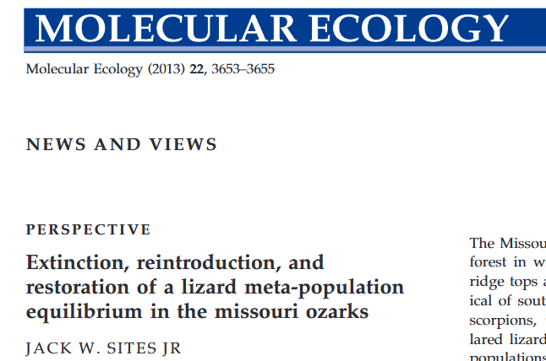
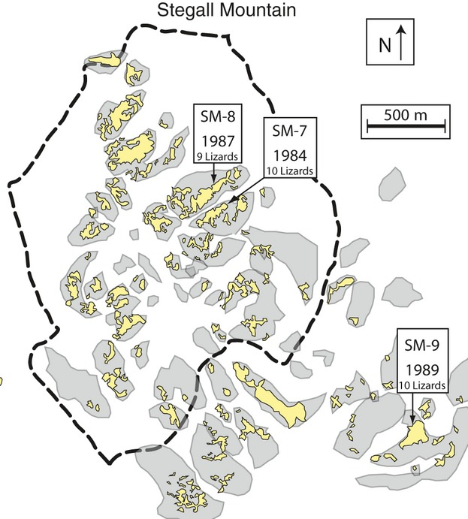
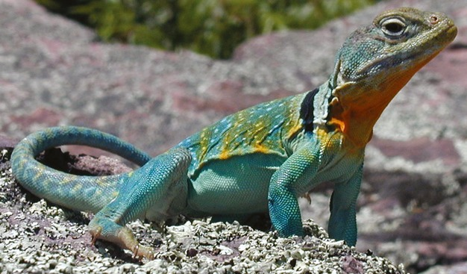
Metapopulations and restoration
Eastern collared lizards (Crotaphytus collaris collaris)
Live in dry, open glades (maintained by fire)
Fire suppression eliminated glades
In 1994 prescribed burns started
Notes:
Grey = original glades, yellow = glades after fire suppression, dashed = area of prescribed burns

Slide 36
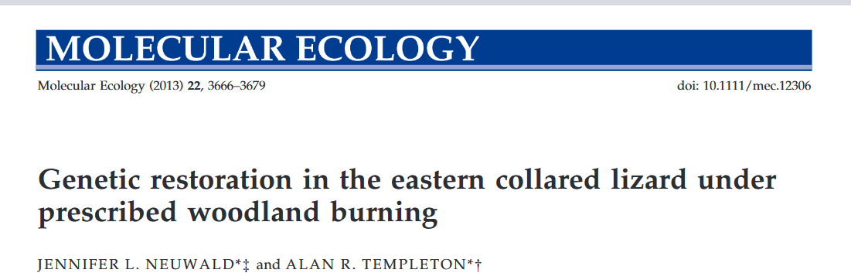
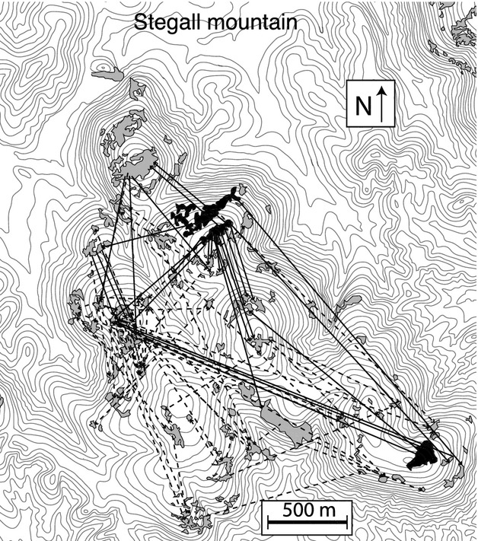
Metapopulations and restoration
Solid lines = dispersal 1994-1998
Dashed lines = dispersal 1999-2000

Slide 37
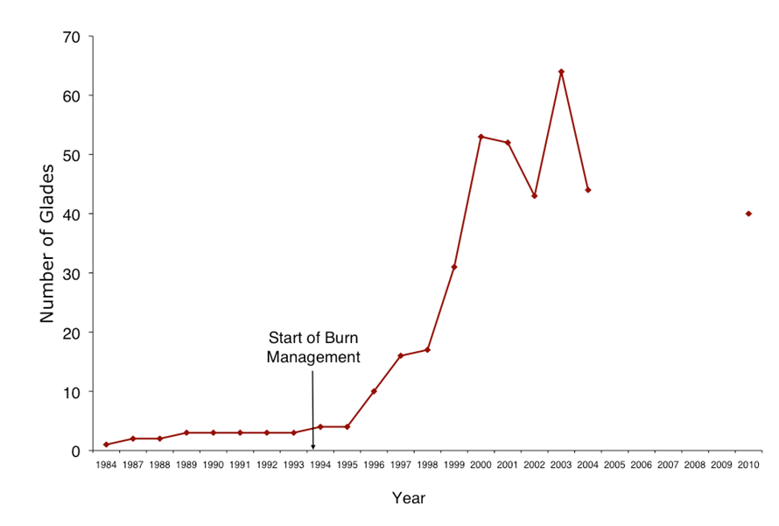
Metapopulations and restoration

Slide 38
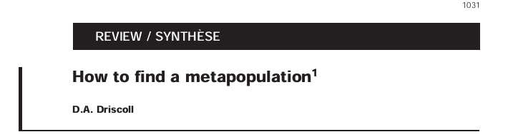
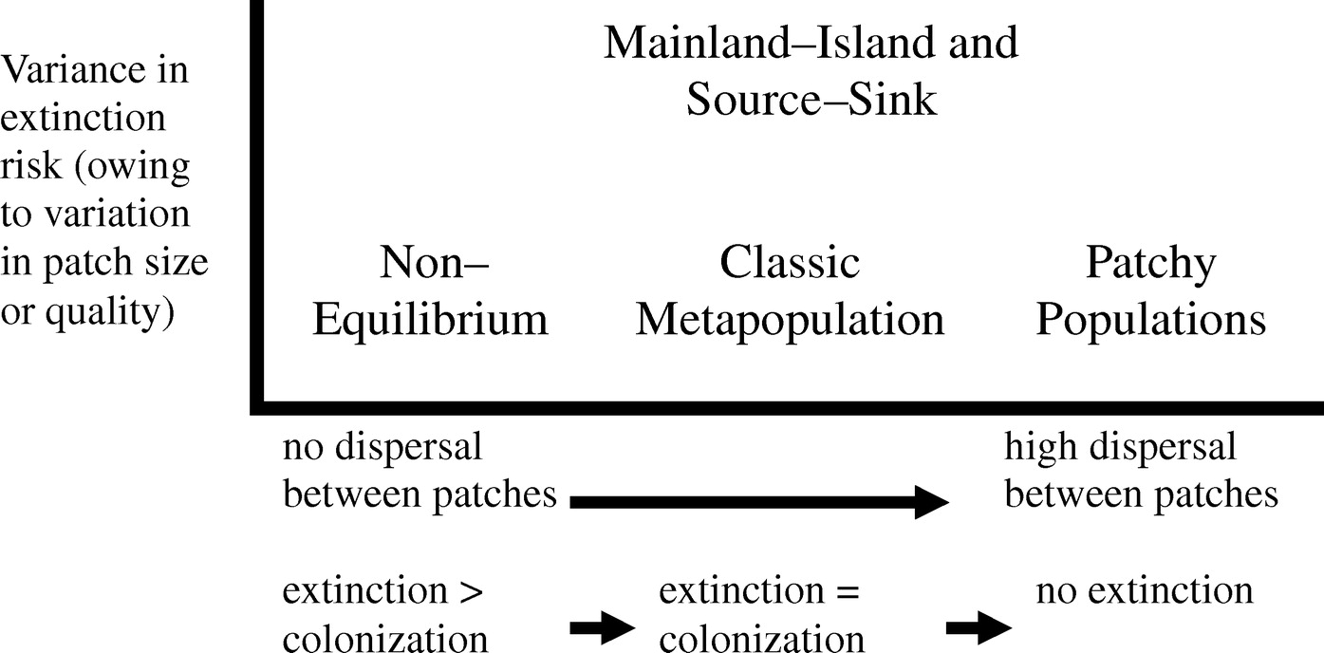
Types of metapopulation structure

Slide 39
Types of metapopulation structure
Important conservation implications!

Slide 40
Next class: More patchy environments

