Slide 1
Variable Environments I
Today’s Agenda:
Quiz
Variable Environments

Slide 2
Variable Environments
Recently we’ve been talking about variation in space
Variation in time is also super important!
Types of variation
Variation around a mean (e.g., temperature, precipitation, tides, etc.)
Long-term trends (e.g., climate change, desertification)

Slide 3
Key ideas
Succession
Intermediate disturbance hypothesis
Temporal variation and coexistence
Alternative Stable States (a phrase that is rarely abbreviated)
Slow change but rapid exposure to new conditions

Slide 4
Succession
Succession = pattern of community change following disturbance
Primary succession = starting from scratch
E.g., newly formed islands, land scraped bare by glaciers
Secondary succession = starting from a large disturbance
E.g., fires, agriculture, floods, etc.
Soil, seeds, maybe some resilient organisms may remain

Slide 5
Succession
Some early ecologists thought succession would always end the same
Any location, if disturbed, would always return to the same climax community

Slide 6
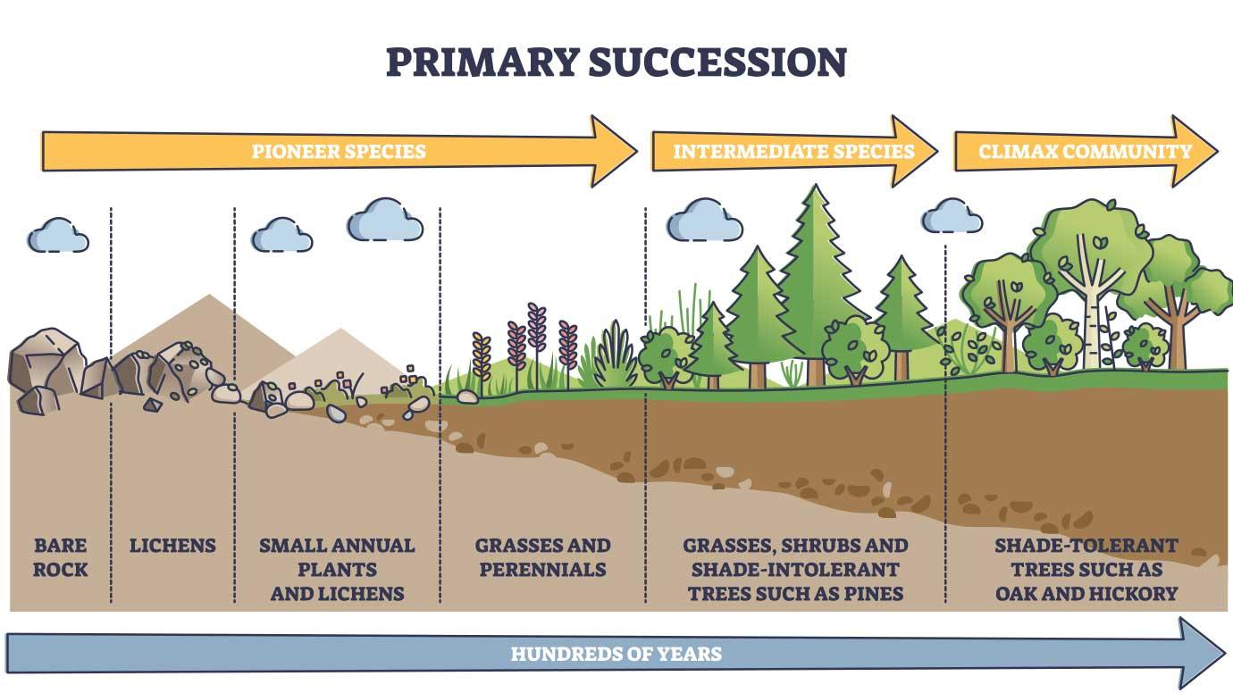
Succession
Image: shutterstock.com

Slide 7
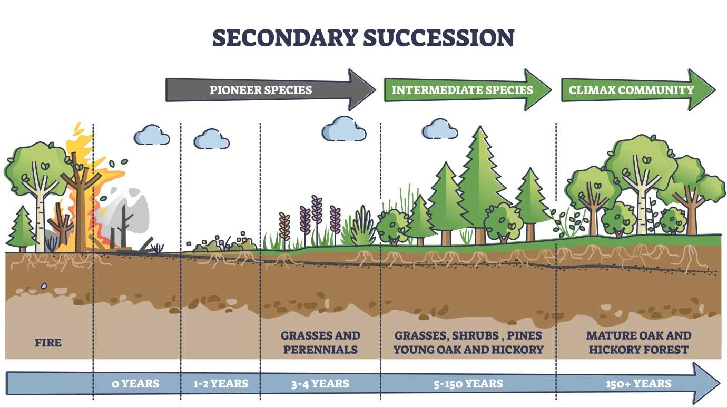
Succession
Image: shutterstock.com

Slide 8
Small-scale succession
Note that these dynamics can occur on different spatial scales
E.g., treefall gaps in forests
These smaller-scale disturbances can increase species diversity
Think about the spatial variation stuff we’ve discussed

Slide 9
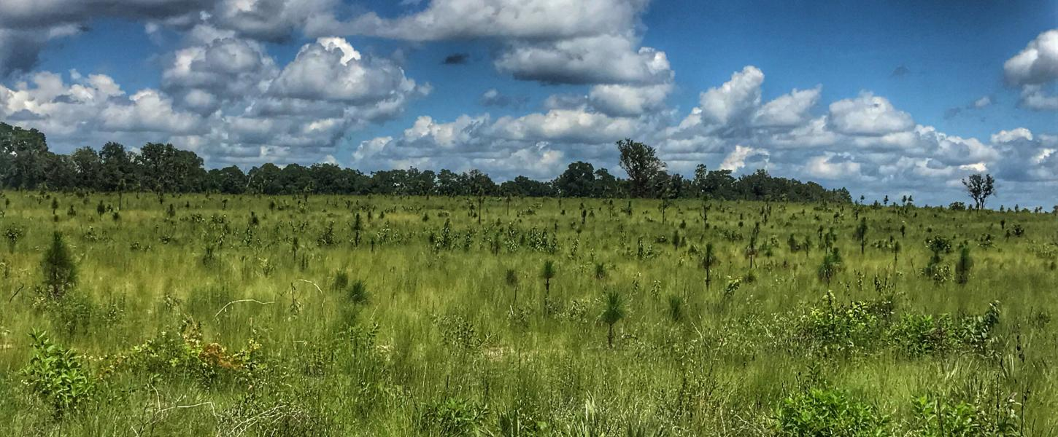
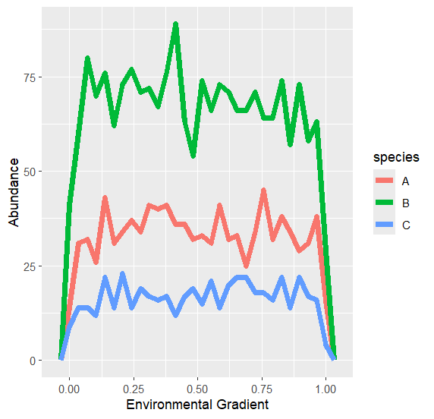
Succession
Climax community assumes a set of species will occur at a given environment
Succession is just a return to this set
Image: Florida Department of Environmental Protection

Slide 10
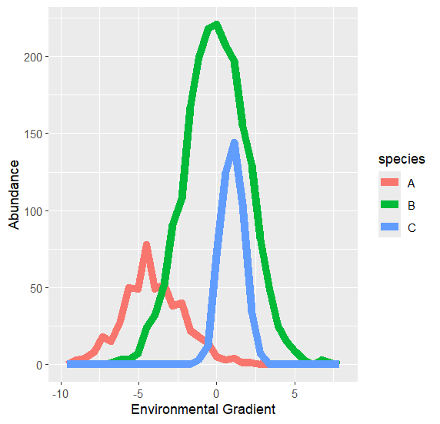
Succession
The idea of fixed types of communities has been abandoned
Communities as aggregations of individual species
Species dominate because they’re suited to the current environment

Slide 11
Succession
Climax communities abandoned
However, there is still a lot of study in how ecosystems change
The focus now has shifted to community assembly, metacommunity, etc.

Slide 12
Intermediate Disturbance Hypothesis
species diversity highest at an intermediate level of disturbance
Species Richness
Disturbance Frequency

Slide 13
Intermediate Disturbance Hypothesis
species diversity highest at an intermediate level of disturbance
What factors might drive this?
Species Richness
Disturbance Frequency

Slide 14
Intermediate Disturbance Hypothesis
Good colonizers and good competitors in different patches
Only good competitors
Only good colonizers
Species Richness
Dispersal Ability
Disturbance Frequency
Competitive Ability

Slide 15
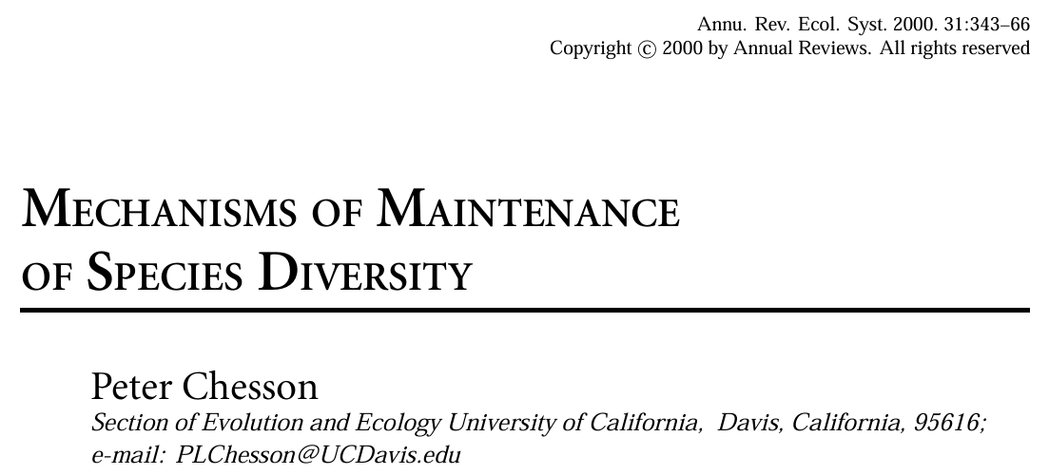
Disturbance and Coexistence
You may read or hear someone say something like:
“Disturbance promotes coexistence by reducing competition”
This is NOT TRUE!
Coexistence is only promoted when species are impacted differently
Needs to increase intraspecific competition relative to interspecific competition

Slide 16
Temporal Variation and Coexistence
Temporal and spatial variation can interact to allow coexistence
Other fluctuation-dependent coexistence mechanisms:
Storage effect
Relative non-linearity

Slide 17
Relative Nonlinearity of competition
Relative dominance at
low resource values
Relative dominance at
high resource values

Slide 18
Relative Nonlinearity of competition
Relative dominance at
low resource values
Growth rate
Relative dominance at
high resource values
Resource availability

Slide 19
Relative Nonlinearity of competition
Resource Availability
Time

Slide 20
Relative Nonlinearity of competition
Resource Availability
Time

Slide 21
Relative Nonlinearity of competition
Resource Availability
Time
Effect on Resources

Slide 22
Storage Effect

Slide 23
Storage Effect
Species differ in the environment they do best in
BUT they can persist through sub-optimal conditions
(Note that there is a spatial version of this as well)

Slide 24
Storage Effect
Relative Growth Rate
Tolerance to low resources

Slide 25



Storage Effect
Mean Annual Precipitation
Adults
Seeds
Time

Slide 26
Storage Effect
α_{ii} > α_{ji}
Mean Annual Precipitation
Adults
Seeds
Time

Slide 27
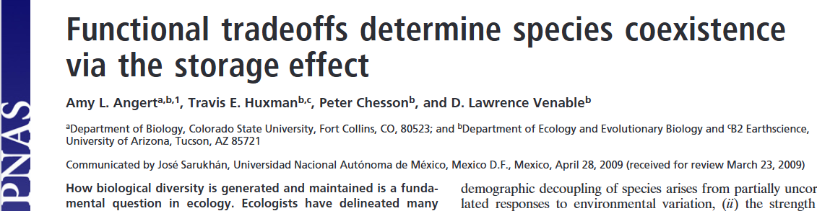
Storage Effect

Slide 28
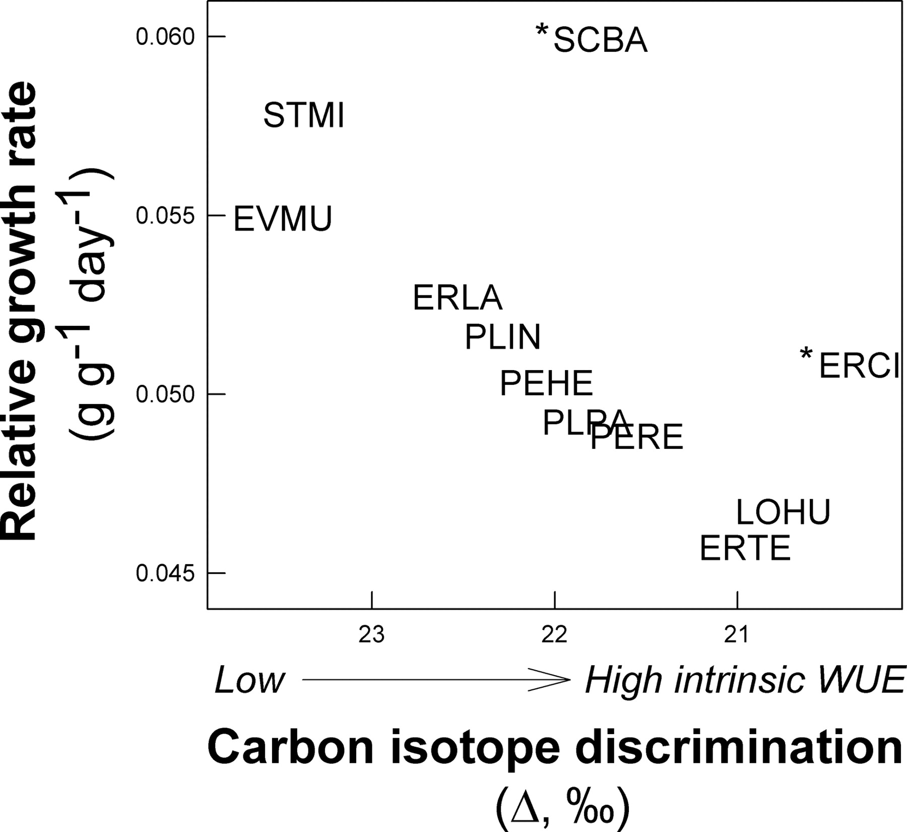
Storage Effect

Slide 29
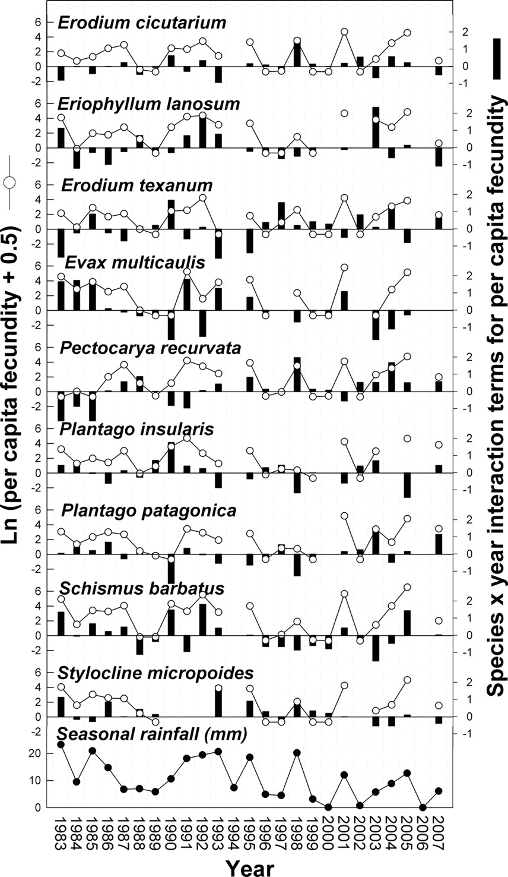
Storage Effect

Slide 30
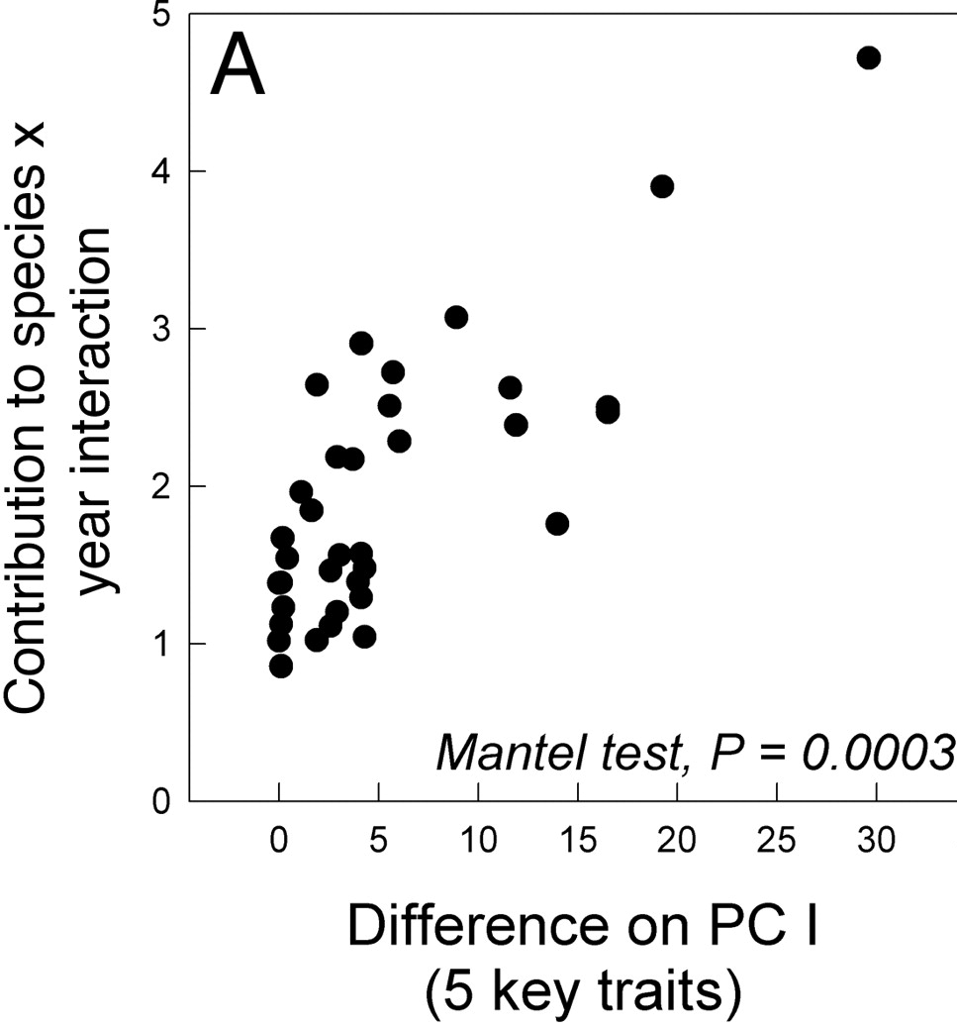
Storage Effect

Slide 31
Regime Shifts and Alternative Stable States
Alternative Stable States
Different communities, same environment
Perturbations may cause a shift from one to the other

Slide 32
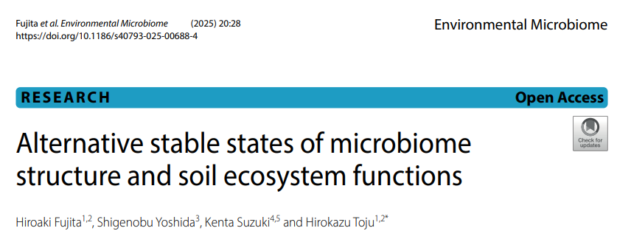
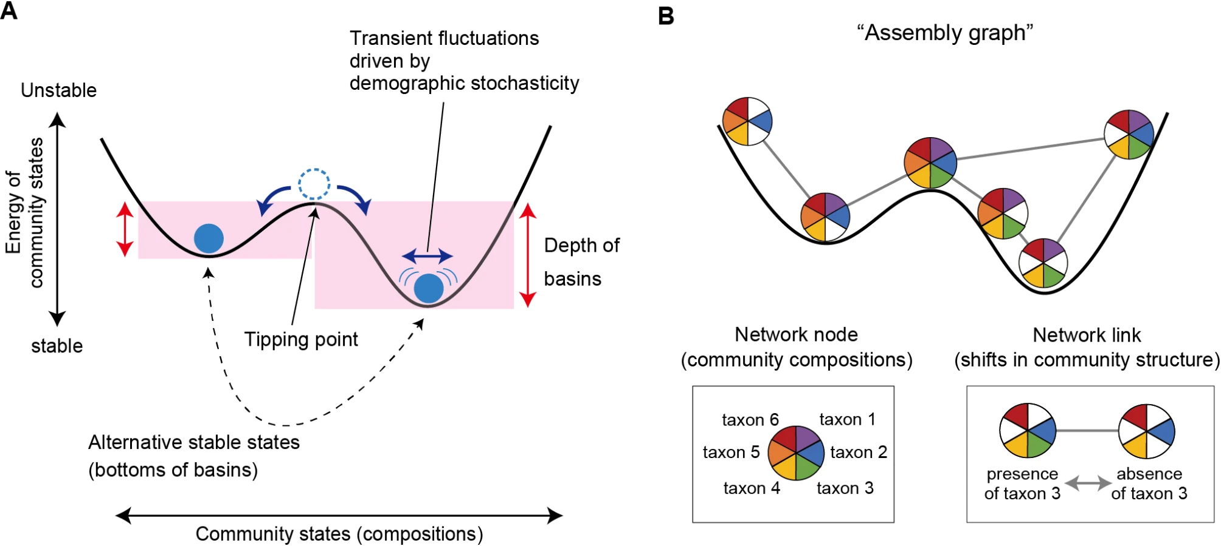
Regime Shifts and Alternative Stable States

Slide 33
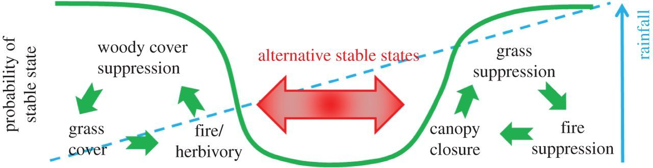
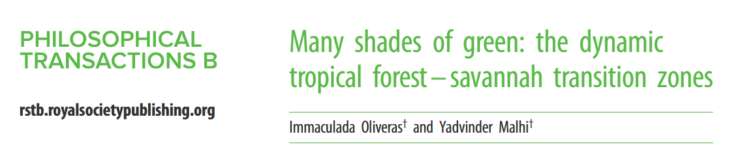
Regime Shifts and Alternative Stable States

Slide 34
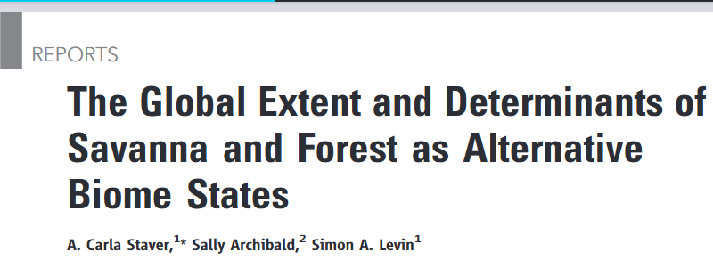
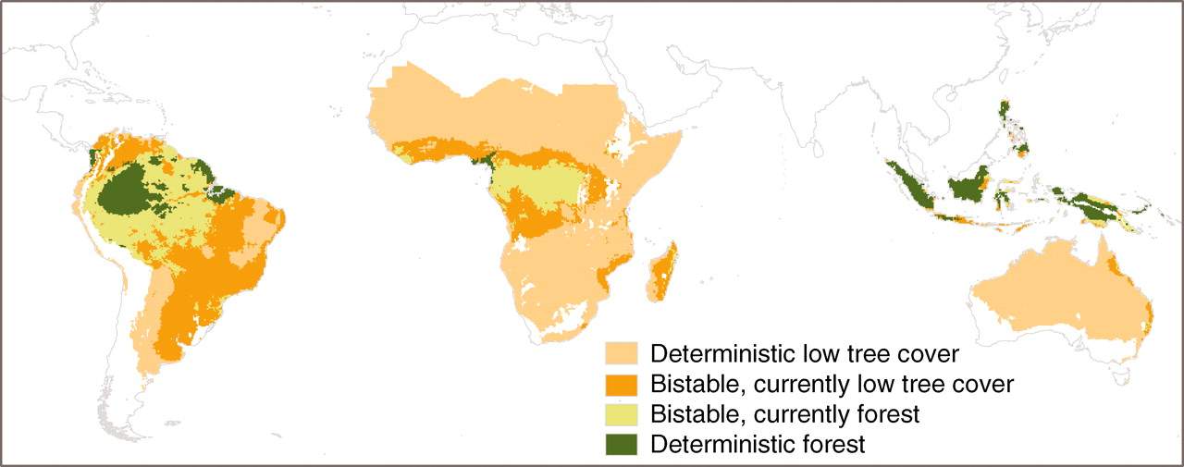
Regime Shifts and Alternative Stable States

Slide 35
Regime Shifts and Alternative Stable States
A switch from forest to savannah has big implications
Different species
Different carbon sequestration
Impacts on global climate models

Slide 36
Regime Shifts and Alternative Stable States
Will shifts be gradual or abrupt?
Gradual gives us time to act
Abrupt may leave us scrambling

Slide 37
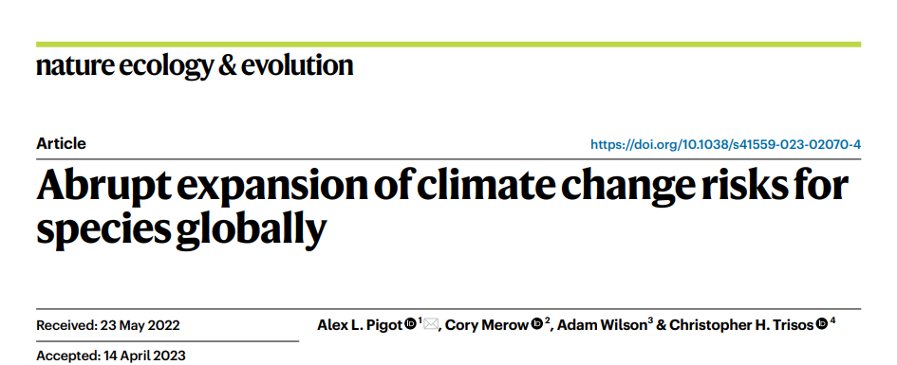
Timing of change
Approach:
When will species be exposed to novel conditions?
Compared species’ historical climates to projected future climates
Asked when species will be exposed to new climates
Novel isn’t necessarily bad
But it does mean we don’t KNOW a species can survive it
High sensitivity, low specificity
Make few assumptions

Slide 38
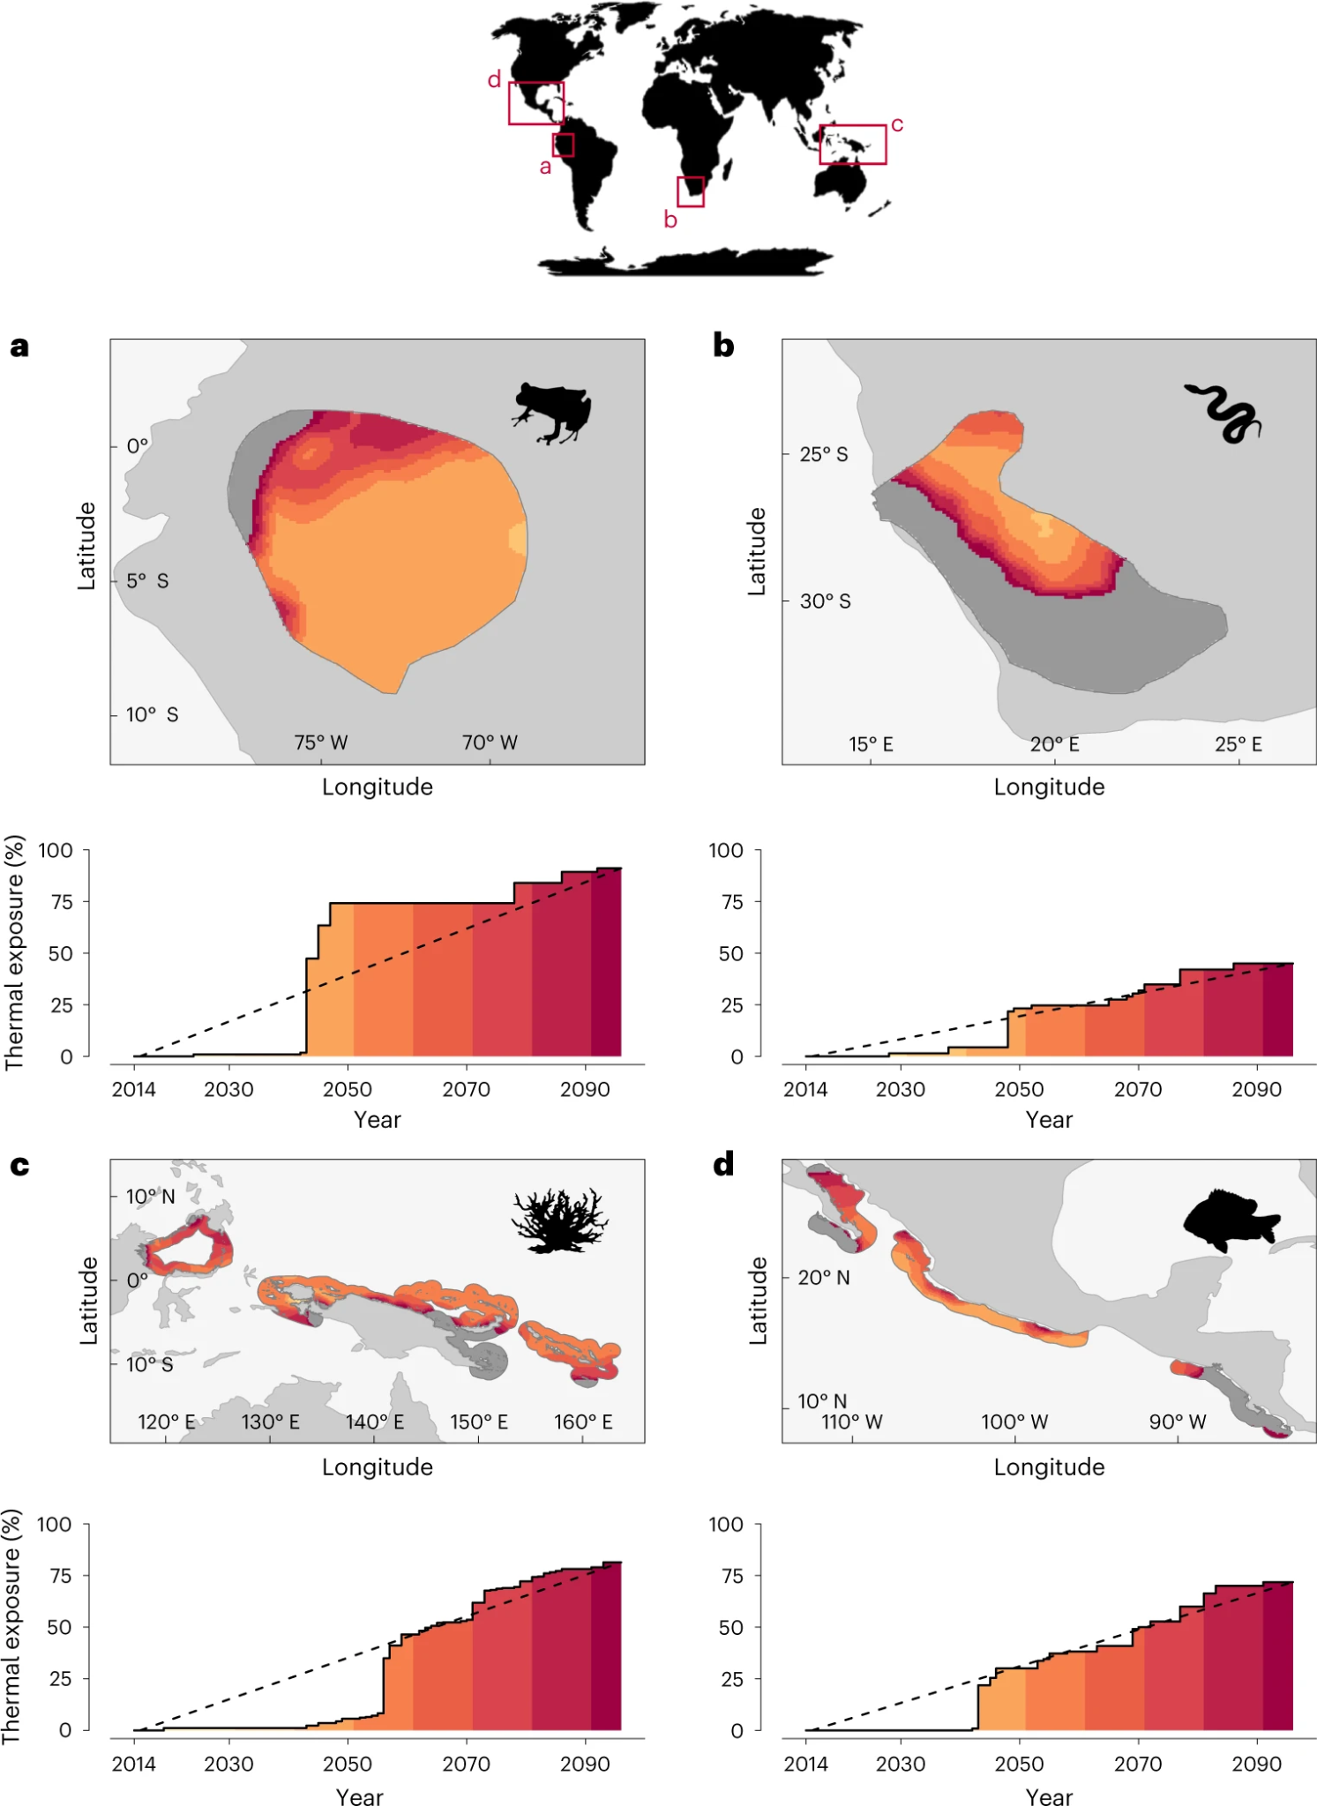
Timing of change
Abrupt onsets of exposure

Slide 39
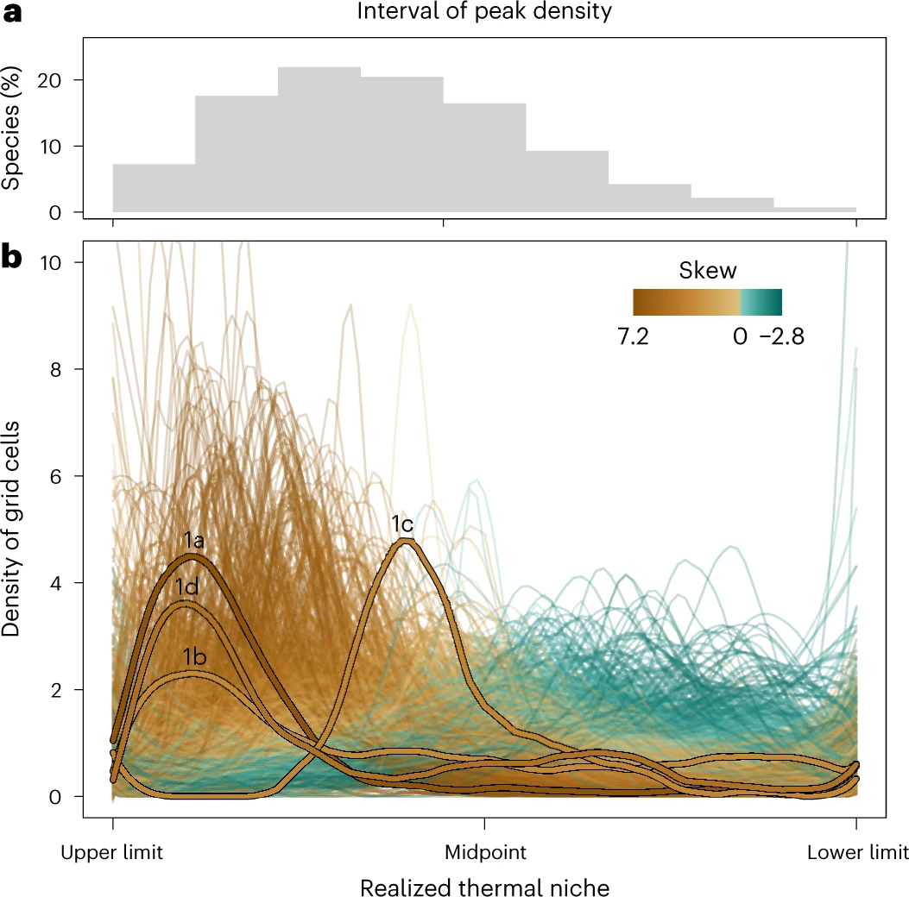
Timing of change
Abrupt onsets of exposure
Driven by realized niches

Slide 40
Timing of change
Note: x-axis is reversed from previous
Density of Grid cells
cold
Realized thermal niche
hot

Slide 41
Timing of change
-Most species are biased towards the warm end
-Warm end has abrupt limit
-Minor shift pushes into novel climate
Density of Grid cells
cold
Realized thermal niche
hot

Slide 42
Timing of change
Relatively slow increases in climate may cause sudden risks to species
Need ways of identifying when exposure to new climate is a risk
In 2023 and 2024, many species were exposed to novel temperatures
Need to understand which species were impacted and which weren’t

Slide 43
Key ideas
Succession
Intermediate disturbance hypothesis
Temporal variation and coexistence
Alternative Stable States
Slow change but rapid exposure to new conditions

Slide 44
Next class: Students present something!

