Slide 1
Diversity Patterns IV
Today’s Agenda:
Quiz
Assignment: Conceptual Figures
Student Presentations

Slide 2
Conceptual figures
“visualisations that do not represent data itself, but help illustrate a theoretical idea or a methodological design. They are often relevant for scientific publications, and can help improve presentations and pitches by making an idea or approach more understandable for the audience.”
https://sustainabilitymethods.org/index.php/Conceptual_Figures

Slide 3
Conceptual figures
Make complex ideas more clear
Show simplified views of a system
Cartoon versions of mechanisms or methods
VERY underappreciated/underutilized

Slide 4
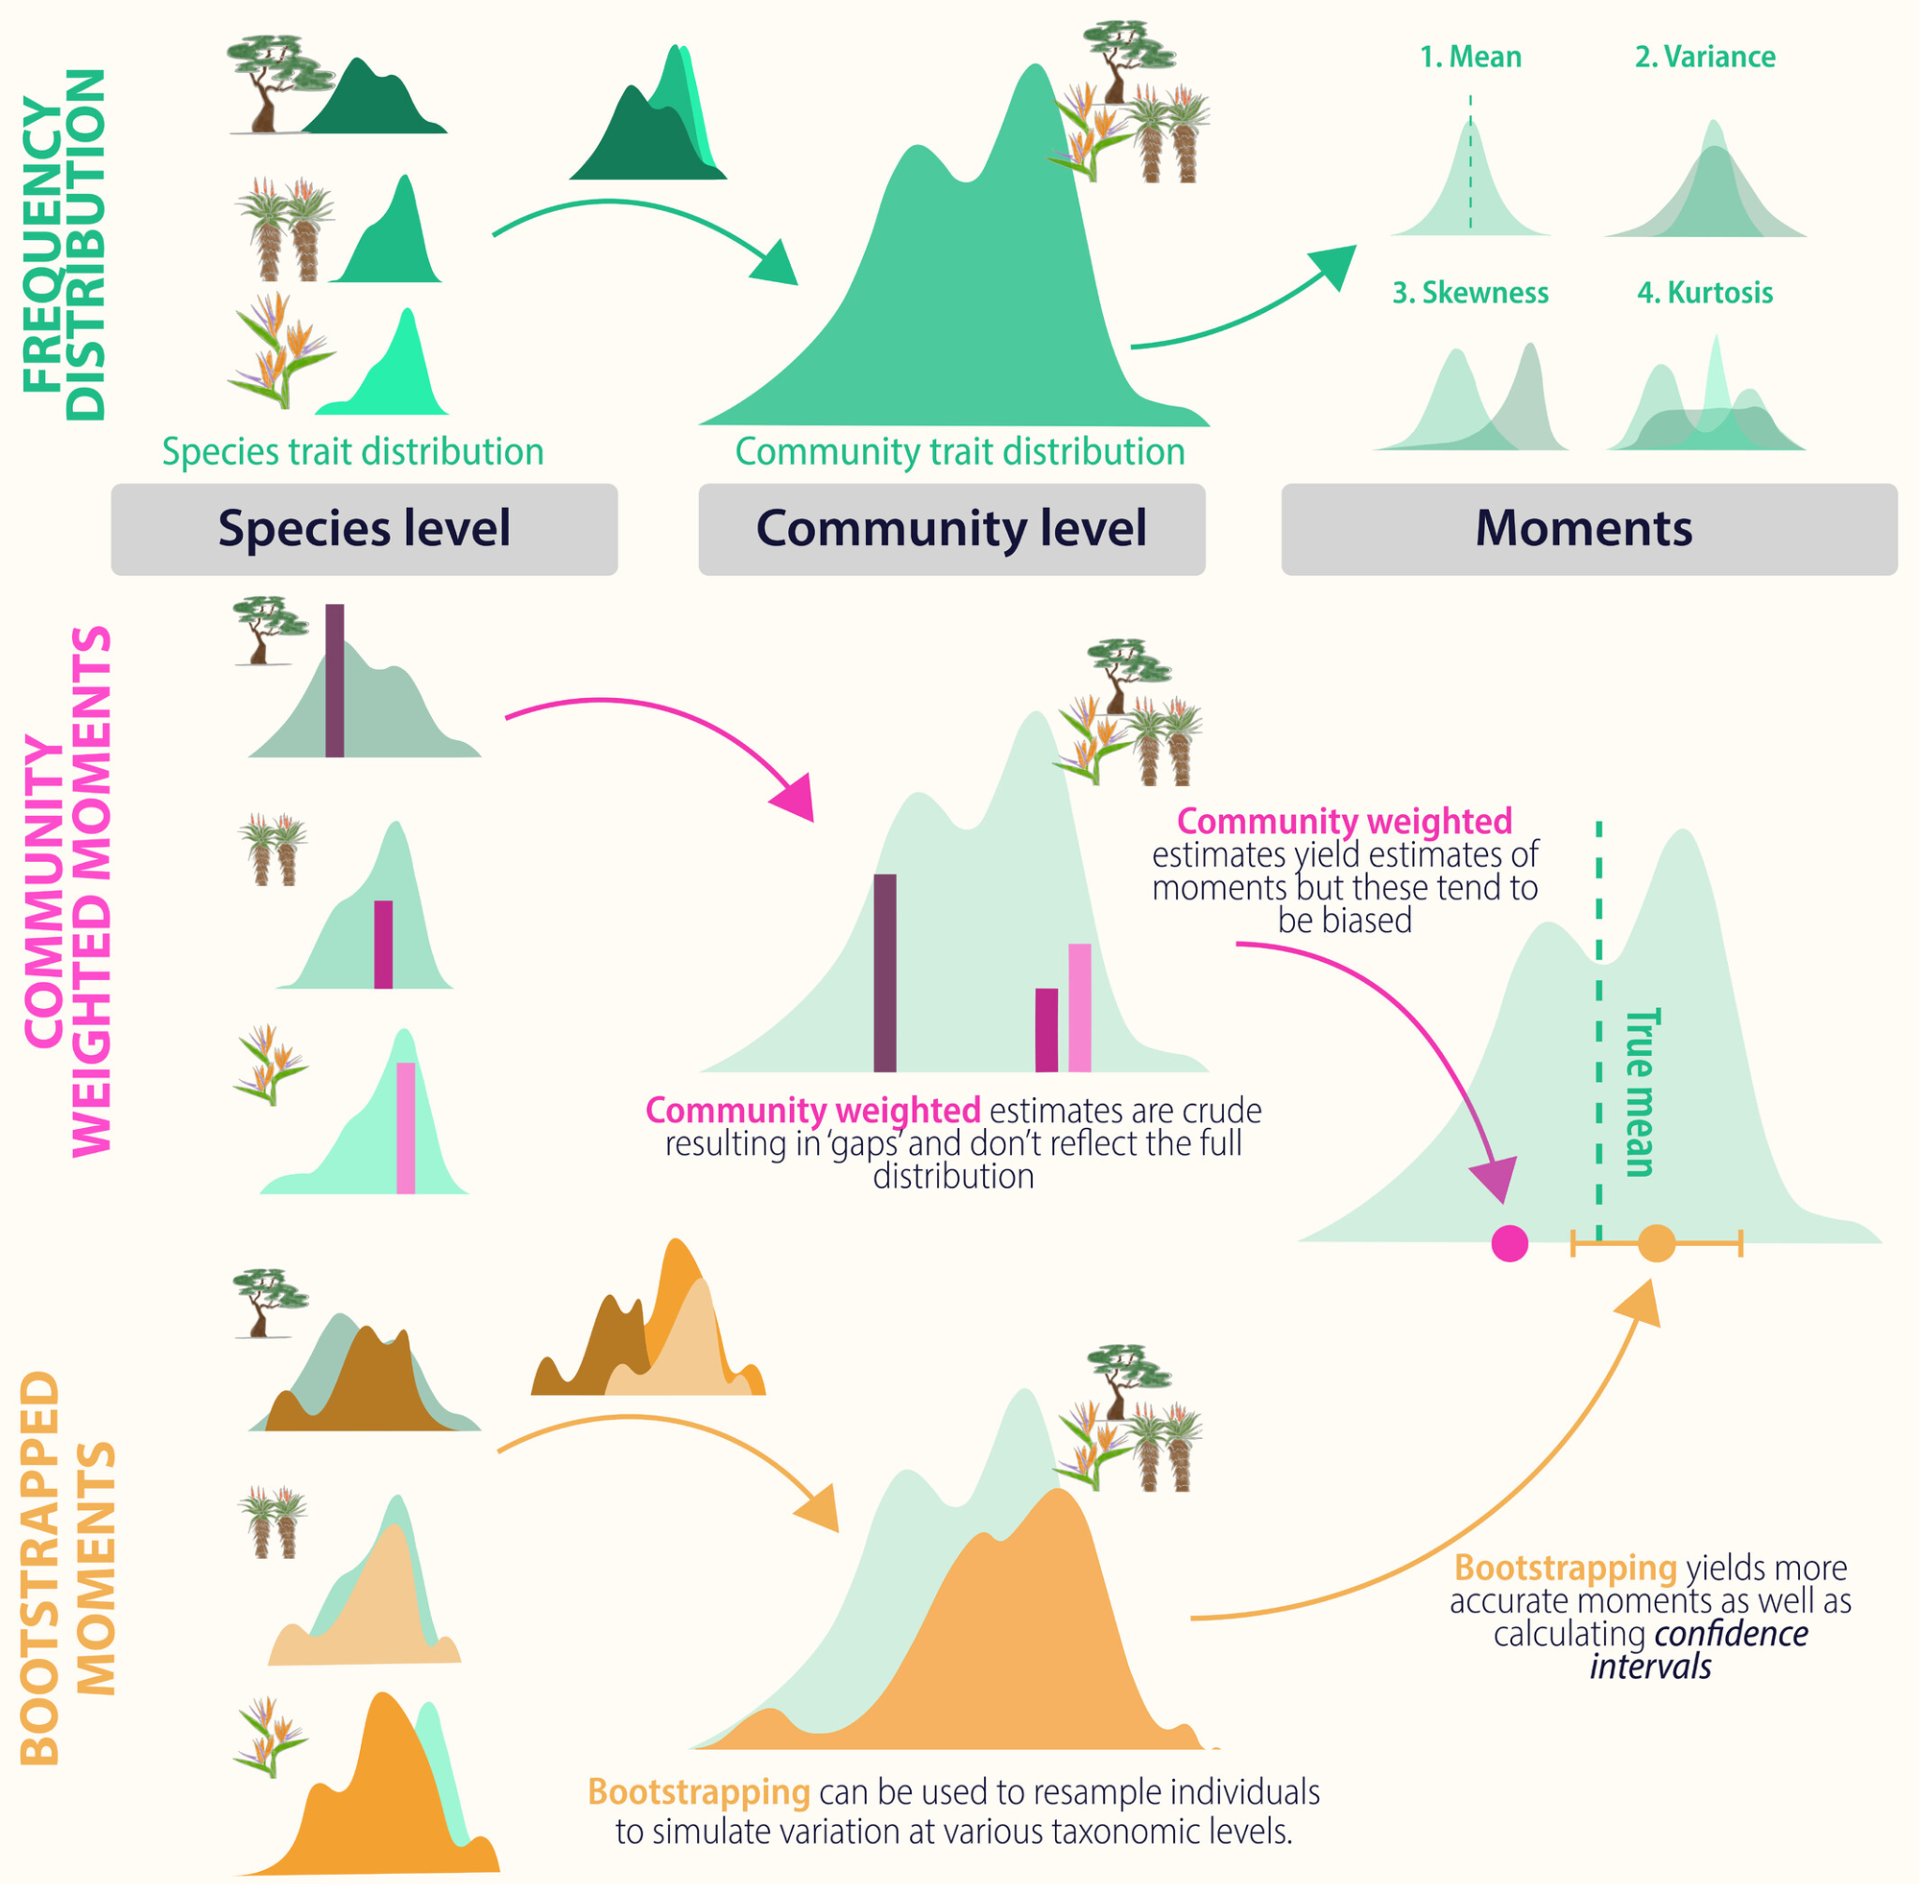
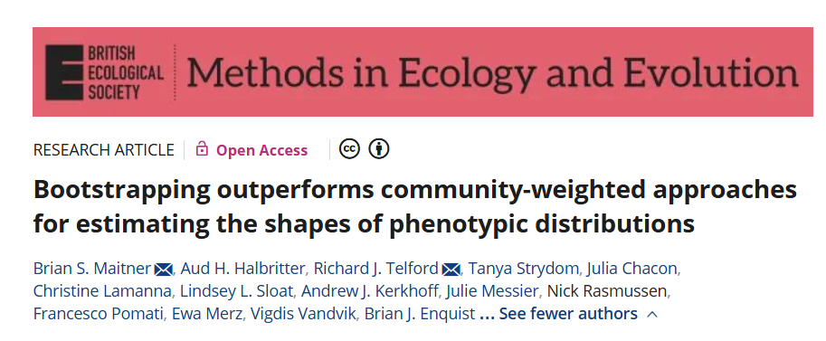
Conceptual figures - Examples

Slide 5
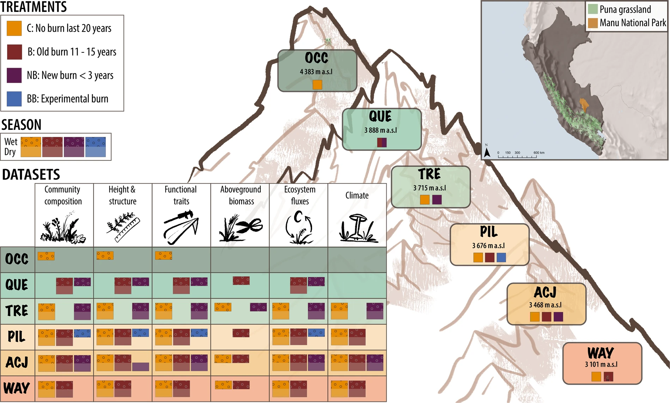
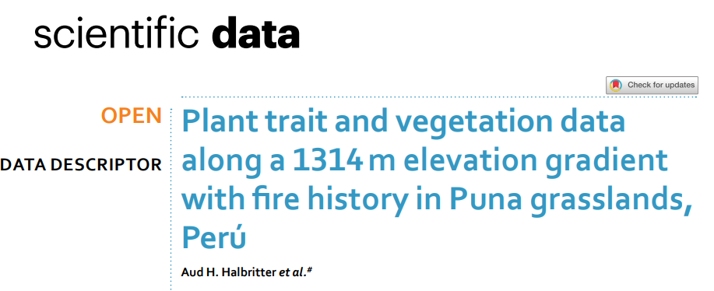
Conceptual figures - Examples

Slide 6
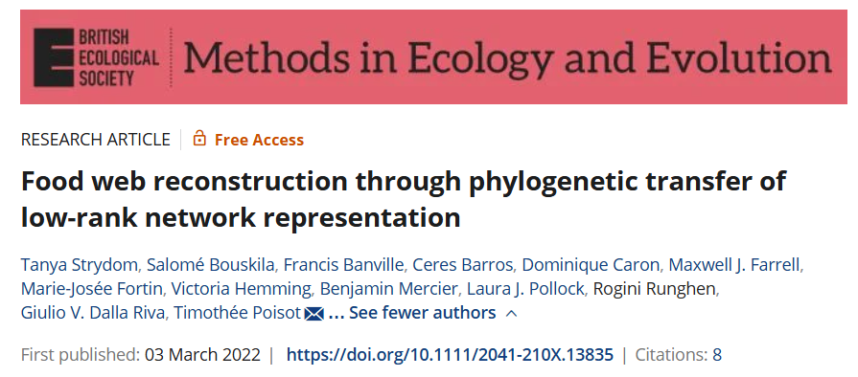
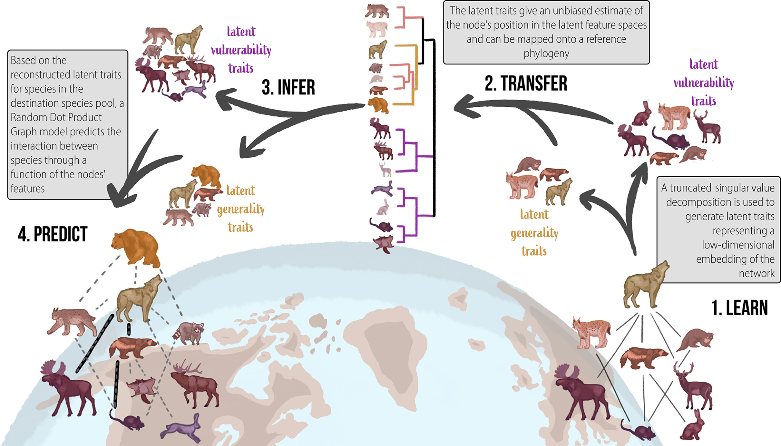
Conceptual figures - Examples

Slide 7
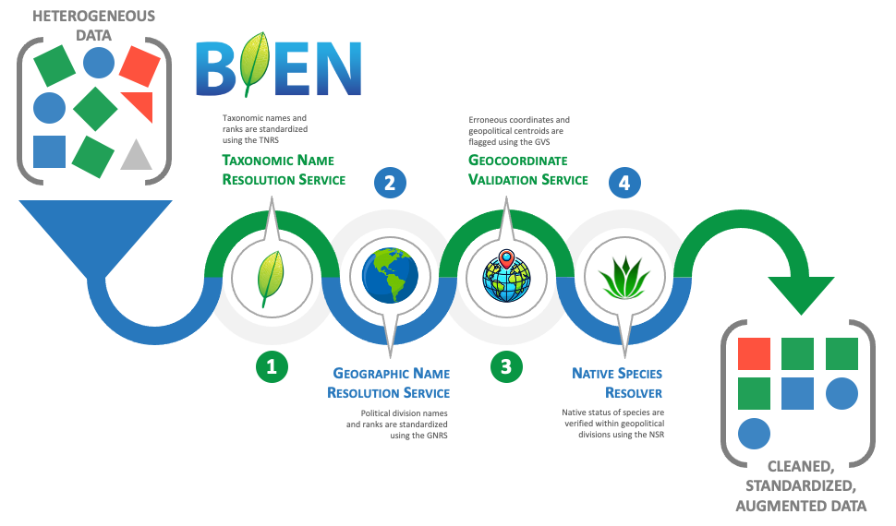
Conceptual figures - Examples
Enquist et al., in prep

Slide 8
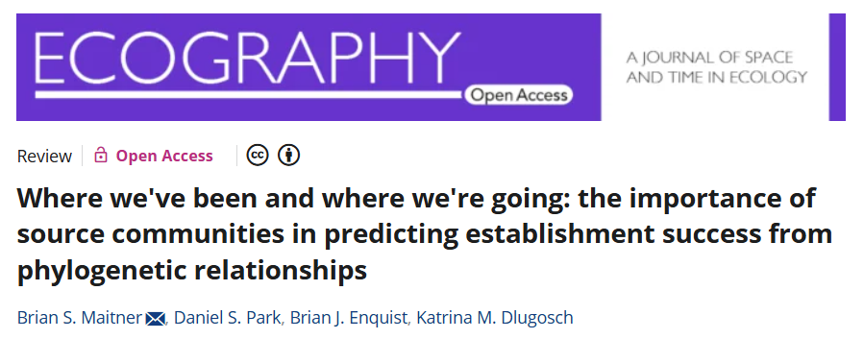
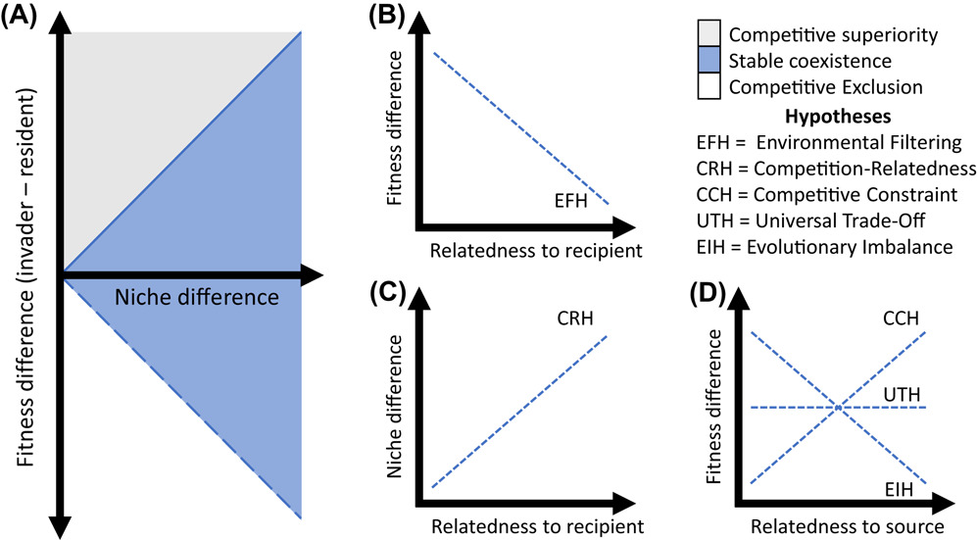
Conceptual figures - Examples

Slide 9
Conceptual Figure Assignment: Due by Feb 13th
Select a paper that focuses on Biodiversity-Ecosystem Functioning
Should be one that doesn’t already have a conceptual figure in it
Ideally will involve your focal system, but not required

Slide 10
Conceptual Figure Assignment: Due by Feb 13th
Select a paper that focuses on Biodiversity-Ecosystem Functioning
Should be one that doesn’t already have a conceptual figure in it
Ideally will involve your focal system, but not required
Make a conceptual figure and caption
Can be any type of conceptual figure, e.g.
Hypotheses
Methods
Workflows
Concepts

Slide 11
Conceptual Figure Assignment: Due by Feb 13th
Select a paper that focuses on Biodiversity-Ecosystem Functioning
Should be one that doesn’t already have a conceptual figure in it
Ideally will involve your focal system, but not required
Make a conceptual figure and caption
Can be any type of conceptual figure, e.g.
Hypotheses
Methods
Workflows
Concepts
Submit to canvas as a Word file or PDF
Conceptual figure, caption, reference

Slide 12
Conceptual Figure Assignment: Due by Feb 13th
Questions?

Slide 13
Student Presentations

Slide 14
Next class: Biodiversity and Ecosystem Functioning!

