Slide 1
Competition
Today’s Agenda:
Quiz
Predator-Prey Interactions

Slide 2
Interspecific Competition
What do we mean when we say that two species compete?

Slide 3
Interspecific Competition
Occurs when one species limits the growth rate of another through:
Reducing resource availability (exploitative/resource competition)

Slide 4
Interspecific Competition
Occurs when one species limits the growth rate of another through:
Reducing resource availability (exploitative/resource competition)
Reducing access to resources (interference/contest competition)

Slide 5
Interspecific Competition
Occurs when one species limits the growth rate of another through:
Reducing resource availability (exploitative/resource competition)
Reducing access to resources (interference/contest competition)
Increasing shared predators (apparent competition)

Slide 6
Interspecific Competition
Occurs when one species limits the growth rate of another through:
Reducing resource availability (exploitative/resource competition)
Reducing access to resources (interference/contest competition)
Increasing shared predators (apparent competition)
Can anyone think of examples of any of these?

Slide 7
Modelling Competition
Lotka-Volterra models again

Slide 8
Modelling Competition
dN₁
k₁ - N₁ - α₁₂N₂
=
r₁N₁
dt
k₁
dN₁/dT = rate of change in N₁
k₁ = carrying capacity of species 1
N₁ = # species 1
N₂ = # species 2
α₁₂ = relative impact of sp. 2 on sp. 1
r₁ = growth rate of species 1

Slide 9
Modelling Competition
dN₁
k₁ - N₁ - α₁₂N₂
dN₂
k₂ - N₂ - α₂₁N₁
=
r₁N₁
=
r₂N₂
dt
k₁
dt
k₂
dN₁/dT = rate of change in N₁
k₁ = carrying capacity of species 1
N₁ = # species 1
N₂ = # species 2
α₁₂ = relative impact of sp. 2 on sp. 1
r₁ = growth rate of species 1
dN₂/dT = rate of change in N₂
k₂ = carrying capacity of species 2
α₂₁ = relative impact of sp. 1 on sp. 2
r₂ = growth rate of species 2

Slide 10
Modelling Competition
α_{ij} = competition coefficient
dN₁
k₁ - N₁ - α₁₂N₂
dN₂
k₂ - N₂ - α₂₁N₁
=
r₁N₁
=
r₂N₂
dt
k₁
dt
k₂
dN₁/dT = rate of change in N₁
k₁ = carrying capacity of species 1
N₁ = # species 1
N₂ = # species 2
α₁₂ = relative impact of sp. 2 on sp. 1
r₁ = growth rate of species 1
dN₂/dT = rate of change in N₂
k₂ = carrying capacity of species 2
α₂₁ = relative impact of sp. 1 on sp. 2
r₂ = growth rate of species 2

Slide 11
Zero Net Growth Isoclines (ZNGIs)
We can ask under what conditions populations are stable
These are isoclines of zero net growth
Set net growth to zero and solve for N1

Slide 12
Zero Net Growth Isoclines (ZNGIs)
dN₁
k₁ - N₁ - α₁₂N₂
dN₂
k₂ - N₂ - α₂₁N₁
=
r₁N₁
=
r₂N₂
dt
k₁
dt
k₂

Slide 13
Zero Net Growth Isoclines (ZNGIs)
k₁ - N₁ - α₁₂N₂
k₂ - N₂ - α₂₁N₁
0
=
r₁N₁
0
=
r₂N₂
k₁
k₂

Slide 14
Zero Net Growth Isoclines (ZNGIs)
k₁ - N₁ - α₁₂N₂
k₂ - N₂ - α₂₁N₁
0
=
0
=
k₁
k₂

Slide 15
Zero Net Growth Isoclines (ZNGIs)
k₁ - N₁ - α₁₂N₂
k₂ - N₂ - α₂₁N₁
0
=
0
=

Slide 16
Zero Net Growth Isoclines (ZNGIs)
N₁
=
k₁ - α₁₂N₂
α₂₁N₁
=
k₂ - N₂

Slide 17
Zero Net Growth Isoclines (ZNGIs)
k₂ - N₂
N₁
=
k₁ - α₁₂N₂
N₁
=
α₂₁
Notes:
Define where species grow/shrink

Slide 18
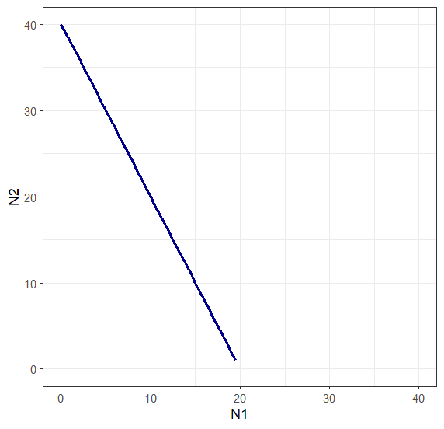
Zero Net Growth Isoclines (ZNGIs)
Species 1
k₂ - N₂
N₁
=
k₁ - α₁₂N₂
N₁
=
α₂₁
Notes:
Define where species grow/shrink

Slide 19
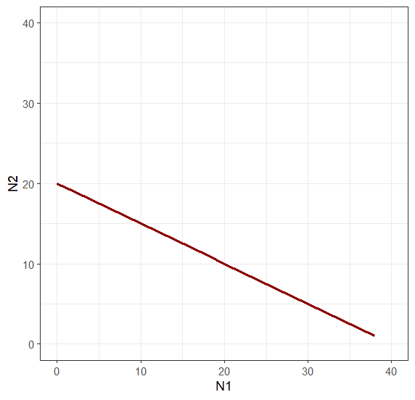
Zero Net Growth Isoclines (ZNGIs)
Species 2
Species 1
k₂ - N₂
N₁
=
k₁ - α₁₂N₂
N₁
=
α₂₁
Notes:
Define where species grow/shrink

Slide 20
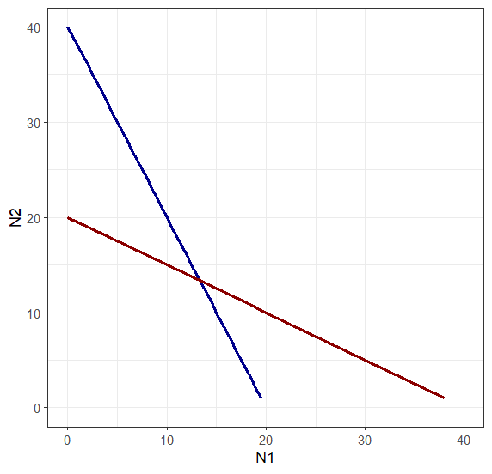
Zero Net Growth Isoclines (ZNGIs)
Species 1
Species 2
Notes:
Define where species grow/shrink

Slide 21
Zero Net Growth Isoclines (ZNGIs)
Species 1
Species 2
Stable coexistence
Both species can invade from low density
Notes:
Define where species grow/shrink

Slide 22
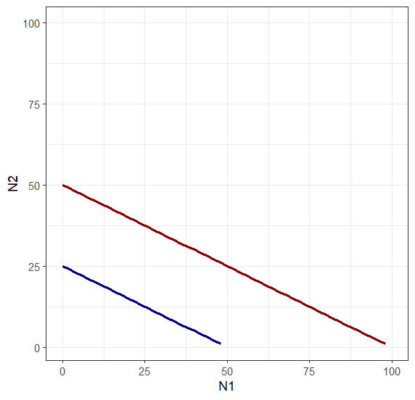
Zero Net Growth Isoclines (ZNGIs)
Species 1
Species 2
Notes:
Define where species grow/shrink

Slide 23
Zero Net Growth Isoclines (ZNGIs)
Species 1
Species 2
Species 2 excludes species 1
Notes:
Define where species grow/shrink

Slide 24
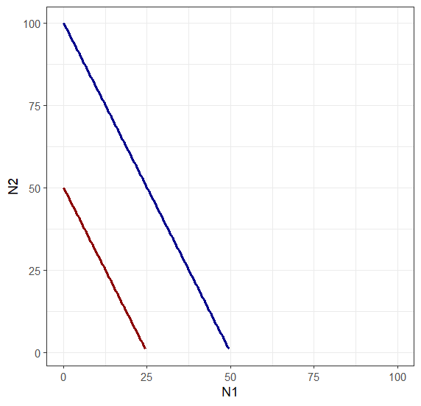
Zero Net Growth Isoclines (ZNGIs)
Species 1
Species 2
Notes:
Define where species grow/shrink

Slide 25
Zero Net Growth Isoclines (ZNGIs)
Species 1
Species 2
Species 1 excludes species 2
Notes:
Define where species grow/shrink

Slide 26
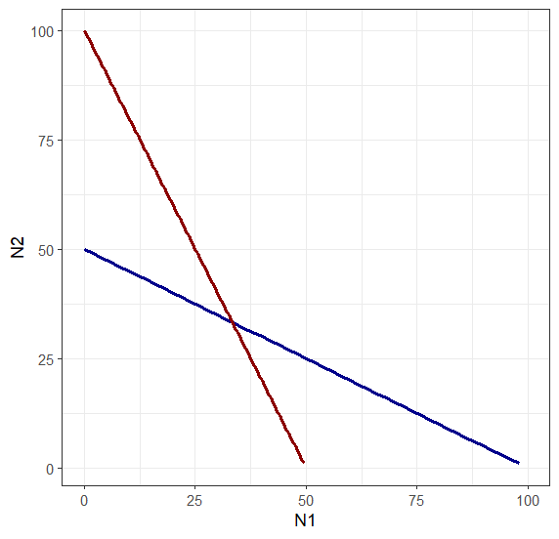
Zero Net Growth Isoclines (ZNGIs)
Species 1
Species 2
Notes:
Define where species grow/shrink

Slide 27
Zero Net Growth Isoclines (ZNGIs)
Species 1
Species 2
Unstable coexistence!
If nudged away from equilibrium, one species or the other can be excluded!
Notes:
Define where species grow/shrink

Slide 28
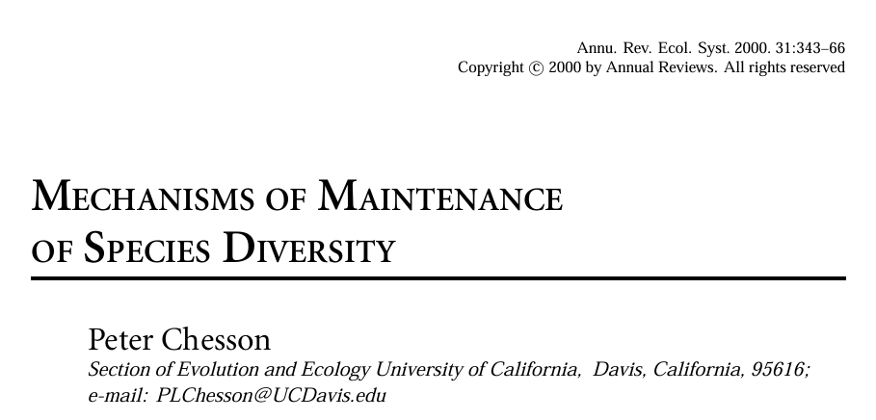
ZNGIs can be confusing
Chesson 2000 provides are more intuitive formulation
1
dN_{i}
·
=
r_{i} (1 - α_{ii}N_{i} - α_{ij}N_{j})
N_{i}
dt

Slide 29
ZNGIs can be confusing
Chesson 2000 provides are more intuitive formulation
1
dN_{i}
·
=
r_{i} (1 - α_{ii}N_{i} - α_{ij}N_{j})
N_{i}
dt
α’s here are absolute impact.
α_{ii} = intraspecific competition
α_{ij} = interspecific competition

Slide 30
Coexistence criteria
Both species need to be able to invade when rare, when other species is present
1
dN₁
·
=
r₁ (1 - α₁₁N₁ - α₁₂N₂)
N₁
dt
α’s here are absolute impact.
α_{ii} = intraspecific competition
α_{ij} = interspecific competition
Notes:
Per capita growth rate needs to be positive. N1 ~ 0, since its invading.

Slide 31
Coexistence criteria
Both species need to be able to invade when rare, when other species is present
0
<
r₁ (1 - α₁₁0 - α₁₂N₂)
α’s here are absolute impact.
α_{ii} = intraspecific competition
α_{ij} = interspecific competition

Slide 32
Coexistence criteria
Both species need to be able to invade when rare, when other species is present
0
<
1 - α₁₂N₂
α’s here are absolute impact.
α_{ii} = intraspecific competition
α_{ij} = interspecific competition

Slide 33
Coexistence criteria
Both species need to be able to invade when rare, when other species is present
0
<
1 - α₁₂N₂
dN₂
1
·
=
r₂ (1 - α₂₂N₂ - α₂₁N₁)
N₂
dt
α’s here are absolute impact.
α_{ii} = intraspecific competition
α_{ij} = interspecific competition

Slide 34
Coexistence criteria
Both species need to be able to invade when rare, when other species is present
0
<
1 - α₁₂N₂
0
=
r₂ (1 - α₂₂N₂ - α₂₁0)
α’s here are absolute impact.
α_{ii} = intraspecific competition
α_{ij} = interspecific competition
Notes:
At equilibrium, dN2/dt =0. Since we’re talking invasion, N1 = 0

Slide 35
Coexistence criteria
Both species need to be able to invade when rare, when other species is present
0
<
1 - α₁₂N₂
0
=
1 - α₂₂N₂
α’s here are absolute impact.
α_{ii} = intraspecific competition
α_{ij} = interspecific competition

Slide 36
Coexistence criteria
Both species need to be able to invade when rare, when other species is present
0
<
1 - α₁₂N₂
α₂₂N₂
=
1
α’s here are absolute impact.
α_{ii} = intraspecific competition
α_{ij} = interspecific competition

Slide 37
Coexistence criteria
Both species need to be able to invade when rare, when other species is present
0
<
1 - α₁₂N₂
N₂
=
1
α₂₂
α’s here are absolute impact.
α_{ii} = intraspecific competition
α_{ij} = interspecific competition

Slide 38
Coexistence criteria
Both species need to be able to invade when rare, when other species is present
α₁₂N₂
<
1
N₂
=
1
α₂₂
α’s here are absolute impact.
α_{ii} = intraspecific competition
α_{ij} = interspecific competition

Slide 39
Coexistence criteria
Both species need to be able to invade when rare, when other species is present
α₁₂N₂
<
1
N₂
=
1
α₂₂
α’s here are absolute impact.
α_{ii} = intraspecific competition
α_{ij} = interspecific competition

Slide 40
Coexistence criteria
Both species need to be able to invade when rare, when other species is present
1
α₁₂
<
1
α₂₂
α’s here are absolute impact.
α_{ii} = intraspecific competition
α_{ij} = interspecific competition

Slide 41
Coexistence criteria
Both species need to be able to invade when rare, when other species is present
α₁₂
<
α₂₂
α’s here are absolute impact.
α_{ii} = intraspecific competition
α_{ij} = interspecific competition

Slide 42
Coexistence criteria
In order to coexist:
α_{ii} > α_{ji}
α_{jj} > α_{ij}
α_{ii} = intraspecific competition
α_{ij} = interspecific competition

Slide 43
Coexistence criteria
In order to coexist:
α_{ii} > α_{ji}
α_{jj} > α_{ij}
In other words: to coexist, species need to limit themselves more than they limit their competitors
α_{ii} = intraspecific competition
α_{ij} = interspecific competition

Slide 44
Coexistence criteria
In order to coexist:
α_{ii} > α_{ji}
α_{jj} > α_{ij}
In other words: to coexist, species need to limit themselves more than they limit their competitors
IMPORTANT:
WILL BE ON A TEST
α_{ii} = intraspecific competition
α_{ij} = interspecific competition

Slide 45
Resource competition
So far we’ve been talking about competition in terms of reduction in growth rate
But competition usually isn’t actually species interacting with each other
It usually involves shared resources
Resource models are more mechanistic

Slide 46
Resource competition
Species A
Species B

Slide 47
Resource competition
Species A
Species B

Slide 48
Resource competition
Species A
Species B
Resource C

Slide 49
Resource competition
Species A
Species B
Resource C

Slide 50
Resource competition
Species A
Species B
Intraspecific competition
Resource C

Slide 51
Resource competition
Species A
Species B
Interspecific competition
Resource C

Slide 52
Resource competition models
What is a resource?

Slide 53
Resource competition models
What is a resource?
Increases population growth
Is consumed by use

Slide 54
Resource competition models
What is a resource?
Increases population growth
Is consumed by use
Resources:
Food
Nutrients
Water (but trivial in aquatic)
Light (for producers)
Oxygen (but trivial in terrestrial)

Slide 55
Resource competition models
What is a resource?
Increases population growth
Is consumed by use
Resources:
Food
Nutrients
Water (but trivial in aquatic)
Light (for producers)
Oxygen (but trivial in terrestrial)
NOT Resources:
Temperature
Elevation
Pressure

Slide 56
R* Theory
1
dN_{i}
·
=
a_{i}R - d_{i}
N₁
dt
R = resource availability
a_{i} = resource consumption rate of species i
d_{i} = death rate of species i

Slide 57
R* Theory
What is the minimum value of R needed?
1
dN_{i}
·
=
a_{i}R - d_{i}
N₁
dt
R = resource availability
a_{i} = resource consumption rate of species i
d_{i} = death rate of species i

Slide 58
R* Theory
What is the minimum value of R needed?
0
=
a_{i}R - d_{i}
R = resource availability
a_{i} = resource consumption rate of species i
d_{i} = death rate of species i

Slide 59
R* Theory
What is the minimum value of R needed?
d_{i}
=
R
a_{i}
R = resource availability
a_{i} = resource consumption rate of species i
d_{i} = death rate of species i

Slide 60
R* Theory
What is the minimum value of R needed?
d_{i}
R*
=
a_{i}
R = resource availability
a_{i} = resource consumption rate of species i
d_{i} = death rate of species i

Slide 61
R* Theory
Minimum resources required
Will determine equilibrium abundance
Population will increase until it draws resources down to this level
Determined by death rate, consumption rate
d_{i}
R*
=
a_{i}
R = resource availability
a_{i} = resource consumption rate of species i
d_{i} = death rate of species i

Slide 62
R* determines who wins in competition
d_{i}
The species with the lowest R* wins
Will draw resource down to a level that excludes all other species
R*
=
a_{i}
R = resource availability
a_{i} = resource consumption rate of species i
d_{i} = death rate of species i

Slide 63
R* determines who wins in competition
d_{i}
The species with the lowest R* wins
Will draw resource down to a level that excludes all other species
Note this is only true for species limited by a single resource under constant conditions
But is still useful generally
R*
=
a_{i}
R = resource availability
a_{i} = resource consumption rate of species i
d_{i} = death rate of species i

Slide 64
Competition for multiple resources
Gets a lot trickier
Resources can be essential vs substitutable

Slide 65
Competition for multiple resources
In order to stably coexist
Species need to differ in resource usage
Species need to have a larger impact on the resources that are most limiting for them

Slide 66
Competition for multiple resources
In order to stably coexist
Species need to differ in resource usage
Species need to have a larger impact on the resources that are most limiting for them
These conditions lead to species limiting themselves more than they limit their competitors (α_{ii} > α_{ji})

Slide 67
Competition for multiple resources
In order to stably coexist
Species need to differ in resource usage
Species need to have a larger impact on the resources that are most limiting for them
These conditions lead to species limiting themselves more than they limit their competitors (α_{ii} > α_{ji})
When coexistence is purely driven by resource differences, the number of species that can be supported is equal to the number of different resources

Slide 68
Apparent Competition
Species A
Species B

Slide 69
Apparent Competition
PredatorD
Species A
Species B

Slide 70
Apparent Competition
PredatorD
Intraspecific
Species A
Species B

Slide 71
Apparent Competition
PredatorD
Interspecific
Species A
Species B

Slide 72
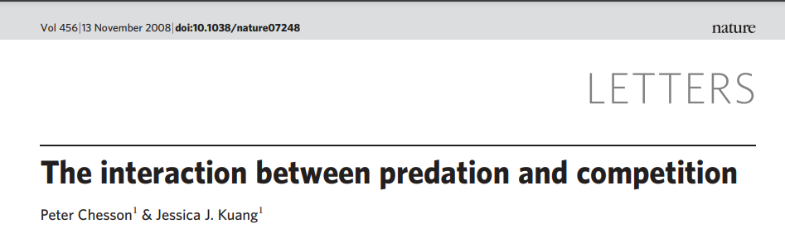
Competition
PredatorD
Species A
Species B
Resource C

Slide 73
Competition
PredatorD
Competition and Predation are symmetrical!
Promote coexistence in the same ways!
2 species can coexist with 2 predators, 2 resources, 1 predator and 1 resource
Species A
Species B
Resource C

Slide 74
P* determines who wins in apparent competition
r_{i}
P* is symmetrical with R*
The species with the highest P* wins
Will increase predation to a level that excludes all other species
Note this is only true for species limited by a single resource under constant conditions
But is still useful generally
This version is for Type I functional response
P_{i}*
=
a_{i}
P* = equilibrial predator density
r_{i} = intrinsic growth rate of species i
a_{i} = predator attack rate on species i

Slide 75
Main Takeaways
To coexist, species need to limit their own growth more than their competitors
Species that can exist on the lowest amount of a resource will win
Species that can tolerate the highest level of a given predator will win
Predation is symmetrical with competition
Resources and predator diversity determines # of coexisting competitors

Slide 76
Next class: Coexistence

