Slide 1
Statistical Ecology
Today’s agenda:
Introductions,
Syllabus,
Why we need stats,
Reproducibility and Openness

Slide 2
Introductions
Tell us:
Your name
Your research interests
Something interesting about yourself

Slide 3
Syllabus: basic stuff
Class Meeting Days: T, Th
Class Meeting Time: 2:00 – 3:15 pm
Class Meeting Location: DAV 266
Instructor: Dr. Brian Maitner
Office Location: DAV 226 (but I’m usually in URL 106, because it’s warmer)
Office Hours: TBD - ?
Email: bmaitner@usf.edu

Slide 4
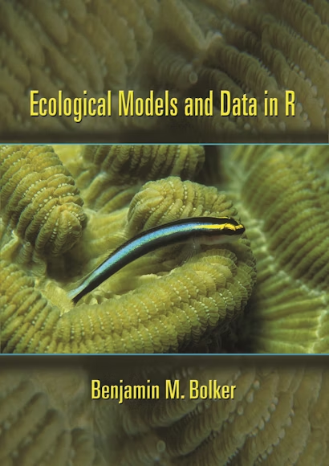
Syllabus: Course structure
Flipped course: read before class, work during class
Assignments will focus on data of your choosing
Graded Items Percent of Final Grade
In-class participation 20%
In-class quizzes 20%
Assignments (4x) 20%
Midterm (take-home) 20%
Final (presentation + take-home) 20%
Digital copies available through the library for free

Slide 5
Course Expectations
Participate! Ask questions. Share ideas, experiences, and knowledge!
Be respectful.

Slide 6
Recommendations
Read the syllabus
Read the book
Take notes on paper
Plan ahead
Bring a laptop

Slide 7
Questions so far?

Slide 8
What will you get out of this class?
In general:
Ability to do common analyses and visualizations
Ability to go further on your own

Slide 9
What will you get out of this class?
More specifically:
Student Learning Outcomes
Load data into R and conduct common data-wrangling tasks
Create data visualizations using base R and ggplot2
List the common types of statistical distribution and provide examples of when they might apply.
Choose appropriate analyses for given ecological questions and datasets.
Demonstrate an ability to troubleshoot and de-bug R code.
Explain how they would approach a novel coding problem
Apply the skills learned to their own work

Slide 10
Learning Stats
People learn differently and stats can be non-intuitive
The book will expose you to verbal and mathematical descriptions of things
In class we’ll use coding and visualizations to try to understand things
The hope is that at least one of these methods will appeal to everyone

Slide 11
Learning Stats
Don’t focus on memorization
DO focus on practice and understanding

Slide 12
A note on AI
We’ll cover AI later in the semester
Strongly recommend that you start out without it
You need reasonable fundamentals to be able to effectively use AI

Slide 13
Questions so far?

Slide 14
Why do we need statistics?

Slide 15
Why do we need statistics?
Human minds are imperfect (biases, fallacies, etc.)
Quantifying effect sizes
Hypothesis testing
Making predictions
Visualizations to make relationships more clear
Lots of other stuff

Slide 16
What is R and why is it useful?
R is a scripted coding language (type commands, rather than click buttons)
Scripted means that:
You can easily re-run or revise analyses
Code and be re-used for similar projects
Your code is basically a methods section

Slide 17
What is R and why is it useful?
R is free!
Users contribute packages (also for free)
This leads to lots of flexibility in what it can do
Popular, so lots of places to look for help

Slide 18
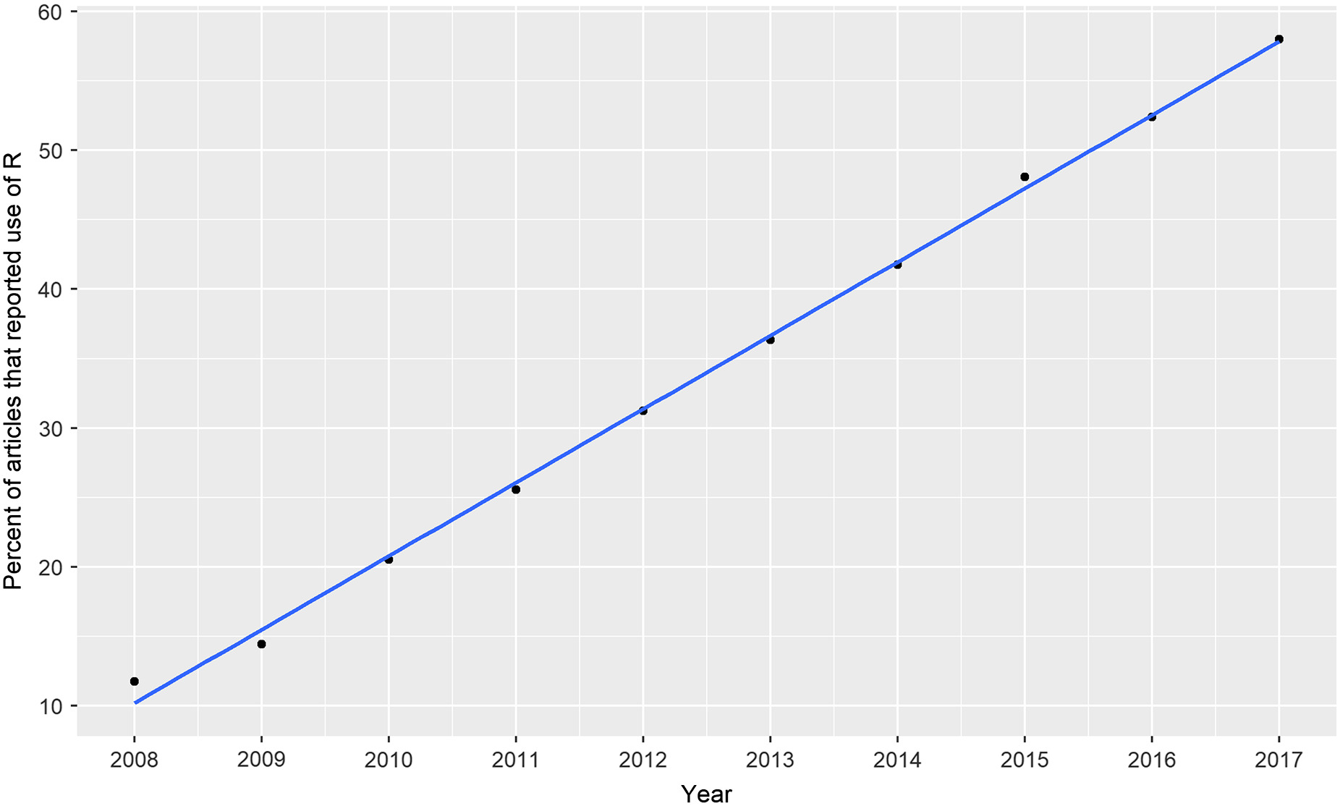
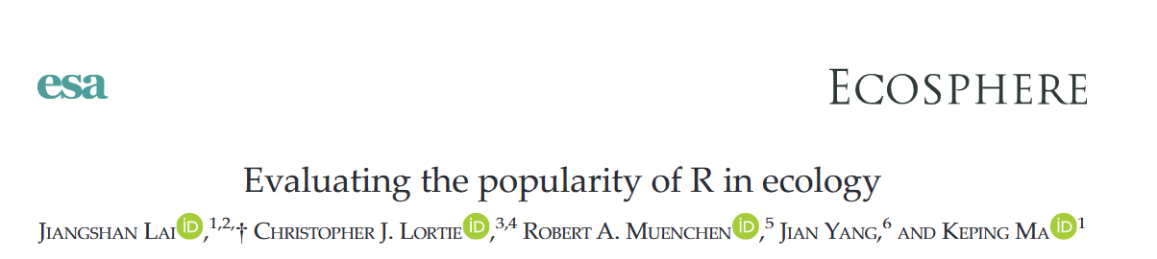
What is R and why is it useful?

Slide 19
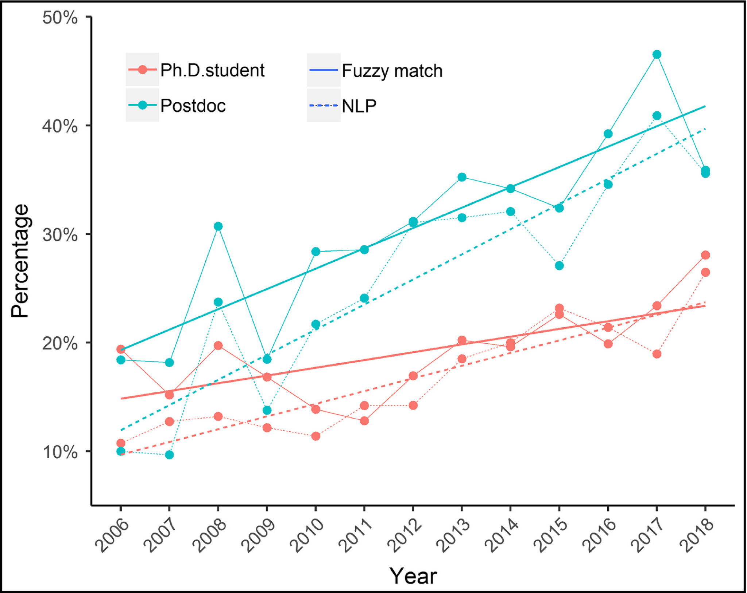
What is R and why is it useful?
Front Ecol Environ 2020; 18(3): 123–124

Slide 20
Transparency and Reproducibility
Science needs to be transparent and reproducible:
Transparency - What was done is clear
Reproducibility - can be re-done with the same results
R helps with both of these!

Slide 21
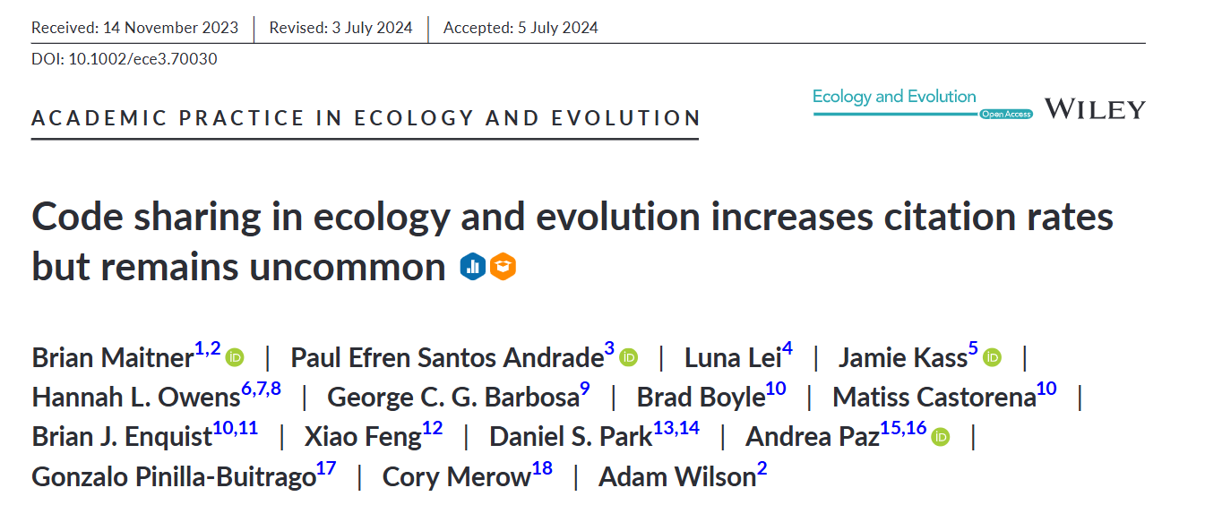
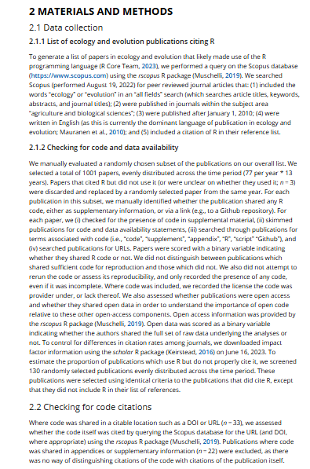
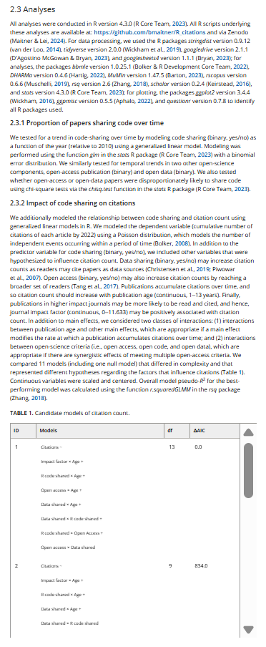
Transparency and Reproducibility

Slide 22
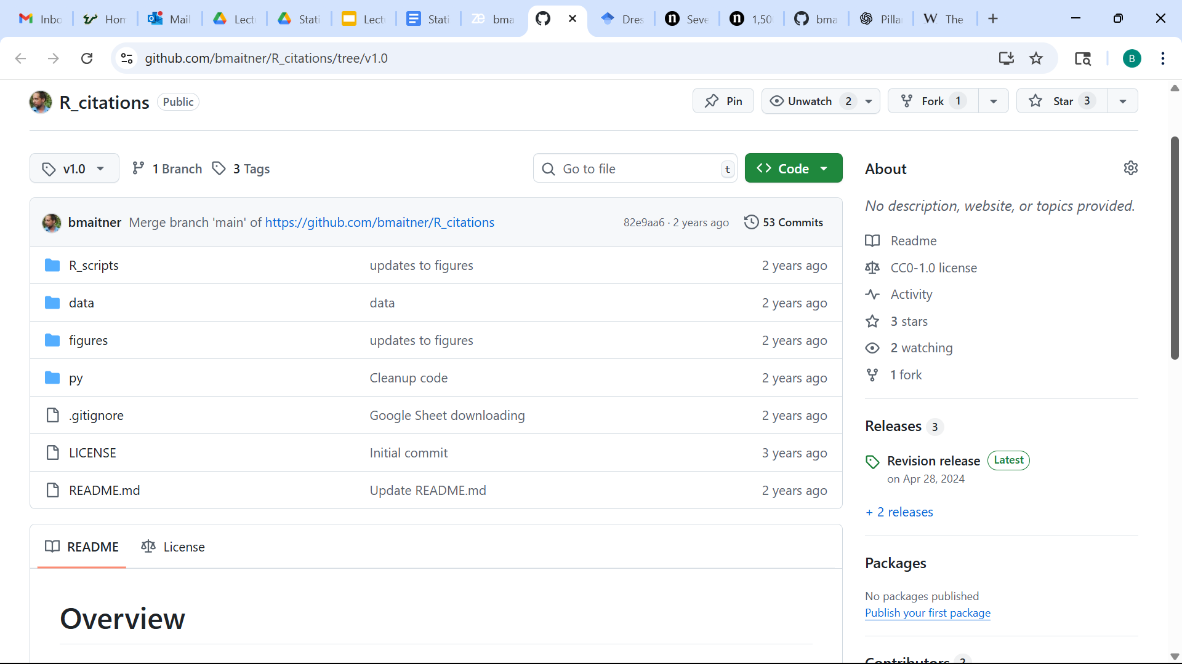
Transparency and Reproducibility

Slide 23
Transparency and Reproducibility
Note: many journals and funders are now requiring code to be published

Slide 24
Questions on any of this?

Slide 25
Next time:
Before class: read 1.1 - 1.3
During class:
Discuss 1.1-1.3
Installing and setting up R, RStudio, and Github

