Slide 1
Getting help
Today’s agenda:
Final Project
Debugging
AI and coding

Slide 2
Final Project
Due December 11th by midnight (note: this is a Thursday)
Includes 3 parts:
Code (submitted as R or .Rmd)
Written portion (Word document)
Presentation (Google slides)
Designed to build on your previous work

Slide 3
Final Project: Code
Upload to canvas or give a Github link
Should be fully reproducible and well-documented
Should build on what you’ve been doing in class
Should essentially be a full analysis now
Loading data
Any needed transformations
Code needed to justify any modelling decisions
Model selection steps (if needed)
Statistical analyses
Figures with ggplot2

Slide 4
Final Project: Writing
An updated draft of your midterm writing
Same three sections as before
Introduction
Methods
Results
Results need to include the results of a statistical model
Figures should also be improved (e.g., using ggplot2)
Feedback from previous draft should be incorporated

Slide 5
Final Project: Presentation
Approximately 5-minute presentation
Done during our scheduled final exam period
Suggested format:
Title slide
Background information: 1-2 slides
What is your question? Why does it matter?
Methods: 1-2 slides
How did you investigate your question?
Results: 1-2 slides
Figure(s)
Statistical results
What does it mean ecologically? In terms of your question?

Slide 6
Final Project: Presentation
Aim to minimize text (7x7 rule)
Practice your timing
Lose points for talking too long

Slide 7
Final Project: Questions?

Slide 8
Debugging
Something you’ve already all had to do
A critical part of working with code
Lots of different techniques you’ll pick up over time, e.g.:
Google
Stack Overflow
Line-by-line running
message() feedback
AI (but also a major source of bugs)

Slide 9
General Workflow
Re-read code for obvious errors
Run code line by line to find where things break
Google the error message
Google a description of the issue
Post on StackOverflow
Add an Issue to the package’s Github page
Dig in to underlying code to fix the error yourself

Slide 10
Basic errors
Things to look for:
Comma, quotation mark, and parentheses placement
Variable names
NAs
Variable class (e.g., factor vs numeric)

Slide 11
Debugging practice
library(tidyverse)
library(reprex)
traits <- read_rds("https://tinyurl.com/amniotes")

Slide 12
Debugging practice
traits |>
group_by(class) |>
summarise(mean_mass = mean(adult_body_mass_g))

Slide 13
Debugging practice
data.frame(scientific_name = paste(traits[4,],traits[5,]))

Slide 14
Debugging practice
traits |>
group_by(class) |>
summarise(SD_svl = sd(adult_svl))

Slide 15
Debugging practice
traits >
mutate(svl_mass_ratio = adult_svl_cm/adult_body_mass_g)

Slide 16
More complex issues
Debugging is harder when working with for(), while(), apply(), etc.
In these cases you can:
Use message() if you need to figure out where things break
Run line-by-line to look for errors within loops/applies
Run only the instances that failed line-by-line
Have R write output to figure out where things work/break

Slide 17
Harder debugging
# Calculate offspring per year, skipping those with NA data
annual_fecundity <- NULL
for(i in 1:length(unique(traits$species))){
species_i <- paste(traits$genus[i]," ",traits$species[i],sep = "")
offspring_per_clutch <- traits$litter_or_clutch_size_n[i]
clutches_per_year <- traits$litters_or_clutches_per_y[i]
# Don't include values with NAs
if(is.na(offspring_per_clutch) &
is.na(clutches_per_year)){
next
}
offspring_per_clutch*clutches_per_year
out <- data.frame(species = species_i,
annual_offspring = offspring_per_clutch*clutches_per_year)
annual_fecundity <- bind_rows(annual_fecundity,out)
}# end i loop

Slide 18
Harder debugging
# Break data into family-sized batches and save them as RDS files
# make a temp folder
family_folder <- tempdir()
# Get data for each family and save as an RDS file
for(i in 1:length(unique(traits[,4]))){
group_i <- unique(traits[,4])[i]
data_i <- traits[which(traits[,4] == group_i),]
data_i |>
saveRDS(file.path(genus_folder,
paste(unique(data_i[,3]), ".rds",sep = "")))
}
# Look at output files
family_files <- list.files(family_folder,pattern = ".rds",full.names = TRUE)
# Load an example
test <- readRDS(family_files[i])

Slide 19
Google
If you can’t figure it out yourself, try Google
A big part of coding is Googling
Include “R” and package names where possible
Pasting in the error you receive can help

Slide 20
reprex
If you’ve tried everything and can’t figure it out:
Ask on stackoverflow using a reproducible example (reprex)
Open and Issue on Github (also using reprex)

Slide 21
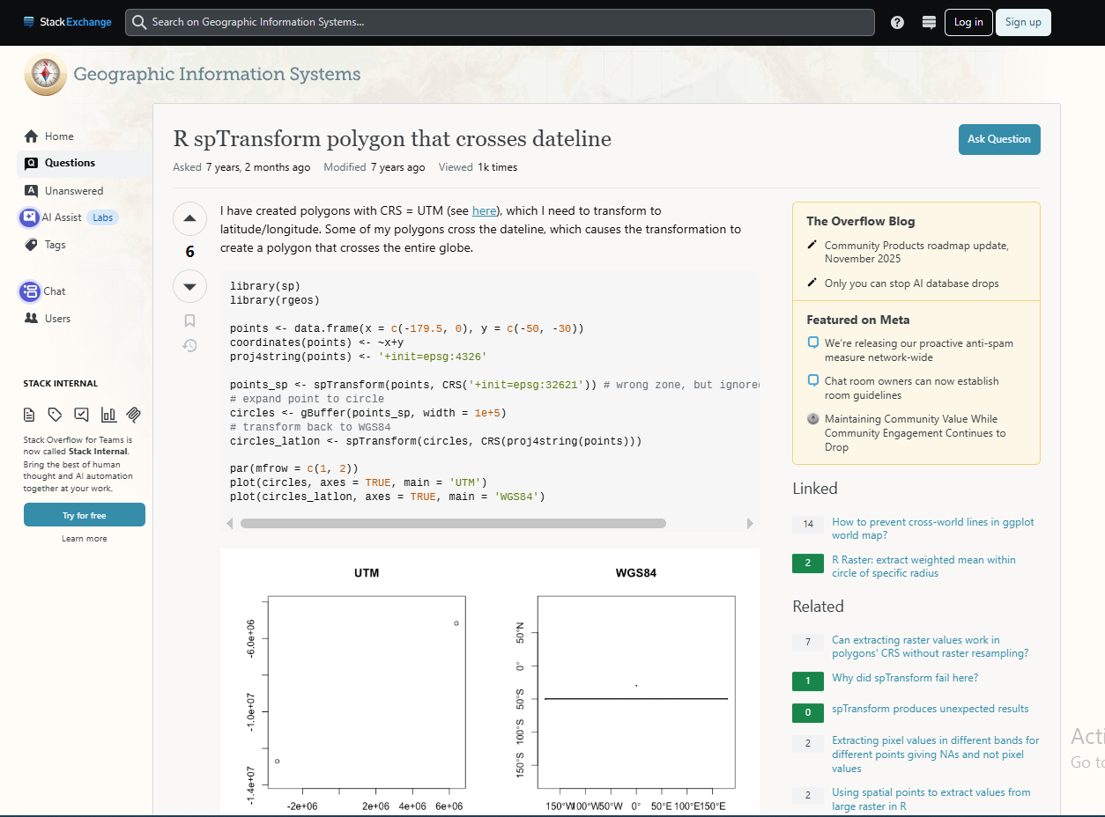
Stack
Stack Overflow
Stack Exchange
Great resources

Slide 22
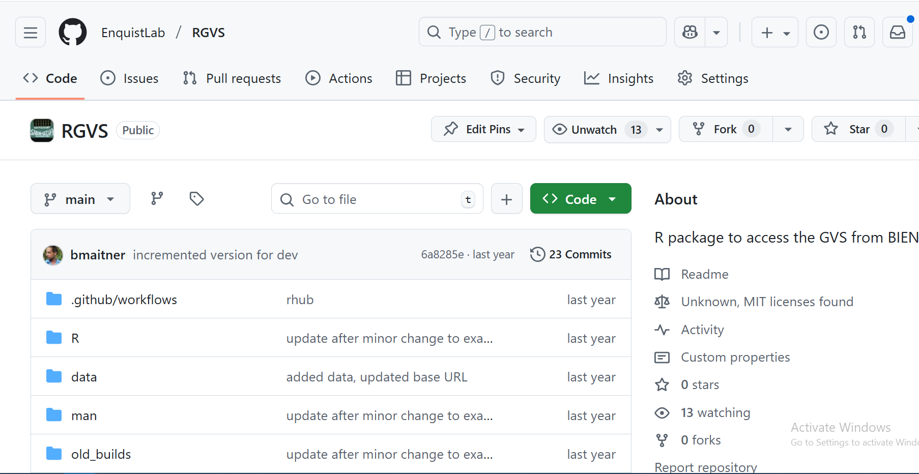
Github issues
Place to note bugs
Use reprex

Slide 23
reprex
R package reprex
Helps you make an easily reproducible example
If your example is not reproducible, people will be jerks to you online
(If your example is reproducible, people may still be jerks)

Slide 24
reprex
reprex({
traits <- read_rds("https://tinyurl.com/amniotes")
traits |>
ggplot(mapping = aes(x=adult_body_mass_g,
y=adult_svl_cm))+
geom_point()+
scale_y_log10()+
scale_x_log10()+
geom_smooth(method = "lm")
})
Run this and examine the output.

Slide 25
reprex
Make a version without the error message
traits <- read_rds("https://tinyurl.com/amniotes")
#> Error in read_rds("https://tinyurl.com/amniotes"): could not find function "read_rds"
traits |>
ggplot(mapping = aes(x=adult_body_mass_g,
y=adult_svl_cm))+
geom_point()+
scale_y_log10()+
scale_x_log10()+
geom_smooth(method = "lm")
#> Error in ggplot(traits, mapping = aes(x = adult_body_mass_g, y = adult_svl_cm)): could not find function "ggplot"
Created on 2025-11-24 with reprex v2.1.1

Slide 26
Asking for help
When asking for help online or reporting an issue:
Be very nice
Make sure you supply a well made reprex
Remember that you’re asking for a favor
Assume the issue is user error on your end

Slide 27
Help from AI
One newer option is to ask AI for help (e.g., ChatGPT)
ChatGPT can be used for:
Writing bits of code
Finding packages to use
Summarizing what code is doing
Debugging

Slide 28
Issues with using AI
The training information may be outdated
Often hallucinates packages, functions
Will confidently give you wrong answers
You still need to be able to debug
Issues with sustainability of AI data centers
Issues with proper crediting of people writing code
Ultimately you still need to justify your decisions based on the literature
E.g., “ChatGPT said to do it this way” isn’t acceptable

Slide 29
Let’s try ChatGPT
If you have ChatGPT, try giving it some code with an error in it.
Can it identify what the error is?
Can it suggest a solution?
Does the solution actually work?

Slide 30
Take-away: General debugging workflow
Re-read code for obvious errors
Run code line by line to find where things break
Google the error message
Google a description of the issue
Post on StackOverflow
Add an Issue to the package’s Github page
Dig in to underlying code to fix the error yourself

Slide 31
Before next class:
Read “R for Data Science” chapter 6:
https://r4ds.hadley.nz/workflow-scripts.html
May be a quiz

