Slide 1
Probability distributions
Today’s agenda:
Assignment 2
Types of probability distributions
How to choose?
Understanding the parameters

Slide 2
Assignment 2
Due October 3rd before midnight
Focused on identifying different types of distributions
2 parts
1) A list of different distributions to identify
2) Identifying the distributions of variables of interest in your own dataset
As before submit as .R, or .Rmd output
For .R files, the answers to #1 can be included as comments, for .Rmd as text.

Slide 3
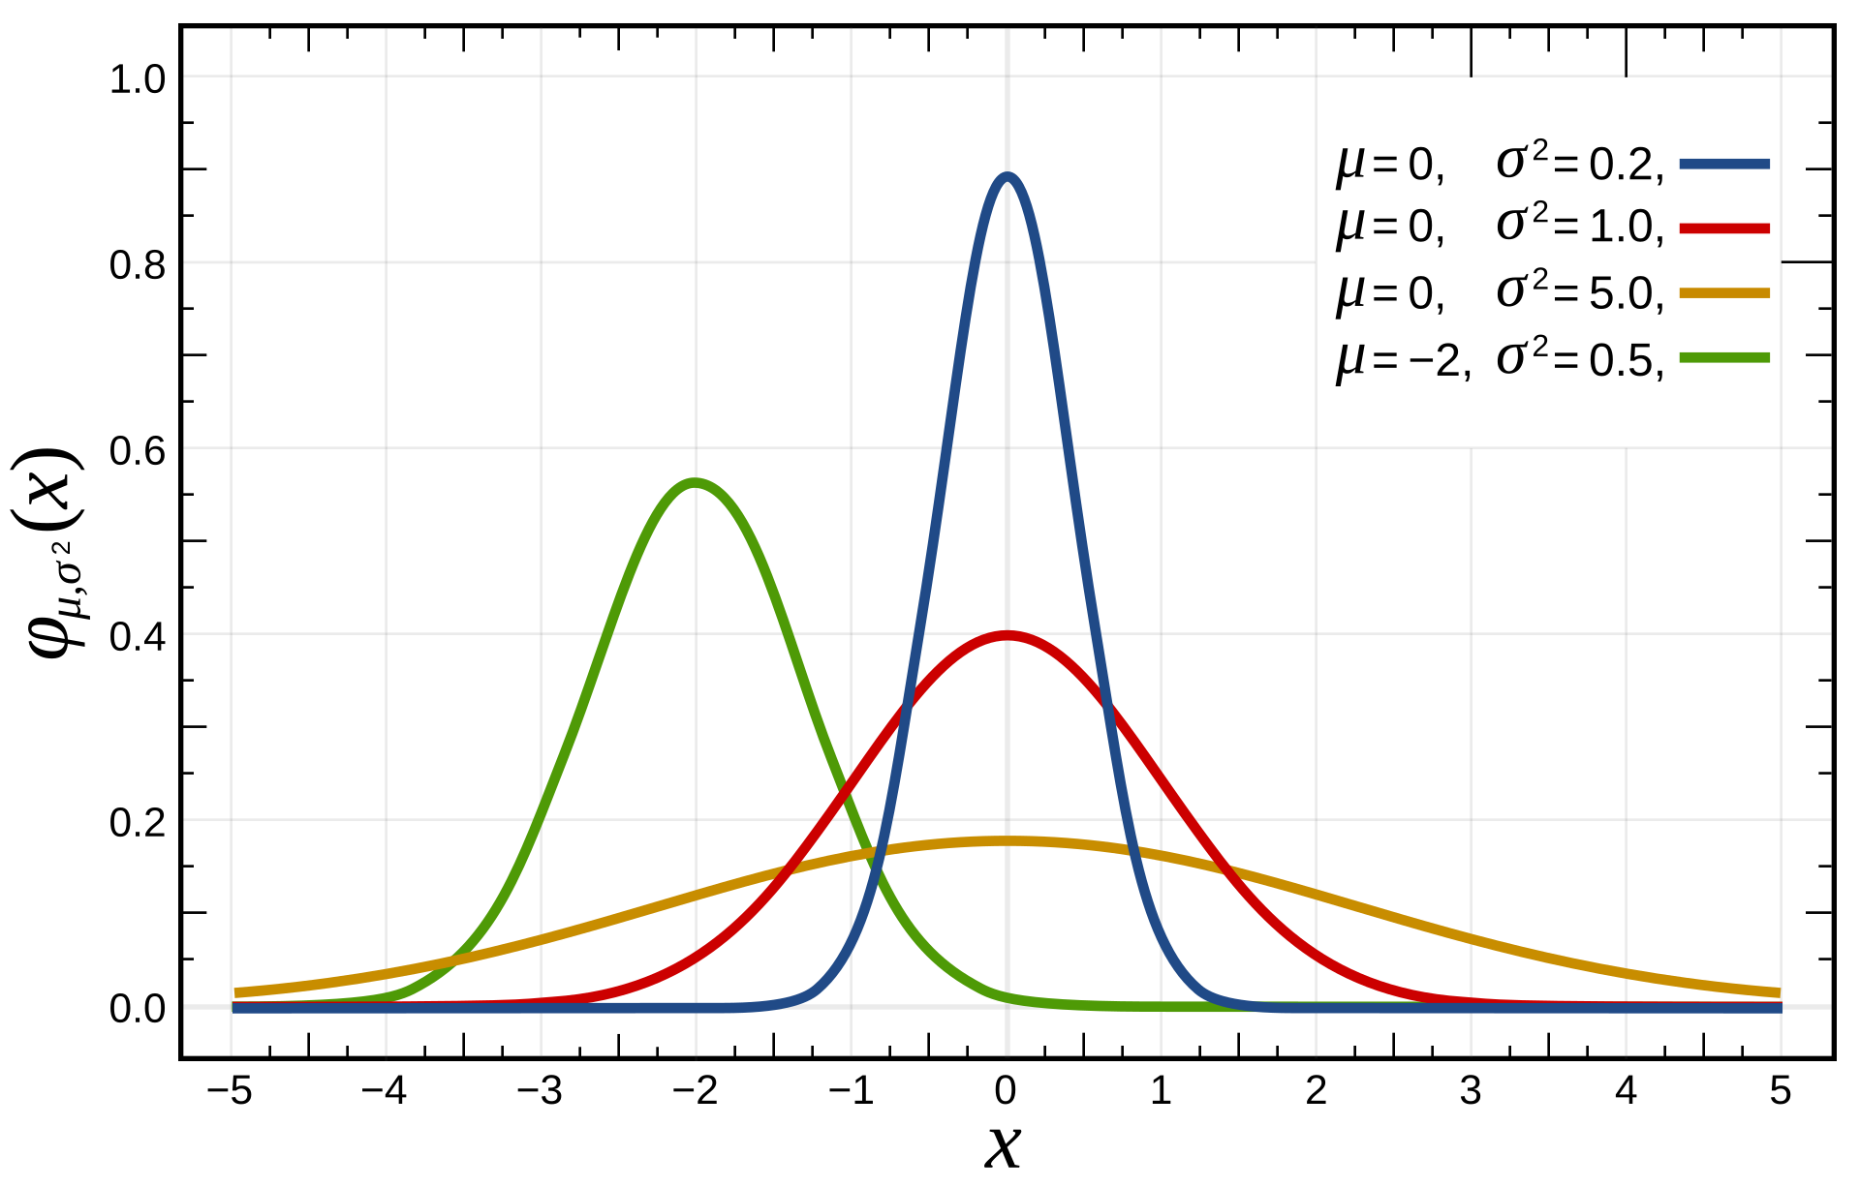
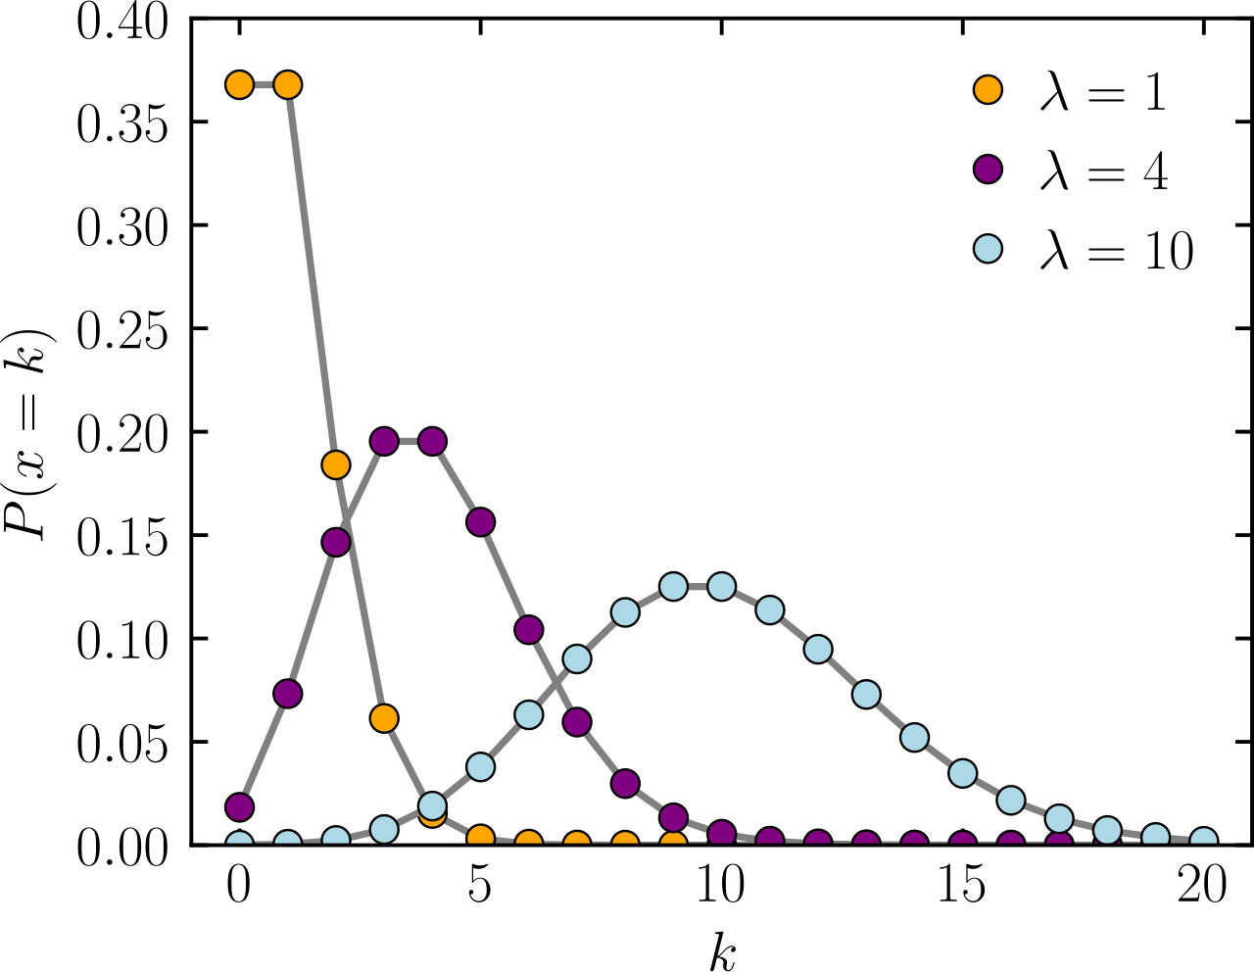
Statistical Distributions
Describe probabilities of different events
Certain types of distributions have mathematical formulas describing them
Normal
Poisson
Images: Wikipedia

Slide 4
Picking a distribution
Your book lists 11 different distribution types in Table 4.1
There are many others
How do you choose?

Slide 5
Picking a distribution
Eliminate possibilities
Discrete vs continuous
Range of values (e.g., 0-1, 0 to infinity, etc.)
Table 4.1 is a good place to start!
Compare the distribution’s shape to your data
Look at what other people have done/said (including your book)
Be able to justify your choice!

Slide 6

Experimental plots of distributions
All distributions are defined by some function, e.g., the normal:
This has two parameters that control what it looks like:
𝜇 = mean
𝜎 = standard deviation

Slide 7
Experimental plots of distributions
Hard for you to understand from the equation?
Use R instead!

Slide 8
Experimental plots of distributions
Distributions all have functions in R (listed in 4.5)
Help documentation tells you the parameters
You can plot distributions with different parameter values
Playing around like this helps understand what parameters do!

Slide 9
Playing with Normal distributions
First, generate a vector of values to calculate the density for
x_vector <- seq(from=-10, to=10, by=0.1)
Then, get the density using dnorm()
norm_density_vector <- dnorm(x = x_vector, mean = 0, sd = 1)
Then plot
plot(norm_density_vector ~ x_vector)

Slide 10
Playing with Normal distributions
You can make it easier to update by combining functions:
x_vector <- seq(from=-10, to=10, by=0.1)
plot(dnorm(x = x_vector, mean = 0, sd = 1) ~ x_vector)
Then try different values for mean and sd:
plot(dnorm(x = x_vector, mean = 1, sd = 1) ~ x_vector)
plot(dnorm(x = x_vector, mean = 3, sd = 1) ~ x_vector)
Try this out for a few values of mean and a few of sd.
What do they do?

Slide 11
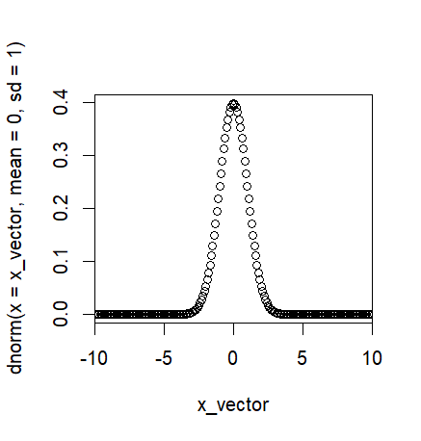
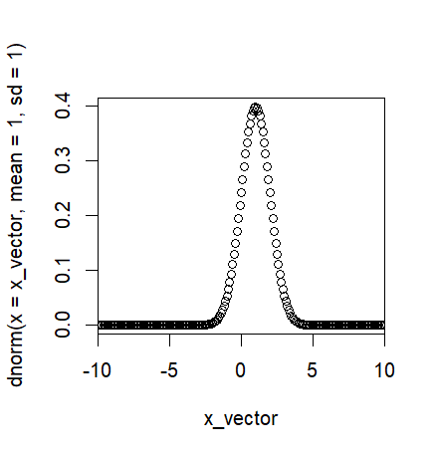
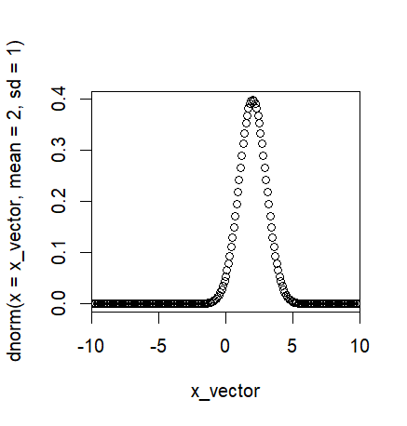
Playing with Normal distributions
From this, we can see how changing the mean shifts things over, but doesn’t change the spread
Trivial example, but this works for more confusing functions

Slide 12
Playing with the binomial distribution
discrete_x_vector <- seq(from=0,to=20,by=1)
binom_density_vector <- dbinom(x = discrete_x_vector,
size = 0, prob = 0.1)
plot(dbinom(x = discrete_x_vector, size = 10, prob = 0.1) ~ discrete_x_vector, ylim = c(0,1) )
Try playing with the size and prob arguments. What do they do?

Slide 13
Goal for today
Play with the different probability distributions in the book
Get a sense of what the different arguments do

Slide 14
Remainder of class:
Play with distributions to understand their arguments
Before next class:
Read 5.1 and 5.1

