Slide 1
Open Science
Today’s agenda:
Final presentation reminder
Code and Data sharing
Coding time in class (optional)

Slide 2
Final Presentations
12:30-2:30 p.m. on Tuesday, December 9th
Remember to have your slides added to the Google Slides file beforehand
Practice your timing to make sure you’re under the 5 minutes

Slide 3
What is Open Science?
Open Science: “transparent and accessible knowledge that is shared and developed through collaborative networks”

Slide 4
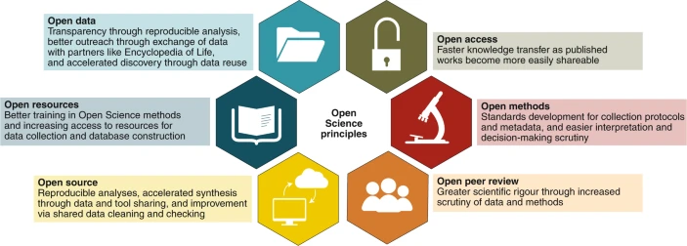
What is Open Science?
Open Science: “transparent and accessible knowledge that is shared and developed through collaborative networks”
Open Data
Open Access
Open Resources
Open Methods
Open Source
Open Peer Review
Gallagher, et al. (2020) NEE

Slide 5
What is Open Science?
Open Science: “transparent and accessible knowledge that is shared and developed through collaborative networks”
Open Data
Open Access
Open Resources
Collaboration
& Inclusion
Open Methods
Open Source
Open Peer Review
Gallagher, et al. (2020) NEE

Slide 6
What is Open Science?
Open Science: “transparent and accessible knowledge that is shared and developed through collaborative networks”
Open Data
Open Access
Open Resources
Collaboration
& Inclusion
Open Methods
Open Source
Open Peer Review
Gallagher, et al. (2020) NEE
Notes:
Focus on these three (more in control, and are free)

Slide 7
What is Open Science?
Open Science: “transparent and accessible knowledge that is shared and developed through collaborative networks”
Open Data
Open Access
Open Resources
Collaboration
& Inclusion
Open Methods
Open Source
Open Peer Review
Gallagher, et al. (2020) NEE
Notes:
Focus on these three (more in control, and are free)

Slide 8
opendatahandbook.org
Notes:
Focus on these three (more in control, and are free)

Slide 9
What are Open Data?
Available and Accessible: the data must be available as a whole and at no more than a reasonable reproduction cost, preferably by downloading over the internet. The data must also be available in a convenient and modifiable form.
Reusable and Redistriable: the data must be provided under terms that permit re-use and redistribution including the intermixing with other datasets.
Universal Participation: everyone must be able to use, re-use and redistribute - there should be no discrimination against fields of endeavour or against persons or groups.
opendatahandbook.org
Notes:
Focus on these three (more in control, and are free)

Slide 10
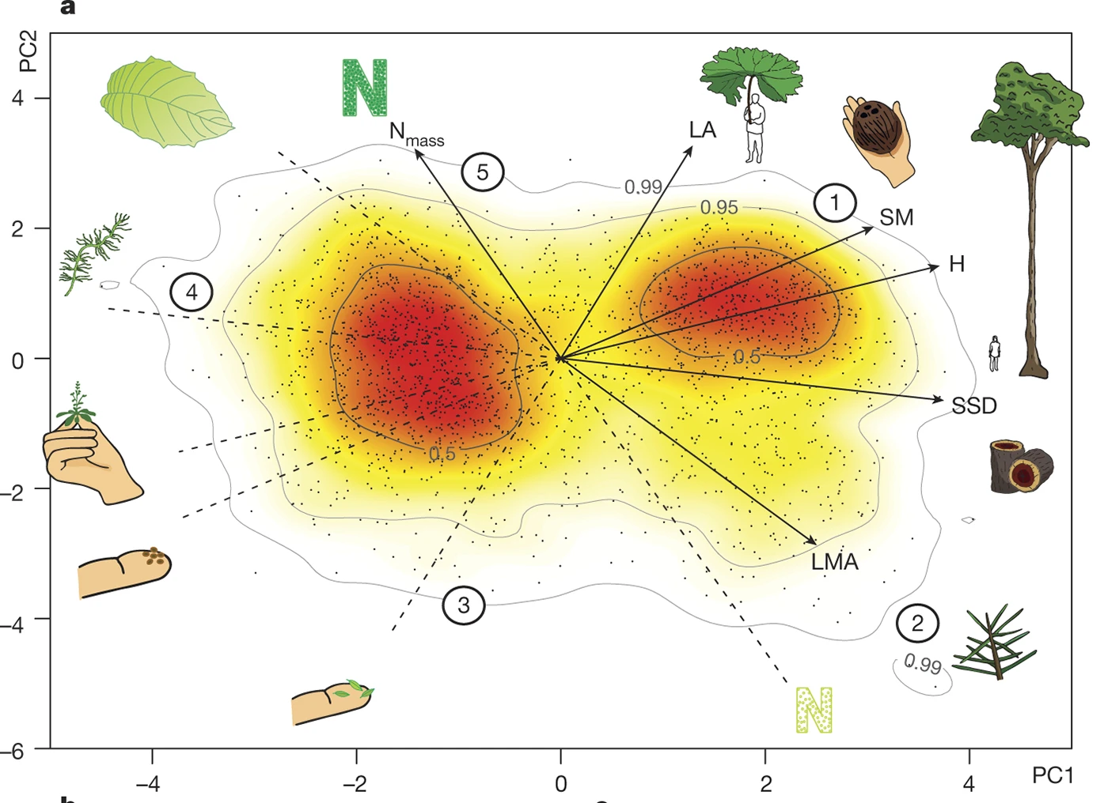
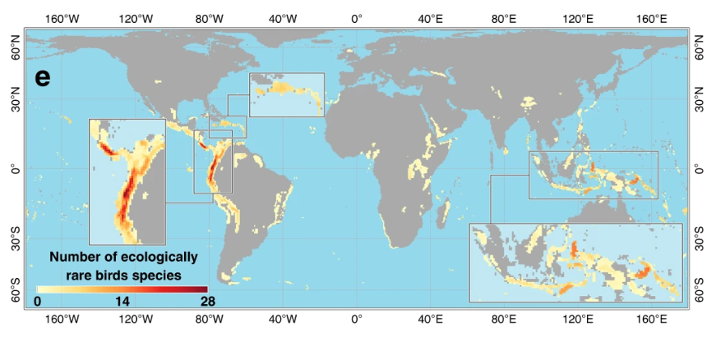
Global Questions Need Global Participation
Global spectrum of plant form and function
Loiseau, et al. (2020) Nature Comm; Diaz, et al. (2016) Nature.
Notes:
Can’t ask global questions without help!

Slide 11
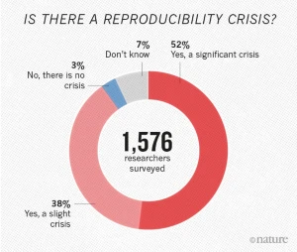
Open Data Enhance Reproducibility
Baker. (2016) Nature.
Notes:
Can’t ask global questions without help!

Slide 12
Ethical Responsibilities
Publicly funded data are public property
Transparency is a key part of science
Open Data increase inclusion
Open Data save money!
Piwowar, et al. (2011) Nature
Notes:
Can’t ask global questions without help!

Slide 13
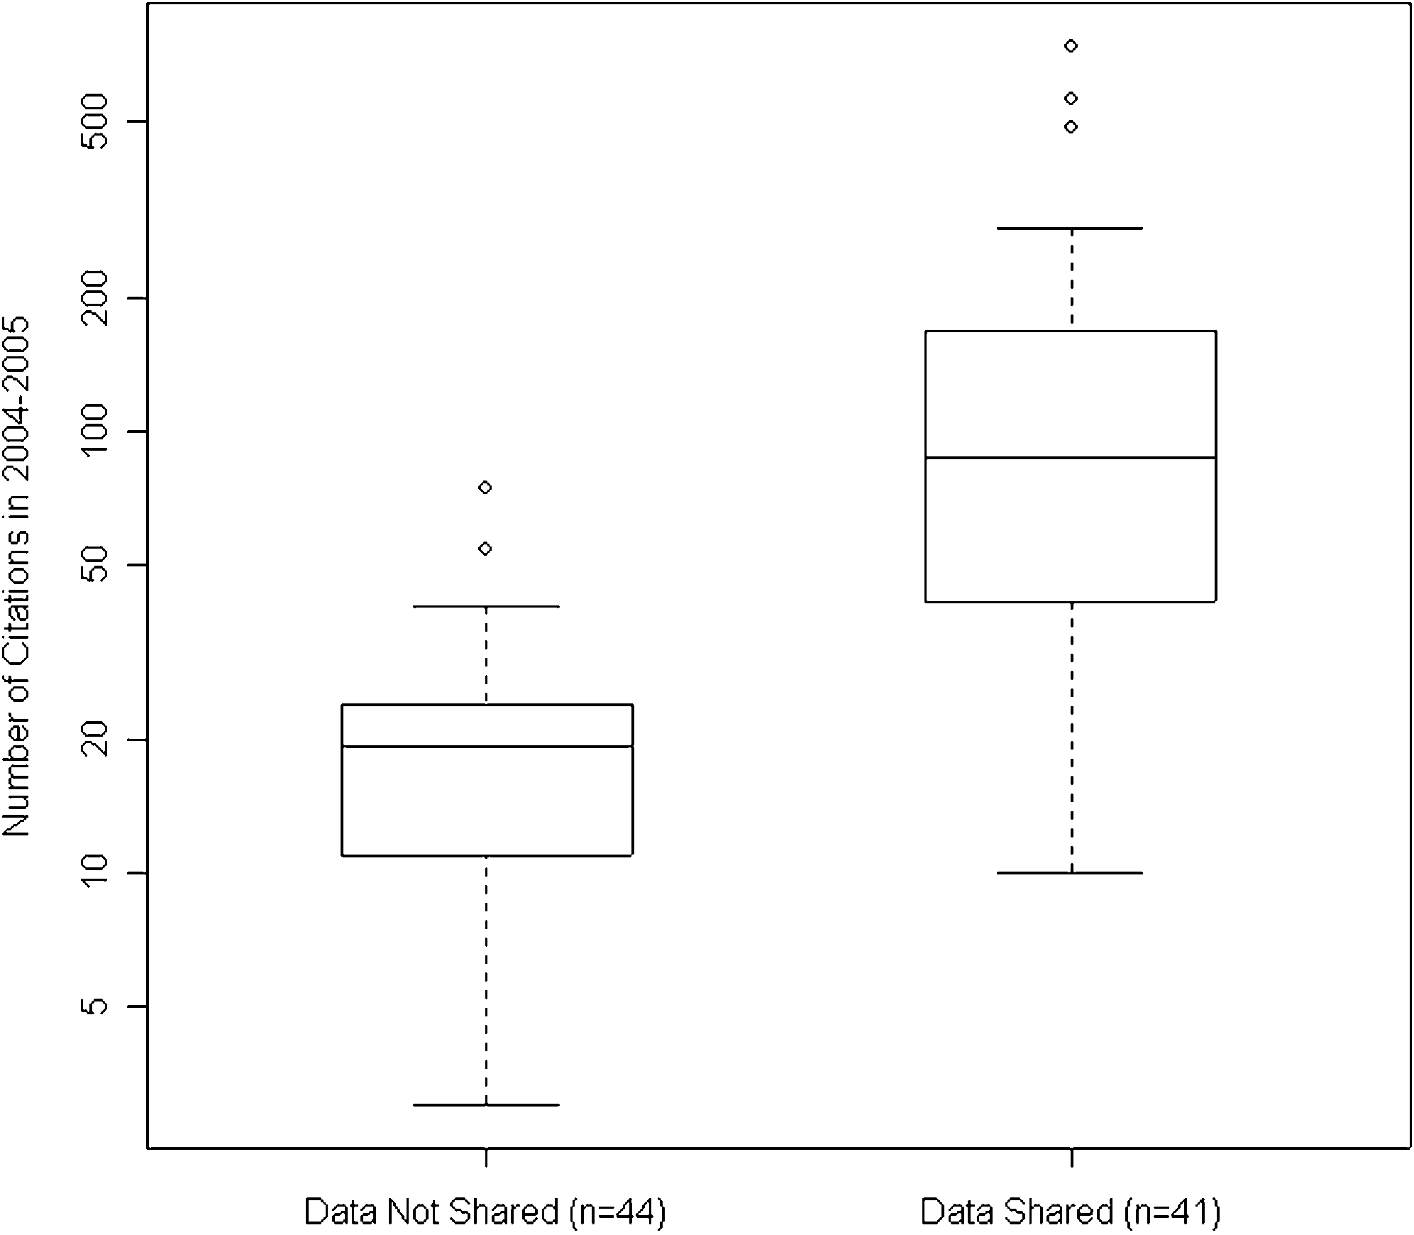
Open Data Improve Citations
Piwowar, et al. (2007) PLOSONE
Notes:
Can’t ask global questions without help!

Slide 14
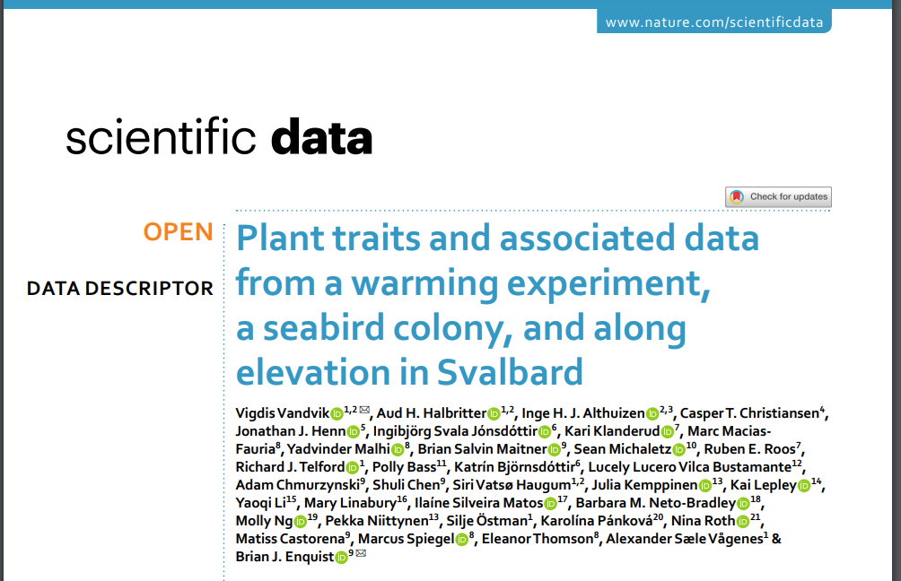
Open Data Improve Citations and Publications
Piwowar, et al. (2007) PLOSONE
Notes:
Can’t ask global questions without help!

Slide 15
How to share data
Range of options
Keller, et al. (2022) MEE

Slide 16
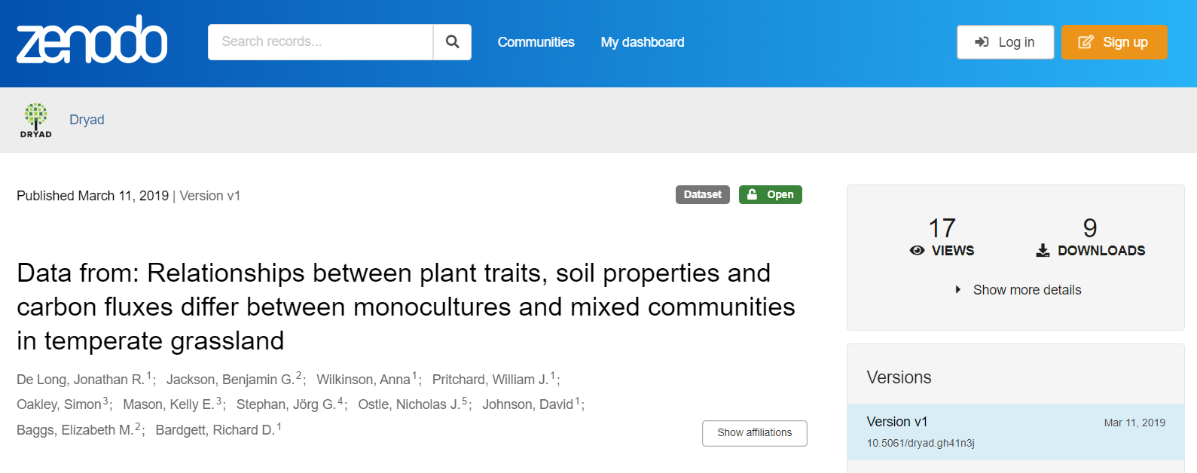
How to share data
Range of options
Keller, et al. (2022) MEE

Slide 17
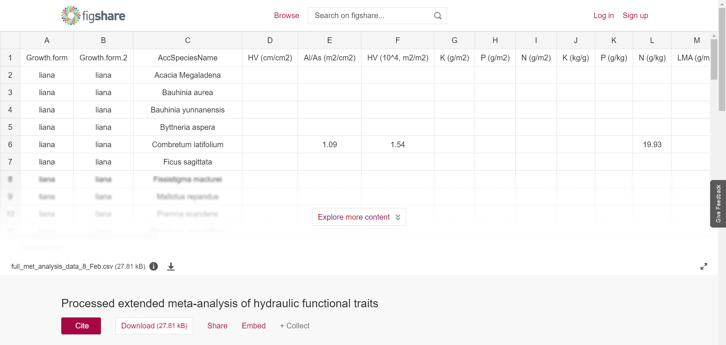
How to share data
Range of options
Keller, et al. (2022) MEE
Notes:
Can’t ask global questions without help!

Slide 18
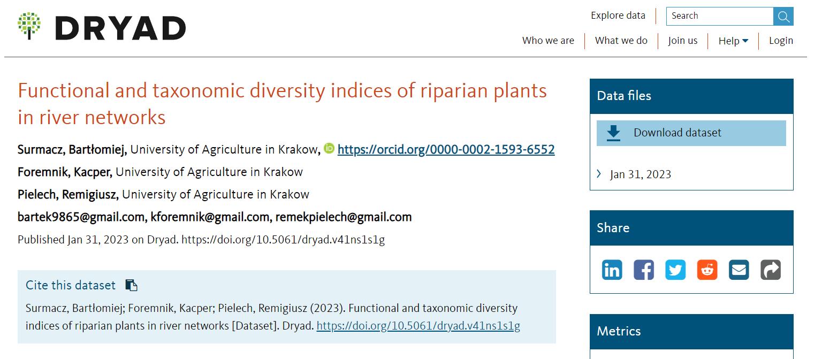
How to share data
Range of options
Keller, et al. (2022) MEE

Slide 19
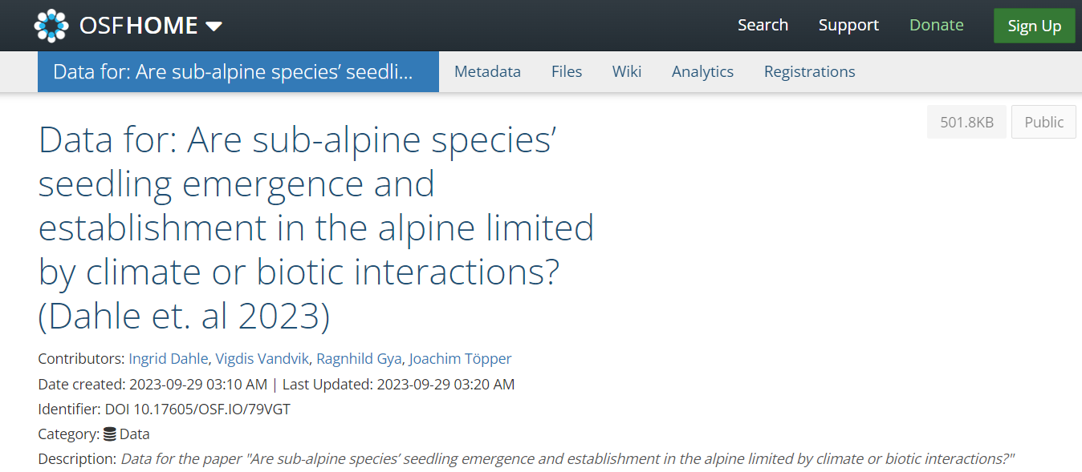
How to share data
Range of options
Keller, et al. (2022) MEE

Slide 20
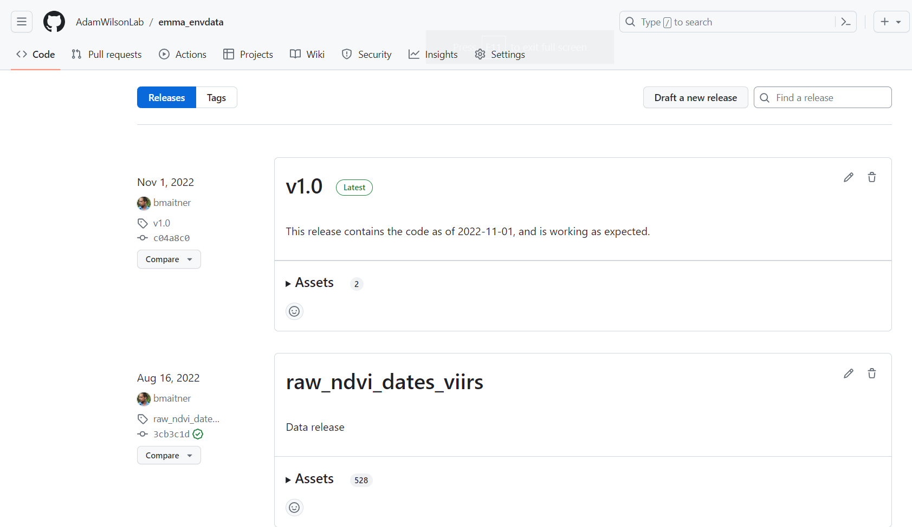
How to share data
Range of options
Keller, et al. (2022) MEE
Notes:
Different repositories have different pros/cons: filesize, number of files, etc. but for most datasets you can find one that works.

Slide 21
How to share data
Range of options
Best Option: Lots Of Copies Kept Securely (LOCKS)
Reduces risk of loss
Increases likelihood people find it (and cite it)
Keller, et al. (2022) MEE
Notes:
Different repositories have different pros/cons: filesize, number of files, etc. but for most datasets you can find one that works.

Slide 22
What is Open Science?
Open Science: “transparent and accessible knowledge that is shared and developed through collaborative networks”
Open Data
Open Access
Open Resources
Collaboration
& Inclusion
Open Methods
Open Source
Open Peer Review
Gallagher, et al. (2020) NEE
Notes:
Hopefully I’ve convinced you theres value in data sharing

Slide 23
What is Open Science?
Open Science: “transparent and accessible knowledge that is shared and developed through collaborative networks”
Open Data
Open Access
Open Resources
Collaboration
& Inclusion
Open Methods
Open Source
Open Peer Review
Gallagher, et al. (2020) NEE
Notes:
Those data aren’t useful unless we do something with them. That’s where open source comes in

Slide 24
https://opensource.org/osd/

Slide 25
What is Open Source?
Free Redistribution The license shall not restrict any party from selling or giving away the software as a component of an aggregate software distribution containing programs from several different sources. The license shall not require a royalty or other fee for such sale.
No Discrimination Against Persons or Groups The license must not discriminate against any person or group of persons.
No Discrimination Against Fields of Endeavor The license must not restrict anyone from making use of the program in a specific field of endeavor. For example, it may not restrict the program from being used in a business, or from being used for genetic research.
https://opensource.org/osd/

Slide 26
What is Open Source?
Free Redistribution The license shall not restrict any party from selling or giving away the software as a component of an aggregate software distribution containing programs from several different sources. The license shall not require a royalty or other fee for such sale.
No Discrimination Against Persons or Groups The license must not discriminate against any person or group of persons.
No Discrimination Against Fields of Endeavor The license must not restrict anyone from making use of the program in a specific field of endeavor. For example, it may not restrict the program from being used in a business, or from being used for genetic research.
Code that is free to use, both in terms of costs and restrictions
https://opensource.org/osd/

Slide 27
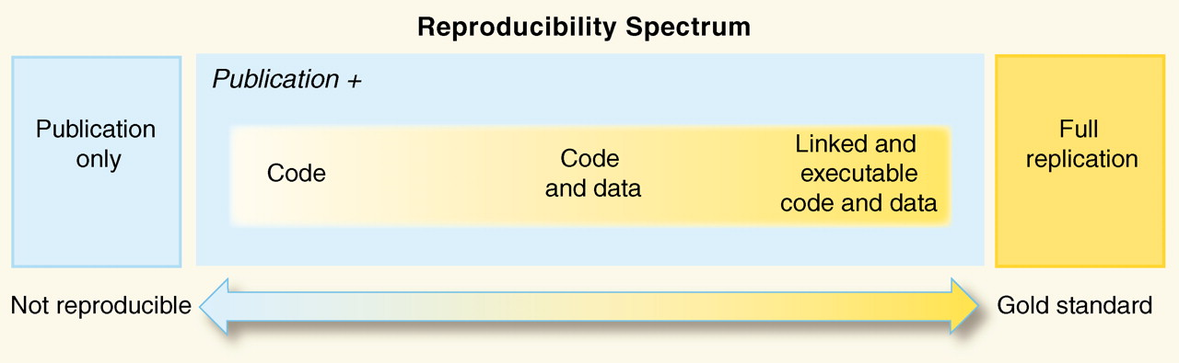
Reproducibility and Transparency
Peng. (2011) Science
Notes:
Stress that having code is better than nothing, but more reproducibly gives us more confidence in things

Slide 28
Open Source Reduces Wasted Efforts
Notes:
Can’t ask global questions without help!

Slide 29
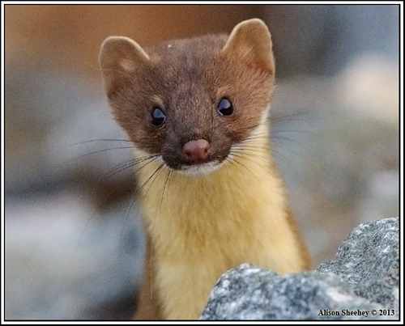
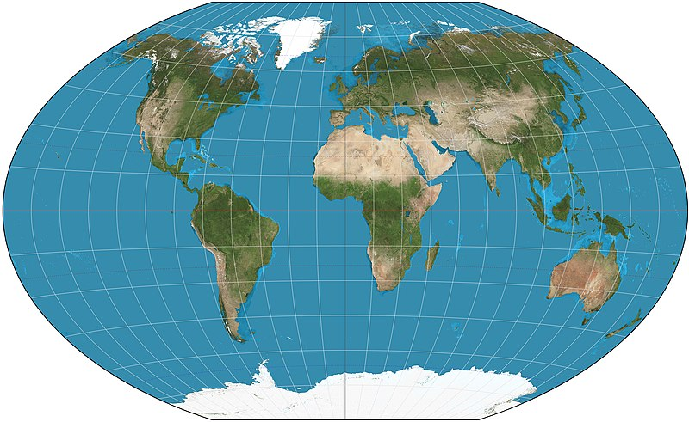
Open Source Reduces Wasted Efforts
Notes:
Can’t ask global questions without help!

Slide 30
Open Source Reduces Wasted Efforts
Data
Data
Notes:
Can’t ask global questions without help!

Slide 31
Open Source Reduces Wasted Efforts
Data
Integration
Data
~ 1 week
Notes:
Can’t ask global questions without help!

Slide 32
Open Source Reduces Wasted Efforts
Data
Integration
Cleaning
Data
~ 1 week
~ 2 weeks
Notes:
Can’t ask global questions without help!

Slide 33
Open Source Reduces Wasted Efforts
Data
Integration
Cleaning
Analyses
Data
~ 1 week
~ 2 weeks
~ 4 weeks
Notes:
Can’t ask global questions without help!

Slide 34
Open Source Reduces Wasted Efforts
Data
Integration
Cleaning
Analyses
Figures
Data
~ 1 week
~ 2 weeks
~ 4 weeks
~ 2 weeks
Notes:
Can’t ask global questions without help!

Slide 35
Open Source Reduces Wasted Efforts
Publish
Code
~ 10 minutes
Data
Integration
Cleaning
Analyses
Figures
Data
~ 1 week
~ 2 weeks
~ 4 weeks
~ 2 weeks
Notes:
Can’t ask global questions without help!

Slide 36
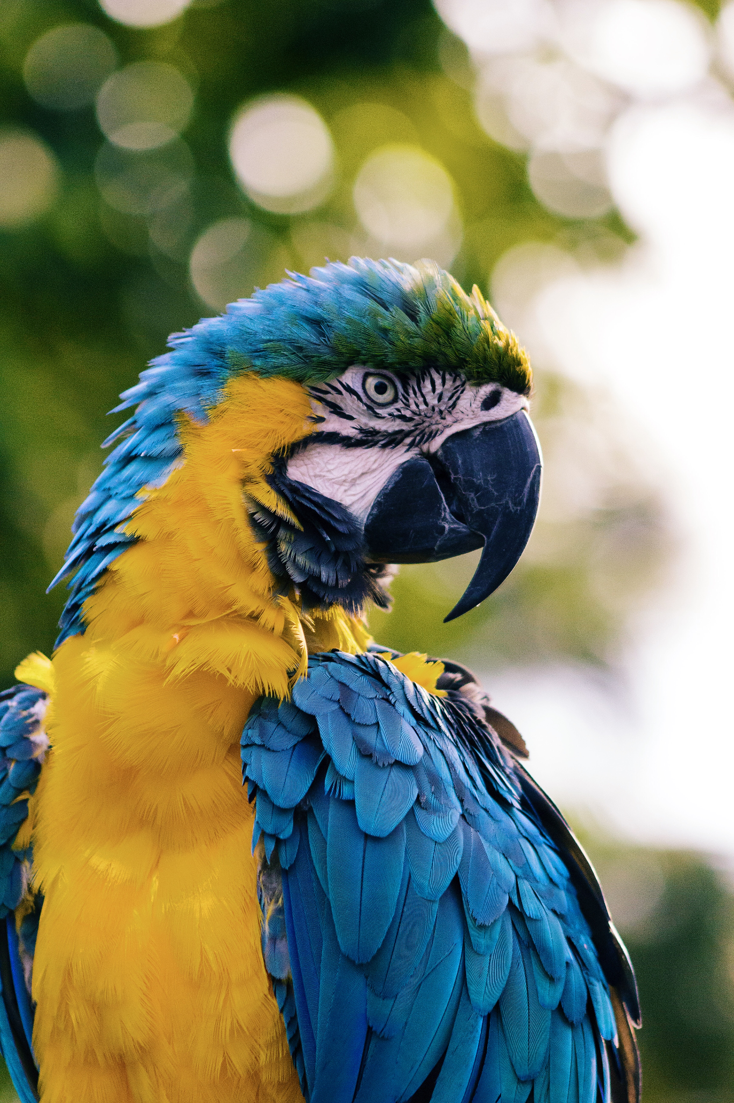
Open Source Reduces Wasted Efforts
Publish
Code
~ 10 minutes
Data
Integration
Cleaning
Analyses
Figures
Data
~ 1 week
~ 2 weeks
~ 4 weeks
~ 2 weeks
Notes:
Can’t ask global questions without help!

Slide 37
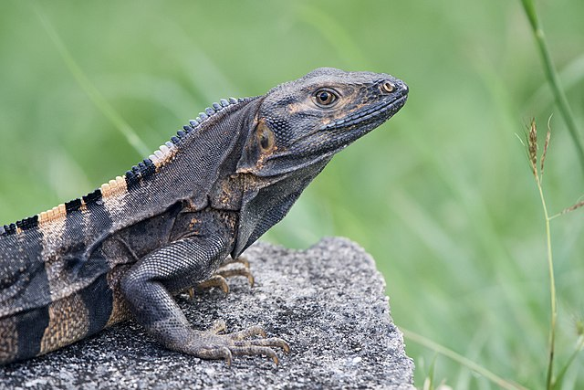
Open Source Reduces Wasted Efforts
Publish
Code
~ 10 minutes
Data
Integration
Cleaning
Analyses
Figures
Data
~ 1 week
~ 2 weeks
~ 4 weeks
~ 2 weeks
Macaw: Andrew Pons, Ctenosaur: Dario
Notes:
Can’t ask global questions without help!

Slide 38
Open Source Reduces Wasted Efforts
Publish
Code
~ 10 minutes
I saved people months of work!
(and got a few good citations)
Data
Integration
Cleaning
Analyses
Figures
Data
~ 1 week
~ 2 weeks
~ 4 weeks
~ 2 weeks
Macaw: Andrew Pons, Ctenosaur: Dario
Notes:
Or maybe its the other way. Maybe someone saved ME months of work and all it costs me is a citation

Slide 39
Open Source Reduces Barriers

Slide 40
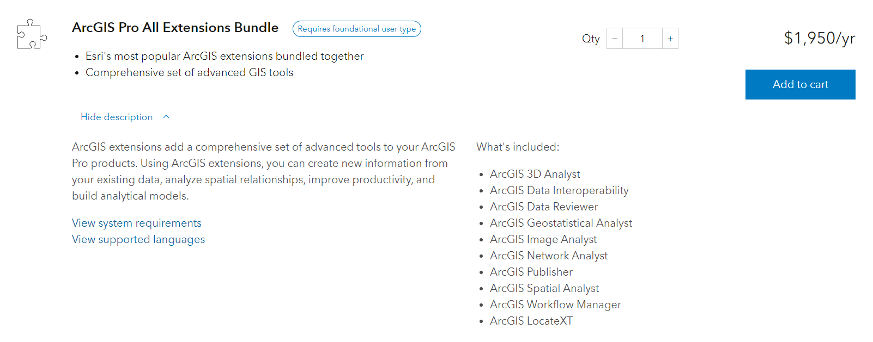
Open Source Reduces Barriers
Notes:
Can’t ask global questions without help!

Slide 41
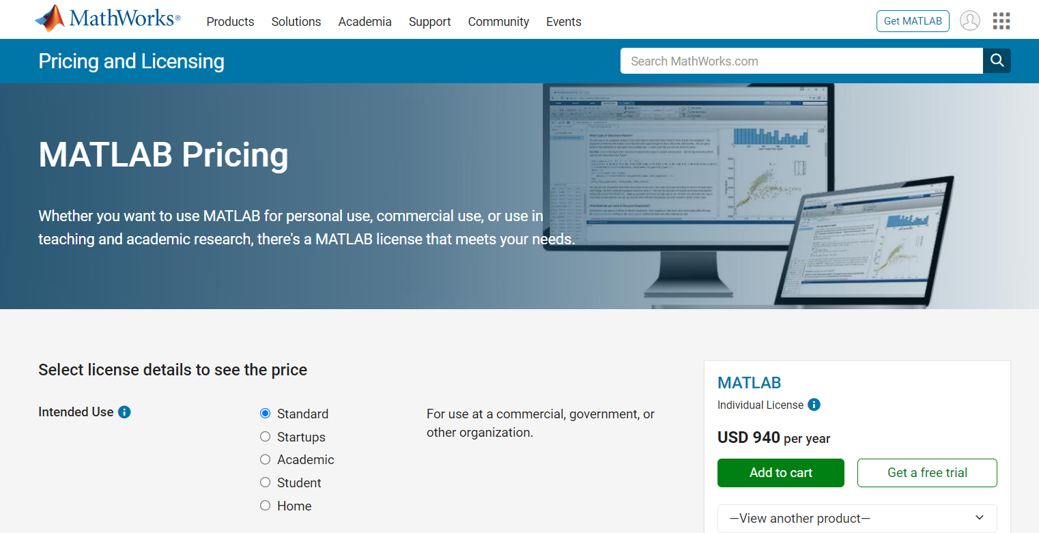
Open Source Reduces Barriers
Notes:
Can’t ask global questions without help!

Slide 42
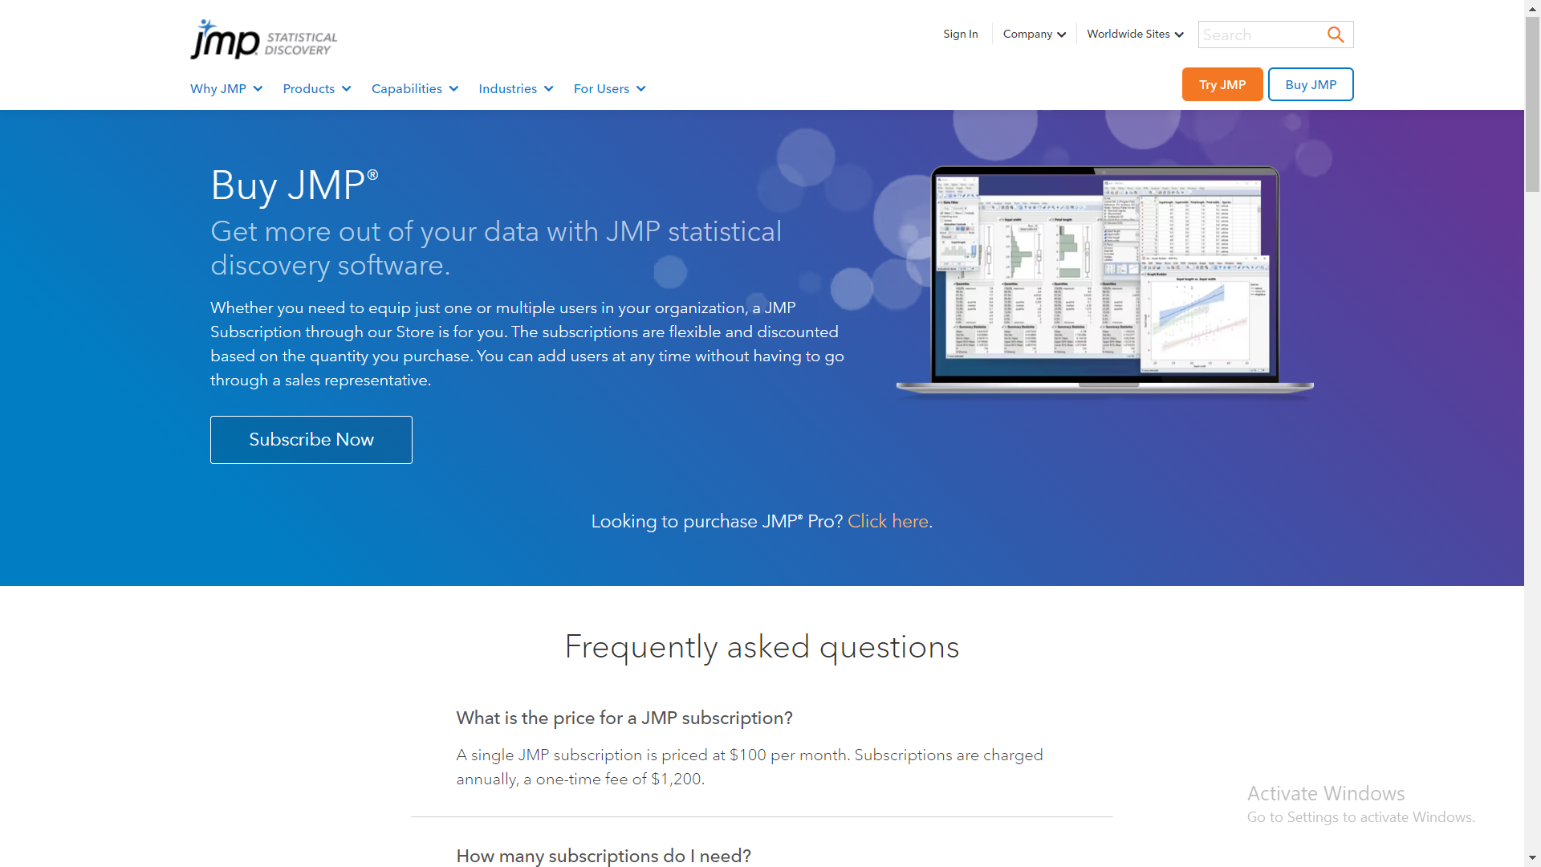
Open Source Reduces Barriers
Notes:
Can’t ask global questions without help!

Slide 43




Open Source Reduces Barriers
$0
Notes:
So anyone can use these

Slide 44
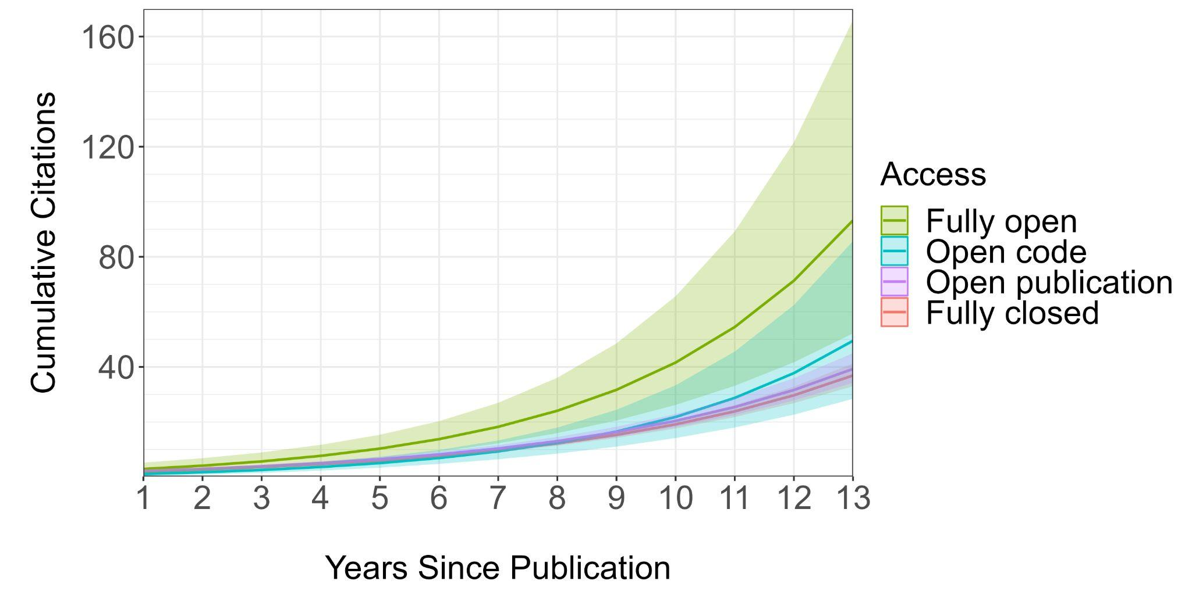
Code Sharing Increases Citations
Maitner, et al. (in revision)
Notes:
More open = more citation = more impact

Slide 45
What is Open Science?
Open Science: “transparent and accessible knowledge that is shared and developed through collaborative networks”
Open Data
Open Access
Open Resources
Collaboration
& Inclusion
Open Methods
Open Source
Open Peer Review
Gallagher, et al. (2020) NEE
Notes:
Focus on these three (more in control, and are free)

Slide 46
What is Open Science?
Open Science: “transparent and accessible knowledge that is shared and developed through collaborative networks”
Open Data
Open Access
Open Resources
Collaboration
& Inclusion
Open Methods
Open Source
Open Peer Review
Gallagher, et al. (2020) NEE
Notes:
Focus on these three (more in control, and are free)

Slide 47
Notes:
More open = more citation = more impact

Slide 48
What are Open Methods?
Making methods underlying research open and freely accessible
Examples:
Laboratory protocols
Data collection protocols
Metadata standards
Materials
Reagents
Code (Overlap with Open Source)
Notes:
More open = more citation = more impact

Slide 49
Open Methods Increase Transparency
Notes:
More open = more citation = more impact

Slide 50
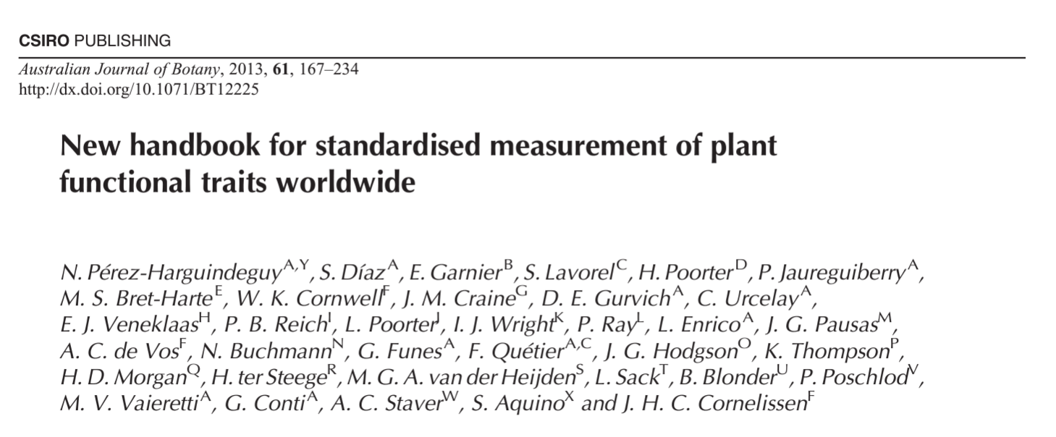
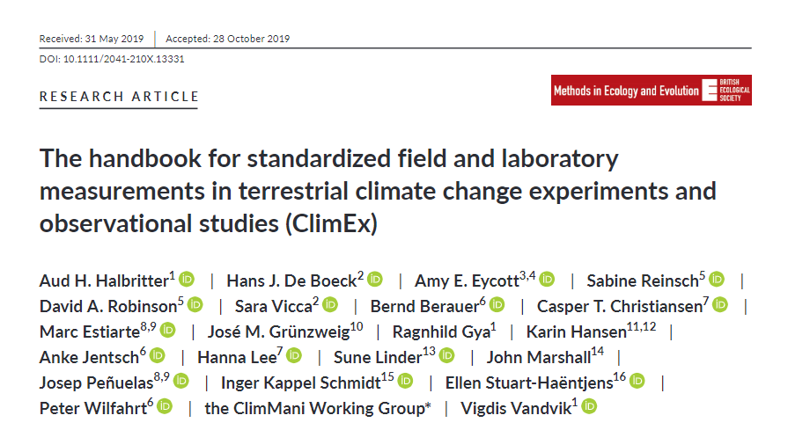
Shared Methods Increase Confidence
Notes:
More open = more citation = more impact

Slide 51
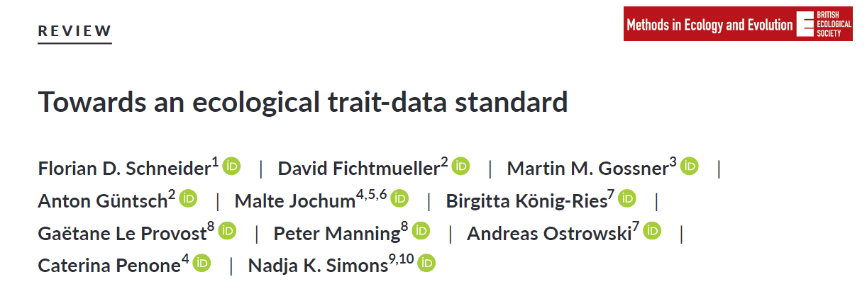
Shared Methods Increase Compatibility
Data Integration is a major time sink
Using shared metadata standards and methods increases interoperability
Notes:
More open = more citation = more impact

Slide 52
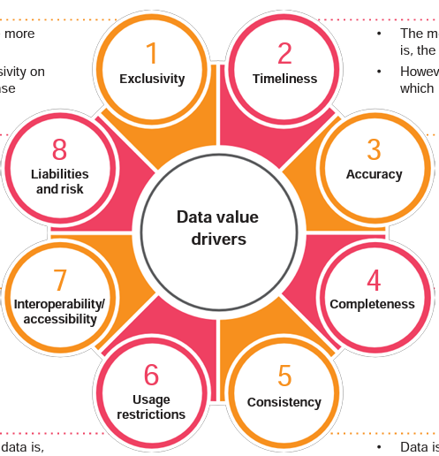
Open Methods Increase Data Value
https://www.pwc.co.uk/data-analytics/documents/putting-value-on-data.pdf
Notes:
More open = more citation = more impact

Slide 53
Open Methods Increase Data Value
https://www.pwc.co.uk/data-analytics/documents/putting-value-on-data.pdf
Notes:
More open = more citation = more impact

Slide 54
Open Methods Increase Data Value
https://www.pwc.co.uk/data-analytics/documents/putting-value-on-data.pdf
Notes:
More open = more citation = more impact

Slide 55
Open Methods Increase Data Value
https://www.pwc.co.uk/data-analytics/documents/putting-value-on-data.pdf
Notes:
More open = more citation = more impact

Slide 56
Open Methods Increase Data Value
https://www.pwc.co.uk/data-analytics/documents/putting-value-on-data.pdf
Notes:
More open = more citation = more impact

Slide 57
Open Methods Increase Data Value
https://www.pwc.co.uk/data-analytics/documents/putting-value-on-data.pdf
Notes:
More open = more citation = more impact

Slide 58
Open Methods Increase Data Value
https://www.pwc.co.uk/data-analytics/documents/putting-value-on-data.pdf
Notes:
More open = more citation = more impact

Slide 59
Open Methods Increase Data Value
https://www.pwc.co.uk/data-analytics/documents/putting-value-on-data.pdf
Notes:
More open = more citation = more impact

Slide 60
Open Methods Increase Data Value
https://www.pwc.co.uk/data-analytics/documents/putting-value-on-data.pdf
Notes:
Arguably, shared workflows and code speeds things up (e.g., australia fires)

Slide 61
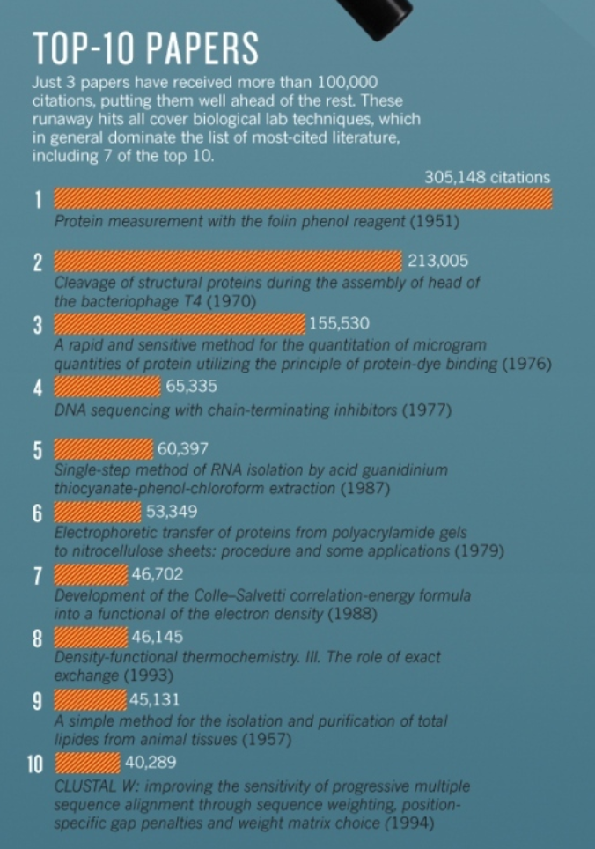
Methods Papers Are Highly Cited
Van Noorden, et al. (2014) Nature
Notes:
More open = more citation = more impact

Slide 62
Methods Papers Are Highly Cited
(as are open access papers, so presumably Open Methods will be especially successful? )
Van Noorden, et al. (2014) Nature
Notes:
More open = more citation = more impact

Slide 63
What is Open Science?
Open Science: “transparent and accessible knowledge that is shared and developed through collaborative networks”
Open Data
Open Access
Open Resources
Collaboration
& Inclusion
Open Methods
Open Source
Open Peer Review
Gallagher, et al. (2020) NEE
Notes:
Focus on these three (more in control, and are free)

Slide 64
What is Open Science?
Open Science: “transparent and accessible knowledge that is shared and developed through collaborative networks”
Open Data
Open Access
Open Resources
Collaboration
& Inclusion
Open Methods
Open Source
Open Peer Review
Gallagher, et al. (2020) NEE

Slide 65
Before next class:
Prepare your presentations

